Slide 1
COMPLETE PROGRAM DECK • WORKSTREAMS 1–5
GEAP Multi-Tenant Agentic AI: Pooled, Sovereign Silos & Hybrid — Complete Program Deck
All 7 Google Cloud Architecture Center blueprints across Workstreams 1–5 as 100% editable slides
Multi-Tenant Agentic AI on Google Cloud • Gemini Enterprise Agent Platform (GEAP) & ADK 2.0
Every diagram slide is 100% native editable (PromptCanvas Vision Decompiler → Draw.io → PowerPoint / Google Slides)
Anchor reference: https://docs.cloud.google.com/architecture/multi-tenant-agentic-ai-system
Notes:
GEAP Multi-Tenant Agentic AI: Pooled, Sovereign Silos & Hybrid — Complete Program Deck
All 7 Google Cloud Architecture Center blueprints across Workstreams 1–5 as 100% editable slides
Series: Multi-Tenant Agentic AI on Google Cloud • Gemini Enterprise Agent Platform (GEAP) & ADK 2.0

Slide 2
PROGRAM | Program Map • Workstreams 1–5
Program Map • Workstreams 1–5
Workstream 1 • Reference Architecture & Cloud Architecture Center Doc PR
Workstream 2 • Pattern A — High-Density Pooled Architecture
Workstream 3 • Pattern B — Zero-Trust Sovereign Silos
Workstream 4 • Pattern C — Dynamic Hybrid, PSC & Live Tier Migration
Workstream 5 • Decision Guide, Agentic Triad & Program Wrap-up
Multi-Tenant Agentic AI on Google Cloud • Gemini Enterprise Agent Platform (GEAP) & ADK 2.0
Notes:
Program Map • Workstreams 1–5
• Workstream 1 • Reference Architecture & Cloud Architecture Center Doc PR
• Workstream 2 • Pattern A — High-Density Pooled Architecture
• Workstream 3 • Pattern B — Zero-Trust Sovereign Silos
• Workstream 4 • Pattern C — Dynamic Hybrid, PSC & Live Tier Migration
• Workstream 5 • Decision Guide, Agentic Triad & Program Wrap-up

Slide 3
WS1
Multi-Tenant Agentic AI on Google Cloud: Taxonomy & 5-Hop Baseline (Workstream 1)
Pooled, Sovereign Silo & Dynamic Hybrid topologies extending the Cloud Architecture Center hub-and-spoke reference for B2B ISV SaaS
Notes:
Multi-Tenant Agentic AI on Google Cloud: Taxonomy & 5-Hop Baseline (Workstream 1)
Pooled, Sovereign Silo & Dynamic Hybrid topologies extending the Cloud Architecture Center hub-and-spoke reference for B2B ISV SaaS

Slide 4
WS1 | Executive TL;DR
Executive TL;DR
Official Architecture Center reference models one spoke project per business unit; 90%+ of B2B SaaS ISVs cannot afford that per Standard-tier tenant.
Agents add four new failure modes: dynamic MCP discovery, confused-deputy credentials, context-cache bleed, and noisy-neighbor runaway reasoning loops.
Workstream 1 defines Pattern A (Pooled), Pattern B (Sovereign Silos), and Pattern C (Dynamic Hybrid) on an 80% reusable core + 20% topology delta.
A single 5-Hop Cryptographic Context Chain (hop1..hop5 Python modules) enforces identical governance across all three patterns.
Deliverables: Doc PR for the Architecture Center (1.3), product review pack (1.2), and an EAP/product-gap ledger with 3 P0 workarounds (1.4).
Workstream 1 • Reference Architecture & Cloud Architecture Center Doc PR
Notes:
Executive TL;DR
• Official Architecture Center reference models one spoke project per business unit; 90%+ of B2B SaaS ISVs cannot afford that per Standard-tier tenant.
• Agents add four new failure modes: dynamic MCP discovery, confused-deputy credentials, context-cache bleed, and noisy-neighbor runaway reasoning loops.
• Workstream 1 defines Pattern A (Pooled), Pattern B (Sovereign Silos), and Pattern C (Dynamic Hybrid) on an 80% reusable core + 20% topology delta.
• A single 5-Hop Cryptographic Context Chain (hop1..hop5 Python modules) enforces identical governance across all three patterns.
• Deliverables: Doc PR for the Architecture Center (1.3), product review pack (1.2), and an EAP/product-gap ledger with 3 P0 workarounds (1.4).

Slide 5
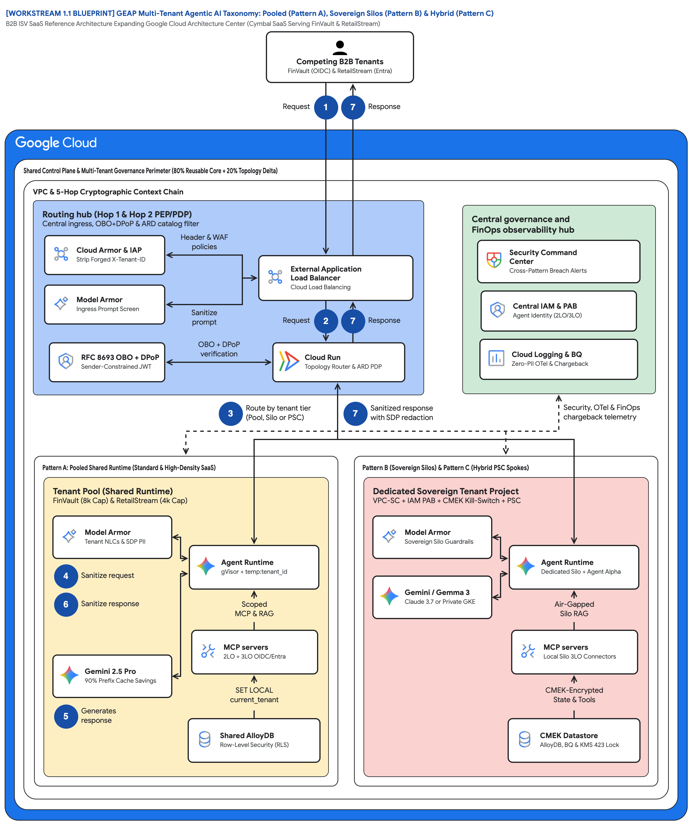
FIGURE 1 — GEAP MULTI-TENANT AGENTIC AI TAXONOMY: POOLED (A), SOVEREIGN SILOS (B) & HYBRID (C) | ID: VIS-WS1-MULTI-TENANT-TAXONOMY-OVERVIEW • 1:1 Master High-Resolution Widescreen Architecture (Slide 2 contains Decomposed Vector Shapes)
Notes:
Figure 1 — GEAP Multi-Tenant Agentic AI Taxonomy: Pooled (A), Sovereign Silos (B) & Hybrid (C)
B2B ISV SaaS Reference Architecture Expanding Google Cloud Architecture Center (Cymbal SaaS Serving FinVault & RetailStream)
• Actor 'Competing B2B Tenants FinVault (OIDC) & RetailStream (Entra)' enters at badge 1 Request and exits at badge 7 Response.
• Wrappers: 'Shared Control Plane & Multi-Tenant Governance Perimeter (80% Reusable Core + 20% Topology Delta)' around the VPC.
• 'Routing hub (Hop 1 & Hop 2 PEP/PDP)': Cloud Armor & IAP strip X-Tenant-ID, Model Armor screen, OBO + DPoP, ALB, Cloud Run Router.
• 'Central governance and FinOps observability hub': SCC, Central IAM & PAB Agent Identity (2LO/3LO), Cloud Logging & BQ Zero-PII OTel.
• Badge 3 'Route by tenant tier (Pool, Silo or PSC)' decides topology; badge 7 'Sanitized response with SDP redaction' scrubs returns.
• Left 'Tenant Pool (Shared Runtime)' vs right 'Dedicated Sovereign Tenant Project' with 'CMEK Datastore AlloyDB, BQ & KMS 423 Lock'.
Editable source: diagrams/ws1-multi-tenant-taxonomy-overview.drawio (PromptCanvas Vision Decompiler)

Slide 6











FIGURE 1 — GEAP MULTI-TENANT AGENTIC AI TAXONOMY: POOLED (A), SOVEREIGN SILOS (B) & HYBRID (C) | ID: VIS-WS1-MULTI-TENANT-TAXONOMY-OVERVIEW • 100% Decomposed Native Editable Vector Shapes, Icons & Arrows (Click any element to move or edit)
[WORKSTREAM 1.1 BLUEPRINT] GEAP Multi-Tenant Agentic AI Taxonomy: Pooled (Pattern A), Sovereign Silos (Pattern B) & Hybrid (Pattern C)
B2B ISV SaaS Reference Architecture Expanding Google Cloud Architecture Center (Cymbal SaaS Serving FinVault & RetailStream)
FIGURE 1
Competing B2B TenantsFinVault (OIDC) & RetailStream (Entra)
GEAP Multi-Tenant Agentic AI Taxonomy: Pooled (A), Sovereign Silos (B) & Hybrid (C)
Request
1
7
Response
Shared Control Plane & Multi-Tenant Governance Perimeter (80% Reusable Core + 20% Topology Delta)
VPC & 5-Hop Cryptographic Context Chain
Actor 'Competing B2B Tenants FinVault (OIDC) & RetailStream (Entra)' enters at badge 1 Request and exits at badge 7 Response.
Wrappers: 'Shared Control Plane & Multi-Tenant Governance Perimeter (80% Reusable Core + 20% Topology Delta)' around the VPC.
'Routing hub (Hop 1 & Hop 2 PEP/PDP)': Cloud Armor & IAP strip X-Tenant-ID, Model Armor screen, OBO + DPoP, ALB, Cloud Run Router.
'Central governance and FinOps observability hub': SCC, Central IAM & PAB Agent Identity (2LO/3LO), Cloud Logging & BQ Zero-PII OTel.
Badge 3 'Route by tenant tier (Pool, Silo or PSC)' decides topology; badge 7 'Sanitized response with SDP redaction' scrubs returns.
Left 'Tenant Pool (Shared Runtime)' vs right 'Dedicated Sovereign Tenant Project' with 'CMEK Datastore AlloyDB, BQ & KMS 423 Lock'.
Routing hub (Hop 1 & Hop 2 PEP/PDP)
Central ingress, OBO+DPoP & ARD catalog filter
Central governance and
FinOps observability hub
Cloud Armor & IAP
Strip Forged X-Tenant-ID
Header & WAF
policies
Security Command
Center • Cross-Pattern Breach Alerts
External Application
Load Balancer • Cloud Load Balancing
Model Armor
Ingress Prompt Screen
Central IAM & PAB
Agent Identity (2LO/3LO)
Sanitize
prompt
Request
2
7
Response
RFC 8693 OBO + DPoP
Sender-Constrained JWT
OBO + DPoP
verification
Cloud Run
Topology Router & ARD PDP
Cloud Logging & BQ
Zero-PII OTel & Chargeback
3
Route by tenant tier
(Pool, Silo or PSC)
7
Sanitized response
with SDP redaction
Security, OTel & FinOps
chargeback telemetry
Pattern A: Pooled Shared Runtime (Standard & High-Density SaaS)
Pattern B (Sovereign Silos) & Pattern C (Hybrid PSC Spokes)
Tenant Pool (Shared Runtime)
FinVault (8k Cap) & RetailStream (4k Cap)
Dedicated Sovereign Tenant Project
VPC-SC + IAM PAB + CMEK Kill-Switch + PSC
Model Armor
Tenant NLCs & SDP PII
Model Armor
Sovereign Silo Guardrails
Agent Runtime
gVisor + temp:tenant_id
Agent Runtime
Dedicated Silo + Agent Alpha
4
Sanitize request
Gemini / Gemma 3
Claude 3.7 or Private GKE
6
Sanitize response
Scoped
MCP & RAG
Air-Gapped
Silo RAG
MCP servers
2LO + 3LO OIDC/Entra
MCP servers
Local Silo 3LO Connectors
Gemini 2.5 Pro
90% Prefix Cache Savings
SET LOCAL
current_tenant
CMEK-Encrypted
State & Tools
56 native shapes • 23 connectors • click any box, icon or arrow to edit
5
Generates
response
Shared AlloyDB
Row-Level Security (RLS)
CMEK Datastore
AlloyDB, BQ & KMS 423 Lock
Zones: Routing hub • Central governance & security hub • Left spoke • Right spoke | Source: diagrams/ws1-multi-tenant-taxonomy-overview.drawio
Notes:
Figure 1 — GEAP Multi-Tenant Agentic AI Taxonomy: Pooled (A), Sovereign Silos (B) & Hybrid (C)
B2B ISV SaaS Reference Architecture Expanding Google Cloud Architecture Center (Cymbal SaaS Serving FinVault & RetailStream)
• Actor 'Competing B2B Tenants FinVault (OIDC) & RetailStream (Entra)' enters at badge 1 Request and exits at badge 7 Response.
• Wrappers: 'Shared Control Plane & Multi-Tenant Governance Perimeter (80% Reusable Core + 20% Topology Delta)' around the VPC.
• 'Routing hub (Hop 1 & Hop 2 PEP/PDP)': Cloud Armor & IAP strip X-Tenant-ID, Model Armor screen, OBO + DPoP, ALB, Cloud Run Router.
• 'Central governance and FinOps observability hub': SCC, Central IAM & PAB Agent Identity (2LO/3LO), Cloud Logging & BQ Zero-PII OTel.
• Badge 3 'Route by tenant tier (Pool, Silo or PSC)' decides topology; badge 7 'Sanitized response with SDP redaction' scrubs returns.
• Left 'Tenant Pool (Shared Runtime)' vs right 'Dedicated Sovereign Tenant Project' with 'CMEK Datastore AlloyDB, BQ & KMS 423 Lock'.
Editable source: diagrams/ws1-multi-tenant-taxonomy-overview.drawio (PromptCanvas Vision Decompiler)

Slide 7
FIGURE 1 — GEAP MULTI-TENANT AGENTIC AI TAXONOMY: POOLED (A), SOVEREIGN SILOS (B) & HYBRID (C) | Editable Architecture Component & Topology Specification Table
Object ID | Component Name | Architectural Role / Details | Type
OBJ-01 | Shared Control Plane & Multi-Tenant Governance Perimeter (80% Reusable Core + 20% Topolog… | Core Architecture Node | Enclave / Tier
OBJ-02 | VPC & 5-Hop Cryptographic Context Chain | Core Architecture Node | Enclave / Tier
OBJ-03 | Pattern A: Pooled Shared Runtime (Standard & High-Density SaaS) | Core Architecture Node | Enclave / Tier
OBJ-04 | Pattern B (Sovereign Silos) & Pattern C (Hybrid PSC Spokes) | Core Architecture Node | Enclave / Tier
OBJ-05 | Tenant Pool (Shared Runtime) | FinVault (8k Cap) & RetailStream (4k Cap) | Enclave / Tier
OBJ-06 | Dedicated Sovereign Tenant Project | VPC-SC + IAM PAB + CMEK Kill-Switch + PSC | Enclave / Tier
OBJ-07 | Routing hub (Hop 1 & Hop 2 PEP/PDP) | Central ingress, OBO+DPoP & ARD catalog filter | Enclave / Tier
OBJ-08 | Central governance and | FinOps observability hub | Enclave / Tier
OBJ-09 | [WORKSTREAM 1.1 BLUEPRINT] GEAP Multi-Tenant Agentic AI Taxonomy: Pooled (Pattern A), Sov… | B2B ISV SaaS Reference Architecture Expanding Google Cloud Architecture Center (Cymbal SaaS Serving FinVault… | Service Node
OBJ-10 | Competing B2B TenantsFinVault (OIDC) & RetailStream (Entra) | Core Architecture Node | Service Node
OBJ-11 | External Application | Load Balancer • Cloud Load Balancing | Service Node
OBJ-12 | Security Command | Center • Cross-Pattern Breach Alerts | Service Node
OBJ-13 | Cloud Logging & BQ | Zero-PII OTel & Chargeback | Service Node
OBJ-14 | Central IAM & PAB | Agent Identity (2LO/3LO) | Service Node
Notes:
Figure 1 component inventory for GEAP Multi-Tenant Agentic AI Taxonomy: Pooled (A), Sovereign Silos (B) & Hybrid (C)

Slide 8
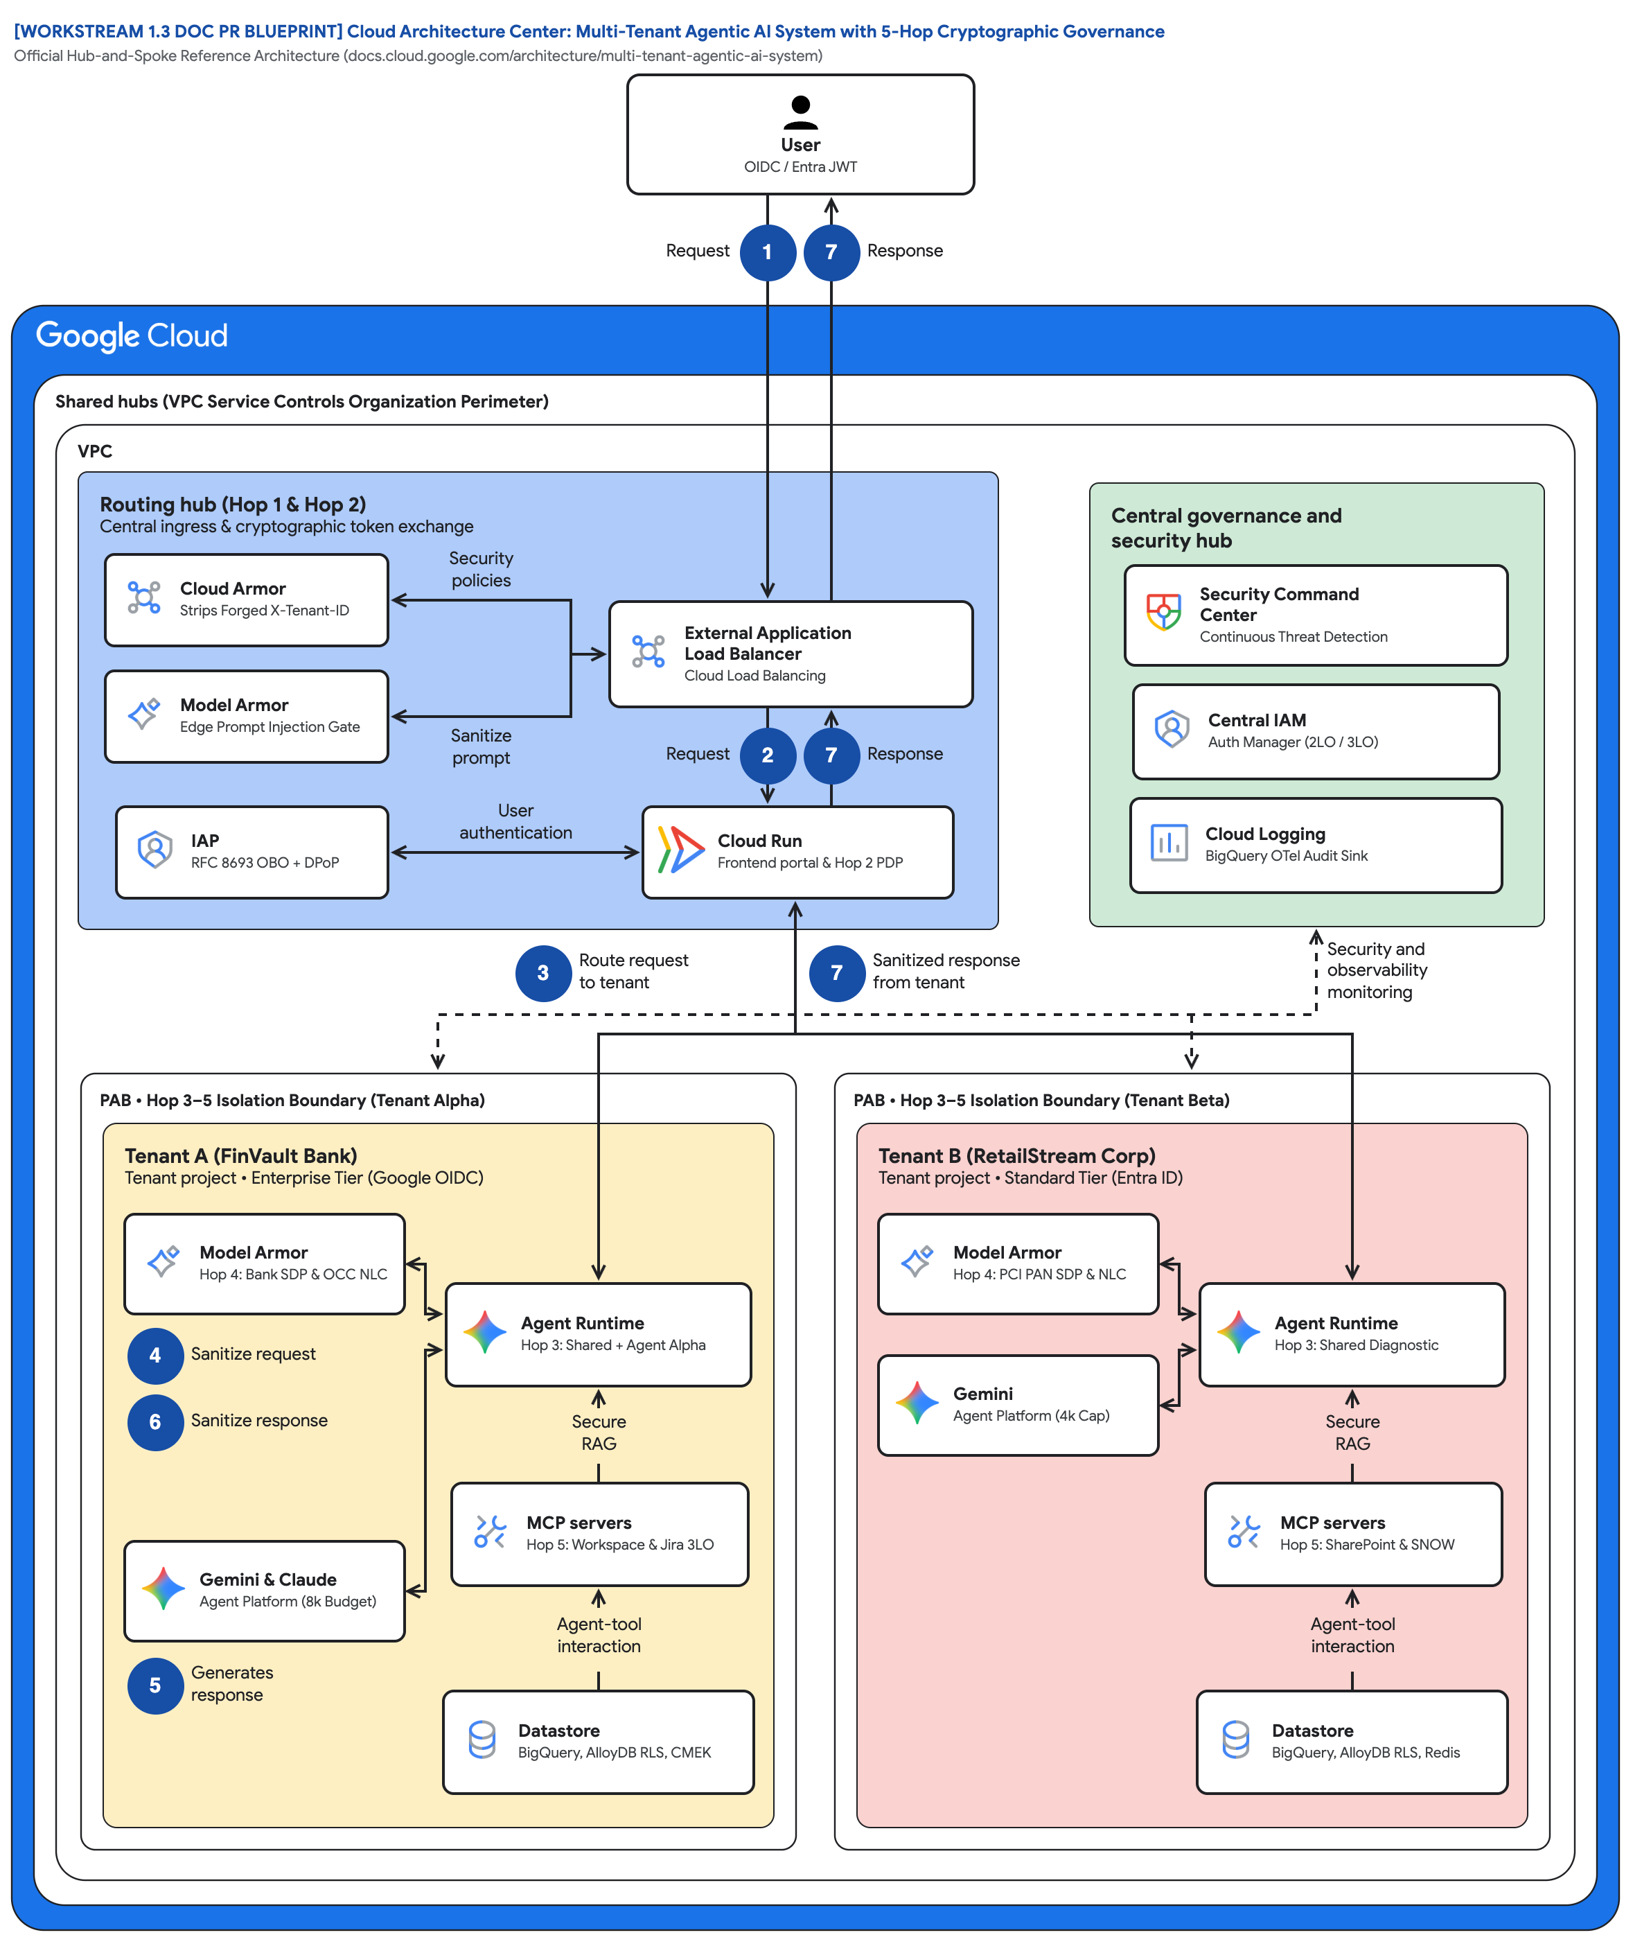
FIGURE 2 — CLOUD ARCHITECTURE CENTER: MULTI-TENANT AGENTIC AI WITH 5-HOP CRYPTOGRAPHIC GOVERNANCE | ID: VIS-WS1-CLOUD-ARCH-CENTER-5HOP-BASELINE • 1:1 Master High-Resolution Widescreen Architecture (Slide 2 contains Decomposed Vector Shapes)
Notes:
Figure 2 — Cloud Architecture Center: Multi-Tenant Agentic AI with 5-Hop Cryptographic Governance
Official Hub-and-Spoke Reference Architecture (docs.cloud.google.com/architecture/multi-tenant-agentic-ai-system)
• Actor 'User OIDC / Entra JWT' with badges 1 Request and 7 Response mirrors the published hub-and-spoke article exactly.
• Outer wrapper 'Shared hubs (VPC Service Controls Organization Perimeter)' and inner 'VPC' are unchanged from the official reference.
• 'Routing hub (Hop 1 & Hop 2)': Cloud Armor Strips Forged X-Tenant-ID, Model Armor Edge Prompt Injection Gate, IAP RFC 8693 OBO + DPoP.
• 'Central governance and security hub': Security Command Center, Central IAM Auth Manager (2LO / 3LO), Cloud Logging BigQuery OTel Sink.
• Dashed 'Security and observability' line fans to both spokes; badge 3 'Route request to tenant', badge 7 'Sanitized response from tenant'.
• 'PAB • Hop 3–5 Isolation Boundary' wraps Tenant A (FinVault, 8k Budget, Bank SDP & OCC NLC) and Tenant B (RetailStream, 4k Cap, PCI).
Editable source: diagrams/ws1-cloud-arch-center-5hop-baseline.drawio (PromptCanvas Vision Decompiler)

Slide 9
FIGURE 2 — CLOUD ARCHITECTURE CENTER: MULTI-TENANT AGENTIC AI WITH 5-HOP CRYPTOGRAPHIC GOVERNANCE | ID: VIS-WS1-CLOUD-ARCH-CENTER-5HOP-BASELINE • 100% Decomposed Native Editable Vector Shapes, Icons & Arrows (Click any element to move or edit)
[WORKSTREAM 1.3 DOC PR BLUEPRINT] Cloud Architecture Center: Multi-Tenant Agentic AI System with 5-Hop Cryptographic Governance
Official Hub-and-Spoke Reference Architecture (docs.cloud.google.com/architecture/multi-tenant-agentic-ai-system)
FIGURE 2
UserOIDC / Entra JWT
Cloud Architecture Center: Multi-Tenant Agentic AI with 5-Hop Cryptographic Governance
Request
1
7
Response
Shared hubs (VPC Service Controls Organization Perimeter)
VPC
Actor 'User OIDC / Entra JWT' with badges 1 Request and 7 Response mirrors the published hub-and-spoke article exactly.
Outer wrapper 'Shared hubs (VPC Service Controls Organization Perimeter)' and inner 'VPC' are unchanged from the official reference.
'Routing hub (Hop 1 & Hop 2)': Cloud Armor Strips Forged X-Tenant-ID, Model Armor Edge Prompt Injection Gate, IAP RFC 8693 OBO + DPoP.
'Central governance and security hub': Security Command Center, Central IAM Auth Manager (2LO / 3LO), Cloud Logging BigQuery OTel Sink.
Dashed 'Security and observability' line fans to both spokes; badge 3 'Route request to tenant', badge 7 'Sanitized response from tenant'.
'PAB • Hop 3–5 Isolation Boundary' wraps Tenant A (FinVault, 8k Budget, Bank SDP & OCC NLC) and Tenant B (RetailStream, 4k Cap, PCI).
Routing hub (Hop 1 & Hop 2)
Central ingress & cryptographic token exchange
Central governance and
security hub
Cloud Armor
Strips Forged X-Tenant-ID
Security
policies
Security Command
Center • Continuous Threat Detection
External Application
Load Balancer • Cloud Load Balancing
Model Armor
Edge Prompt Injection Gate
Central IAM
Auth Manager (2LO / 3LO)
Sanitize
prompt
Request
2
7
Response
IAP
RFC 8693 OBO + DPoP
User
authentication
Cloud Run
Frontend portal & Hop 2 PDP
Cloud Logging
BigQuery OTel Audit Sink
3
Route request
to tenant
7
Sanitized response
from tenant
Security and
observability • monitoring
PAB • Hop 3–5 Isolation Boundary (Tenant Alpha)
PAB • Hop 3–5 Isolation Boundary (Tenant Beta)
Tenant A (FinVault Bank)
Tenant project • Enterprise Tier (Google OIDC)
Tenant B (RetailStream Corp)
Tenant project • Standard Tier (Entra ID)
Model Armor
Hop 4: Bank SDP & OCC NLC
Model Armor
Hop 4: PCI PAN SDP & NLC
Agent Runtime
Hop 3: Shared + Agent Alpha
Agent Runtime
Hop 3: Shared Diagnostic
4
Sanitize request
Gemini
Agent Platform (4k Cap)
6
Sanitize response
Secure
RAG
Secure
RAG
MCP servers
Hop 5: Workspace & Jira 3LO
MCP servers
Hop 5: SharePoint & SNOW
Gemini & Claude
Agent Platform (8k Budget)
Agent-tool
interaction
Agent-tool
interaction
56 native shapes • 23 connectors • click any box, icon or arrow to edit
5
Generates
response
Datastore
BigQuery, AlloyDB RLS, CMEK
Datastore
BigQuery, AlloyDB RLS, Redis
Zones: Routing hub • Central governance & security hub • Left spoke • Right spoke | Source: diagrams/ws1-cloud-arch-center-5hop-baseline.drawio
Notes:
Figure 2 — Cloud Architecture Center: Multi-Tenant Agentic AI with 5-Hop Cryptographic Governance
Official Hub-and-Spoke Reference Architecture (docs.cloud.google.com/architecture/multi-tenant-agentic-ai-system)
• Actor 'User OIDC / Entra JWT' with badges 1 Request and 7 Response mirrors the published hub-and-spoke article exactly.
• Outer wrapper 'Shared hubs (VPC Service Controls Organization Perimeter)' and inner 'VPC' are unchanged from the official reference.
• 'Routing hub (Hop 1 & Hop 2)': Cloud Armor Strips Forged X-Tenant-ID, Model Armor Edge Prompt Injection Gate, IAP RFC 8693 OBO + DPoP.
• 'Central governance and security hub': Security Command Center, Central IAM Auth Manager (2LO / 3LO), Cloud Logging BigQuery OTel Sink.
• Dashed 'Security and observability' line fans to both spokes; badge 3 'Route request to tenant', badge 7 'Sanitized response from tenant'.
• 'PAB • Hop 3–5 Isolation Boundary' wraps Tenant A (FinVault, 8k Budget, Bank SDP & OCC NLC) and Tenant B (RetailStream, 4k Cap, PCI).
Editable source: diagrams/ws1-cloud-arch-center-5hop-baseline.drawio (PromptCanvas Vision Decompiler)

Slide 10
FIGURE 2 — CLOUD ARCHITECTURE CENTER: MULTI-TENANT AGENTIC AI WITH 5-HOP CRYPTOGRAPHIC GOVERNANCE | Editable Architecture Component & Topology Specification Table
Object ID | Component Name | Architectural Role / Details | Type
OBJ-01 | Shared hubs (VPC Service Controls Organization Perimeter) | Core Architecture Node | Enclave / Tier
OBJ-02 | VPC | Core Architecture Node | Enclave / Tier
OBJ-03 | PAB • Hop 3–5 Isolation Boundary (Tenant Alpha) | Core Architecture Node | Enclave / Tier
OBJ-04 | PAB • Hop 3–5 Isolation Boundary (Tenant Beta) | Core Architecture Node | Enclave / Tier
OBJ-05 | Tenant A (FinVault Bank) | Tenant project • Enterprise Tier (Google OIDC) | Enclave / Tier
OBJ-06 | Tenant B (RetailStream Corp) | Tenant project • Standard Tier (Entra ID) | Enclave / Tier
OBJ-07 | Routing hub (Hop 1 & Hop 2) | Central ingress & cryptographic token exchange | Enclave / Tier
OBJ-08 | Central governance and | security hub | Enclave / Tier
OBJ-09 | [WORKSTREAM 1.3 DOC PR BLUEPRINT] Cloud Architecture Center: Multi-Tenant Agentic AI Syst… | Official Hub-and-Spoke Reference Architecture (docs.cloud.google.com/architecture/multi-tenant-agentic-ai-sys… | Service Node
OBJ-10 | UserOIDC / Entra JWT | Core Architecture Node | Service Node
OBJ-11 | External Application | Load Balancer • Cloud Load Balancing | Service Node
OBJ-12 | Security Command | Center • Continuous Threat Detection | Service Node
OBJ-13 | Cloud Logging | BigQuery OTel Audit Sink | Service Node
OBJ-14 | Central IAM | Auth Manager (2LO / 3LO) | Service Node
Notes:
Figure 2 component inventory for Cloud Architecture Center: Multi-Tenant Agentic AI with 5-Hop Cryptographic Governance

Slide 11
WS1 | Key Takeaways
Key Takeaways
Agentic multi-tenancy needs controls at edge, registry, runtime, guardrail, and data layers; a tenant_id column is not isolation.
Choose topology per tenant tier: Pattern A for Standard, Pattern B for regulator-mandated perimeters, Pattern C when you serve both.
The 5-Hop chain is topology-agnostic code; the trust boundary changes, the governance modules do not.
Prompt prefix caching is safe in a pool only when ContextCacheConfig is read-only on shared system instructions.
Three P0 product gaps already have engineered workarounds; EAP allowlists target Q4 2026 for native support.
Review the 1.3 Doc PR, enable the 1.4 allowlist checklist in your sandbox, then proceed to Workstream 2 (Pattern A Pooled, Milestone 1).
Notes:
Key Takeaways
• Agentic multi-tenancy needs controls at edge, registry, runtime, guardrail, and data layers; a tenant_id column is not isolation.
• Choose topology per tenant tier: Pattern A for Standard, Pattern B for regulator-mandated perimeters, Pattern C when you serve both.
• The 5-Hop chain is topology-agnostic code; the trust boundary changes, the governance modules do not.
• Prompt prefix caching is safe in a pool only when ContextCacheConfig is read-only on shared system instructions.
• Three P0 product gaps already have engineered workarounds; EAP allowlists target Q4 2026 for native support.

Slide 12
WS2
Pattern A — Pooled Architecture: One Shared Runtime, Two Competing Tenants, Zero Bleed
High-Density Pooled Multi-Tenancy on GEAP & ADK 2.0 — 5-Hop Cryptographic Context Chain, 10-point breach suite, 90% ContextCacheConfig save
Notes:
Pattern A — Pooled Architecture: One Shared Runtime, Two Competing Tenants, Zero Bleed
High-Density Pooled Multi-Tenancy on GEAP & ADK 2.0 — 5-Hop Cryptographic Context Chain, 10-point breach suite, 90% ContextCacheConfig save

Slide 13
WS2 | Executive TL;DR
Executive TL;DR
Problem: dedicated projects per Standard-tier SaaS customer destroy gross margin, but naive shared runtimes leak agents, tools, caches and PII.
Solution: one shared project (cymbal-pooled-saas-prod) governed by the 5-Hop Cryptographic Context Chain from edge PEP to AlloyDB RLS.
FinVault Bank (Enterprise, Google OIDC/Jira) and RetailStream Corp (Standard, Entra ID/ServiceNow) share one runtime with 10/10 breach vectors blocked.
ContextCacheConfig READ_ONLY_IMMUTABLE_PREFIX bills the 32,000-token operator prefix at a 90% discount for ~84.7% net input COGS reduction.
Ships as Milestone 1 (Week 4) with a Terraform starter, 90-minute codelab, and locally runnable run_breach_simulations.py.
Workstream 2 • Pattern A — High-Density Pooled Architecture
Notes:
Executive TL;DR
• Problem: dedicated projects per Standard-tier SaaS customer destroy gross margin, but naive shared runtimes leak agents, tools, caches and PII.
• Solution: one shared project (cymbal-pooled-saas-prod) governed by the 5-Hop Cryptographic Context Chain from edge PEP to AlloyDB RLS.
• FinVault Bank (Enterprise, Google OIDC/Jira) and RetailStream Corp (Standard, Entra ID/ServiceNow) share one runtime with 10/10 breach vectors blocked.
• ContextCacheConfig READ_ONLY_IMMUTABLE_PREFIX bills the 32,000-token operator prefix at a 90% discount for ~84.7% net input COGS reduction.
• Ships as Milestone 1 (Week 4) with a Terraform starter, 90-minute codelab, and locally runnable run_breach_simulations.py.

Slide 14

FIGURE 1 — PATTERN A: HIGH-DENSITY POOLED MULTI-TENANT ARCHITECTURE & SHARED RUNTIME GOVERNANCE | ID: VIS-WS2-PATTERN-A-POOLED-5HOP-ARCHITECTURE • 1:1 Master High-Resolution Widescreen Architecture (Slide 2 contains Decomposed Vector Shapes)
Notes:
Figure 1 — Pattern A: High-Density Pooled Multi-Tenant Architecture & Shared Runtime Governance
Milestone 1 (Weeks 1–4) • Shared Project (cymbal-pooled-saas-prod) with 90% Prompt Prefix Cache Savings & 0 Bleed
• One actor, 'FinVault & RetailStream Competing SaaS Tenants', enters one 'Shared GCP Project: cymbal-pooled-saas-prod'.
• Routing hub 'Hop 1 & Hop 2: Edge PEP & GEAP Registry PDP': strip X-Tenant-ID, filter ARD catalog, mint OBO + DPoP token.
• Governance hub 'Hop 3 & 5: Shared FinOps, Cache & OTel Hub': ContextCacheConfig 90%, Redis Rate Bulkhead, BigQuery OTel Sink.
• Trunk badge 3 'Bind immutable temp:tenant_id' before any tenant code runs; badge 7 returns 'SDP-redacted tenant response'.
• Slice A FinVault: Model Armor masks IBAN/SWIFT + OCC NLC, Gemini & Claude 3.7, 3LO Workspace/Jira, Shared AlloyDB RLS.
• Slice B RetailStream: Card PAN + PCI NLC, Gemini 2.5 Pro clamped to 4,000 tokens, 3LO Entra & SNOW inline consent gate.
Editable source: diagrams/ws2-pattern-a-pooled-5hop-architecture.drawio (PromptCanvas Vision Decompiler)

Slide 15
FIGURE 1 — PATTERN A: HIGH-DENSITY POOLED MULTI-TENANT ARCHITECTURE & SHARED RUNTIME GOVERNANCE | ID: VIS-WS2-PATTERN-A-POOLED-5HOP-ARCHITECTURE • 100% Decomposed Native Editable Vector Shapes, Icons & Arrows (Click any element to move or edit)
[WORKSTREAM 2.1 • PATTERN A BLUEPRINT] Pattern A: High-Density Pooled Multi-Tenant Architecture & Shared Runtime Governance
Milestone 1 (Weeks 1–4) • Shared Project (cymbal-pooled-saas-prod) with 90% Prompt Prefix Cache Savings & 0 Bleed
FIGURE 1
FinVault & RetailStreamCompeting SaaS Tenants
Pattern A: High-Density Pooled Multi-Tenant Architecture & Shared Runtime Governance
Request
1
7
Response
Shared GCP Project: cymbal-pooled-saas-prod (Maximum Density Pooled SaaS)
Shared VPC • 5-Hop Cryptographic Context Chain
One actor, 'FinVault & RetailStream Competing SaaS Tenants', enters one 'Shared GCP Project: cymbal-pooled-saas-prod'.
Routing hub 'Hop 1 & Hop 2: Edge PEP & GEAP Registry PDP': strip X-Tenant-ID, filter ARD catalog, mint OBO + DPoP token.
Governance hub 'Hop 3 & 5: Shared FinOps, Cache & OTel Hub': ContextCacheConfig 90%, Redis Rate Bulkhead, BigQuery OTel Sink.
Trunk badge 3 'Bind immutable temp:tenant_id' before any tenant code runs; badge 7 returns 'SDP-redacted tenant response'.
Slice A FinVault: Model Armor masks IBAN/SWIFT + OCC NLC, Gemini & Claude 3.7, 3LO Workspace/Jira, Shared AlloyDB RLS.
Slice B RetailStream: Card PAN + PCI NLC, Gemini 2.5 Pro clamped to 4,000 tokens, 3LO Entra & SNOW inline consent gate.
Hop 1 & Hop 2: Edge PEP & GEAP Registry PDP
Header stripping, OBO+DPoP & ARD catalog pruning
Hop 3 & 5: Shared FinOps,
Cache & OTel Hub
Cloud Armor WAF
Strips Forged X-Tenant-ID
Strip header
X-Tenant-ID
ContextCacheConfig
(90% COGS Save) • 32k Shared Operator Prefix
External Application
Load Balancer • Cloud Load Balancing
GEAP Registry PDP
ARD Catalog Filter (403 Alpha)
Redis Rate Bulkhead
4k Standard vs 8k Enterprise
Filter ARD
catalog
Request
2
7
Response
IAP + OBO Broker
RFC 8693 OBO + DPoP (jkt)
Mint OBO +
DPoP token
ADK Callback Gate
before_agent_callback Prune
BigQuery OTel Sink
Zero-PII Token Chargeback
3
Bind immutable
temp:tenant_id
7
SDP-redacted
tenant response
84.7% Net Input
COGS Savings & OTel
Logical & Cryptographic Slice A • FinVault Bank (Enterprise Tier)
Logical & Cryptographic Slice B • RetailStream Corp (Standard Tier)
FinVault Logical Partition
Namespace: finvault:user:session (Envelope CMEK)
RetailStream Logical Partition
Namespace: retailstream:user:session (120 RPM Cap)
Model Armor
Masks IBAN/SWIFT + OCC NLC
Model Armor
Masks Card PAN + PCI NLC
Pooled gVisor Pod
Shared + Private Agent Alpha
Pooled gVisor Pod
Shared Agent Only (403 Alpha)
4
Sanitize request
Gemini 2.5 Pro
Clamped to 4,000 Tokens
6
Sanitize response
gs://cymbal-
skills-finvault
gs://cymbal-
skills-retail
3LO Workspace/Jira
Drive, Calendar, Gmail, Jira
3LO Entra & SNOW
Inline OAuth Consent Gate
Gemini & Claude 3.7
8,000 Thinking-Token Budget
RLS Filtered
FinVault Rows
RLS Filtered
Retail Rows
56 native shapes • 23 connectors • click any box, icon or arrow to edit
5
Generates
response
Shared AlloyDB RLS
app.current_tenant='finvault'
Shared AlloyDB RLS
current_tenant='retailstream'
Zones: Routing hub • Central governance & security hub • Left spoke • Right spoke | Source: diagrams/ws2-pattern-a-pooled-5hop-architecture.drawio
Notes:
Figure 1 — Pattern A: High-Density Pooled Multi-Tenant Architecture & Shared Runtime Governance
Milestone 1 (Weeks 1–4) • Shared Project (cymbal-pooled-saas-prod) with 90% Prompt Prefix Cache Savings & 0 Bleed
• One actor, 'FinVault & RetailStream Competing SaaS Tenants', enters one 'Shared GCP Project: cymbal-pooled-saas-prod'.
• Routing hub 'Hop 1 & Hop 2: Edge PEP & GEAP Registry PDP': strip X-Tenant-ID, filter ARD catalog, mint OBO + DPoP token.
• Governance hub 'Hop 3 & 5: Shared FinOps, Cache & OTel Hub': ContextCacheConfig 90%, Redis Rate Bulkhead, BigQuery OTel Sink.
• Trunk badge 3 'Bind immutable temp:tenant_id' before any tenant code runs; badge 7 returns 'SDP-redacted tenant response'.
• Slice A FinVault: Model Armor masks IBAN/SWIFT + OCC NLC, Gemini & Claude 3.7, 3LO Workspace/Jira, Shared AlloyDB RLS.
• Slice B RetailStream: Card PAN + PCI NLC, Gemini 2.5 Pro clamped to 4,000 tokens, 3LO Entra & SNOW inline consent gate.
Editable source: diagrams/ws2-pattern-a-pooled-5hop-architecture.drawio (PromptCanvas Vision Decompiler)

Slide 16
FIGURE 1 — PATTERN A: HIGH-DENSITY POOLED MULTI-TENANT ARCHITECTURE & SHARED RUNTIME GOVERNANCE | Editable Architecture Component & Topology Specification Table
Object ID | Component Name | Architectural Role / Details | Type
OBJ-01 | Shared GCP Project: cymbal-pooled-saas-prod (Maximum Density Pooled SaaS) | Core Architecture Node | Enclave / Tier
OBJ-02 | Shared VPC • 5-Hop Cryptographic Context Chain | Core Architecture Node | Enclave / Tier
OBJ-03 | Logical & Cryptographic Slice A • FinVault Bank (Enterprise Tier) | Core Architecture Node | Enclave / Tier
OBJ-04 | Logical & Cryptographic Slice B • RetailStream Corp (Standard Tier) | Core Architecture Node | Enclave / Tier
OBJ-05 | FinVault Logical Partition | Namespace: finvault:user:session (Envelope CMEK) | Enclave / Tier
OBJ-06 | RetailStream Logical Partition | Namespace: retailstream:user:session (120 RPM Cap) | Enclave / Tier
OBJ-07 | Hop 1 & Hop 2: Edge PEP & GEAP Registry PDP | Header stripping, OBO+DPoP & ARD catalog pruning | Enclave / Tier
OBJ-08 | Hop 3 & 5: Shared FinOps, | Cache & OTel Hub | Enclave / Tier
OBJ-09 | [WORKSTREAM 2.1 • PATTERN A BLUEPRINT] Pattern A: High-Density Pooled Multi-Tenant Archit… | Milestone 1 (Weeks 1–4) • Shared Project (cymbal-pooled-saas-prod) with 90% Prompt Prefix Cache Savings & 0 B… | Service Node
OBJ-10 | FinVault & RetailStreamCompeting SaaS Tenants | Core Architecture Node | Service Node
OBJ-11 | External Application | Load Balancer • Cloud Load Balancing | Service Node
OBJ-12 | ContextCacheConfig | (90% COGS Save) • 32k Shared Operator Prefix | Service Node
OBJ-13 | BigQuery OTel Sink | Zero-PII Token Chargeback | Service Node
OBJ-14 | Redis Rate Bulkhead | 4k Standard vs 8k Enterprise | Service Node
Notes:
Figure 1 component inventory for Pattern A: High-Density Pooled Multi-Tenant Architecture & Shared Runtime Governance

Slide 17

FIGURE 2 — PATTERN A: 10-POINT CROSS-TENANT BREACH SIMULATION & CRYPTOGRAPHIC DEFENSE MATRIX | ID: VIS-WS2-PATTERN-A-BREACH-DEFENSE-SEQUENCE • 1:1 Master High-Resolution Widescreen Architecture (Slide 2 contains Decomposed Vector Shapes)
Notes:
Figure 2 — Pattern A: 10-Point Cross-Tenant Breach Simulation & Cryptographic Defense Matrix
Workstream 2.2 & 2.5 (run_breach_simulations.py) • 10/10 Adversarial Vectors Neutralized Across Hops 1–5
• Same geometry as Figure 1, relabeled as gates: 'Red-Team Attacker Spoofed Headers & Injections' probes, badge 7 returns 'Blocked / Safe'.
• 'Hop 1 & Hop 2 Gates (Vectors 1, 2, 3 & 10)': header strip, Agent 403, tool prune of FinVault Jira MCP.
• 'Hop 3 & 5 FinOps &' hub: Vector 6 Redis 429 & 4k clamp, Vector 10 inline 3LO, BigQuery OTel logs every blocked vector.
• 'Hop 4 Guardrail Gates (Vectors 4, 5 & 8)': HTTP 400 SQLi/cache dump, HTTP 422 NLC, SDP mask IBAN/SWIFT/PAN, zero raw PII egress.
• 'Hop 3 & Hop 5 Storage Gates (Vectors 7 & 9)': L4 memory, GCS skills, READ_ONLY_IMMUTABLE_PREFIX cache, AlloyDB RLS SET LOCAL.
• Dashed governance line: 'Real-time security violation spans' — every denial is a queryable audit record.
Editable source: diagrams/ws2-pattern-a-breach-defense-sequence.drawio (PromptCanvas Vision Decompiler)

Slide 18
FIGURE 2 — PATTERN A: 10-POINT CROSS-TENANT BREACH SIMULATION & CRYPTOGRAPHIC DEFENSE MATRIX | ID: VIS-WS2-PATTERN-A-BREACH-DEFENSE-SEQUENCE • 100% Decomposed Native Editable Vector Shapes, Icons & Arrows (Click any element to move or edit)
[WORKSTREAM 2.5 • BREACH SUITE BLUEPRINT] Pattern A: 10-Point Cross-Tenant Breach Simulation & Cryptographic Defense Matrix
Workstream 2.2 & 2.5 (run_breach_simulations.py) • 10/10 Adversarial Vectors Neutralized Across Hops 1–5
FIGURE 2
Red-Team AttackerSpoofed Headers & Injections
Pattern A: 10-Point Cross-Tenant Breach Simulation & Cryptographic Defense Matrix
Attack Probe
1
7
Blocked / Safe
Adversarial Breach Verification Harness (10/10 Deterministic Security Gates PASS)
VPC • Zero-Trust 5-Hop Enforcement Pipeline
Same geometry as Figure 1, relabeled as gates: 'Red-Team Attacker Spoofed Headers & Injections' probes, badge 7 returns 'Blocked / Safe'.
'Hop 1 & Hop 2 Gates (Vectors 1, 2, 3 & 10)': header strip, Agent 403, tool prune of FinVault Jira MCP.
'Hop 3 & 5 FinOps &' hub: Vector 6 Redis 429 & 4k clamp, Vector 10 inline 3LO, BigQuery OTel logs every blocked vector.
'Hop 4 Guardrail Gates (Vectors 4, 5 & 8)': HTTP 400 SQLi/cache dump, HTTP 422 NLC, SDP mask IBAN/SWIFT/PAN, zero raw PII egress.
'Hop 3 & Hop 5 Storage Gates (Vectors 7 & 9)': L4 memory, GCS skills, READ_ONLY_IMMUTABLE_PREFIX cache, AlloyDB RLS SET LOCAL.
Dashed governance line: 'Real-time security violation spans' — every denial is a queryable audit record.
Hop 1 & Hop 2 Gates (Vectors 1, 2, 3 & 10)
Neutralizes header spoofing, Agent Alpha & MCP leaks
Hop 3 & 5 FinOps &
Audit Gates (Vectors 6 & 9)
Vector 1: Header Strip
Drops Forged X-Tenant-ID
Strip spoofed
header
Vector 6: Redis 429
& 4k Token Clamp • Blocks 250 RPM Flood & 16k
External Application
Load Balancer • Cloud Armor Edge PEP
Vector 2: Agent 403
Blocks Retail -> Agent Alpha
Vector 10: Inline 3LO
HTTP 401 Entra OAuth Challenge
Return HTTP
403 Forbidden
Probe
2
7
403 / 200
Vector 3: Tool Prune
Prunes FinVault Jira MCP
Prune 3LO
MCP tools
Hop 2 Registry PDP
ARD Catalog + ADK Callback
BigQuery OTel Audit
Logs Every Blocked Vector
3
Verified context
enters Hop 3–5
7
Zero cross-tenant
data/cache bleed
Real-time security
violation spans
Hop 4 Guardrail Gates (Vectors 4, 5 & 8) • Prompt, NLC & SDP DLP
Hop 3 & Hop 5 Storage Gates (Vectors 7 & 9) • Memory, Skills & RLS
Model Armor & Semantic NLCs
Ingress Injection Screen & Egress SDP Redaction
Memory Bank, Skills & AlloyDB RLS
Cryptographic Namespace & Storage-Engine Isolation
Vector 4: HTTP 400
Blocks SQLi & Cache Dump
Vector 7A: L4 Memory
PermissionError on Cross-Read
Agent Runtime
Executes Only Clean Turns
Vector 9: Prefix Cache
READ_ONLY_IMMUTABLE_PREFIX
4
Screen prompt
Vector 7B: GCS Skills
Blocks gs://cymbal-skills-fv
6
Redact PII
DLP Egress
Filter
Isolated
Prefix Cache
Vector 8: SDP Mask
Redacts IBAN, SWIFT & PAN
Auth Manager Vault
Tenant-Scoped OAuth Tokens
Vector 5: HTTP 422
Blocks OCC Escalation Suppress
Zero PII in
Completion
SET LOCAL
current_tenant
56 native shapes • 23 connectors • click any box, icon or arrow to edit
5
Evaluate
NLC rules
Zero Raw PII Egress
[REDACTED-FINVAULT-*]
Vector 7C: AlloyDB RLS
0 Cross-Tenant Rows Returned
Zones: Routing hub • Central governance & security hub • Left spoke • Right spoke | Source: diagrams/ws2-pattern-a-breach-defense-sequence.drawio
Notes:
Figure 2 — Pattern A: 10-Point Cross-Tenant Breach Simulation & Cryptographic Defense Matrix
Workstream 2.2 & 2.5 (run_breach_simulations.py) • 10/10 Adversarial Vectors Neutralized Across Hops 1–5
• Same geometry as Figure 1, relabeled as gates: 'Red-Team Attacker Spoofed Headers & Injections' probes, badge 7 returns 'Blocked / Safe'.
• 'Hop 1 & Hop 2 Gates (Vectors 1, 2, 3 & 10)': header strip, Agent 403, tool prune of FinVault Jira MCP.
• 'Hop 3 & 5 FinOps &' hub: Vector 6 Redis 429 & 4k clamp, Vector 10 inline 3LO, BigQuery OTel logs every blocked vector.
• 'Hop 4 Guardrail Gates (Vectors 4, 5 & 8)': HTTP 400 SQLi/cache dump, HTTP 422 NLC, SDP mask IBAN/SWIFT/PAN, zero raw PII egress.
• 'Hop 3 & Hop 5 Storage Gates (Vectors 7 & 9)': L4 memory, GCS skills, READ_ONLY_IMMUTABLE_PREFIX cache, AlloyDB RLS SET LOCAL.
• Dashed governance line: 'Real-time security violation spans' — every denial is a queryable audit record.
Editable source: diagrams/ws2-pattern-a-breach-defense-sequence.drawio (PromptCanvas Vision Decompiler)

Slide 19
FIGURE 2 — PATTERN A: 10-POINT CROSS-TENANT BREACH SIMULATION & CRYPTOGRAPHIC DEFENSE MATRIX | Editable Architecture Component & Topology Specification Table
Object ID | Component Name | Architectural Role / Details | Type
OBJ-01 | Adversarial Breach Verification Harness (10/10 Deterministic Security Gates PASS) | Core Architecture Node | Enclave / Tier
OBJ-02 | VPC • Zero-Trust 5-Hop Enforcement Pipeline | Core Architecture Node | Enclave / Tier
OBJ-03 | Hop 4 Guardrail Gates (Vectors 4, 5 & 8) • Prompt, NLC & SDP DLP | Core Architecture Node | Enclave / Tier
OBJ-04 | Hop 3 & Hop 5 Storage Gates (Vectors 7 & 9) • Memory, Skills & RLS | Core Architecture Node | Enclave / Tier
OBJ-05 | Model Armor & Semantic NLCs | Ingress Injection Screen & Egress SDP Redaction | Enclave / Tier
OBJ-06 | Memory Bank, Skills & AlloyDB RLS | Cryptographic Namespace & Storage-Engine Isolation | Enclave / Tier
OBJ-07 | Hop 1 & Hop 2 Gates (Vectors 1, 2, 3 & 10) | Neutralizes header spoofing, Agent Alpha & MCP leaks | Enclave / Tier
OBJ-08 | Hop 3 & 5 FinOps & | Audit Gates (Vectors 6 & 9) | Enclave / Tier
OBJ-09 | [WORKSTREAM 2.5 • BREACH SUITE BLUEPRINT] Pattern A: 10-Point Cross-Tenant Breach Simulat… | Workstream 2.2 & 2.5 (run_breach_simulations.py) • 10/10 Adversarial Vectors Neutralized Across Hops 1–5 | Service Node
OBJ-10 | Red-Team AttackerSpoofed Headers & Injections | Core Architecture Node | Service Node
OBJ-11 | External Application | Load Balancer • Cloud Armor Edge PEP | Service Node
OBJ-12 | Vector 6: Redis 429 | & 4k Token Clamp • Blocks 250 RPM Flood & 16k | Service Node
OBJ-13 | BigQuery OTel Audit | Logs Every Blocked Vector | Service Node
OBJ-14 | Vector 10: Inline 3LO | HTTP 401 Entra OAuth Challenge | Service Node
Notes:
Figure 2 component inventory for Pattern A: 10-Point Cross-Tenant Breach Simulation & Cryptographic Defense Matrix

Slide 20
WS2 | Key Takeaways
Key Takeaways
Pooled density and zero-bleed isolation are compatible when tenant identity is cryptographic and enforced at every hop, not just the gateway.
Shared compute (gVisor pods) and shared storage (AlloyDB RLS) plus tenant-scoped policy is the whole Pattern A picture.
Read-only immutable prefix caching is both the FinOps lever (90% prefix discount) and a security control (no suffix write-back).
Verify architecture with a deterministic red-team suite that asserts status codes, decisions and payloads for all 10 vectors.
Graduate tenants to Pattern B Sovereign Silos only when they mandate VPC-SC, project separation, CMEK kill-switch or air-gapped Gemma 3.
Run run_breach_simulations.py, apply the 2.6 Terraform starter, complete the 90-minute codelab, then continue to Workstream 3 — Pattern B Sovereign Silos.
Notes:
Key Takeaways
• Pooled density and zero-bleed isolation are compatible when tenant identity is cryptographic and enforced at every hop, not just the gateway.
• Shared compute (gVisor pods) and shared storage (AlloyDB RLS) plus tenant-scoped policy is the whole Pattern A picture.
• Read-only immutable prefix caching is both the FinOps lever (90% prefix discount) and a security control (no suffix write-back).
• Verify architecture with a deterministic red-team suite that asserts status codes, decisions and payloads for all 10 vectors.
• Graduate tenants to Pattern B Sovereign Silos only when they mandate VPC-SC, project separation, CMEK kill-switch or air-gapped Gemma 3.

Slide 21
WS3
Pattern B — Sovereign Silos: One Project, One Perimeter, One Key per Tenant
Reusing the 80% 5-Hop Cymbal core inside dedicated VPC-SC / PAB / CMEK tenant projects with air-gapped Gemma 3 on GKE
Notes:
Pattern B — Sovereign Silos: One Project, One Perimeter, One Key per Tenant
Reusing the 80% 5-Hop Cymbal core inside dedicated VPC-SC / PAB / CMEK tenant projects with air-gapped Gemma 3 on GKE

Slide 22
WS3 | Executive TL;DR
Executive TL;DR
Regulated tenants (OCC/FDIC, DORA, HIPAA, public sector) often prohibit shared compute, shared databases, and platform-owned keys.
Pattern B keeps core-cymbal-agent unchanged and adds a 20% delta: mTLS SPIFFE pinning, IAM PAB, VPC-SC perimeter, CMEK kill-switch, Gemma 3 on GKE.
Each tenant gets a dedicated project: cymbal-finvault-silo-prod and cymbal-retailstream-silo-prod, each with its own agent-memory-cmek key.
Revoking the tenant CMEK halts every agent turn at Hop 3 with HTTP 423 KMS_KEY_DISABLED; all 6 sovereign security tests pass.
Trade-off: zero noisy neighbours and simple per-project quotas versus a higher per-tenant infrastructure floor and multi-project operations.
Workstream 3 • Pattern B — Zero-Trust Sovereign Silos
Notes:
Executive TL;DR
• Regulated tenants (OCC/FDIC, DORA, HIPAA, public sector) often prohibit shared compute, shared databases, and platform-owned keys.
• Pattern B keeps core-cymbal-agent unchanged and adds a 20% delta: mTLS SPIFFE pinning, IAM PAB, VPC-SC perimeter, CMEK kill-switch, Gemma 3 on GKE.
• Each tenant gets a dedicated project: cymbal-finvault-silo-prod and cymbal-retailstream-silo-prod, each with its own agent-memory-cmek key.
• Revoking the tenant CMEK halts every agent turn at Hop 3 with HTTP 423 KMS_KEY_DISABLED; all 6 sovereign security tests pass.
• Trade-off: zero noisy neighbours and simple per-project quotas versus a higher per-tenant infrastructure floor and multi-project operations.

Slide 23
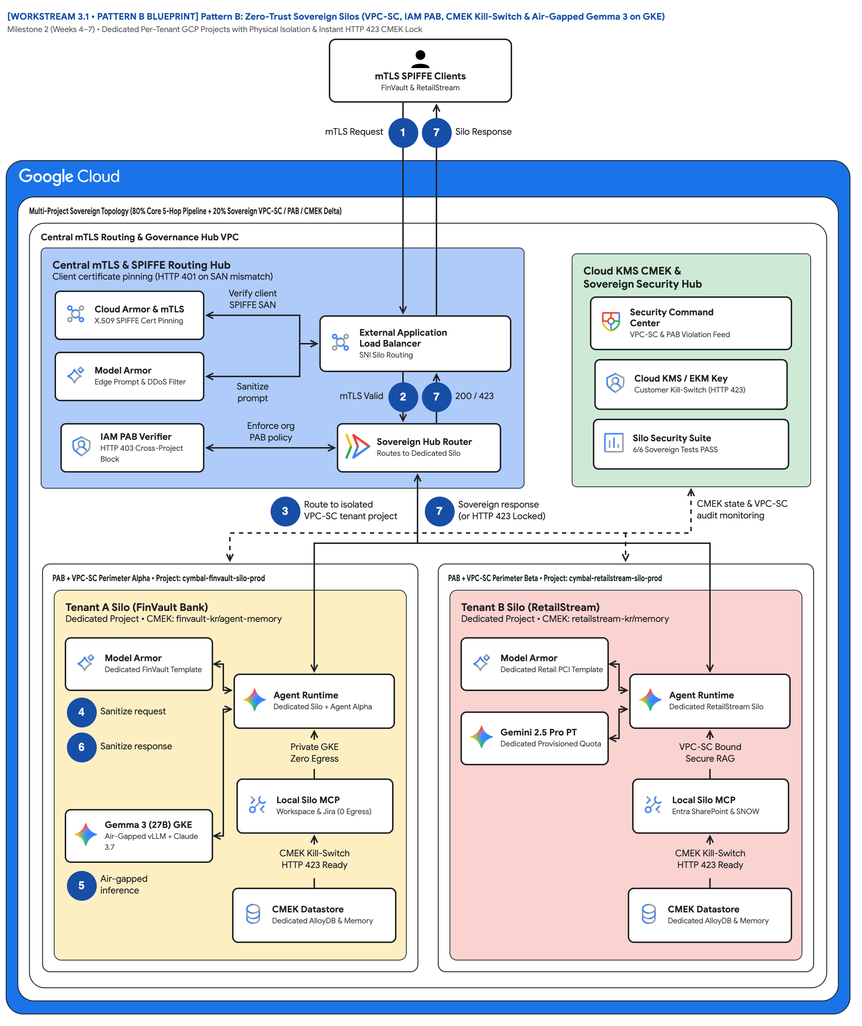
FIGURE 1 — PATTERN B: ZERO-TRUST SOVEREIGN SILOS (VPC-SC, IAM PAB, CMEK & AIR-GAPPED GEMMA 3 ON GKE) | ID: VIS-WS3-PATTERN-B-SOVEREIGN-SILOS-ARCHITECTURE • 1:1 Master High-Resolution Widescreen Architecture (Slide 2 contains Decomposed Vector Shapes)
Notes:
Figure 1 — Pattern B: Zero-Trust Sovereign Silos (VPC-SC, IAM PAB, CMEK & Air-Gapped Gemma 3 on GKE)
Milestone 2 (Weeks 4–7) • Dedicated Per-Tenant GCP Projects with Physical Isolation & Instant HTTP 423 CMEK Lock
• Follow badges 1→7: mTLS Request enters from the SPIFFE clients; Silo Response or HTTP 423 Locked returns on the same trunk.
• Routing hub: Cloud Armor SPIFFE pinning, Model Armor edge filter, IAM PAB Verifier, External ALB, Sovereign Hub Router.
• Governance hub: Security Command Center, Cloud KMS / EKM Key, and the Silo Security Suite 6/6 Sovereign Tests PASS card.
• Dashed line 'CMEK state & VPC-SC audit monitoring' feeds both silos — the signal Hop 3 uses to refuse work instantly.
• Left spoke: Perimeter Alpha / cymbal-finvault-silo-prod with Gemma 3 (27B) GKE air-gapped inference and Private GKE Zero Egress.
• Right spoke: Perimeter Beta / cymbal-retailstream-silo-prod with Gemini 2.5 Pro PT and Local Silo MCP Entra SharePoint & SNOW.
Editable source: diagrams/ws3-pattern-b-sovereign-silos-architecture.drawio (PromptCanvas Vision Decompiler)

Slide 24
FIGURE 1 — PATTERN B: ZERO-TRUST SOVEREIGN SILOS (VPC-SC, IAM PAB, CMEK & AIR-GAPPED GEMMA 3 ON GKE) | ID: VIS-WS3-PATTERN-B-SOVEREIGN-SILOS-ARCHITECTURE • 100% Decomposed Native Editable Vector Shapes, Icons & Arrows (Click any element to move or edit)
[WORKSTREAM 3.1 • PATTERN B BLUEPRINT] Pattern B: Zero-Trust Sovereign Silos (VPC-SC, IAM PAB, CMEK Kill-Switch & Air-Gapped Gemma 3 on GKE)
Milestone 2 (Weeks 4–7) • Dedicated Per-Tenant GCP Projects with Physical Isolation & Instant HTTP 423 CMEK Lock
FIGURE 1
mTLS SPIFFE ClientsFinVault & RetailStream
Pattern B: Zero-Trust Sovereign Silos (VPC-SC, IAM PAB, CMEK & Air-Gapped Gemma 3 on GKE)
mTLS Request
1
7
Silo Response
Multi-Project Sovereign Topology (80% Core 5-Hop Pipeline + 20% Sovereign VPC-SC / PAB / CMEK Delta)
Central mTLS Routing & Governance Hub VPC
Follow badges 1→7: mTLS Request enters from the SPIFFE clients; Silo Response or HTTP 423 Locked returns on the same trunk.
Routing hub: Cloud Armor SPIFFE pinning, Model Armor edge filter, IAM PAB Verifier, External ALB, Sovereign Hub Router.
Governance hub: Security Command Center, Cloud KMS / EKM Key, and the Silo Security Suite 6/6 Sovereign Tests PASS card.
Dashed line 'CMEK state & VPC-SC audit monitoring' feeds both silos — the signal Hop 3 uses to refuse work instantly.
Left spoke: Perimeter Alpha / cymbal-finvault-silo-prod with Gemma 3 (27B) GKE air-gapped inference and Private GKE Zero Egress.
Right spoke: Perimeter Beta / cymbal-retailstream-silo-prod with Gemini 2.5 Pro PT and Local Silo MCP Entra SharePoint & SNOW.
Central mTLS & SPIFFE Routing Hub
Client certificate pinning (HTTP 401 on SAN mismatch)
Cloud KMS CMEK &
Sovereign Security Hub
Cloud Armor & mTLS
X.509 SPIFFE Cert Pinning
Verify client
SPIFFE SAN
Security Command
Center • VPC-SC & PAB Violation Feed
External Application
Load Balancer • SNI Silo Routing
Model Armor
Edge Prompt & DDoS Filter
Cloud KMS / EKM Key
Customer Kill-Switch (HTTP 423)
Sanitize
prompt
mTLS Valid
2
7
200 / 423
IAM PAB Verifier
HTTP 403 Cross-Project Block
Enforce org
PAB policy
Sovereign Hub Router
Routes to Dedicated Silo
Silo Security Suite
6/6 Sovereign Tests PASS
3
Route to isolated
VPC-SC tenant project
7
Sovereign response
(or HTTP 423 Locked)
CMEK state & VPC-SC
audit monitoring
PAB + VPC-SC Perimeter Alpha • Project: cymbal-finvault-silo-prod
PAB + VPC-SC Perimeter Beta • Project: cymbal-retailstream-silo-prod
Tenant A Silo (FinVault Bank)
Dedicated Project • CMEK: finvault-kr/agent-memory
Tenant B Silo (RetailStream)
Dedicated Project • CMEK: retailstream-kr/memory
Model Armor
Dedicated FinVault Template
Model Armor
Dedicated Retail PCI Template
Agent Runtime
Dedicated Silo + Agent Alpha
Agent Runtime
Dedicated RetailStream Silo
4
Sanitize request
Gemini 2.5 Pro PT
Dedicated Provisioned Quota
6
Sanitize response
Private GKE
Zero Egress
VPC-SC Bound
Secure RAG
Local Silo MCP
Workspace & Jira (0 Egress)
Local Silo MCP
Entra SharePoint & SNOW
Gemma 3 (27B) GKE
Air-Gapped vLLM + Claude 3.7
CMEK Kill-Switch
HTTP 423 Ready
CMEK Kill-Switch
HTTP 423 Ready
56 native shapes • 23 connectors • click any box, icon or arrow to edit
5
Air-gapped
inference
CMEK Datastore
Dedicated AlloyDB & Memory
CMEK Datastore
Dedicated AlloyDB & Memory
Zones: Routing hub • Central governance & security hub • Left spoke • Right spoke | Source: diagrams/ws3-pattern-b-sovereign-silos-architecture.drawio
Notes:
Figure 1 — Pattern B: Zero-Trust Sovereign Silos (VPC-SC, IAM PAB, CMEK & Air-Gapped Gemma 3 on GKE)
Milestone 2 (Weeks 4–7) • Dedicated Per-Tenant GCP Projects with Physical Isolation & Instant HTTP 423 CMEK Lock
• Follow badges 1→7: mTLS Request enters from the SPIFFE clients; Silo Response or HTTP 423 Locked returns on the same trunk.
• Routing hub: Cloud Armor SPIFFE pinning, Model Armor edge filter, IAM PAB Verifier, External ALB, Sovereign Hub Router.
• Governance hub: Security Command Center, Cloud KMS / EKM Key, and the Silo Security Suite 6/6 Sovereign Tests PASS card.
• Dashed line 'CMEK state & VPC-SC audit monitoring' feeds both silos — the signal Hop 3 uses to refuse work instantly.
• Left spoke: Perimeter Alpha / cymbal-finvault-silo-prod with Gemma 3 (27B) GKE air-gapped inference and Private GKE Zero Egress.
• Right spoke: Perimeter Beta / cymbal-retailstream-silo-prod with Gemini 2.5 Pro PT and Local Silo MCP Entra SharePoint & SNOW.
Editable source: diagrams/ws3-pattern-b-sovereign-silos-architecture.drawio (PromptCanvas Vision Decompiler)

Slide 25
FIGURE 1 — PATTERN B: ZERO-TRUST SOVEREIGN SILOS (VPC-SC, IAM PAB, CMEK & AIR-GAPPED GEMMA 3 ON GKE) | Editable Architecture Component & Topology Specification Table
Object ID | Component Name | Architectural Role / Details | Type
OBJ-01 | Multi-Project Sovereign Topology (80% Core 5-Hop Pipeline + 20% Sovereign VPC-SC / PAB /… | Core Architecture Node | Enclave / Tier
OBJ-02 | Central mTLS Routing & Governance Hub VPC | Core Architecture Node | Enclave / Tier
OBJ-03 | PAB + VPC-SC Perimeter Alpha • Project: cymbal-finvault-silo-prod | Core Architecture Node | Enclave / Tier
OBJ-04 | PAB + VPC-SC Perimeter Beta • Project: cymbal-retailstream-silo-prod | Core Architecture Node | Enclave / Tier
OBJ-05 | Tenant A Silo (FinVault Bank) | Dedicated Project • CMEK: finvault-kr/agent-memory | Enclave / Tier
OBJ-06 | Tenant B Silo (RetailStream) | Dedicated Project • CMEK: retailstream-kr/memory | Enclave / Tier
OBJ-07 | Central mTLS & SPIFFE Routing Hub | Client certificate pinning (HTTP 401 on SAN mismatch) | Enclave / Tier
OBJ-08 | Cloud KMS CMEK & | Sovereign Security Hub | Enclave / Tier
OBJ-09 | [WORKSTREAM 3.1 • PATTERN B BLUEPRINT] Pattern B: Zero-Trust Sovereign Silos (VPC-SC, IAM… | Milestone 2 (Weeks 4–7) • Dedicated Per-Tenant GCP Projects with Physical Isolation & Instant HTTP 423 CMEK L… | Service Node
OBJ-10 | mTLS SPIFFE ClientsFinVault & RetailStream | Core Architecture Node | Service Node
OBJ-11 | External Application | Load Balancer • SNI Silo Routing | Service Node
OBJ-12 | Security Command | Center • VPC-SC & PAB Violation Feed | Service Node
OBJ-13 | Silo Security Suite | 6/6 Sovereign Tests PASS | Service Node
OBJ-14 | Cloud KMS / EKM Key | Customer Kill-Switch (HTTP 423) | Service Node
Notes:
Figure 1 component inventory for Pattern B: Zero-Trust Sovereign Silos (VPC-SC, IAM PAB, CMEK & Air-Gapped Gemma 3 on GKE)

Slide 26
WS3 | Key Takeaways
Key Takeaways
Choose Pattern B only when a contract demands a dedicated blast radius, a customer-revocable key, or no multi-tenant model endpoints.
Keep the governance code identical across patterns; pay for infrastructure, not for a second engineering team.
PAB answers 'which projects may this principal ever reach?' — it blocks lateral movement even when another project's IAM is wrong.
Make the tenant CMEK the single dependency for runtime, memory, data, and audit so one key disable is a complete kill-switch.
Prove every control with the 6-test suite before onboarding, and keep the results visible on the architecture diagram.
Run run_silo_security_tests.py, apply the 3.6 Terraform silo blueprint for one tenant, and book the 90-minute Pattern B codelab with your security team.
Notes:
Key Takeaways
• Choose Pattern B only when a contract demands a dedicated blast radius, a customer-revocable key, or no multi-tenant model endpoints.
• Keep the governance code identical across patterns; pay for infrastructure, not for a second engineering team.
• PAB answers 'which projects may this principal ever reach?' — it blocks lateral movement even when another project's IAM is wrong.
• Make the tenant CMEK the single dependency for runtime, memory, data, and audit so one key disable is a complete kill-switch.
• Prove every control with the 6-test suite before onboarding, and keep the results visible on the architecture diagram.

Slide 27
WS4
Pattern C — Dynamic Hybrid: One Control Plane, Pooled & Sovereign Tiers, Live Upgrades
Tenant-aware hub routing Standard to a shared pool and Enterprise over Private Service Connect to CMEK spokes, with 0-dropped-turn upgrades
Notes:
Pattern C — Dynamic Hybrid: One Control Plane, Pooled & Sovereign Tiers, Live Upgrades
Tenant-aware hub routing Standard to a shared pool and Enterprise over Private Service Connect to CMEK spokes, with 0-dropped-turn upgrades

Slide 28
WS4 | Executive TL;DR
Executive TL;DR
Tiered SaaS needs Pattern A economics for Standard and Pattern B sovereignty for Enterprise — Pattern C serves both behind one SaaS URL.
Unified Hybrid Control Hub (cymbal-hybrid-hub-prod): Cloud Armor/IAP, Cloud Run Router, Firestore Route Table, Cross-Project ARD Federated GEAP Registry.
RetailStream (Standard) runs in the Shared Pooled Runtime at a 4,000 thinking cap; FinVault (Enterprise) is reached over PSC at psc://10.10.0.50.
3-Phase engine (SHADOW_SYNC → ATOMIC_CUTOVER → DRAIN_AND_VERIFY) promotes RetailStream to its own CMEK PSC spoke on the same live session.
4.5 suite verifies 4/4 PASS: 0 ms replication lag, 0 dropped sessions, 8,000 budget unclamped, rs-agent-cmek bound, zero global state bleed.
Workstream 4 • Pattern C — Dynamic Hybrid, PSC & Live Tier Migration
Notes:
Executive TL;DR
• Tiered SaaS needs Pattern A economics for Standard and Pattern B sovereignty for Enterprise — Pattern C serves both behind one SaaS URL.
• Unified Hybrid Control Hub (cymbal-hybrid-hub-prod): Cloud Armor/IAP, Cloud Run Router, Firestore Route Table, Cross-Project ARD Federated GEAP Registry.
• RetailStream (Standard) runs in the Shared Pooled Runtime at a 4,000 thinking cap; FinVault (Enterprise) is reached over PSC at psc://10.10.0.50.
• 3-Phase engine (SHADOW_SYNC → ATOMIC_CUTOVER → DRAIN_AND_VERIFY) promotes RetailStream to its own CMEK PSC spoke on the same live session.
• 4.5 suite verifies 4/4 PASS: 0 ms replication lag, 0 dropped sessions, 8,000 budget unclamped, rs-agent-cmek bound, zero global state bleed.

Slide 29
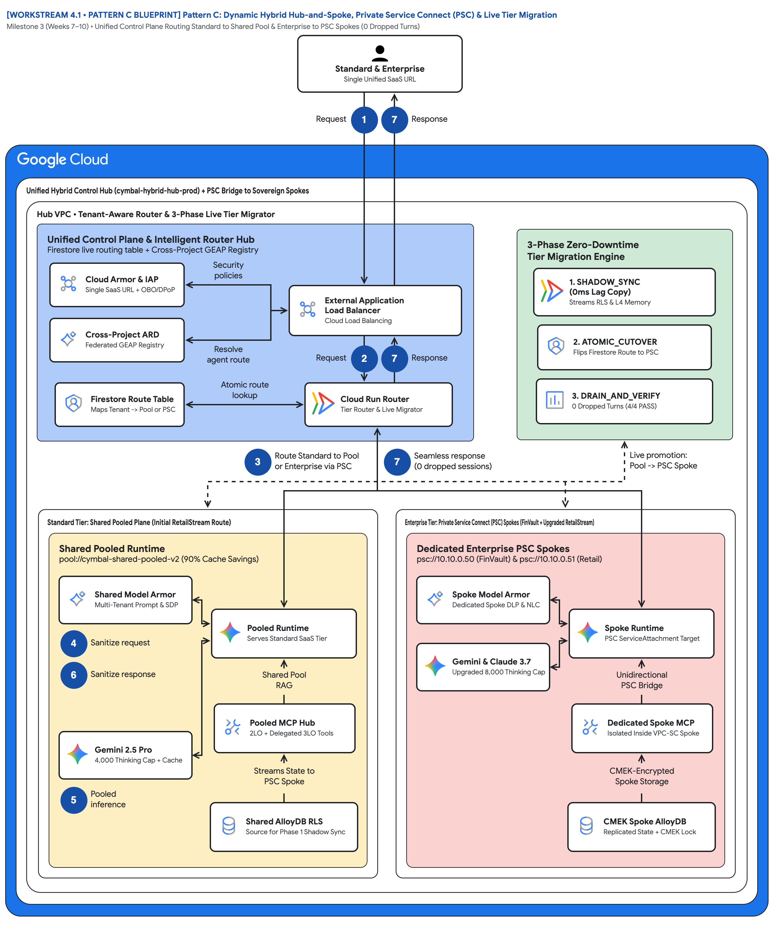
FIGURE 1 — PATTERN C: DYNAMIC HYBRID HUB-AND-SPOKE, PRIVATE SERVICE CONNECT & LIVE TIER MIGRATION | ID: VIS-WS4-PATTERN-C-HYBRID-PSC-AND-MIGRATION • 1:1 Master High-Resolution Widescreen Architecture (Slide 2 contains Decomposed Vector Shapes)
Notes:
Figure 1 — Pattern C: Dynamic Hybrid Hub-and-Spoke, Private Service Connect & Live Tier Migration
Milestone 3 (Weeks 7–10) • Unified Control Plane Routing Standard to Shared Pool & Enterprise to PSC Spokes (0 Dropped Turns)
• Start at the actor: Standard & Enterprise Single Unified SaaS URL — one hostname for both tiers, step 1 Request in, step 7 Response out.
• Routing hub: Cloud Armor & IAP + OBO/DPoP, Cross-Project ARD Federated GEAP Registry, Firestore Route Table, ALB, Cloud Run Router.
• Governance hub: 3-Phase Zero-Downtime Tier Migration Engine — SHADOW_SYNC (0ms Lag Copy), ATOMIC_CUTOVER, DRAIN_AND_VERIFY (4/4 PASS).
• Trunk badge 3 'Route Standard to Pool or Enterprise via PSC' fans out; badge 7 'Seamless response (0 dropped sessions)' returns.
• Left spoke: Shared Pooled Runtime with Gemini 2.5 Pro 4,000 Thinking Cap + Cache and Shared AlloyDB RLS that Streams State to PSC Spoke.
• Right spoke: Dedicated Enterprise PSC Spokes, Unidirectional PSC Bridge, CMEK Spoke AlloyDB; dashed Live promotion: Pool -> PSC Spoke.
Editable source: diagrams/ws4-pattern-c-hybrid-psc-and-migration.drawio (PromptCanvas Vision Decompiler)

Slide 30
FIGURE 1 — PATTERN C: DYNAMIC HYBRID HUB-AND-SPOKE, PRIVATE SERVICE CONNECT & LIVE TIER MIGRATION | ID: VIS-WS4-PATTERN-C-HYBRID-PSC-AND-MIGRATION • 100% Decomposed Native Editable Vector Shapes, Icons & Arrows (Click any element to move or edit)
[WORKSTREAM 4.1 • PATTERN C BLUEPRINT] Pattern C: Dynamic Hybrid Hub-and-Spoke, Private Service Connect (PSC) & Live Tier Migration
Milestone 3 (Weeks 7–10) • Unified Control Plane Routing Standard to Shared Pool & Enterprise to PSC Spokes (0 Dropped Turns)
FIGURE 1
Standard & EnterpriseSingle Unified SaaS URL
Pattern C: Dynamic Hybrid Hub-and-Spoke, Private Service Connect & Live Tier Migration
Request
1
7
Response
Unified Hybrid Control Hub (cymbal-hybrid-hub-prod) + PSC Bridge to Sovereign Spokes
Hub VPC • Tenant-Aware Router & 3-Phase Live Tier Migrator
Start at the actor: Standard & Enterprise Single Unified SaaS URL — one hostname for both tiers, step 1 Request in, step 7 Response out.
Routing hub: Cloud Armor & IAP + OBO/DPoP, Cross-Project ARD Federated GEAP Registry, Firestore Route Table, ALB, Cloud Run Router.
Governance hub: 3-Phase Zero-Downtime Tier Migration Engine — SHADOW_SYNC (0ms Lag Copy), ATOMIC_CUTOVER, DRAIN_AND_VERIFY (4/4 PASS).
Trunk badge 3 'Route Standard to Pool or Enterprise via PSC' fans out; badge 7 'Seamless response (0 dropped sessions)' returns.
Left spoke: Shared Pooled Runtime with Gemini 2.5 Pro 4,000 Thinking Cap + Cache and Shared AlloyDB RLS that Streams State to PSC Spoke.
Right spoke: Dedicated Enterprise PSC Spokes, Unidirectional PSC Bridge, CMEK Spoke AlloyDB; dashed Live promotion: Pool -> PSC Spoke.
Unified Control Plane & Intelligent Router Hub
Firestore live routing table + Cross-Project GEAP Registry
3-Phase Zero-Downtime
Tier Migration Engine
Cloud Armor & IAP
Single SaaS URL + OBO/DPoP
Security
policies
1. SHADOW_SYNC
(0ms Lag Copy) • Streams RLS & L4 Memory
External Application
Load Balancer • Cloud Load Balancing
Cross-Project ARD
Federated GEAP Registry
2. ATOMIC_CUTOVER
Flips Firestore Route to PSC
Resolve
agent route
Request
2
7
Response
Firestore Route Table
Maps Tenant -> Pool or PSC
Atomic route
lookup
Cloud Run Router
Tier Router & Live Migrator
3. DRAIN_AND_VERIFY
0 Dropped Turns (4/4 PASS)
3
Route Standard to Pool
or Enterprise via PSC
7
Seamless response
(0 dropped sessions)
Live promotion:
Pool -> PSC Spoke
Standard Tier: Shared Pooled Plane (Initial RetailStream Route)
Enterprise Tier: Private Service Connect (PSC) Spokes (FinVault + Upgraded RetailStream)
Shared Pooled Runtime
pool://cymbal-shared-pooled-v2 (90% Cache Savings)
Dedicated Enterprise PSC Spokes
psc://10.10.0.50 (FinVault) & psc://10.10.0.51 (Retail)
Shared Model Armor
Multi-Tenant Prompt & SDP
Spoke Model Armor
Dedicated Spoke DLP & NLC
Pooled Runtime
Serves Standard SaaS Tier
Spoke Runtime
PSC ServiceAttachment Target
4
Sanitize request
Gemini & Claude 3.7
Upgraded 8,000 Thinking Cap
6
Sanitize response
Shared Pool
RAG
Unidirectional
PSC Bridge
Pooled MCP Hub
2LO + Delegated 3LO Tools
Dedicated Spoke MCP
Isolated Inside VPC-SC Spoke
Gemini 2.5 Pro
4,000 Thinking Cap + Cache
Streams State to
PSC Spoke
CMEK-Encrypted
Spoke Storage
56 native shapes • 23 connectors • click any box, icon or arrow to edit
5
Pooled
inference
Shared AlloyDB RLS
Source for Phase 1 Shadow Sync
CMEK Spoke AlloyDB
Replicated State + CMEK Lock
Zones: Routing hub • Central governance & security hub • Left spoke • Right spoke | Source: diagrams/ws4-pattern-c-hybrid-psc-and-migration.drawio
Notes:
Figure 1 — Pattern C: Dynamic Hybrid Hub-and-Spoke, Private Service Connect & Live Tier Migration
Milestone 3 (Weeks 7–10) • Unified Control Plane Routing Standard to Shared Pool & Enterprise to PSC Spokes (0 Dropped Turns)
• Start at the actor: Standard & Enterprise Single Unified SaaS URL — one hostname for both tiers, step 1 Request in, step 7 Response out.
• Routing hub: Cloud Armor & IAP + OBO/DPoP, Cross-Project ARD Federated GEAP Registry, Firestore Route Table, ALB, Cloud Run Router.
• Governance hub: 3-Phase Zero-Downtime Tier Migration Engine — SHADOW_SYNC (0ms Lag Copy), ATOMIC_CUTOVER, DRAIN_AND_VERIFY (4/4 PASS).
• Trunk badge 3 'Route Standard to Pool or Enterprise via PSC' fans out; badge 7 'Seamless response (0 dropped sessions)' returns.
• Left spoke: Shared Pooled Runtime with Gemini 2.5 Pro 4,000 Thinking Cap + Cache and Shared AlloyDB RLS that Streams State to PSC Spoke.
• Right spoke: Dedicated Enterprise PSC Spokes, Unidirectional PSC Bridge, CMEK Spoke AlloyDB; dashed Live promotion: Pool -> PSC Spoke.
Editable source: diagrams/ws4-pattern-c-hybrid-psc-and-migration.drawio (PromptCanvas Vision Decompiler)

Slide 31
FIGURE 1 — PATTERN C: DYNAMIC HYBRID HUB-AND-SPOKE, PRIVATE SERVICE CONNECT & LIVE TIER MIGRATION | Editable Architecture Component & Topology Specification Table
Object ID | Component Name | Architectural Role / Details | Type
OBJ-01 | Unified Hybrid Control Hub (cymbal-hybrid-hub-prod) + PSC Bridge to Sovereign Spokes | Core Architecture Node | Enclave / Tier
OBJ-02 | Hub VPC • Tenant-Aware Router & 3-Phase Live Tier Migrator | Core Architecture Node | Enclave / Tier
OBJ-03 | Standard Tier: Shared Pooled Plane (Initial RetailStream Route) | Core Architecture Node | Enclave / Tier
OBJ-04 | Enterprise Tier: Private Service Connect (PSC) Spokes (FinVault + Upgraded RetailStream) | Core Architecture Node | Enclave / Tier
OBJ-05 | Shared Pooled Runtime | pool://cymbal-shared-pooled-v2 (90% Cache Savings) | Enclave / Tier
OBJ-06 | Dedicated Enterprise PSC Spokes | psc://10.10.0.50 (FinVault) & psc://10.10.0.51 (Retail) | Enclave / Tier
OBJ-07 | Unified Control Plane & Intelligent Router Hub | Firestore live routing table + Cross-Project GEAP Registry | Enclave / Tier
OBJ-08 | 3-Phase Zero-Downtime | Tier Migration Engine | Enclave / Tier
OBJ-09 | [WORKSTREAM 4.1 • PATTERN C BLUEPRINT] Pattern C: Dynamic Hybrid Hub-and-Spoke, Private S… | Milestone 3 (Weeks 7–10) • Unified Control Plane Routing Standard to Shared Pool & Enterprise to PSC Spokes (… | Service Node
OBJ-10 | Standard & EnterpriseSingle Unified SaaS URL | Core Architecture Node | Service Node
OBJ-11 | External Application | Load Balancer • Cloud Load Balancing | Service Node
OBJ-12 | 1. SHADOW_SYNC | (0ms Lag Copy) • Streams RLS & L4 Memory | Service Node
OBJ-13 | 3. DRAIN_AND_VERIFY | 0 Dropped Turns (4/4 PASS) | Service Node
OBJ-14 | 2. ATOMIC_CUTOVER | Flips Firestore Route to PSC | Service Node
Notes:
Figure 1 component inventory for Pattern C: Dynamic Hybrid Hub-and-Spoke, Private Service Connect & Live Tier Migration

Slide 32
WS4 | Key Takeaways
Key Takeaways
Pattern C routes isolation instead of duplicating it: one control plane, one URL, two execution tiers.
Routing is keyed only on the Hop 1 cryptographic tenant_id — a client header can never claim Enterprise tier.
Instance-scoped profile mutation makes the live upgrade safe: zero global state bleed across tenants or test runs.
Private Service Connect removes CIDR overlap and VPC-peering limits while keeping spokes unidirectional and VPC-SC compatible.
The migration is measurable: 0 ms lag, 0 dropped sessions, same session id, 4/4 suite gates passing.
Apply the 4.6 Terraform PSC blueprint, run the 4.5 zero-downtime upgrade suite, then continue to Workstream 5 for the decision guide and capstone.
Notes:
Key Takeaways
• Pattern C routes isolation instead of duplicating it: one control plane, one URL, two execution tiers.
• Routing is keyed only on the Hop 1 cryptographic tenant_id — a client header can never claim Enterprise tier.
• Instance-scoped profile mutation makes the live upgrade safe: zero global state bleed across tenants or test runs.
• Private Service Connect removes CIDR overlap and VPC-peering limits while keeping spokes unidirectional and VPC-SC compatible.
• The migration is measurable: 0 ms lag, 0 dropped sessions, same session id, 4/4 suite gates passing.

Slide 33
WS5
Pooled, Siloed, or Hybrid? Executive Decision Guide & the Multi-Tenant Agentic Triad
Workstream 5 wrap-up: topology decision tree, Pattern A/B/C comparison, the Agentic Triad, 5-Hop invariant, and the EAP backlog
Notes:
Pooled, Siloed, or Hybrid? Executive Decision Guide & the Multi-Tenant Agentic Triad
Workstream 5 wrap-up: topology decision tree, Pattern A/B/C comparison, the Agentic Triad, 5-Hop invariant, and the EAP backlog

Slide 34
WS5 | Executive TL;DR
Executive TL;DR
Two questions decide topology: all tenants need physical isolation (VPC-SC / Gemma 3)? -> Pattern B; else tiered packaging? No -> A, Yes -> C.
80% of the code is identical: core-cymbal-agent/ implements the 5-Hop Cryptographic Context Chain once; A, B and C are 20% perimeter deltas.
The Multi-Tenant Agentic Triad balances Zero-Trust Security (Hops 1-5), FinOps & COGS Engineering, and Privacy-Preserving Tenant Observability.
Unit cost ladder: Pattern A $ (85-90% shared prefix savings), Pattern C $$ (blended SaaS margin), Pattern B $$$ (dedicated baseline per tenant).
Nine open product gaps (3 P0, 4 P1, 2 P2) each ship with a repo workaround and a named EAP allowlist targeting Q4 2026 - Q1 2027.
Workstream 5 • Decision Guide, Agentic Triad & Program Wrap-up
Notes:
Executive TL;DR
• Two questions decide topology: all tenants need physical isolation (VPC-SC / Gemma 3)? -> Pattern B; else tiered packaging? No -> A, Yes -> C.
• 80% of the code is identical: core-cymbal-agent/ implements the 5-Hop Cryptographic Context Chain once; A, B and C are 20% perimeter deltas.
• The Multi-Tenant Agentic Triad balances Zero-Trust Security (Hops 1-5), FinOps & COGS Engineering, and Privacy-Preserving Tenant Observability.
• Unit cost ladder: Pattern A $ (85-90% shared prefix savings), Pattern C $$ (blended SaaS margin), Pattern B $$$ (dedicated baseline per tenant).
• Nine open product gaps (3 P0, 4 P1, 2 P2) each ship with a repo workaround and a named EAP allowlist targeting Q4 2026 - Q1 2027.

Slide 35
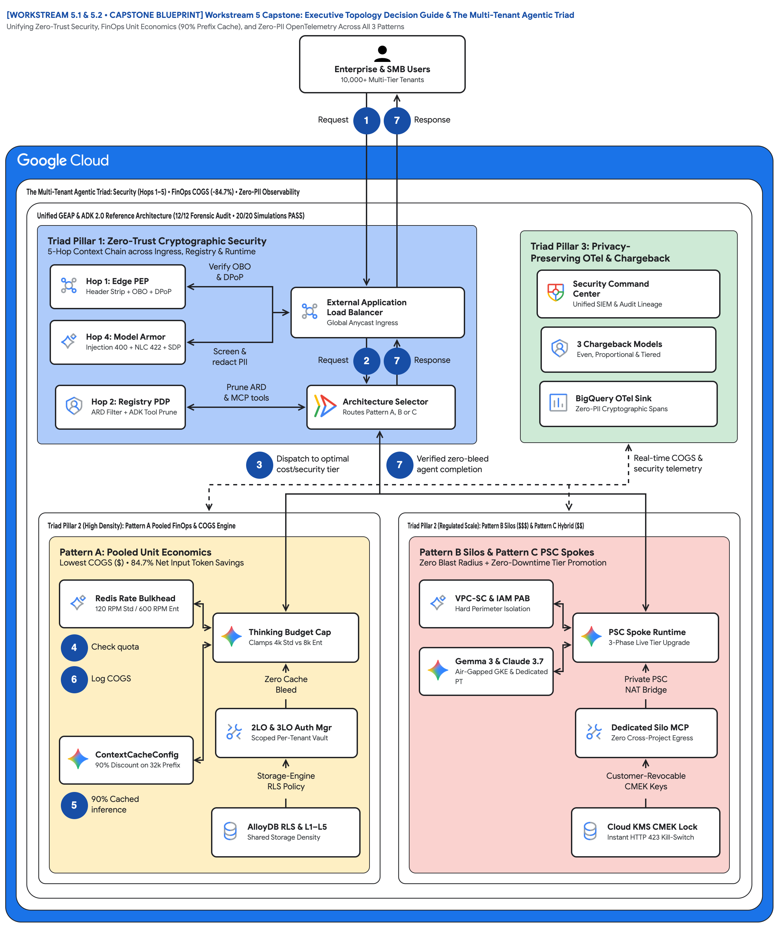
FIGURE 1 — WORKSTREAM 5 CAPSTONE: EXECUTIVE TOPOLOGY DECISION GUIDE & THE MULTI-TENANT AGENTIC TRIAD | ID: VIS-WS5-DECISION-TREE-AND-AGENTIC-TRIAD • 1:1 Master High-Resolution Widescreen Architecture (Slide 2 contains Decomposed Vector Shapes)
Notes:
Figure 1 — Workstream 5 Capstone: Executive Topology Decision Guide & The Multi-Tenant Agentic Triad
Unifying Zero-Trust Security, FinOps Unit Economics (90% Prefix Cache), and Zero-PII OpenTelemetry Across All 3 Patterns
• Actor 'Enterprise & SMB Users 10,000+ Multi-Tier Tenants' enters at badge 1 Request and receives badge 7 Response.
• Routing hub = Triad Pillar 1: Hop 1 Edge PEP, Hop 4 Model Armor, Hop 2 Registry PDP, External ALB, Architecture Selector (Pattern A/B/C).
• Governance hub = Triad Pillar 3: Security Command Center, 3 Chargeback Models, BigQuery OTel Sink; dashed line carries zero-PII telemetry.
• Badge 3 'Dispatch to optimal cost/security tier' is where the selector commits; badge 7 'Verified zero-bleed agent completion' closes it.
• Left spoke Pattern A Pooled Unit Economics: Redis Rate Bulkhead, Thinking Budget Cap, ContextCacheConfig 90% Discount, AlloyDB RLS & L1-L5.
• Right spoke Pattern B Silos & Pattern C PSC Spokes: VPC-SC & IAM PAB, Gemma 3 & Claude 3.7, PSC Spoke Runtime, Silo MCP, CMEK Lock.
Editable source: diagrams/ws5-decision-tree-and-agentic-triad.drawio (PromptCanvas Vision Decompiler)

Slide 36
FIGURE 1 — WORKSTREAM 5 CAPSTONE: EXECUTIVE TOPOLOGY DECISION GUIDE & THE MULTI-TENANT AGENTIC TRIAD | ID: VIS-WS5-DECISION-TREE-AND-AGENTIC-TRIAD • 100% Decomposed Native Editable Vector Shapes, Icons & Arrows (Click any element to move or edit)
[WORKSTREAM 5.1 & 5.2 • CAPSTONE BLUEPRINT] Workstream 5 Capstone: Executive Topology Decision Guide & The Multi-Tenant Agentic Triad
Unifying Zero-Trust Security, FinOps Unit Economics (90% Prefix Cache), and Zero-PII OpenTelemetry Across All 3 Patterns
FIGURE 1
Enterprise & SMB Users10,000+ Multi-Tier Tenants
Workstream 5 Capstone: Executive Topology Decision Guide & The Multi-Tenant Agentic Triad
Request
1
7
Response
The Multi-Tenant Agentic Triad: Security (Hops 1–5) • FinOps COGS (-84.7%) • Zero-PII Observability
Unified GEAP & ADK 2.0 Reference Architecture (12/12 Forensic Audit • 20/20 Simulations PASS)
Actor 'Enterprise & SMB Users 10,000+ Multi-Tier Tenants' enters at badge 1 Request and receives badge 7 Response.
Routing hub = Triad Pillar 1: Hop 1 Edge PEP, Hop 4 Model Armor, Hop 2 Registry PDP, External ALB, Architecture Selector (Pattern A/B/C).
Governance hub = Triad Pillar 3: Security Command Center, 3 Chargeback Models, BigQuery OTel Sink; dashed line carries zero-PII telemetry.
Badge 3 'Dispatch to optimal cost/security tier' is where the selector commits; badge 7 'Verified zero-bleed agent completion' closes it.
Left spoke Pattern A Pooled Unit Economics: Redis Rate Bulkhead, Thinking Budget Cap, ContextCacheConfig 90% Discount, AlloyDB RLS & L1-L5.
Right spoke Pattern B Silos & Pattern C PSC Spokes: VPC-SC & IAM PAB, Gemma 3 & Claude 3.7, PSC Spoke Runtime, Silo MCP, CMEK Lock.
Triad Pillar 1: Zero-Trust Cryptographic Security
5-Hop Context Chain across Ingress, Registry & Runtime
Triad Pillar 3: Privacy-
Preserving OTel & Chargeback
Hop 1: Edge PEP
Header Strip + OBO + DPoP
Verify OBO
& DPoP
Security Command
Center • Unified SIEM & Audit Lineage
External Application
Load Balancer • Global Anycast Ingress
Hop 4: Model Armor
Injection 400 + NLC 422 + SDP
3 Chargeback Models
Even, Proportional & Tiered
Screen &
redact PII
Request
2
7
Response
Hop 2: Registry PDP
ARD Filter + ADK Tool Prune
Prune ARD
& MCP tools
Architecture Selector
Routes Pattern A, B or C
BigQuery OTel Sink
Zero-PII Cryptographic Spans
3
Dispatch to optimal
cost/security tier
7
Verified zero-bleed
agent completion
Real-time COGS &
security telemetry
Triad Pillar 2 (High Density): Pattern A Pooled FinOps & COGS Engine
Triad Pillar 2 (Regulated Scale): Pattern B Silos ($$$) & Pattern C Hybrid ($$)
Pattern A: Pooled Unit Economics
Lowest COGS ($) • 84.7% Net Input Token Savings
Pattern B Silos & Pattern C PSC Spokes
Zero Blast Radius + Zero-Downtime Tier Promotion
Redis Rate Bulkhead
120 RPM Std / 600 RPM Ent
VPC-SC & IAM PAB
Hard Perimeter Isolation
Thinking Budget Cap
Clamps 4k Std vs 8k Ent
PSC Spoke Runtime
3-Phase Live Tier Upgrade
4
Check quota
Gemma 3 & Claude 3.7
Air-Gapped GKE & Dedicated PT
6
Log COGS
Zero Cache
Bleed
Private PSC
NAT Bridge
2LO & 3LO Auth Mgr
Scoped Per-Tenant Vault
Dedicated Silo MCP
Zero Cross-Project Egress
ContextCacheConfig
90% Discount on 32k Prefix
Storage-Engine
RLS Policy
Customer-Revocable
CMEK Keys
56 native shapes • 23 connectors • click any box, icon or arrow to edit
5
90% Cached
inference
AlloyDB RLS & L1–L5
Shared Storage Density
Cloud KMS CMEK Lock
Instant HTTP 423 Kill-Switch
Zones: Routing hub • Central governance & security hub • Left spoke • Right spoke | Source: diagrams/ws5-decision-tree-and-agentic-triad.drawio
Notes:
Figure 1 — Workstream 5 Capstone: Executive Topology Decision Guide & The Multi-Tenant Agentic Triad
Unifying Zero-Trust Security, FinOps Unit Economics (90% Prefix Cache), and Zero-PII OpenTelemetry Across All 3 Patterns
• Actor 'Enterprise & SMB Users 10,000+ Multi-Tier Tenants' enters at badge 1 Request and receives badge 7 Response.
• Routing hub = Triad Pillar 1: Hop 1 Edge PEP, Hop 4 Model Armor, Hop 2 Registry PDP, External ALB, Architecture Selector (Pattern A/B/C).
• Governance hub = Triad Pillar 3: Security Command Center, 3 Chargeback Models, BigQuery OTel Sink; dashed line carries zero-PII telemetry.
• Badge 3 'Dispatch to optimal cost/security tier' is where the selector commits; badge 7 'Verified zero-bleed agent completion' closes it.
• Left spoke Pattern A Pooled Unit Economics: Redis Rate Bulkhead, Thinking Budget Cap, ContextCacheConfig 90% Discount, AlloyDB RLS & L1-L5.
• Right spoke Pattern B Silos & Pattern C PSC Spokes: VPC-SC & IAM PAB, Gemma 3 & Claude 3.7, PSC Spoke Runtime, Silo MCP, CMEK Lock.
Editable source: diagrams/ws5-decision-tree-and-agentic-triad.drawio (PromptCanvas Vision Decompiler)

Slide 37
FIGURE 1 — WORKSTREAM 5 CAPSTONE: EXECUTIVE TOPOLOGY DECISION GUIDE & THE MULTI-TENANT AGENTIC TRIAD | Editable Architecture Component & Topology Specification Table
Object ID | Component Name | Architectural Role / Details | Type
OBJ-01 | The Multi-Tenant Agentic Triad: Security (Hops 1–5) • FinOps COGS (-84.7%) • Zero-PII Obs… | Core Architecture Node | Enclave / Tier
OBJ-02 | Unified GEAP & ADK 2.0 Reference Architecture (12/12 Forensic Audit • 20/20 Simulations P… | Core Architecture Node | Enclave / Tier
OBJ-03 | Triad Pillar 2 (High Density): Pattern A Pooled FinOps & COGS Engine | Core Architecture Node | Enclave / Tier
OBJ-04 | Triad Pillar 2 (Regulated Scale): Pattern B Silos ($$$) & Pattern C Hybrid ($$) | Core Architecture Node | Enclave / Tier
OBJ-05 | Pattern A: Pooled Unit Economics | Lowest COGS ($) • 84.7% Net Input Token Savings | Enclave / Tier
OBJ-06 | Pattern B Silos & Pattern C PSC Spokes | Zero Blast Radius + Zero-Downtime Tier Promotion | Enclave / Tier
OBJ-07 | Triad Pillar 1: Zero-Trust Cryptographic Security | 5-Hop Context Chain across Ingress, Registry & Runtime | Enclave / Tier
OBJ-08 | Triad Pillar 3: Privacy- | Preserving OTel & Chargeback | Enclave / Tier
OBJ-09 | [WORKSTREAM 5.1 & 5.2 • CAPSTONE BLUEPRINT] Workstream 5 Capstone: Executive Topology Dec… | Unifying Zero-Trust Security, FinOps Unit Economics (90% Prefix Cache), and Zero-PII OpenTelemetry Across All… | Service Node
OBJ-10 | Enterprise & SMB Users10,000+ Multi-Tier Tenants | Core Architecture Node | Service Node
OBJ-11 | External Application | Load Balancer • Global Anycast Ingress | Service Node
OBJ-12 | Security Command | Center • Unified SIEM & Audit Lineage | Service Node
OBJ-13 | BigQuery OTel Sink | Zero-PII Cryptographic Spans | Service Node
OBJ-14 | 3 Chargeback Models | Even, Proportional & Tiered | Service Node
Notes:
Figure 1 component inventory for Workstream 5 Capstone: Executive Topology Decision Guide & The Multi-Tenant Agentic Triad

Slide 38
WS5 | Key Takeaways
Key Takeaways
Answer the compliance question before the packaging question; most topology debates are really about which question is being asked.
Whatever pattern you pick, the same five hops run; only the blast radius of each hop changes.
Pooled density, sovereign isolation and hybrid routing are points on one cost/security curve ($ / $$$ / $$), not three products.
The Triad is a balance: security-only raises TCO, cost-only invites noisy neighbors and cache bleed, observability without redaction leaks PII.
Adopt the Milestone 1 sign-off gate as your acceptance criteria: header strip, deterministic 403s, tiered clamps and 429s, PII redaction plus RLS.
Run the decision tree with legal and product together, clone core-cymbal-agent/, run the three test suites, and request the P0 EAP allowlists.
Notes:
Key Takeaways
• Answer the compliance question before the packaging question; most topology debates are really about which question is being asked.
• Whatever pattern you pick, the same five hops run; only the blast radius of each hop changes.
• Pooled density, sovereign isolation and hybrid routing are points on one cost/security curve ($ / $$$ / $$), not three products.
• The Triad is a balance: security-only raises TCO, cost-only invites noisy neighbors and cache bleed, observability without redaction leaks PII.
• Adopt the Milestone 1 sign-off gate as your acceptance criteria: header strip, deterministic 403s, tiered clamps and 429s, PII redaction plus RLS.

Slide 39
PROGRAM | Assets, Editable Diagrams & Source Documents
Assets & Editable Diagrams
Diagram | Editable Draw.io | Draw.io Render | Vision AST
WORKSTREAM 1.1 BLUEPRINT GEAP Multi-Tenant Agentic AI Taxonomy: Pooled (Pattern A), Sovereign Silos (Pattern B) & Hybrid (Pattern C) | diagrams/ws1-multi-tenant-taxonomy-overview.drawio | diagrams/ws1-multi-tenant-taxonomy-overview.drawio.png | diagrams/vision_metadata/ws1-multi-tenant-taxonomy-overview.vision.json
WORKSTREAM 1.3 DOC PR BLUEPRINT Cloud Architecture Center: Multi-Tenant Agentic AI System with 5-Hop Cryptographic Governance | diagrams/ws1-cloud-arch-center-5hop-baseline.drawio | diagrams/ws1-cloud-arch-center-5hop-baseline.drawio.png | diagrams/vision_metadata/ws1-cloud-arch-center-5hop-baseline.vision.json
WORKSTREAM 2.1 • PATTERN A BLUEPRINT Pattern A: High-Density Pooled Multi-Tenant Architecture & Shared Runtime Governance | diagrams/ws2-pattern-a-pooled-5hop-architecture.drawio | diagrams/ws2-pattern-a-pooled-5hop-architecture.drawio.png | diagrams/vision_metadata/ws2-pattern-a-pooled-5hop-architecture.vision.json
WORKSTREAM 2.5 • BREACH SUITE BLUEPRINT Pattern A: 10-Point Cross-Tenant Breach Simulation & Cryptographic Defense Matrix | diagrams/ws2-pattern-a-breach-defense-sequence.drawio | diagrams/ws2-pattern-a-breach-defense-sequence.drawio.png | diagrams/vision_metadata/ws2-pattern-a-breach-defense-sequence.vision.json
WORKSTREAM 3.1 • PATTERN B BLUEPRINT Pattern B: Zero-Trust Sovereign Silos (VPC-SC, IAM PAB, CMEK Kill-Switch & Air-Gapped Gemma 3 on GKE) | diagrams/ws3-pattern-b-sovereign-silos-architecture.drawio | diagrams/ws3-pattern-b-sovereign-silos-architecture.drawio.png | diagrams/vision_metadata/ws3-pattern-b-sovereign-silos-architecture.vision.json
WORKSTREAM 4.1 • PATTERN C BLUEPRINT Pattern C: Dynamic Hybrid Hub-and-Spoke, Private Service Connect (PSC) & Live Tier Migration | diagrams/ws4-pattern-c-hybrid-psc-and-migration.drawio | diagrams/ws4-pattern-c-hybrid-psc-and-migration.drawio.png | diagrams/vision_metadata/ws4-pattern-c-hybrid-psc-and-migration.vision.json
WORKSTREAM 5.1 & 5.2 • CAPSTONE BLUEPRINT Workstream 5 Capstone: Executive Topology Decision Guide & The Multi-Tenant Agentic Triad | diagrams/ws5-decision-tree-and-agentic-triad.drawio | diagrams/ws5-decision-tree-and-agentic-triad.drawio.png | diagrams/vision_metadata/ws5-decision-tree-and-agentic-triad.vision.json
Blog: blogs/ws1-reference-architecture-taxonomy-and-5hop-baseline.md • Deck: slides/ws1-reference-architecture-editable-slides.pptx
Blog: blogs/ws2-pattern-a-pooled-architecture.md • Deck: slides/ws2-pattern-a-pooled-editable-slides.pptx
Blog: blogs/ws3-pattern-b-sovereign-silos.md • Deck: slides/ws3-pattern-b-siloed-editable-slides.pptx
Blog: blogs/ws4-pattern-c-hybrid-dynamic-tiering.md • Deck: slides/ws4-pattern-c-hybrid-editable-slides.pptx
Blog: blogs/ws5-decision-guide-and-agentic-triad.md • Deck: slides/ws5-wrap-up-editable-slides.pptx
Anchor reference: https://docs.cloud.google.com/architecture/multi-tenant-agentic-ai-system
GitHub: https://github.com/nitinaggarwal-12/blogs
Notes:
See blogs/ for the full explanatory articles and slides/ for per-workstream decks.

