Slide 1
WORKSTREAM 1 • REFERENCE ARCHITECTURE & CLOUD ARCHITECTURE CENTER DOC PR
Multi-Tenant Agentic AI on Google Cloud: Taxonomy & 5-Hop Baseline (Workstream 1)
Pooled, Sovereign Silo & Dynamic Hybrid topologies extending the Cloud Architecture Center hub-and-spoke reference for B2B ISV SaaS
Multi-Tenant Agentic AI on Google Cloud • Gemini Enterprise Agent Platform (GEAP) & ADK 2.0
Every diagram slide is 100% native editable (PromptCanvas Vision Decompiler → Draw.io → PowerPoint / Google Slides)
Anchor reference: https://docs.cloud.google.com/architecture/multi-tenant-agentic-ai-system
Notes:
Multi-Tenant Agentic AI on Google Cloud: Taxonomy & 5-Hop Baseline (Workstream 1)
Pooled, Sovereign Silo & Dynamic Hybrid topologies extending the Cloud Architecture Center hub-and-spoke reference for B2B ISV SaaS
Series: Multi-Tenant Agentic AI on Google Cloud • Gemini Enterprise Agent Platform (GEAP) & ADK 2.0

Slide 2
WS1 | Executive TL;DR
Executive TL;DR
Official Architecture Center reference models one spoke project per business unit; 90%+ of B2B SaaS ISVs cannot afford that per Standard-tier tenant.
Agents add four new failure modes: dynamic MCP discovery, confused-deputy credentials, context-cache bleed, and noisy-neighbor runaway reasoning loops.
Workstream 1 defines Pattern A (Pooled), Pattern B (Sovereign Silos), and Pattern C (Dynamic Hybrid) on an 80% reusable core + 20% topology delta.
A single 5-Hop Cryptographic Context Chain (hop1..hop5 Python modules) enforces identical governance across all three patterns.
Deliverables: Doc PR for the Architecture Center (1.3), product review pack (1.2), and an EAP/product-gap ledger with 3 P0 workarounds (1.4).
Workstream 1 • Reference Architecture & Cloud Architecture Center Doc PR • Multi-Tenant Agentic AI on Google Cloud • Gemini Enterprise Agent Platform (GEAP) & ADK 2.0
Notes:
Executive TL;DR
• Official Architecture Center reference models one spoke project per business unit; 90%+ of B2B SaaS ISVs cannot afford that per Standard-tier tenant.
• Agents add four new failure modes: dynamic MCP discovery, confused-deputy credentials, context-cache bleed, and noisy-neighbor runaway reasoning loops.
• Workstream 1 defines Pattern A (Pooled), Pattern B (Sovereign Silos), and Pattern C (Dynamic Hybrid) on an 80% reusable core + 20% topology delta.
• A single 5-Hop Cryptographic Context Chain (hop1..hop5 Python modules) enforces identical governance across all three patterns.
• Deliverables: Doc PR for the Architecture Center (1.3), product review pack (1.2), and an EAP/product-gap ledger with 3 P0 workarounds (1.4).

Slide 3
WS1 | Why classic SaaS tenancy breaks for agents
Why classic SaaS tenancy breaks for agents
Static routes and WHERE-clause tenancy cannot govern multi-turn reasoning, dynamic MCP tool calls, or shared prompt caches.
Failure mode 1: mid-turn MCP discovery can expose another tenant's private connectors or custom agents.
Failure mode 2: ambient service-account IAM turns prompt injection into cross-tenant bucket and API reads.
Failure mode 3: shared prompt caches and session memory leak context without cryptographic prefix separation.
Failure mode 4: unbounded thinking_budget or recursive tool retries exhaust shared model TPM quotas for every tenant.
Workstream 1 • Reference Architecture & Cloud Architecture Center Doc PR
Notes:
Why classic SaaS tenancy breaks for agents
• Static routes and WHERE-clause tenancy cannot govern multi-turn reasoning, dynamic MCP tool calls, or shared prompt caches.
• Failure mode 1: mid-turn MCP discovery can expose another tenant's private connectors or custom agents.
• Failure mode 2: ambient service-account IAM turns prompt injection into cross-tenant bucket and API reads.
• Failure mode 3: shared prompt caches and session memory leak context without cryptographic prefix separation.
• Failure mode 4: unbounded thinking_budget or recursive tool retries exhaust shared model TPM quotas for every tenant.

Slide 4
WS1 | Anchor case study: Cymbal, FinVault, RetailStream
Anchor case study: Cymbal, FinVault, RetailStream
Cymbal SaaS (ISV) runs a Shared Incident Diagnostic Agent on Gemini 2.5 Pro with ContextCacheConfig for up to 90% COGS savings.
FinVault Bank (Enterprise): Google OIDC, 8,000 thinking tokens, private Agent Alpha on Claude Sonnet, CMEK memory finvault:user:session.
RetailStream Corp (Standard): zero Google footprint, Microsoft Entra ID, 4,000 token cap, Redis bulkhead, inline 3LO consent for ServiceNow.
Symmetric invisibility: RetailStream gets 403 on Agent Alpha; RetailStream's ServiceNow MCP connector never appears to FinVault.
Workstream 1 • Reference Architecture & Cloud Architecture Center Doc PR
Notes:
Anchor case study: Cymbal, FinVault, RetailStream
• Cymbal SaaS (ISV) runs a Shared Incident Diagnostic Agent on Gemini 2.5 Pro with ContextCacheConfig for up to 90% COGS savings.
• FinVault Bank (Enterprise): Google OIDC, 8,000 thinking tokens, private Agent Alpha on Claude Sonnet, CMEK memory finvault:user:session.
• RetailStream Corp (Standard): zero Google footprint, Microsoft Entra ID, 4,000 token cap, Redis bulkhead, inline 3LO consent for ServiceNow.
• Symmetric invisibility: RetailStream gets 403 on Agent Alpha; RetailStream's ServiceNow MCP connector never appears to FinVault.

Slide 5
WS1 | Three-pattern taxonomy (A / B / C)
Three-pattern taxonomy (A / B / C)
Pattern A Pooled: shared gVisor runtime + temp:tenant_id, shared VPC behind Cloud Armor + IAP, AlloyDB RLS, lowest unit COGS.
Pattern B Sovereign Silos: dedicated project, VPC-SC perimeter, IAM PAB, Cloud KMS CMEK kill-switch, optional air-gapped Gemma 3 on GKE.
Pattern C Dynamic Hybrid: unified control plane, tenant-aware router, PSC spokes for Enterprise, zero-downtime live tier upgrades.
Isolation is a per-tenant tier decision, not a per-platform decision; the same 80% core code runs in every pattern.
Milestones: Pattern A Week 4 (WS2), Pattern B Week 7 (WS3), Pattern C Week 10 (WS4).
Workstream 1 • Reference Architecture & Cloud Architecture Center Doc PR
Notes:
Three-pattern taxonomy (A / B / C)
• Pattern A Pooled: shared gVisor runtime + temp:tenant_id, shared VPC behind Cloud Armor + IAP, AlloyDB RLS, lowest unit COGS.
• Pattern B Sovereign Silos: dedicated project, VPC-SC perimeter, IAM PAB, Cloud KMS CMEK kill-switch, optional air-gapped Gemma 3 on GKE.
• Pattern C Dynamic Hybrid: unified control plane, tenant-aware router, PSC spokes for Enterprise, zero-downtime live tier upgrades.
• Isolation is a per-tenant tier decision, not a per-platform decision; the same 80% core code runs in every pattern.
• Milestones: Pattern A Week 4 (WS2), Pattern B Week 7 (WS3), Pattern C Week 10 (WS4).

Slide 6
WS1 | The 5-Hop Cryptographic Context Chain
The 5-Hop Cryptographic Context Chain
Hop 1 hop1_edge_identity_pep.py: Cloud Armor/IAP strip forged X-Tenant-ID; RFC 8693 OBO bound to RFC 9449 DPoP jkt thumbprint.
Hop 2 hop2_registry_pdp_callbacks.py: Registry PDP + ARD catalog filtering; ADK before_agent_callback tool pruning; 403 on private agents.
Hop 3 hop3_compute_finops_bulkhead.py: gVisor temp:tenant_id, Firestore/Memorystore config, 5-Level Memory Bank, Redis bulkheads.
Hop 4 hop4_model_armor_guardrails.py: Model Armor ingress screen, tenant Semantic NLCs (OCC/FDIC vs PCI), egress SDP PII redaction.
Hop 5 hop5_data_rls_and_otel.py: SET LOCAL app.current_tenant AlloyDB RLS, 2LO/3LO Auth Manager broker, BigQuery OTel chargeback.
Workstream 1 • Reference Architecture & Cloud Architecture Center Doc PR
Notes:
The 5-Hop Cryptographic Context Chain
• Hop 1 hop1_edge_identity_pep.py: Cloud Armor/IAP strip forged X-Tenant-ID; RFC 8693 OBO bound to RFC 9449 DPoP jkt thumbprint.
• Hop 2 hop2_registry_pdp_callbacks.py: Registry PDP + ARD catalog filtering; ADK before_agent_callback tool pruning; 403 on private agents.
• Hop 3 hop3_compute_finops_bulkhead.py: gVisor temp:tenant_id, Firestore/Memorystore config, 5-Level Memory Bank, Redis bulkheads.
• Hop 4 hop4_model_armor_guardrails.py: Model Armor ingress screen, tenant Semantic NLCs (OCC/FDIC vs PCI), egress SDP PII redaction.
• Hop 5 hop5_data_rls_and_otel.py: SET LOCAL app.current_tenant AlloyDB RLS, 2LO/3LO Auth Manager broker, BigQuery OTel chargeback.

Slide 7
WS1 | Doc PR: extending the Architecture Center
Doc PR: extending the Architecture Center
Keeps the official routing hub, central governance & security hub, tenant spokes, VPC-SC org perimeter, and PAB boundaries intact.
Rewrites the intro for two audiences: B2B SaaS/ISVs protecting COGS and large decentralized enterprises governing regulated units.
Adds a 'Choose a multi-tenant agentic topology' decision table covering Pattern A, B, and C controls.
Inserts a new 'Enforcing the 5-Hop Cryptographic Context Chain' section with the four failure modes and the Cymbal case study.
Workstream 1 • Reference Architecture & Cloud Architecture Center Doc PR
Notes:
Doc PR: extending the Architecture Center
• Keeps the official routing hub, central governance & security hub, tenant spokes, VPC-SC org perimeter, and PAB boundaries intact.
• Rewrites the intro for two audiences: B2B SaaS/ISVs protecting COGS and large decentralized enterprises governing regulated units.
• Adds a 'Choose a multi-tenant agentic topology' decision table covering Pattern A, B, and C controls.
• Inserts a new 'Enforcing the 5-Hop Cryptographic Context Chain' section with the four failure modes and the Cymbal case study.

Slide 8
WS1 | Product gaps & EAP asks (1.2 / 1.4)
Product gaps & EAP asks (1.2 / 1.4)
GAP-P0-01 GEAP Registry filters by IAM project principal, not tenant_id; workaround: gateway PEP + before_agent_callback, 403 Forbidden.
GAP-P0-02 Memory Bank lacks per-tenant namespace CMEK; workaround: Cloud KMS envelope encryption or Pattern C PSC Memory Spoke.
GAP-P0-03 Auth Manager needs custom DPoP jkt verification for external Entra ID tenants before 3LO brokering.
P1/P2: unified Model Garden cache API, stateless ADK OAuth checkpoint, VPC-SC MCP egress bridge, 423 Locked CMEK SLA, PSC registry, migrator.
CISO sign-offs: immutability of temp: state, Entra ID federation with no shadow account, CMEK revocation propagation within 60 seconds.
Workstream 1 • Reference Architecture & Cloud Architecture Center Doc PR
Notes:
Product gaps & EAP asks (1.2 / 1.4)
• GAP-P0-01 GEAP Registry filters by IAM project principal, not tenant_id; workaround: gateway PEP + before_agent_callback, 403 Forbidden.
• GAP-P0-02 Memory Bank lacks per-tenant namespace CMEK; workaround: Cloud KMS envelope encryption or Pattern C PSC Memory Spoke.
• GAP-P0-03 Auth Manager needs custom DPoP jkt verification for external Entra ID tenants before 3LO brokering.
• P1/P2: unified Model Garden cache API, stateless ADK OAuth checkpoint, VPC-SC MCP egress bridge, 423 Locked CMEK SLA, PSC registry, migrator.
• CISO sign-offs: immutability of temp: state, Entra ID federation with no shadow account, CMEK revocation propagation within 60 seconds.

Slide 9
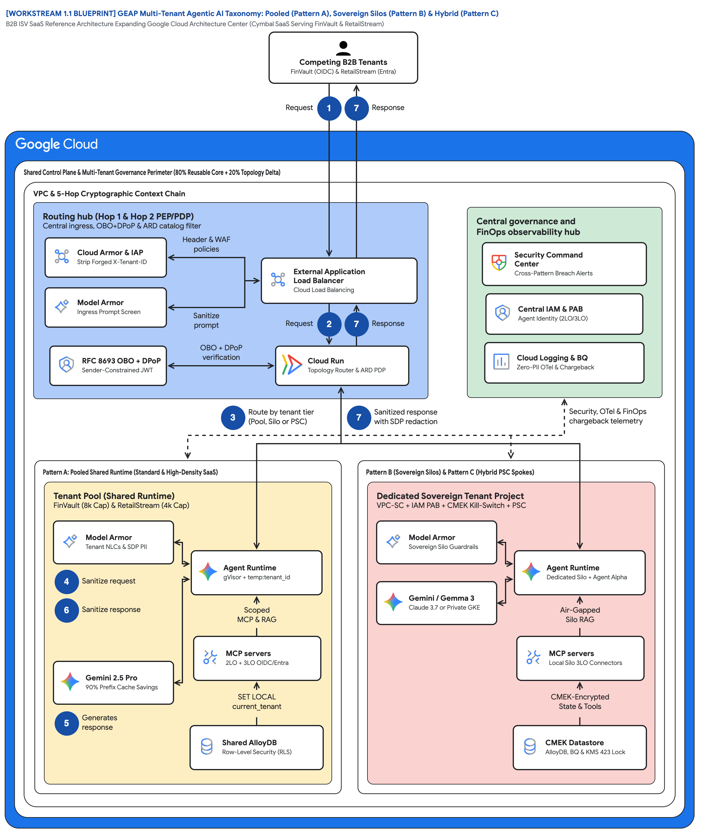
FIGURE 1 — GEAP MULTI-TENANT AGENTIC AI TAXONOMY: POOLED (A), SOVEREIGN SILOS (B) & HYBRID (C) | ID: VIS-WS1-MULTI-TENANT-TAXONOMY-OVERVIEW • 1:1 Master High-Resolution Widescreen Architecture (Slide 2 contains Decomposed Vector Shapes)
Notes:
Figure 1 — GEAP Multi-Tenant Agentic AI Taxonomy: Pooled (A), Sovereign Silos (B) & Hybrid (C)
B2B ISV SaaS Reference Architecture Expanding Google Cloud Architecture Center (Cymbal SaaS Serving FinVault & RetailStream)
• Actor 'Competing B2B Tenants FinVault (OIDC) & RetailStream (Entra)' enters at badge 1 Request and exits at badge 7 Response.
• Wrappers: 'Shared Control Plane & Multi-Tenant Governance Perimeter (80% Reusable Core + 20% Topology Delta)' around the VPC.
• 'Routing hub (Hop 1 & Hop 2 PEP/PDP)': Cloud Armor & IAP strip X-Tenant-ID, Model Armor screen, OBO + DPoP, ALB, Cloud Run Router.
• 'Central governance and FinOps observability hub': SCC, Central IAM & PAB Agent Identity (2LO/3LO), Cloud Logging & BQ Zero-PII OTel.
• Badge 3 'Route by tenant tier (Pool, Silo or PSC)' decides topology; badge 7 'Sanitized response with SDP redaction' scrubs returns.
• Left 'Tenant Pool (Shared Runtime)' vs right 'Dedicated Sovereign Tenant Project' with 'CMEK Datastore AlloyDB, BQ & KMS 423 Lock'.
Editable source: diagrams/ws1-multi-tenant-taxonomy-overview.drawio (PromptCanvas Vision Decompiler)

Slide 10





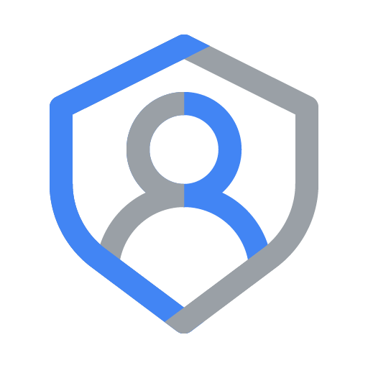




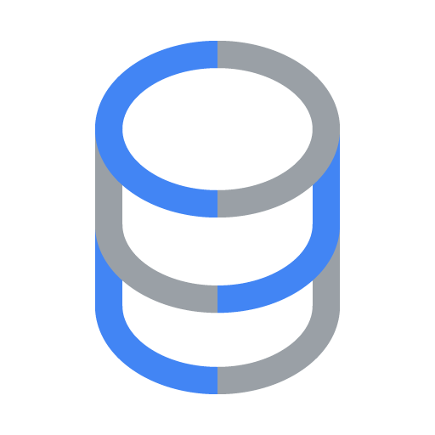
FIGURE 1 — GEAP MULTI-TENANT AGENTIC AI TAXONOMY: POOLED (A), SOVEREIGN SILOS (B) & HYBRID (C) | ID: VIS-WS1-MULTI-TENANT-TAXONOMY-OVERVIEW • 100% Decomposed Native Editable Vector Shapes, Icons & Arrows (Click any element to move or edit)
[WORKSTREAM 1.1 BLUEPRINT] GEAP Multi-Tenant Agentic AI Taxonomy: Pooled (Pattern A), Sovereign Silos (Pattern B) & Hybrid (Pattern C)
B2B ISV SaaS Reference Architecture Expanding Google Cloud Architecture Center (Cymbal SaaS Serving FinVault & RetailStream)
FIGURE 1
Competing B2B TenantsFinVault (OIDC) & RetailStream (Entra)
GEAP Multi-Tenant Agentic AI Taxonomy: Pooled (A), Sovereign Silos (B) & Hybrid (C)
Request
1
7
Response
Shared Control Plane & Multi-Tenant Governance Perimeter (80% Reusable Core + 20% Topology Delta)
VPC & 5-Hop Cryptographic Context Chain
Actor 'Competing B2B Tenants FinVault (OIDC) & RetailStream (Entra)' enters at badge 1 Request and exits at badge 7 Response.
Wrappers: 'Shared Control Plane & Multi-Tenant Governance Perimeter (80% Reusable Core + 20% Topology Delta)' around the VPC.
'Routing hub (Hop 1 & Hop 2 PEP/PDP)': Cloud Armor & IAP strip X-Tenant-ID, Model Armor screen, OBO + DPoP, ALB, Cloud Run Router.
'Central governance and FinOps observability hub': SCC, Central IAM & PAB Agent Identity (2LO/3LO), Cloud Logging & BQ Zero-PII OTel.
Badge 3 'Route by tenant tier (Pool, Silo or PSC)' decides topology; badge 7 'Sanitized response with SDP redaction' scrubs returns.
Left 'Tenant Pool (Shared Runtime)' vs right 'Dedicated Sovereign Tenant Project' with 'CMEK Datastore AlloyDB, BQ & KMS 423 Lock'.
Routing hub (Hop 1 & Hop 2 PEP/PDP)
Central ingress, OBO+DPoP & ARD catalog filter
Central governance and
FinOps observability hub
Cloud Armor & IAP
Strip Forged X-Tenant-ID
Header & WAF
policies
Security Command
Center • Cross-Pattern Breach Alerts
External Application
Load Balancer • Cloud Load Balancing
Model Armor
Ingress Prompt Screen
Central IAM & PAB
Agent Identity (2LO/3LO)
Sanitize
prompt
Request
2
7
Response
RFC 8693 OBO + DPoP
Sender-Constrained JWT
OBO + DPoP
verification
Cloud Run
Topology Router & ARD PDP
Cloud Logging & BQ
Zero-PII OTel & Chargeback
3
Route by tenant tier
(Pool, Silo or PSC)
7
Sanitized response
with SDP redaction
Security, OTel & FinOps
chargeback telemetry
Pattern A: Pooled Shared Runtime (Standard & High-Density SaaS)
Pattern B (Sovereign Silos) & Pattern C (Hybrid PSC Spokes)
Tenant Pool (Shared Runtime)
FinVault (8k Cap) & RetailStream (4k Cap)
Dedicated Sovereign Tenant Project
VPC-SC + IAM PAB + CMEK Kill-Switch + PSC
Model Armor
Tenant NLCs & SDP PII
Model Armor
Sovereign Silo Guardrails
Agent Runtime
gVisor + temp:tenant_id
Agent Runtime
Dedicated Silo + Agent Alpha
4
Sanitize request
Gemini / Gemma 3
Claude 3.7 or Private GKE
6
Sanitize response
Scoped
MCP & RAG
Air-Gapped
Silo RAG
MCP servers
2LO + 3LO OIDC/Entra
MCP servers
Local Silo 3LO Connectors
Gemini 2.5 Pro
90% Prefix Cache Savings
SET LOCAL
current_tenant
CMEK-Encrypted
State & Tools
56 native shapes • 23 connectors • click any box, icon or arrow to edit
5
Generates
response
Shared AlloyDB
Row-Level Security (RLS)
CMEK Datastore
AlloyDB, BQ & KMS 423 Lock
Zones: Routing hub • Central governance & security hub • Left spoke • Right spoke | Source: diagrams/ws1-multi-tenant-taxonomy-overview.drawio
Notes:
Figure 1 — GEAP Multi-Tenant Agentic AI Taxonomy: Pooled (A), Sovereign Silos (B) & Hybrid (C)
B2B ISV SaaS Reference Architecture Expanding Google Cloud Architecture Center (Cymbal SaaS Serving FinVault & RetailStream)
• Actor 'Competing B2B Tenants FinVault (OIDC) & RetailStream (Entra)' enters at badge 1 Request and exits at badge 7 Response.
• Wrappers: 'Shared Control Plane & Multi-Tenant Governance Perimeter (80% Reusable Core + 20% Topology Delta)' around the VPC.
• 'Routing hub (Hop 1 & Hop 2 PEP/PDP)': Cloud Armor & IAP strip X-Tenant-ID, Model Armor screen, OBO + DPoP, ALB, Cloud Run Router.
• 'Central governance and FinOps observability hub': SCC, Central IAM & PAB Agent Identity (2LO/3LO), Cloud Logging & BQ Zero-PII OTel.
• Badge 3 'Route by tenant tier (Pool, Silo or PSC)' decides topology; badge 7 'Sanitized response with SDP redaction' scrubs returns.
• Left 'Tenant Pool (Shared Runtime)' vs right 'Dedicated Sovereign Tenant Project' with 'CMEK Datastore AlloyDB, BQ & KMS 423 Lock'.
Editable source: diagrams/ws1-multi-tenant-taxonomy-overview.drawio (PromptCanvas Vision Decompiler)

Slide 11
FIGURE 1 — GEAP MULTI-TENANT AGENTIC AI TAXONOMY: POOLED (A), SOVEREIGN SILOS (B) & HYBRID (C) | Editable Architecture Component & Topology Specification Table
Object ID | Component Name | Architectural Role / Details | Type
OBJ-01 | Shared Control Plane & Multi-Tenant Governance Perimeter (80% Reusable Core + 20% Topolog… | Core Architecture Node | Enclave / Tier
OBJ-02 | VPC & 5-Hop Cryptographic Context Chain | Core Architecture Node | Enclave / Tier
OBJ-03 | Pattern A: Pooled Shared Runtime (Standard & High-Density SaaS) | Core Architecture Node | Enclave / Tier
OBJ-04 | Pattern B (Sovereign Silos) & Pattern C (Hybrid PSC Spokes) | Core Architecture Node | Enclave / Tier
OBJ-05 | Tenant Pool (Shared Runtime) | FinVault (8k Cap) & RetailStream (4k Cap) | Enclave / Tier
OBJ-06 | Dedicated Sovereign Tenant Project | VPC-SC + IAM PAB + CMEK Kill-Switch + PSC | Enclave / Tier
OBJ-07 | Routing hub (Hop 1 & Hop 2 PEP/PDP) | Central ingress, OBO+DPoP & ARD catalog filter | Enclave / Tier
OBJ-08 | Central governance and | FinOps observability hub | Enclave / Tier
OBJ-09 | [WORKSTREAM 1.1 BLUEPRINT] GEAP Multi-Tenant Agentic AI Taxonomy: Pooled (Pattern A), Sov… | B2B ISV SaaS Reference Architecture Expanding Google Cloud Architecture Center (Cymbal SaaS Serving FinVault… | Service Node
OBJ-10 | Competing B2B TenantsFinVault (OIDC) & RetailStream (Entra) | Core Architecture Node | Service Node
OBJ-11 | External Application | Load Balancer • Cloud Load Balancing | Service Node
OBJ-12 | Security Command | Center • Cross-Pattern Breach Alerts | Service Node
OBJ-13 | Cloud Logging & BQ | Zero-PII OTel & Chargeback | Service Node
OBJ-14 | Central IAM & PAB | Agent Identity (2LO/3LO) | Service Node
Notes:
Figure 1 component inventory for GEAP Multi-Tenant Agentic AI Taxonomy: Pooled (A), Sovereign Silos (B) & Hybrid (C)

Slide 12
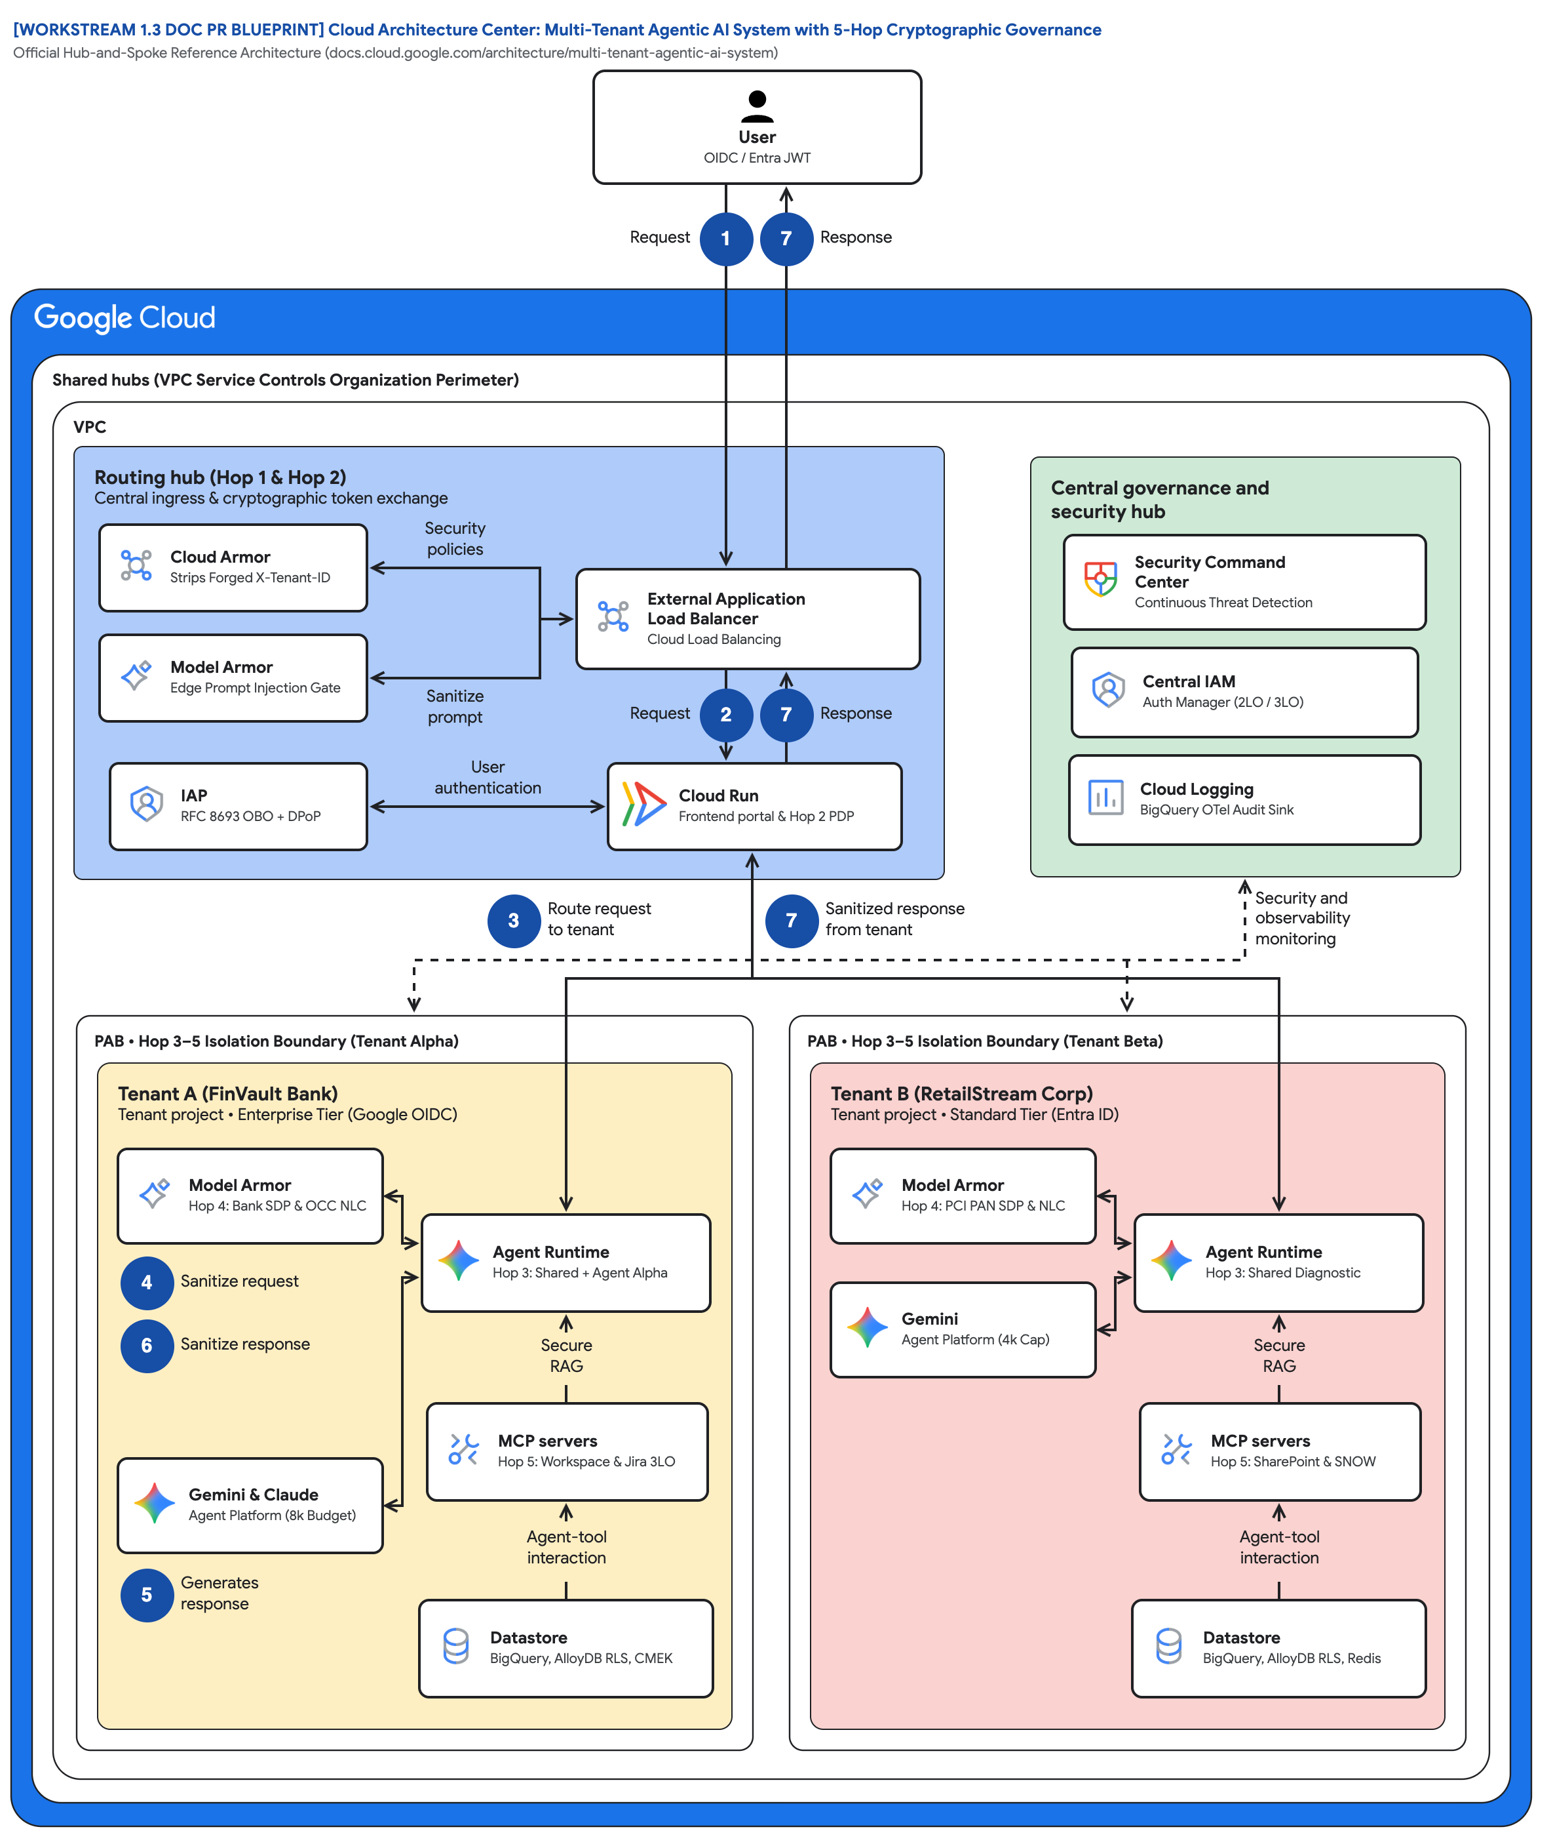
FIGURE 2 — CLOUD ARCHITECTURE CENTER: MULTI-TENANT AGENTIC AI WITH 5-HOP CRYPTOGRAPHIC GOVERNANCE | ID: VIS-WS1-CLOUD-ARCH-CENTER-5HOP-BASELINE • 1:1 Master High-Resolution Widescreen Architecture (Slide 2 contains Decomposed Vector Shapes)
Notes:
Figure 2 — Cloud Architecture Center: Multi-Tenant Agentic AI with 5-Hop Cryptographic Governance
Official Hub-and-Spoke Reference Architecture (docs.cloud.google.com/architecture/multi-tenant-agentic-ai-system)
• Actor 'User OIDC / Entra JWT' with badges 1 Request and 7 Response mirrors the published hub-and-spoke article exactly.
• Outer wrapper 'Shared hubs (VPC Service Controls Organization Perimeter)' and inner 'VPC' are unchanged from the official reference.
• 'Routing hub (Hop 1 & Hop 2)': Cloud Armor Strips Forged X-Tenant-ID, Model Armor Edge Prompt Injection Gate, IAP RFC 8693 OBO + DPoP.
• 'Central governance and security hub': Security Command Center, Central IAM Auth Manager (2LO / 3LO), Cloud Logging BigQuery OTel Sink.
• Dashed 'Security and observability' line fans to both spokes; badge 3 'Route request to tenant', badge 7 'Sanitized response from tenant'.
• 'PAB • Hop 3–5 Isolation Boundary' wraps Tenant A (FinVault, 8k Budget, Bank SDP & OCC NLC) and Tenant B (RetailStream, 4k Cap, PCI).
Editable source: diagrams/ws1-cloud-arch-center-5hop-baseline.drawio (PromptCanvas Vision Decompiler)

Slide 13
FIGURE 2 — CLOUD ARCHITECTURE CENTER: MULTI-TENANT AGENTIC AI WITH 5-HOP CRYPTOGRAPHIC GOVERNANCE | ID: VIS-WS1-CLOUD-ARCH-CENTER-5HOP-BASELINE • 100% Decomposed Native Editable Vector Shapes, Icons & Arrows (Click any element to move or edit)
[WORKSTREAM 1.3 DOC PR BLUEPRINT] Cloud Architecture Center: Multi-Tenant Agentic AI System with 5-Hop Cryptographic Governance
Official Hub-and-Spoke Reference Architecture (docs.cloud.google.com/architecture/multi-tenant-agentic-ai-system)
FIGURE 2
UserOIDC / Entra JWT
Cloud Architecture Center: Multi-Tenant Agentic AI with 5-Hop Cryptographic Governance
Request
1
7
Response
Shared hubs (VPC Service Controls Organization Perimeter)
VPC
Actor 'User OIDC / Entra JWT' with badges 1 Request and 7 Response mirrors the published hub-and-spoke article exactly.
Outer wrapper 'Shared hubs (VPC Service Controls Organization Perimeter)' and inner 'VPC' are unchanged from the official reference.
'Routing hub (Hop 1 & Hop 2)': Cloud Armor Strips Forged X-Tenant-ID, Model Armor Edge Prompt Injection Gate, IAP RFC 8693 OBO + DPoP.
'Central governance and security hub': Security Command Center, Central IAM Auth Manager (2LO / 3LO), Cloud Logging BigQuery OTel Sink.
Dashed 'Security and observability' line fans to both spokes; badge 3 'Route request to tenant', badge 7 'Sanitized response from tenant'.
'PAB • Hop 3–5 Isolation Boundary' wraps Tenant A (FinVault, 8k Budget, Bank SDP & OCC NLC) and Tenant B (RetailStream, 4k Cap, PCI).
Routing hub (Hop 1 & Hop 2)
Central ingress & cryptographic token exchange
Central governance and
security hub
Cloud Armor
Strips Forged X-Tenant-ID
Security
policies
Security Command
Center • Continuous Threat Detection
External Application
Load Balancer • Cloud Load Balancing
Model Armor
Edge Prompt Injection Gate
Central IAM
Auth Manager (2LO / 3LO)
Sanitize
prompt
Request
2
7
Response
IAP
RFC 8693 OBO + DPoP
User
authentication
Cloud Run
Frontend portal & Hop 2 PDP
Cloud Logging
BigQuery OTel Audit Sink
3
Route request
to tenant
7
Sanitized response
from tenant
Security and
observability • monitoring
PAB • Hop 3–5 Isolation Boundary (Tenant Alpha)
PAB • Hop 3–5 Isolation Boundary (Tenant Beta)
Tenant A (FinVault Bank)
Tenant project • Enterprise Tier (Google OIDC)
Tenant B (RetailStream Corp)
Tenant project • Standard Tier (Entra ID)
Model Armor
Hop 4: Bank SDP & OCC NLC
Model Armor
Hop 4: PCI PAN SDP & NLC
Agent Runtime
Hop 3: Shared + Agent Alpha
Agent Runtime
Hop 3: Shared Diagnostic
4
Sanitize request
Gemini
Agent Platform (4k Cap)
6
Sanitize response
Secure
RAG
Secure
RAG
MCP servers
Hop 5: Workspace & Jira 3LO
MCP servers
Hop 5: SharePoint & SNOW
Gemini & Claude
Agent Platform (8k Budget)
Agent-tool
interaction
Agent-tool
interaction
56 native shapes • 23 connectors • click any box, icon or arrow to edit
5
Generates
response
Datastore
BigQuery, AlloyDB RLS, CMEK
Datastore
BigQuery, AlloyDB RLS, Redis
Zones: Routing hub • Central governance & security hub • Left spoke • Right spoke | Source: diagrams/ws1-cloud-arch-center-5hop-baseline.drawio
Notes:
Figure 2 — Cloud Architecture Center: Multi-Tenant Agentic AI with 5-Hop Cryptographic Governance
Official Hub-and-Spoke Reference Architecture (docs.cloud.google.com/architecture/multi-tenant-agentic-ai-system)
• Actor 'User OIDC / Entra JWT' with badges 1 Request and 7 Response mirrors the published hub-and-spoke article exactly.
• Outer wrapper 'Shared hubs (VPC Service Controls Organization Perimeter)' and inner 'VPC' are unchanged from the official reference.
• 'Routing hub (Hop 1 & Hop 2)': Cloud Armor Strips Forged X-Tenant-ID, Model Armor Edge Prompt Injection Gate, IAP RFC 8693 OBO + DPoP.
• 'Central governance and security hub': Security Command Center, Central IAM Auth Manager (2LO / 3LO), Cloud Logging BigQuery OTel Sink.
• Dashed 'Security and observability' line fans to both spokes; badge 3 'Route request to tenant', badge 7 'Sanitized response from tenant'.
• 'PAB • Hop 3–5 Isolation Boundary' wraps Tenant A (FinVault, 8k Budget, Bank SDP & OCC NLC) and Tenant B (RetailStream, 4k Cap, PCI).
Editable source: diagrams/ws1-cloud-arch-center-5hop-baseline.drawio (PromptCanvas Vision Decompiler)

Slide 14
FIGURE 2 — CLOUD ARCHITECTURE CENTER: MULTI-TENANT AGENTIC AI WITH 5-HOP CRYPTOGRAPHIC GOVERNANCE | Editable Architecture Component & Topology Specification Table
Object ID | Component Name | Architectural Role / Details | Type
OBJ-01 | Shared hubs (VPC Service Controls Organization Perimeter) | Core Architecture Node | Enclave / Tier
OBJ-02 | VPC | Core Architecture Node | Enclave / Tier
OBJ-03 | PAB • Hop 3–5 Isolation Boundary (Tenant Alpha) | Core Architecture Node | Enclave / Tier
OBJ-04 | PAB • Hop 3–5 Isolation Boundary (Tenant Beta) | Core Architecture Node | Enclave / Tier
OBJ-05 | Tenant A (FinVault Bank) | Tenant project • Enterprise Tier (Google OIDC) | Enclave / Tier
OBJ-06 | Tenant B (RetailStream Corp) | Tenant project • Standard Tier (Entra ID) | Enclave / Tier
OBJ-07 | Routing hub (Hop 1 & Hop 2) | Central ingress & cryptographic token exchange | Enclave / Tier
OBJ-08 | Central governance and | security hub | Enclave / Tier
OBJ-09 | [WORKSTREAM 1.3 DOC PR BLUEPRINT] Cloud Architecture Center: Multi-Tenant Agentic AI Syst… | Official Hub-and-Spoke Reference Architecture (docs.cloud.google.com/architecture/multi-tenant-agentic-ai-sys… | Service Node
OBJ-10 | UserOIDC / Entra JWT | Core Architecture Node | Service Node
OBJ-11 | External Application | Load Balancer • Cloud Load Balancing | Service Node
OBJ-12 | Security Command | Center • Continuous Threat Detection | Service Node
OBJ-13 | Cloud Logging | BigQuery OTel Audit Sink | Service Node
OBJ-14 | Central IAM | Auth Manager (2LO / 3LO) | Service Node
Notes:
Figure 2 component inventory for Cloud Architecture Center: Multi-Tenant Agentic AI with 5-Hop Cryptographic Governance

Slide 15
WS1 | Key Takeaways
Key Takeaways
Agentic multi-tenancy needs controls at edge, registry, runtime, guardrail, and data layers; a tenant_id column is not isolation.
Choose topology per tenant tier: Pattern A for Standard, Pattern B for regulator-mandated perimeters, Pattern C when you serve both.
The 5-Hop chain is topology-agnostic code; the trust boundary changes, the governance modules do not.
Prompt prefix caching is safe in a pool only when ContextCacheConfig is read-only on shared system instructions.
Three P0 product gaps already have engineered workarounds; EAP allowlists target Q4 2026 for native support.
Review the 1.3 Doc PR, enable the 1.4 allowlist checklist in your sandbox, then proceed to Workstream 2 (Pattern A Pooled, Milestone 1).
Notes:
Key Takeaways
• Agentic multi-tenancy needs controls at edge, registry, runtime, guardrail, and data layers; a tenant_id column is not isolation.
• Choose topology per tenant tier: Pattern A for Standard, Pattern B for regulator-mandated perimeters, Pattern C when you serve both.
• The 5-Hop chain is topology-agnostic code; the trust boundary changes, the governance modules do not.
• Prompt prefix caching is safe in a pool only when ContextCacheConfig is read-only on shared system instructions.
• Three P0 product gaps already have engineered workarounds; EAP allowlists target Q4 2026 for native support.

Slide 16
WS1 | Assets, Editable Diagrams & Source Documents
Assets & Editable Diagrams
Diagram | Editable Draw.io | Draw.io Render | Vision AST
WORKSTREAM 1.1 BLUEPRINT GEAP Multi-Tenant Agentic AI Taxonomy: Pooled (Pattern A), Sovereign Silos (Pattern B) & Hybrid (Pattern C) | diagrams/ws1-multi-tenant-taxonomy-overview.drawio | diagrams/ws1-multi-tenant-taxonomy-overview.drawio.png | diagrams/vision_metadata/ws1-multi-tenant-taxonomy-overview.vision.json
WORKSTREAM 1.3 DOC PR BLUEPRINT Cloud Architecture Center: Multi-Tenant Agentic AI System with 5-Hop Cryptographic Governance | diagrams/ws1-cloud-arch-center-5hop-baseline.drawio | diagrams/ws1-cloud-arch-center-5hop-baseline.drawio.png | diagrams/vision_metadata/ws1-cloud-arch-center-5hop-baseline.vision.json
Blog: blogs/ws1-reference-architecture-taxonomy-and-5hop-baseline.md
Source: workstream-1-reference-architecture/1.1-architecture-taxonomy-and-diagrams.md
Source: workstream-1-reference-architecture/1.3-cloud-architecture-center-doc-update-pr.md
Source: workstream-1-reference-architecture/1.4-eap-and-product-gap-tracker.md
Anchor reference: https://docs.cloud.google.com/architecture/multi-tenant-agentic-ai-system
GitHub: https://github.com/nitinaggarwal-12/blogs
Notes:
Review the 1.3 Doc PR, enable the 1.4 allowlist checklist in your sandbox, then proceed to Workstream 2 (Pattern A Pooled, Milestone 1).

