Slide 1
WORKSTREAM 4 • PATTERN C — DYNAMIC HYBRID, PSC & LIVE TIER MIGRATION
Pattern C — Dynamic Hybrid: One Control Plane, Pooled & Sovereign Tiers, Live Upgrades
Tenant-aware hub routing Standard to a shared pool and Enterprise over Private Service Connect to CMEK spokes, with 0-dropped-turn upgrades
Multi-Tenant Agentic AI on Google Cloud • Gemini Enterprise Agent Platform (GEAP) & ADK 2.0
Every diagram slide is 100% native editable (PromptCanvas Vision Decompiler → Draw.io → PowerPoint / Google Slides)
Anchor reference: https://docs.cloud.google.com/architecture/multi-tenant-agentic-ai-system
Notes:
Pattern C — Dynamic Hybrid: One Control Plane, Pooled & Sovereign Tiers, Live Upgrades
Tenant-aware hub routing Standard to a shared pool and Enterprise over Private Service Connect to CMEK spokes, with 0-dropped-turn upgrades
Series: Multi-Tenant Agentic AI on Google Cloud • Gemini Enterprise Agent Platform (GEAP) & ADK 2.0

Slide 2
WS4 | Executive TL;DR
Executive TL;DR
Tiered SaaS needs Pattern A economics for Standard and Pattern B sovereignty for Enterprise — Pattern C serves both behind one SaaS URL.
Unified Hybrid Control Hub (cymbal-hybrid-hub-prod): Cloud Armor/IAP, Cloud Run Router, Firestore Route Table, Cross-Project ARD Federated GEAP Registry.
RetailStream (Standard) runs in the Shared Pooled Runtime at a 4,000 thinking cap; FinVault (Enterprise) is reached over PSC at psc://10.10.0.50.
3-Phase engine (SHADOW_SYNC → ATOMIC_CUTOVER → DRAIN_AND_VERIFY) promotes RetailStream to its own CMEK PSC spoke on the same live session.
4.5 suite verifies 4/4 PASS: 0 ms replication lag, 0 dropped sessions, 8,000 budget unclamped, rs-agent-cmek bound, zero global state bleed.
Workstream 4 • Pattern C — Dynamic Hybrid, PSC & Live Tier Migration • Multi-Tenant Agentic AI on Google Cloud • Gemini Enterprise Agent Platform (GEAP) & ADK 2.0
Notes:
Executive TL;DR
• Tiered SaaS needs Pattern A economics for Standard and Pattern B sovereignty for Enterprise — Pattern C serves both behind one SaaS URL.
• Unified Hybrid Control Hub (cymbal-hybrid-hub-prod): Cloud Armor/IAP, Cloud Run Router, Firestore Route Table, Cross-Project ARD Federated GEAP Registry.
• RetailStream (Standard) runs in the Shared Pooled Runtime at a 4,000 thinking cap; FinVault (Enterprise) is reached over PSC at psc://10.10.0.50.
• 3-Phase engine (SHADOW_SYNC → ATOMIC_CUTOVER → DRAIN_AND_VERIFY) promotes RetailStream to its own CMEK PSC spoke on the same live session.
• 4.5 suite verifies 4/4 PASS: 0 ms replication lag, 0 dropped sessions, 8,000 budget unclamped, rs-agent-cmek bound, zero global state bleed.

Slide 3
WS4 | Why Tiered SaaS Needs Both Pooled and Sovereign
Why Tiered SaaS Needs Both Pooled and Sovereign
RetailStream Corp: Microsoft Entra ID, shared Diagnostic Agent only, 4,000 thinking cap, shared AlloyDB RLS, SharePoint/ServiceNow via inline 3LO.
FinVault Bank: Google Workspace OIDC, private Agent Alpha (Claude Sonnet), 8,000 budget, CMEK AlloyDB in a VPC-SC spoke, Workspace/Jira via 3LO.
Neither pure pattern fits both rows; two disconnected stacks double the control plane and turn tier upgrades into maintenance windows.
4.4 triage: if you sell Standard on shared infra plus Enterprise with dedicated data spokes and custom agents, deploy Pattern C.
Workstream 4 • Pattern C — Dynamic Hybrid, PSC & Live Tier Migration
Notes:
Why Tiered SaaS Needs Both Pooled and Sovereign
• RetailStream Corp: Microsoft Entra ID, shared Diagnostic Agent only, 4,000 thinking cap, shared AlloyDB RLS, SharePoint/ServiceNow via inline 3LO.
• FinVault Bank: Google Workspace OIDC, private Agent Alpha (Claude Sonnet), 8,000 budget, CMEK AlloyDB in a VPC-SC spoke, Workspace/Jira via 3LO.
• Neither pure pattern fits both rows; two disconnected stacks double the control plane and turn tier upgrades into maintenance windows.
• 4.4 triage: if you sell Standard on shared infra plus Enterprise with dedicated data spokes and custom agents, deploy Pattern C.

Slide 4
WS4 | Hybrid Hub-and-Spoke Control Plane
Hybrid Hub-and-Spoke Control Plane
Single project cymbal-hybrid-hub-prod owns the public URL, External Application Load Balancer, Cloud Armor and IAP for both tiers.
Cloud Run Router resolves the Hop 1 verified tenant_id against the Firestore Route Table: PATTERN_C_HYBRID_POOL or PATTERN_C_HYBRID_PSC_SPOKE.
Standard route pool://cymbal-shared-pooled-runtime-v2; Enterprise route psc://10.10.0.50/.../finvault-agent-spoke-psc.
PSC producer ServiceAttachment uses ACCEPT_MANUAL with a hub-only accept list; spokes reuse 10.40.0.0/20 and cannot reach back into the hub.
Cross-Project ARD Federated GEAP Registry surfaces Agent Alpha to FinVault while returning 403 Forbidden to RetailStream.
Workstream 4 • Pattern C — Dynamic Hybrid, PSC & Live Tier Migration
Notes:
Hybrid Hub-and-Spoke Control Plane
• Single project cymbal-hybrid-hub-prod owns the public URL, External Application Load Balancer, Cloud Armor and IAP for both tiers.
• Cloud Run Router resolves the Hop 1 verified tenant_id against the Firestore Route Table: PATTERN_C_HYBRID_POOL or PATTERN_C_HYBRID_PSC_SPOKE.
• Standard route pool://cymbal-shared-pooled-runtime-v2; Enterprise route psc://10.10.0.50/.../finvault-agent-spoke-psc.
• PSC producer ServiceAttachment uses ACCEPT_MANUAL with a hub-only accept list; spokes reuse 10.40.0.0/20 and cannot reach back into the hub.
• Cross-Project ARD Federated GEAP Registry surfaces Agent Alpha to FinVault while returning 403 Forbidden to RetailStream.

Slide 5
WS4 | The 5-Hop Chain in Pattern C
The 5-Hop Chain in Pattern C
Hop 1 strips forged X-Tenant-ID headers, verifies IdP JWT, mints RFC 8693 OBO + DPoP context — the only input to routing.
Hop 2 federates spoke agent cards into the hub PDP and prunes tools via ADK 2.0 before_agent_callback.
Hop 3 enforces 4,000 vs 8,000 budgets and Redis bulkheads from an instance-scoped tenant_profiles dict — never global TENANT_PROFILES.
Hop 4 runs Shared Model Armor Multi-Tenant Prompt & SDP in the pool and Spoke Model Armor Dedicated Spoke DLP & NLC in each spoke.
Hop 5 binds SET LOCAL app.current_tenant for AlloyDB RLS, brokers 2LO/3LO tokens, and emits OTel audit traces to BigQuery.
Workstream 4 • Pattern C — Dynamic Hybrid, PSC & Live Tier Migration
Notes:
The 5-Hop Chain in Pattern C
• Hop 1 strips forged X-Tenant-ID headers, verifies IdP JWT, mints RFC 8693 OBO + DPoP context — the only input to routing.
• Hop 2 federates spoke agent cards into the hub PDP and prunes tools via ADK 2.0 before_agent_callback.
• Hop 3 enforces 4,000 vs 8,000 budgets and Redis bulkheads from an instance-scoped tenant_profiles dict — never global TENANT_PROFILES.
• Hop 4 runs Shared Model Armor Multi-Tenant Prompt & SDP in the pool and Spoke Model Armor Dedicated Spoke DLP & NLC in each spoke.
• Hop 5 binds SET LOCAL app.current_tenant for AlloyDB RLS, brokers 2LO/3LO tokens, and emits OTel audit traces to BigQuery.

Slide 6
WS4 | Zero-Downtime Live Tier Upgrade (Standard → Enterprise)
Zero-Downtime Live Tier Upgrade (Standard → Enterprise)
TEST 1A/1B: RetailStream clamped to 4,000 in the pool; FinVault gets 8,000 over PSC on sess-fv-hybrid-01.
SHADOW_SYNC: Terraform provisions cymbal-retailstream-spoke-prod, CMEK key and PSC attachment; RLS rows replicate to 0 ms lag.
ATOMIC_CUTOVER: one replace() profile write flips tier, 8,000 budget, redis_rpm_limit 600, CMEK and route to psc://10.10.0.51.
DRAIN_AND_VERIFY: in-flight pooled turns finish; dropped_sessions == 0; status MIGRATION_COMPLETE.
TEST 3: same sess-rs-live-upgrade-01 and DPoP key now ENTERPRISE, unclamped 8,000, rs-agent-cmek bound.
Workstream 4 • Pattern C — Dynamic Hybrid, PSC & Live Tier Migration
Notes:
Zero-Downtime Live Tier Upgrade (Standard → Enterprise)
• TEST 1A/1B: RetailStream clamped to 4,000 in the pool; FinVault gets 8,000 over PSC on sess-fv-hybrid-01.
• SHADOW_SYNC: Terraform provisions cymbal-retailstream-spoke-prod, CMEK key and PSC attachment; RLS rows replicate to 0 ms lag.
• ATOMIC_CUTOVER: one replace() profile write flips tier, 8,000 budget, redis_rpm_limit 600, CMEK and route to psc://10.10.0.51.
• DRAIN_AND_VERIFY: in-flight pooled turns finish; dropped_sessions == 0; status MIGRATION_COMPLETE.
• TEST 3: same sess-rs-live-upgrade-01 and DPoP key now ENTERPRISE, unclamped 8,000, rs-agent-cmek bound.

Slide 7
WS4 | Product Collaboration, Terraform Blueprint & Codelab
Product Collaboration, Terraform Blueprint & Codelab
4.4 aligned Cross-Project Registry, PSC Spoke Bridge and Live Tier Migration with product engineering plus a GA Field Enablement Playbook.
4.6 main.tf: hub VPC/subnet 10.10.0.0/20, spoke PSC NAT subnet 10.40.240.0/24, service attachment, 10.10.0.50 consumer endpoint.
90-minute L400 Master Codelab: router, PSC wiring, SHADOW_SYNC + ATOMIC_CUTOVER, DRAIN_AND_VERIFY session continuity.
go/demos slug geap-multi-tenant-pattern-c-hybrid with a 5-minute video script ending on ALL 4 PATTERN C TESTS PASSED.
Workstream 4 • Pattern C — Dynamic Hybrid, PSC & Live Tier Migration
Notes:
Product Collaboration, Terraform Blueprint & Codelab
• 4.4 aligned Cross-Project Registry, PSC Spoke Bridge and Live Tier Migration with product engineering plus a GA Field Enablement Playbook.
• 4.6 main.tf: hub VPC/subnet 10.10.0.0/20, spoke PSC NAT subnet 10.40.240.0/24, service attachment, 10.10.0.50 consumer endpoint.
• 90-minute L400 Master Codelab: router, PSC wiring, SHADOW_SYNC + ATOMIC_CUTOVER, DRAIN_AND_VERIFY session continuity.
• go/demos slug geap-multi-tenant-pattern-c-hybrid with a 5-minute video script ending on ALL 4 PATTERN C TESTS PASSED.

Slide 8
WS4 | FinOps & SLA Outcomes
FinOps & SLA Outcomes
Pooled tier keeps up to 90% COGS savings from shared ContextCacheConfig; enterprise spokes get dedicated quotas with zero noisy neighbours.
Budgets, rate limits and CMEK live in one instance-scoped profile and flip atomically — no half-migrated state.
Unidirectional PSC limits blast radius: the hub initiates, the spoke never connects back.
Standard → Enterprise becomes a same-day product action with no URL change and no re-authentication.
Workstream 4 • Pattern C — Dynamic Hybrid, PSC & Live Tier Migration
Notes:
FinOps & SLA Outcomes
• Pooled tier keeps up to 90% COGS savings from shared ContextCacheConfig; enterprise spokes get dedicated quotas with zero noisy neighbours.
• Budgets, rate limits and CMEK live in one instance-scoped profile and flip atomically — no half-migrated state.
• Unidirectional PSC limits blast radius: the hub initiates, the spoke never connects back.
• Standard → Enterprise becomes a same-day product action with no URL change and no re-authentication.

Slide 9
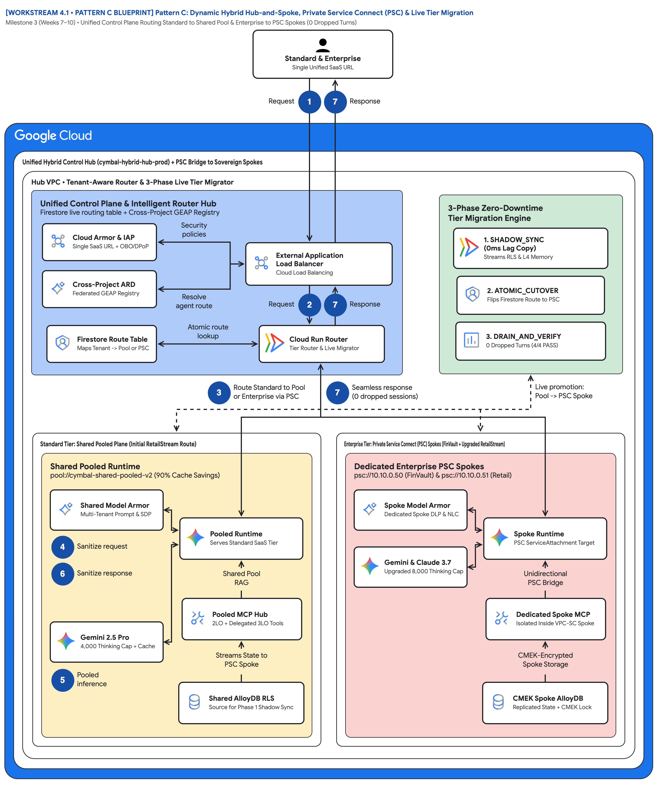
FIGURE 1 — PATTERN C: DYNAMIC HYBRID HUB-AND-SPOKE, PRIVATE SERVICE CONNECT & LIVE TIER MIGRATION | ID: VIS-WS4-PATTERN-C-HYBRID-PSC-AND-MIGRATION • 1:1 Master High-Resolution Widescreen Architecture (Slide 2 contains Decomposed Vector Shapes)
Notes:
Figure 1 — Pattern C: Dynamic Hybrid Hub-and-Spoke, Private Service Connect & Live Tier Migration
Milestone 3 (Weeks 7–10) • Unified Control Plane Routing Standard to Shared Pool & Enterprise to PSC Spokes (0 Dropped Turns)
• Start at the actor: Standard & Enterprise Single Unified SaaS URL — one hostname for both tiers, step 1 Request in, step 7 Response out.
• Routing hub: Cloud Armor & IAP + OBO/DPoP, Cross-Project ARD Federated GEAP Registry, Firestore Route Table, ALB, Cloud Run Router.
• Governance hub: 3-Phase Zero-Downtime Tier Migration Engine — SHADOW_SYNC (0ms Lag Copy), ATOMIC_CUTOVER, DRAIN_AND_VERIFY (4/4 PASS).
• Trunk badge 3 'Route Standard to Pool or Enterprise via PSC' fans out; badge 7 'Seamless response (0 dropped sessions)' returns.
• Left spoke: Shared Pooled Runtime with Gemini 2.5 Pro 4,000 Thinking Cap + Cache and Shared AlloyDB RLS that Streams State to PSC Spoke.
• Right spoke: Dedicated Enterprise PSC Spokes, Unidirectional PSC Bridge, CMEK Spoke AlloyDB; dashed Live promotion: Pool -> PSC Spoke.
Editable source: diagrams/ws4-pattern-c-hybrid-psc-and-migration.drawio (PromptCanvas Vision Decompiler)

Slide 10









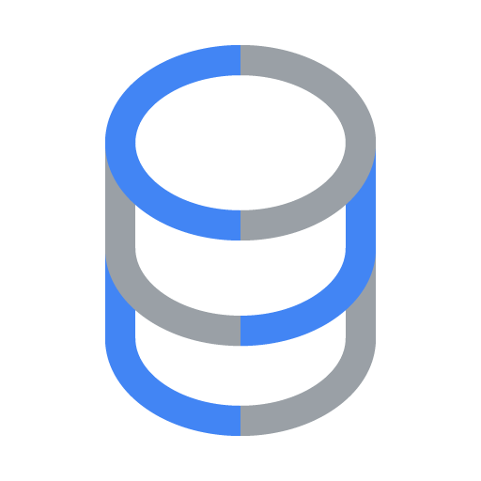
FIGURE 1 — PATTERN C: DYNAMIC HYBRID HUB-AND-SPOKE, PRIVATE SERVICE CONNECT & LIVE TIER MIGRATION | ID: VIS-WS4-PATTERN-C-HYBRID-PSC-AND-MIGRATION • 100% Decomposed Native Editable Vector Shapes, Icons & Arrows (Click any element to move or edit)
[WORKSTREAM 4.1 • PATTERN C BLUEPRINT] Pattern C: Dynamic Hybrid Hub-and-Spoke, Private Service Connect (PSC) & Live Tier Migration
Milestone 3 (Weeks 7–10) • Unified Control Plane Routing Standard to Shared Pool & Enterprise to PSC Spokes (0 Dropped Turns)
FIGURE 1
Standard & EnterpriseSingle Unified SaaS URL
Pattern C: Dynamic Hybrid Hub-and-Spoke, Private Service Connect & Live Tier Migration
Request
1
7
Response
Unified Hybrid Control Hub (cymbal-hybrid-hub-prod) + PSC Bridge to Sovereign Spokes
Hub VPC • Tenant-Aware Router & 3-Phase Live Tier Migrator
Start at the actor: Standard & Enterprise Single Unified SaaS URL — one hostname for both tiers, step 1 Request in, step 7 Response out.
Routing hub: Cloud Armor & IAP + OBO/DPoP, Cross-Project ARD Federated GEAP Registry, Firestore Route Table, ALB, Cloud Run Router.
Governance hub: 3-Phase Zero-Downtime Tier Migration Engine — SHADOW_SYNC (0ms Lag Copy), ATOMIC_CUTOVER, DRAIN_AND_VERIFY (4/4 PASS).
Trunk badge 3 'Route Standard to Pool or Enterprise via PSC' fans out; badge 7 'Seamless response (0 dropped sessions)' returns.
Left spoke: Shared Pooled Runtime with Gemini 2.5 Pro 4,000 Thinking Cap + Cache and Shared AlloyDB RLS that Streams State to PSC Spoke.
Right spoke: Dedicated Enterprise PSC Spokes, Unidirectional PSC Bridge, CMEK Spoke AlloyDB; dashed Live promotion: Pool -> PSC Spoke.
Unified Control Plane & Intelligent Router Hub
Firestore live routing table + Cross-Project GEAP Registry
3-Phase Zero-Downtime
Tier Migration Engine
Cloud Armor & IAP
Single SaaS URL + OBO/DPoP
Security
policies
1. SHADOW_SYNC
(0ms Lag Copy) • Streams RLS & L4 Memory
External Application
Load Balancer • Cloud Load Balancing
Cross-Project ARD
Federated GEAP Registry
2. ATOMIC_CUTOVER
Flips Firestore Route to PSC
Resolve
agent route
Request
2
7
Response
Firestore Route Table
Maps Tenant -> Pool or PSC
Atomic route
lookup
Cloud Run Router
Tier Router & Live Migrator
3. DRAIN_AND_VERIFY
0 Dropped Turns (4/4 PASS)
3
Route Standard to Pool
or Enterprise via PSC
7
Seamless response
(0 dropped sessions)
Live promotion:
Pool -> PSC Spoke
Standard Tier: Shared Pooled Plane (Initial RetailStream Route)
Enterprise Tier: Private Service Connect (PSC) Spokes (FinVault + Upgraded RetailStream)
Shared Pooled Runtime
pool://cymbal-shared-pooled-v2 (90% Cache Savings)
Dedicated Enterprise PSC Spokes
psc://10.10.0.50 (FinVault) & psc://10.10.0.51 (Retail)
Shared Model Armor
Multi-Tenant Prompt & SDP
Spoke Model Armor
Dedicated Spoke DLP & NLC
Pooled Runtime
Serves Standard SaaS Tier
Spoke Runtime
PSC ServiceAttachment Target
4
Sanitize request
Gemini & Claude 3.7
Upgraded 8,000 Thinking Cap
6
Sanitize response
Shared Pool
RAG
Unidirectional
PSC Bridge
Pooled MCP Hub
2LO + Delegated 3LO Tools
Dedicated Spoke MCP
Isolated Inside VPC-SC Spoke
Gemini 2.5 Pro
4,000 Thinking Cap + Cache
Streams State to
PSC Spoke
CMEK-Encrypted
Spoke Storage
56 native shapes • 23 connectors • click any box, icon or arrow to edit
5
Pooled
inference
Shared AlloyDB RLS
Source for Phase 1 Shadow Sync
CMEK Spoke AlloyDB
Replicated State + CMEK Lock
Zones: Routing hub • Central governance & security hub • Left spoke • Right spoke | Source: diagrams/ws4-pattern-c-hybrid-psc-and-migration.drawio
Notes:
Figure 1 — Pattern C: Dynamic Hybrid Hub-and-Spoke, Private Service Connect & Live Tier Migration
Milestone 3 (Weeks 7–10) • Unified Control Plane Routing Standard to Shared Pool & Enterprise to PSC Spokes (0 Dropped Turns)
• Start at the actor: Standard & Enterprise Single Unified SaaS URL — one hostname for both tiers, step 1 Request in, step 7 Response out.
• Routing hub: Cloud Armor & IAP + OBO/DPoP, Cross-Project ARD Federated GEAP Registry, Firestore Route Table, ALB, Cloud Run Router.
• Governance hub: 3-Phase Zero-Downtime Tier Migration Engine — SHADOW_SYNC (0ms Lag Copy), ATOMIC_CUTOVER, DRAIN_AND_VERIFY (4/4 PASS).
• Trunk badge 3 'Route Standard to Pool or Enterprise via PSC' fans out; badge 7 'Seamless response (0 dropped sessions)' returns.
• Left spoke: Shared Pooled Runtime with Gemini 2.5 Pro 4,000 Thinking Cap + Cache and Shared AlloyDB RLS that Streams State to PSC Spoke.
• Right spoke: Dedicated Enterprise PSC Spokes, Unidirectional PSC Bridge, CMEK Spoke AlloyDB; dashed Live promotion: Pool -> PSC Spoke.
Editable source: diagrams/ws4-pattern-c-hybrid-psc-and-migration.drawio (PromptCanvas Vision Decompiler)

Slide 11
FIGURE 1 — PATTERN C: DYNAMIC HYBRID HUB-AND-SPOKE, PRIVATE SERVICE CONNECT & LIVE TIER MIGRATION | Editable Architecture Component & Topology Specification Table
Object ID | Component Name | Architectural Role / Details | Type
OBJ-01 | Unified Hybrid Control Hub (cymbal-hybrid-hub-prod) + PSC Bridge to Sovereign Spokes | Core Architecture Node | Enclave / Tier
OBJ-02 | Hub VPC • Tenant-Aware Router & 3-Phase Live Tier Migrator | Core Architecture Node | Enclave / Tier
OBJ-03 | Standard Tier: Shared Pooled Plane (Initial RetailStream Route) | Core Architecture Node | Enclave / Tier
OBJ-04 | Enterprise Tier: Private Service Connect (PSC) Spokes (FinVault + Upgraded RetailStream) | Core Architecture Node | Enclave / Tier
OBJ-05 | Shared Pooled Runtime | pool://cymbal-shared-pooled-v2 (90% Cache Savings) | Enclave / Tier
OBJ-06 | Dedicated Enterprise PSC Spokes | psc://10.10.0.50 (FinVault) & psc://10.10.0.51 (Retail) | Enclave / Tier
OBJ-07 | Unified Control Plane & Intelligent Router Hub | Firestore live routing table + Cross-Project GEAP Registry | Enclave / Tier
OBJ-08 | 3-Phase Zero-Downtime | Tier Migration Engine | Enclave / Tier
OBJ-09 | [WORKSTREAM 4.1 • PATTERN C BLUEPRINT] Pattern C: Dynamic Hybrid Hub-and-Spoke, Private S… | Milestone 3 (Weeks 7–10) • Unified Control Plane Routing Standard to Shared Pool & Enterprise to PSC Spokes (… | Service Node
OBJ-10 | Standard & EnterpriseSingle Unified SaaS URL | Core Architecture Node | Service Node
OBJ-11 | External Application | Load Balancer • Cloud Load Balancing | Service Node
OBJ-12 | 1. SHADOW_SYNC | (0ms Lag Copy) • Streams RLS & L4 Memory | Service Node
OBJ-13 | 3. DRAIN_AND_VERIFY | 0 Dropped Turns (4/4 PASS) | Service Node
OBJ-14 | 2. ATOMIC_CUTOVER | Flips Firestore Route to PSC | Service Node
Notes:
Figure 1 component inventory for Pattern C: Dynamic Hybrid Hub-and-Spoke, Private Service Connect & Live Tier Migration

Slide 12
WS4 | Key Takeaways
Key Takeaways
Pattern C routes isolation instead of duplicating it: one control plane, one URL, two execution tiers.
Routing is keyed only on the Hop 1 cryptographic tenant_id — a client header can never claim Enterprise tier.
Instance-scoped profile mutation makes the live upgrade safe: zero global state bleed across tenants or test runs.
Private Service Connect removes CIDR overlap and VPC-peering limits while keeping spokes unidirectional and VPC-SC compatible.
The migration is measurable: 0 ms lag, 0 dropped sessions, same session id, 4/4 suite gates passing.
Apply the 4.6 Terraform PSC blueprint, run the 4.5 zero-downtime upgrade suite, then continue to Workstream 5 for the decision guide and capstone.
Notes:
Key Takeaways
• Pattern C routes isolation instead of duplicating it: one control plane, one URL, two execution tiers.
• Routing is keyed only on the Hop 1 cryptographic tenant_id — a client header can never claim Enterprise tier.
• Instance-scoped profile mutation makes the live upgrade safe: zero global state bleed across tenants or test runs.
• Private Service Connect removes CIDR overlap and VPC-peering limits while keeping spokes unidirectional and VPC-SC compatible.
• The migration is measurable: 0 ms lag, 0 dropped sessions, same session id, 4/4 suite gates passing.

Slide 13
WS4 | Assets, Editable Diagrams & Source Documents
Assets & Editable Diagrams
Diagram | Editable Draw.io | Draw.io Render | Vision AST
WORKSTREAM 4.1 • PATTERN C BLUEPRINT Pattern C: Dynamic Hybrid Hub-and-Spoke, Private Service Connect (PSC) & Live Tier Migration | diagrams/ws4-pattern-c-hybrid-psc-and-migration.drawio | diagrams/ws4-pattern-c-hybrid-psc-and-migration.drawio.png | diagrams/vision_metadata/ws4-pattern-c-hybrid-psc-and-migration.vision.json
Blog: blogs/ws4-pattern-c-hybrid-dynamic-tiering.md
Source: workstream-4-pattern-c-hybrid/4.1-case-study-and-solution-architecture.md
Source: workstream-4-pattern-c-hybrid/4.5-zero-downtime-tier-upgrade-suite
Source: workstream-4-pattern-c-hybrid/4.7-blog-dynamic-tiering-and-migration.md
Anchor reference: https://docs.cloud.google.com/architecture/multi-tenant-agentic-ai-system
GitHub: https://github.com/nitinaggarwal-12/blogs
Notes:
Apply the 4.6 Terraform PSC blueprint, run the 4.5 zero-downtime upgrade suite, then continue to Workstream 5 for the decision guide and capstone.

