Slide 1
INSURANCE DECISION
INTELLIGENCE PLATFORM
From BI Dashboards to AI Decision Intelligence
Client briefing: campaign effectiveness workflow, data architecture, ML features, pgvector context, text-to-SQL and evidence lineage
Campaign scenario
SQL-backed insights
Evidence Hub
Prepared for client discussion
June 2026
Notes:
Open by positioning the product as a decision intelligence layer, not a chatbot. The client should understand that dashboards, AI, models, data context and evidence are connected into a governed workflow.

Slide 2
INSURANCE DECISION INTELLIGENCE PLATFORM
Why this matters
Insurance Intelligence Product
Traditional BI is a box. AI decision intelligence is a network.
Dashboards answer known questions. Decision intelligence helps users ask new questions, connects context, validates SQL and explains recommendations with evidence.
TRADITIONAL BI
AI DECISION INTELLIGENCE
Fixed report layer
Dynamic question layer
• Predefined dashboards
• Predefined metrics
• Slow follow-up analysis
• Limited explanation
• Business logic hidden in reports
• Role-aware questions
• SQL generated from verified schema
• Business context retrieved from pgvector
• Model scores and recommendations
• Evidence and lineage for trust
From reports → decisions
Client briefing | 2
Synthetic insurance data • Supabase • pgvector • Gemini / LLM • Evidence Hub
Notes:
Use this slide to contrast the old BI mental model with the AI network. Emphasize that the network includes data, ML models, semantic context, validation and evidence.

Slide 3
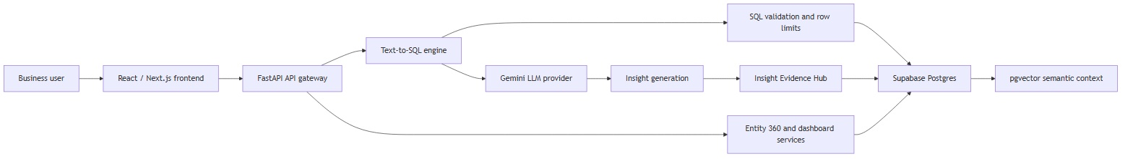
INSURANCE DECISION INTELLIGENCE PLATFORM
Solution architecture
Insurance Intelligence Product
The platform connects business users to verified SQL, insights and evidence
1
2
3
4
React / Next.js
FastAPI services
Gemini LLM provider
Supabase + pgvector
Client-facing decision workspace and role-aware dashboards
Orchestrates context retrieval, SQL generation, execution and evidence logging
Generates SQL and human business insights using retrieved context
Holds insurance facts and semantic context embeddings
Client briefing | 3
Synthetic insurance data • Supabase • pgvector • Gemini / LLM • Evidence Hub
Notes:
Describe the flow from user to frontend, API gateway, text-to-SQL engine, SQL validation, Supabase and pgvector context. Emphasize controlled orchestration rather than direct database access by the LLM.

Slide 4
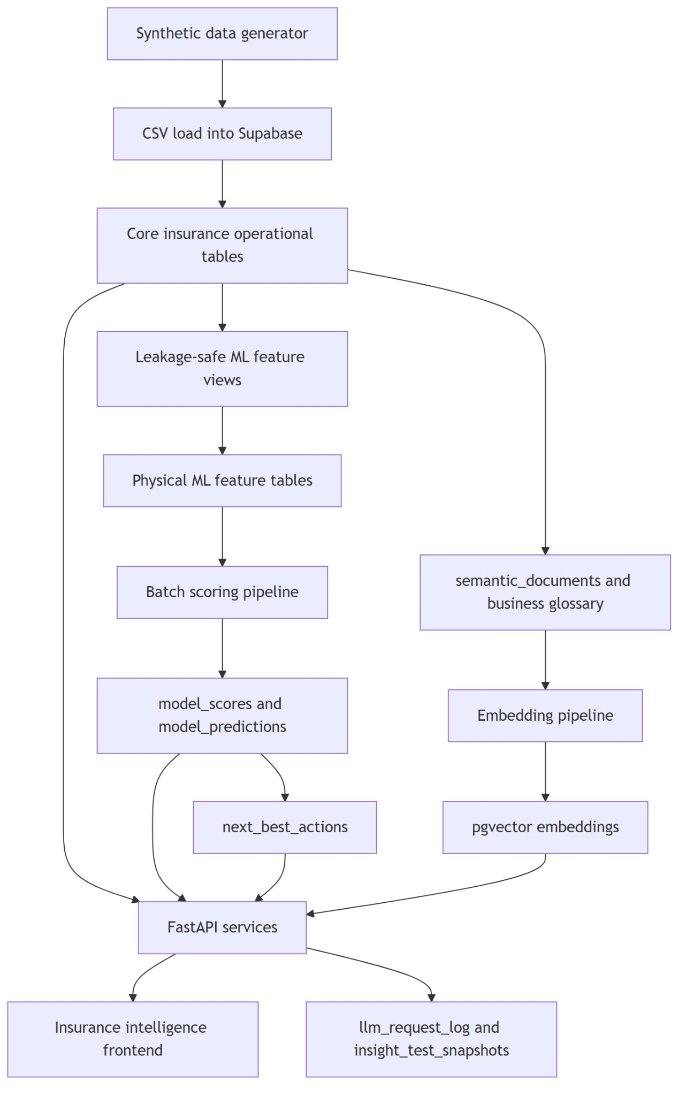
INSURANCE DECISION INTELLIGENCE PLATFORM
Data architecture
Insurance Intelligence Product
LAYERED BUILD
From synthetic data to evidence-backed AI insights
1. Generate insurance data for customers, policies, agents and campaigns
2. Load into Supabase operational tables
3. Build leakage-safe features and model scores
4. Embed semantic context in pgvector
5. Serve insights through FastAPI and React
Facts stay relational • Meaning goes vector
Client briefing | 4
Synthetic insurance data • Supabase • pgvector • Gemini / LLM • Evidence Hub
Notes:
Use this as the core build explanation. Facts are in operational tables, ML scores are in model tables, context is in pgvector, and the API connects all layers.

Slide 5
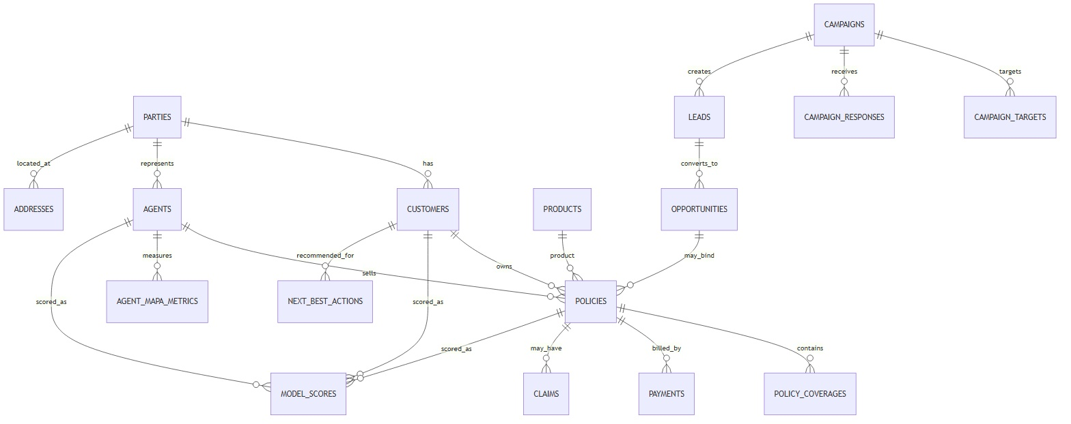
INSURANCE DECISION INTELLIGENCE PLATFORM
Insurance subject-area model
Insurance Intelligence Product
Campaign effectiveness sits across customer, campaign, sales funnel, policy and agent domains
Campaign
Sales funnel
Customer & agent
Models
campaigns, campaign_targets, campaign_responses
leads, opportunities, policies
customers, agents, parties
model_scores, next_best_actions
Who was targeted and how they responded
Which responses became issued policies
Who responded and who owns the follow-up
Which leads/customers should be prioritized
Client briefing | 5
Synthetic insurance data • Supabase • pgvector • Gemini / LLM • Evidence Hub
Notes:
Walk the client through how campaign effectiveness cannot be solved from campaign data alone. It requires customer, policy, sales funnel, agent and model data.

Slide 6
INSURANCE DECISION INTELLIGENCE PLATFORM
Campaign ETL and feature flow
Insurance Intelligence Product
The campaign funnel is converted into feature and scoring signals
RAW BUSINESS EVENTS
FEATURE LAYER
ACTION LAYER
• Campaign target
• Response / click / open
• Lead created
• Opportunity created
• Policy issued
• Premium generated
• Response count
• Lead conversion
• Policy conversion
• Cost per lead / policy
• Product gap
• Customer engagement
• Model scores
• Priority customers
• Next-best-actions
• Agent follow-up lists
• Campaign budget decisions
Client briefing | 6
Synthetic insurance data • Supabase • pgvector • Gemini / LLM • Evidence Hub
Notes:
Explain ETL as a business flow, not just a technical pipeline. Campaign events become features; features become scores; scores become actions.

Slide 7
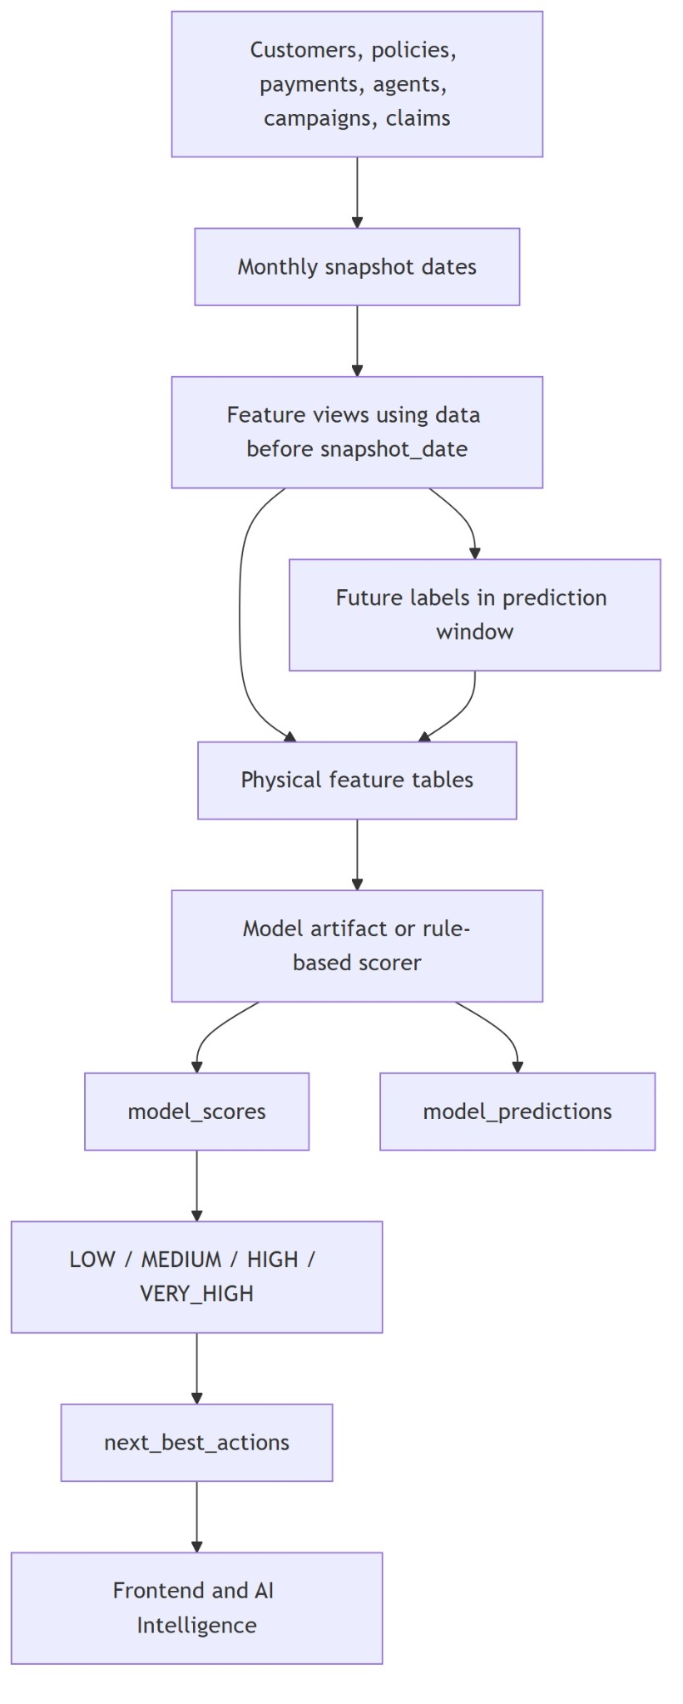
INSURANCE DECISION INTELLIGENCE PLATFORM
Feature and model layer
Insurance Intelligence Product
CAMPAIGN MODEL SIGNALS
Predictive signals convert funnel activity into decisions
Campaign response
Open/click/respond/lead
Prioritize responsive segments
Lead conversion
Lead score, source, agent assignment
Route best leads to senior agents
Propensity to buy
Engagement, product gap, past response
Create call lists by likelihood to buy
Next best product
Existing holdings, segment, behavior
Recommend health rider or upgrade
Revenue opportunity
Expected premium × conversion probability
Rank campaigns by growth potential
Model outputs feed model_scores, model_predictions and next_best_actions
Client briefing | 7
Synthetic insurance data • Supabase • pgvector • Gemini / LLM • Evidence Hub
Notes:
Show how the feature layer feeds batch scoring, which writes scores and recommended actions. Use campaign response and lead conversion as concrete examples.

Slide 8
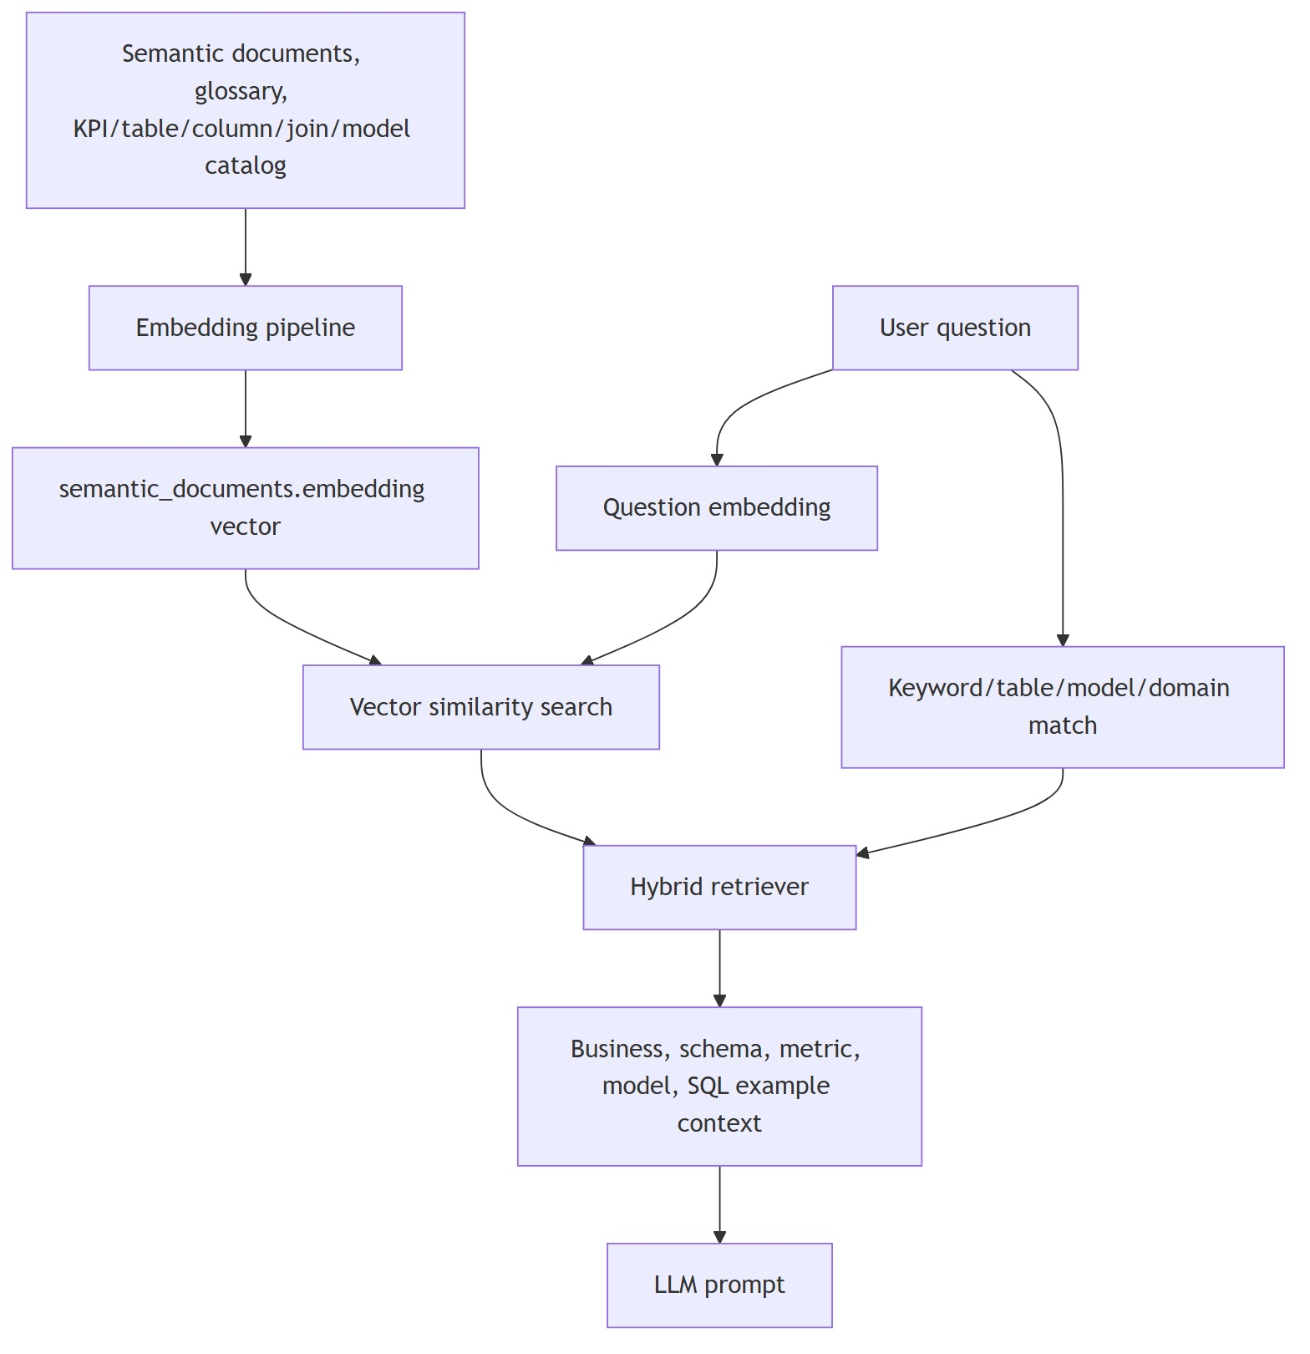
INSURANCE DECISION INTELLIGENCE PLATFORM
Semantic context and pgvector
Insurance Intelligence Product
WHY PGVECTOR MATTERS
Facts stay in SQL. Meaning is retrieved from vectors.
The vector store does not replace the database. It stores business meaning so the LLM understands what to ask from the database.
CONTEXT EXAMPLES
• Campaign conversion definition
• Valid joins across campaign → lead → policy
• Model score interpretation
• KPI formula and grain
• SQL examples using real tables
• Missing data rules
Client briefing | 8
Synthetic insurance data • Supabase • pgvector • Gemini / LLM • Evidence Hub
Notes:
This is the key AI explanation: pgvector stores semantic context, not facts. It retrieves table meanings, KPI definitions, model descriptions and join paths for SQL generation.

Slide 9
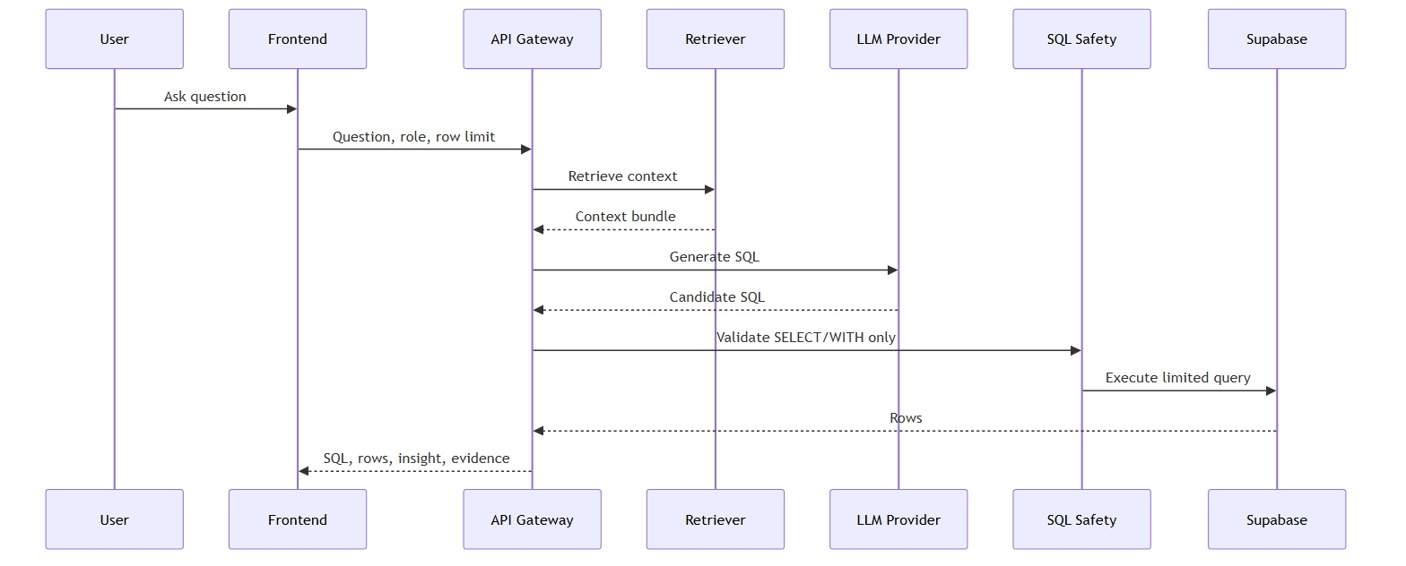
INSURANCE DECISION INTELLIGENCE PLATFORM
Text-to-SQL and validation
Insurance Intelligence Product
The LLM never acts as the source of truth
Demo-safe guardrail
The platform retrieves verified context, generates candidate SQL, validates SELECT/WITH only, applies row limits, executes against Supabase, and only then generates business language.
SQL is validated against actual Supabase tables and columns before results or insights are shown.
Client briefing | 9
Synthetic insurance data • Supabase • pgvector • Gemini / LLM • Evidence Hub
Notes:
Address risk directly: the LLM is powerful, but the platform controls execution. Validation and evidence make it enterprise-safe and demo-stable.

Slide 10
INSURANCE DECISION INTELLIGENCE PLATFORM
Campaign effectiveness walkthrough
Insurance Intelligence Product
Example business question: “Which campaign generated the highest policy conversion?”
A campaign manager needs to move from engagement metrics to business action.
1
Target
2
Respond
3
Convert
4
Score
5
Act
Customers selected for campaign
Open, click, reply or opt-in
Lead → opportunity → policy
Propensity and lead conversion
Assign leads and retarget segments
AI ANSWER SHOULD SAY
EVIDENCE BEHIND IT
The Health Protection Upgrade campaign generated the strongest conversion, driven by affluent family customers. Prioritize follow-up for engaged non-converters and assign high-propensity leads to senior agents.
campaigns, campaign_targets, campaign_responses, leads, opportunities, policies, model_scores, next_best_actions
Dashboard answers standard questions • AI answers follow-up questions
Client briefing | 10
Synthetic insurance data • Supabase • pgvector • Gemini / LLM • Evidence Hub
Notes:
Use this as the demo pivot. State the question, walk through the funnel, and then point to the evidence sources that prove the answer.

Slide 11
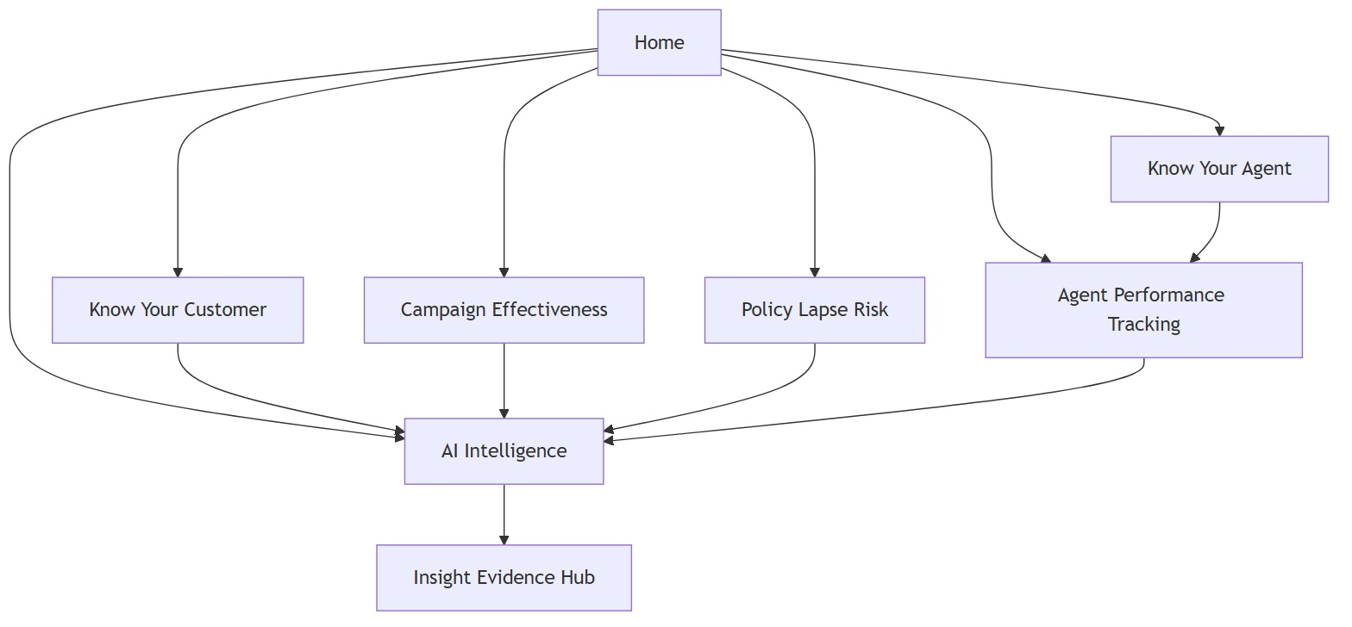
INSURANCE DECISION INTELLIGENCE PLATFORM
User experience
Insurance Intelligence Product
TAB-BY-TAB STORY
Every dashboard feeds the AI layer and the Evidence Hub
• Campaign Effectiveness shows the campaign funnel
• Agent Performance shows productivity and coaching needs
• Policy Lapse Risk identifies revenue at risk
• AI Intelligence answers open business questions
• Insight Evidence Hub explains why the answer is trusted
Dashboard → Ask → Evidence
Client briefing | 11
Synthetic insurance data • Supabase • pgvector • Gemini / LLM • Evidence Hub
Notes:
Explain that the user experience is not a collection of dashboards only. Dashboards are entry points into AI Intelligence, and Evidence Hub is the trust layer.

Slide 12
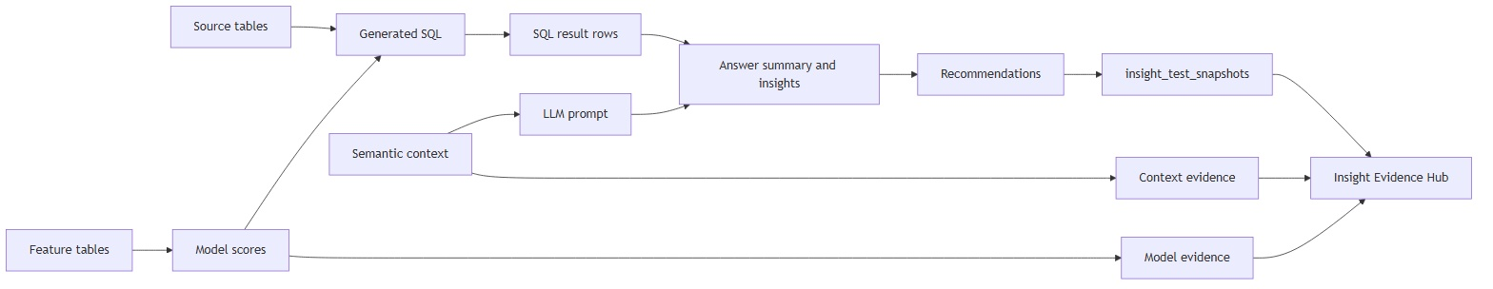
INSURANCE DECISION INTELLIGENCE PLATFORM
Insight Evidence Hub
Insurance Intelligence Product
Trust comes from showing the lineage from data to recommendation
Source data
Campaigns, responses, leads, policies, model scores
Generated SQL
Validated read-only query, row limits and execution status
Semantic context
KPI definitions, table meanings, join paths and model context
Business insight
Human explanation with key data points and recommendations
Client briefing | 12
Synthetic insurance data • Supabase • pgvector • Gemini / LLM • Evidence Hub
Notes:
Use this slide to show explainability. Every answer should have a trace: the source tables, generated SQL, context used, model scores, limitations and recommendation.

Slide 13
INSURANCE DECISION INTELLIGENCE PLATFORM
Productionized version
Insurance Intelligence Product
How the same pattern scales to production
The POC demonstrates the architectural pattern. Production hardens the data ingestion, security, model governance and operational controls.
1. Data ingestion
2. Curated insurance layer
3. Feature + model ops
Policy admin, CRM, campaign platform, claims, payments and agent systems feed a governed data lake / warehouse.
Customer, policy, campaign, agent, claims and payment domains are conformed and quality controlled.
Feature pipelines, model training, scoring, monitoring and drift detection run with auditability.
4. Semantic governance
5. AI harness
6. Experience layer
Glossary, KPI definitions, schema catalog, join paths and context documents are approved and versioned.
LLM routing, SQL validation, result validation, role access, evidence capture and feedback loops.
Role-based dashboards, AI Intelligence, Evidence Hub and operational actions integrated into CRM/workflow.
POC validates pattern • Production adds governance, integrations and scale
Client briefing | 13
Synthetic insurance data • Supabase • pgvector • Gemini / LLM • Evidence Hub
Notes:
Close the architecture section with a realistic production view. Make it clear this is a POC pattern that can be hardened with real ingestion, governance and MLOps.

Slide 14
INSURANCE DECISION INTELLIGENCE PLATFORM
Client message and next steps
Insurance Intelligence Product
Recommended client storyline
1
Start with the business problem
Dashboards answer known questions, but business users need follow-up answers and actions.
2
Show campaign and agency scenarios
Demonstrate conversion, premium at risk, agent productivity and retention actions.
3
Ask AI Intelligence
Use a validated question such as “Which campaign generated the highest policy conversion?”
4
Open Insight Evidence Hub
Show SQL, tables, context, model signals, validation and lineage.
5
Close with production path
Connect to real systems, govern the context layer and operationalize the AI harness.
Decision intelligence pattern: structured data + ML scores + semantic context + LLM + evidence.
Client briefing | 14
Synthetic insurance data • Supabase • pgvector • Gemini / LLM • Evidence Hub
Notes:
Finish with the client story and next steps. The strongest message is that this is a repeatable pattern for insurance decision intelligence, not a one-off dashboard.

