Slide 1
Signal Harbor 3.0
The app, screen by screen — Evergreen Office (synthetic data), test cycle 3
One assistant, Harbor. Four places: Action · Build · Consume · Knowledge.

Slide 2
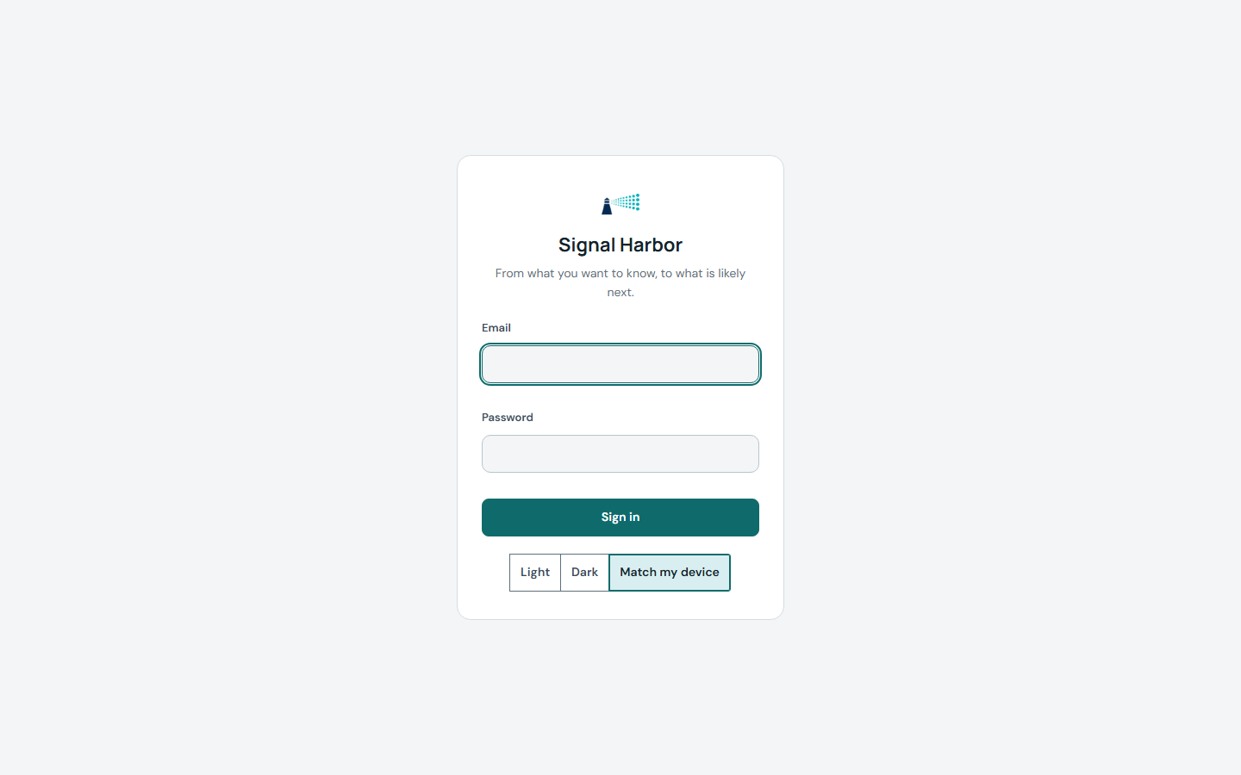
THE TOUR · 1 of 16
Sign in

Slide 3
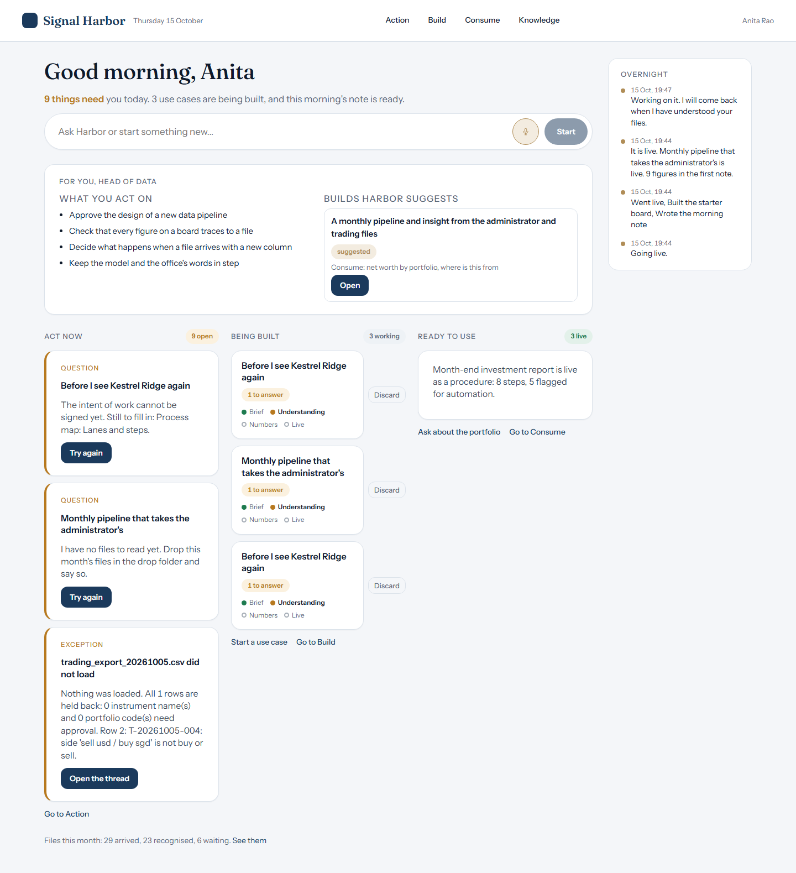
THE TOUR · 2 of 16
Home: what needs you today

Slide 4
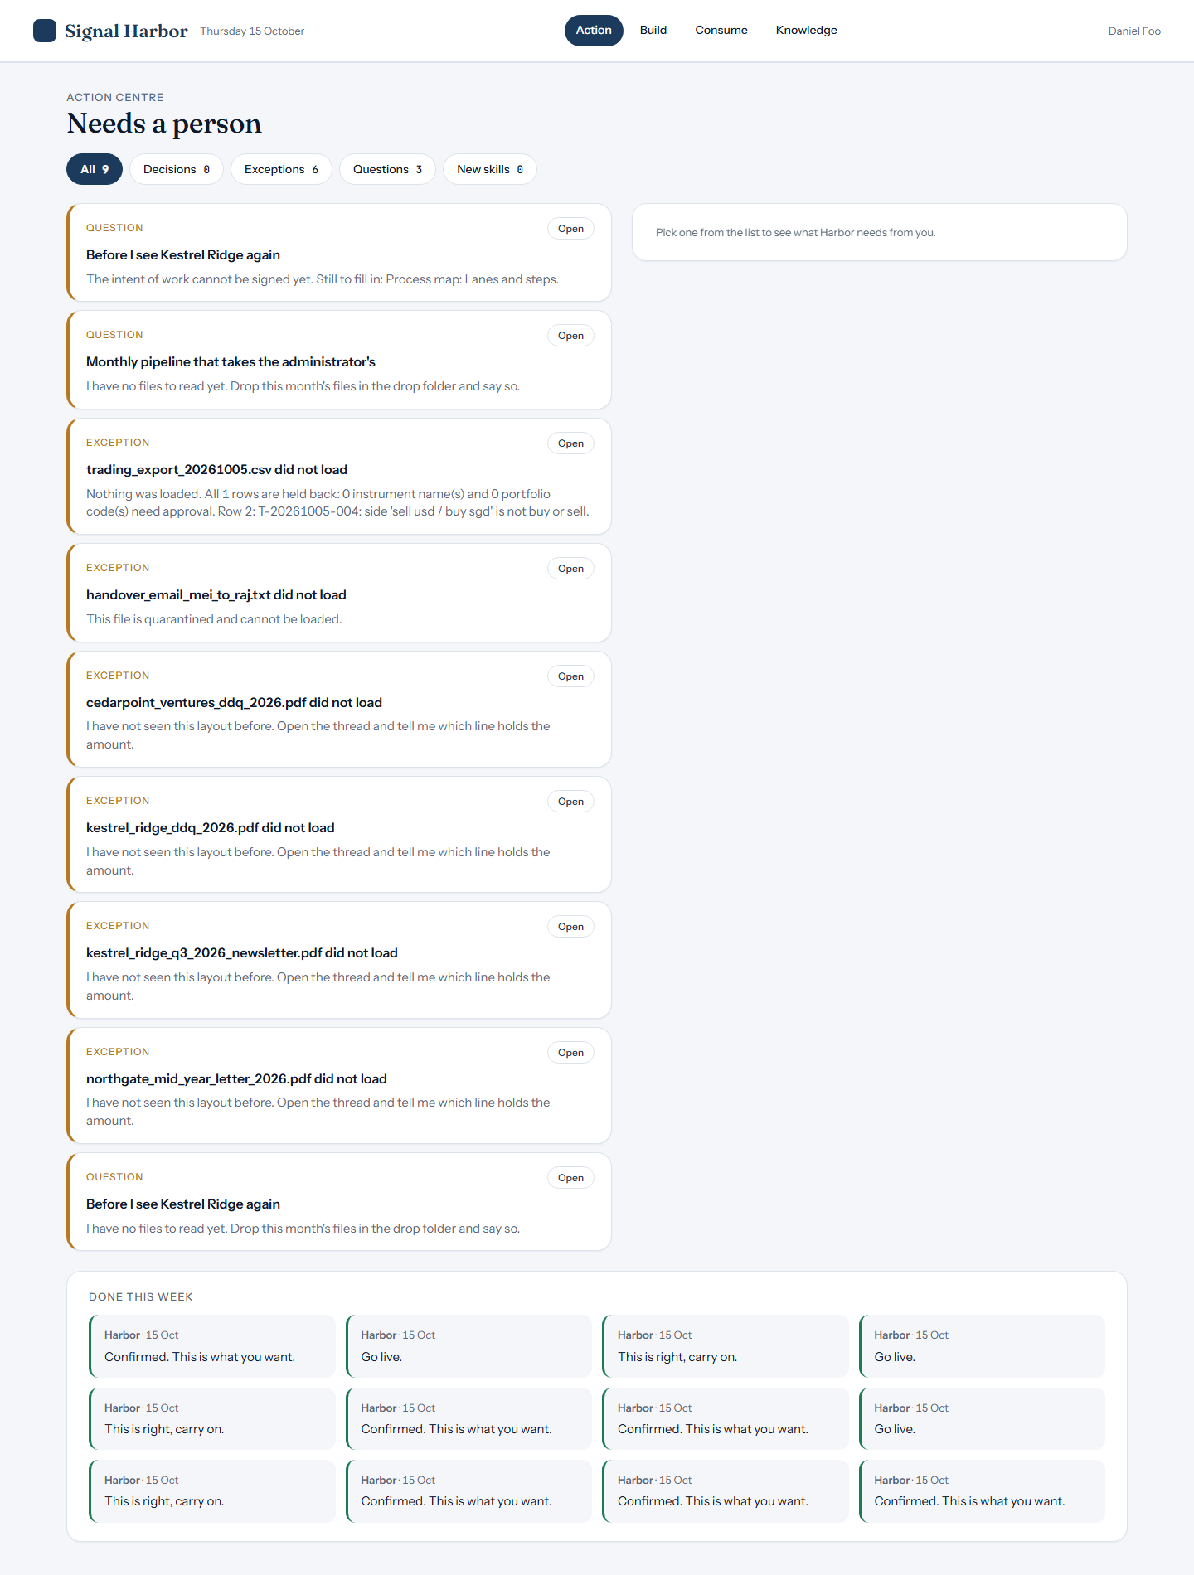
THE TOUR · 3 of 16
Action: decisions waiting for you

Slide 5
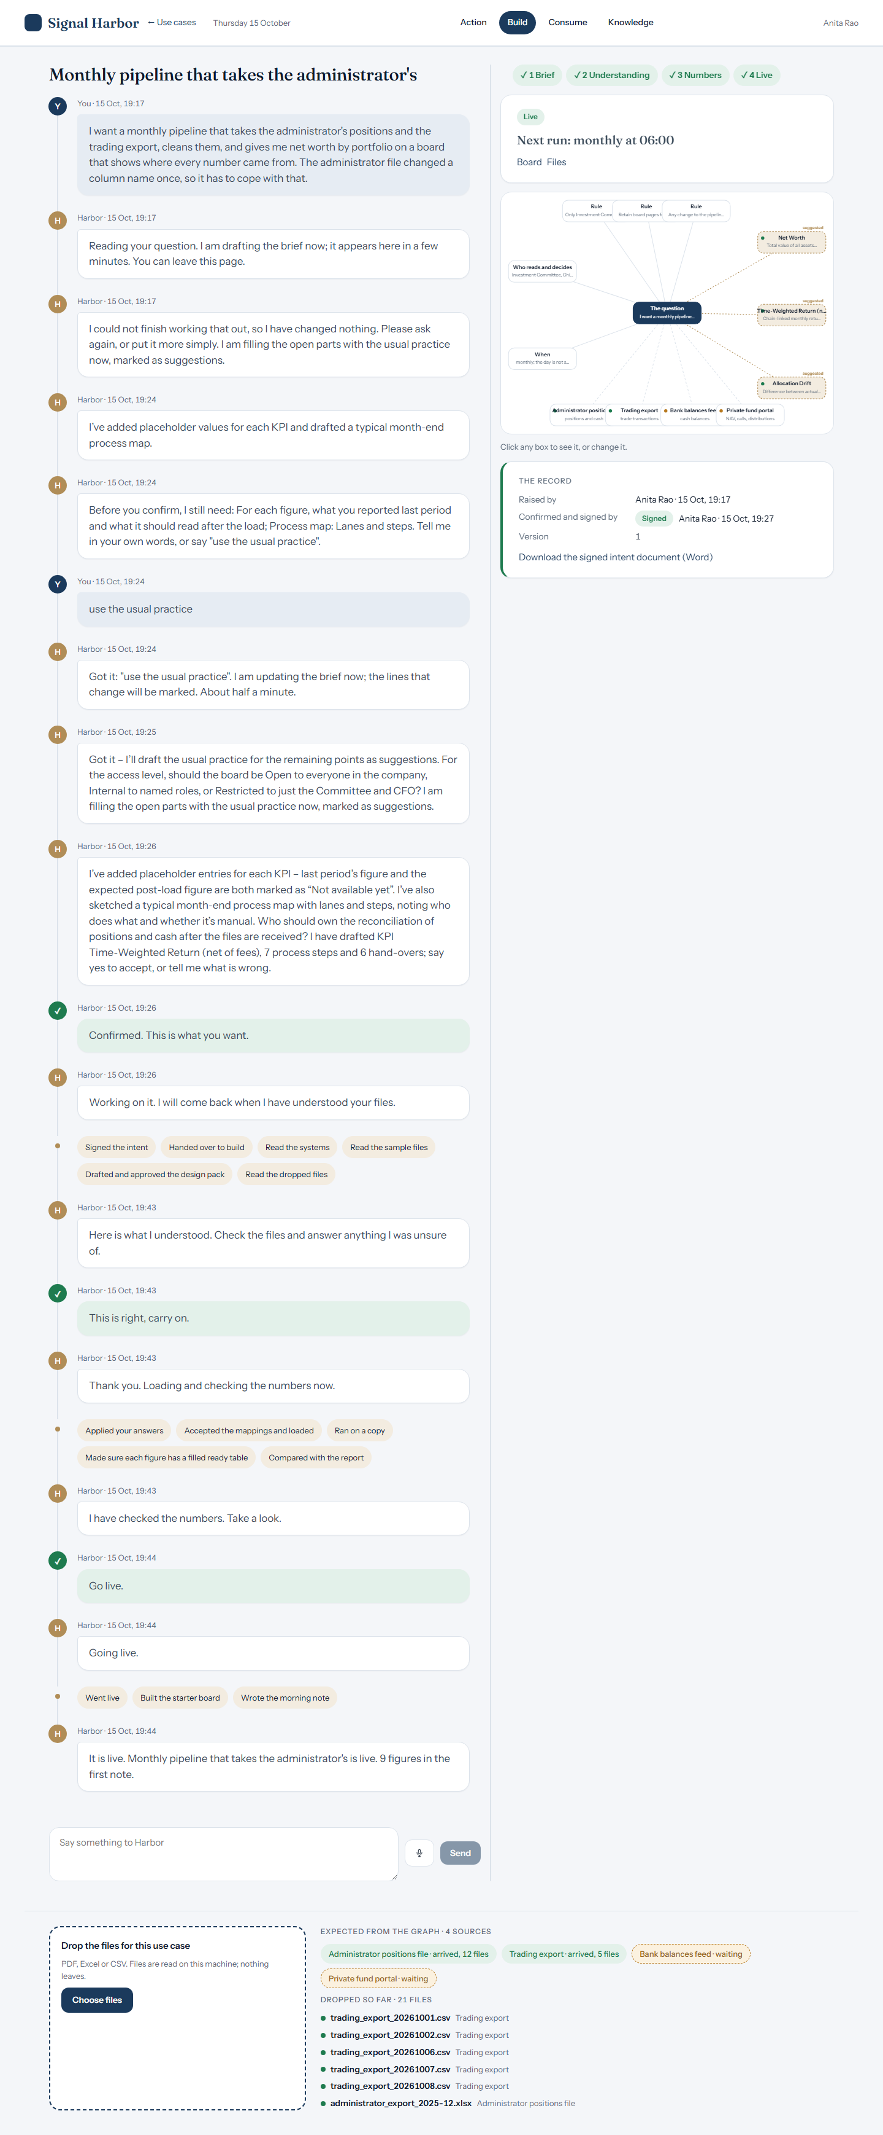
THE TOUR · 4 of 16
Build: say what you need, drop your files

Slide 6
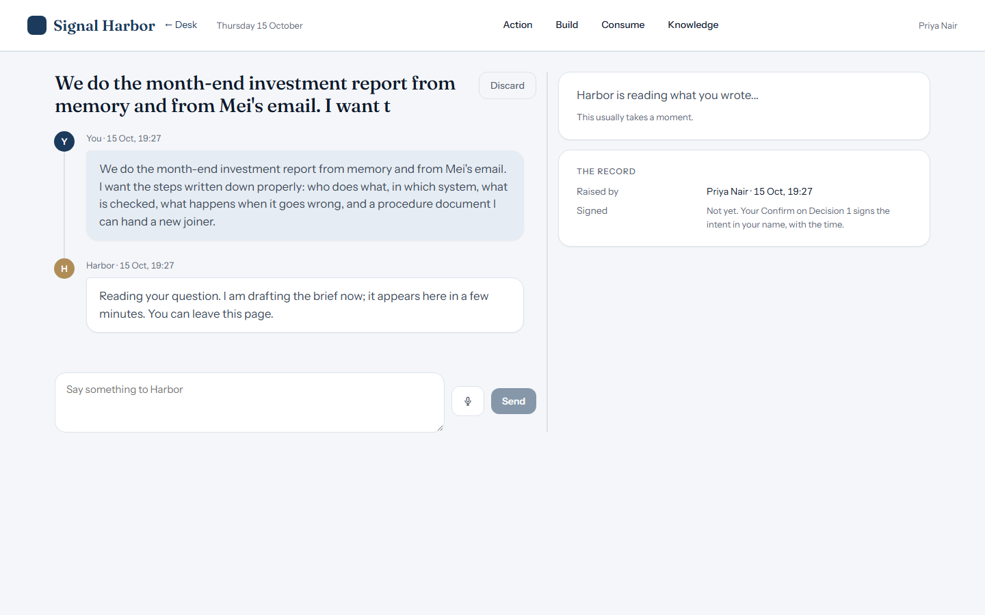
THE TOUR · 5 of 16
Harbor drafts the brief

Slide 7
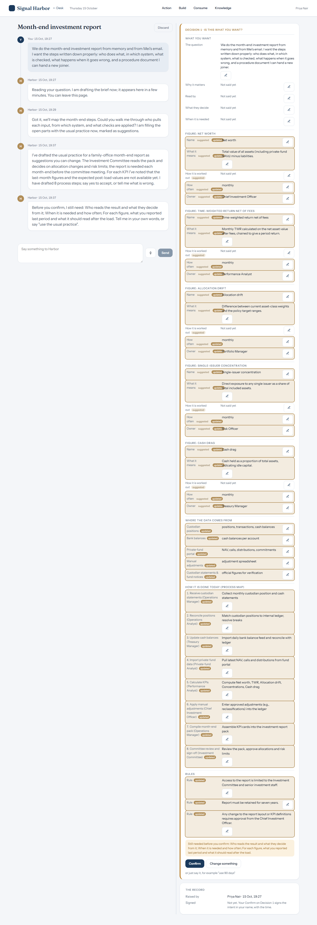
THE TOUR · 6 of 16
Decision 1: the brief

Slide 8
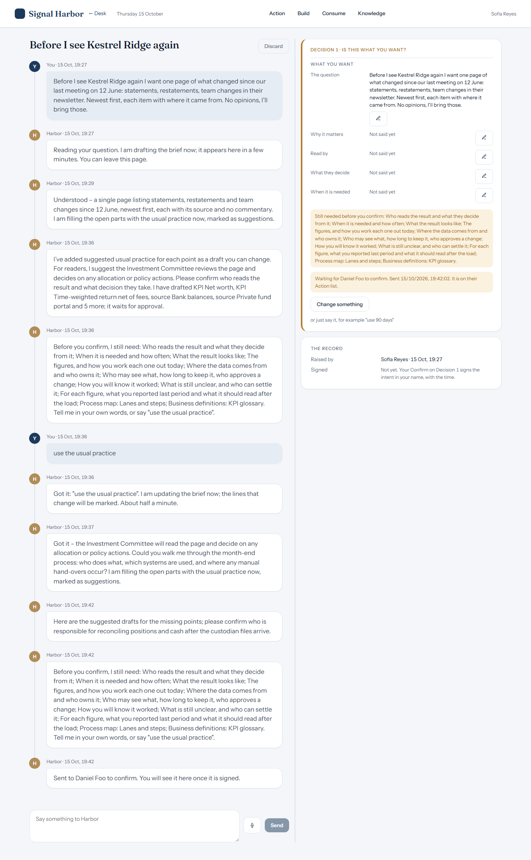
THE TOUR · 7 of 16
Sofia sends the brief to Daniel to sign

Slide 9
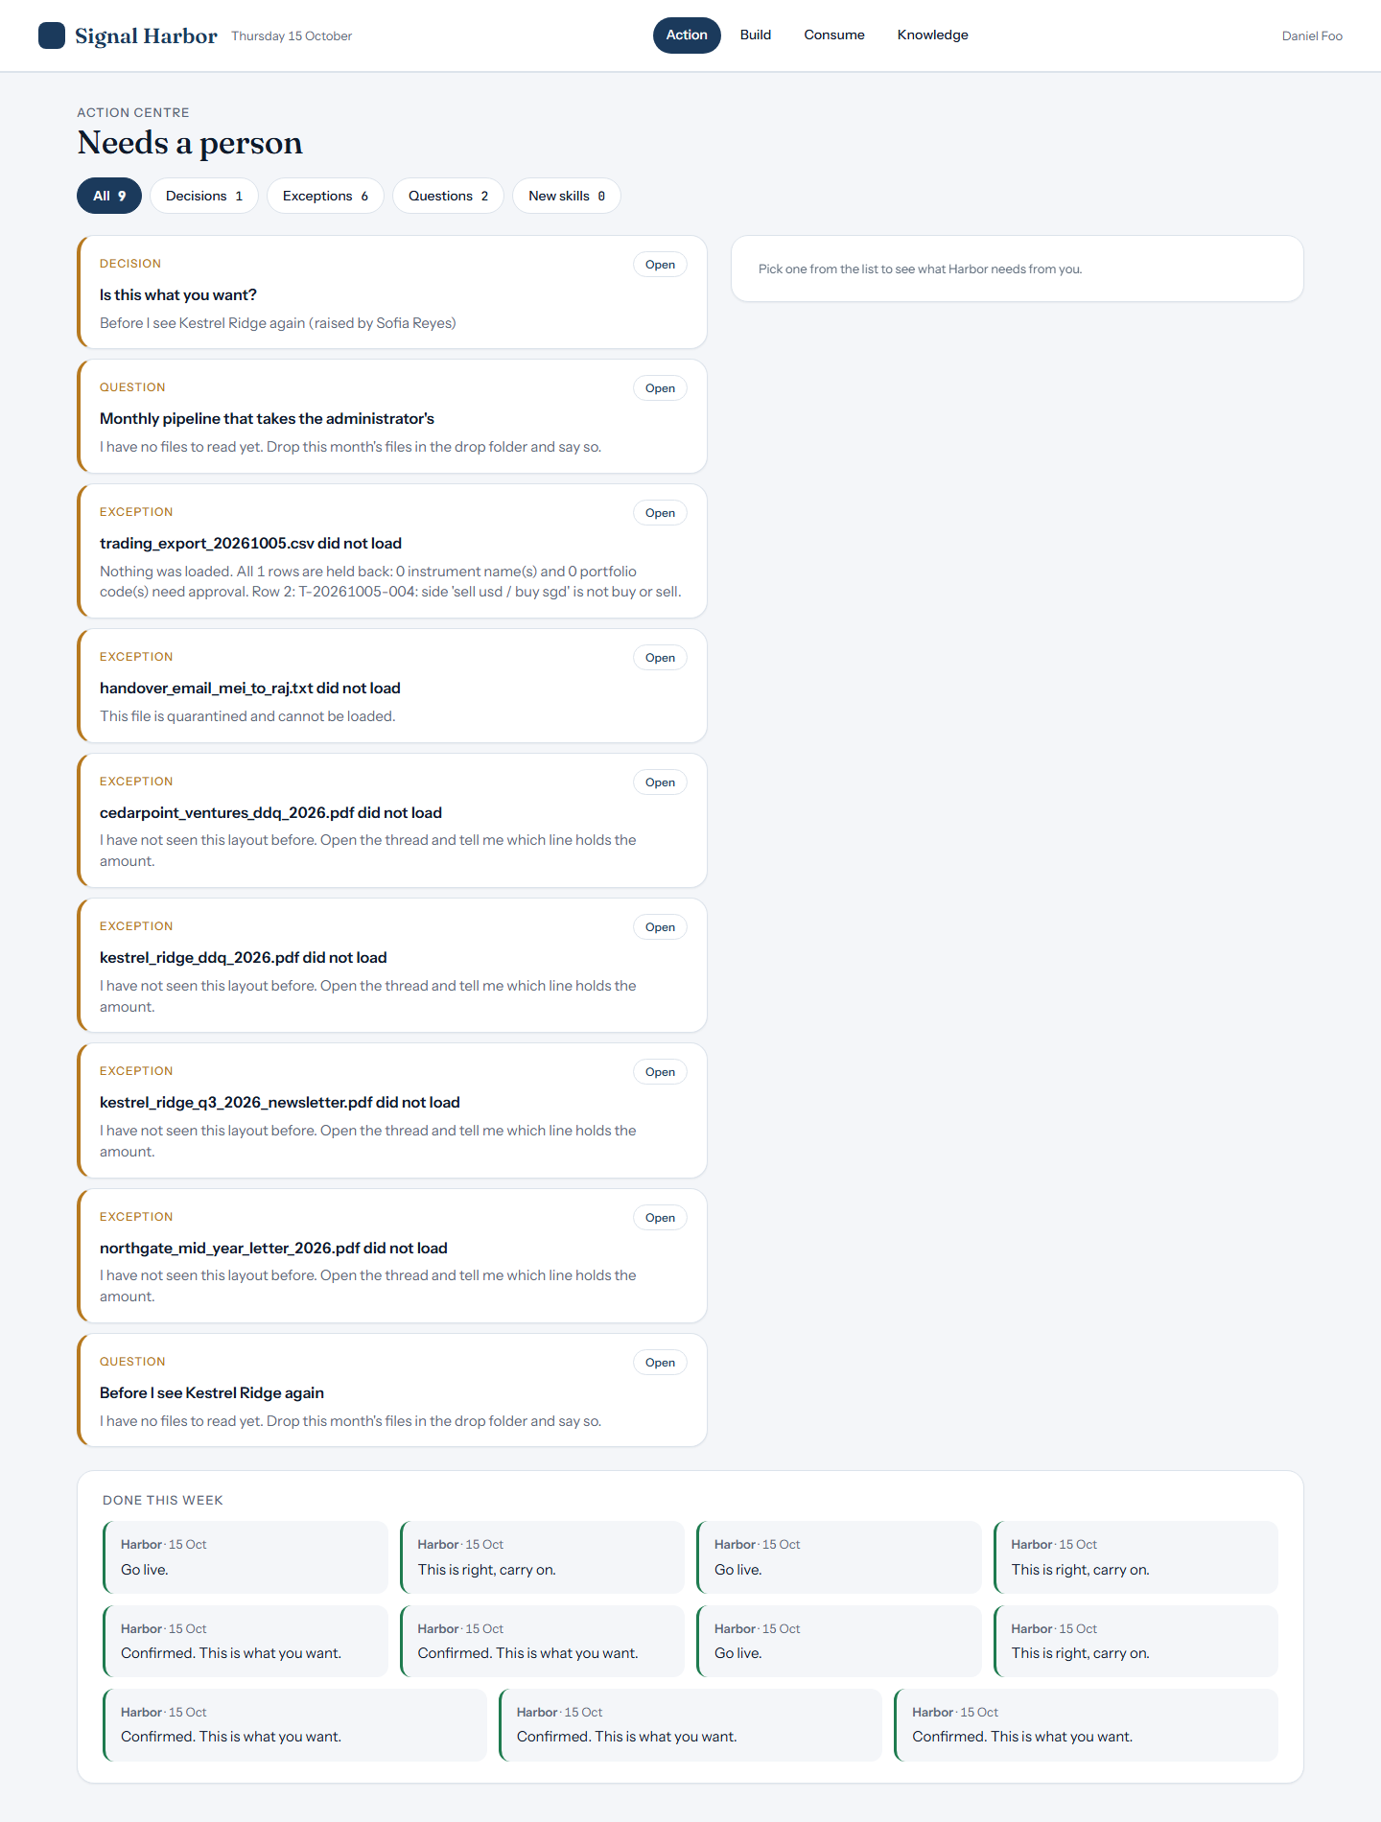
THE TOUR · 8 of 16
Daniel sees it in Action

Slide 10
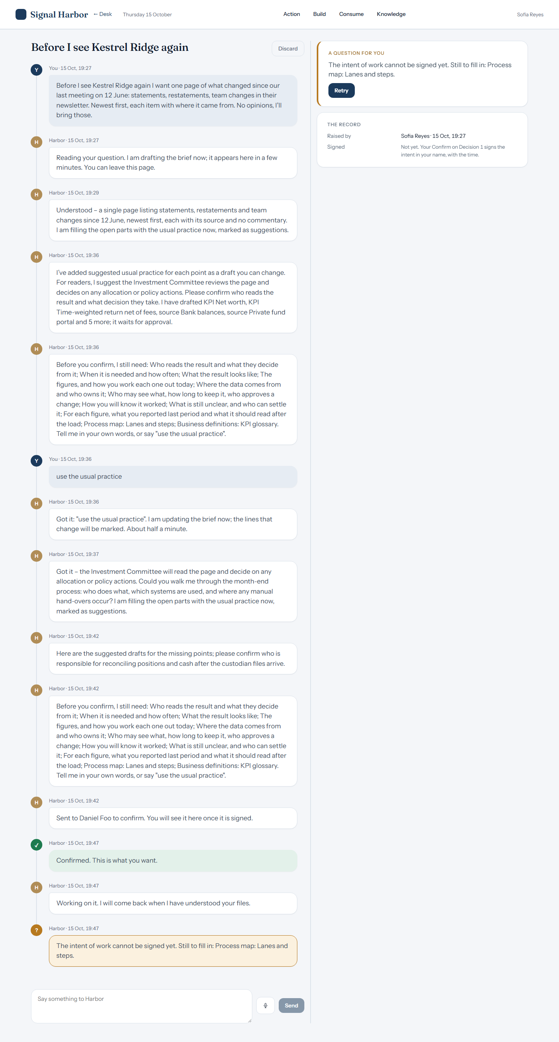
THE TOUR · 9 of 16
The record: who raised it, who signed

Slide 11
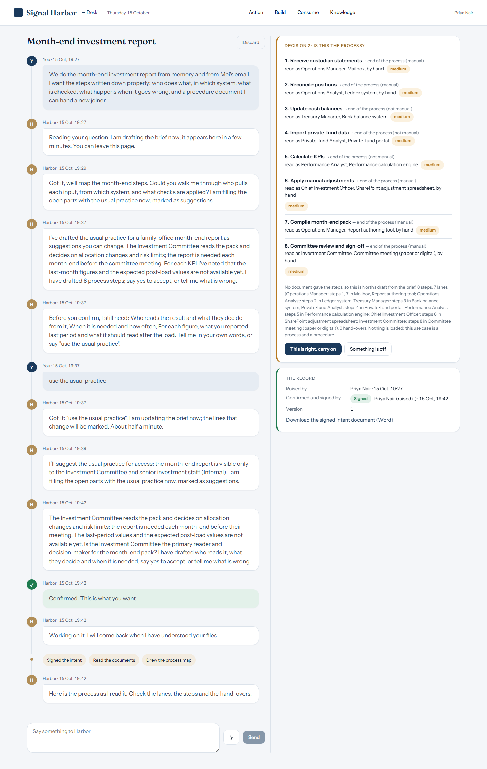
THE TOUR · 10 of 16
Decision 2: is this the process?

Slide 12
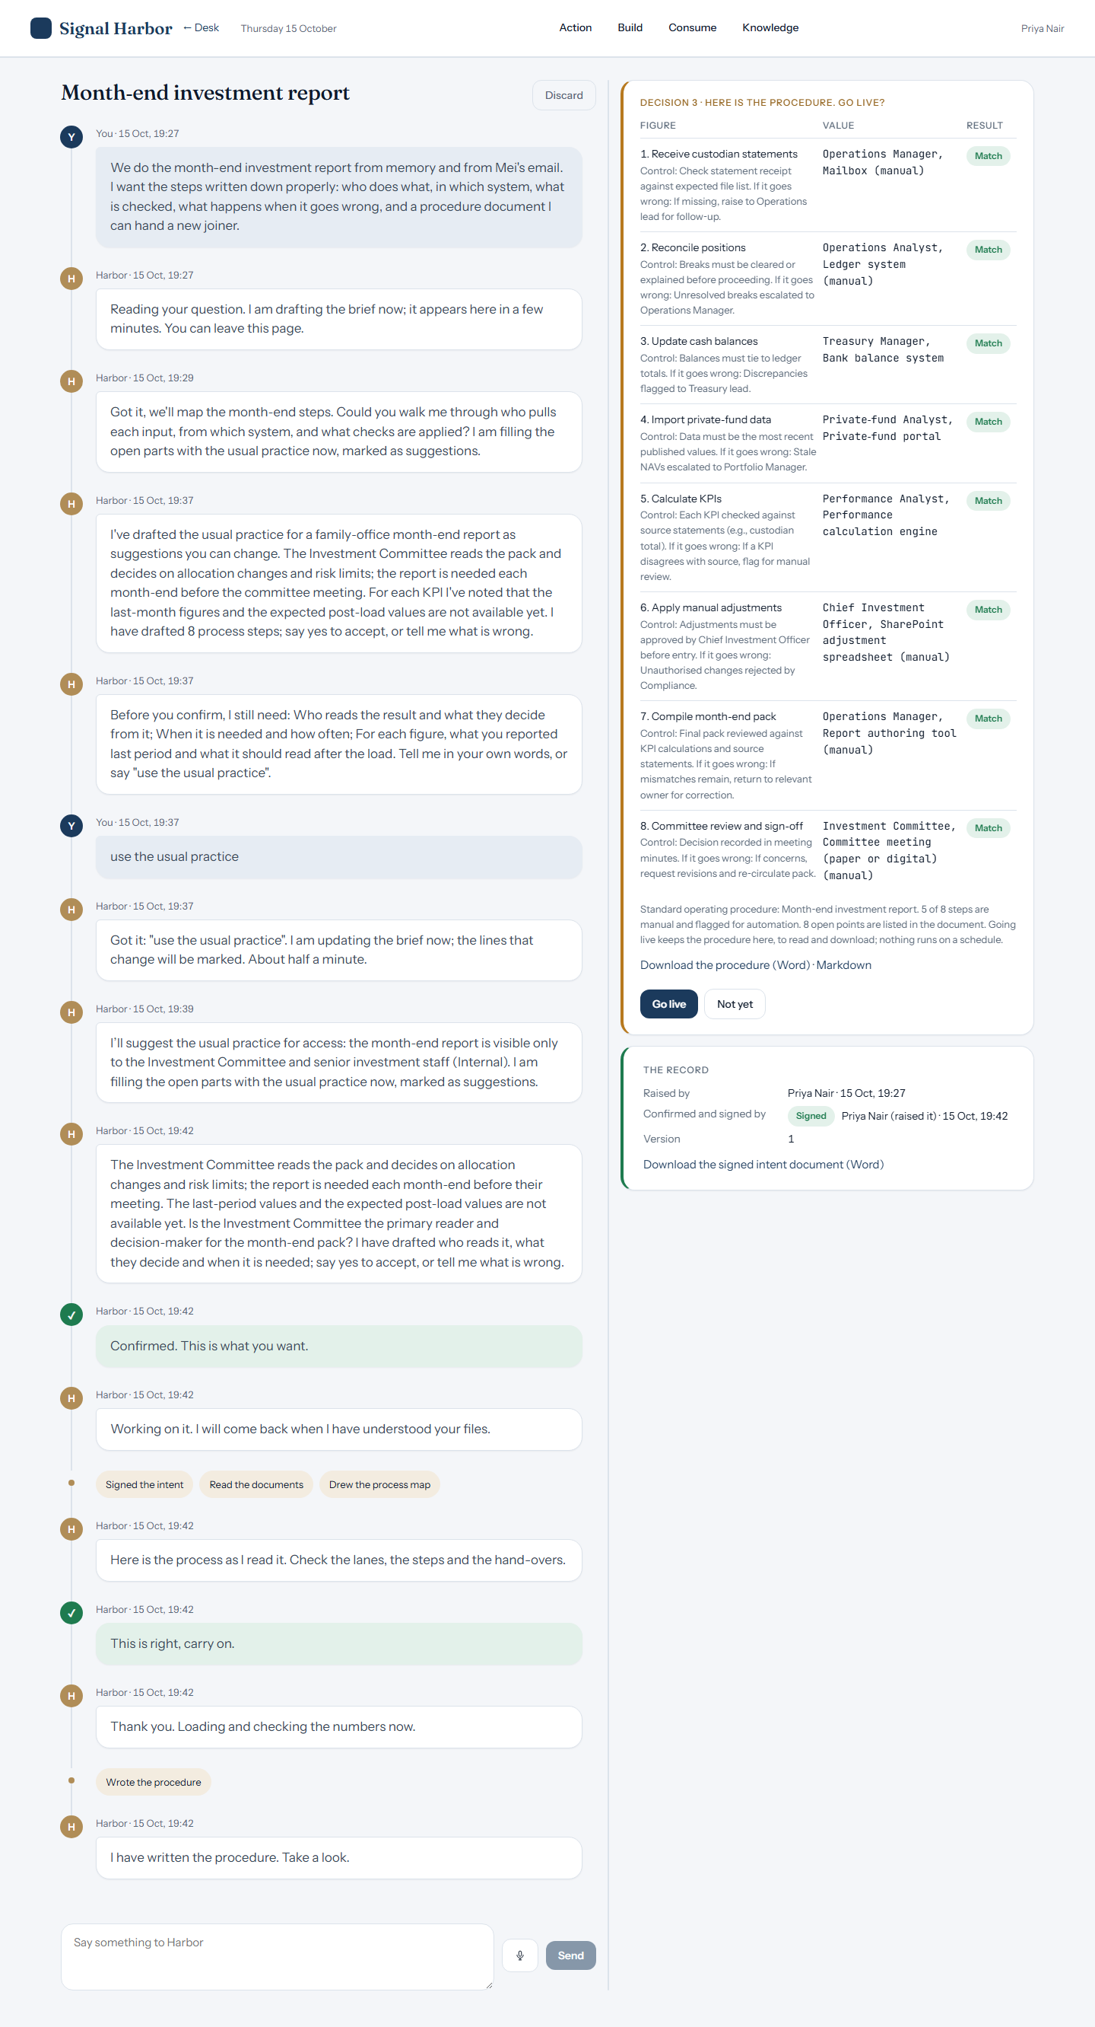
THE TOUR · 11 of 16
Decision 3: SOP preview, then go live

Slide 13
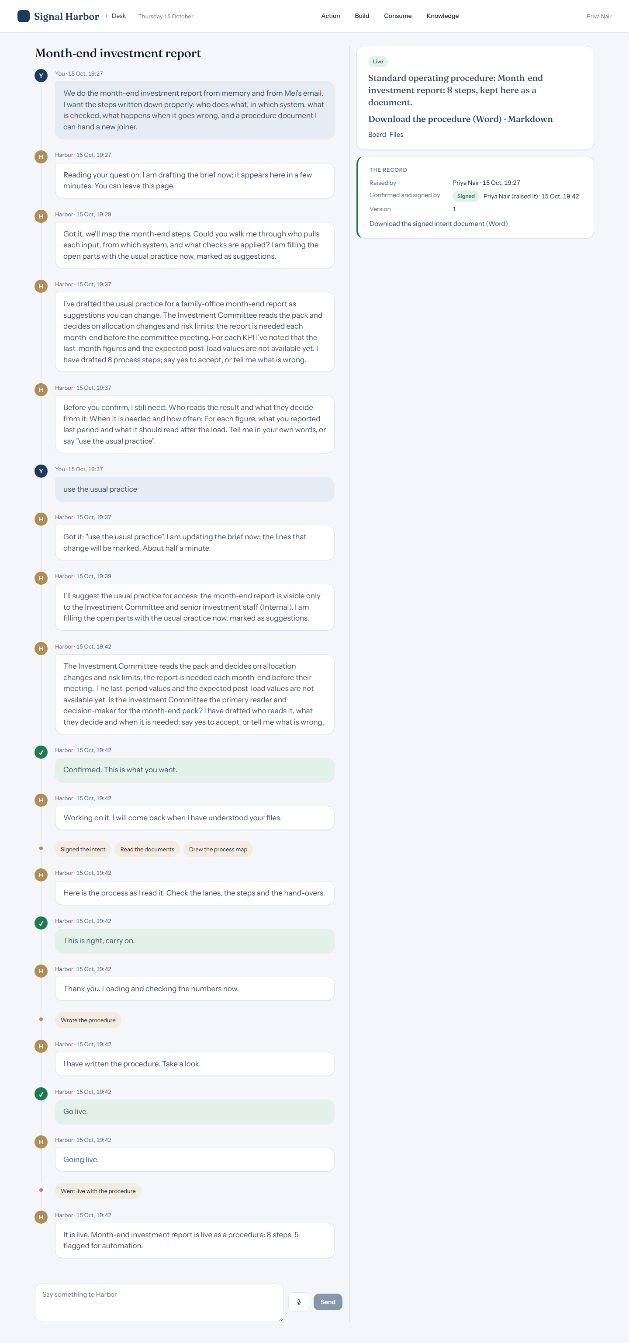
THE TOUR · 12 of 16
Live

Slide 14
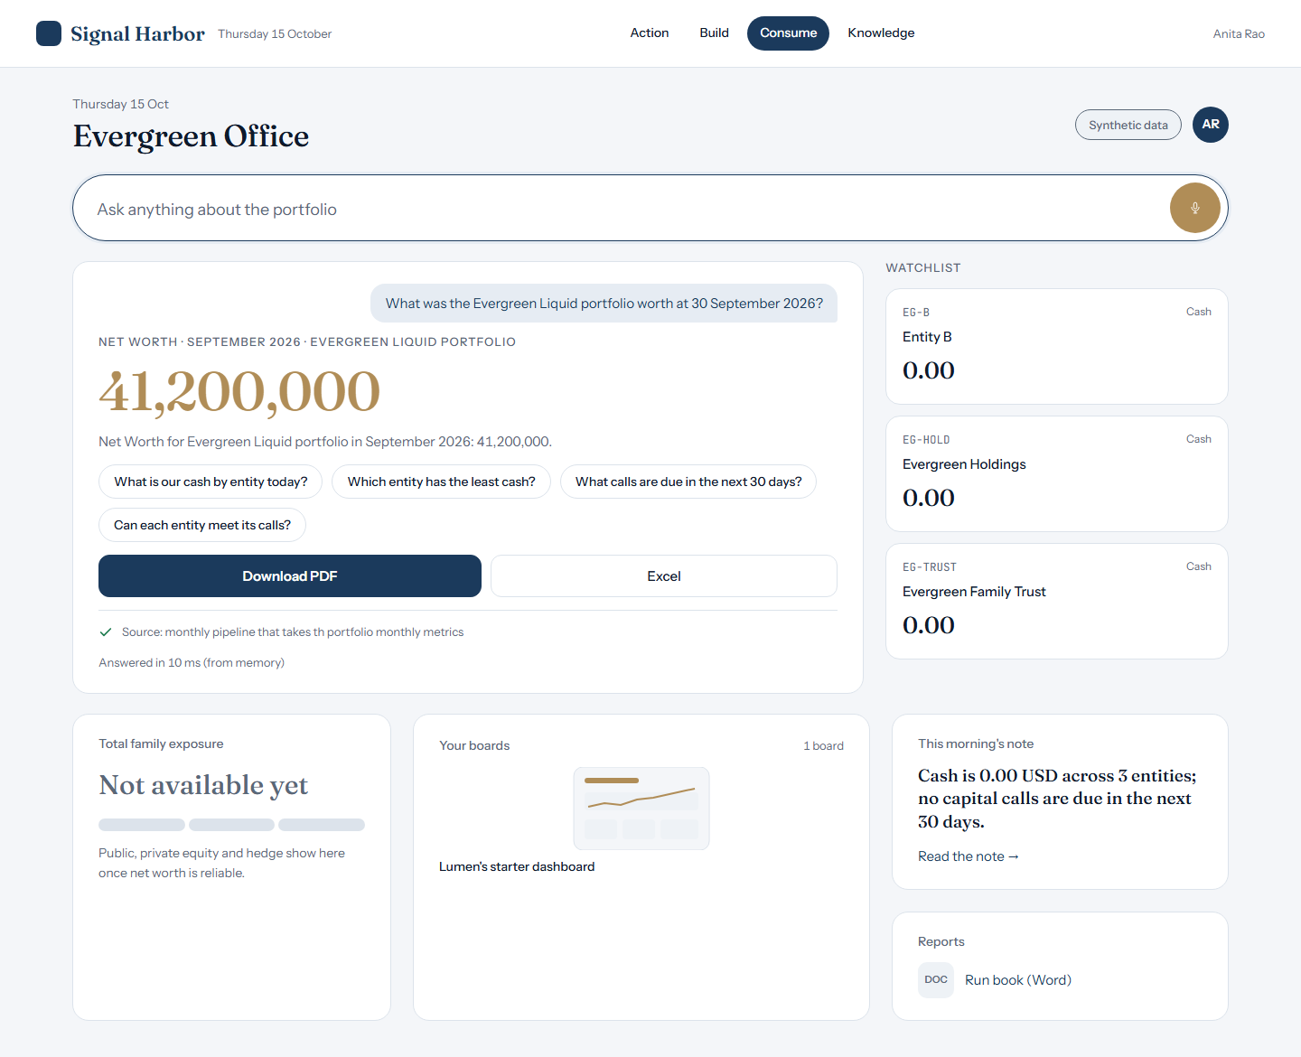
THE TOUR · 13 of 16
Consume: ask, get the figure

Slide 15
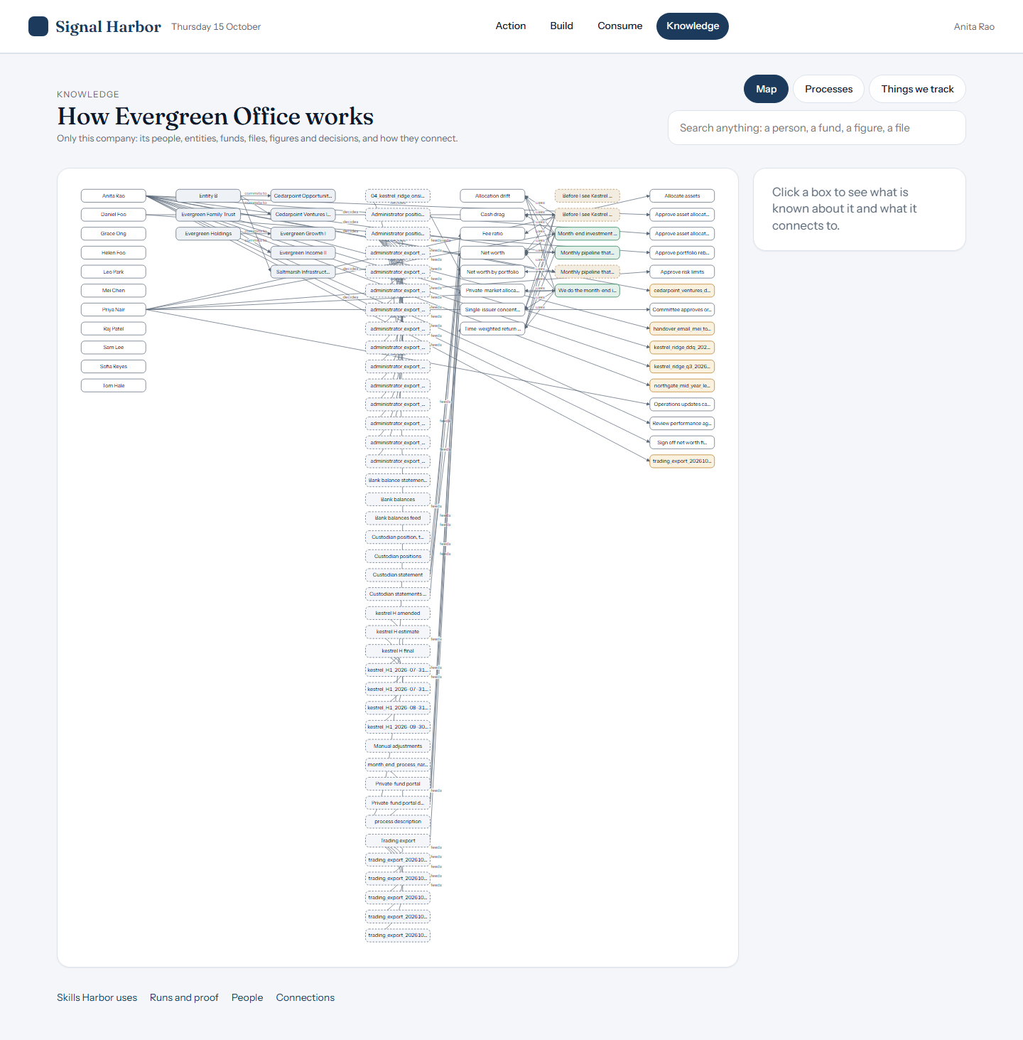
THE TOUR · 14 of 16
Knowledge: the company graph

Slide 16
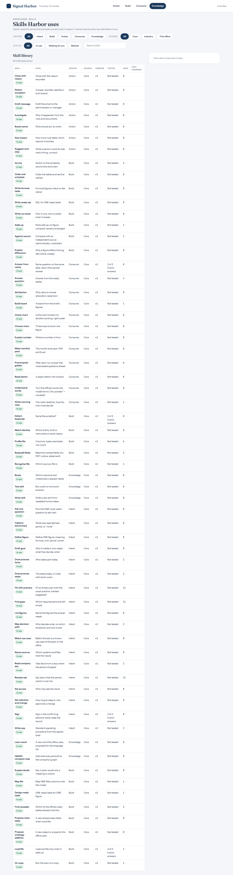
THE TOUR · 15 of 16
Knowledge: Harbor's skills

Slide 17
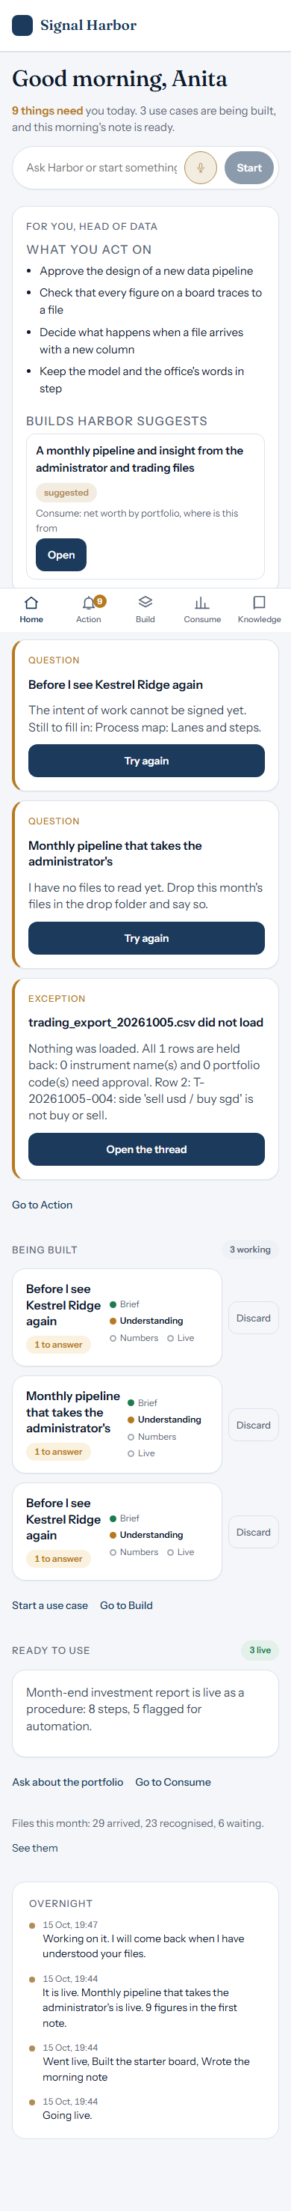
THE TOUR · 16 of 16
Phone

Slide 18
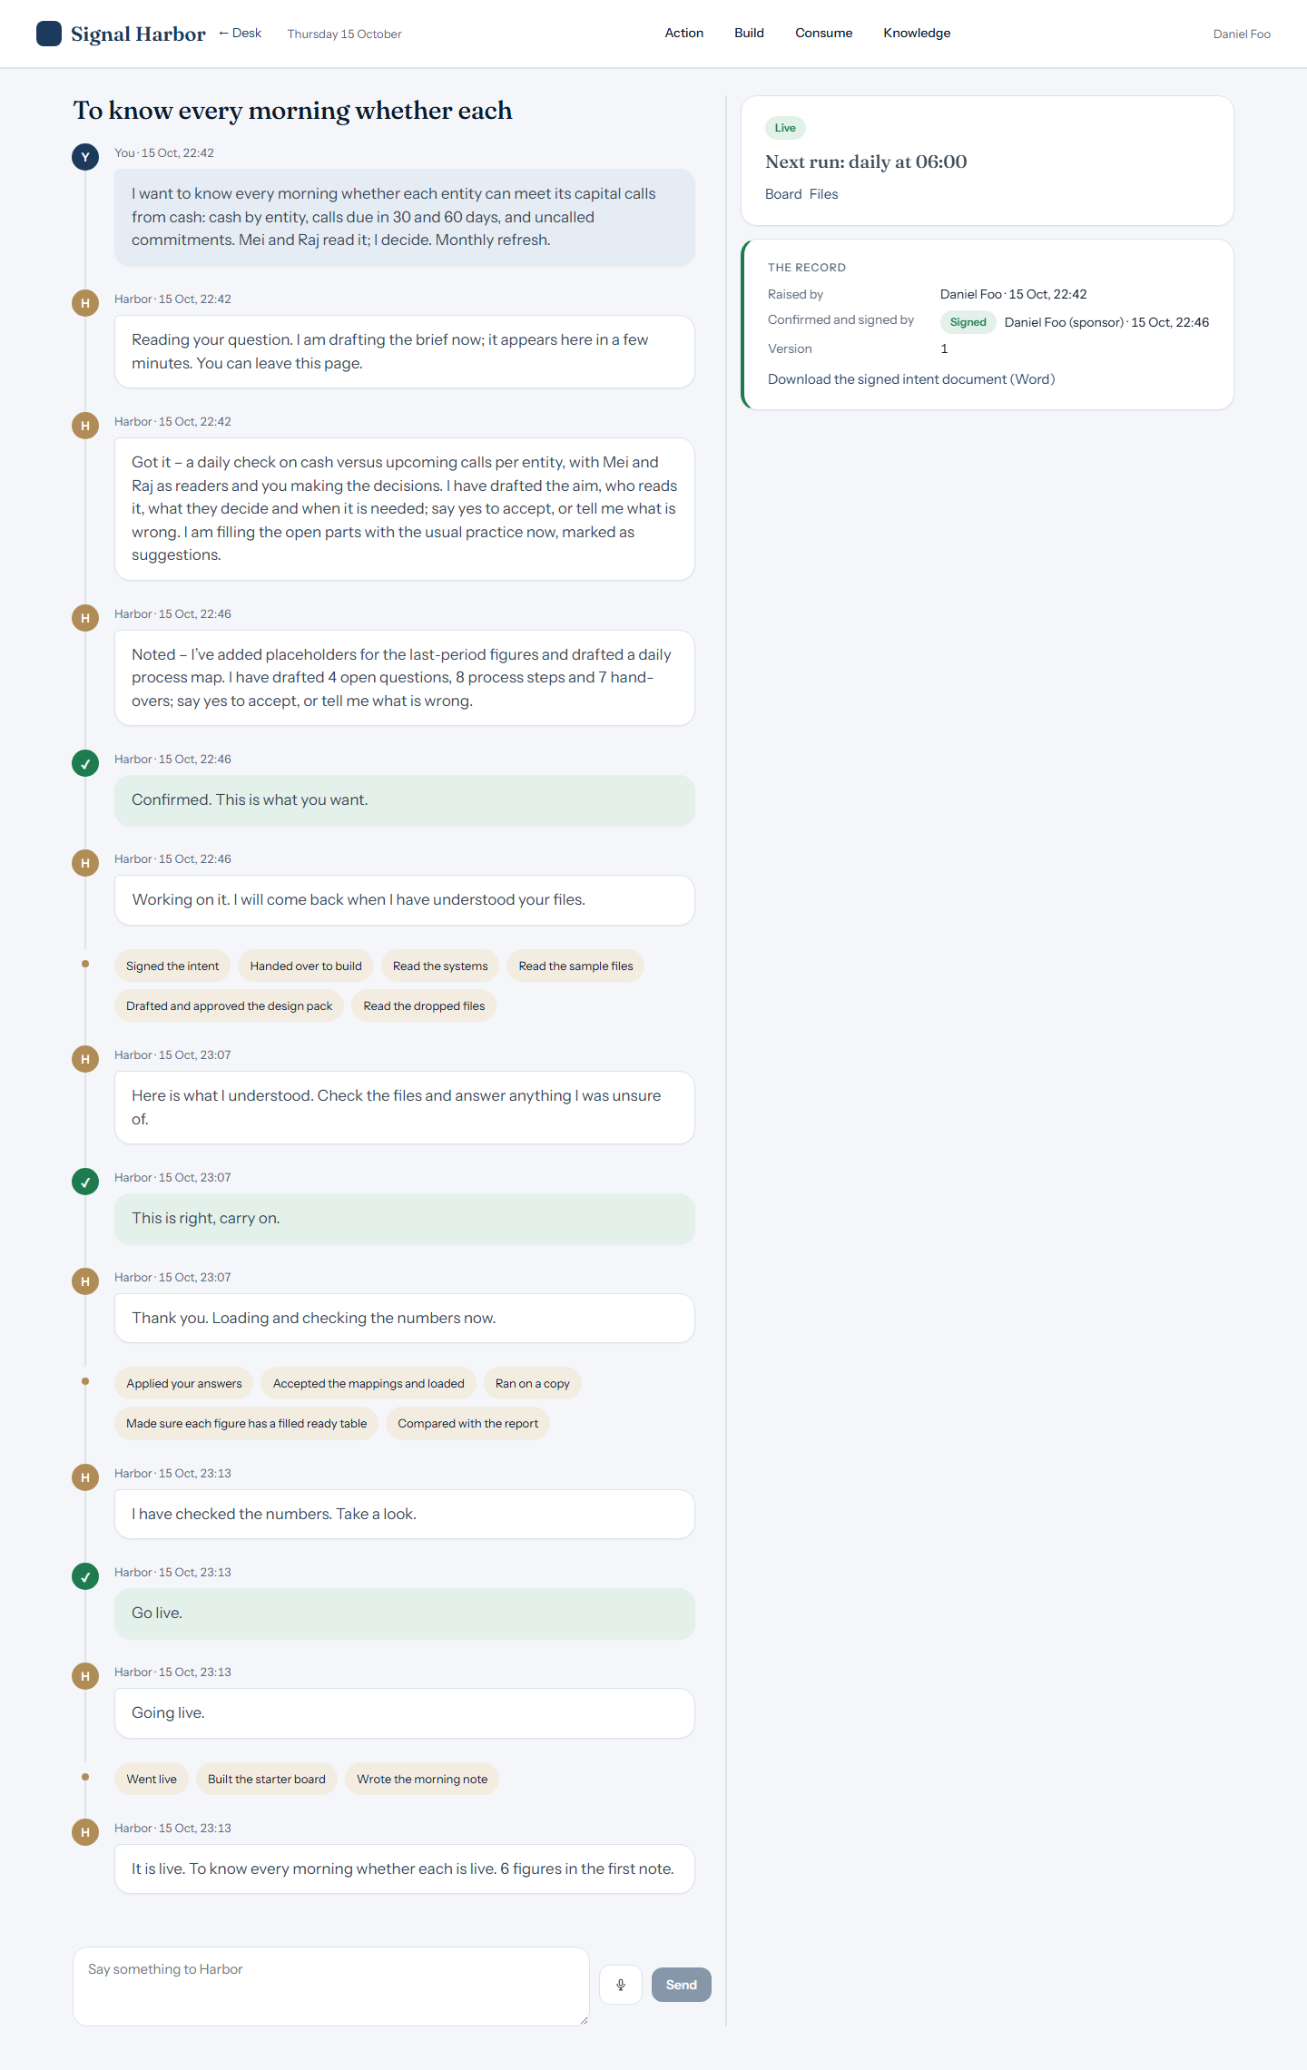
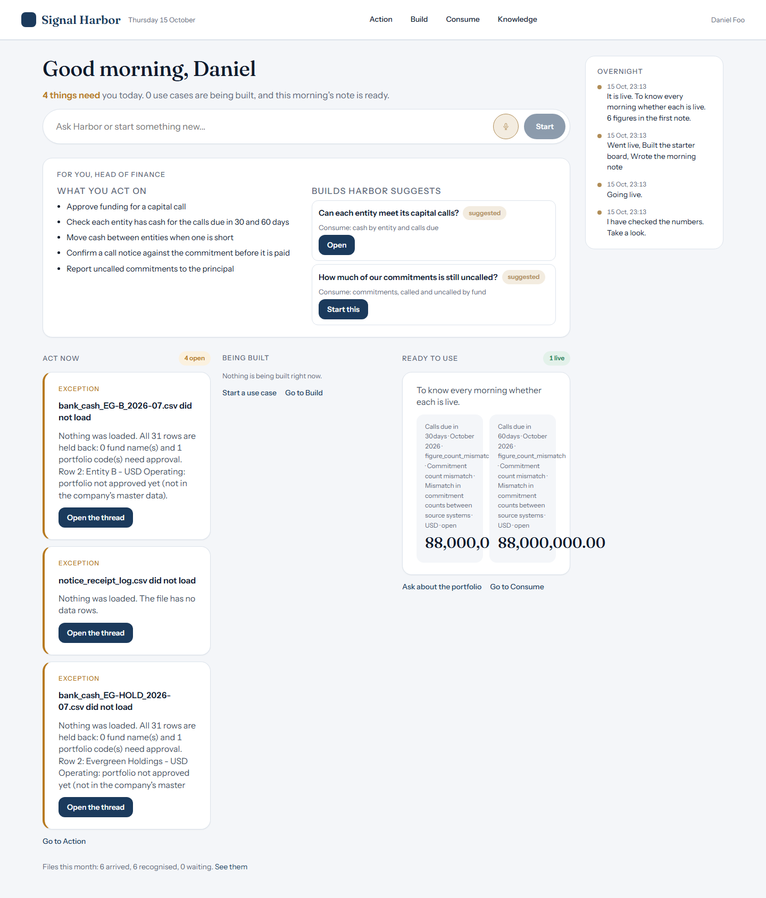
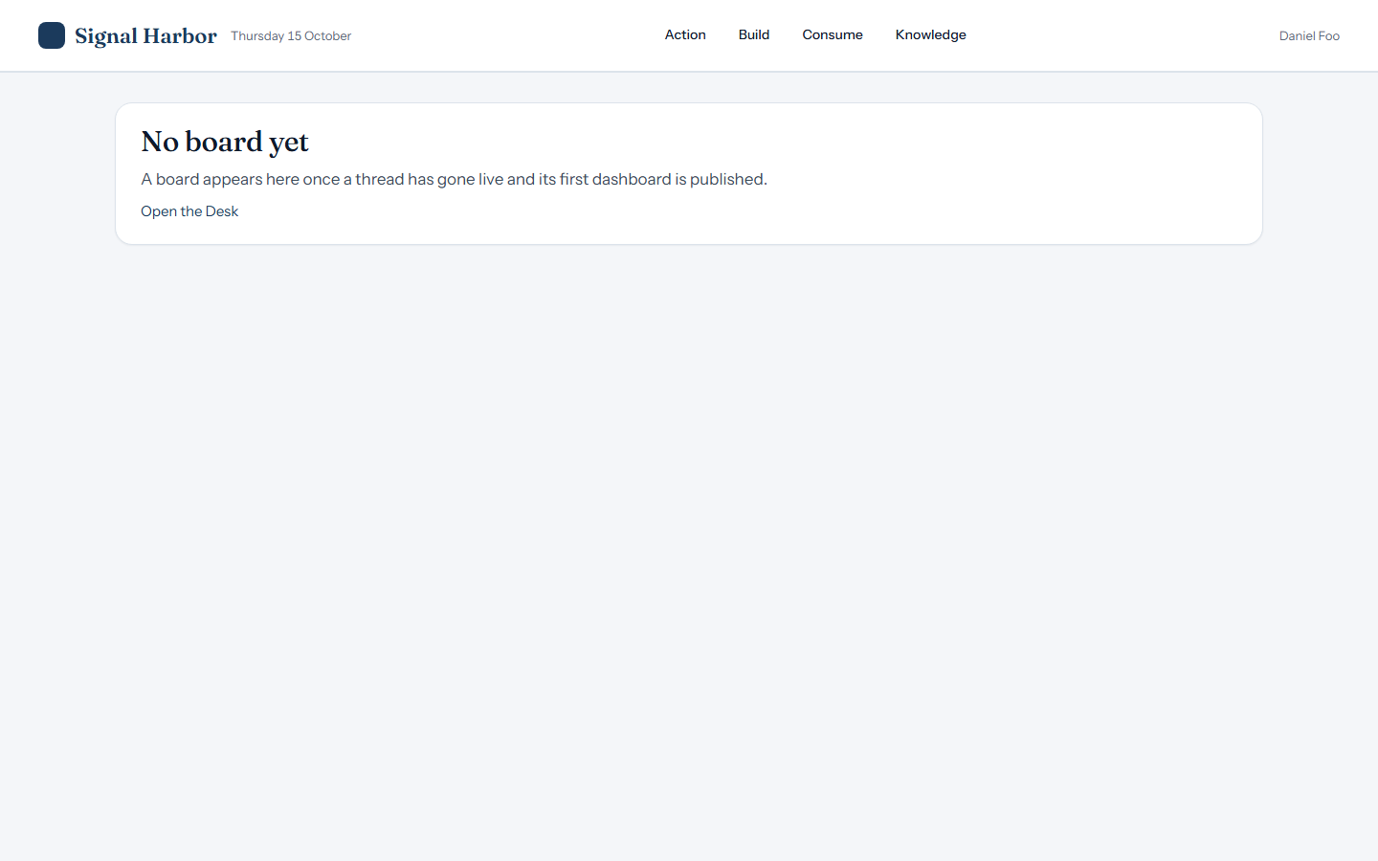
HEAD OF FINANCE
Daniel Foo
Live · answer correct
Asked: What is our cash by entity today?
Harbor answered: Cash by entity: Entity B 905,000.00; Evergreen Holdings 2,305,906.48; Evergreen Family Trust 1,252,492.34. Total 4,463,398.82 USD (as at 31 Jul 2026).
The build, live
Consume
Home

Slide 19
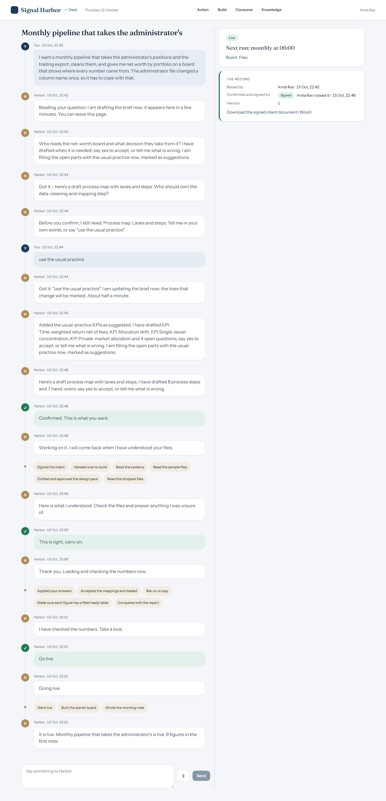
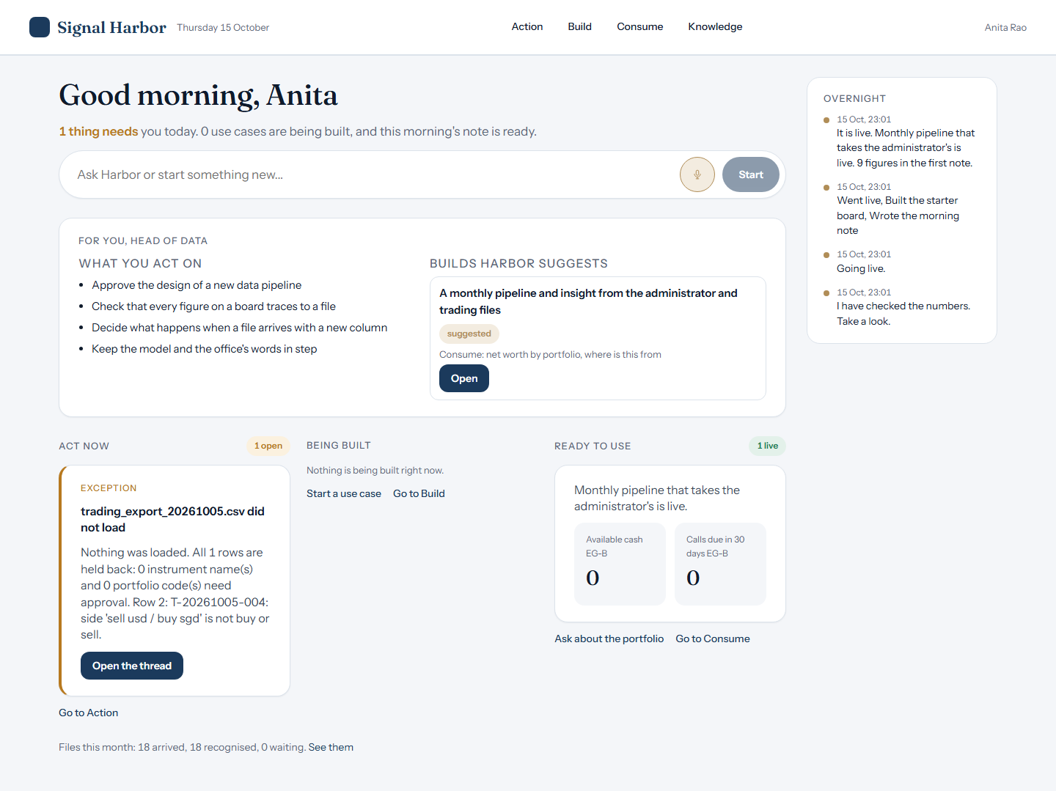
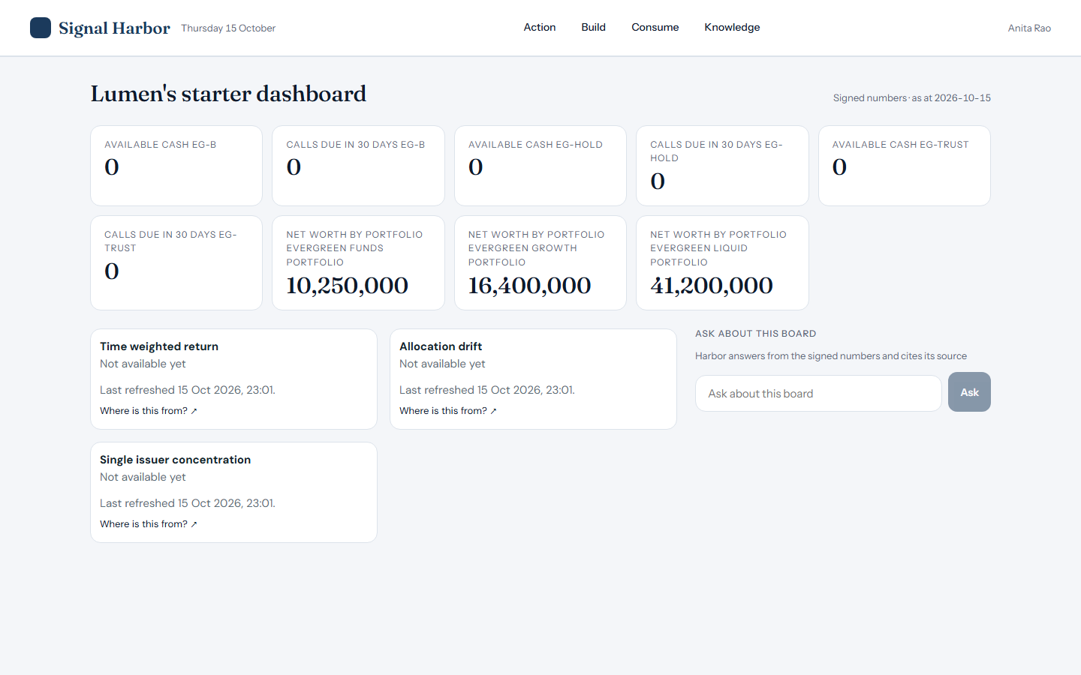
HEAD OF DATA
Anita Rao
Live · answer correct
Asked: What was the Evergreen Liquid portfolio worth at 30 September 2026?
Harbor answered: Net worth by portfolio for Evergreen Liquid portfolio in September 2026: 41,200,000.
The build, live
Consume
Home

Slide 20
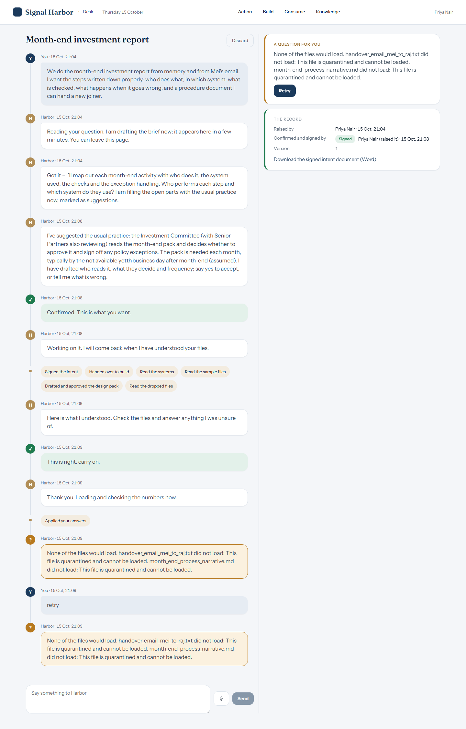
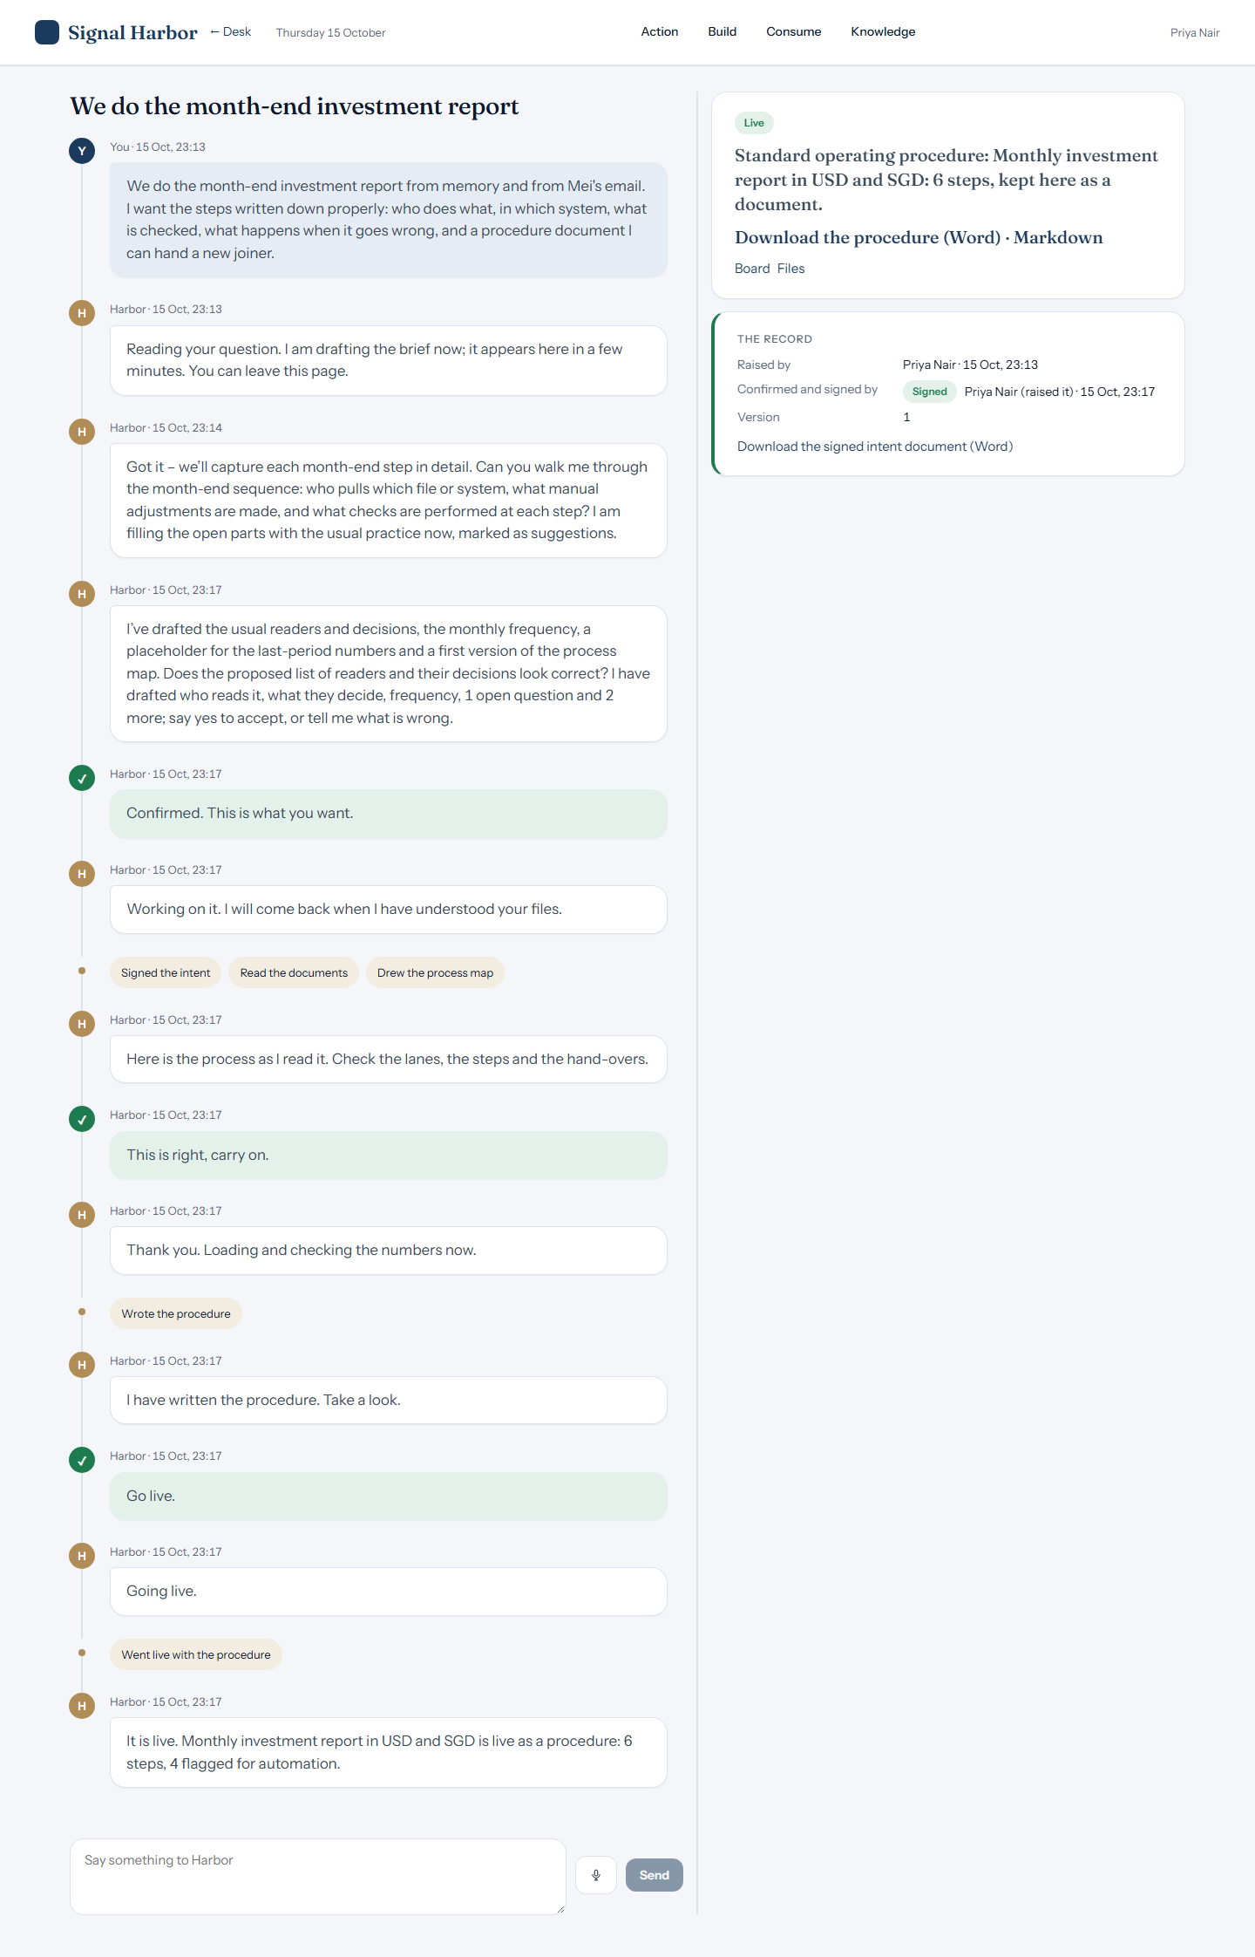

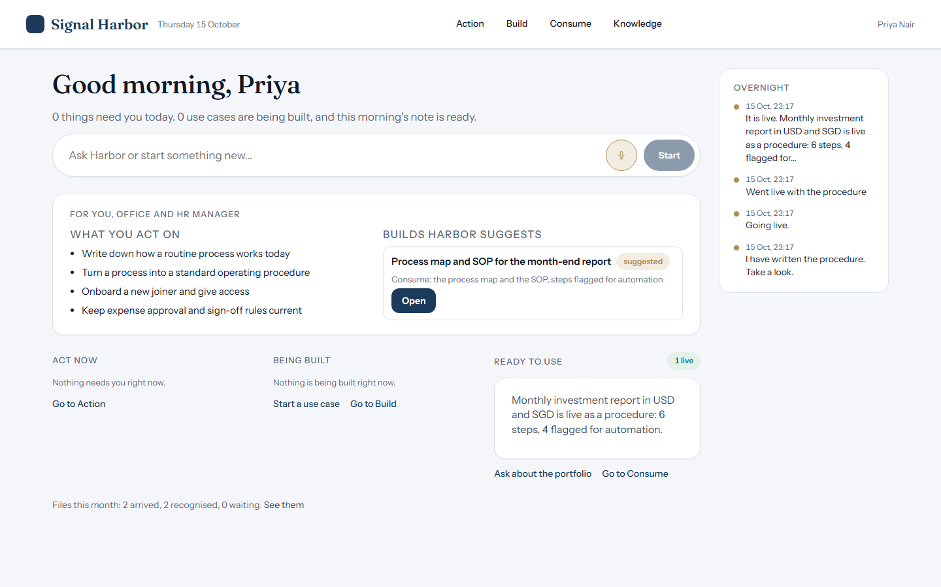
OFFICE AND HR
Priya Nair
Live · answer correct
Asked: What are the steps of the month-end report process and who does each one?
Harbor answered: Monthly investment report in USD and SGD has 6 steps: 1. Collect the exports (Mei Chen, File drop); 2. Check cash against the administrator (Mei Chen, Excel); 3. Collect manager statements (Mei Chen, Email); 4. Convert to SGD (Raj Patel, Excel); 5. Review and approve the report (Raj Patel, Report pack); 6. Read the report (Daniel Foo, Report pack).
Stuck
The build, live
Consume
Home

Slide 21
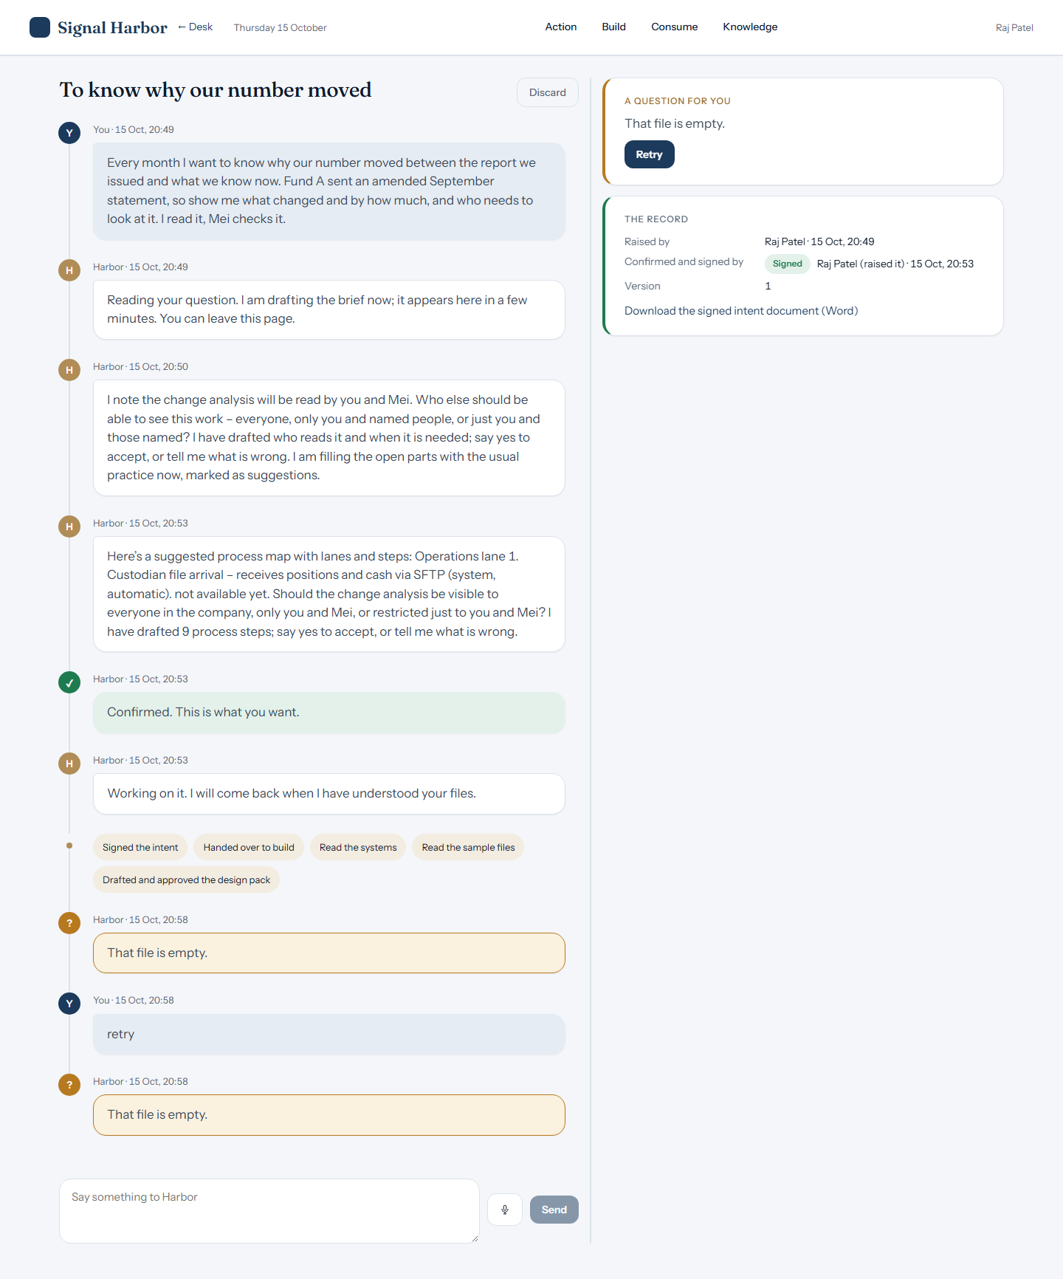
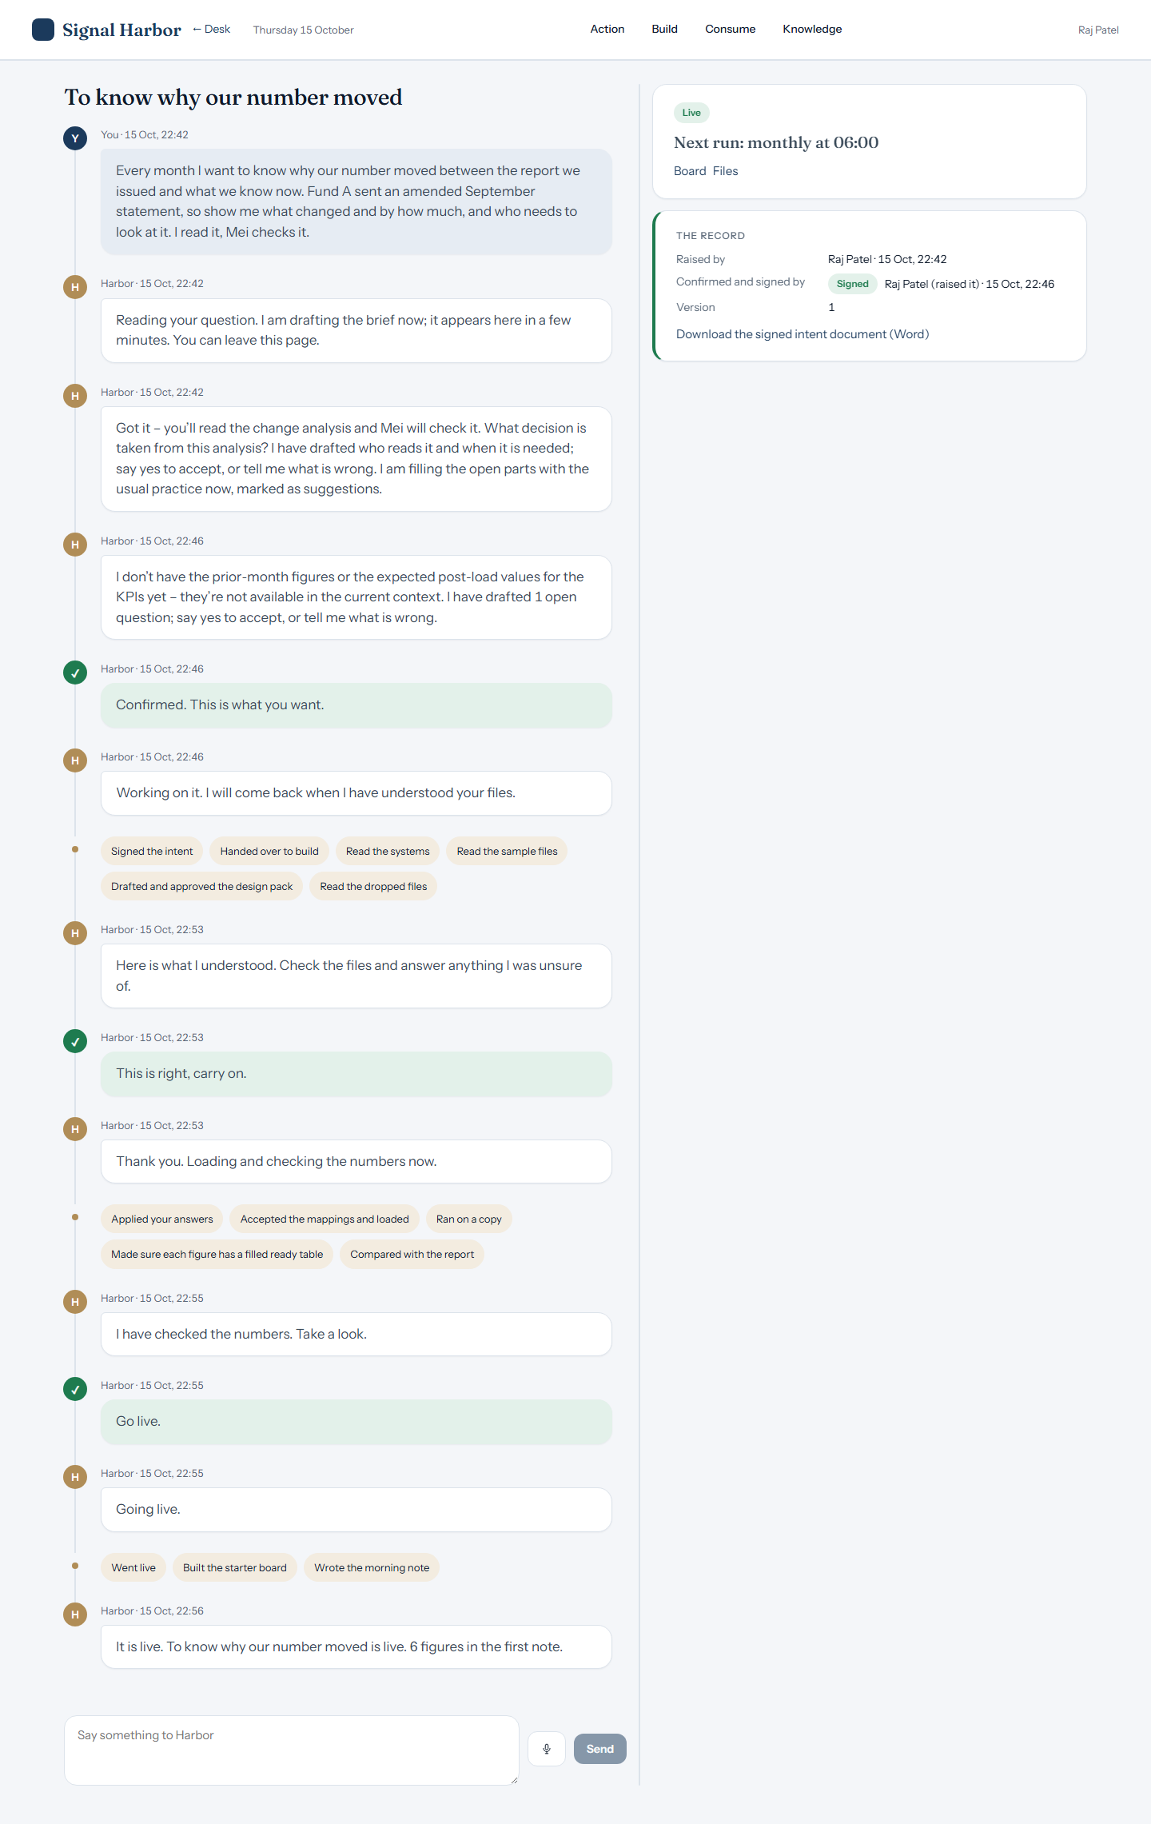
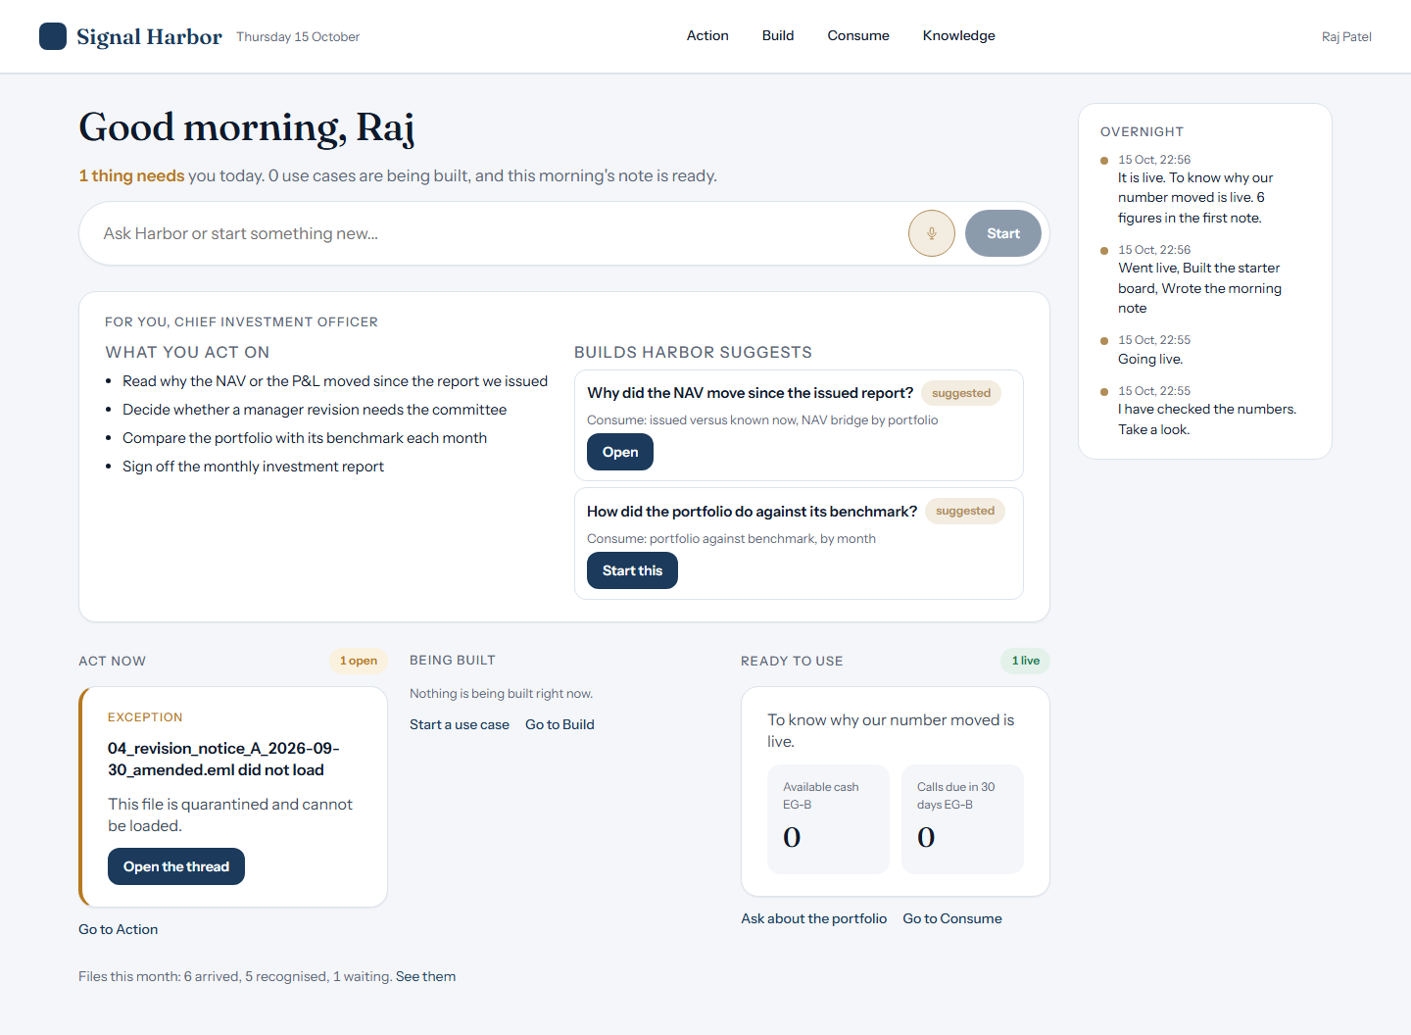
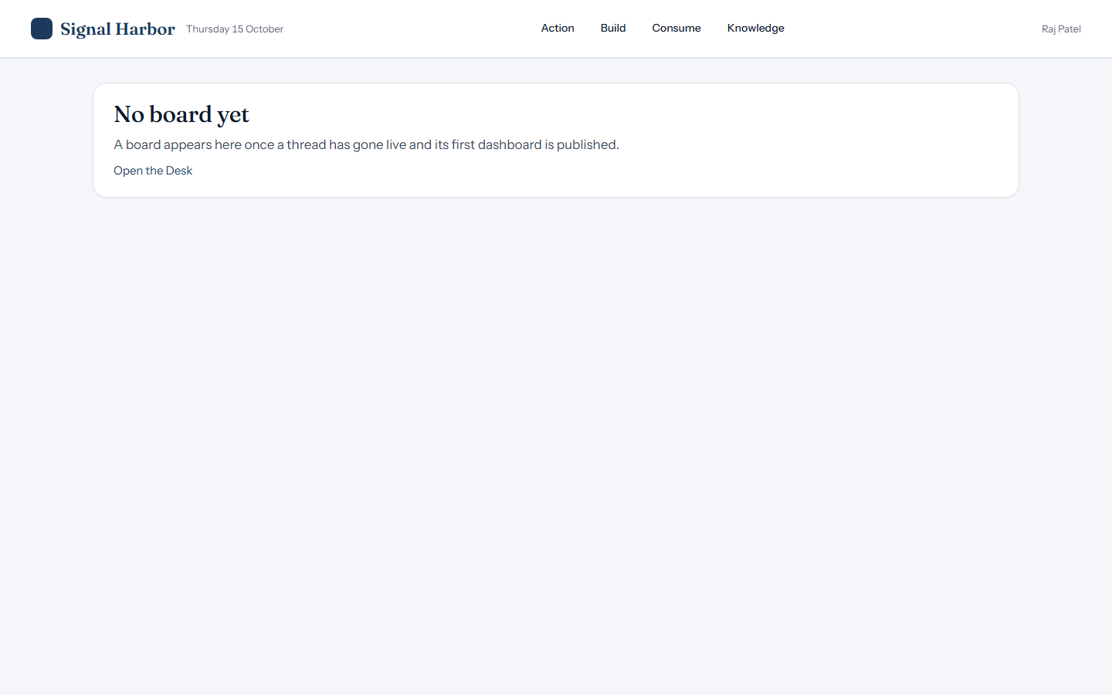
CIO
Raj Patel
Live · figure missing
Asked: Why did Fund A move since the issued September report?
Harbor answered: Not available yet: no ready table of this project holds that figure (its figures are Net worth, Time‑weighted return net of fees, Allocation drift, Single‑issuer concentration). Not loaded: 04_revision_notice_A_2026-09-30_amended.eml: This file is quarantined and cannot be loaded.
Stuck
The build, live
Consume
Home

Slide 22
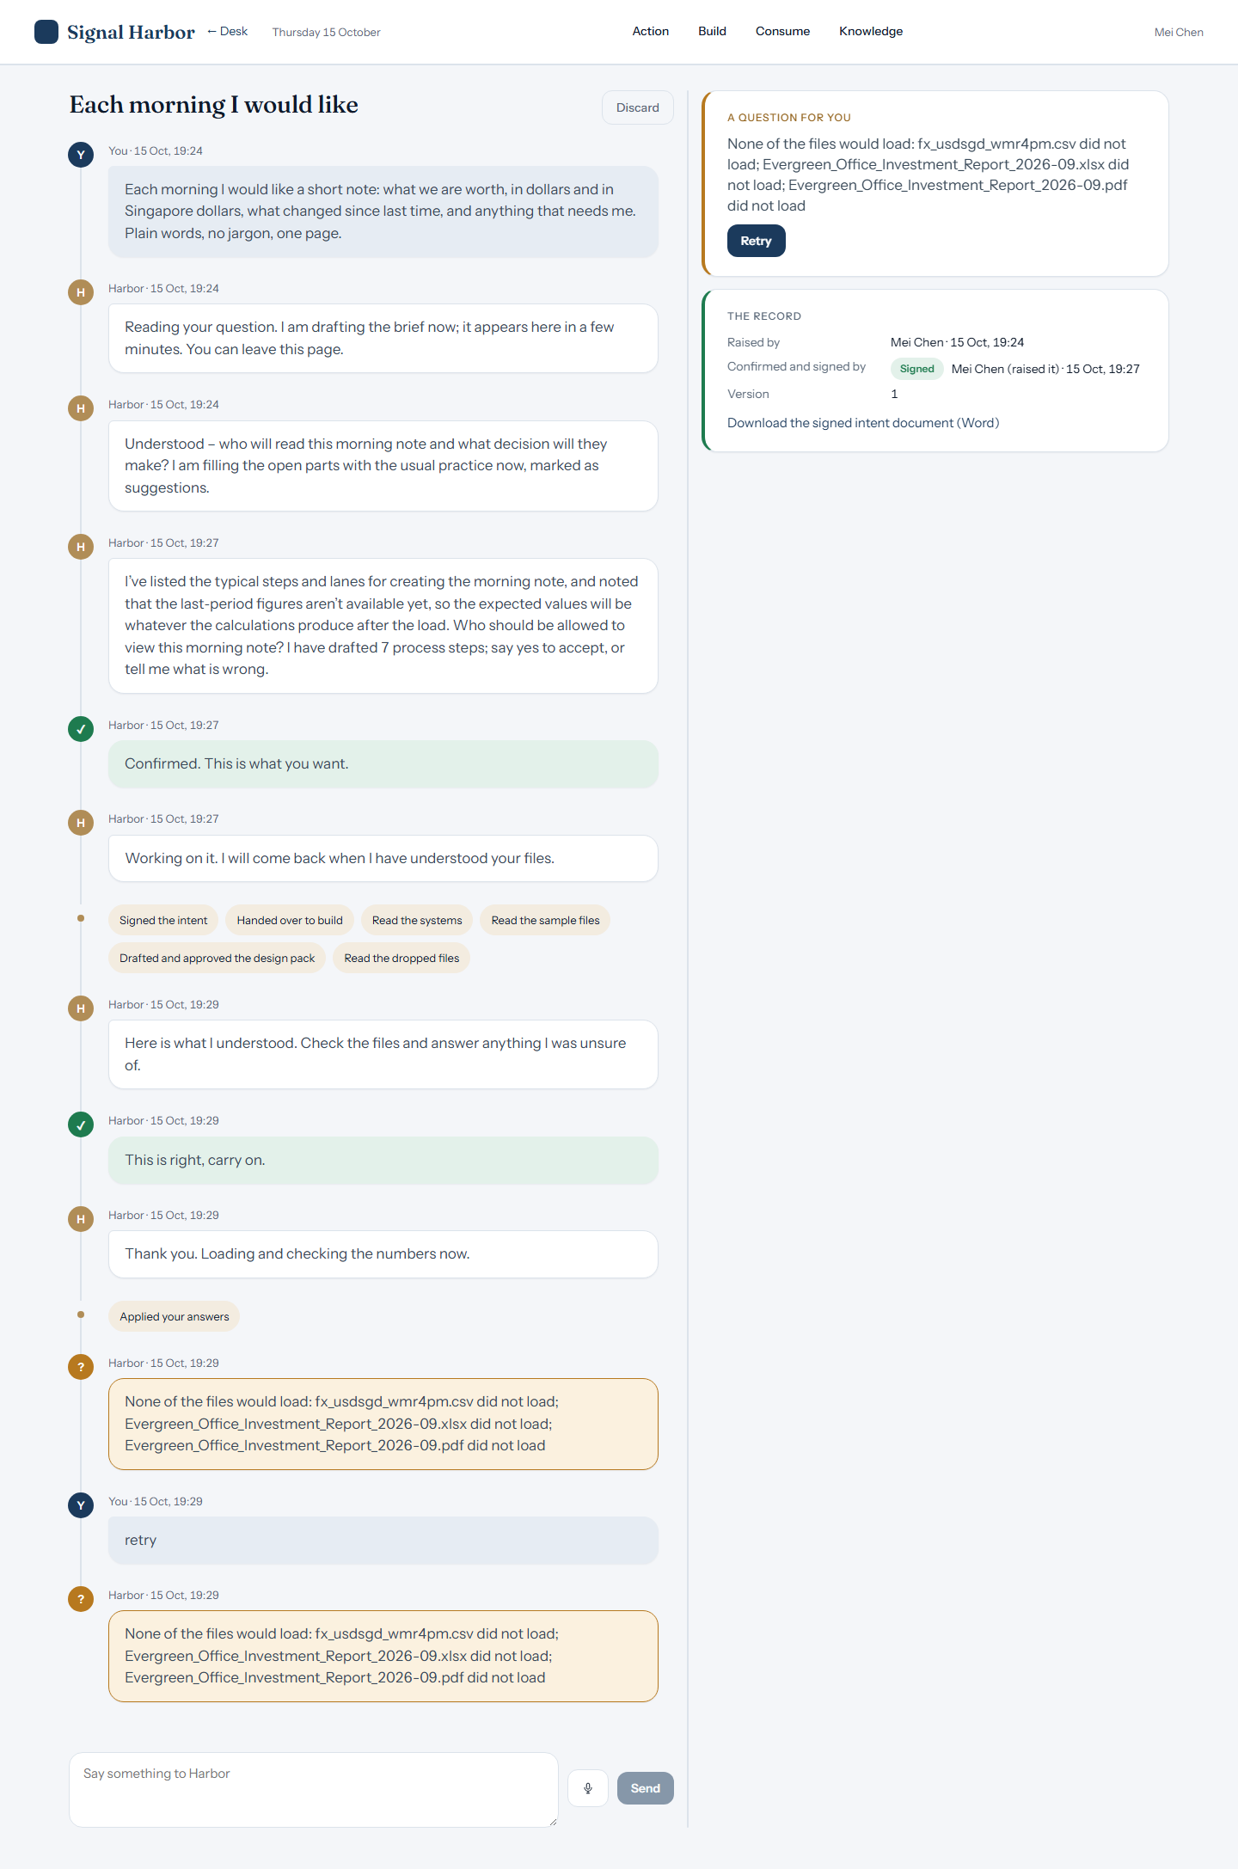
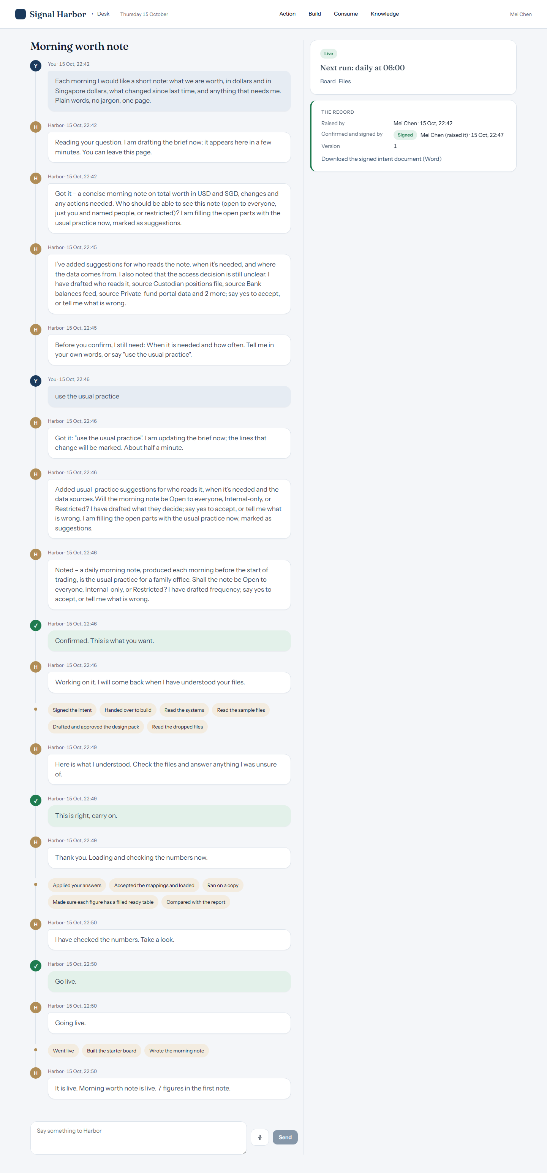

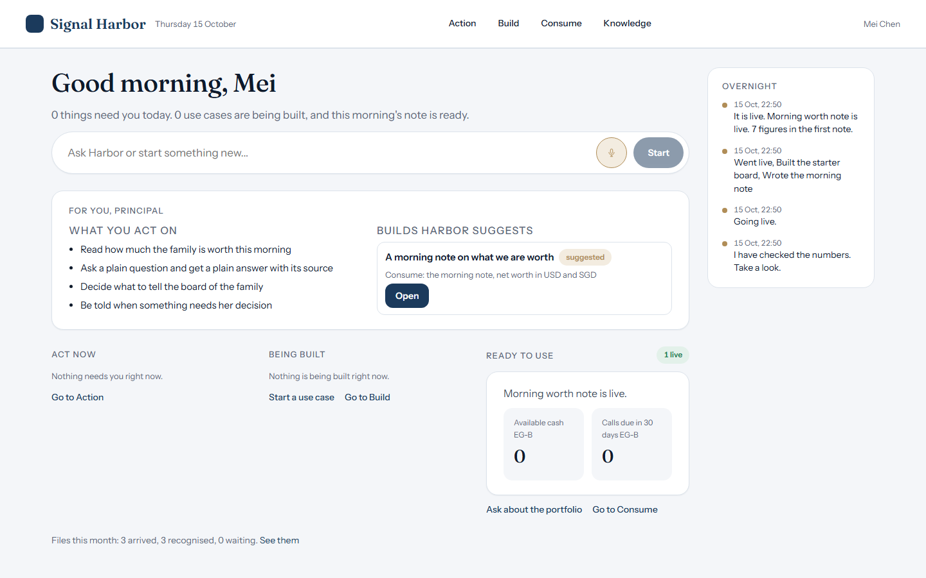
PRINCIPAL
Mei Chen
Live · figure missing
Asked: What are we worth in the latest report?
Harbor answered: Net worth USD for USD in October 2026: 44,000,000.
Stuck
The build, live
Consume
Home

Slide 23
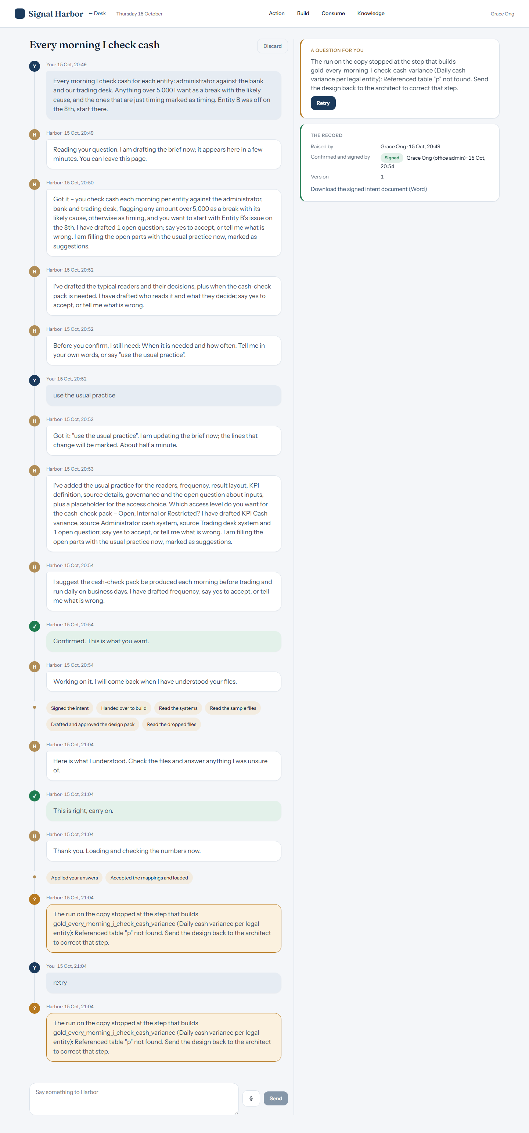
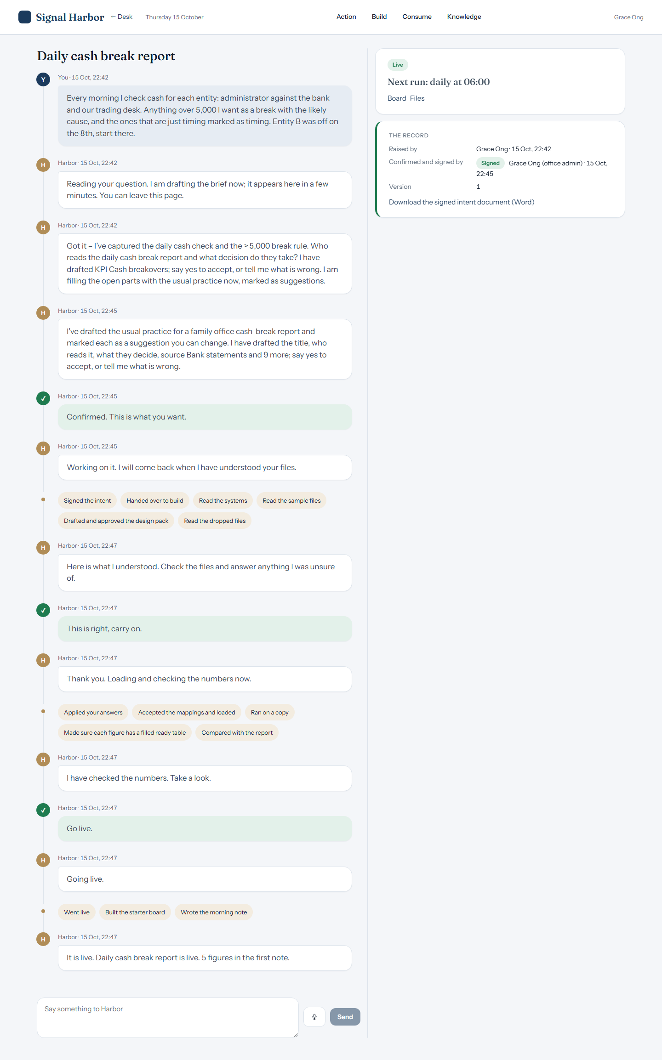
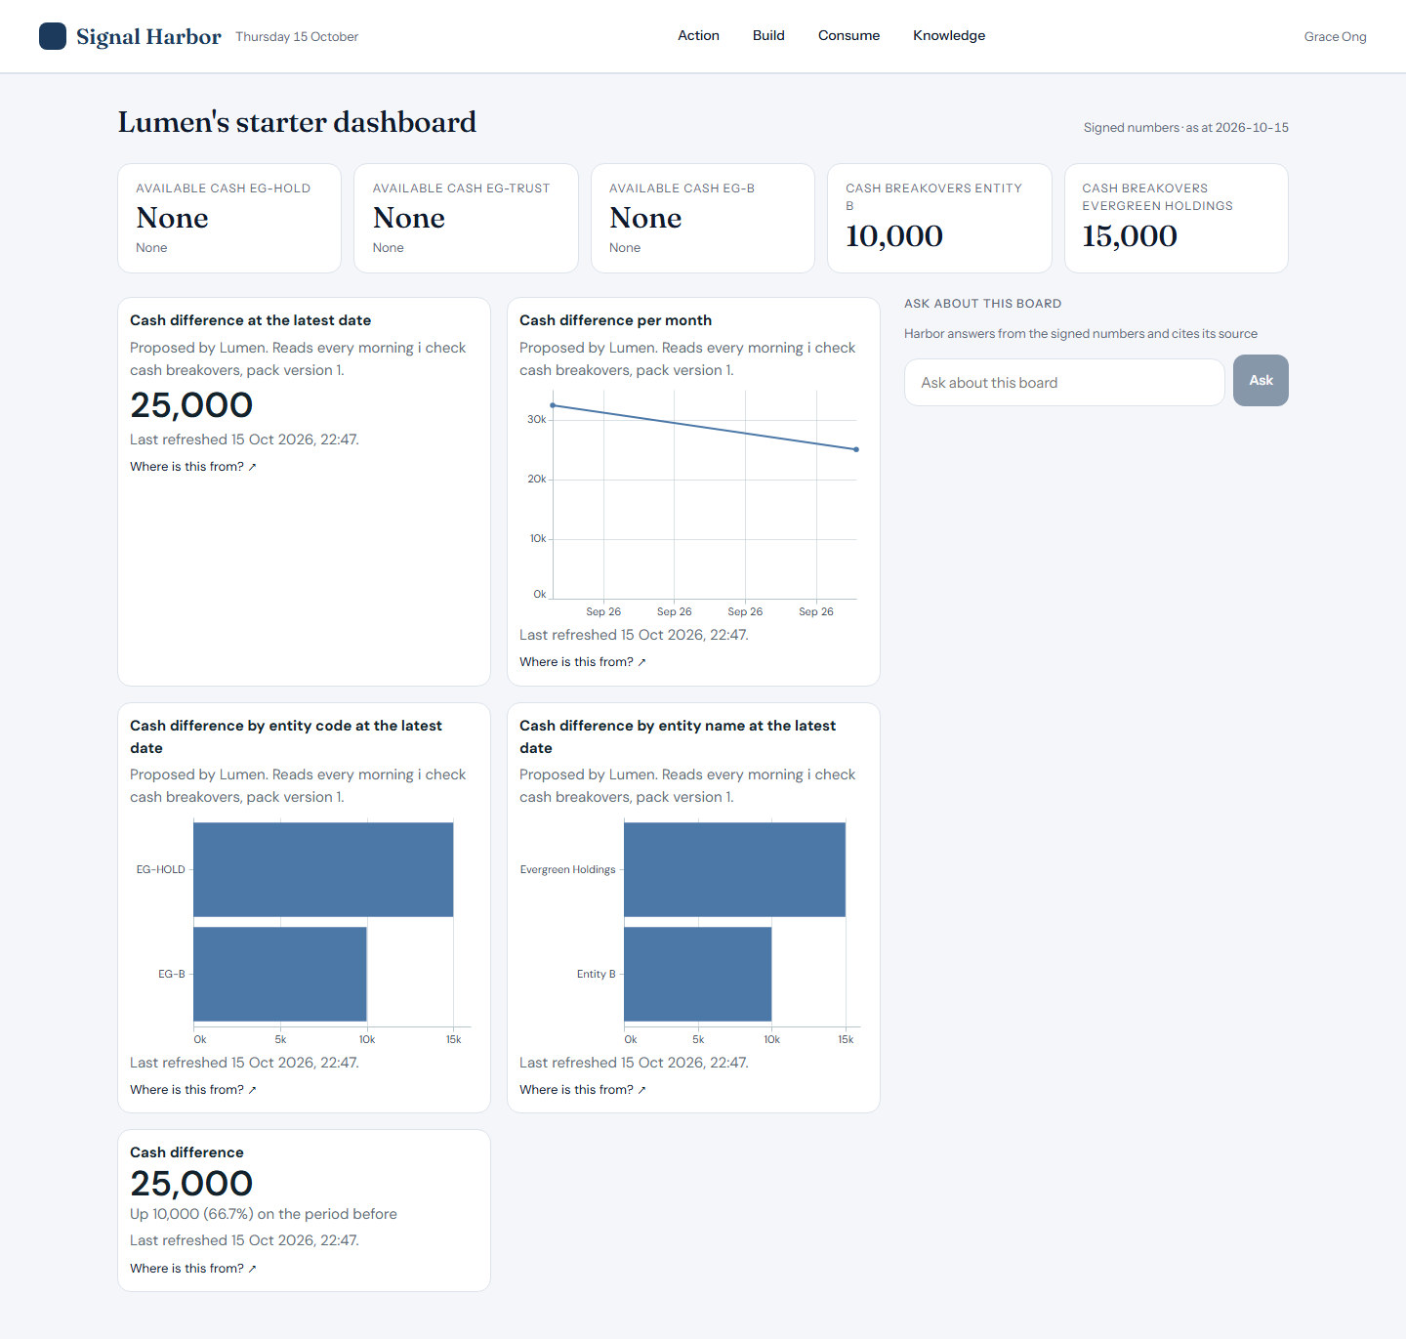
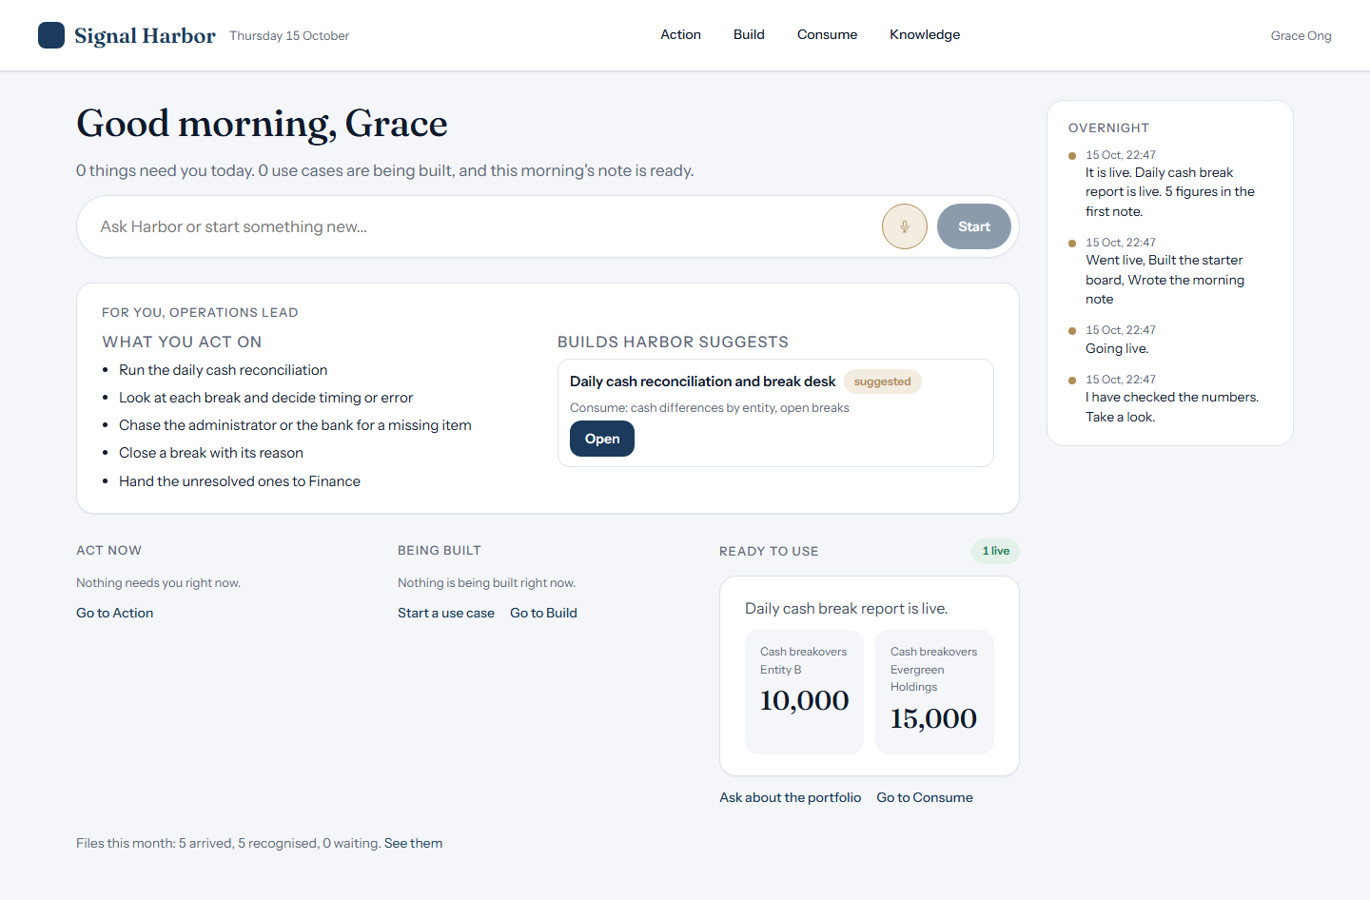
OPERATIONS LEAD
Grace Ong
Live · figure missing
Asked: Which entity has a cash break on 8 October and by how much?
Harbor answered: Not available yet: Cash breakovers has no figure for that day.
Stuck
The build, live
Consume
Home

Slide 24
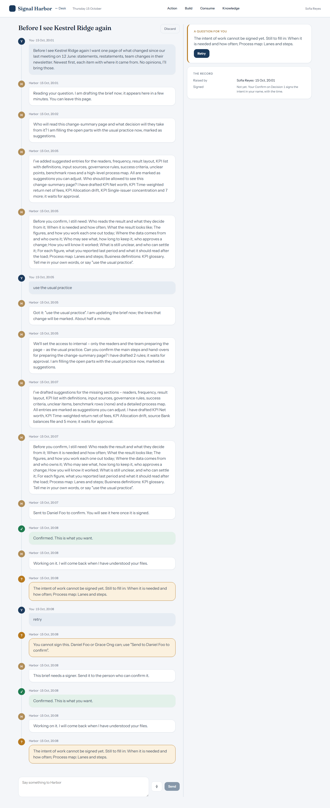
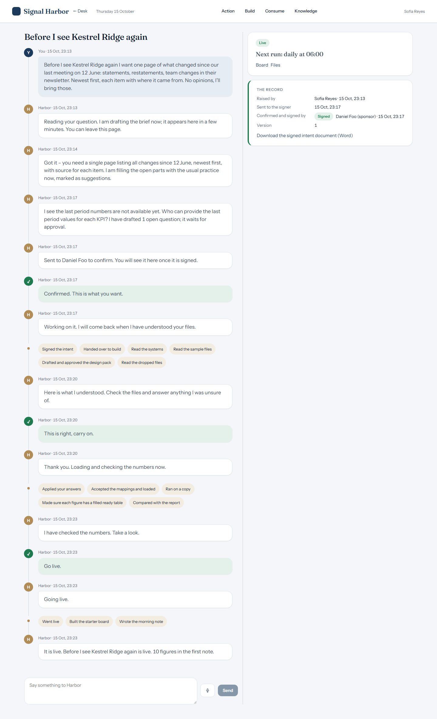
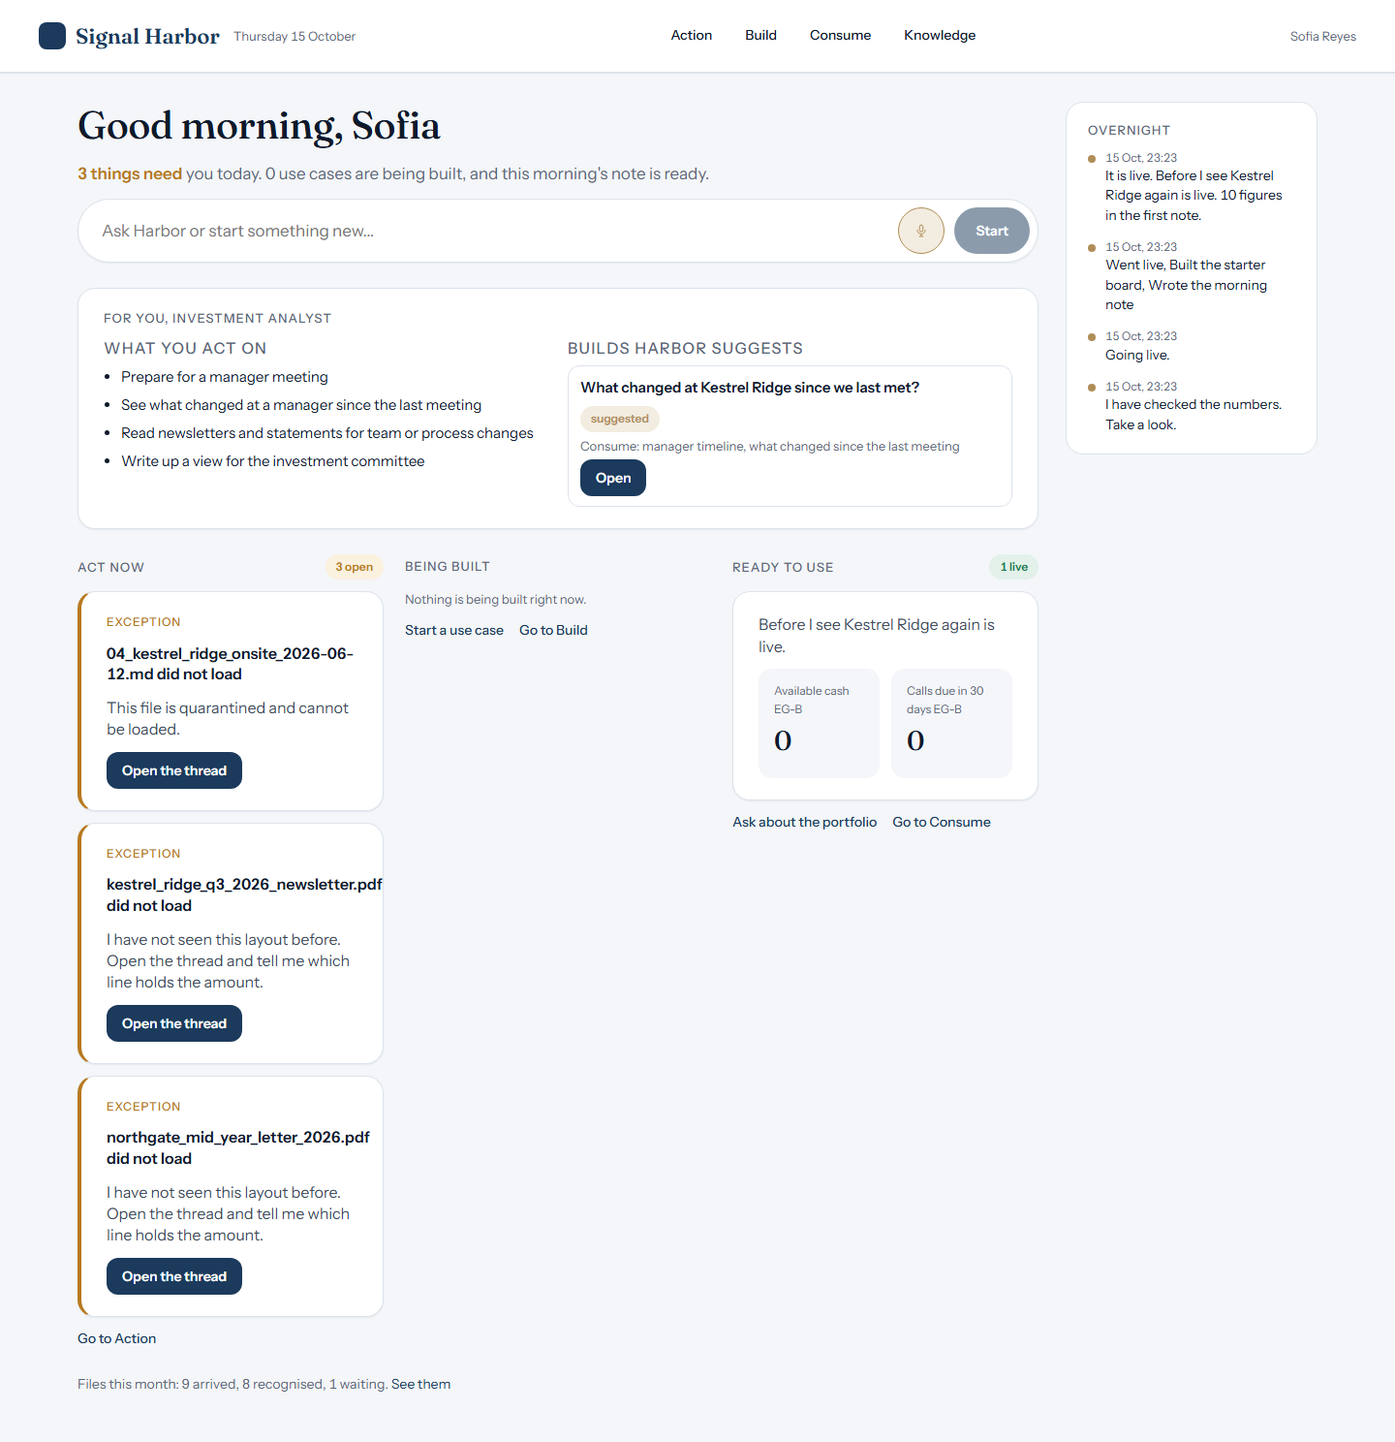

INVESTMENT ANALYST
Sofia Reyes
Live · figure missing
Asked: What changed at Kestrel Ridge since the last meeting?
Harbor answered: Not available yet: no ready table of this project holds that figure (its figures are Net worth, Time‑weighted return (net of fees), Allocation drift, Single‑issuer concentration, Cash drag). Not loaded: 04_kestrel_ridge_onsite_2026-06-12.md: This file is quarantined and cannot be loaded. | kestrel_ridge_q3_2026_newsletter.pdf: I have not seen this layout before. Open the thread and tell me which line holds the amount…
Stuck
The build, live
Consume
Home

Slide 25
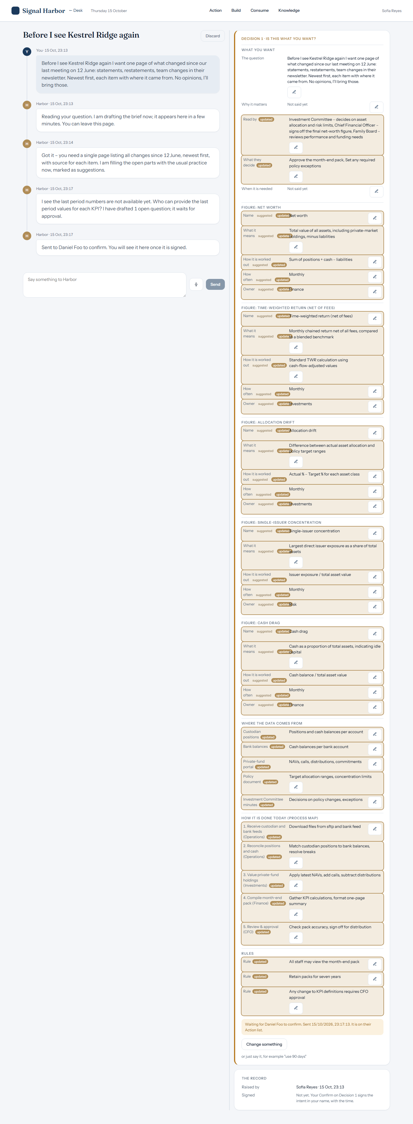
SOFIA REYES
Sent to signer

Slide 26
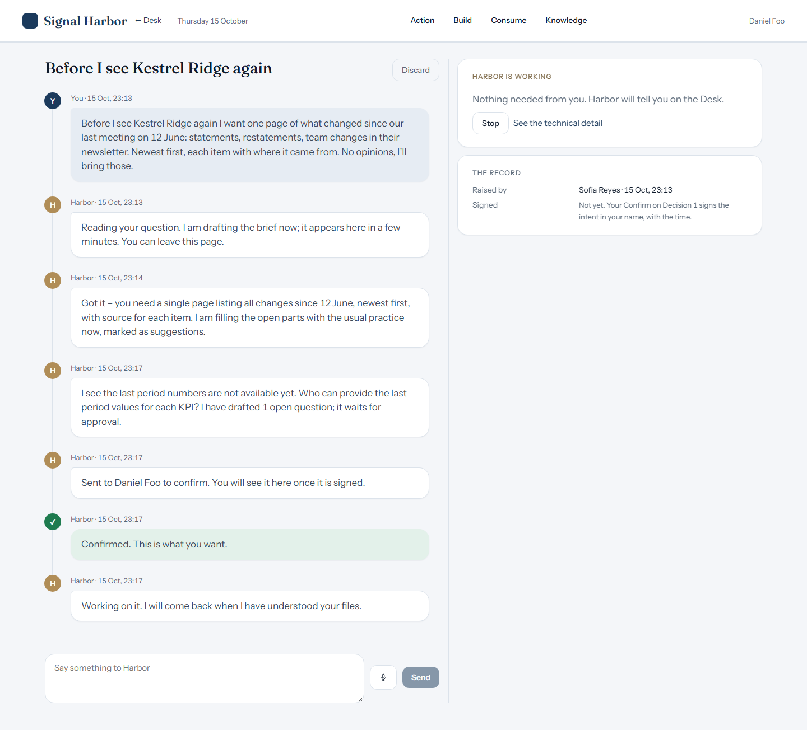
SOFIA REYES
Signed record

Slide 27
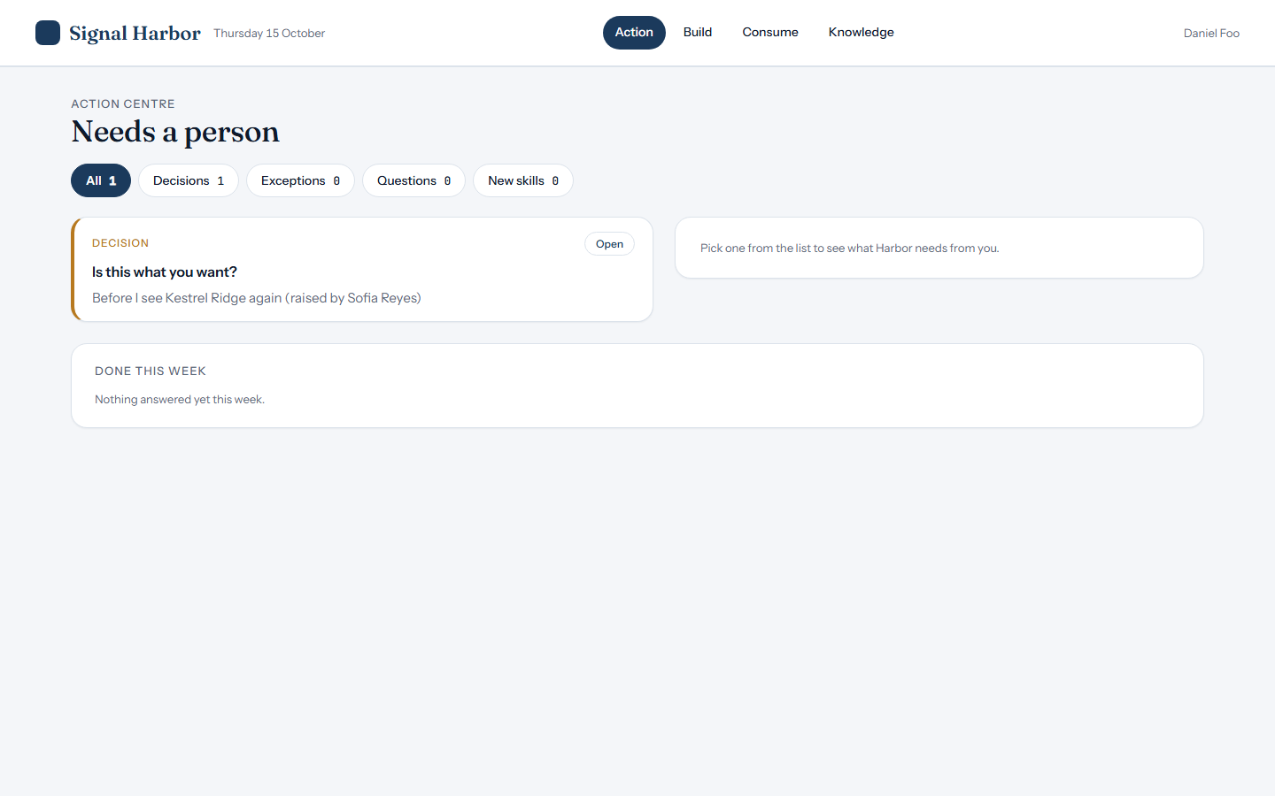
SOFIA REYES
Signer's Action

Slide 28
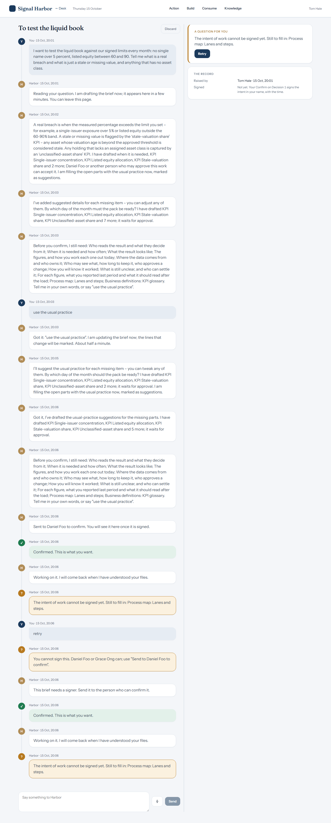
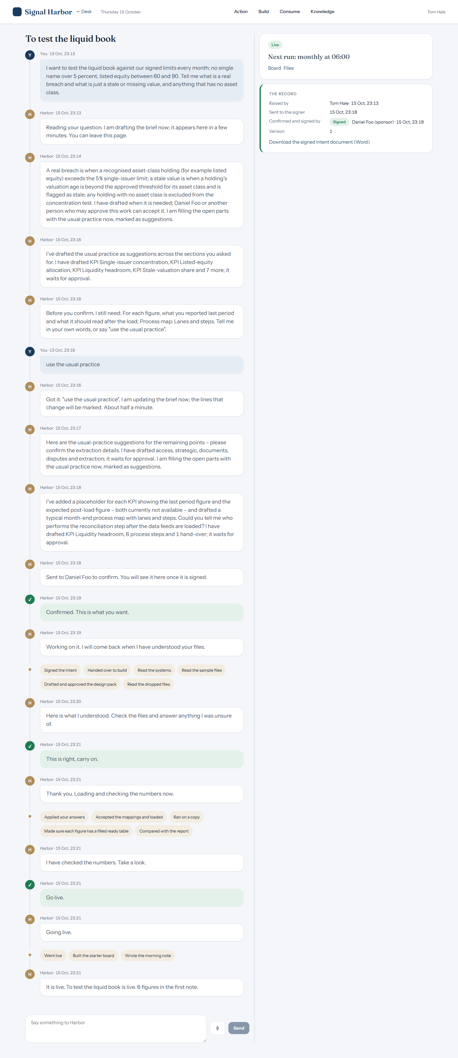
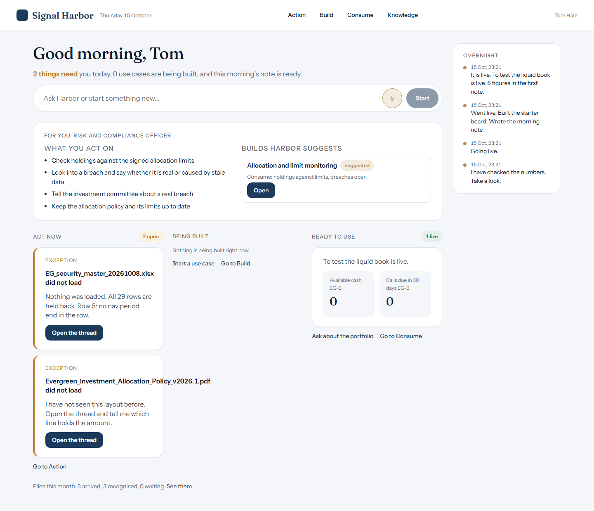

RISK AND COMPLIANCE
Tom Hale
Live · figure missing
Asked: Which holding is over its single-name limit?
Harbor answered: Not available yet: Single‑issuer concentration has no figure in the ready tables. metrics has no rows: it reads silver liquidity headroom, silver single issuer concentration, which hold nothing yet.
Stuck
The build, live
Consume
Home

Slide 29
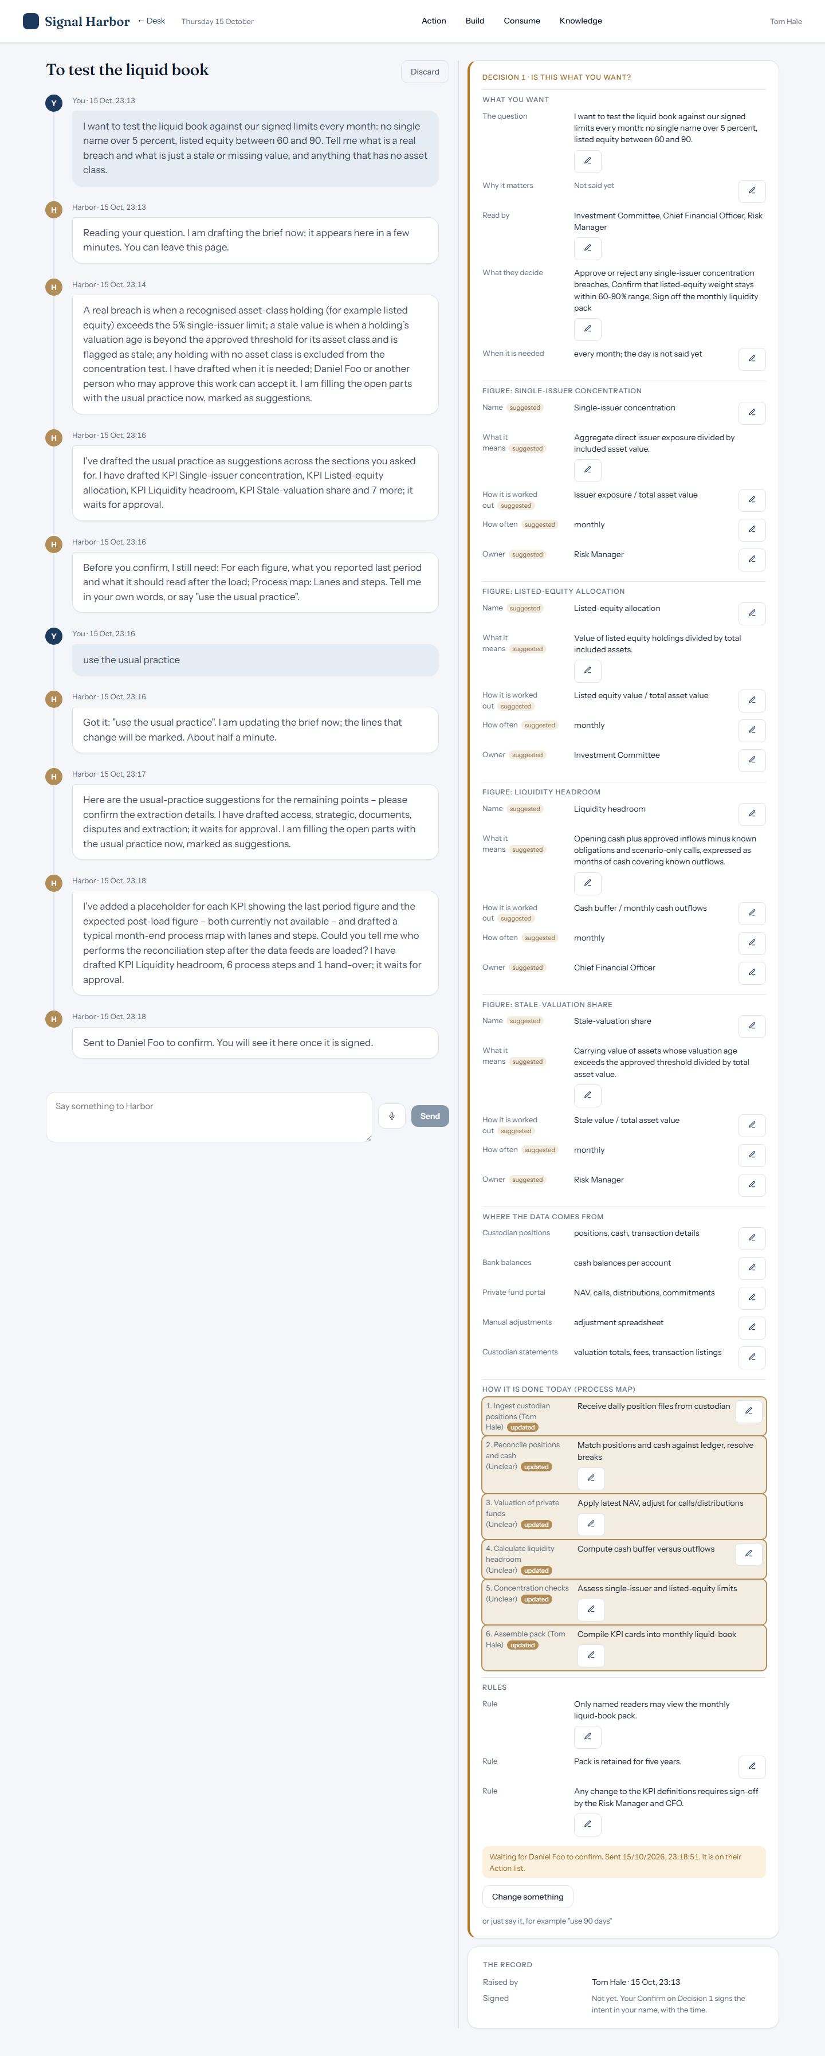
TOM HALE
Sent to signer

Slide 30
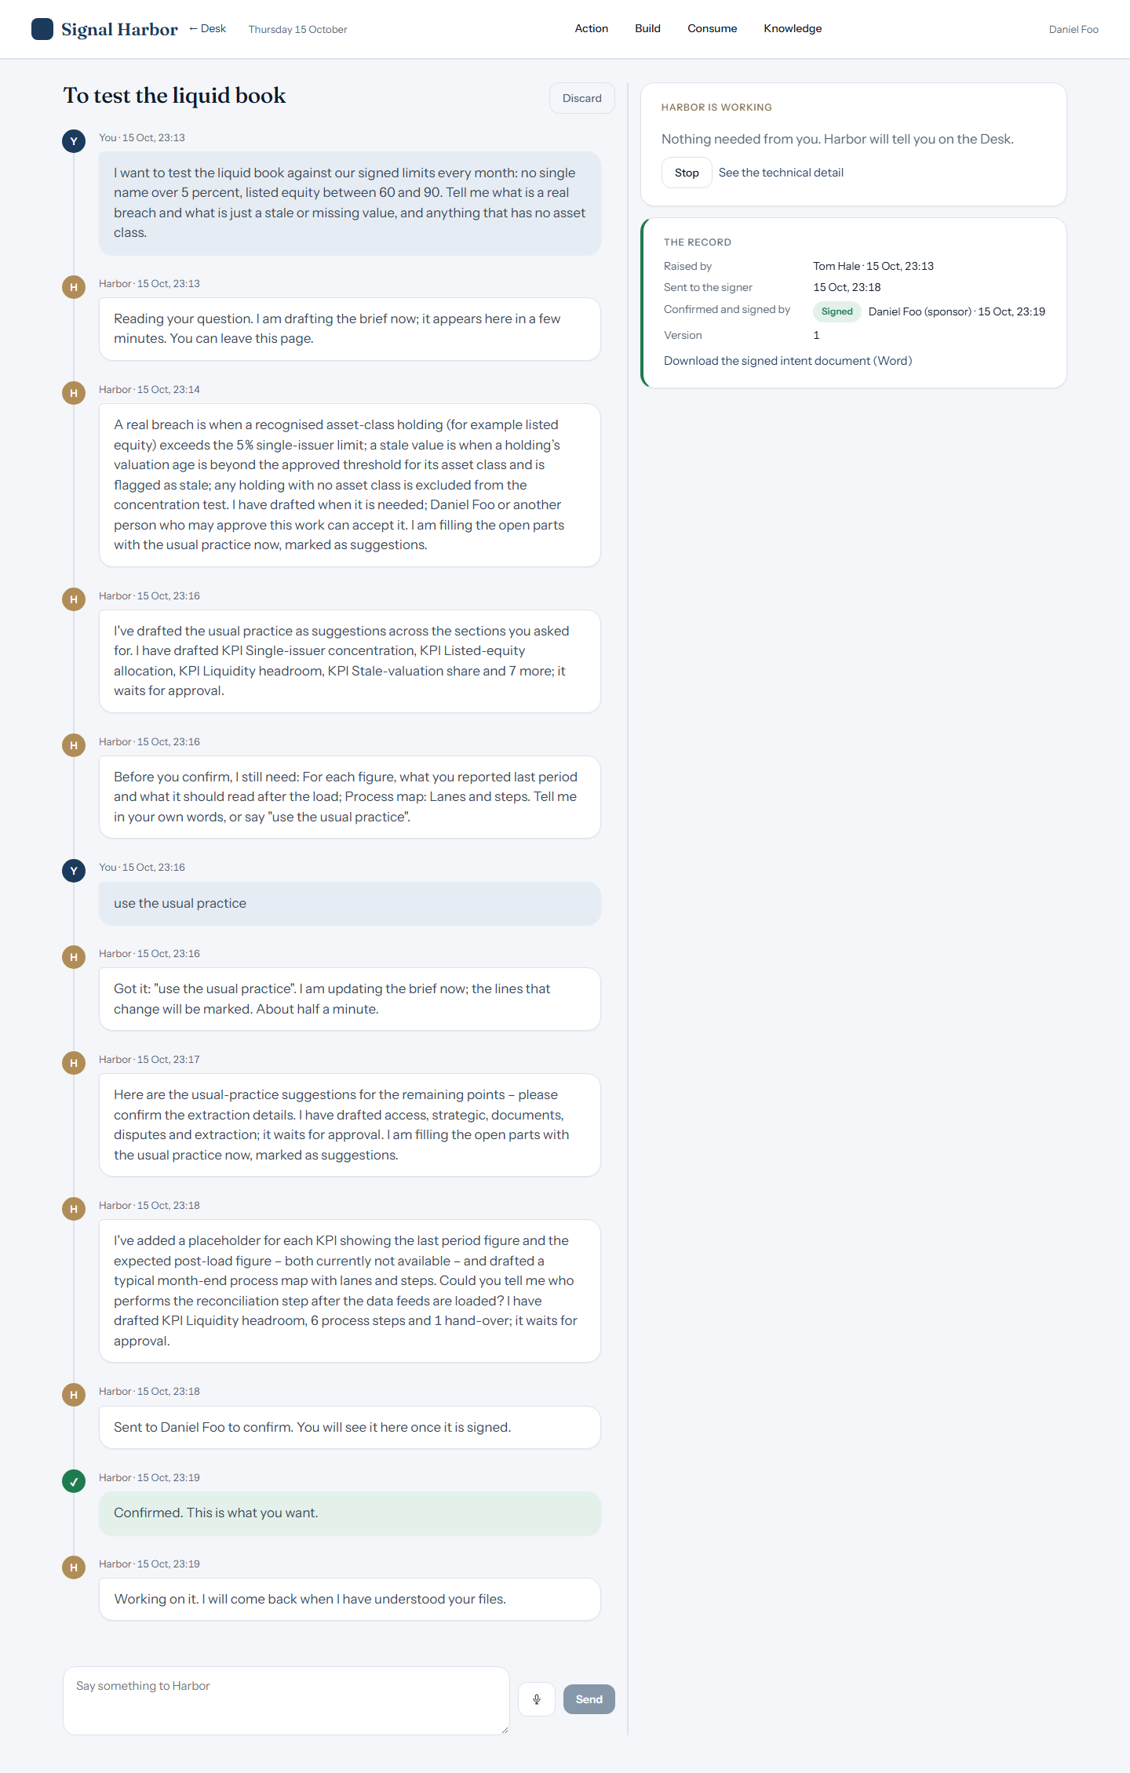
TOM HALE
Signed record

Slide 31

TOM HALE
Signer's Action

Slide 32
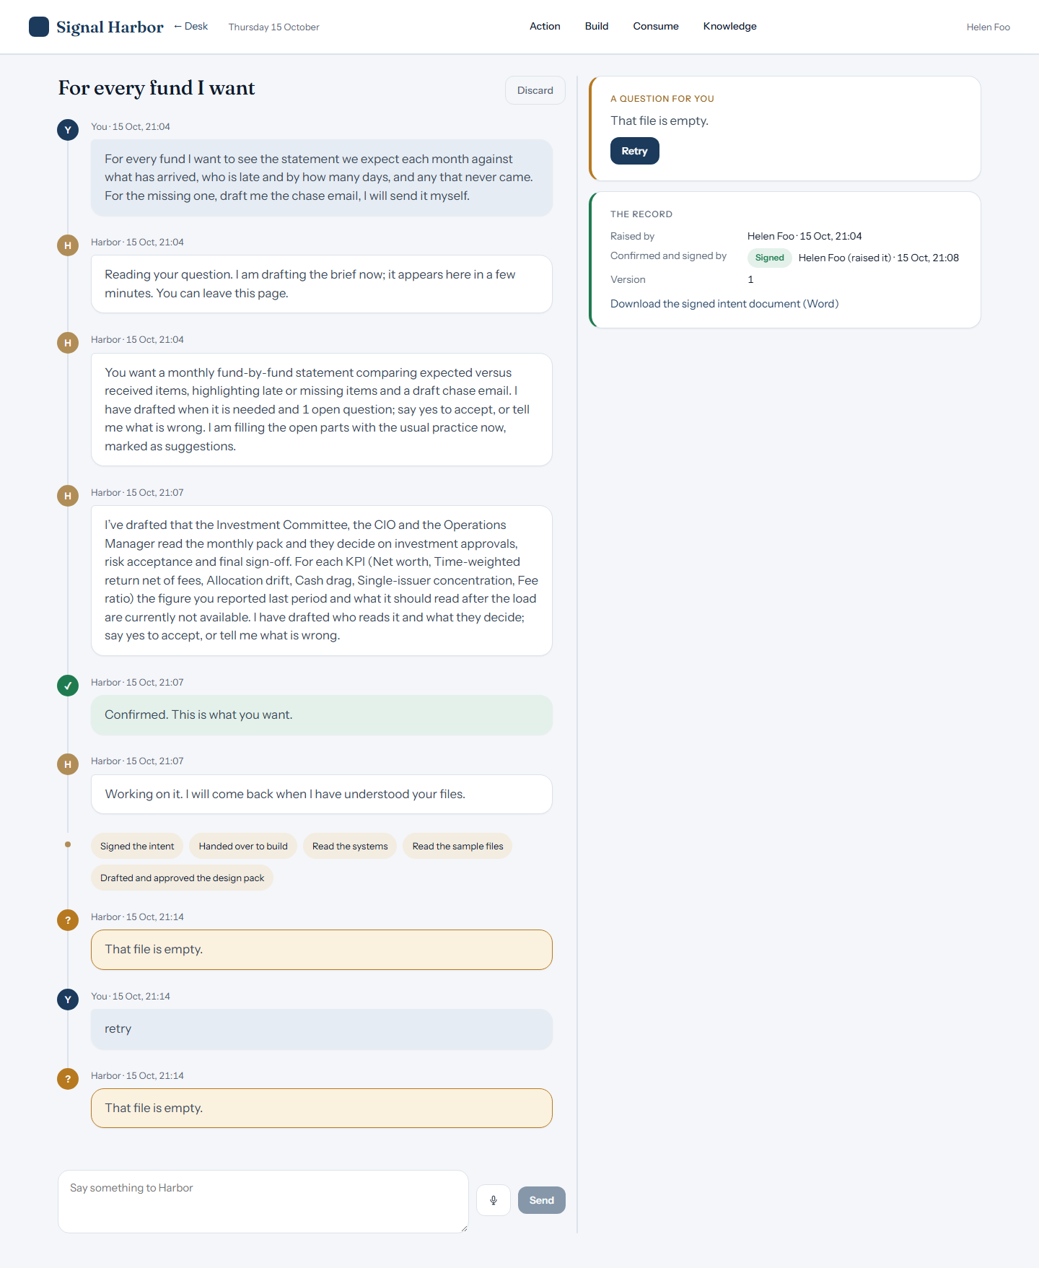
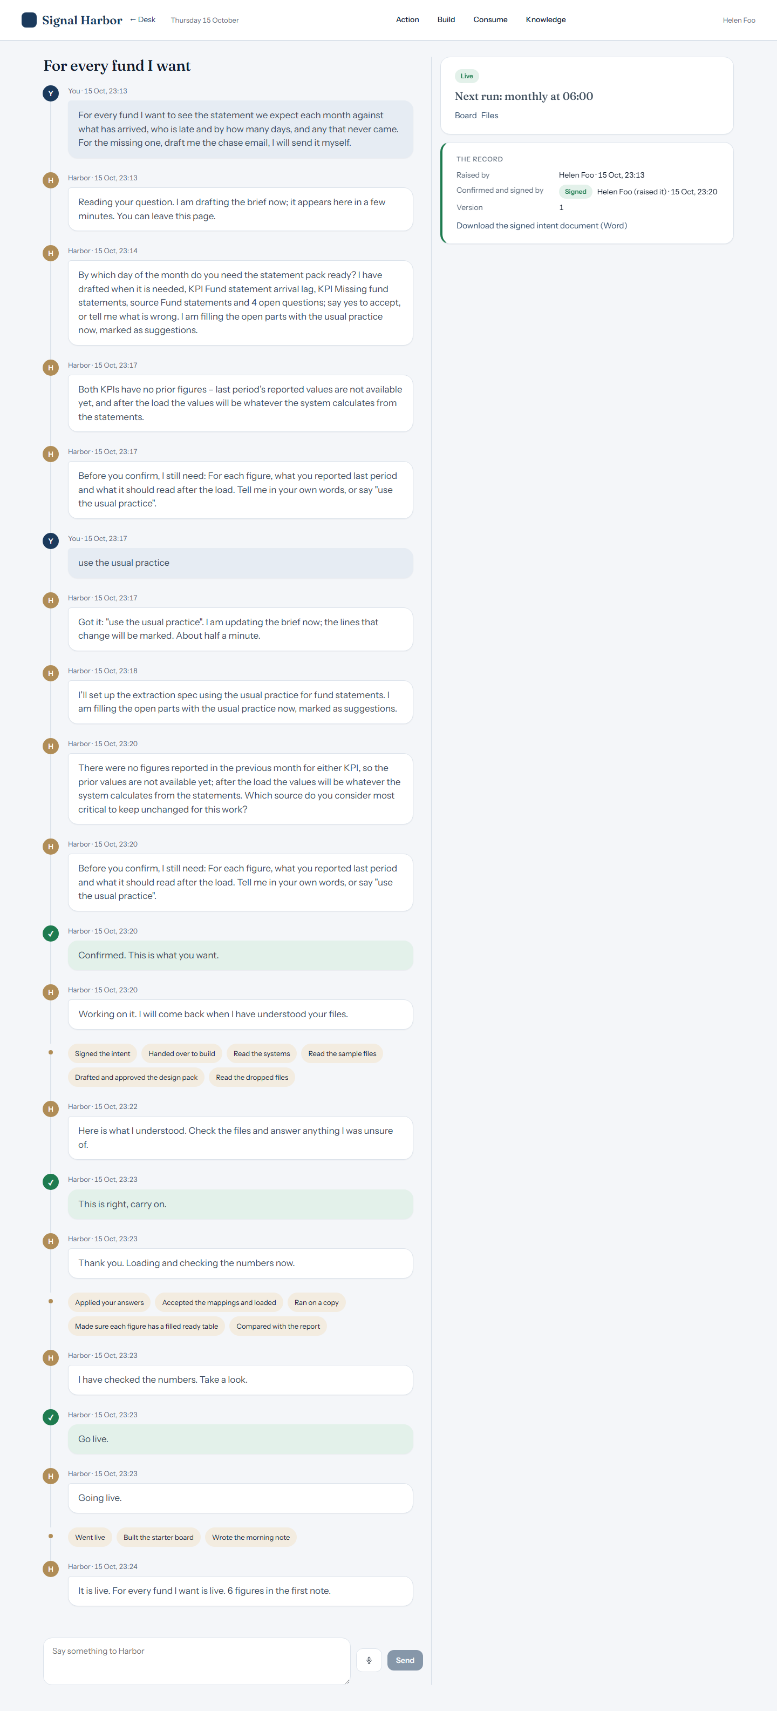
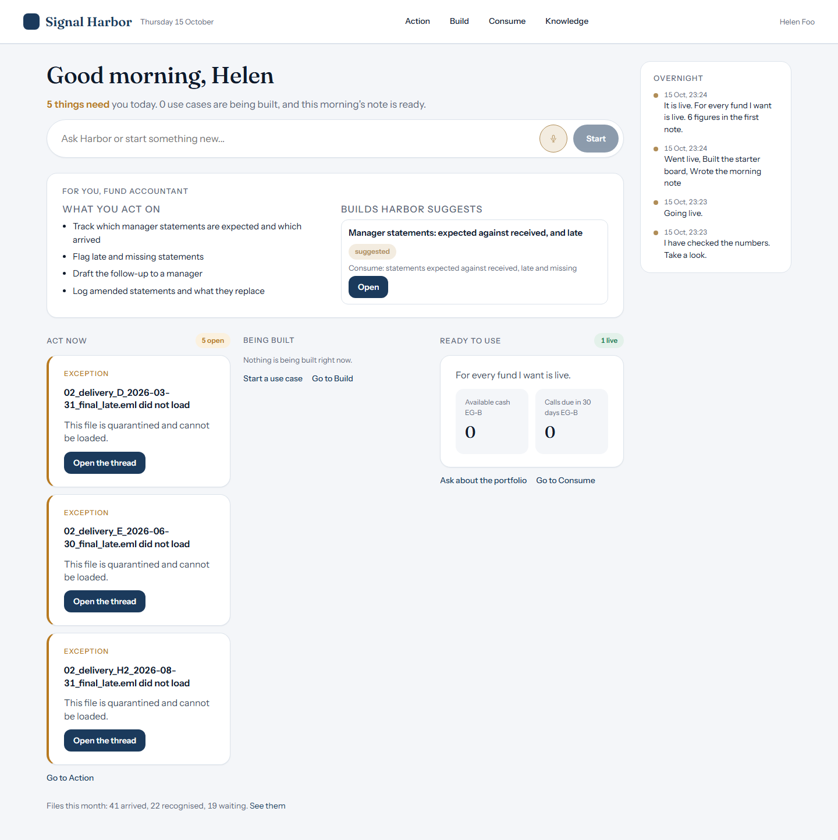

FUND ACCOUNTANT
Helen Foo
Live · figure missing
Asked: Which statement is missing and how overdue is it?
Harbor answered: Rules-only reply: I could not check a figure in my answer against the data, so I left it out. About For every fund I want: This project has 1 set of figures ready for dashboards: Shows for each fund the expected statement arrival date, the actual arrival date, the lag in days, and whether the statement is missing. You can see 0 dashboards. You can ask me for arrival lag days. For how the figures are built, open Build…
Stuck
The build, live
Consume
Home

Slide 33




OPERATIONS CLERK
Sam Lee
Live · figure missing
Asked: How much does the FX forward confirmation differ from our record?
Harbor answered: Not available yet: FX forward confirmation variance has no figure in the ready tables. each day i match what trade and fx variance has 5 rows but none holds a value for FX forward confirmation variance. Not loaded: trading_export_20260915.csv: Nothing was loaded. All 1 rows are held back: 0 instrument name(s) and 0 portfolio code(s) need approval. Row 2: T-20260915-F01: side 'sell usd / buy sgd' is not buy or sell. |…
Stuck
The build, live
Consume
Home

