Slide 1
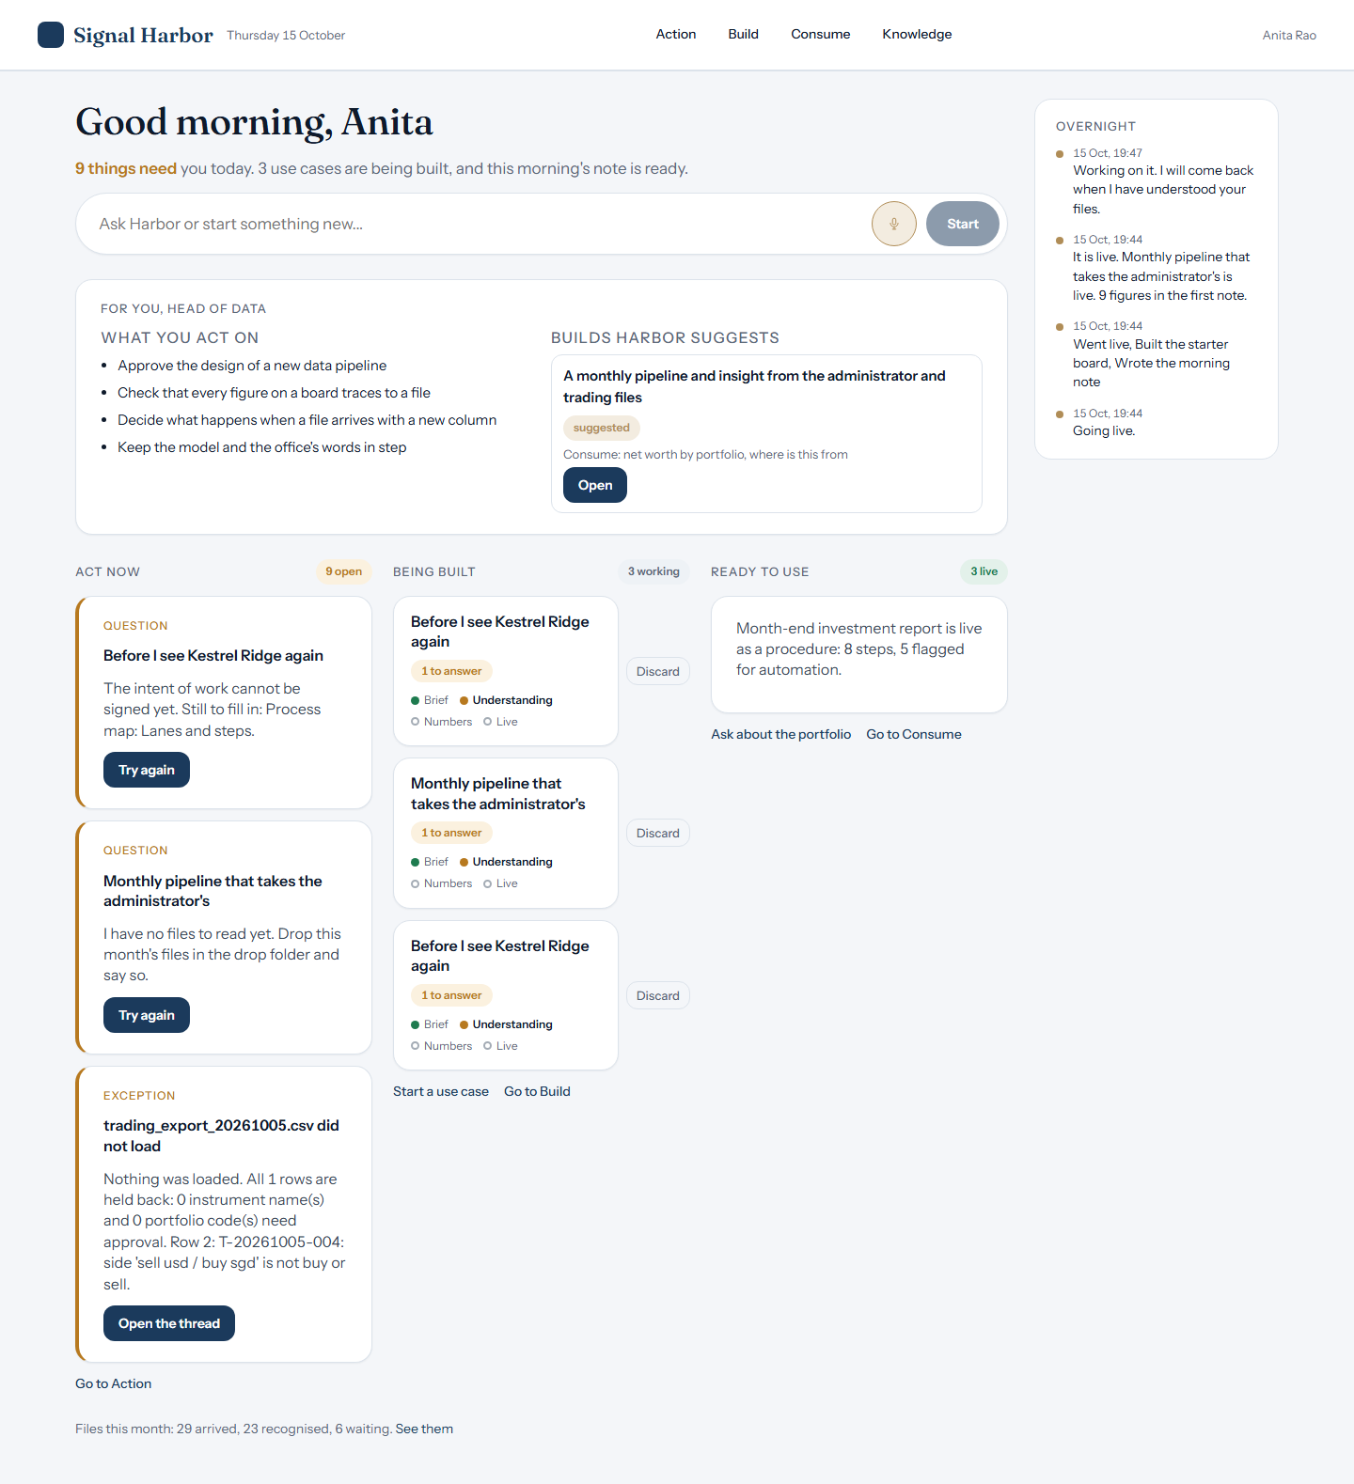
Signal Harbor 3.0: a walkthrough of the app as it is today
The Evergreen family office, start to end, from real screens of a running local server.

Slide 2
Four places: Action, Build, Consume, Knowledge
The top bar holds the four places; the Desk is home.

Slide 3
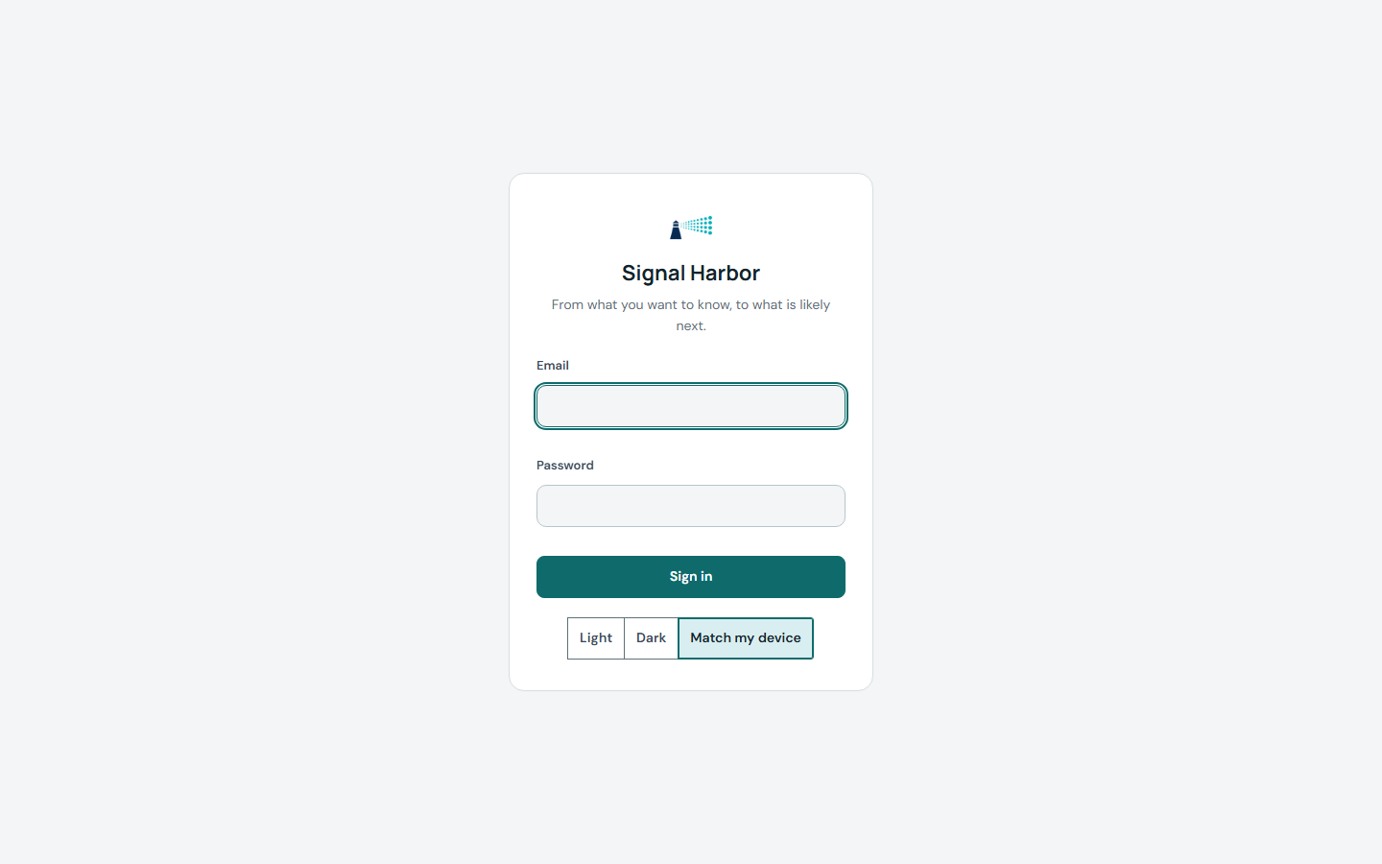
Sign in
A person signs in with their own office account.

Slide 4
The Desk
The Desk lists what needs a person and what Harbor is working on.

Slide 5
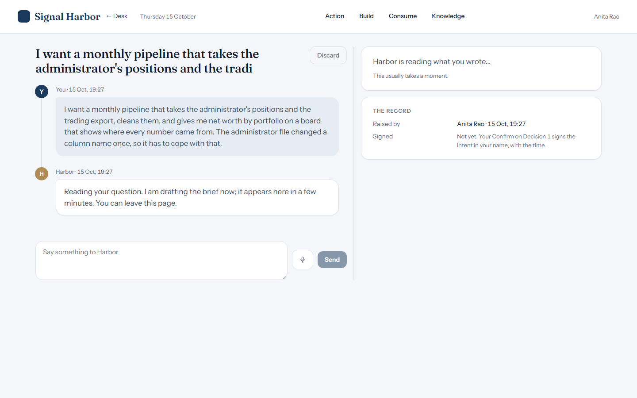
Start a build by talking
A person describes the use case in their own words; Harbor starts drafting the brief.

Slide 6
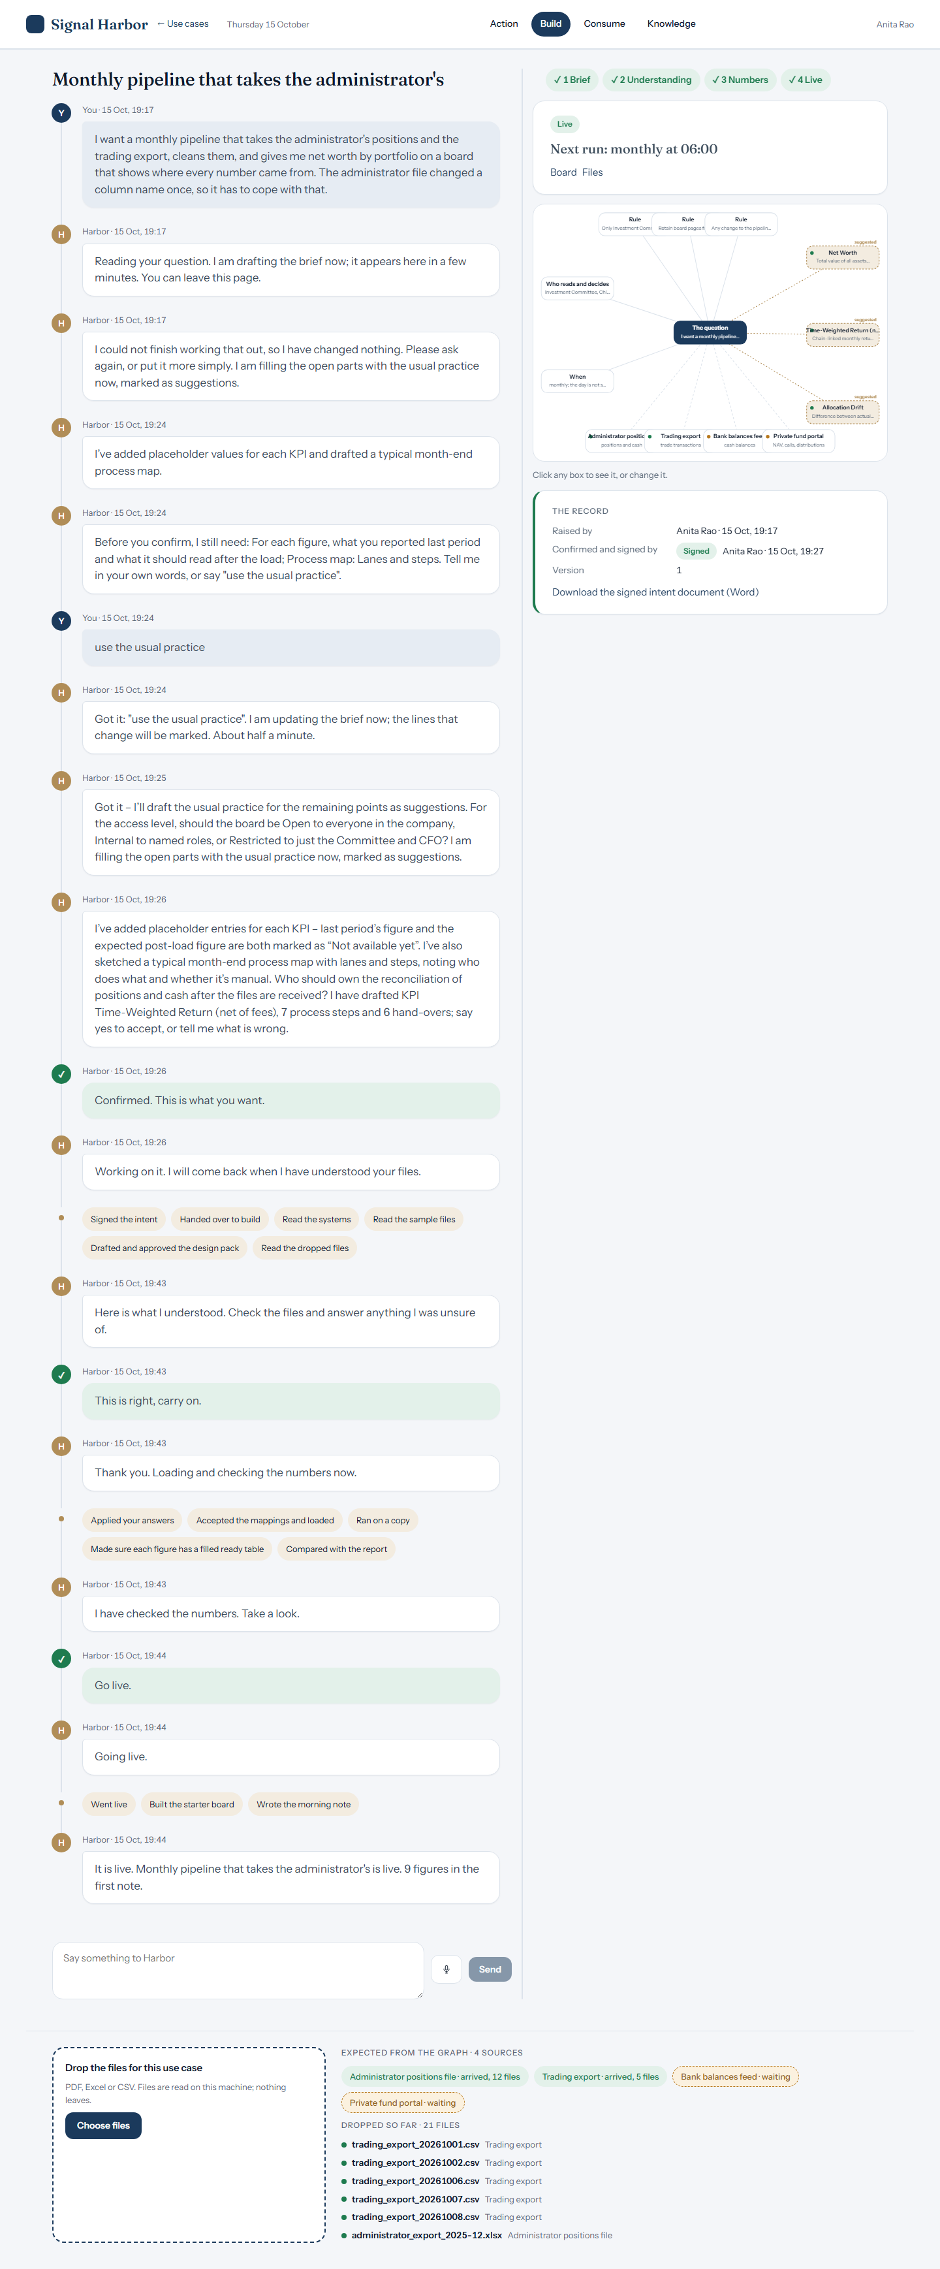
Drop files for the use case
Files are dropped on the band under the conversation; Harbor reads them on this machine.

Slide 7
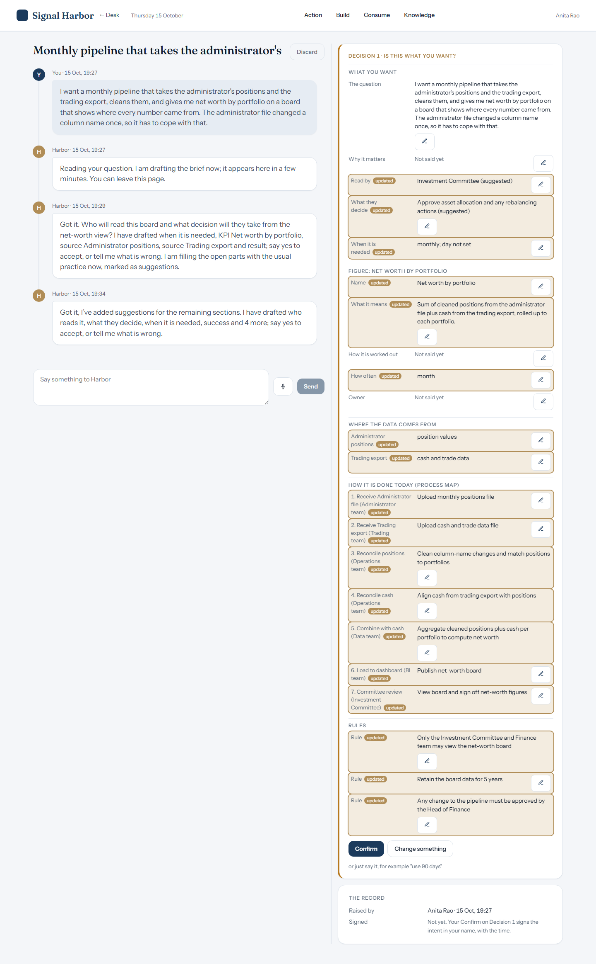
Decision 1: is this the brief you want?
Harbor shows the brief, the open points and the record; the person confirms or changes it.

Slide 8
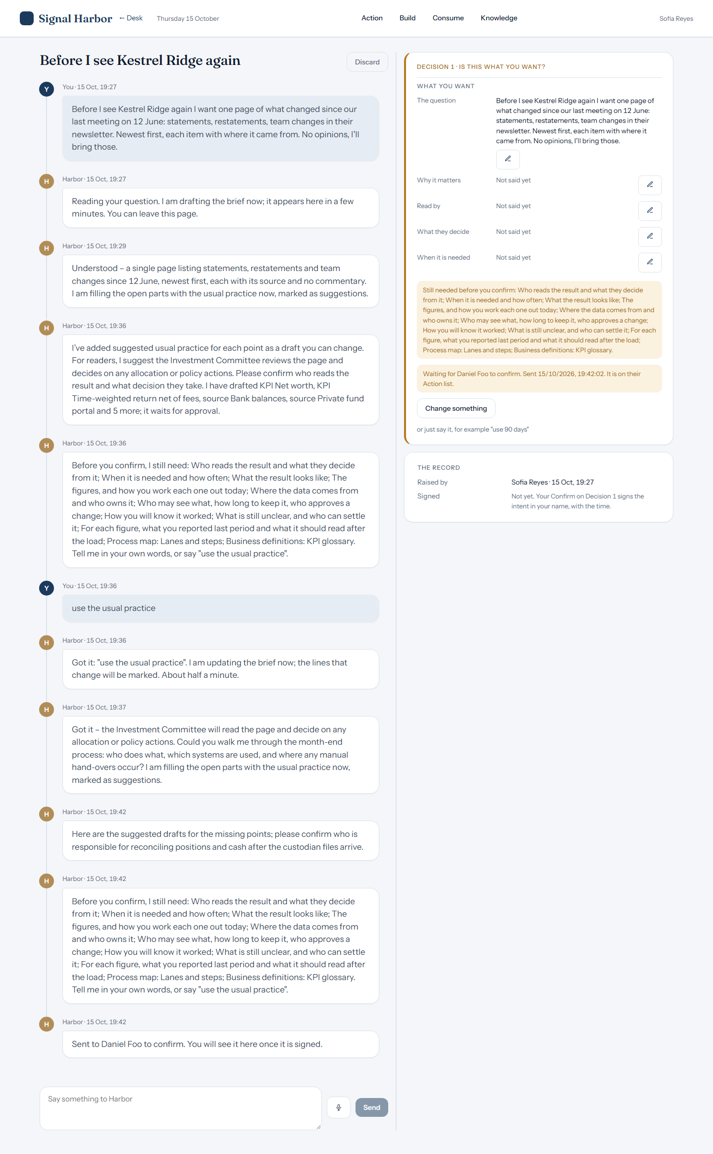
Sending to a signer
A person who may not sign sends Decision 1 to the signer; the thread waits in their name.

Slide 9
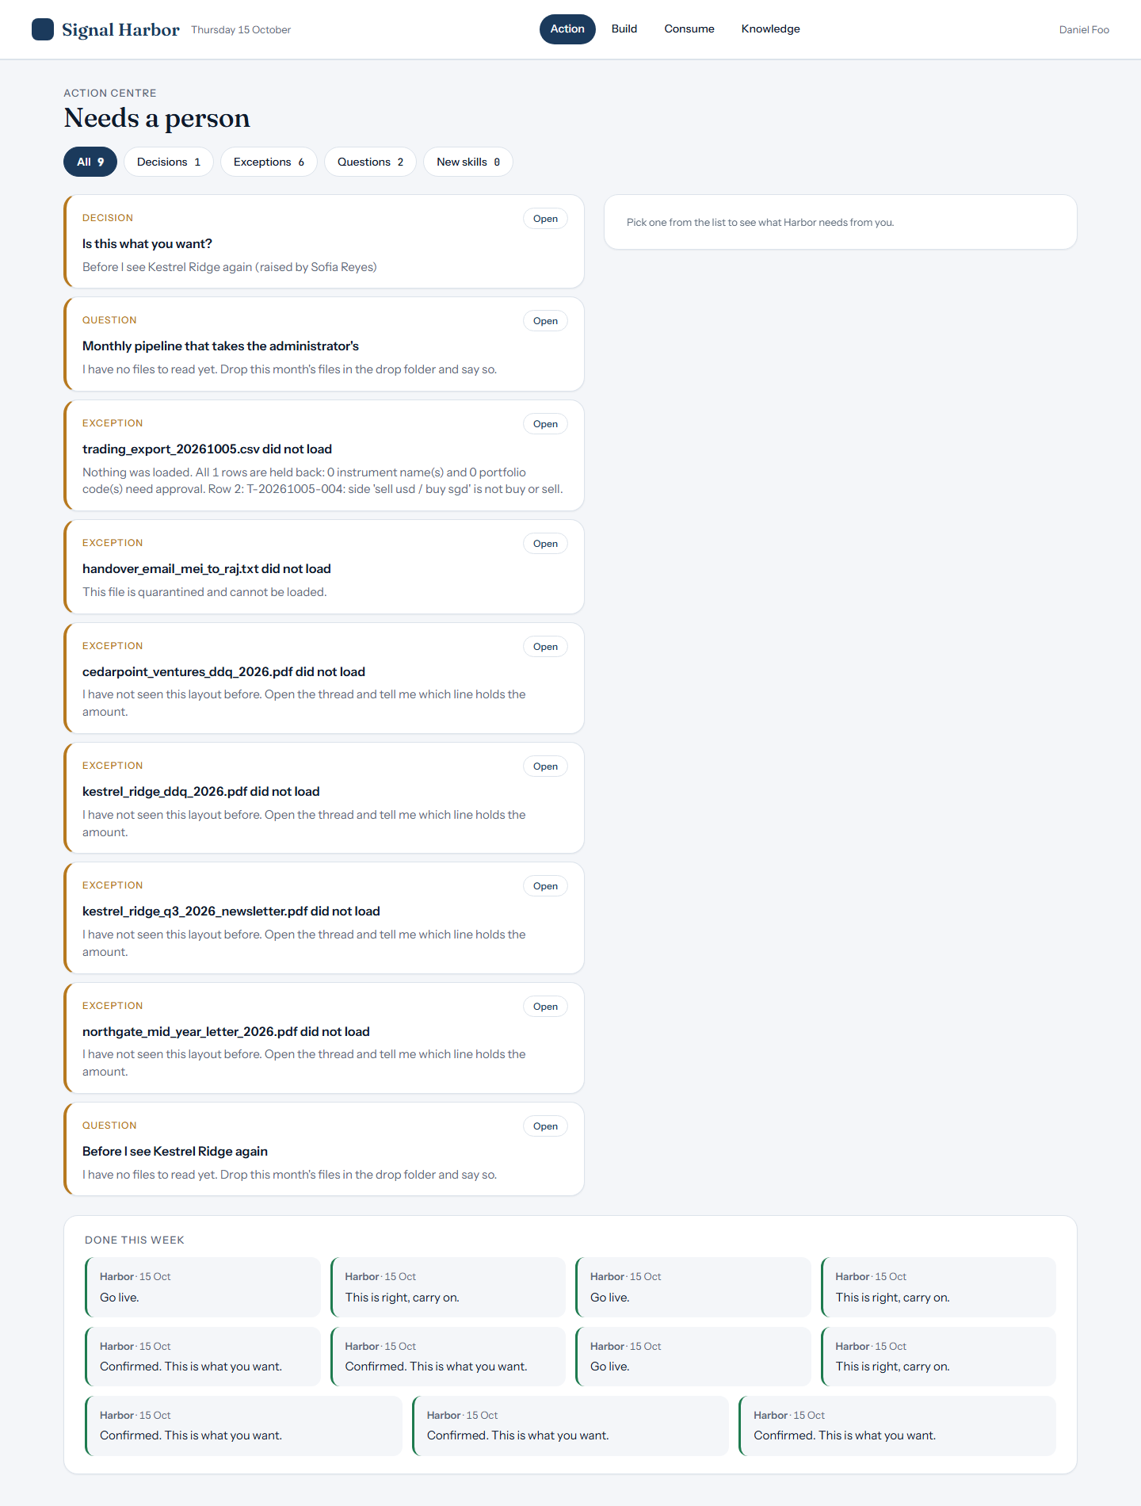
The signer's Action card
The signer sees the decision waiting on the Action page.

Slide 10
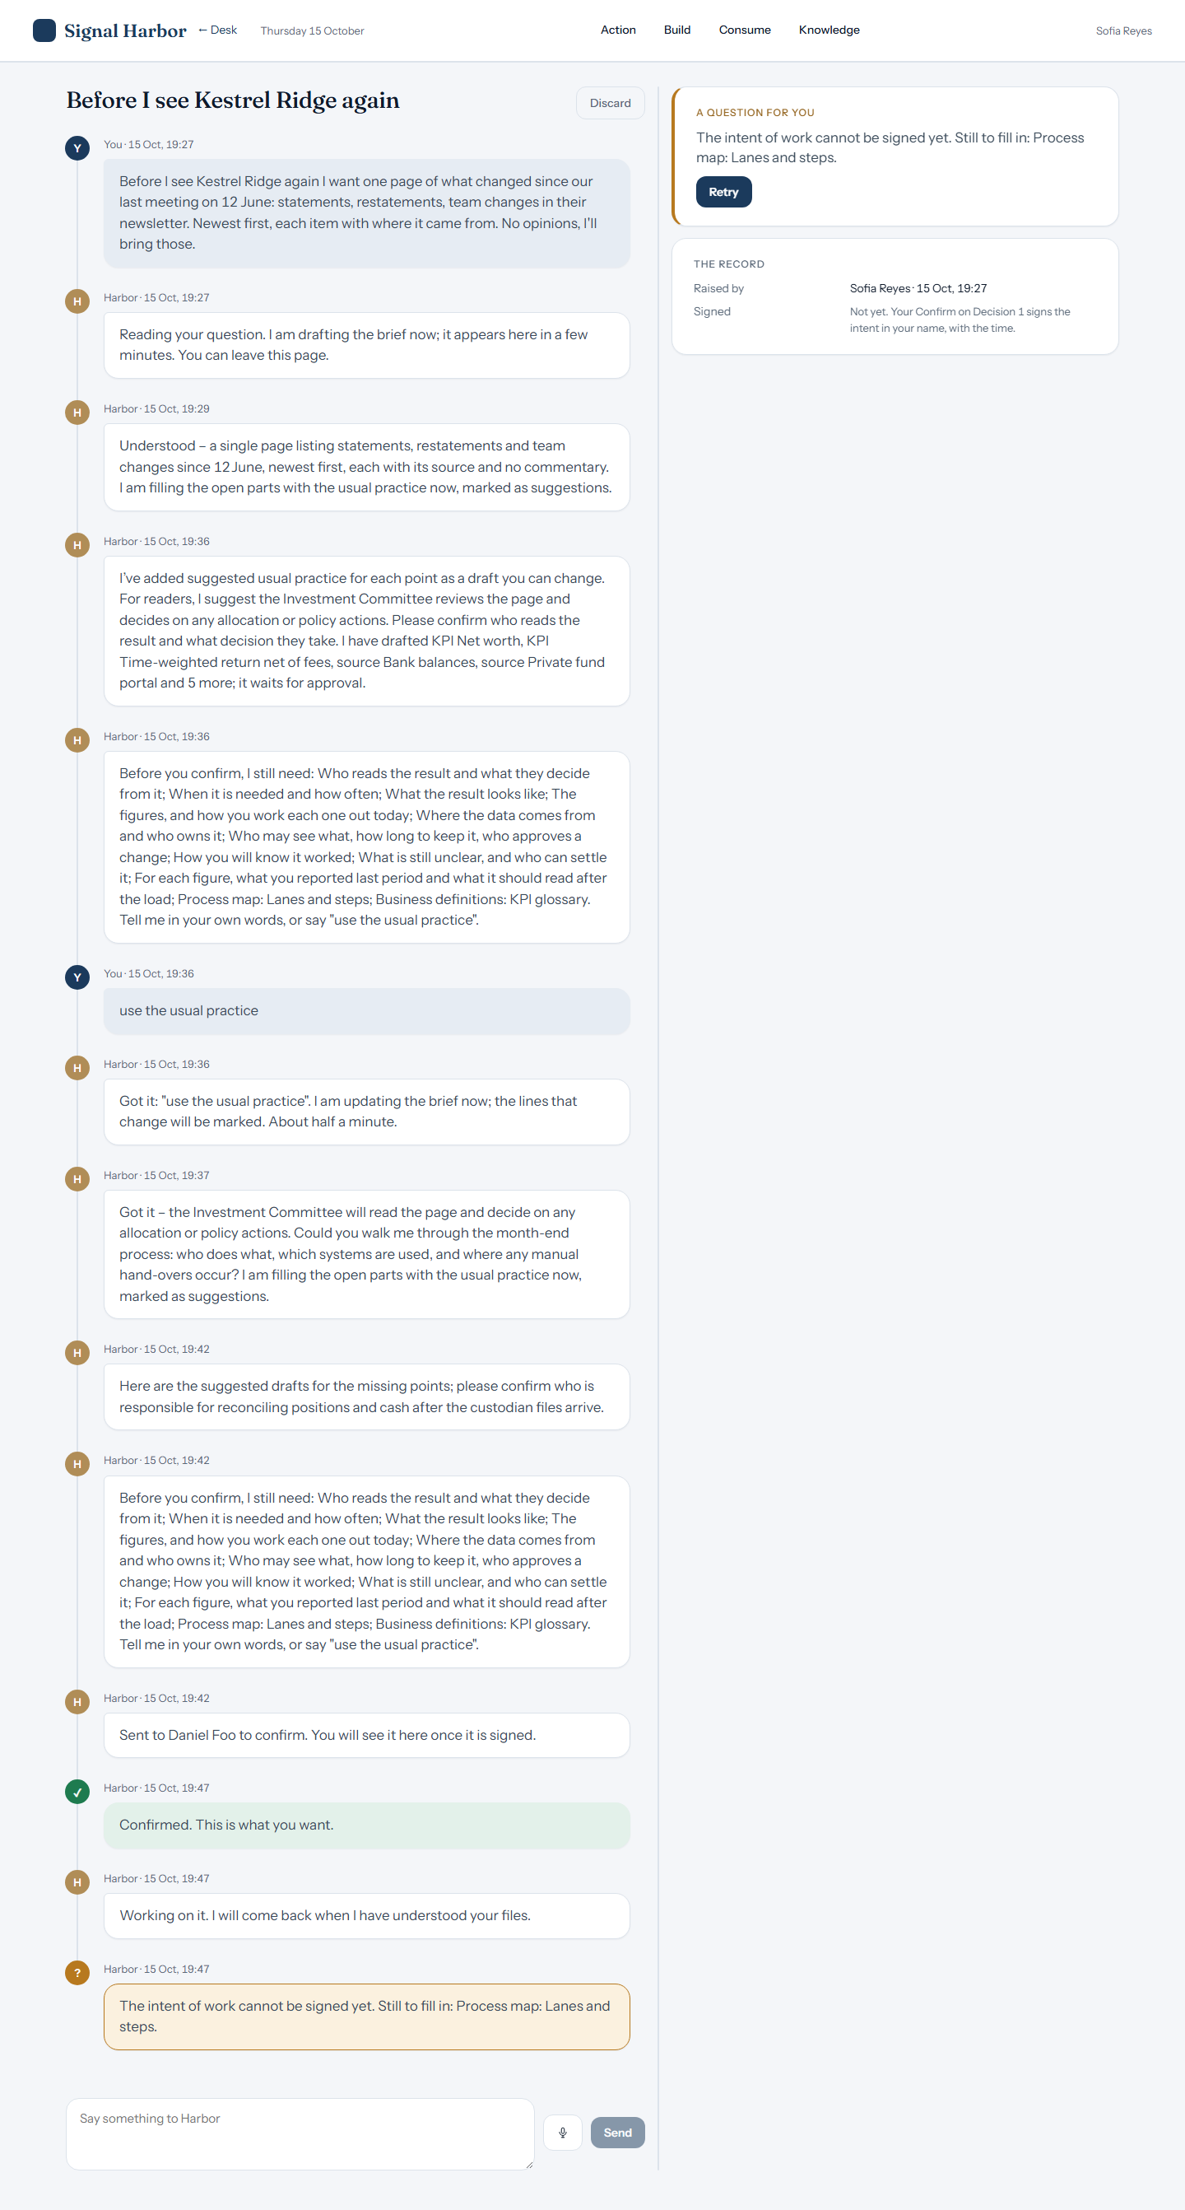
The signer confirms; the record shows both names
Daniel Foo confirmed, and the record names Sofia Reyes as raiser. The signature line still reads Not yet, because the build then stopped on a missing step.

Slide 11
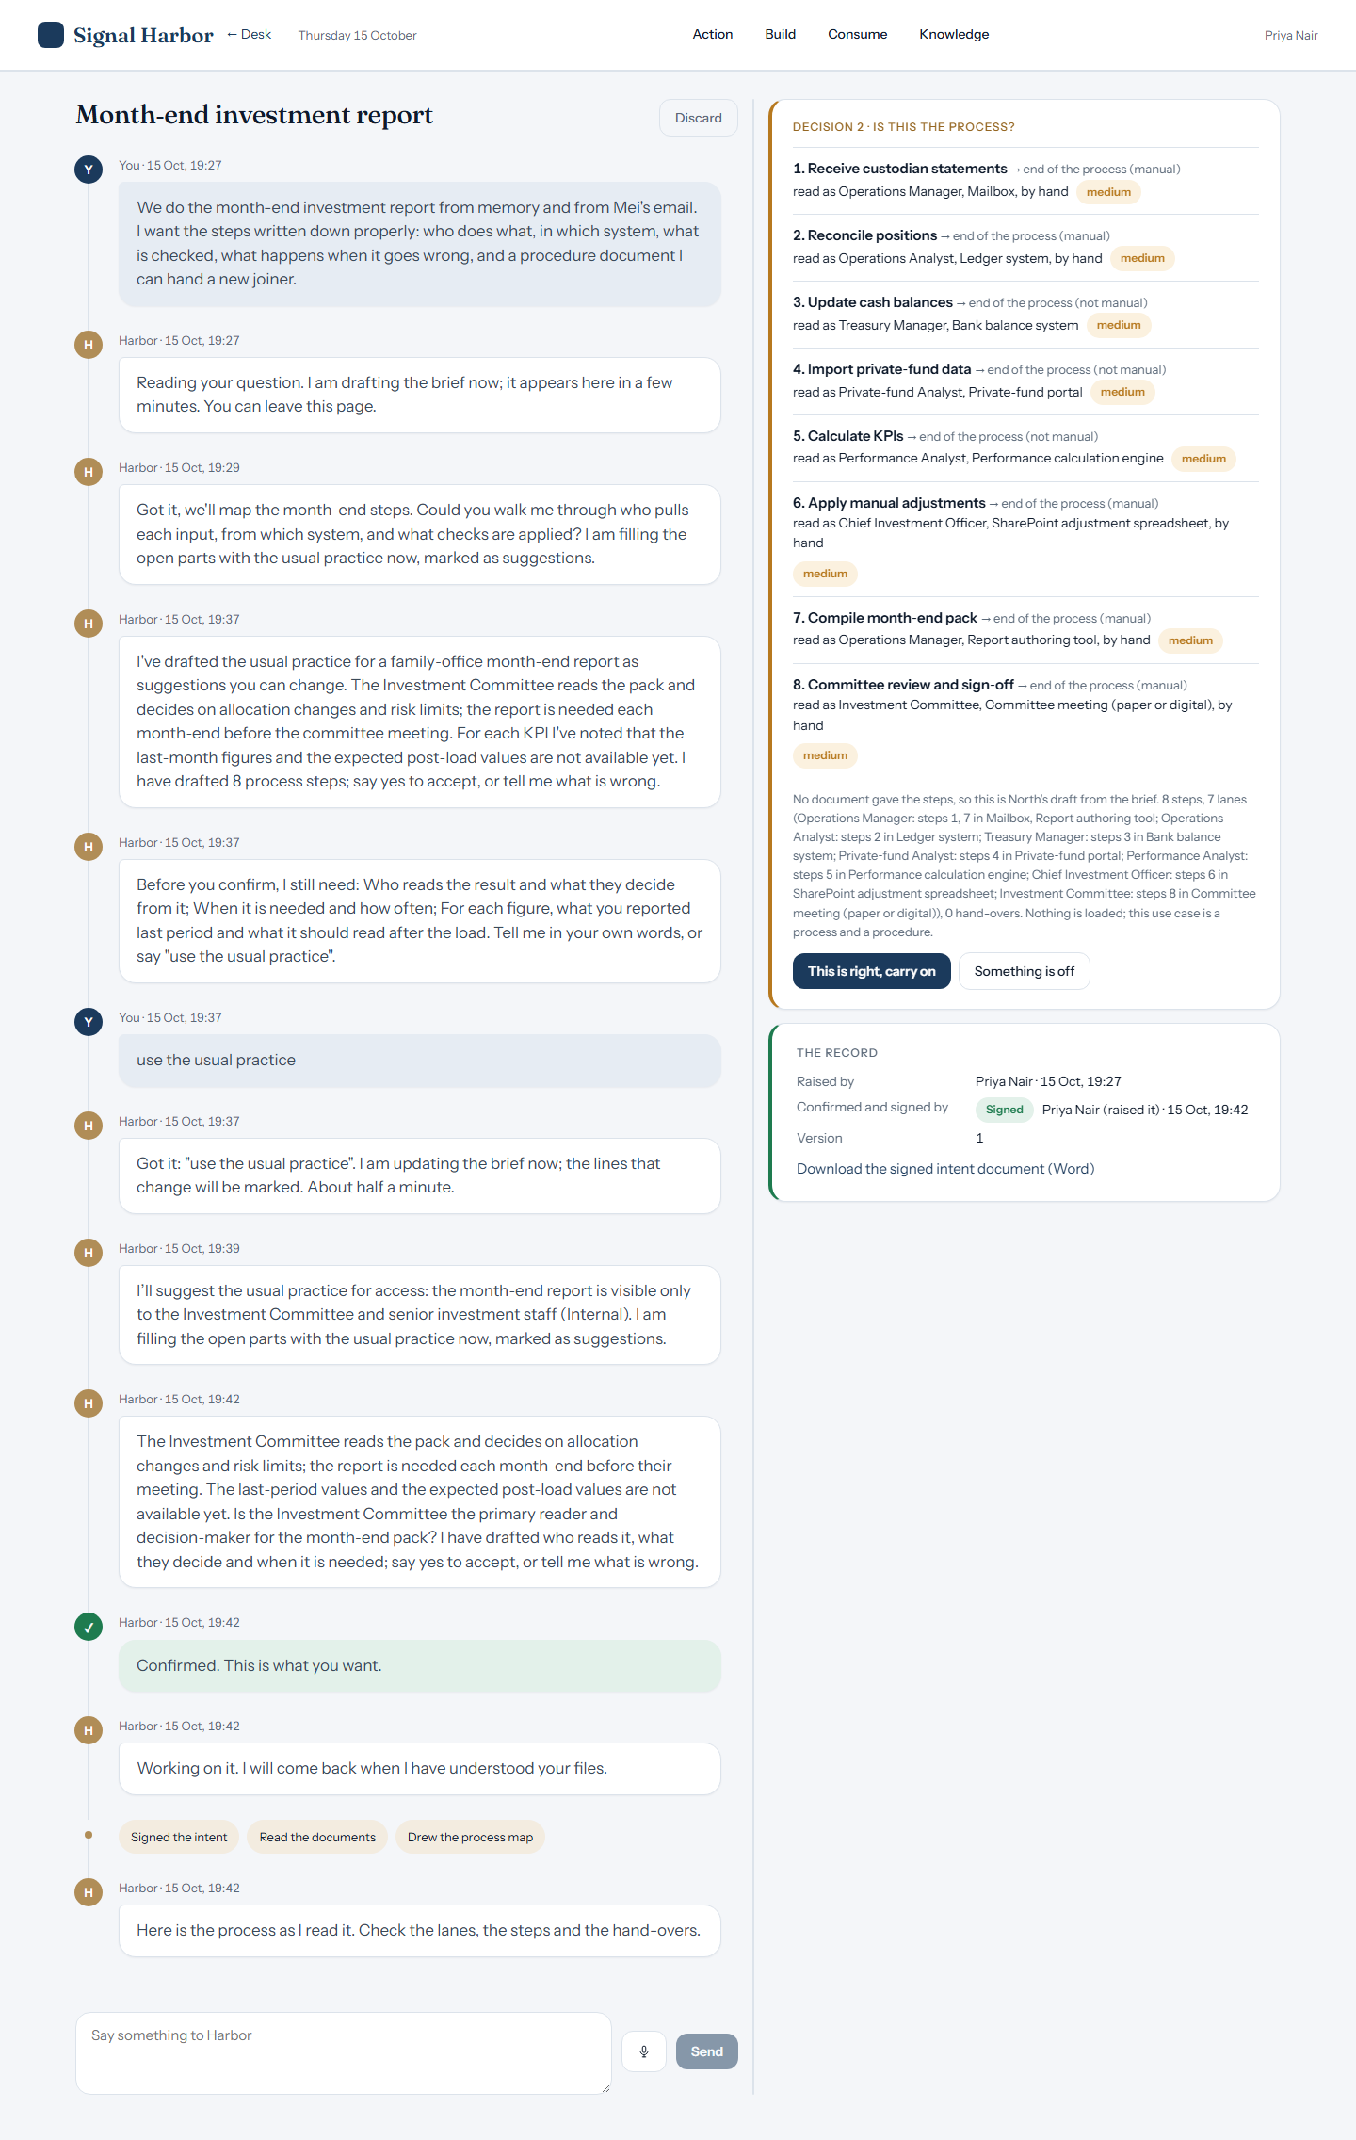
Decision 2: here is what I understood
Harbor lists what it understood and asks the person to check it before carrying on.

Slide 12
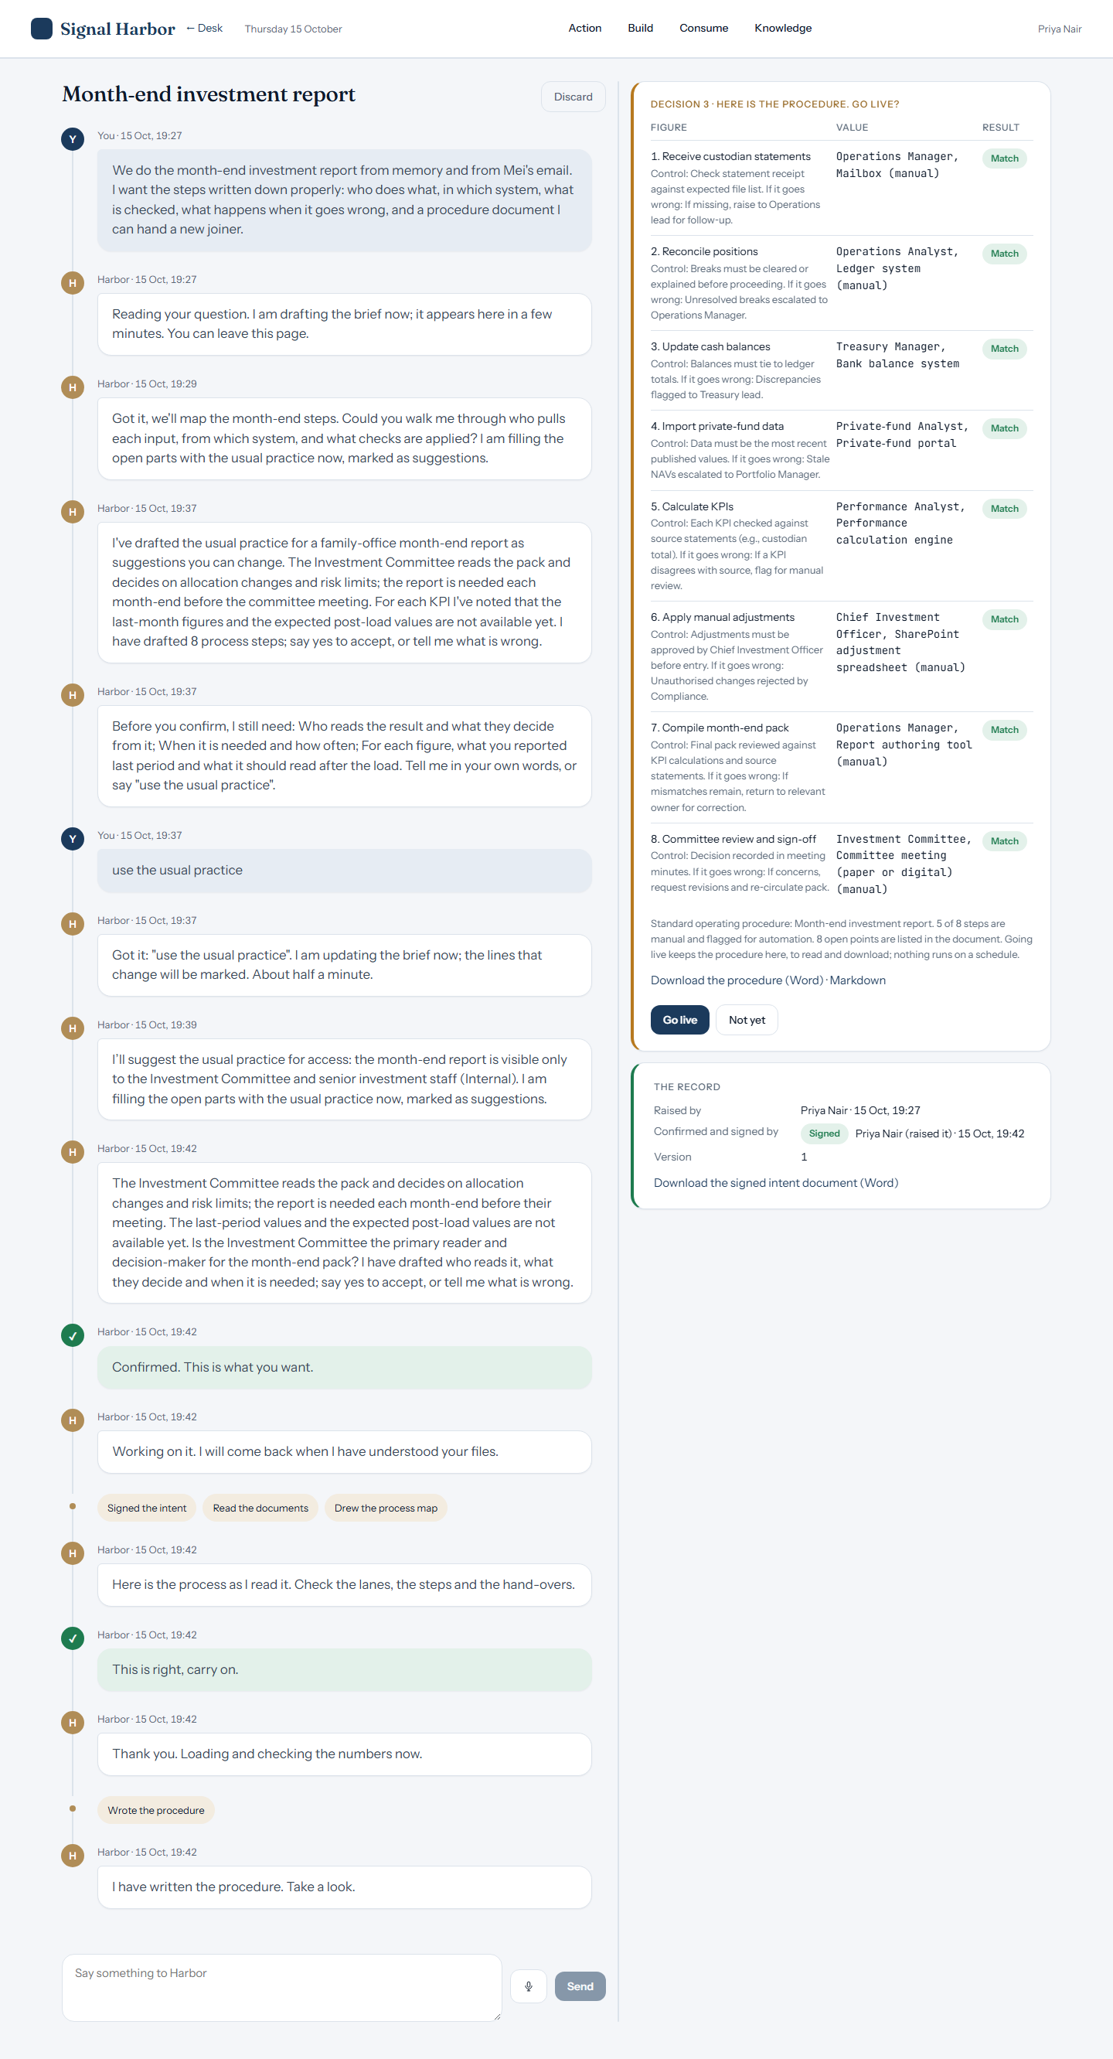
Decision 3: numbers match, go live?
Harbor checks its work and asks for go-live. This build has no figures, so the screen shows the process check rather than row counts.

Slide 13
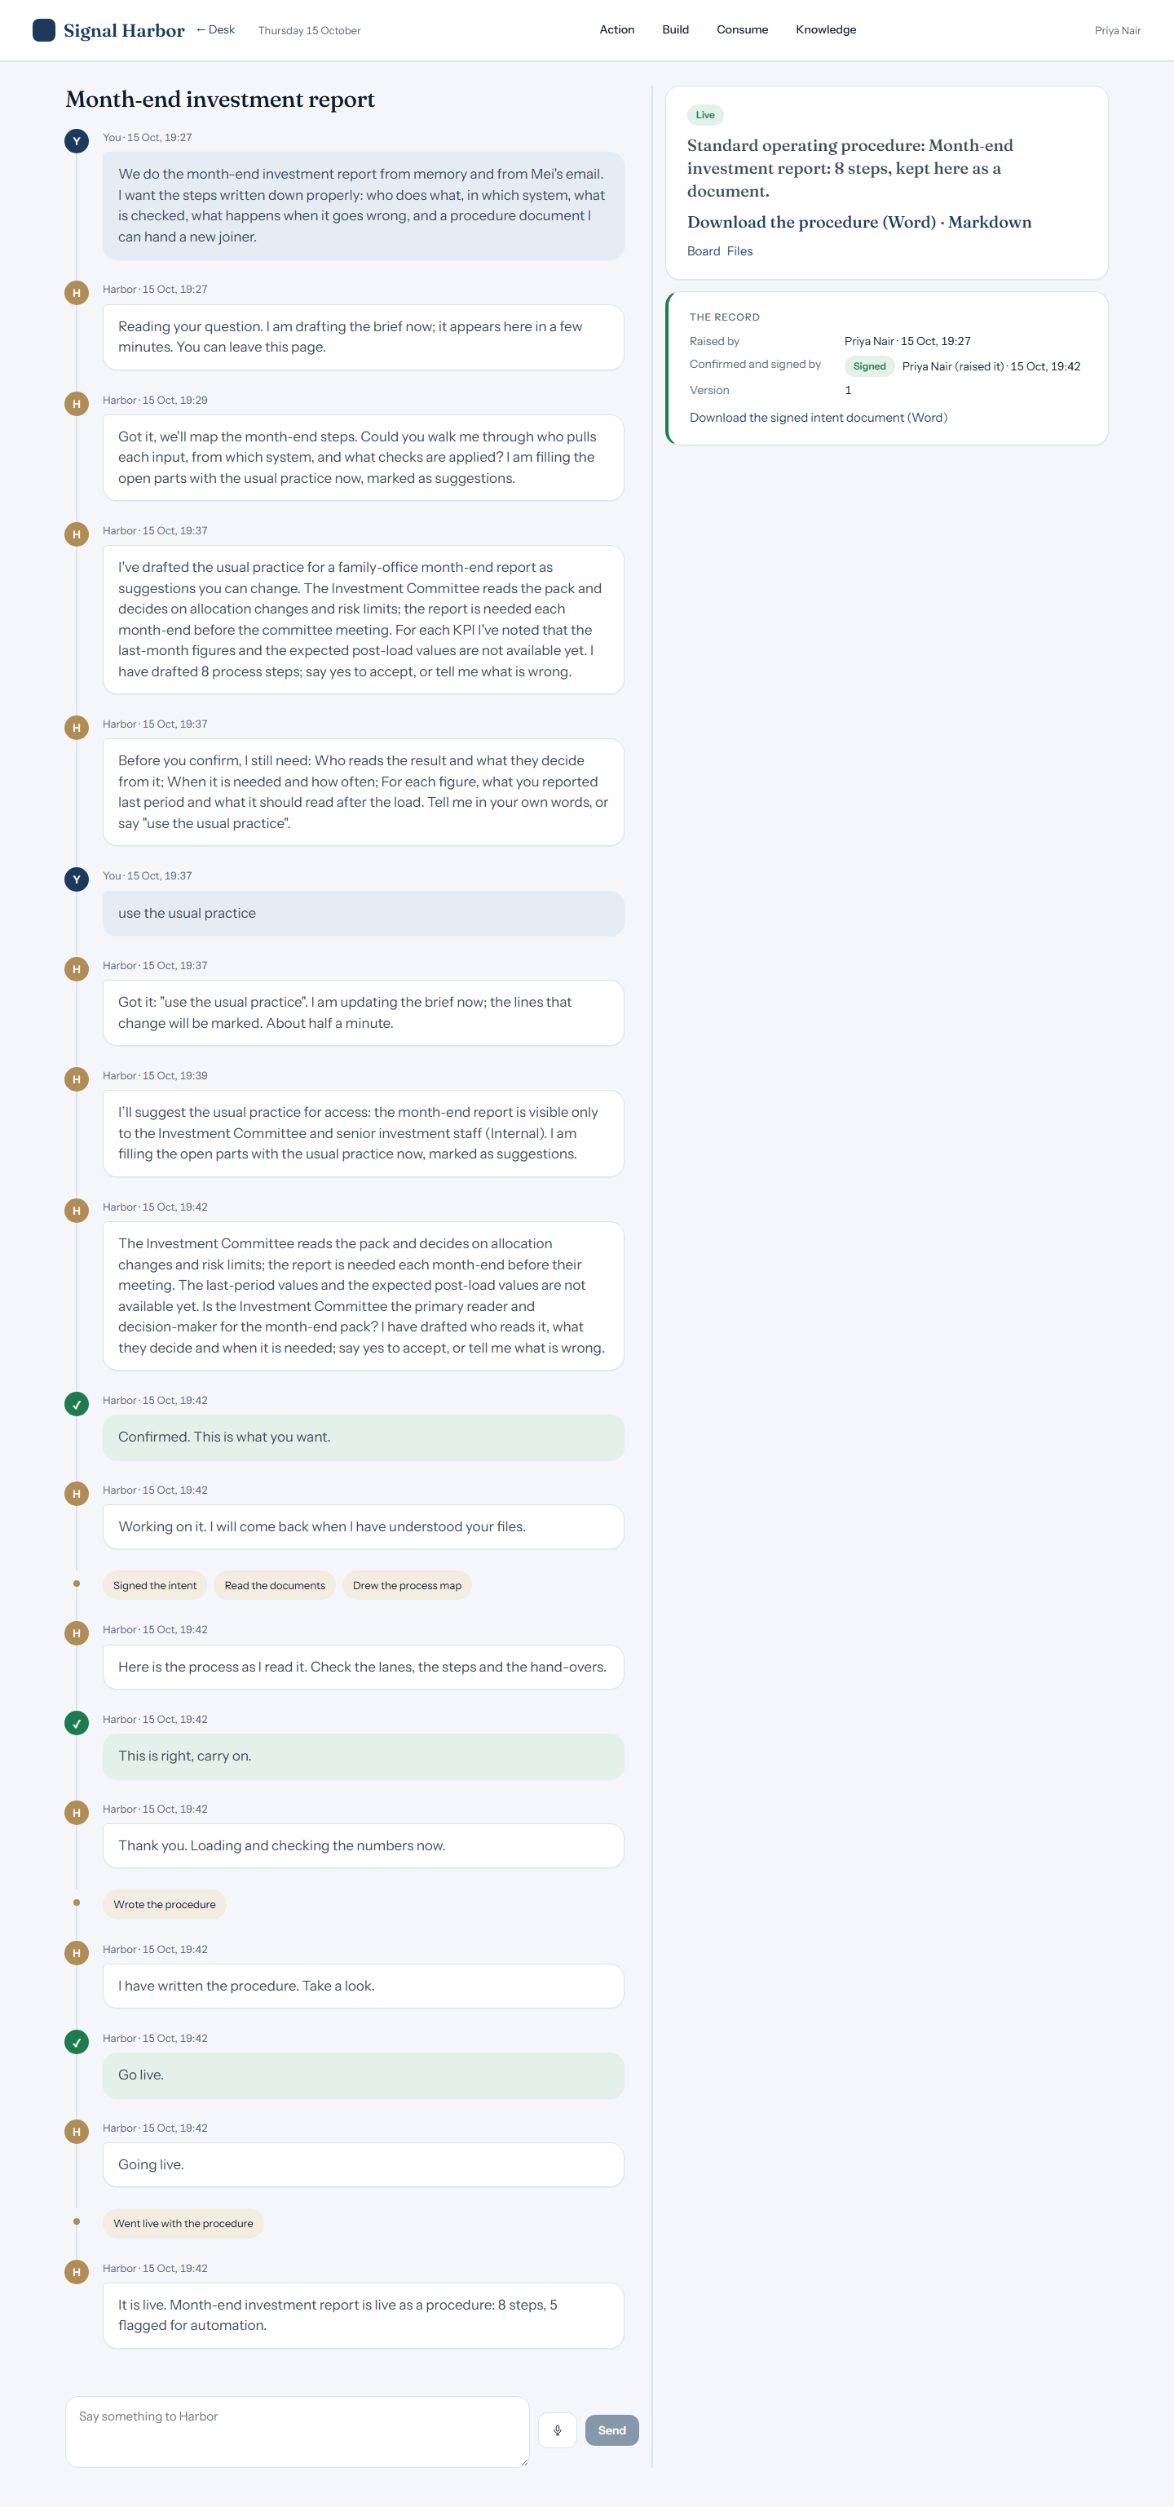
Live
Once confirmed, the use case goes live and Harbor writes the first note.

Slide 14
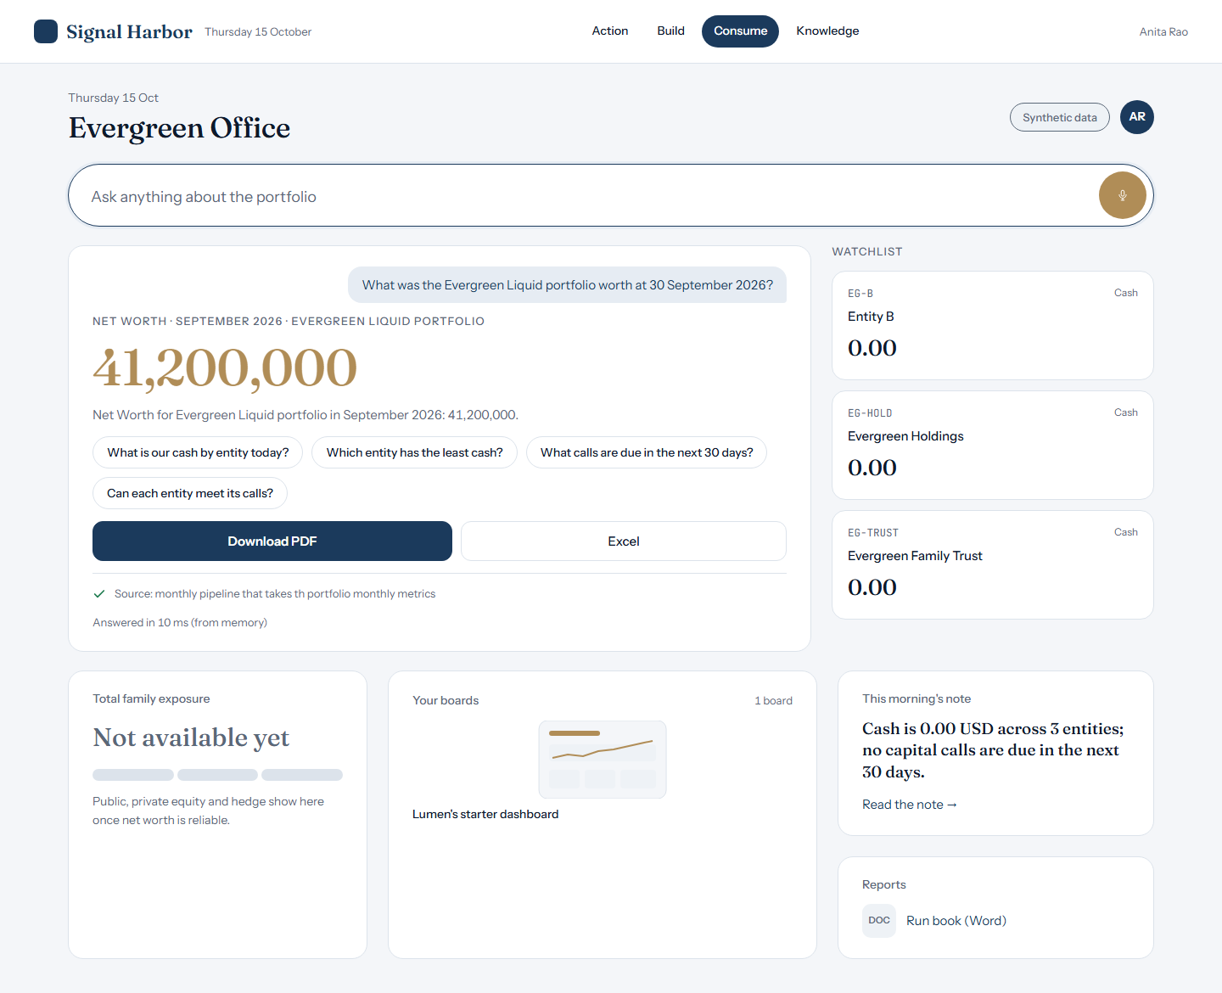
Consume: a question answered from the live data
A question about the portfolio is answered from the live use case, with its source named.

Slide 15
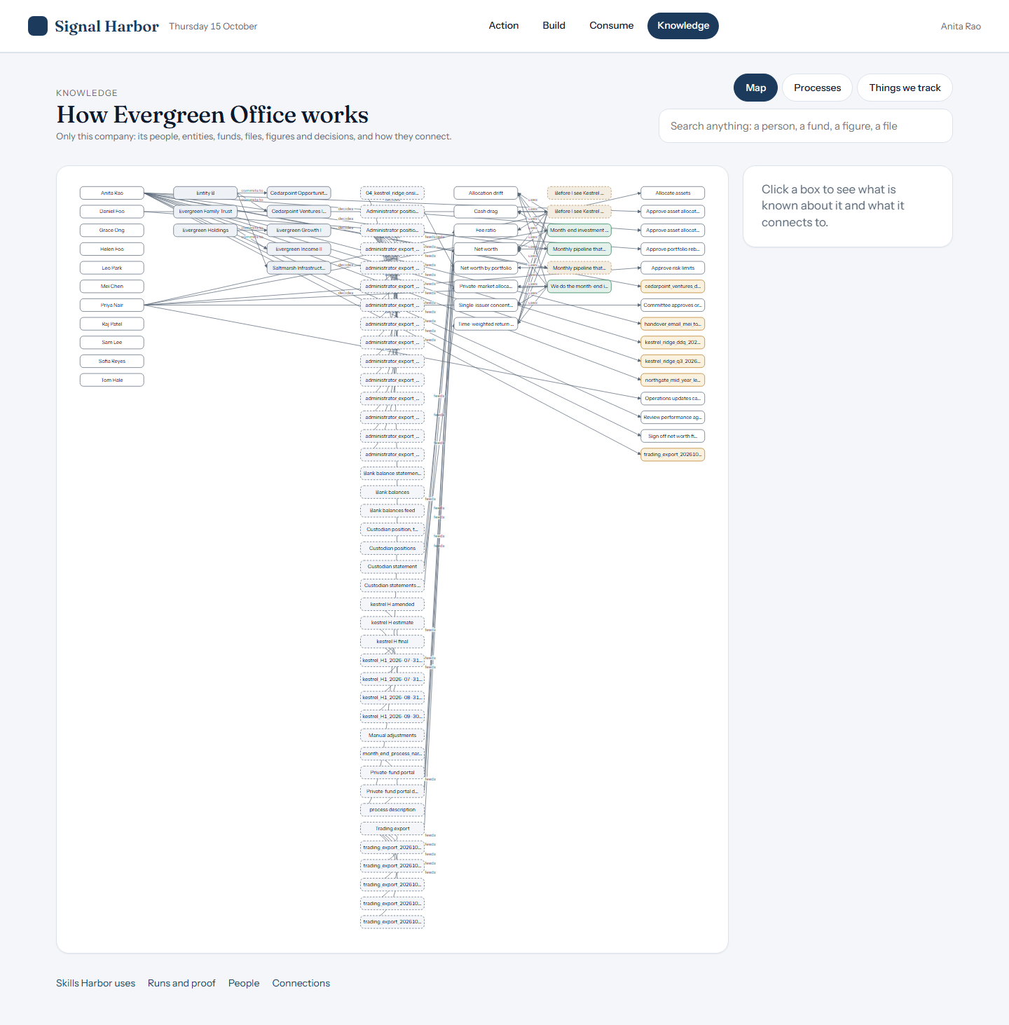
Knowledge
Knowledge shows what the office knows about itself, from its own records.

Slide 16
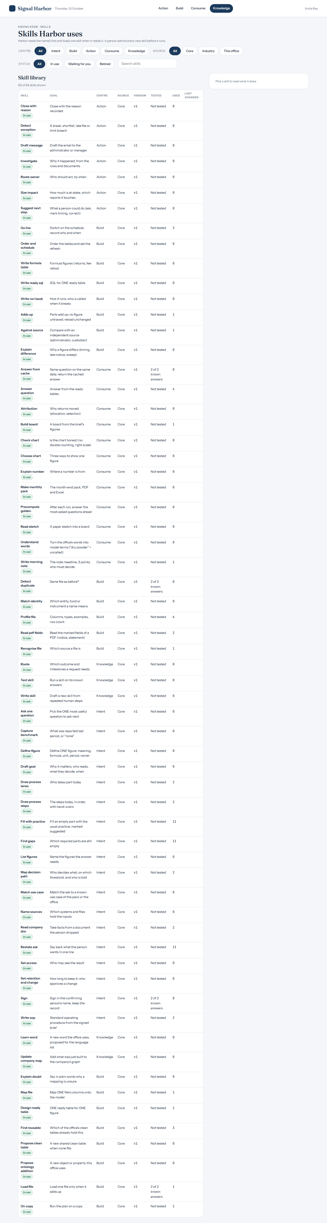
Knowledge > Skills
Skills lists the steps Harbor uses, each one named.

Slide 17
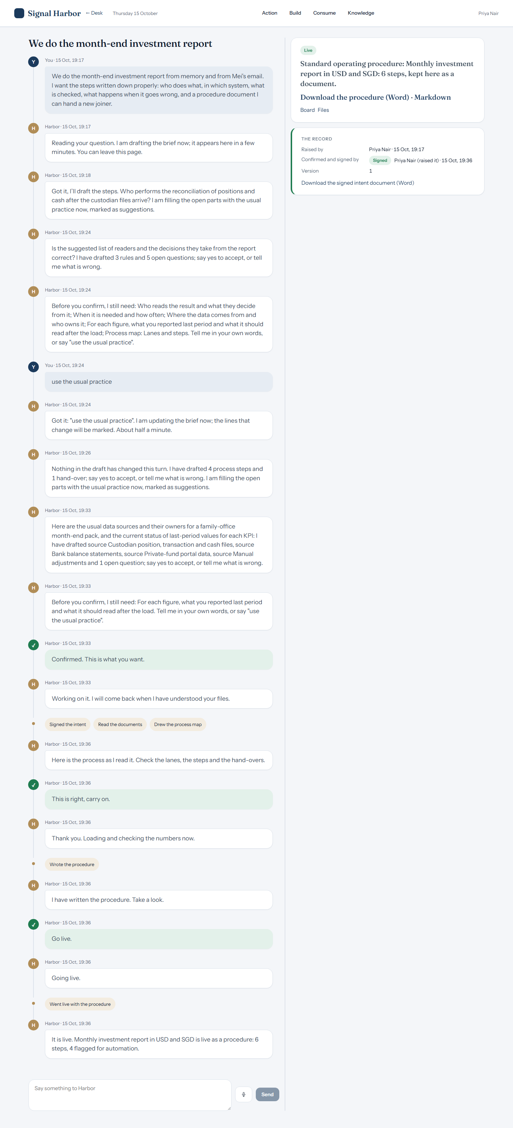
A process-only SOP: no numbers
Priya Nair's build turns a written process into a process map and an SOP; there are no figures to check.

Slide 18
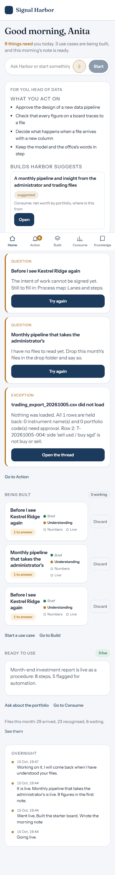
Phone view (390 x 844)
The Desk on a phone keeps the same places in a narrow column.

Slide 19
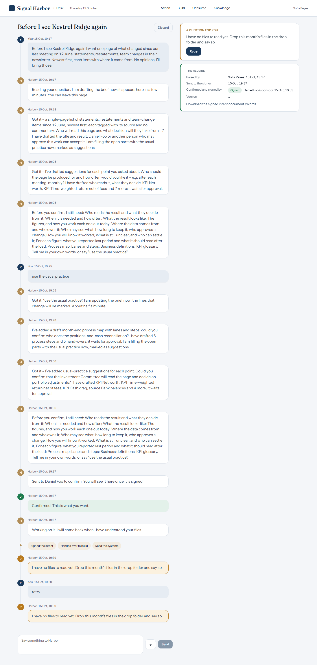
A build that stopped: the file step
Sofia Reyes's manager-diligence build stopped at 'I have no files to read yet'; it did not reach Decision 2 or Decision 3.

Slide 20
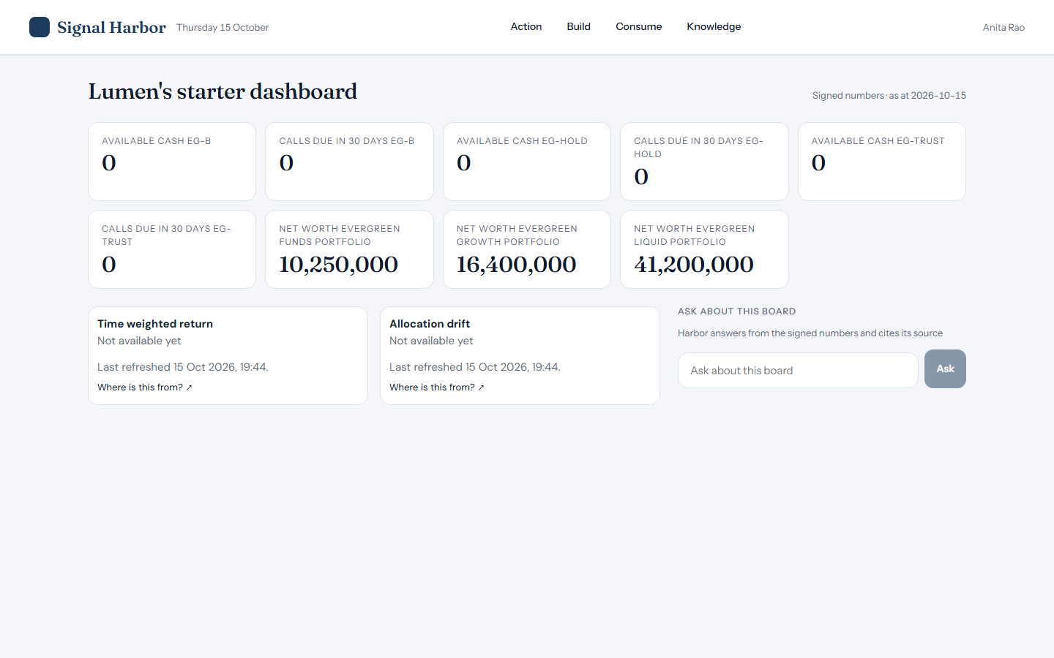
What is still being built
Harbor reading PDF statements and confirmations; the break amount for operations; figures from report workbooks. The screens above are what runs today.

