Slide 1
CLIENT SHOWCASE · EVERGREEN OFFICE · 13 OCT 2026
Signal Harbor — every figure, explained
How a monthly number moves from the source file, through a design the head of data approves, to a dashboard, a case and a traceable answer for the family council.
Evergreen Office is a synthetic family office. All names, files and figures are invented.
1 / 20
Notes:
OPEN (0:00, 3 minutes with slides 2 and 3). Say: 'Every figure should be able to show where it came from.' Evergreen Office is a fictional family office; every name, file and figure is invented. Do not name any real client.

Slide 2
THE PROBLEM
When the council asks “how did we do?”, the answer is in six places.
Manager statements
Administrator export
● Late. The figures arrive after the date the council needs them.
● Revised. A statement is amended after a report has been issued, and nobody is sure which version was used.
● Untraceable. A number cannot be walked back to its file, its row or the person who checked it.
PDFs, one per fund, arriving at different times.
Month-end positions and values, as a spreadsheet.
Trading file
Working spreadsheets
Trades and cash, on its own daily cycle.
Copied tabs, typed-in formulas, one person’s version.
The question is simple. Answering it should take minutes, and every figure should be able to show where it came from.
Signal Harbor
2 / 20
Notes:
Say: the council asks one question each month. The answer is in manager statements (PDFs), an administrator export, a trading file and someone's working spreadsheet. Three things go wrong: it is late, it is revised after issue, and a number cannot be walked back to its file or the person who checked it. The question is simple; every figure should be able to show where it came from.

Slide 3
WHAT IT IS
Four centres for the work, four agents that draft. People sign.
Action
Build
Consume
Map
Today’s cases, reconciliations and what waits for a person.
Intent, design pack, pipelines and the dashboard studio.
Today, financial health, markets, reports and what if, in USD or SGD.
The office’s ontology, data model with impact, process maps and glossary.
North
Span
Lumen
Tally
Listens and drafts the intent of work and the process map.
Architect designs the data. Builder connects, runs and checks it.
Proposes a starter dashboard and drafts the briefs.
Explains a case and answers questions about Action items.
Agents draft and check. A named person approves each step that changes what the council sees.
Signal Harbor
3 / 20
Notes:
Say: four centres, four agents; agents draft, people sign. Action is what needs a person today. Build turns a need into a live approved report. Consume is where the council reads. Map shows what each number is made of. North listens and drafts the intent; Span designs the data as architect and builds it as builder; Lumen proposes the dashboard; Tally explains a case.

Slide 4
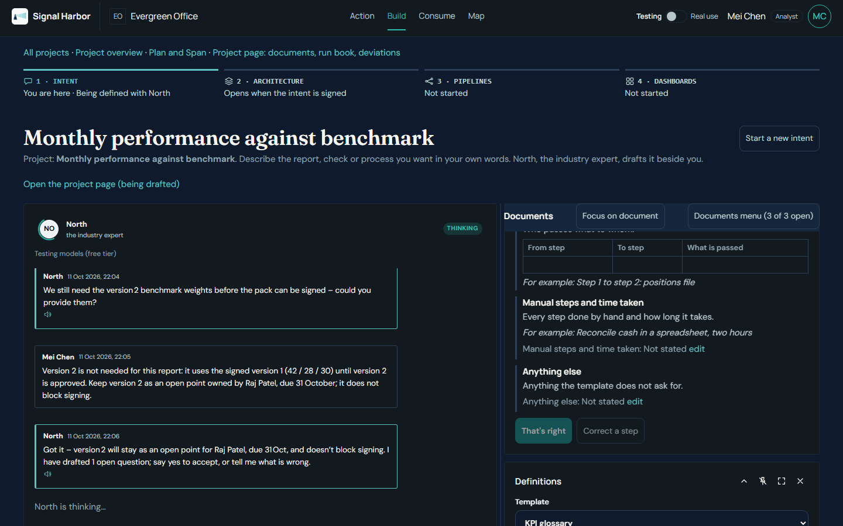
HOW IT WORKS · 1 OF 5 · INTENT (NORTH)
The business owner says what is needed, in her own words.
● North asks one question at a time and drafts the figures, readers, sources and the process map as the conversation goes.
● The sponsor reads the signed intent and signs it.
● A signed intent is read-only. Changes go in as a new version.
MEASURED In our walkthrough: about ten minutes of conversation, ten messages from the business owner, one signature.
Intent drafted with North, ready for the sponsor to sign. Evergreen Office, synthetic data.
Signal Harbor
4 / 20
Notes:
Live (0:03 to 0:06): sign in as Daniel Foo, open Intent, read the signed intent, then open the Process map tab. Say: 'The sponsor signed this. It is read-only; a change is a new version.' Point at the signature line and the process map lanes. Measured in our walkthrough: about ten minutes of conversation, ten messages from the business owner, one signature. Fallback: img/intent-ready.png.

Slide 5
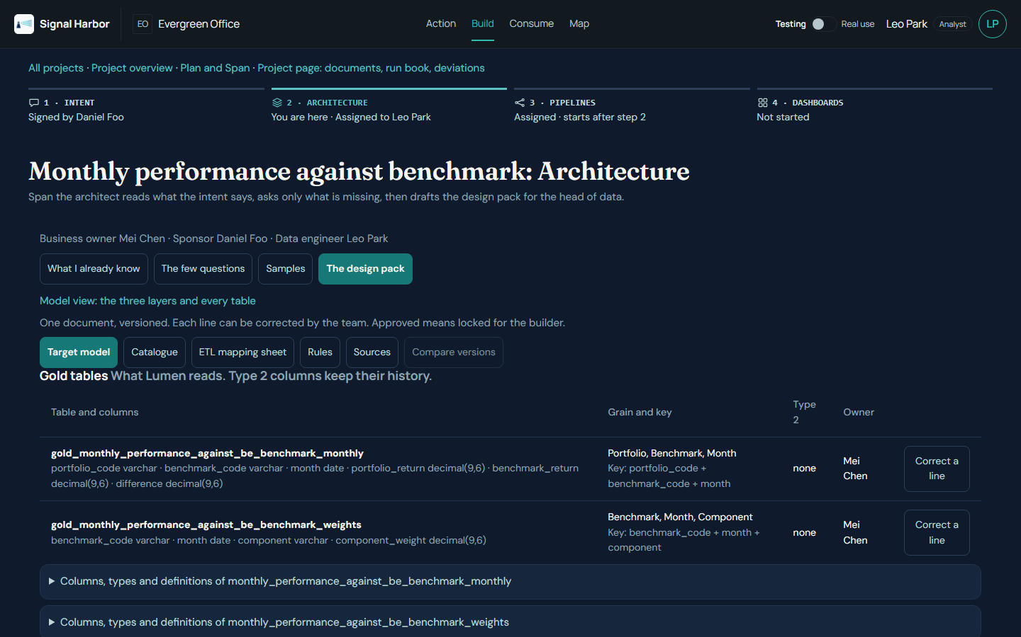
HOW IT WORKS · 2 OF 5 · DESIGN PACK (SPAN, ARCHITECT)
Span designs the target. The head of data approves it before anything is built.
● Span reads the signed intent and asks only what it does not already know, each with a default to accept.
● It profiles the sample files and drafts a versioned pack: bronze, silver and gold tables, the catalogue, and a mapping sheet from each source field to the figure.
● The head of data approves. Approved means locked for the builder; any change is a new version.
MEASURED Walkthrough pack: two gold tables, five silver tables, 19 mapping rows, four questions answered.
Design pack as drafted by the architect. Approval is a separate step.
Signal Harbor
5 / 20
Notes:
Live (0:06 to 0:10): sign in as Anita Rao, open Build, pick the project, open Tables and SQL, open one gold table. Say: 'Span drafted the design. Anita approves it before anything is built. Approved means locked.' Measured: two gold tables, five silver tables, 19 mapping rows, four questions answered. Fallback: img/span-design-pack.png and img/head-of-data-approve.png.

Slide 6
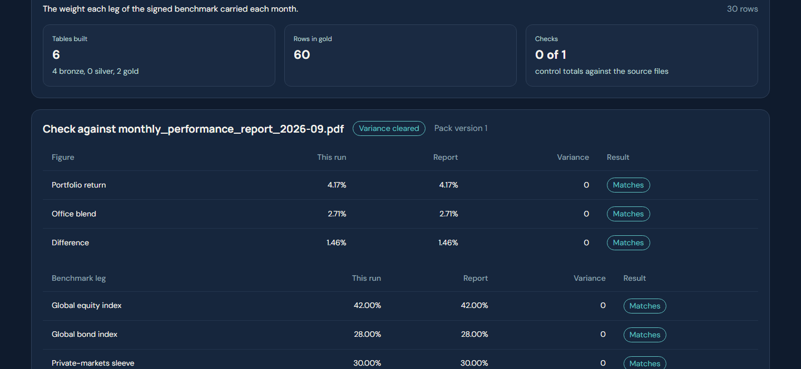
HOW IT WORKS · 3 OF 5 · BUILD AND PROVE (SPAN, BUILDER)
The builder runs on a copy and checks every line against the report already issued.
1 Connect
2 Run on a copy
3 Check
4 Correct
5 Approve and rerun
6 Go live
Sources as the pack says
→
→
Against September’s issued report
→
Four definition texts, version 2
→
→
Monthly at 06:00, from the pack
Automatic, no click
Head of data approves; builder checks again
Built figures against the issued September report
Portfolio 4.17% vs 4.17% issued
Office blend 2.71% vs 2.71% issued
Difference +1.46 vs 1.46 points
All three legs matched too.
MEASURED The first run matched the report. Version 2 corrected four definition texts, and the rerun matched again before go-live.
Benchmark check against the report as issued. Source: walkthrough, 11 Oct 2026, synthetic data.
Signal Harbor
6 / 20
Notes:
Live (0:10 to 0:15): still as Anita, open Pipelines and show the last check result. Say: 'The builder ran on a copy and checked every line against the September report. All three figures matched.' Point at the 4.17 / 2.71 / 1.46 lines with Matches. Sign convention: say 'portfolio minus benchmark, in percentage points'. The first run matched; version 2 corrected four definition texts and the rerun matched again before go-live. Fallbacks: img/builder-variance.png, img/pack-v2-approved.png, img/go-live.png.

Slide 7
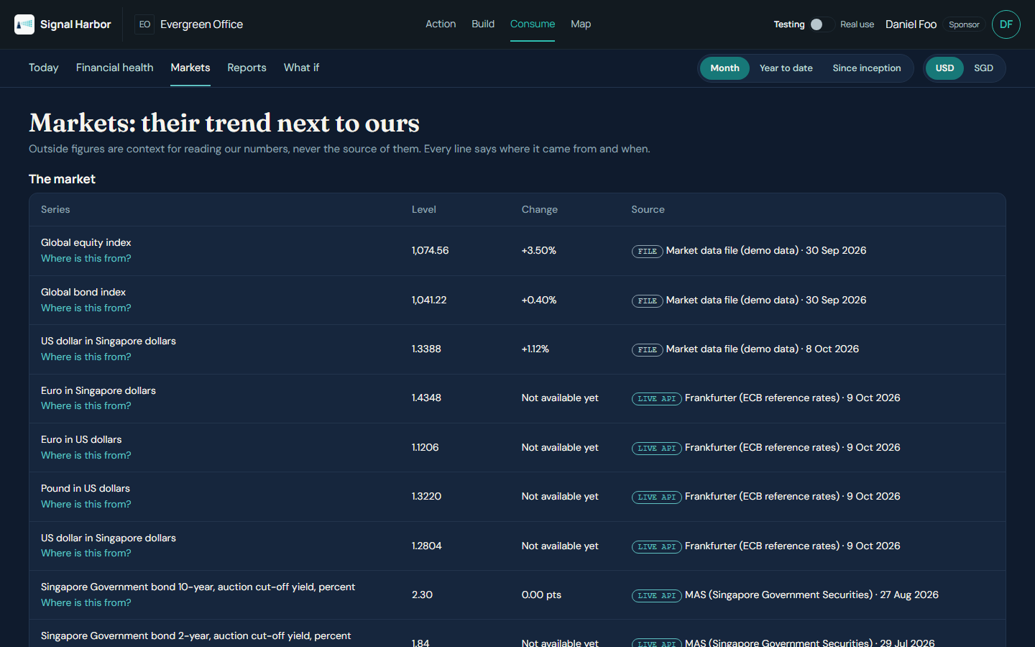
HOW IT WORKS · 4 OF 5 · CONSUME
Consume: the morning note, financial health and markets, each line with its source.
● Today. One sentence, four key numbers, and what moved against the benchmark.
● Financial health. Daily P&L and NAV by portfolio, entity or fund, with how far each value can be trusted.
● Markets. Every outside line is tagged FILE or LIVE API, with its source and date.
● Reports hold the library and the dashboards a person approved. What if shows attribution.
● One USD / SGD switch stays set as you move between pages.
A missing input shows as missing. If the daily price file has not arrived, the screen says so instead of showing a number.
Consume, Markets: each outside line carries FILE or LIVE API, its source and its date. Synthetic data.
Signal Harbor
7 / 20
Notes:
Live (0:15 to 0:20): sign in as Daniel Foo. Open Consume: Today, then Financial health, then Markets. On one Markets line read the FILE or LIVE API tag and its date. Say: 'Every outside line says where it came from and when.' Also mention Reports (library and approved dashboards), What if, and the USD/SGD switch at top right. A missing input shows as missing. Fallbacks: img/consume-today.png, consume-health.png, consume-markets.png.

Slide 8
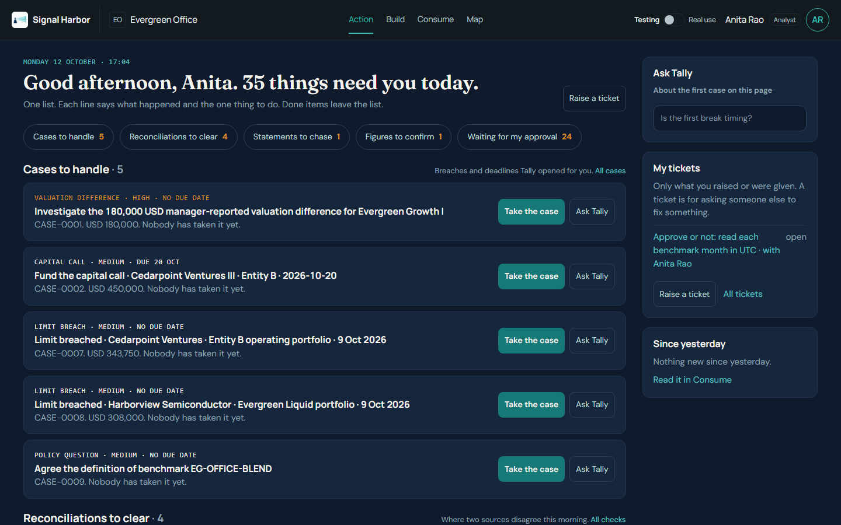
HOW IT WORKS · 5 OF 5 · ACTION
Action is one page: what needs a person today, and why.
● Cases to handle, with the evidence attached.
● Reconciliations to clear. When Tally reads a break as timing, one click closes it as timing.
● Figures to confirm read from files, and statements to chase.
● Waiting for my approval: packs, plans, dashboards, deliveries and Map items.
● Done today grows as the team clears the list.
Follow-ups to managers are drafted for a person to copy. Nothing is sent by the system.
Action, one page, as the head of data sees it. “Where is this from?” opens the trail on any figure. Synthetic data.
Signal Harbor
8 / 20
Notes:
Live (0:20 to 0:24): sign in as Raj Patel, open Action, open one case, click Where is this from? on a figure. Say: 'Action is one page of what needs a person. Every figure shows its trail.' Show Close as timing on a break Tally reads as timing, and Done today growing. Follow-ups to managers are drafted for a person to copy; nothing is sent. Fallback: img/action-one-page.png.

Slide 9
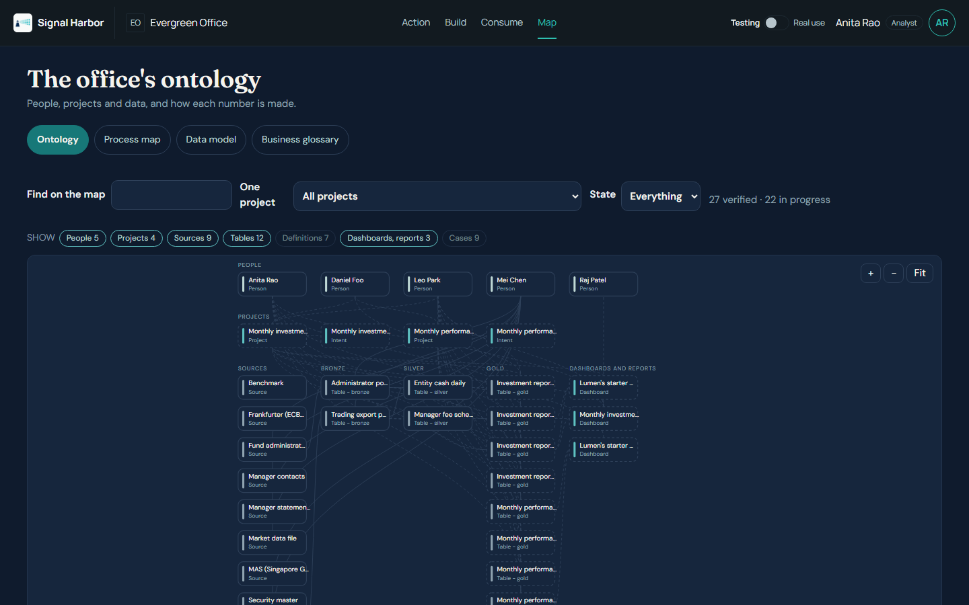
THE MAP · ONTOLOGY
One graph of the office: people, projects, data and how each number is made.
● Whole company. People, projects, sources, tables, dashboards and reports, cases and decisions on one graph.
● Zoom and pan. Plus, minus and Fit buttons; ctrl-wheel or pinch zooms at the pointer; drag to pan.
● Narrow it. Find box, one project at a time, state, and Show chips.
● Click a node for its owner, state and what it connects to.
● Switch to Process map, Data model or Business glossary.
Map, Ontology view. Synthetic data.
Signal Harbor
9 / 20
Notes:
Live (0:24 to 0:27): sign in as Anita Rao, open Map. The default view is Ontology. Zoom with the plus and minus buttons or ctrl-wheel at the pointer, Fit resets, drag pans. Click a node for its owner, state and connections. Pick one project to see its steps grow. Then switch to Data model on the next slide. Fallback: img/map-ontology.png.

Slide 10
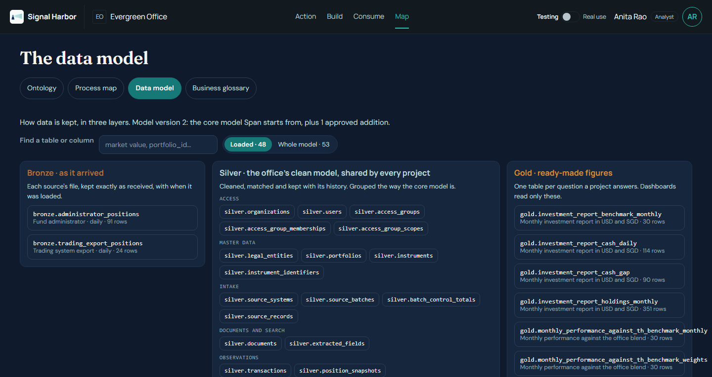
THE MAP · DATA MODEL WITH IMPACT
See what each number is made of, and what a change to a table would touch.
Bronze
Silver
Gold
As it arrived. Originals are kept.
→
The clean model, one version for the whole office.
→
Ready-made figures, per project. What a dashboard or report reads.
● Pick a table. Columns with meaning, row count, owner and what it reads.
● If this table changes. The gold tables, dashboards, reports and projects that depend on it.
● Loaded or whole model. Tables that hold rows today, or the full model with the rest dimmed.
● Model additions. A new table needs a model change first. The head of data approves it, and it then joins the model, outlined as added for this office.
The data team sees every layer. Everyone else sees only the gold tables of projects they may see.
Data model: every table by layer, with row counts. A picked table lights what it reads and what reads it.
Signal Harbor
10 / 20
Notes:
Live: still on Map, switch to Data model. Say: 'The Map shows what each number is made of.' Point at the Bronze, Silver and Gold labels. Switch between Loaded and Whole model. Pick a silver table and show what it feeds; pick a gold table and show what it reads and 'If this table changes'. The data team sees every layer; everyone else sees only the gold tables of projects they may see. Fallback: img/map-data-model.png.

Slide 11
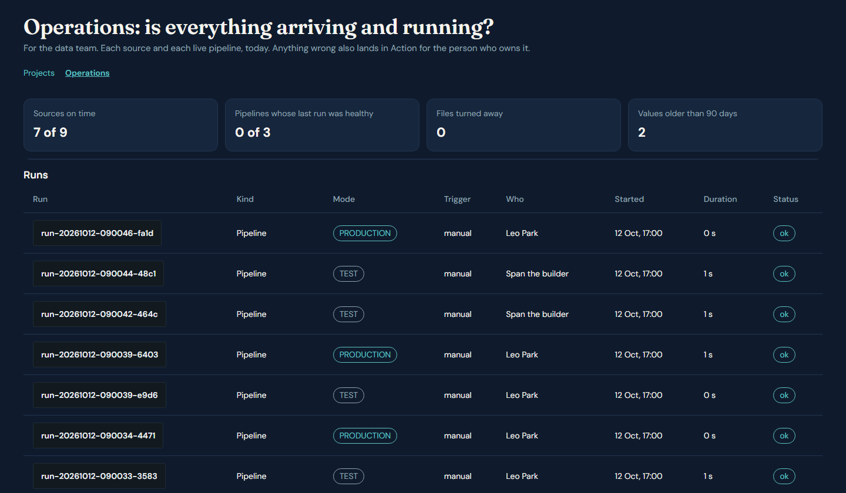
OPERATIONS · DATA TEAM
Is everything arriving and running? Sources, runs and deliveries on one page.
● Sources. Each source, who owns it, when it last arrived and whether it is late.
● Live pipelines. Each pipeline that has gone live, and whether its last run was healthy.
● Runs. Every run has a run ID, a TEST or PRODUCTION badge and its steps.
● Deliveries. The email and Slack previews and what is waiting to go out.
Anything wrong also lands in Action for the person who owns it. Operations sits under Build, next to Projects.
Operations: tiles, then Runs with run IDs and TEST or PRODUCTION badges. Sources, live pipelines and deliveries are on the same page. Synthetic data.
Signal Harbor
11 / 20
Notes:
Live: sign in as Leo Park (data engineer and ops), open Build, then the Operations tab next to Projects. Four tiles, then the Sources table (when each source last arrived), Live pipelines, Runs (run ID, TEST or PRODUCTION badge, click a run for its steps) and Deliveries (email and Slack previews). Anything wrong also lands in Action for the person who owns it. Fallback: img/operations.png.

Slide 12
LIVE MARKET DATA · CONNECT AN API
Four public sources, Singapore included, on the same controls as the files.
SOURCE | WHAT IT GIVES | KEY
Frankfurter (ECB reference rates) | USD/SGD, EUR/USD, EUR/SGD, GBP/USD | None
FRED (US Federal Reserve data) | US 10- and 2-year Treasury yields, SGD per USD, Singapore CPI inflation | Free key
Finnhub | ETF quotes (ACWI, AGG, EWS) and market news | Free key, sent in a header
MAS (Monetary Authority of Singapore) | Singapore Government Securities auction yields, 2 to 30 years | None
How a connection works
● Choose the source and series, then Test: you see real rows and the time it took.
● Save, and the daily pull runs. Fetch now is on the Connectors page.
● The host is fixed on an allowlist. Every call goes through the egress gateway.
● Keys are read from the environment, never shown on screen or in the address.
● Each series is tagged LIVE API with its source and date on Consume.
SGS yields are the yield at the last auction of each tenor, not a daily curve. EWS stands in for the licensed Straits Times Index. SORA is not connected yet: it needs a MAS API key registration.
Signal Harbor
12 / 20
Notes:
Live (0:27 to 0:28): as Leo Park, open Build, then Connect an API (also under Settings, Connectors). Show the four providers and their key status. Do not enter or paste any key. Say: 'Market data comes in through the same gateway and labels as the files.' Frankfurter and MAS need no key; FRED and Finnhub use a key stored by the administrator. SGS yields are the yield at the last auction of each tenor, not a daily curve. SORA is not connected: it needs a MAS API key registration. Fallback: img/connect-api.png.

Slide 13
GOVERNANCE · LINEAGE AND RUN IDS
Every run has an ID, and every gold figure walks back to its file.
Source file
File batch
Record
Bronze
Gold
From a named source and owner
→
One batch ID, with control totals
→
Each row kept with its batch
→
As received, with its load ID
→
Each table carries the run ID that built it
A run ID on every run
What governance can answer
● An ID like run-20261012-131500-ab12, with who started it and what triggered it: manual, schedule, file arrived or connector.
● TEST runs are on a copy. PRODUCTION runs are live.
● Covers pipeline runs, file loads, connector pulls and reconciliations, each with its steps.
● Which run built this figure, and when?
● Which file and batch did it come from?
● Who started the run, and was it a test?
The run ID is on gold tables today. The bronze load ID on the market-data loader, and the run ID on the silver tables, are still being joined up.
Runs are listed in Operations (data team)
13 / 20
Notes:
Say: every run, test or production, gets an ID such as run-20261012-131500-ab12. Operations lists them. The chain is: source file, file batch, record, bronze with its load ID, gold with the run ID that built it. Be honest about the edges: the run ID is on gold tables today; the bronze load ID on the market-data loader and the run ID on silver tables are still being joined up. Runs are visible to the data team in Operations.

Slide 14
PEOPLE AND ACCESS
Each person sees what their role needs. The maker never approves their own work.
ROLE (IN THE DEMO) | WHAT THEY SEE AND DO | WHAT THEY SIGN OR APPROVE
Sponsor · Daniel Foo, CIO | Action, Build (their own intent), Consume, Map (read only). Decides what the office needs. | Signs the intent. Approves the dashboard and each delivery channel.
Business owner · Mei Chen, Operations | Talks to North, reads Consume and Map, acts on her Action items. Not the data team. | Sends work for approval. Never approves her own.
Approver · Raj Patel, Finance | Action, Consume, Map. Clears cases and confirms figures. | Approves what is sent to him, never his own work.
Head of data · Anita Rao | Owns the data design and the data approvals in Action. | Approves the design pack, the build plan, verified Map items and model changes.
Data engineer · Leo Park | Operations, Pipelines and Connect an API. Confirms sources and takes the pipeline live. | Confirms the sources. Presses Go live.
Administrator · Grace Ong | Access and every setting. | Gives people access to each centre.
Settings follow the role: three items for the sponsor and the business owner, seven for the head of data, eight for the data engineer, sixteen for the administrator. Operations and the full data model are for the data team; everyone else sees the gold tables of their own projects.
Evergreen Office is synthetic. Access is set per office at rollout.
14 / 20
Notes:
Say: agents draft, people sign. Sponsor signs the intent and approves the dashboard and each delivery channel. The business owner sends work for approval and never approves her own. The head of data approves the design pack, the build plan and verified Map items. The data engineer confirms sources and presses Go live. The admin gives access. Every role opens on Action and can read Consume, with figures filtered by access. Settings follow the role: three items for the sponsor and the business owner, up to sixteen for the administrator. Operations and the full data model are for the data team. Signing in per role is on the run sheet.

Slide 15
TECHNICAL ARCHITECTURE
One application, one exit, one data plane for each company.
People
Sponsor
Analyst
Approver
Head of data
Browser
Action
Build
Consume
Map
Settings
API
One permission table. Any route not in it is refused by default.
Company and module checks per request
Four agents
North
Span
Lumen
Tally
One shared read-only loop. A guard: each figure must trace to a recorded fact.
One exit
Egress gateway: allowlist, names masked, no raw rows leave, every call logged, outage breaker
Model services and the four market sources, through the gateway only
Company data
Landing (originals)
Bronze
Silver
Gold per project
Checks, cases, documents, logs
Deployment: one service, one persistent volume per company, a health check. Demo platform today; the office’s own cloud is a rollout option.
Diagrams in the technical pack: four centres, data layers, deployment
15 / 20
Notes:
Slides only. Say: 'one exit'. People use a browser; the API has one permission table and refuses any route not in it; four agents share one read-only loop with a guard that every figure must trace to a recorded fact; the only way out is the egress gateway (allowlist, names masked, no raw rows, every call logged, outage breaker). Company data sits in its own plane: landing, bronze, silver, gold per project, checks, cases, documents and logs. Deployment: one service, one persistent volume per company, a health check; the office's own cloud is a rollout option.

Slide 16
SECURITY AND DATA GOVERNANCE
The office’s data stays in its own space. Every figure traces to a file and a person.
● Data stays in the office’s space. Each company has its own data plane and volume.
● One way out. The egress gateway is the only route to any outside service.
● Names are masked before text leaves the office. Raw rows never leave.
● Every figure traces to its file, row and person through “Where is this from?”.
● Approvals by a different person. Maker and checker differ. Approved is locked.
● Text in files is data, never instructions. Agents cannot approve or send.
Run tracking: every run, test or production, has a run ID, its person, its trigger and its steps. Slide 13 shows the chain from file to gold figure.
Demo data is synthetic. Production controls (keys, roles, retention) are set per office during rollout.
Signal Harbor
16 / 20
Notes:
Slides only. Say: names are masked and raw rows never leave. Every figure traces through Where is this from?. Approvals are by a different person; approved is locked. Text in files is data, never instructions; agents cannot approve or send. Run tracking: every run, test or production, has a run ID, its person, its trigger and its steps; slide 13 shows the chain. Demo data is synthetic. Production controls (keys, roles, retention) are set per office during rollout.

Slide 17
OPERATING EFFICIENCY
One monthly report: measured in our walkthrough, against a typical manual month.
WHAT | MEASURED IN OUR WALKTHROUGH | TYPICAL MANUAL MONTH-END
Time to a delivered report | MEASURED About 45 minutes, first words to delivery live, of which about 10 minutes was the conversation. | ESTIMATED Typically two working days of spreadsheet work, to be validated with your team.
People involved | MEASURED Four people, each acting at their own points. Agents ran and checked between them. | ESTIMATED An analyst and a reviewer, plus time chasing statements. To be validated.
Model cost | MEASURED About USD 0.01 for the whole run (test mode, 26 model calls). | ESTIMATED No model cost; the cost is staff time.
Not included in the 45 minutes: waiting for managers to send statements, and any real corrections found later. The manual figures are typical, not measured in your office.
Measured = from the walkthrough of 11 Oct 2026 (synthetic data). Estimated = to validate.
17 / 20
Notes:
Slides only. Measured in our walkthrough (11 Oct 2026, synthetic data): about 45 minutes from first words to delivery live, of which about 10 minutes was the conversation with North; four people; 26 model calls and about USD 0.01 of model cost in test mode. Estimated, to be validated with the client's team: the typical manual month-end (two working days). Never present the manual figure as measured. Not included in the 45 minutes: waiting for managers to send statements, and real corrections found later.

Slide 18
ROLLOUT PLAN
Start with one use case in two to four weeks, then add the next.
1 · Choose
2 · Prove
3 · Run alongside
4 · Extend
One use case with an owner. Proposed: the monthly portfolio against its benchmark.
Build on synthetic or pilot files. Check every line against a report already issued.
One real month-end in parallel with the current process. Head of data signs off.
Add the next use case on the same design and approvals, one at a time.
● Pilot data first. Synthetic or pilot files until the pack is approved.
● Hosting. The demo platform today; your own cloud when the pilot ends.
● Success is measured. The pilot report must tie to the issued figures line by line.
● Timing. Two to four weeks to the first parallel run, depending on file access.
Signal Harbor
18 / 20
Notes:
Slides only. Four steps: choose one use case with an owner (proposed: the monthly portfolio against its benchmark); prove it on synthetic or pilot files, checking every line against a report already issued; run alongside one real month-end with the head of data signing off; extend one use case at a time. Hosting: the demo platform today, your own cloud when the pilot ends. Timing depends on file access.

Slide 19
WHAT WE NEED FROM YOU
Six decisions to start the pilot.
● One use case and one owner for the pilot.
● Sample files for each source, or confirmation of the list in the intent.
● A head of data who approves the design pack and the plan.
● An access list: who signs, who reads, who approves.
● Hosting choice: the demo platform for the pilot, or your cloud.
● The success line: the pilot report ties to the issued figures.
Next step: a working session with the owner, the head of data and the business reader, within the week.
Signal Harbor
19 / 20
Notes:
Slides only. The six decisions: one use case and one owner; sample files for each source; a head of data who approves the design pack and the plan; an access list (who signs, who reads, who approves); the hosting choice; and the success line (the pilot report ties to the issued figures). Next step: a working session with the owner, the head of data and the business reader, within the week.

Slide 20
THANK YOU
Questions and discussion
Every figure in this session came from synthetic Evergreen Office data. The same trail works on your data once the pilot starts.
Signal Harbor · Evergreen Office is synthetic
20 / 20
Notes:
Close (0:29 to 0:30). If a question goes beyond the deck, say you will follow up in writing. Do not guess at a figure. See the run sheet for likely questions.

