Slide 1
Finance & Risk Analytics
By – Nitin Bhardwaj

Slide 2
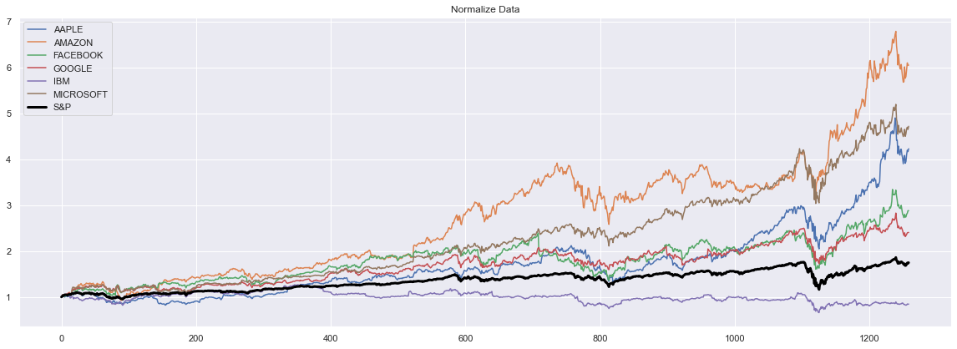
Technology Stock if we see technology stocks most of technology stocks has outperformed index . only stock which has not performed is IBM.

Slide 3
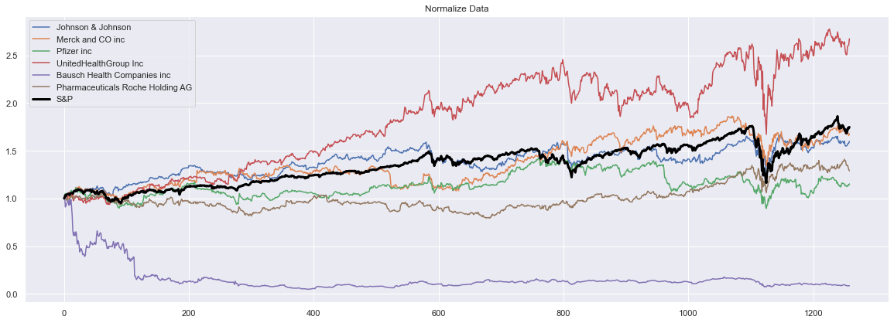
Pharma Stocks In pharma stocks only UCB has outperformed , other stocks like MRK and JNJ has given some decent returns but slightly lower than market index. other stocks has not performed and BHC has given negative returns

Slide 4
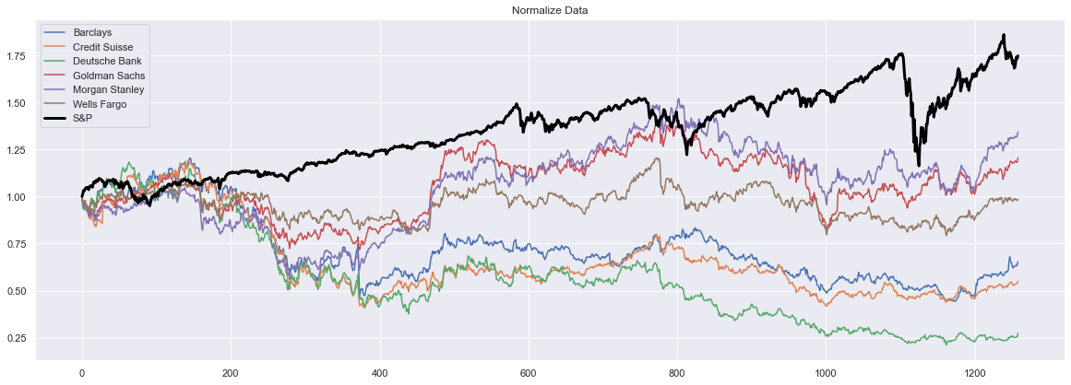
Finance stock In previous 5 years all finance stocks has underperformed in comparison to index . out of all six stocks only 2 stocks has very less cumulative return (GS,MS). all other stocks have negative growth

Slide 5
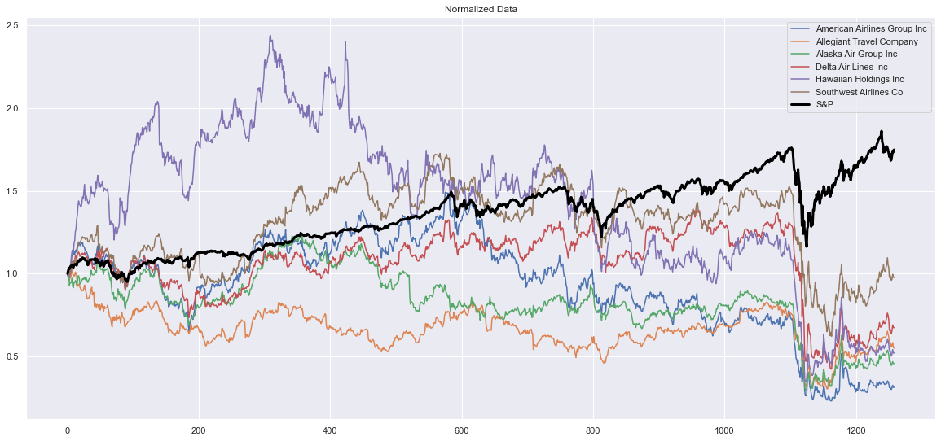
Aviation Stock In the initial years aviation stocks like AAL & LUV gave some good returns compare to market index but later all aviation stock started declining and Covid situation make it worse when all stock prices get negative returns due to travel ban

Slide 6
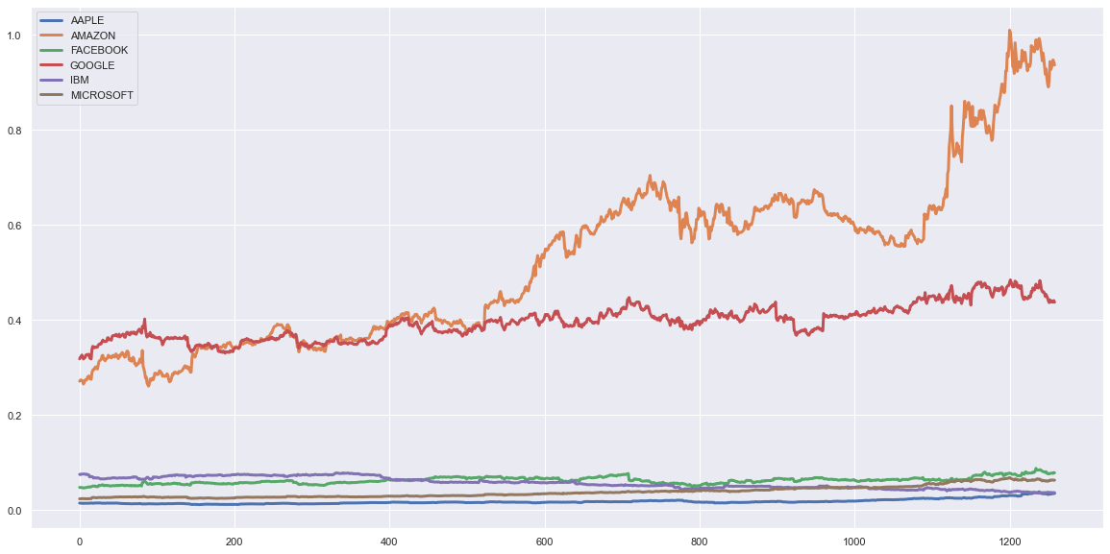
Finance Stocks RSI As the market has increased Amazon has shown very Positive RSI which means the pace of increase in price of amazon is higher than market index .Google has also shown +ve RSI where as other stocks have increased with with the same speed as market index speed other than IBM whoes RSI has declined over the time period

Slide 7
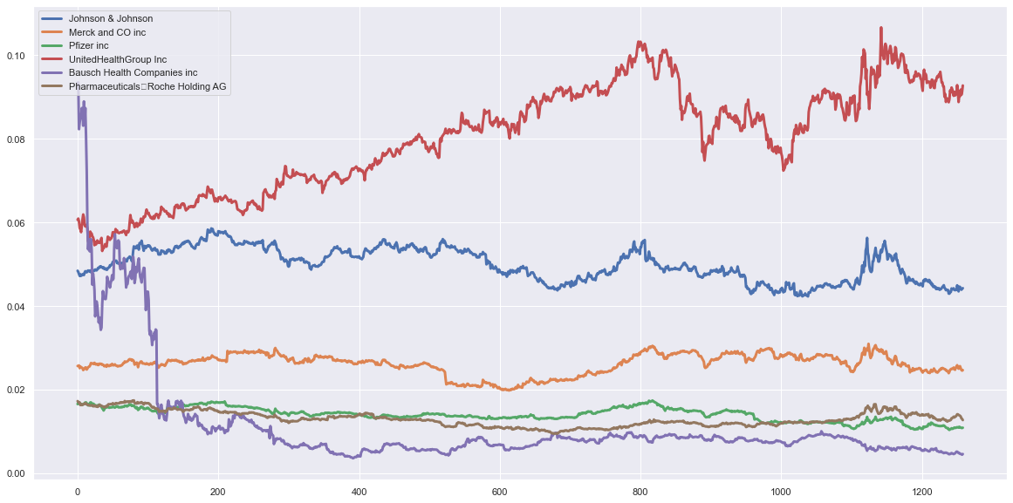
Pharma Stocks UNH has shown very Strong RSI Growth than other stocks

Slide 8
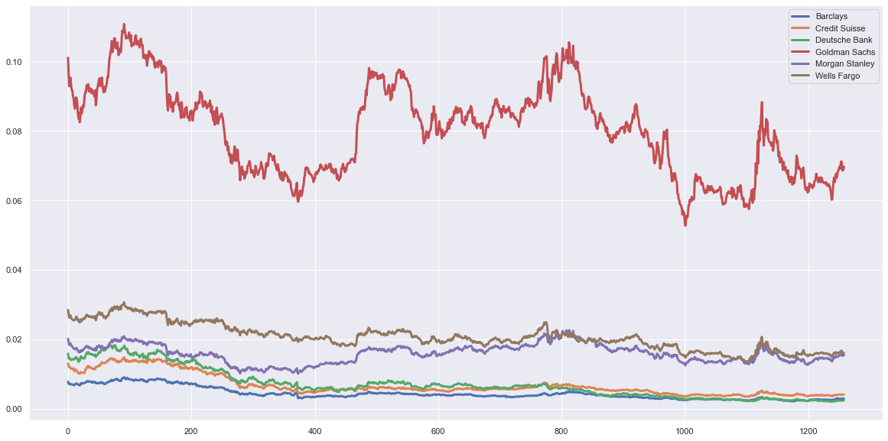
Finance Stocks RSI All Finance stocks have Negative RSI as the market has increased

Slide 9
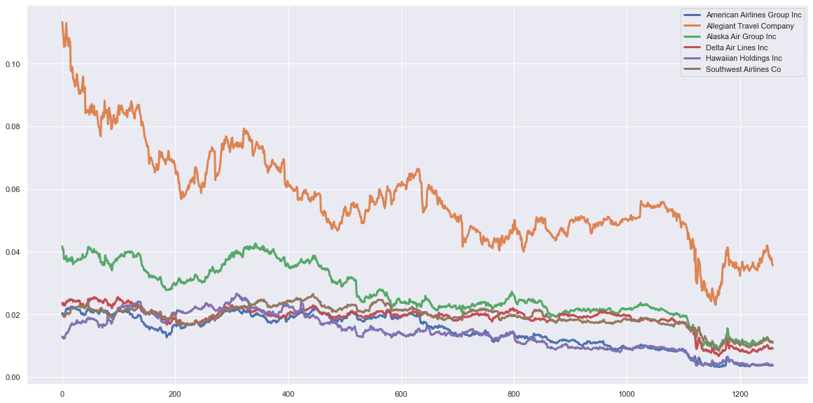
Aviation Stocks RSI All Aviation stocks have Negative RSI growth . As the Market has increased all these Stocks price has fallen

Slide 10
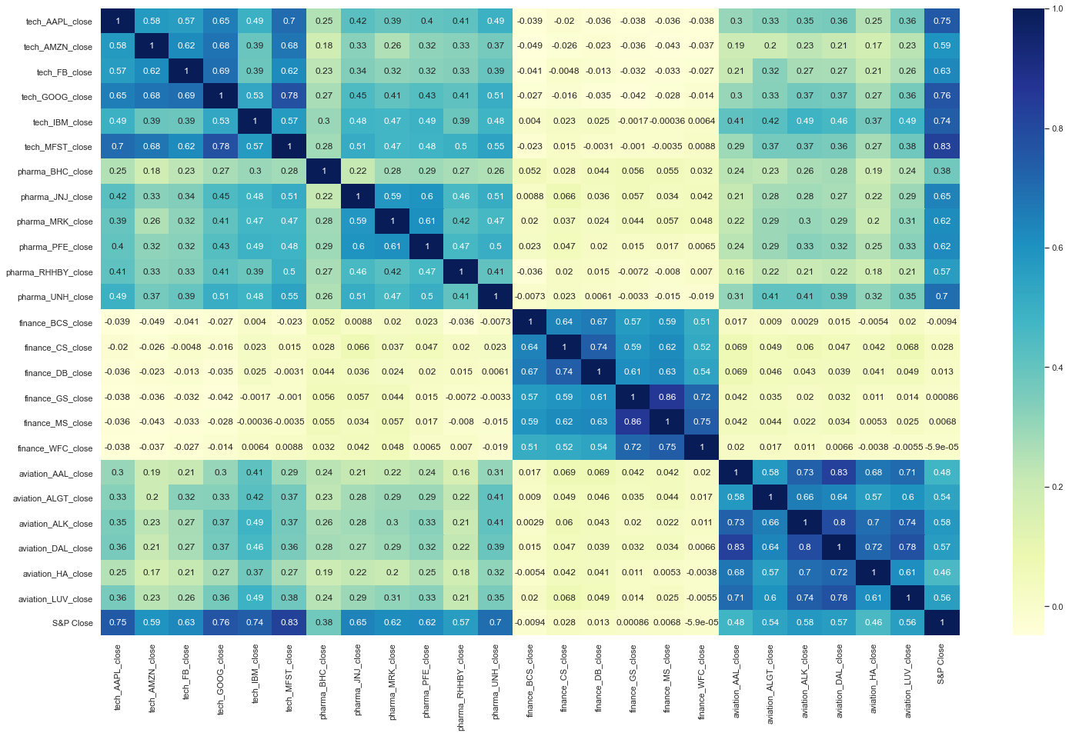
If we see the correlation Heat Map we can conclude all the Different industry Stocks Have High Positive Correlation with Market index but Finance industry stocks have very least and Negative correlation which is not preferable by investor All the stocks of same industry have High Correlation with each other . Some Technology stocks have decent Positive Correlation with Pharma stocks like UNH has more than and 0.5 correlation with Google and Microsoft

Slide 11
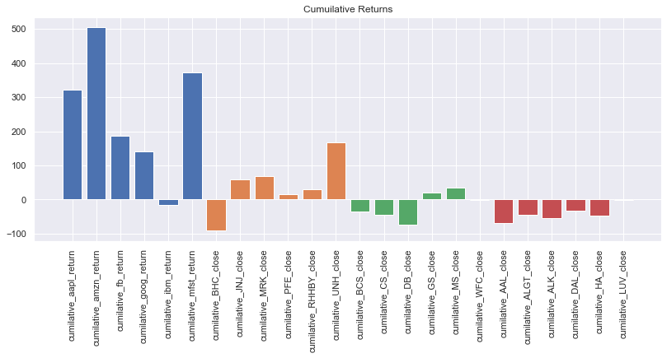
Comparatively to other industry Technology stocks have good Cumulative returns except 'IBM‘ . Pharma stock like 'MRK' & 'JNJ' has decent returns & 'UNH' has Best returns compare to other Pharma stocks. Finance Stocks has Negative returns except 'GS' , 'MS' which have very low returns and have higher Risk. Where as all Aviation stocks have Negative growth

Slide 12
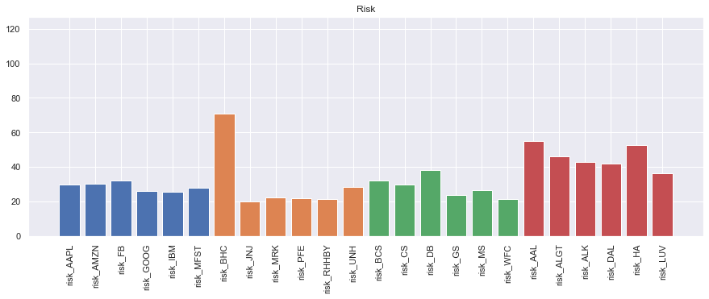
Risk Technology & Pharma stocks are less volatile except one pharma stock (BHC) finance stocks are also less volatile compare to aviation stock. aviation industry has highly volatile and one of the main reason is due to Covid restriction to Fly to other Countries.

Slide 13
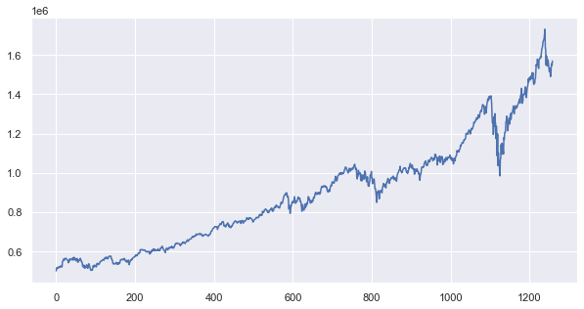
MR Patrick Jyanger Portfolio after Selecting Stocks According to their goals and Risk Appetite are [MRK GOOG MFST,UNH,AAPL]. if Mr Patrick has invested 500000 on 30 Sep 2015 then at the end of 5 years he would have got 1570015

Slide 14
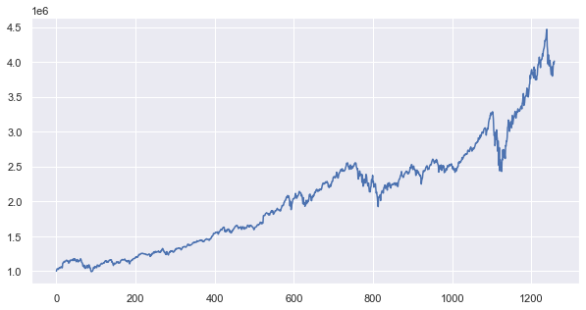
MR Peter Jyanger Portfolio after Selecting Stocks According to their goals and Risk Appetite are [GOOG,MFST,AAPL,AMZN,MRK]. if Mr Patrick has invested 1000000 on 30 Sep 2015 then at the end of 5 years he would have got 4013372

Slide 15
Expected value on Portfolio
expected portfolio return value is 2875527
portfolio_risk is 29.21
Expected Average Annual Portfolio return % 31.24
portfolio beta value is 1.04
expected portfolio return is 1162440
portfolio_risk is 26.86
Expected Average Annual Portfolio return % 0 25.16
portfolio beta value is 1.015
Mr Peter Jyengar
Mr Patrick Jyengar

