Slide 1
Facial Emotion Recognition
Manasa Donepudi
Nitin Chakravarthy Gummidela
Shruthi Reddy Rodda

Slide 2
Outline/Agenda
Introduction
Dataset overview
Model
Experimental Results
Visualization
Conclusion
Future work
References

Slide 3
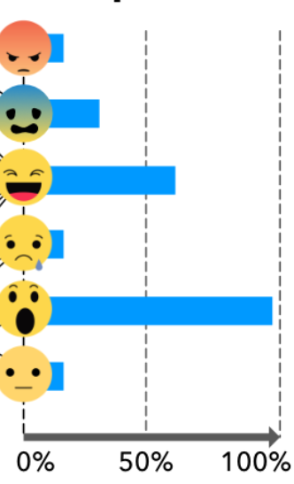
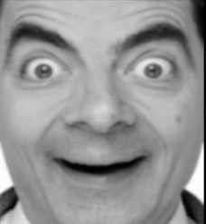
Objective
MODEL
Prediction of emotion from facial expressions
Compare different models and techniques
Analyse the prediction by diving into the model

Slide 4
Related Work
In order to recognize and categorize facial expressions accurately, based on our knowledge in class, we first thought of using basic machine learning techniques such as Support Vector Machine using PCA.
Krizhevsky et.al.[4] Simonyan et.al.[5] Y. LeCun et.al[6] used VGG, AlexNet and LeNet architecture for ImageNet dataset
Tang et.al. used SVM over global features extracted from the CNNs

Slide 5
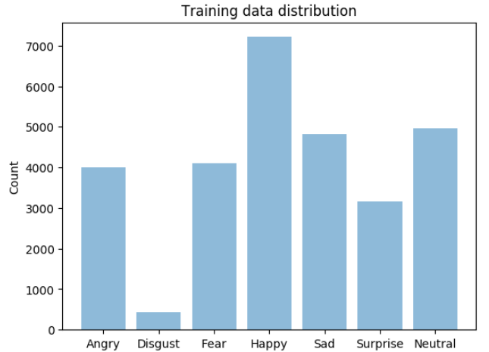
Overview of FER2013
Training data: 28,709
Validation data: 3,589
Test data: 3,589
48x48 Grey scale Images
0 – angry
1 – disgust
2 – fear
3 – happy
4 – sad
5 – surprise
6 – neutral
Notes:
The data set we used is FER2013. This dataset contains 48x48 grayscale images.

Slide 6
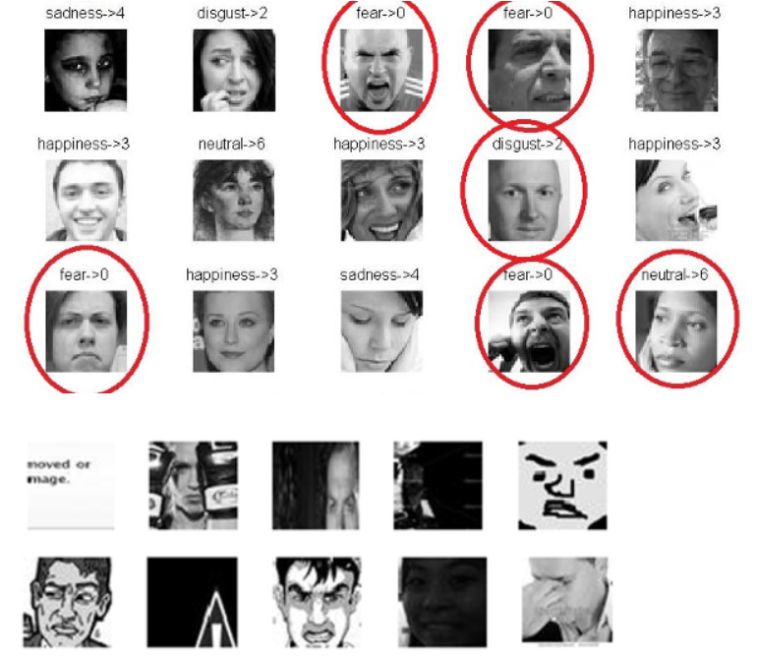
FER2013
Incorrectly Labeled samples
Samples which are not faces
Difficult because the model has to generalize for incorrect data
Human accuracy on the dataset is 65+-5 %

Slide 7
CNNs
Shallow CNNs to deeper CNNs
LeNet
2 Convolution layers
AlexNet
5 Convolution layers
VGG12
12 Convolution layers

Slide 8
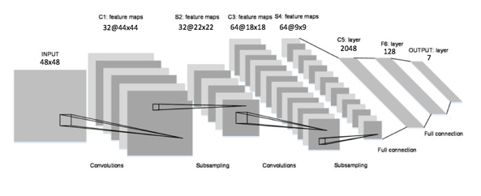
2-Layer ConvNet
2-layer convolution net - LeNet Architecture

Slide 9
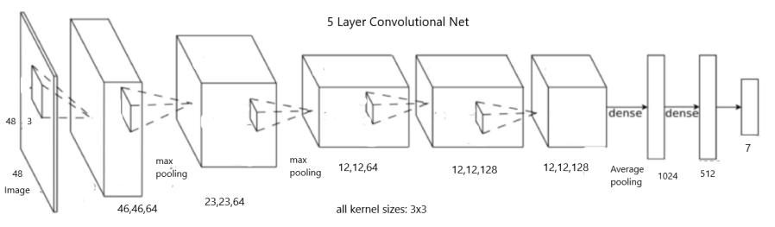
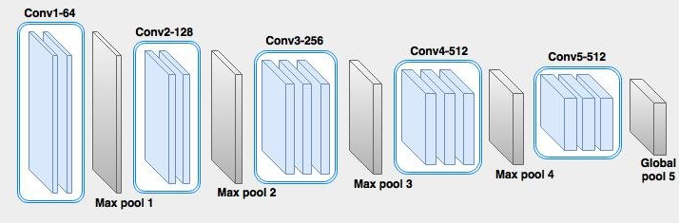
Deep-ConvNets
5 Layer CNN
16 layer CNN (adapted to 12 layers)

Slide 10
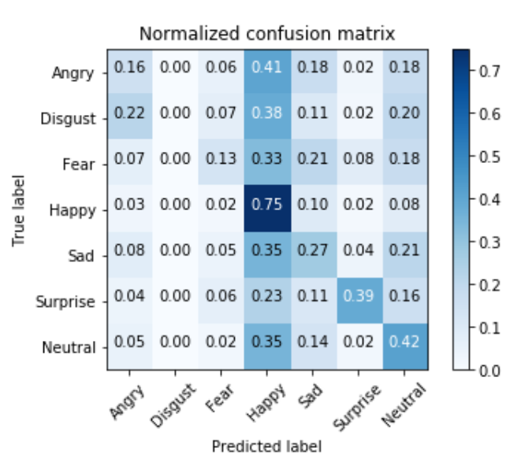
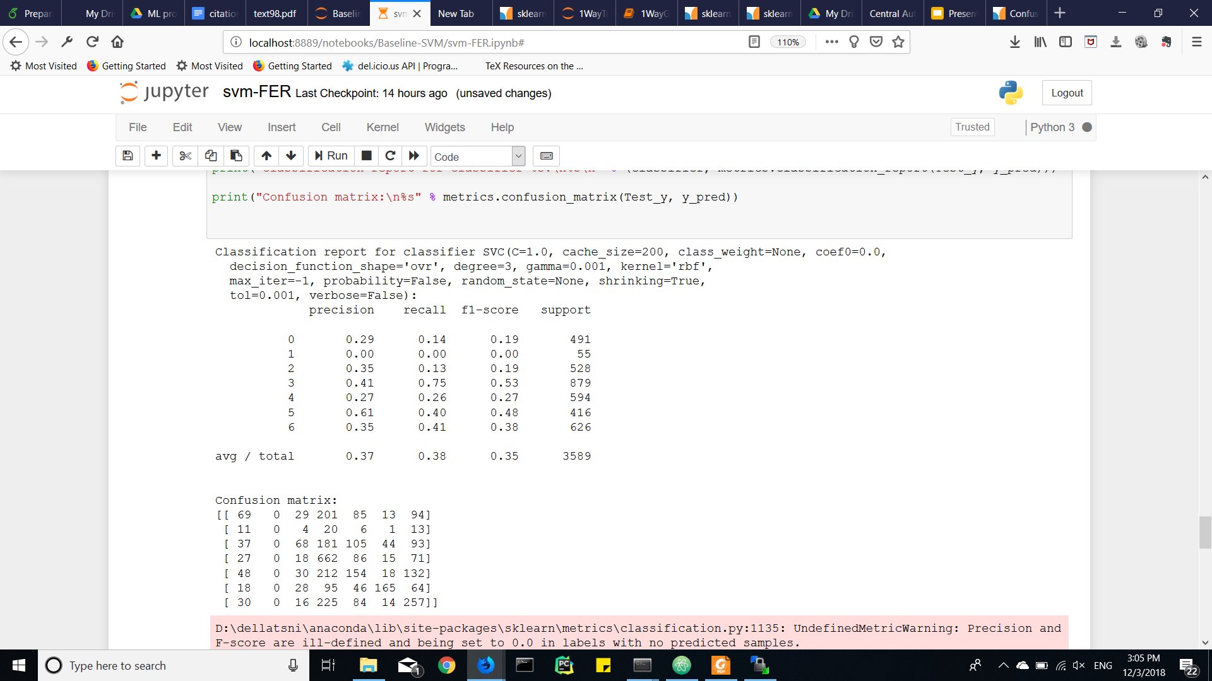
SVM with PCA
# principal components = 200
radial Basis function
C = 1
gamma = 0.0001
accuracy = 39.98 %
Notes:
The class ‘disgust’ is highly imbalanced in the data set. SVM was not able to handle highly imbalanced classes. But CNN was able to handle it
SVM is generally biased towards a major class when we have an imbalanced dataset.

Slide 11
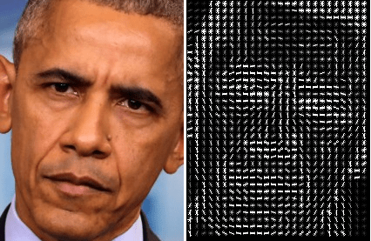
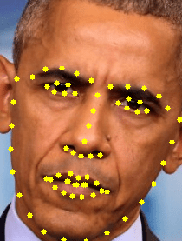
SVM on HOG and Facial Landmarks
accuracy = 48.2%
Notes:
Linear Support Vector Machines trained on HOG
features are now a de facto standard across many visual
perception tasks.
The reason SVM on HOG and facial landmarks work better is the

Slide 12
Softmax v/s SVM
•Multiclass SVM instead of softmax
•consistent increase in accuray
model | Softmax | MultiClass SVM
LeNet | 56.2 | 56.9
AlexNet | 61.1 | 61.8
VGG12 | 63.9 | 64.5

Slide 13
Results
Model | Avg. Precision | Avg. Recall | Avg. f1 score | Accuracy (%)
SVM with PCA | 0.37 | 0.38 | 0.35 | 39.98
SVM on HOG and Face Landmarks | 1.00 | 0.48 | 0.65 | 48.2
AlexNet | 0.62 | 0.62 | 0.62 | 61.1
LeNet | 0.55 | 0.56 | 0.55 | 56.2
VGG12 | 0.63 | 0.64 | 0.63 | 63.9
SVM on CNN | 0.64 | 0.64 | 0.64 | 64.4

Slide 14
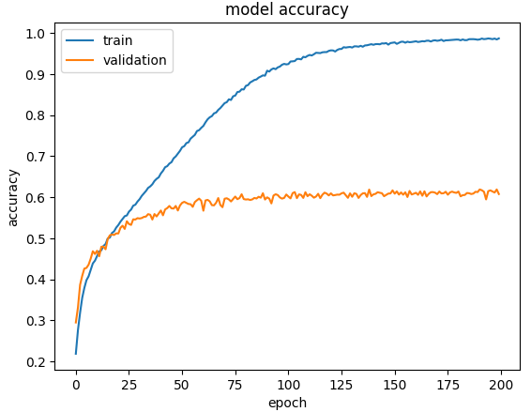
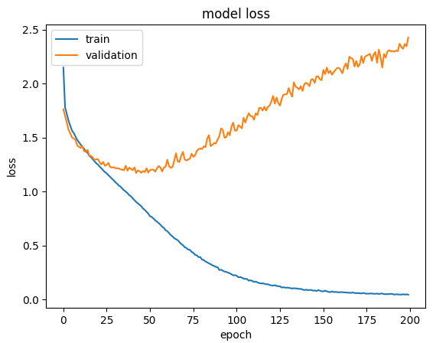
Analysis
Training Curves:

Slide 15
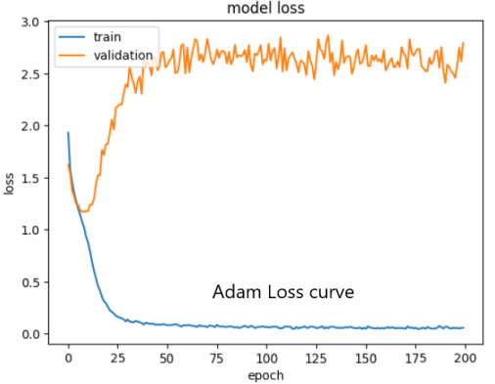
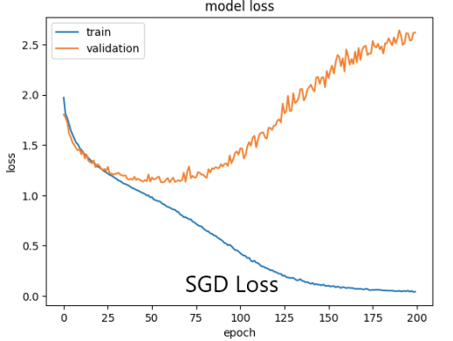
Hyperparameter Tuning on 5-Layer Net
Optimizers:
We have tried several optimizers like SGD, Adam, Adadelta, RMS Prop.

Slide 16
Number of filters:
All layers have same number of filters(64)
Top three layers have 64 filters and rest two have 128 filters
Top three layers have 128 filters and rest two have 64
Dropout rates:
Without dropout, accuracy 0.55
With optimal dropout, accuracy 0.61
Fully Connected Layers
Number of Convolutional Layers
Shallow to deep CNNs
Notes:
Dropout helps reducing the interdependent learning amongst the neurons.

Slide 17
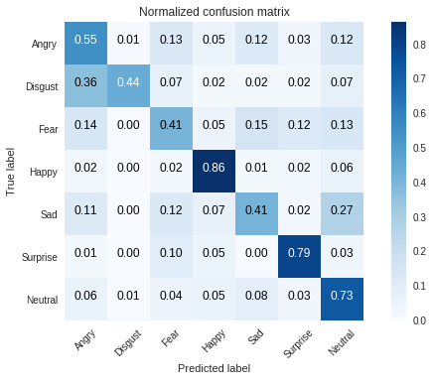
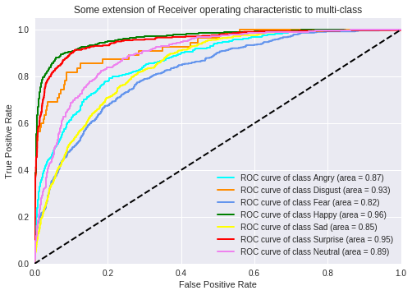
Confusion matrix, ROC curves
Misclassifications:
Disgust -> Angry
Sad -> Neutral

Slide 18
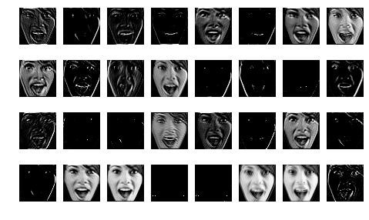
Visualization -Layer activations
Layer -1 activations

Slide 19
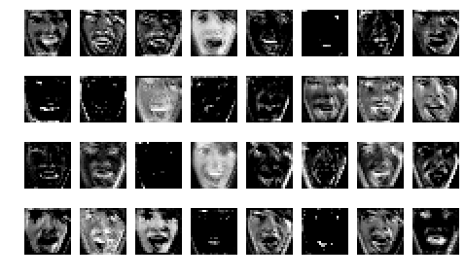
More visualization...
Layer -3
1 max pooling

Slide 20
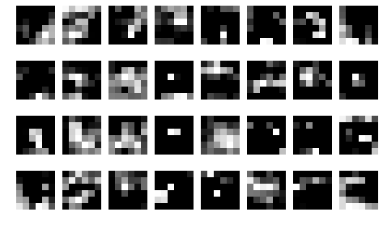
And more ...
Layer -8
3 max pooling layers

Slide 21
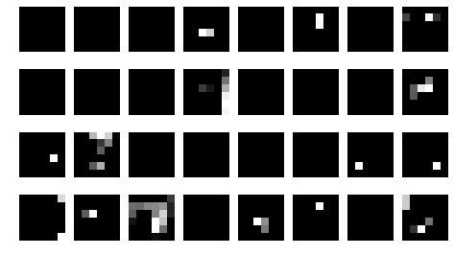
And more...
Layer -9
Final Activation map
inputs to dense layers that predict the probabilities

Slide 22
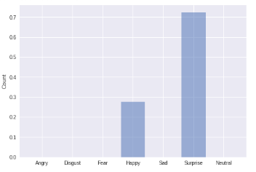
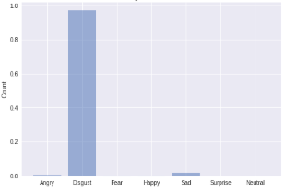
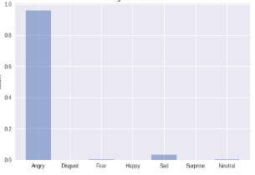
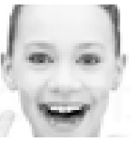
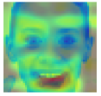
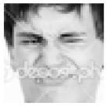

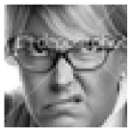
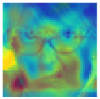
Images and Prediction probabilities
Correctly classified
Label: 5, Surprise
Correctly classified
Label: 1, Disgust
Correctly classified
Label: 0, Angry

Slide 23
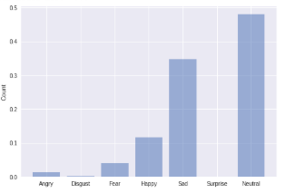
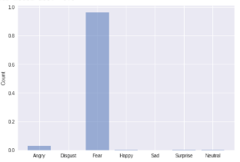
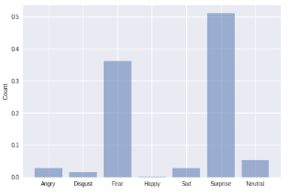
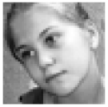
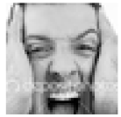
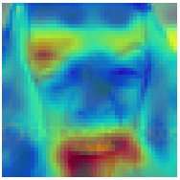
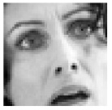
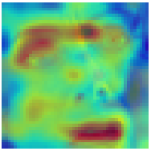
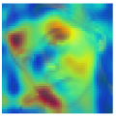
More Images ...
Classified Neutral (6)
Original Sad(4)
Classified Fear (2)
Original Angry(1)
Classified Surprise (5)
Original Angry(1)

Slide 24
Conclusion
SVMs perform better over global features (global activation, HOG and Face landmarks) rather than dimensionally reduced images
Increasing dropout improves accuracy to a certain extent (bias-variance trade off)
Deep networks perform better for classification than shallow networks.
CNNs performed better for a class with less samples database where SVM was biased towards the class with more samples

Slide 25
Future Work
Exploring bigger networks - GoogLE Net, ResNet
Using pretrained models
Realtime classification

Slide 26
References
Arriaga, Octavio, Matias Valdenegro-Toro, and Paul Plöger. "Real-time Convolutional Neural Networks for Emotion and Gender Classification." arXiv preprint arXiv:1710.07557 (2017).
https://www.kaggle.com/c/challenges-in-representation-learningfacial-expression-recognition-challenge/leaderboard
Mollahosseini, Ali, David Chan, and Mohammad H. Mahoor. "Going deeper in facial expression recognition using deep neural networks." Applications of Computer Vision (WACV), 2016 IEEE Winter Conference on. IEEE, 2016.
Simonyan, K., & Zisserman, A. (2014). Very Deep Convolutional Networks for Large-Scale Image Recognition. Arxiv.org. Retrieved 18 November 2018, from https://arxiv.org/abs/1409.1556
Krizhevsky, Alex, Ilya Sutskever, and Geoffrey E. Hinton. "Imagenet classification with deep convolutional neural networks." In Advances in neural information processing systems, pp. 1097-1105. 2012.
Y. LeCun, L. Bottou, Y. Bengio, and P. Haffner. Gradient-based learning applied to document recognition. Proceedings of the IEEE, november 1998
Tang, Yichuan. "Deep learning using linear support vector machines." arXiv preprint arXiv:1306.0239 (2013).
Notes:
Aditya Chattopadhyay, Anirban Sarkar, Prantik Howlader, Vineeth N Balasubramanian
Grad-CAM++: Improved Visual Explanations for Deep Convolutional Networks

Slide 27
Thank You

