Slide 1
Restaurants and Eateries information from Hinjewadi Phase-I, Pune
capstone Project

Slide 2
Introduction
Whenever people move to any other place,
they explore the place and try to fetch as much information as possible about it.
It can be the neighbourhood, locality, market, price of the place and many more factors including neighbourhood analysis.
This project aims
to create information on the restaurants/Hotel information for the people visiting Hinjewadi Phase-I for the purpose of official work.

Slide 3
Project Description
It is assumed that the customer is visiting the Hinjewadi Phase-I in Infosys DC, Pune for official work.
His preference for stay is "Hotel Lemon Tree", which is near to Infosys Development Centre, Hinjewadi Phase-I, Pune.
This project will help him to know about the restaurants and food centres available in the nearby places for the purpose of visiting and dining.

Slide 4
Data Set Description
Foursquare API:
This API has a database of more than 105 million places. This project would use Four-square API as its prime data gathering source. This API provides the ability to perform location search, location sharing and details about a business. Foursquare users can also use photos, tips and reviews in many productive ways to add value to the results. This API will be used to explore the information of various restaurants available in the Hinjewadi Area.

Slide 5
Data Set Description (Continued…)
Folium-
Python visualization library would be used to visualize the neighborhoods cluster distribution of Chicago city over an interactive leaflet map.Extensive comparative analysis of two randomly picked neighborhoods world be carried out to derive the desirable insights from the outcomes using python’s scientific libraries Pandas, NumPy and Scikit-learn.<br>

Slide 6
Methodology
Importing the important Libraries
Loading data from Foursquare app
Getting location information
Getting list of Hotels and Their ratings from Foursquare app
Exploring the nearby area for restaurants and eateries

Slide 7
Details of Hotels near the place of Stay ”Hotel Lemon Tree”
Hotel 1 : Irish restaurant
Hotel 2 : Cascade Restaurant - Le Royal
Rating of Both Hotels are 07/10 (seven out of 10).
Recommended : to take Lunch/Dinner in any of the Hotels. It is also found that Hotel Lemon Tree also has Restaurant Facility and Its rating is also 07, which is considered as good rating.
Conclusion:

Slide 8
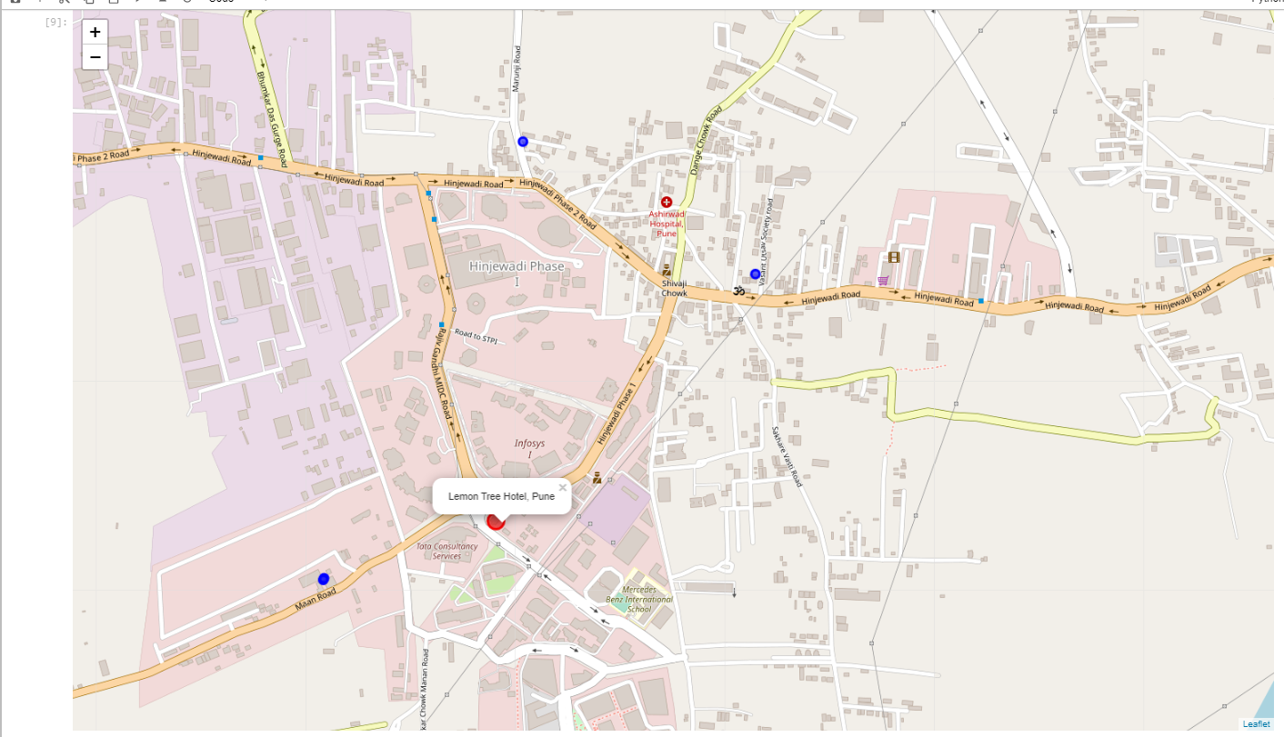
Map of Nearby Hotels

Slide 9
Map of Nearby places to visit

Slide 10
Exploring the Neighbourhood
Based on thedata from FourSquare app, It is found that the Neighbourhood has many places for visiting during free time including
Shopping Mall (E-Square-Xion which has a multiplex also),
Small restaurants (Little-Italy, MainLand-China, Café-Coffie-Day etc… ),
Small time eateries( Mauli Snacks Center, Talk about, Saundarya Restaurant, etc),
where a leisure time can be spent.

Slide 11
Conclusion
The client’’s decision to stay at “Hotel Lemon Tree” is good, as it has good rating as well as it is available nearby to Infosys Development Center, Pune. He can also have relaxed time in the evening and enjoy the delicious food in nearby restaurants in evening.
The visitors have multiple options to visit for the dinner/Lunch in the form of three good Restaurants to have Indian Food in the area nearby to Hotel Lemon Tree (in the radius of two kilometres.)

Slide 12
From the data explored from Foursquare app and its representation on the Folium map it is found that there are three good Hotels/Restaurants with Rating 07 out of 10 in the Hinjewadi Area those are:
Hotel Lemon Tree
“Irish Restaurant” and
“Cascade Restaurant-Le-Royal”
These restaurants are excellent for Staying as well as having dinner/Lunch.
The people visiting this area can also enjoy evening snacks or alternate food in the nearby area where around 15-20 places/eateries/small size restaurants are available.

Slide 13
Thanks

