Slide 1
Software
Quality Attributes

Slide 2
Quality
Quality can be defined as -
Degree of Excellence – Oxford Dictionary
Fitness for purpose – Edward Deming
Best for Customer’s use and selling price - Feigenbaum

Slide 3
Software Quality
Software quality is the degree to which software possesses a desired combination of attributes (e.g., reliability, interoperability) [IEEE 1061].

Slide 4
Software Quality Attributes
Common Quality Attributes as below:
Design qualities
Runtime qualities
System qualities
User qualities
Non-runtime qualities
Architecture qualities
Business qualities

Slide 5
Design Quality Attributes
Conceptual Integrity
  Defines the consistency and logic of the overall design.
  Includes the way that components or modules are designed.
Maintainability
  Ability of the system to undergo changes with a degree of ease.
Reusability
  Defines the capability for components and subsystems to suitable for use in other applications

Slide 6
Runtime Quality Attributes
Interoperability
  Ability of a system or different systems to operate successfully by communicating and exchanging information with other external systems written and run by external parties.
Manageability
  Defines how easy it is for system administrators to manage the application.
Reliability
  Ability of a system to remain operational over time.

Slide 7
Runtime Quality Attributes contd…
Scalability
  Ability of a system to either handle increases in load without impact on the performance of the system, or the ability to be readily enlarged.
Performance
  Indication of the responsiveness of a system to execute any action.
Security
  Capability of a system to prevent malicious or accidental actions of the designed usage.

Slide 8
Runtime Quality Attributes contd…
Availability
  Proportion of time that the system is functional and working.
  Measured as a percentage of the total system downtime over a predefined period.

Slide 9
System Quality Attributes
Supportability
  Ability of a system to provide information helpful for identifying and resolve issues when it fails to work correctly.
Testability
  Measure of how easy it is to create test criteria for the system and its components.

Slide 10
User Quality Attributes
Usability
  Defines how well the application meets the requirements of the user and consumer by being intuitive.

Slide 11
Non-runtime Quality Attributes
Portability
  Ability of a system to run under different computing environments.
Re-usability
  Degree to which existing applications can be reused in new applications.
Integrity
  Ability to make the separately developed components of the system work correctly together.
Modifiability
  Ease with which a software system can accommodate any changes.

Slide 12
Architecture Quality Attributes
Correctness
  Accountability for satisfying all requirements of the system.
Conceptual Integrity
  Integrity of the overall structure that is composed from a number of small architectural structures.

Slide 13
Business Quality Attributes
Cost & Schedule
  Cost of the system with respect to time to market, expected project lifetime, and utilization of legacy and COTS System.
Marketability
  Use of system with respect to market competition.
COTS: Commercial-off-the-shelf

Slide 14
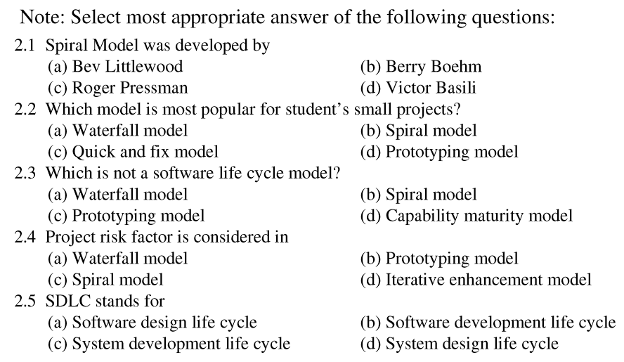

Slide 15
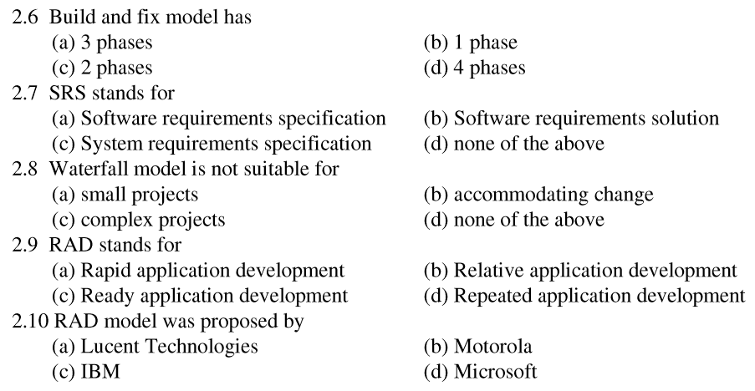

Slide 16
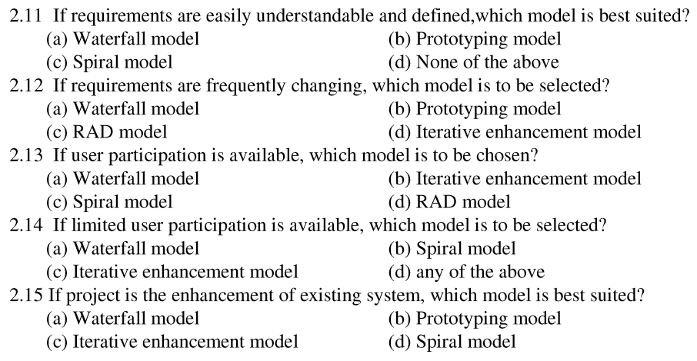

Slide 17
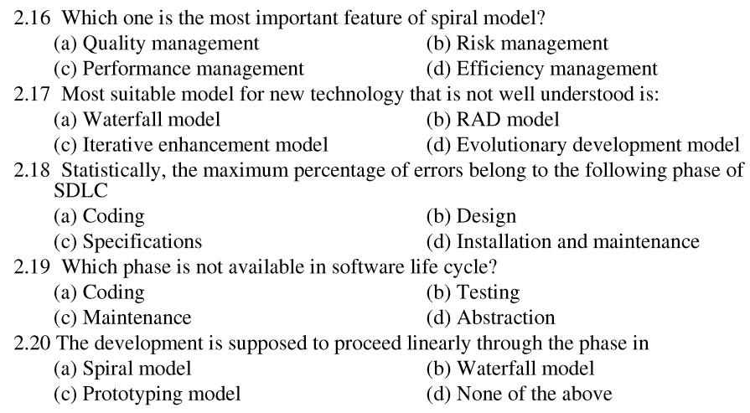

Slide 18
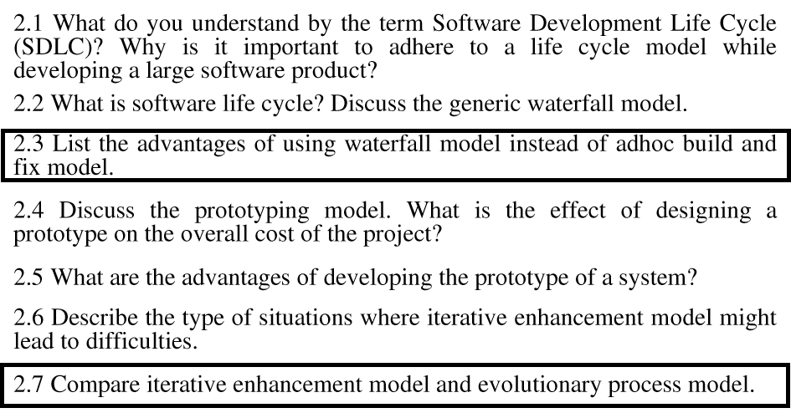

Slide 19
Software Requirement & Analysis

