Slide 1
Software Development Life Cycle
Software Engineering

Slide 2
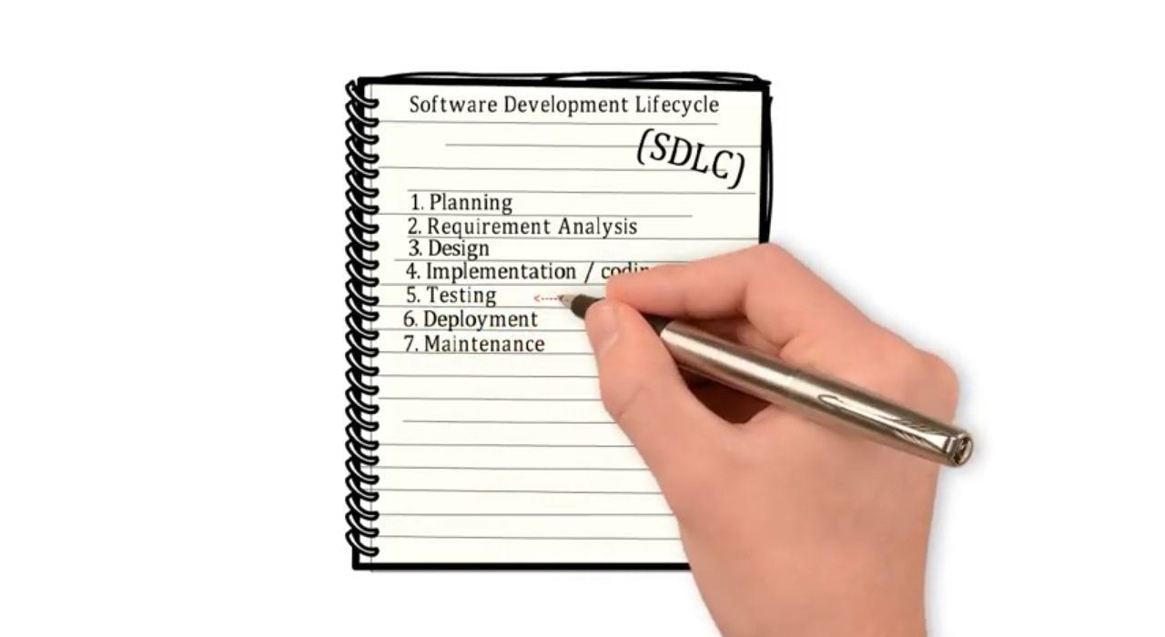

Slide 3
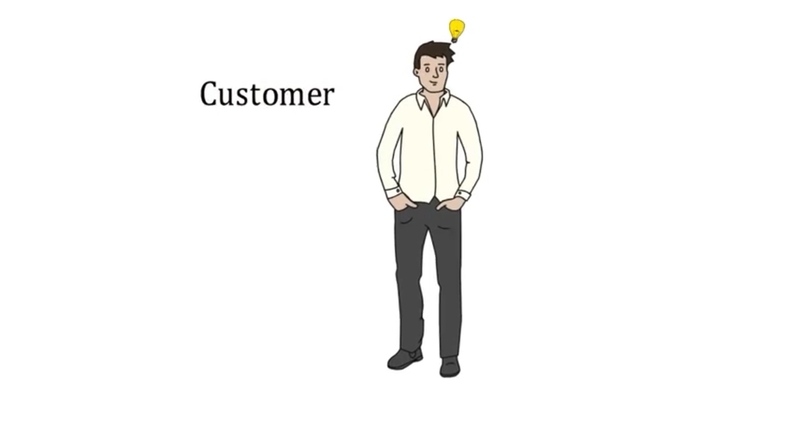
got an idea to automate the manual work

Slide 4
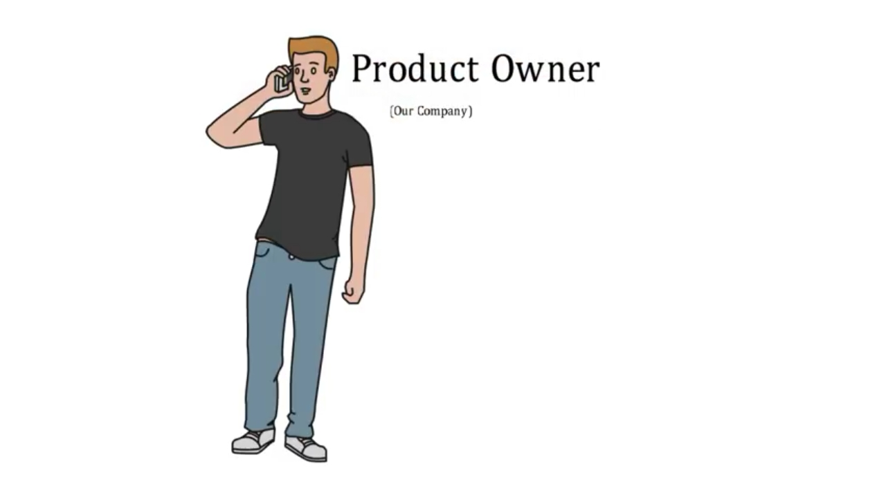
has or can develop the product which customer wants

Slide 5
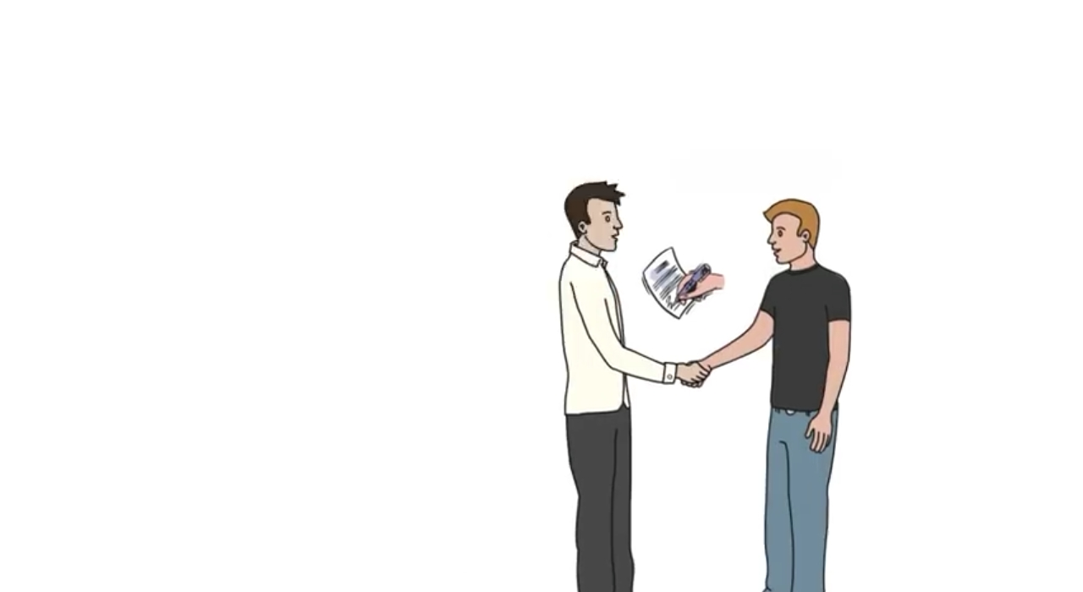
Both meets and customer put his idea to the product owner and signed the deal to automate his manual work.
And put the problem statement describing the actual expectation.

Slide 6
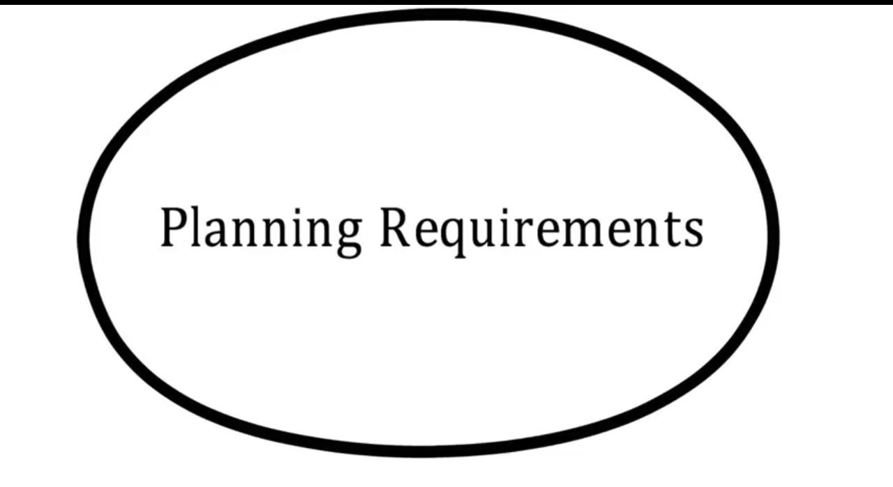

Slide 7
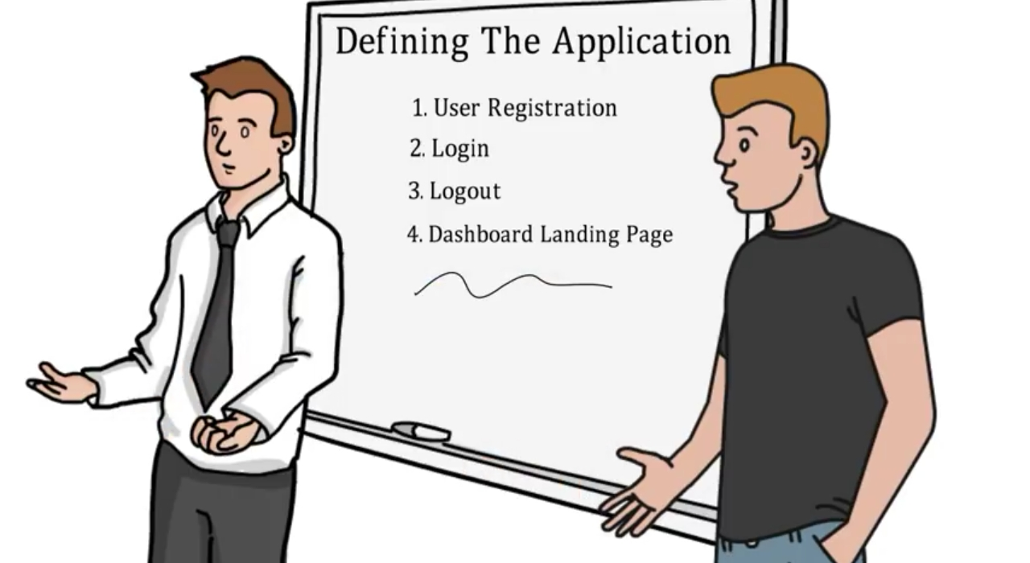
Then the product owner and the person assigned to follow up with the customer develops the presentation explaining the project to the team to work on…

Slide 8
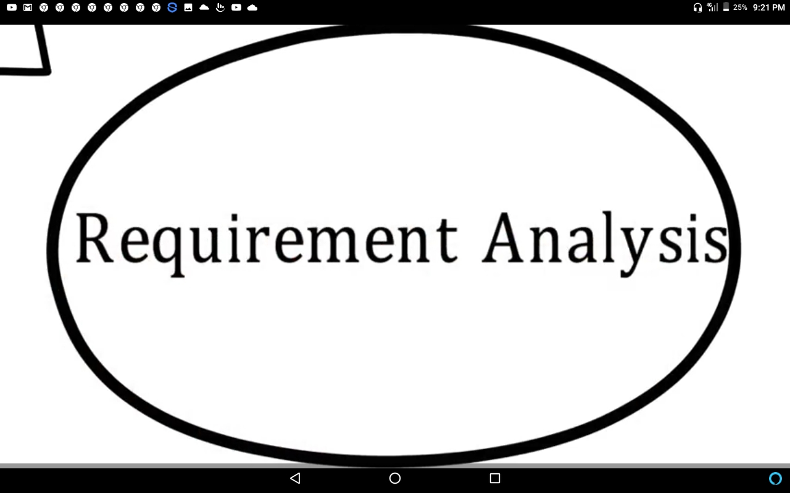

Slide 9
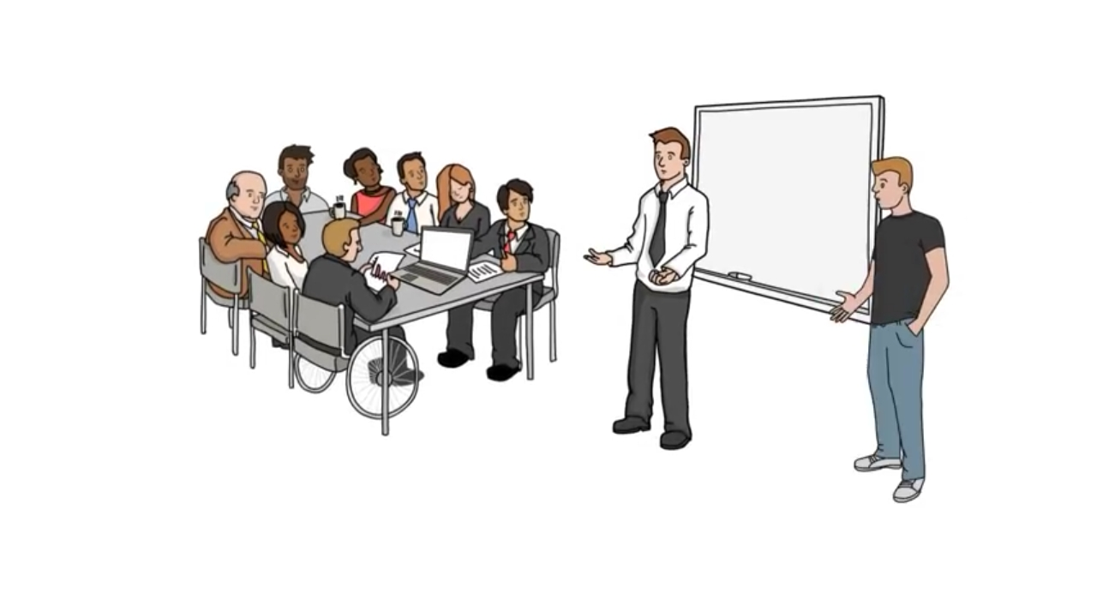
Then the team of experts from design, coding, testing and maintenance sit together and analyze the whole project whether the requirement collected is enough or needs more to clear out all the confusions to have a crystal clear picture…

Slide 10
DESIGN

Slide 11
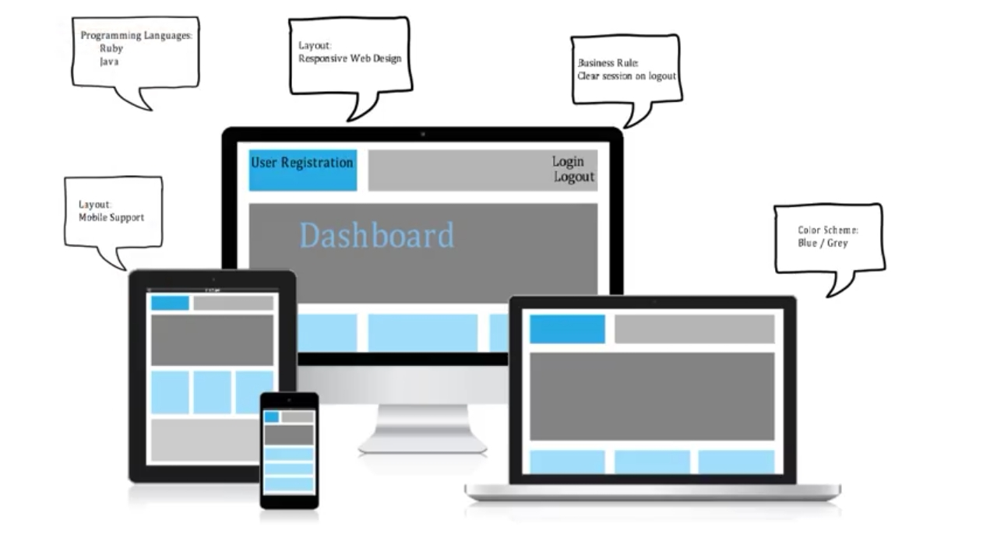
Planning for effective design which can execute at almost every device used by different users.

Slide 12
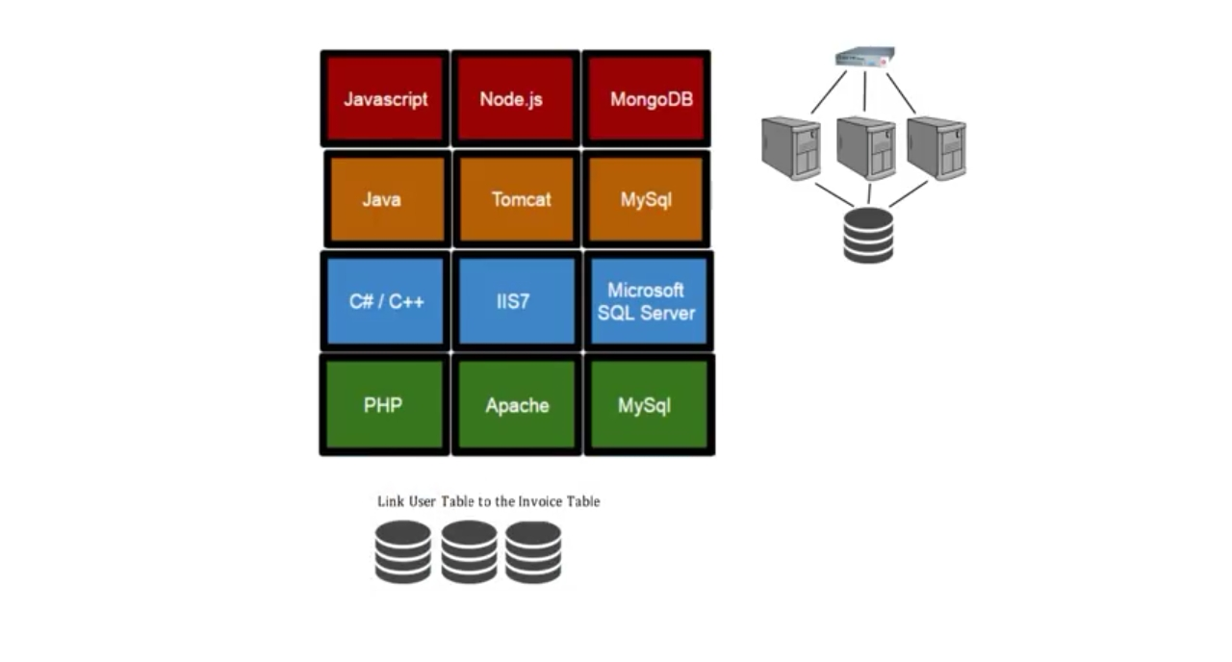
Planning for the required platform needs to use to develop the system.

Slide 13
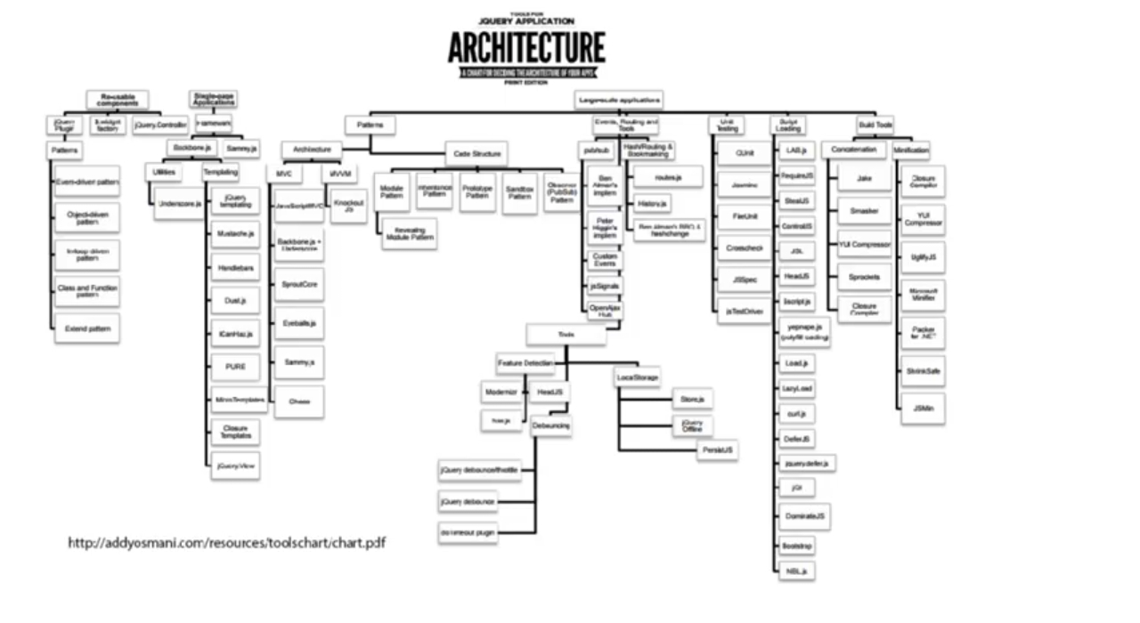
Planning for the required architecture which is analyzed finally with all facilities and modules.

Slide 14
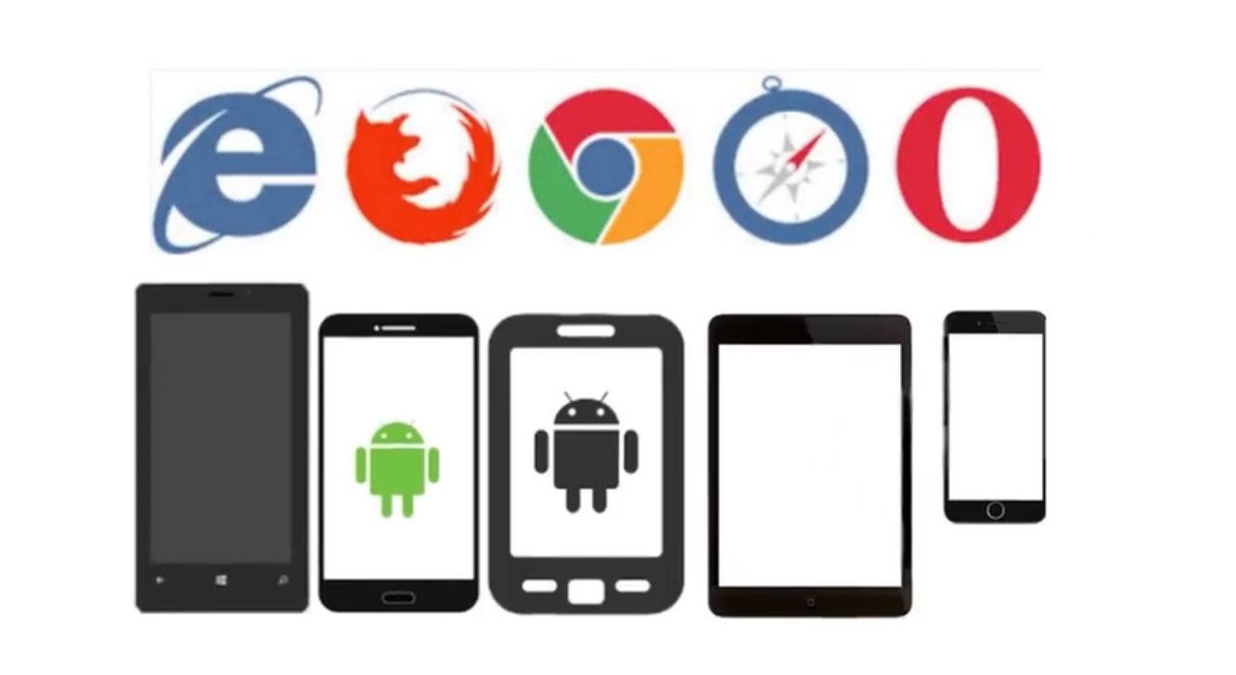
Considering all the browser support to the software for the user to facilitate him/ her for better usability.

Slide 15
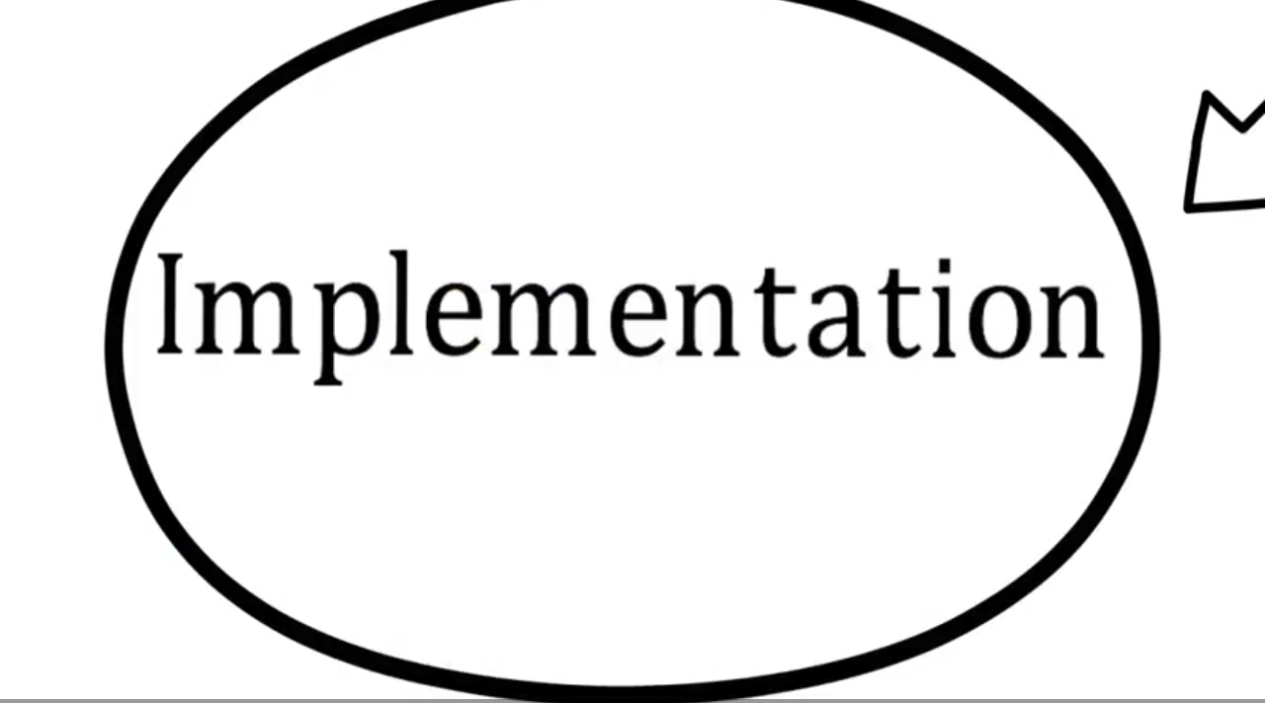

Slide 16
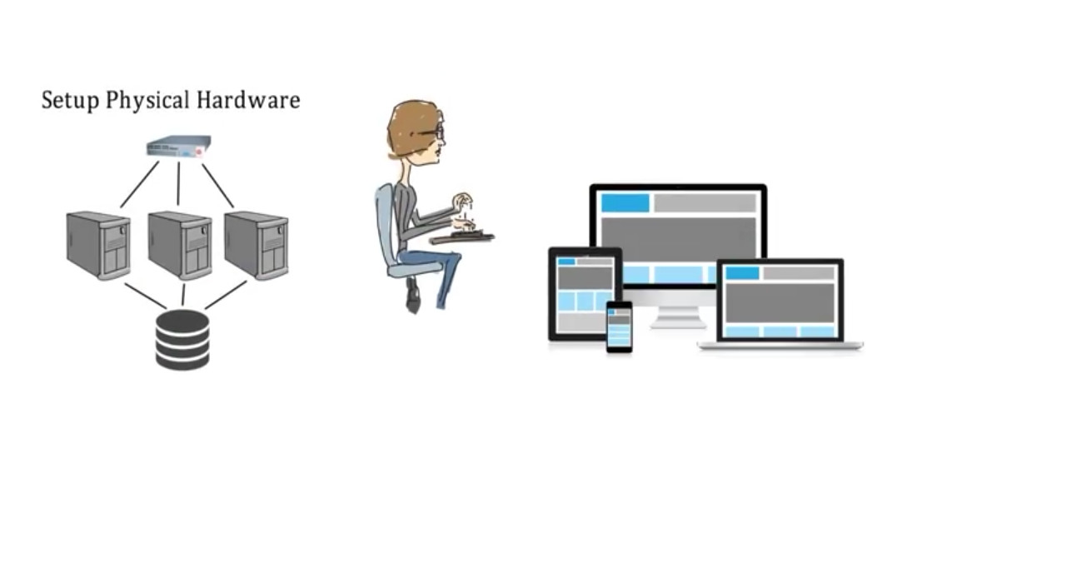
Coding Team
Interface designing team
Hardware Team
Finally every different team for different tasks engaged in their work to complete the task as per the timeline . . .

Slide 17
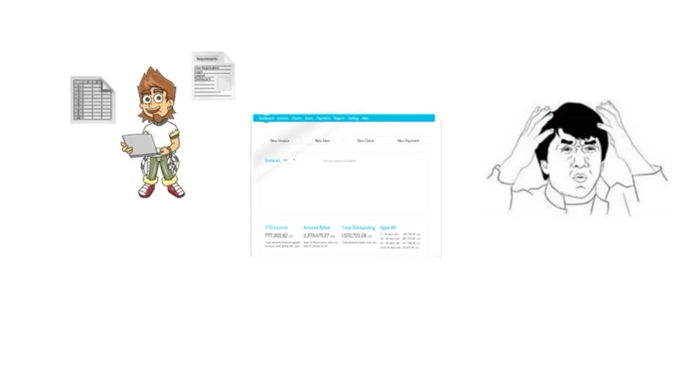
Simultaneously one more team in parallel test the whole process from registering > login > doing whatever task > then logout…. And find the process very tie consuming and irritating… Then submit report to re-design the working of overall process….

Slide 18
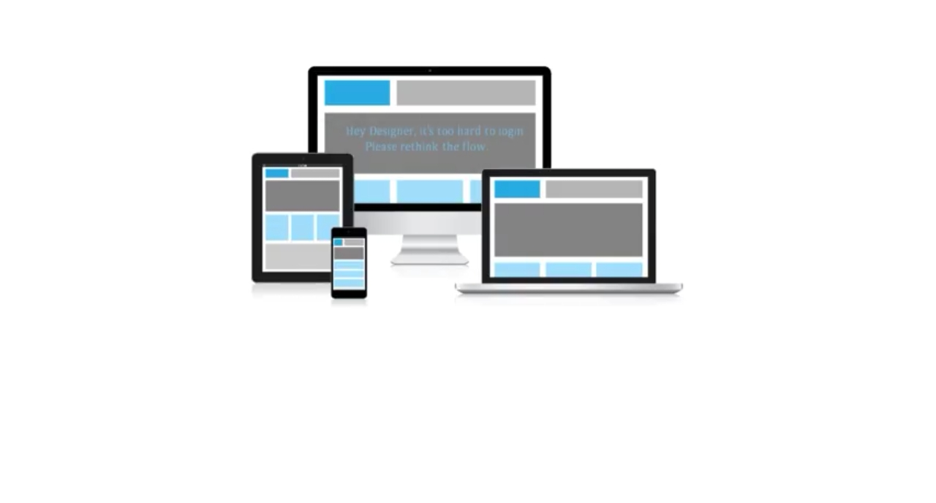
Designing team re-designs the whole process to make it more easier than earlier… This process can confirm by confirming by the customer also to freeze the work finally or may be by other means of policy documented…

Slide 19
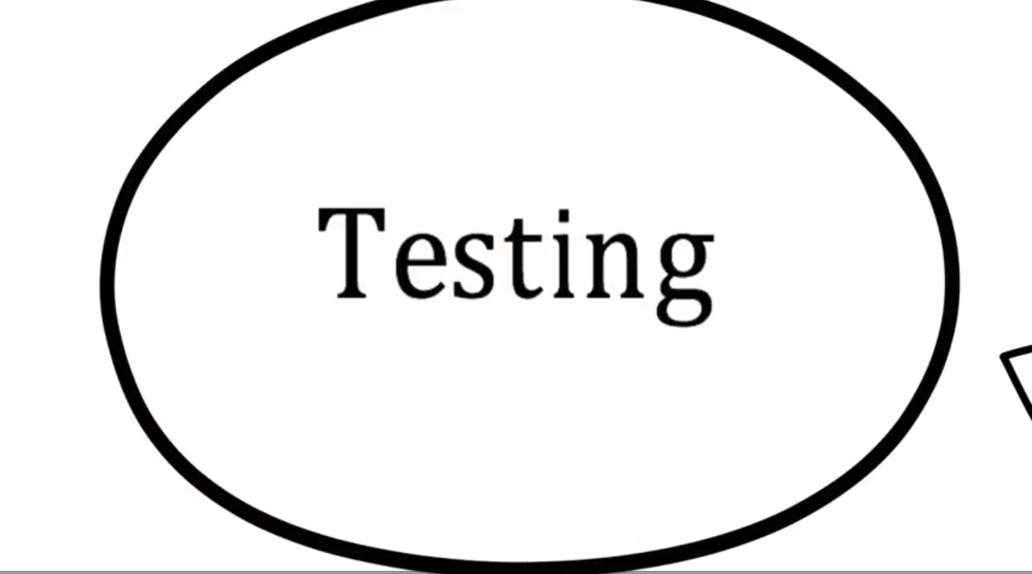

Slide 20
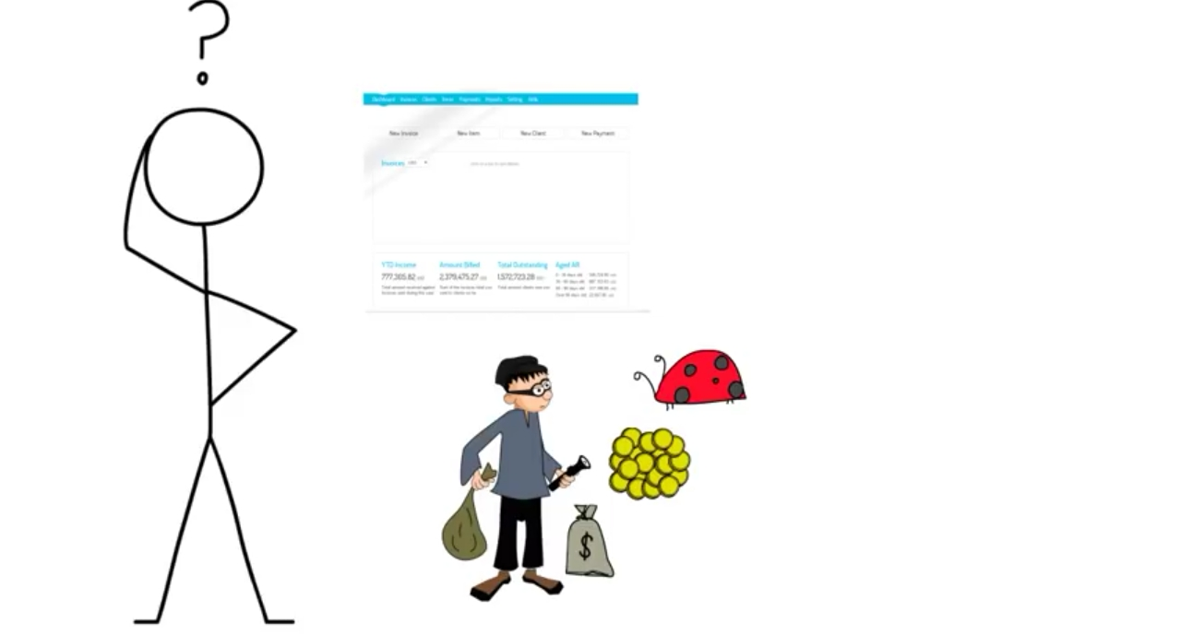
May be the system has many issues and could be hacking prone or having some left-out bugs @ development time…
So testing of the product at developers site is a good practice . . . .

Slide 21
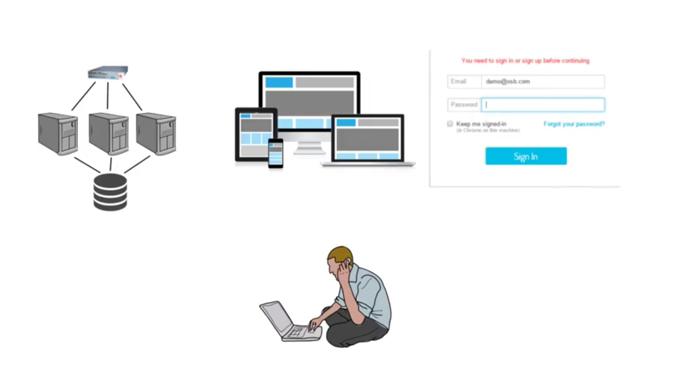
Testing begins

Slide 22
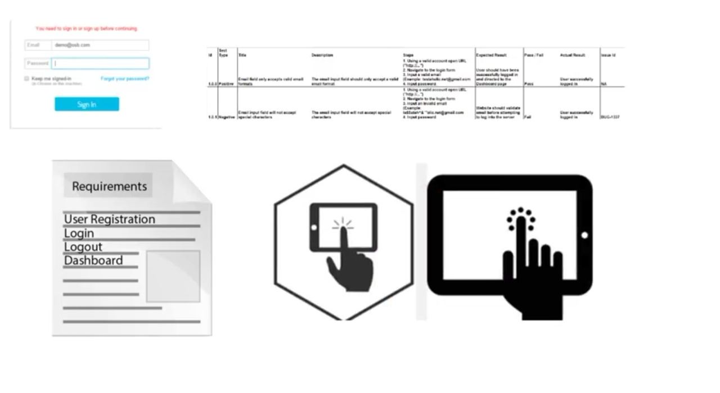
Test cases should matches the expectation written in Requirement specification documentation otherwise intimate all the errors found to the developer for corrections..

Slide 23
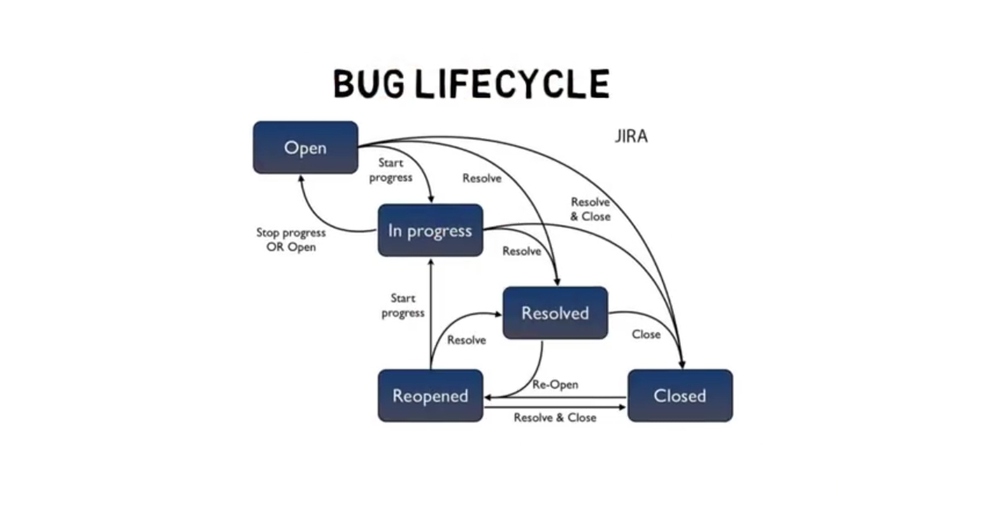
Testing is like a bug lifecycle

Slide 24


Slide 25
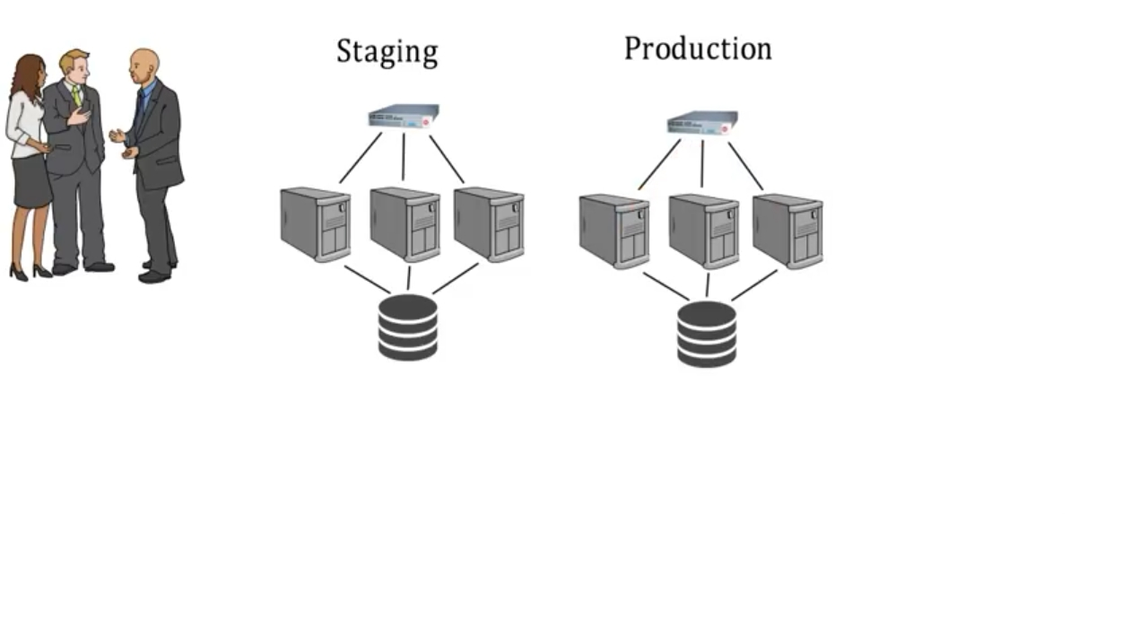
Deployment means to install the developed product at customer’s site. Here team discusses the deployment plan for staging and production

Slide 26
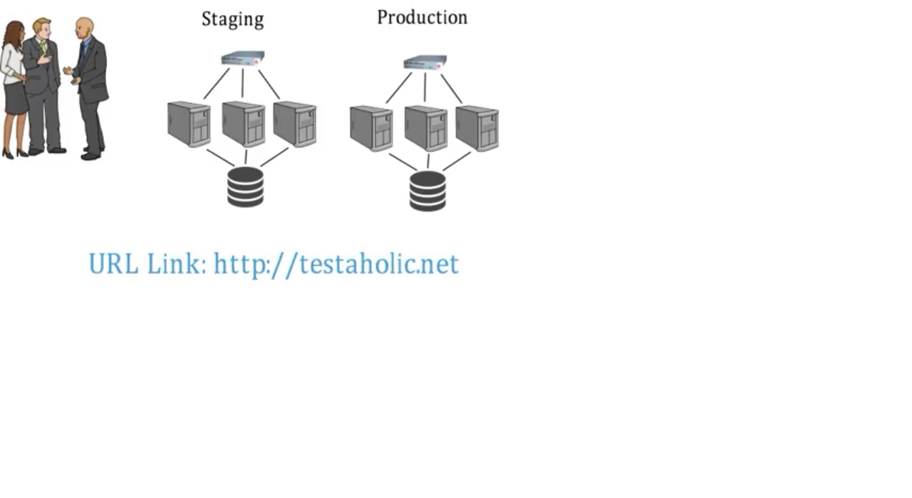
https:// www.erponline.com
Generate the URL for the online-product….

Slide 27
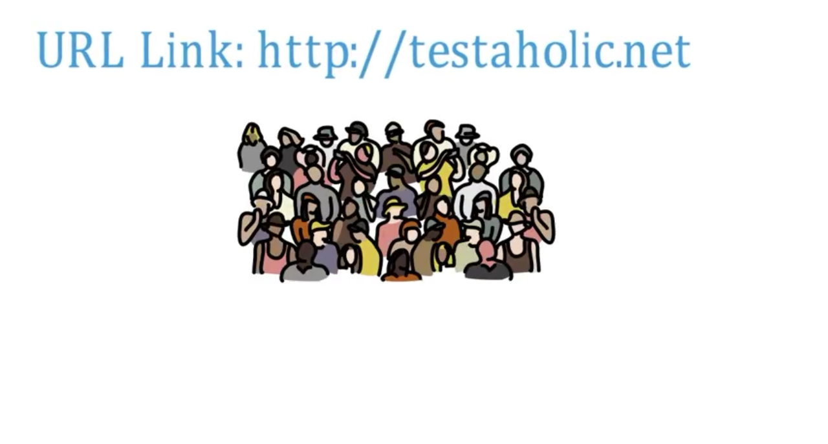
https:// www.erponline.com
Start the product by registering the customers….

Slide 28
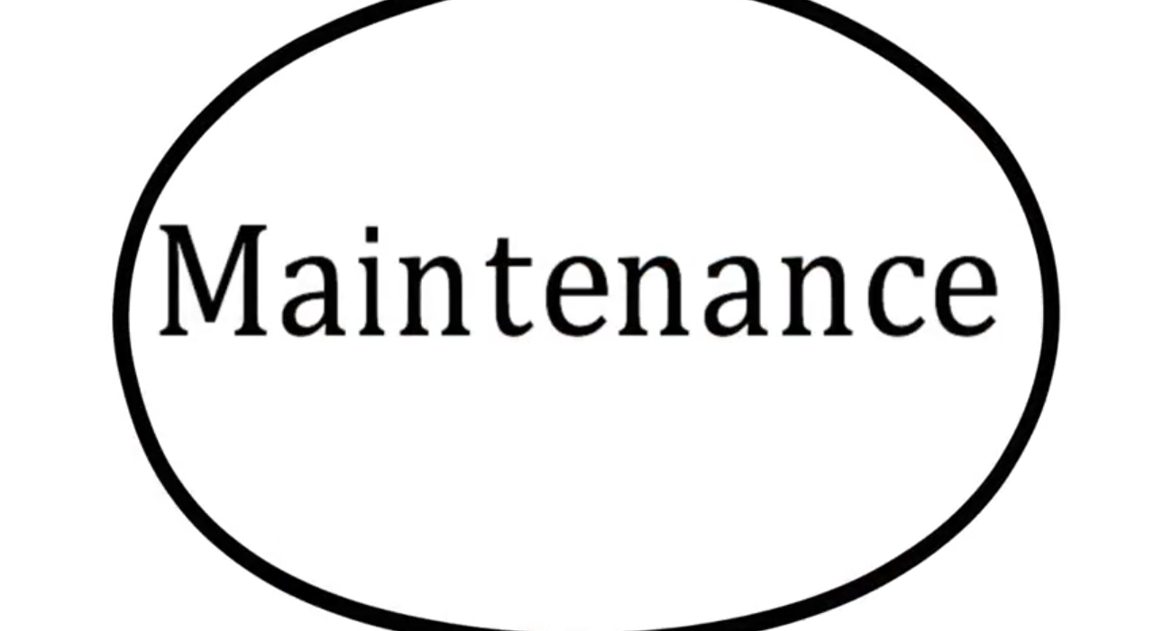

Slide 29
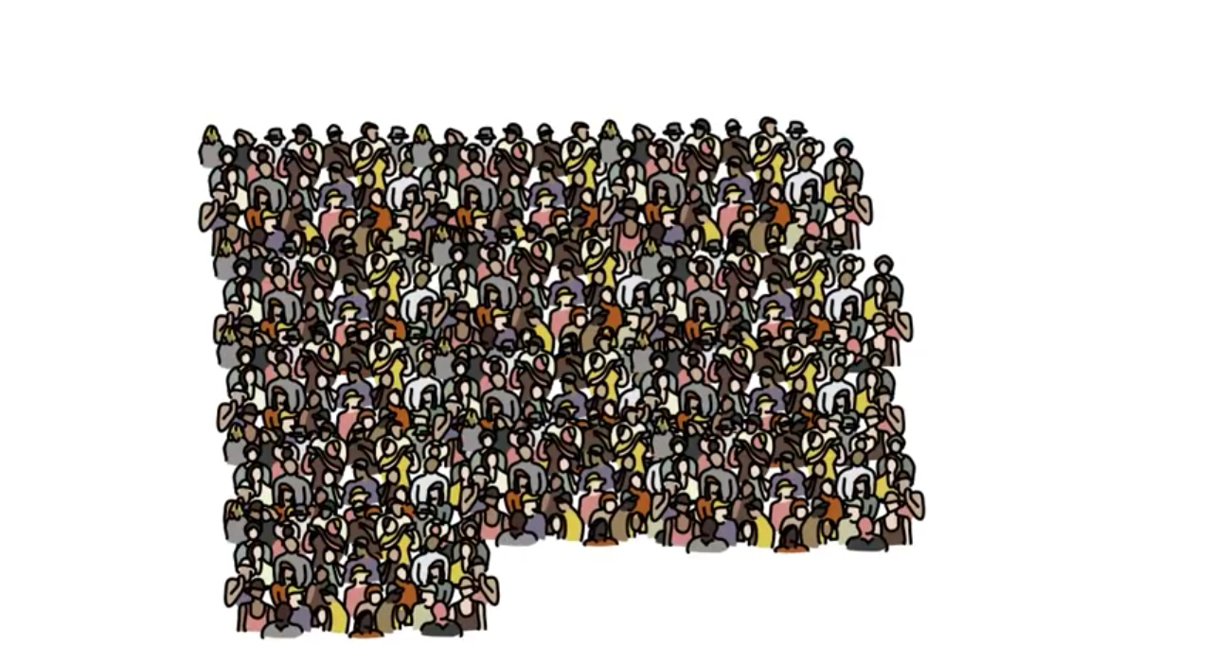
Monitoring more n more customers registering….

Slide 30
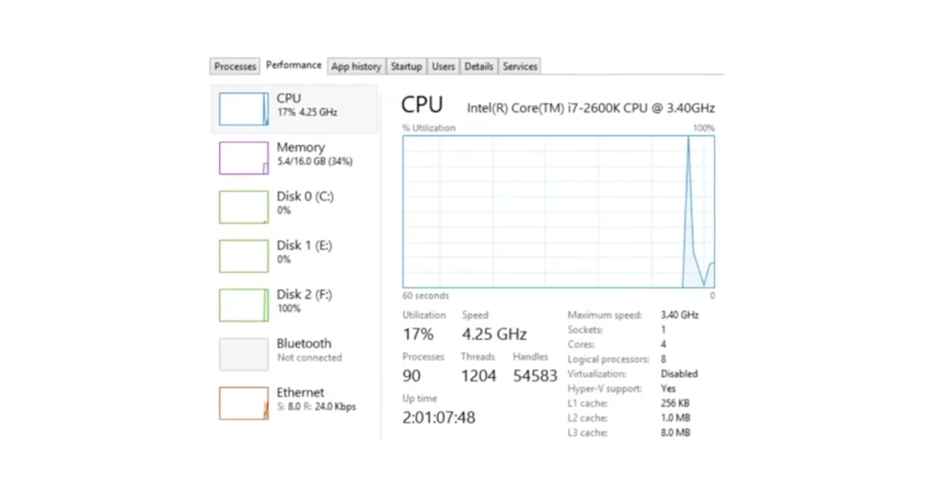
Monitoring the load balancing…. And if any error or issue raises then reverse-engineering and re-engineering comes into action

Slide 31
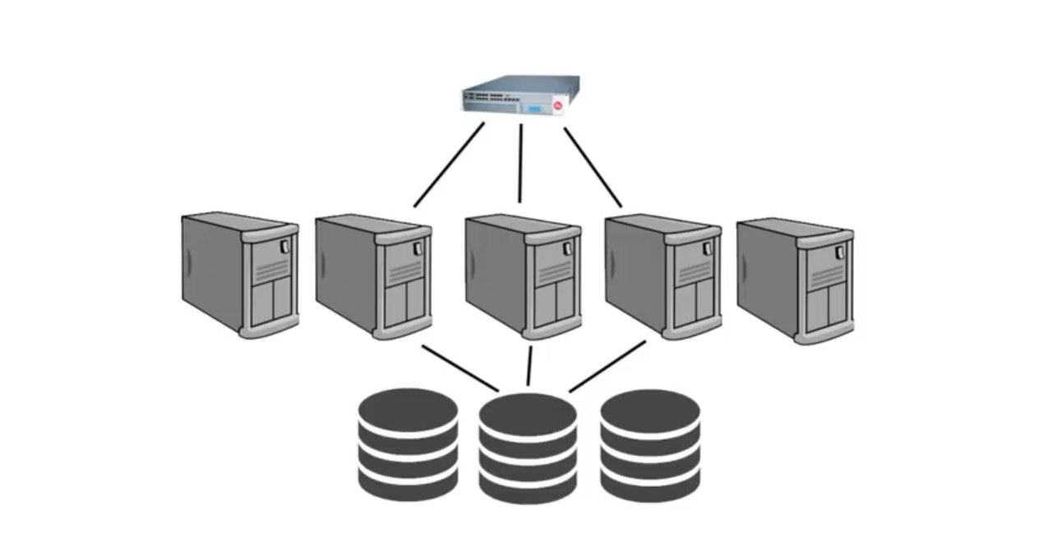
Expandability also defined effectively

Slide 32
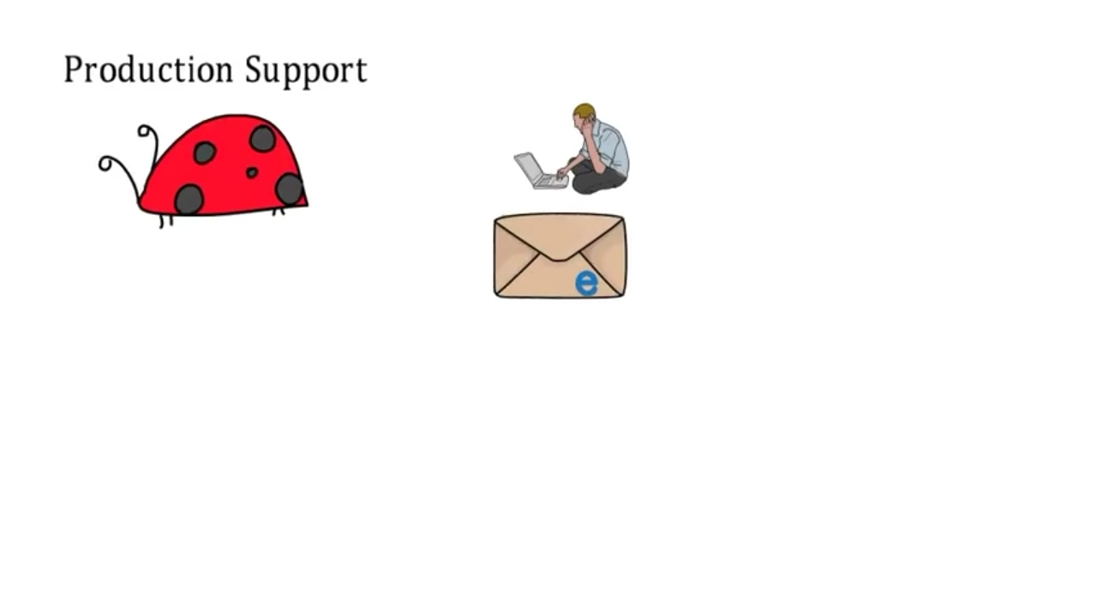
24/7 support mechanism established

Slide 33
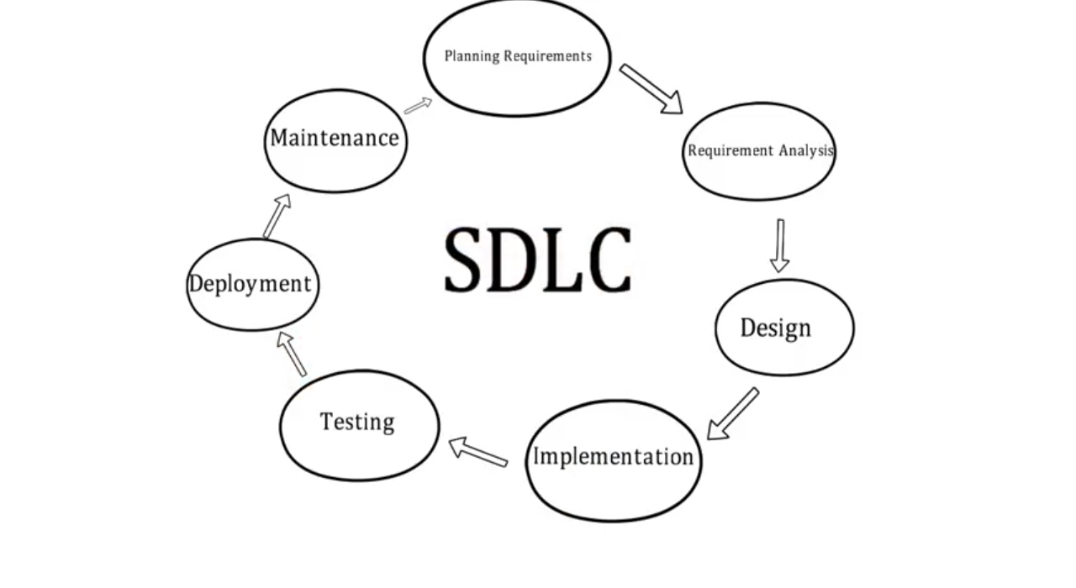

Slide 34
Thanks

