Slide 1
SOFTWARE
PROJECT
PLANNING

Slide 2
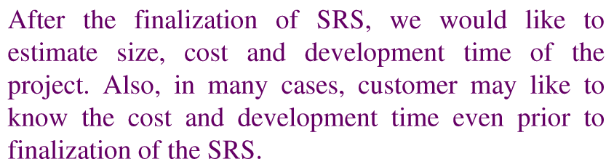
Software Project Planning

Slide 3
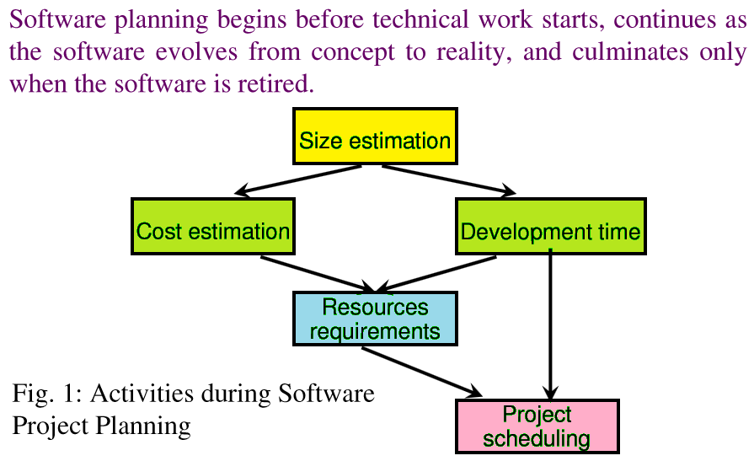
Software Project Planning

Slide 4
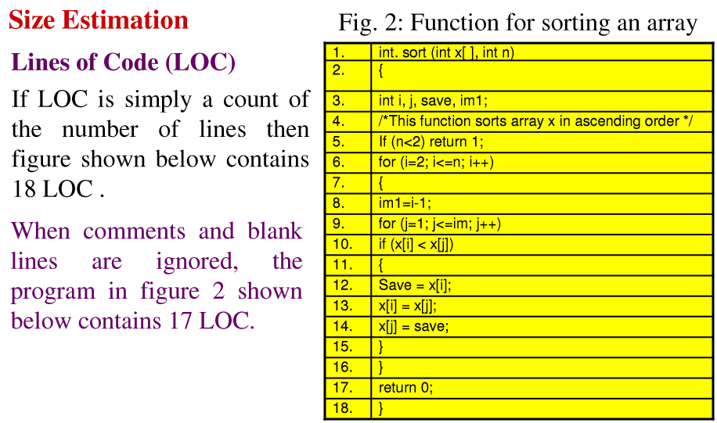
Software Project Planning

Slide 5
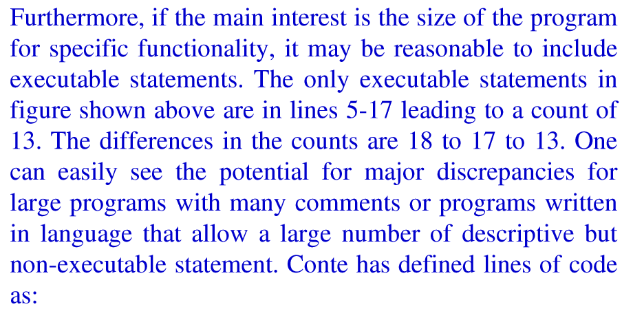
Software Project Planning

Slide 6
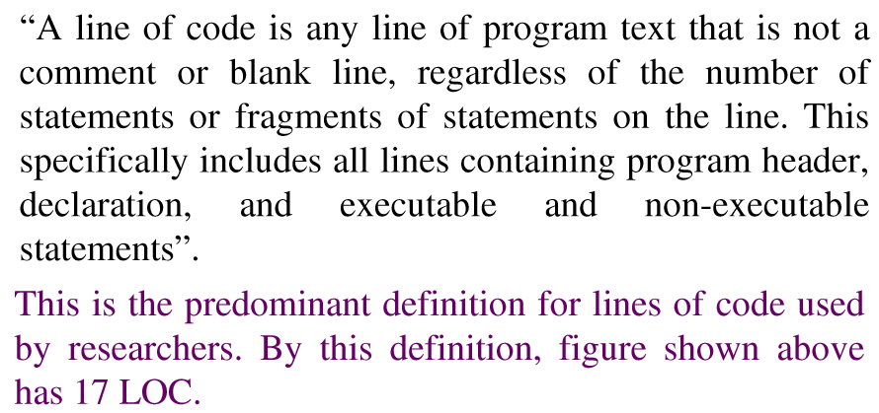
Software Project Planning

Slide 7
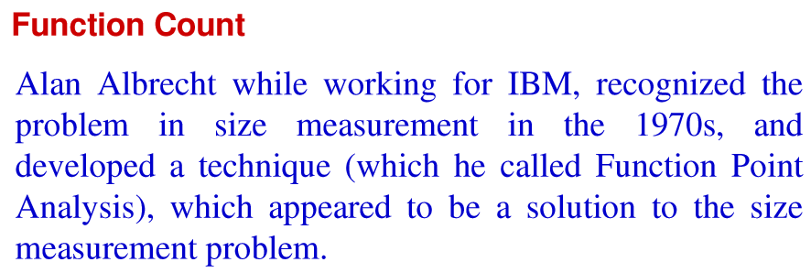
Software Project Planning

Slide 8
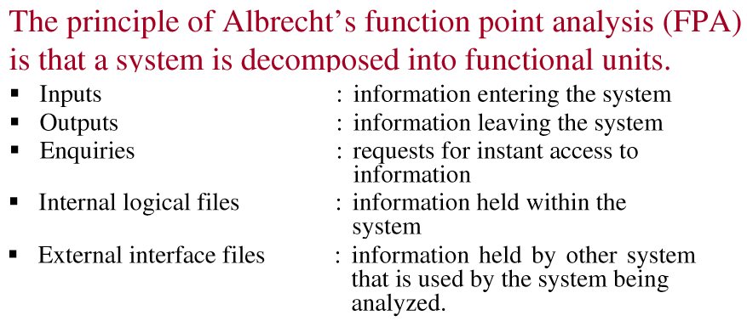
Software Project Planning

Slide 9
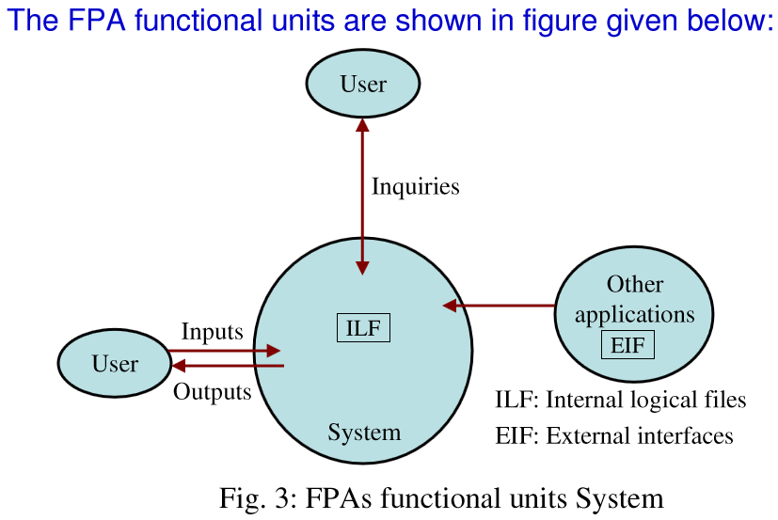
Software Project Planning

Slide 10
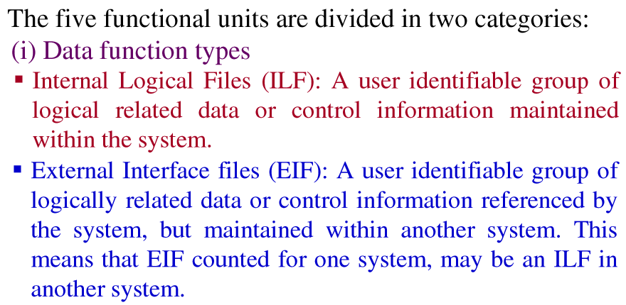
Software Project Planning

Slide 11
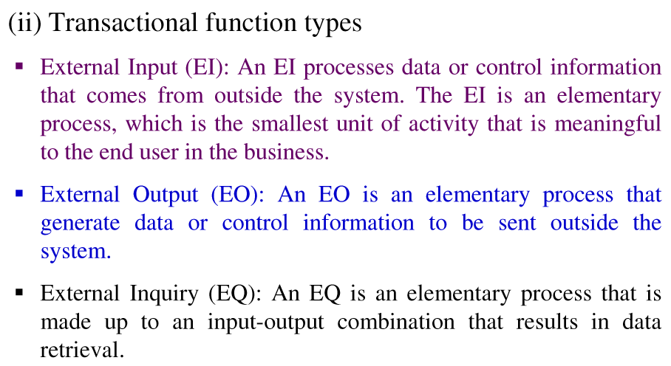
Software Project Planning

Slide 12
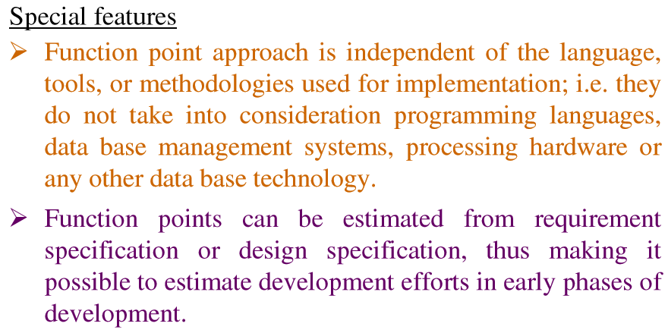
Software Project Planning

Slide 13
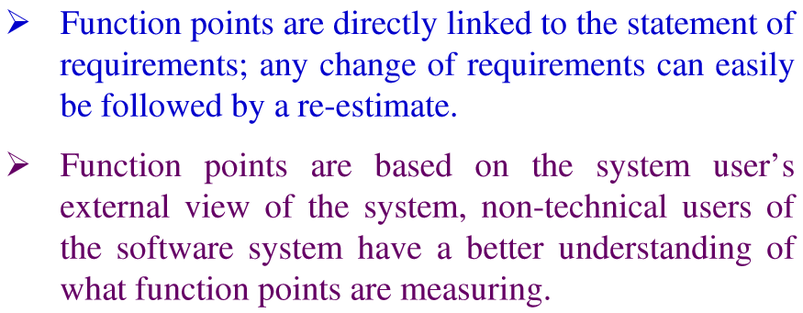
Software Project Planning

Slide 14
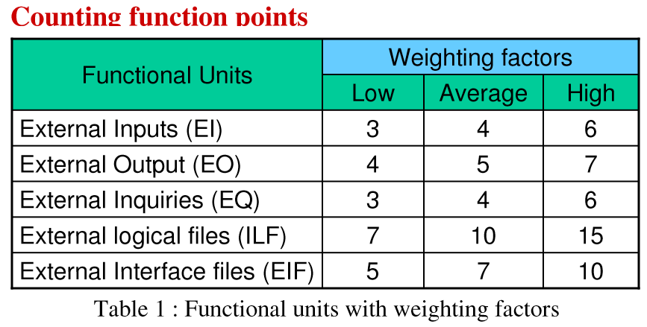
Software Project Planning
Internal

Slide 15
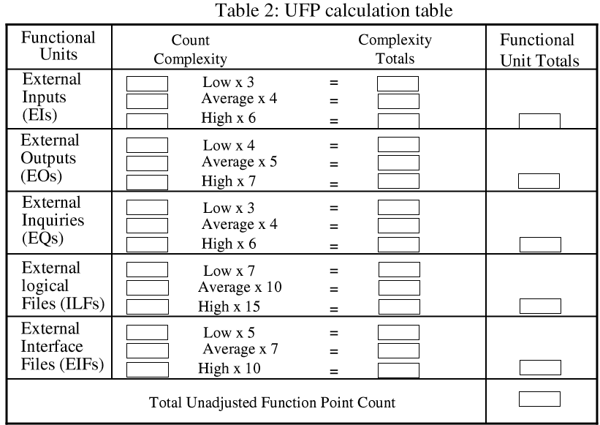
Software Project Planning
Internal

Slide 16
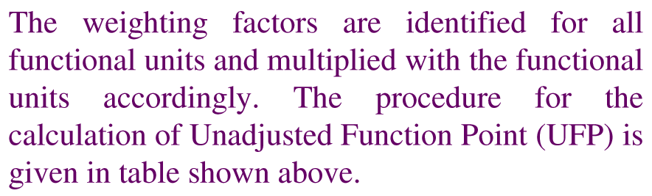
Software Project Planning

Slide 17
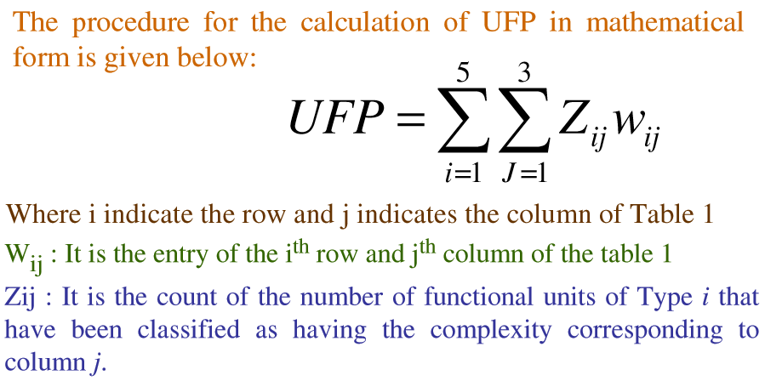
Software Project Planning

Slide 18
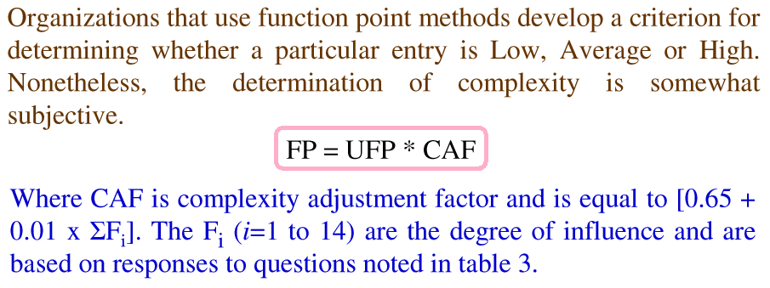
Software Project Planning

Slide 19
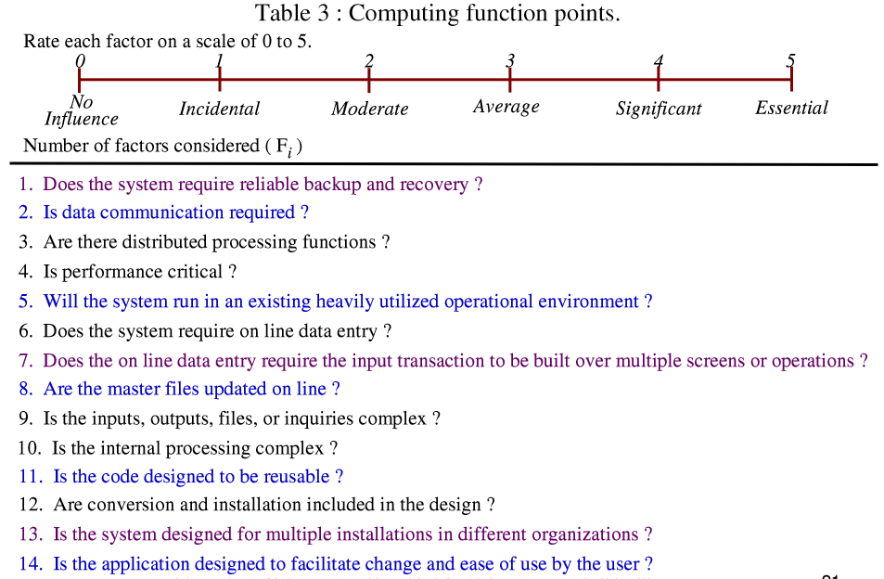

Slide 20
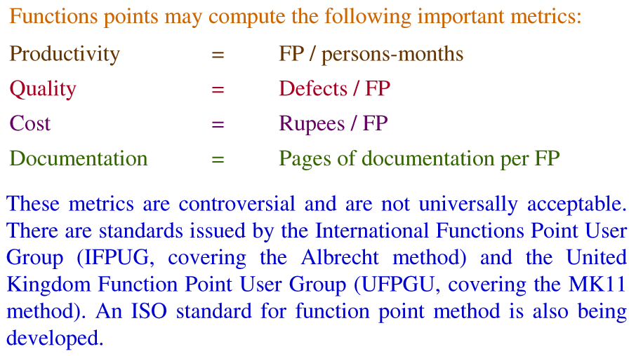
Software Project Planning

Slide 21
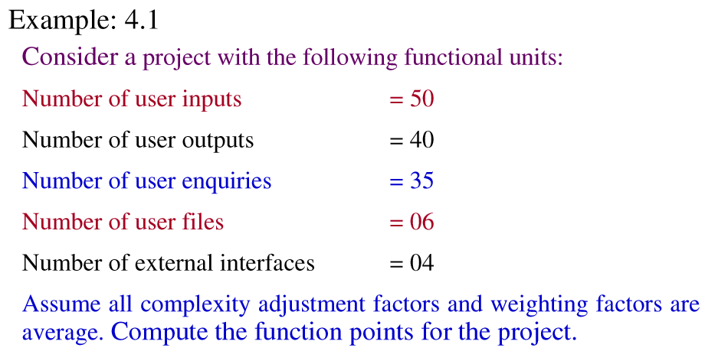
Software Project Planning

Slide 22
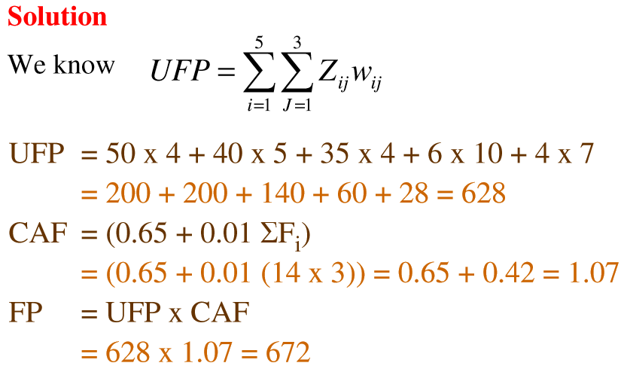
Software Project Planning

Slide 23
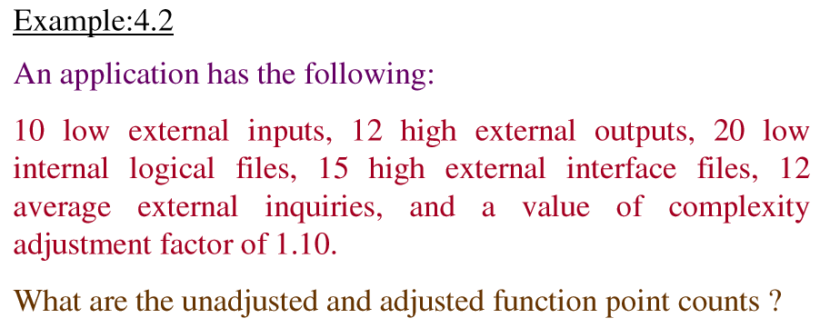
Software Project Planning

Slide 24
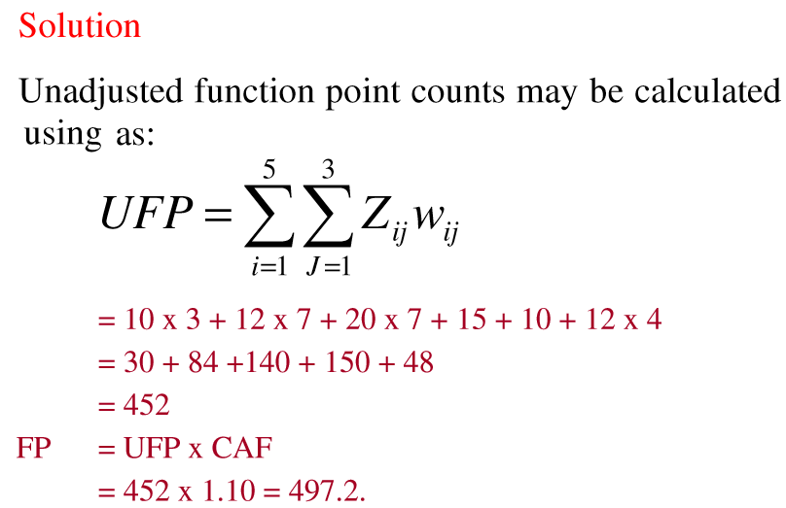
Software Project Planning

Slide 25
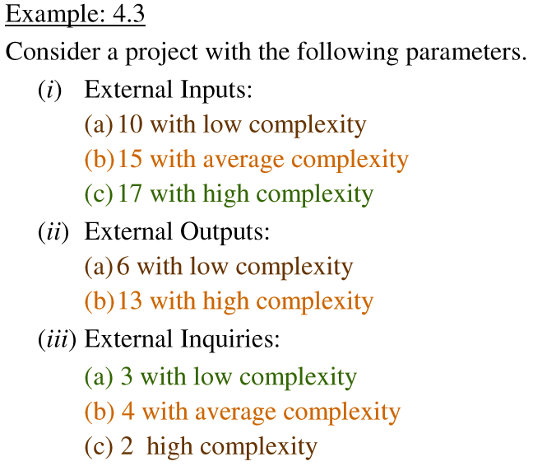
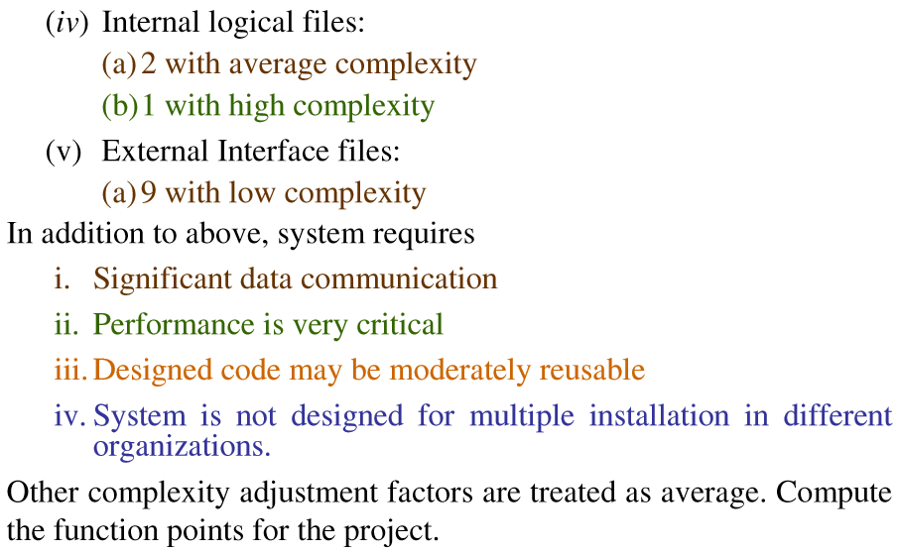
Software Project Planning

Slide 26
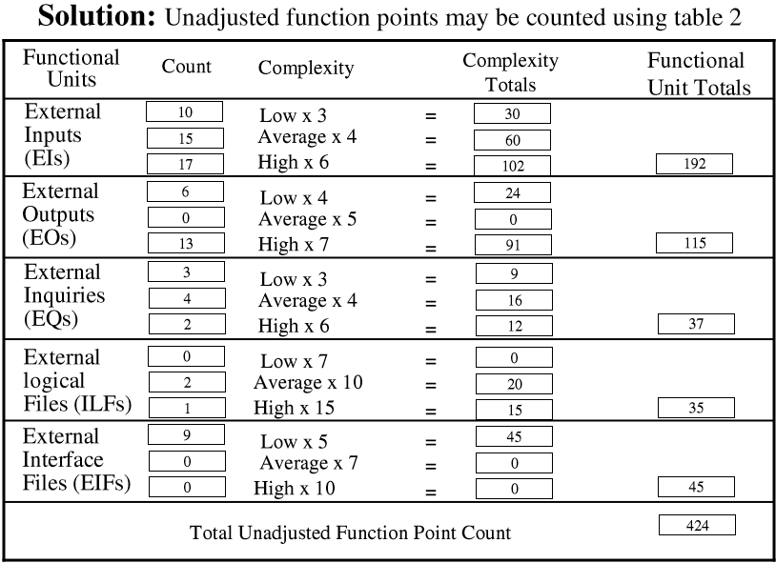
Software Project Planning

Slide 27
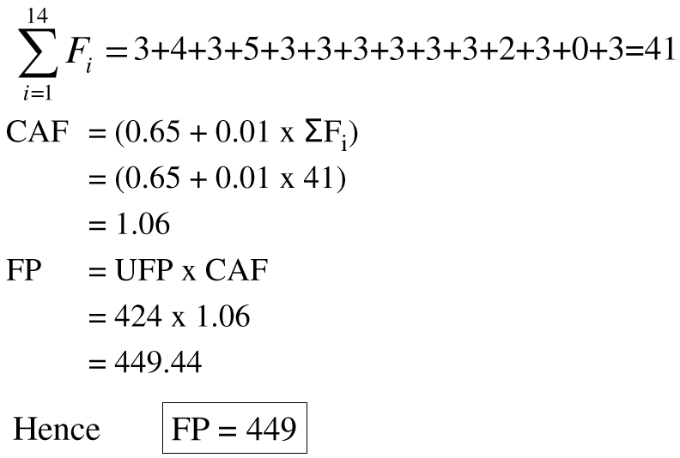
Software Project Planning

Slide 28
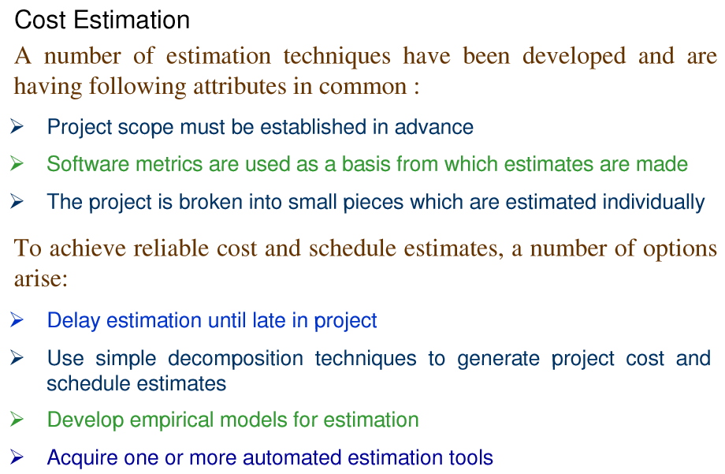
Software Project Planning

Slide 29
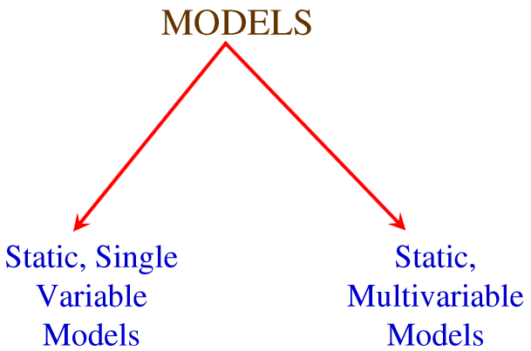
Software Project Planning

Slide 30
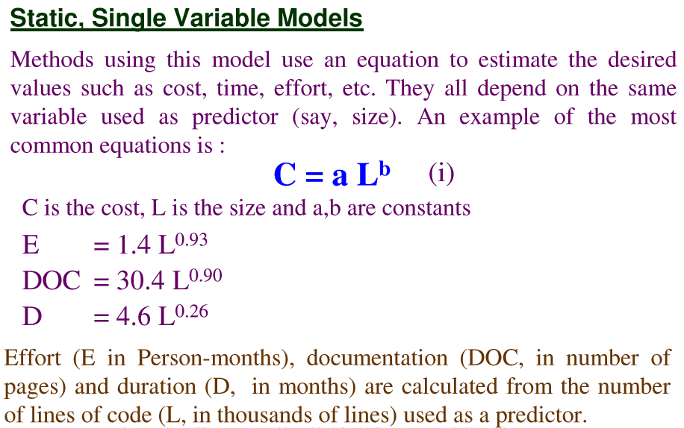
Software Project Planning
The SEL Model established in Software Engineering Lab of
The University of Maryland.

Slide 31
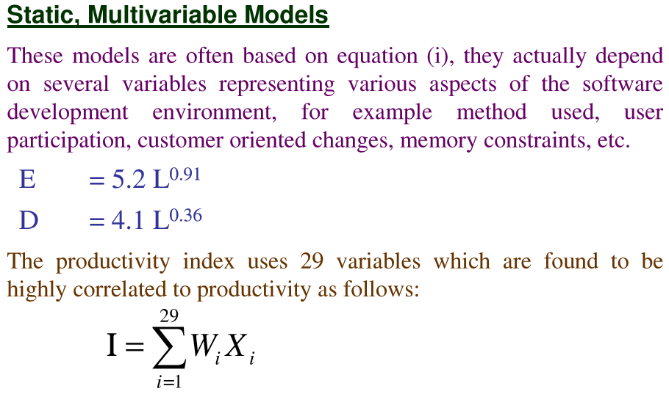
Software Project Planning
The Walston & Felix Model at IBM.

Slide 32
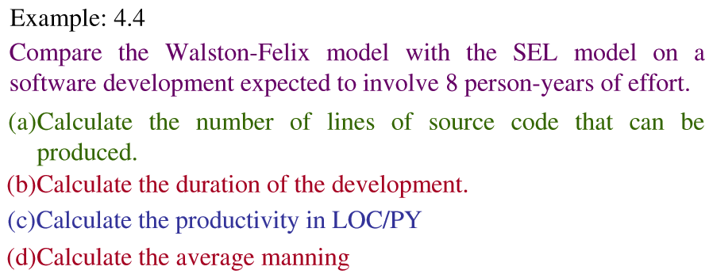
Software Project Planning

Slide 33
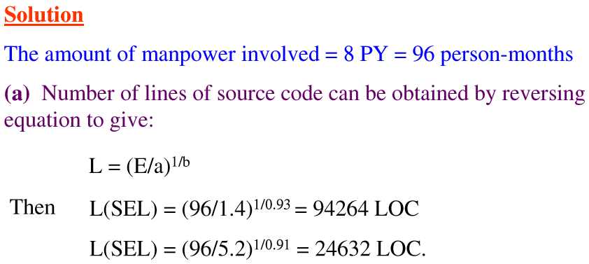
Software Project Planning

Slide 34
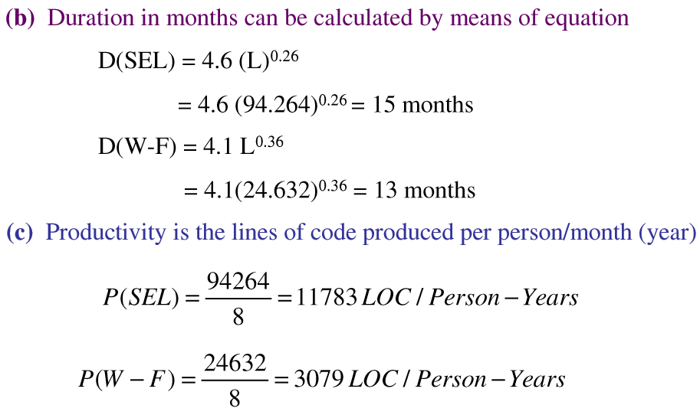
Software Project Planning

Slide 35
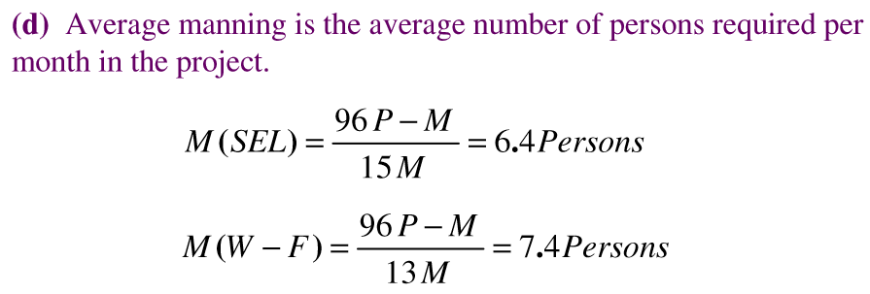
Software Project Planning

Slide 36
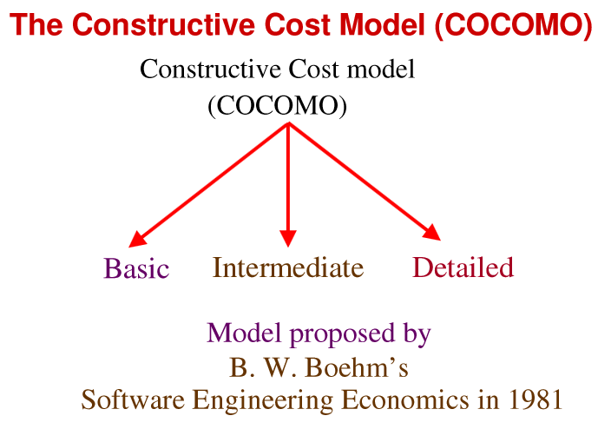
Software Project Planning

Slide 37
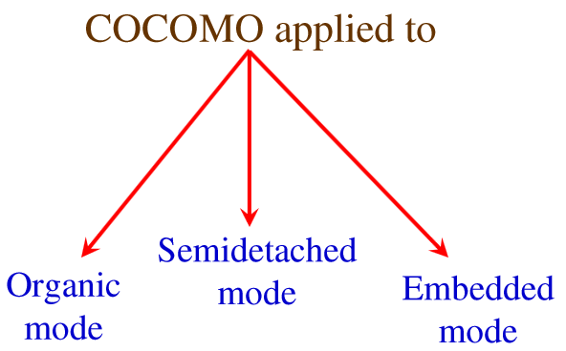
Software Project Planning

Slide 38
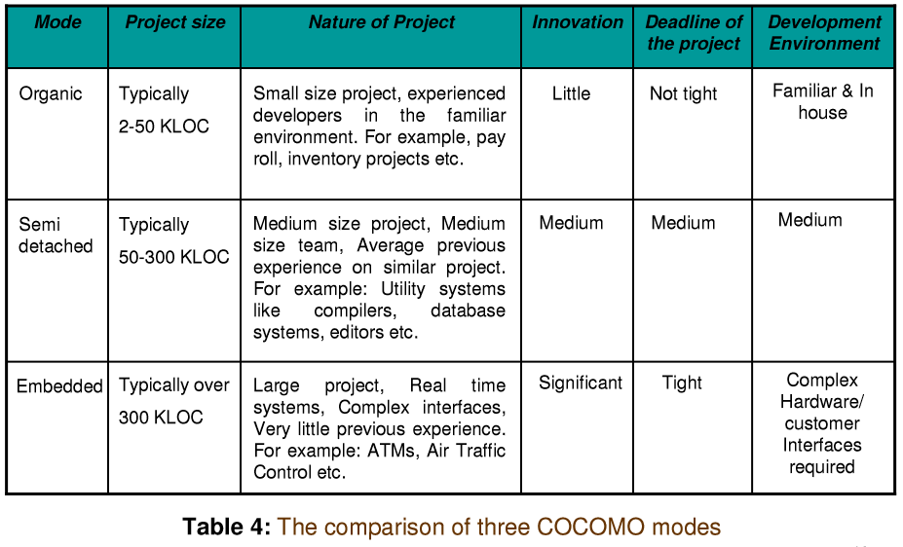
Software Project Planning

Slide 39
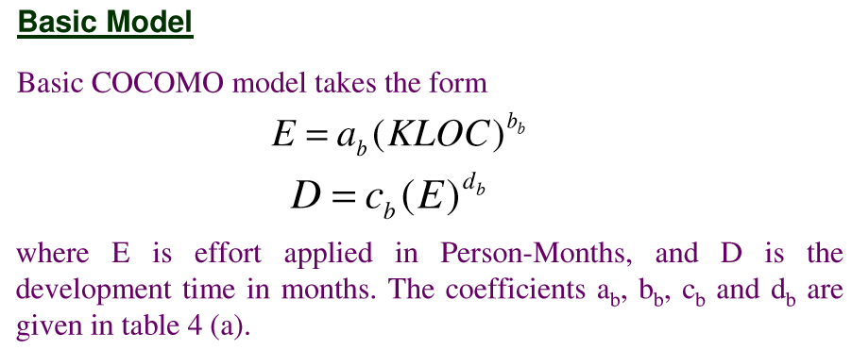
Software Project Planning

Slide 40
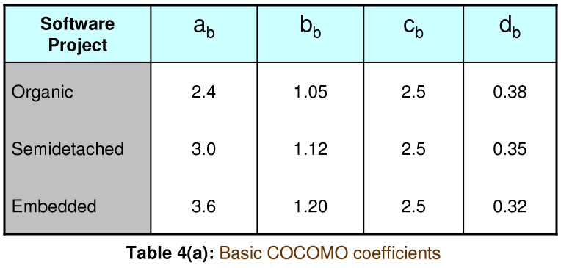
Software Project Planning

Slide 41
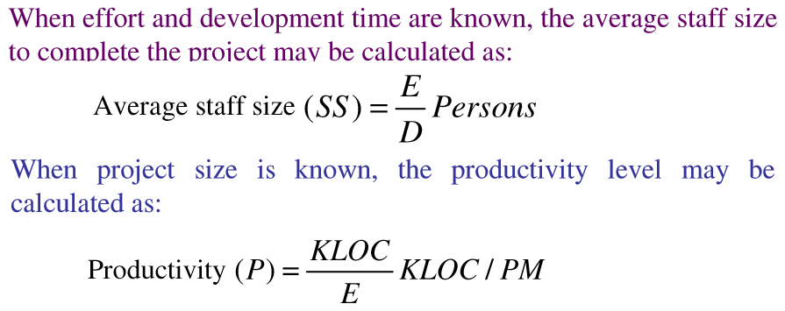
Software Project Planning

Slide 42
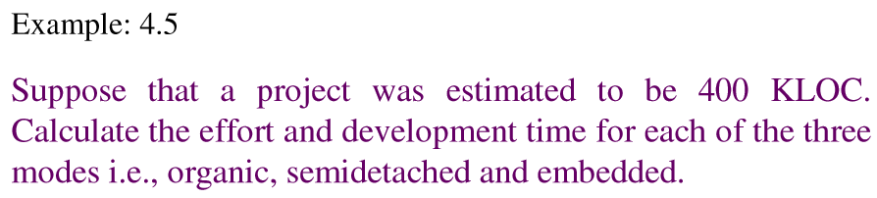
Software Project Planning

Slide 43
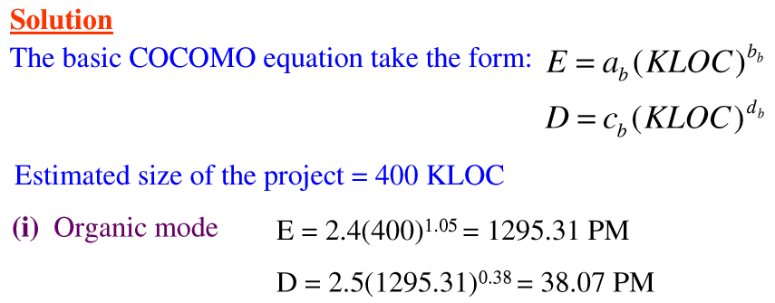
Software Project Planning

Slide 44
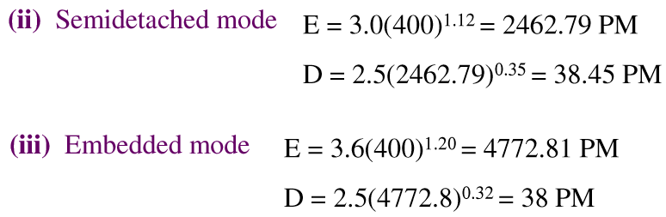
Software Project Planning

Slide 45
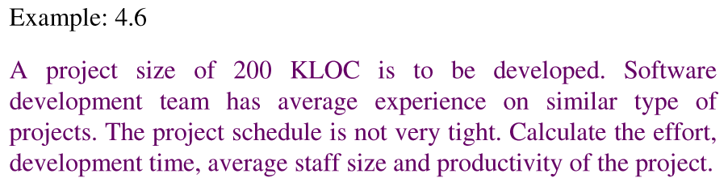
Software Project Planning

Slide 46
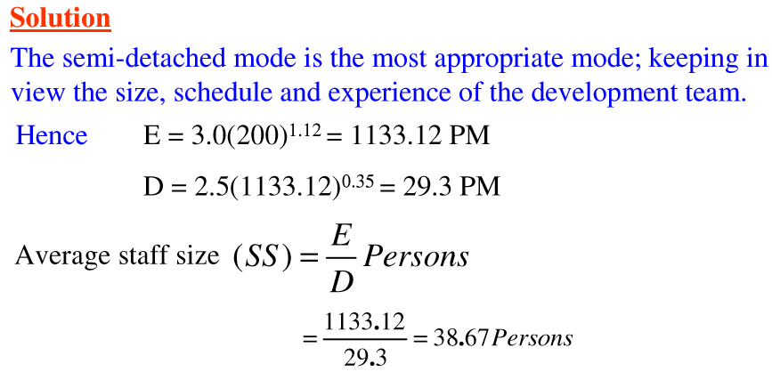
Software Project Planning

Slide 47
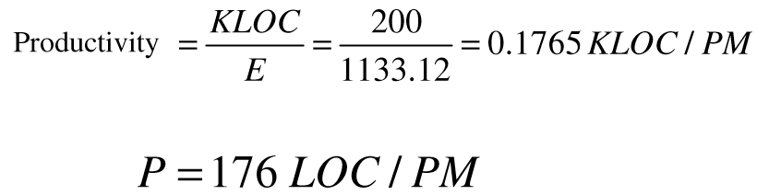
Software Project Planning

Slide 48
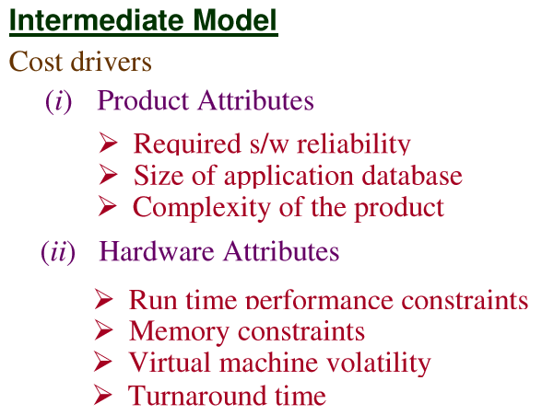
Software Project Planning

Slide 49
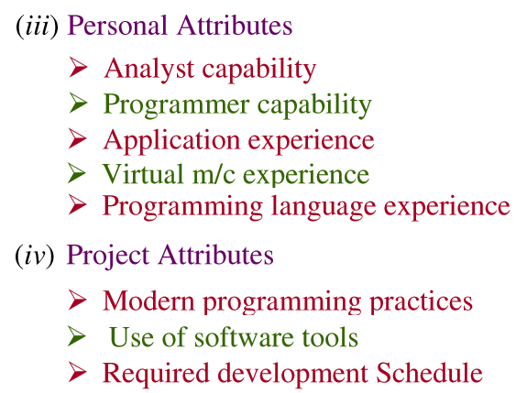
Software Project Planning

Slide 50
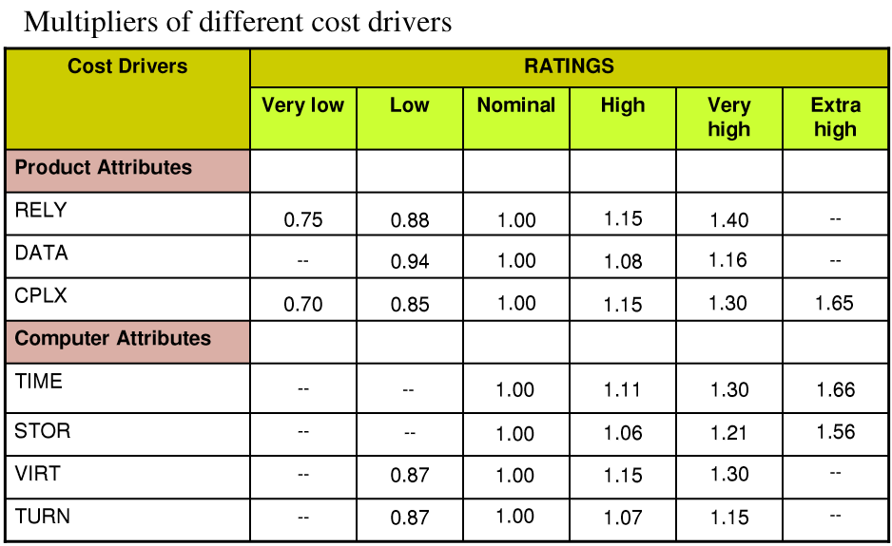
Software Project Planning

Slide 51

Software Project Planning

Slide 52

Software Project Planning

Slide 53
Software Project Planning
COCOMO II
It is the revised version of the original COCOMO and is developed at University of Southern California under the leadership of Dr. Berry Boehm.
The following categories of applications/projects are identified by COCOMO II for the estimation as below:
End user programming
Infrastructure sector
Intermediate sectors
Application generators and composition aids
Application Composition sector
System integration

Slide 54
Software Project Planning
End user programming
Applicable to small systems, developed by end user using application generators. For e.g. spreadsheets, extended query system, report generators etc.
Hence, the excellent domain knowledge may motivate them to develop an application using user friendly tools like MS-Excel, MS-Access, MS-Studio etc.

Slide 55
Software Project Planning
Infrastructure sector
Applicable to the infrastructure development i.e. operating systems, database management systems, user interface management system, networking systems etc.
In which capabilities required to build many components and capabilities from scratch.

Slide 56
Software Project Planning
Intermediate sectors
This category is divided into 3 sub-categories:
Application generators and composition aids
Largely pre-packaged programming skills needed to develop reusable components, develop application generators and also capabilities for new development from scratch.
Application composition sector
Deals with applications which are sufficiently simple to be rapidly composable from interoperable components. Development using VB, ASP, PHP, JSP etc.
System integration
Deals with large scale, highly embedded, or unprecedented systems. Generally demands significant amount of upfront systems engineering and customized software development activities.

Slide 57

Software Project Planning

Slide 58
Risk
Management

Slide 59
Risk
Tomorrow’s problems are today’s risk.
Problem that could cause some loss or threaten the success of the project, but which has not happened yet.
These potential problems might have an adverse impact on cost, schedule, or technical success of the project, the quality of our software products, or project team morale.

Slide 60
Example
Staff shortage because we have not been able to hire people with the right technical skills is a current problem;
But
The threat of our technical people being hired away by the competition is a risk.
We might choose to avoid the risk entirely by changing the project approach or even cancelling the project.

Slide 61
Software Risk Management
The art of managing the risks effectively so that the WIN-WIN situation and friendly relationship is established between the team and the customer is called Risk Management.

Slide 62

Typical Software Risk

Slide 63

Typical Software Risk

Slide 64

Typical Software Risk

Slide 65

Typical Software Risk

Slide 66

Typical Software Risk

Slide 67

Typical Software Risk

Slide 68

Typical Software Risk

Slide 69

Typical Software Risk

Slide 70

Typical Software Risk

Slide 71

Questions & Answers

Slide 72

Questions & Answers

Slide 73

Questions & Answers

Slide 74

Questions & Answers

Slide 75

Questions & Answers

Slide 76

Questions & Answers

Slide 77
THANKS
Software Design

