Slide 1
Software
Requirement
Specification
- SRS -

Slide 2
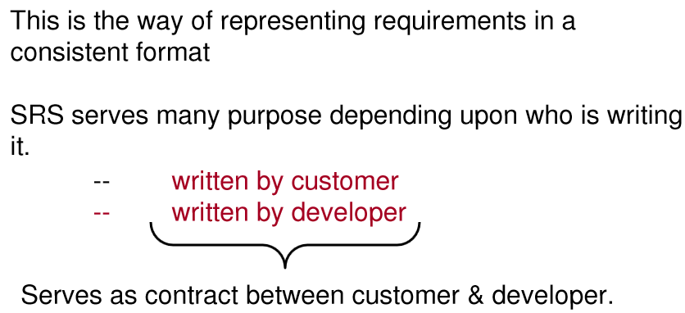
Software Documentation

Slide 3
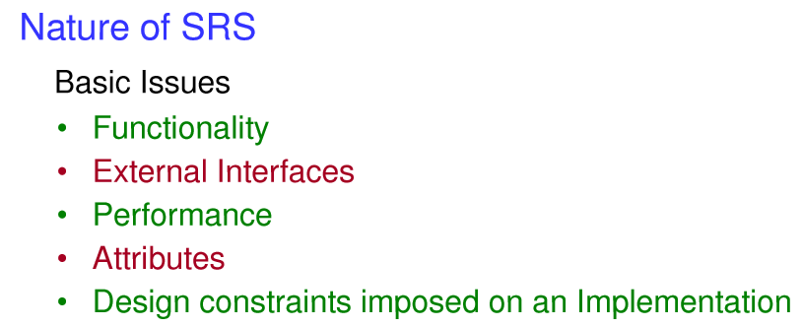
Software Documentation

Slide 4
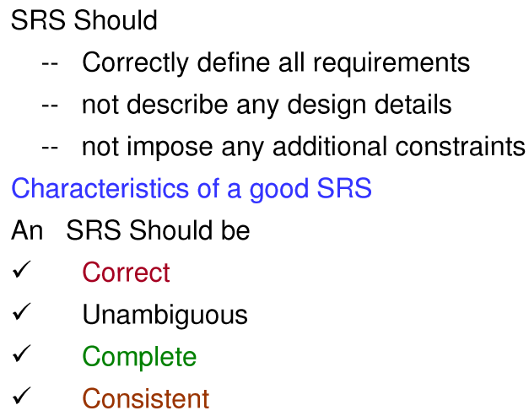
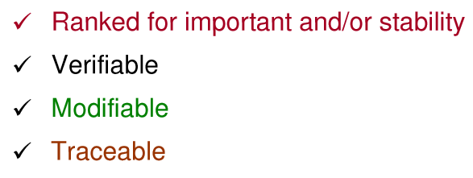
Software Documentation

Slide 5
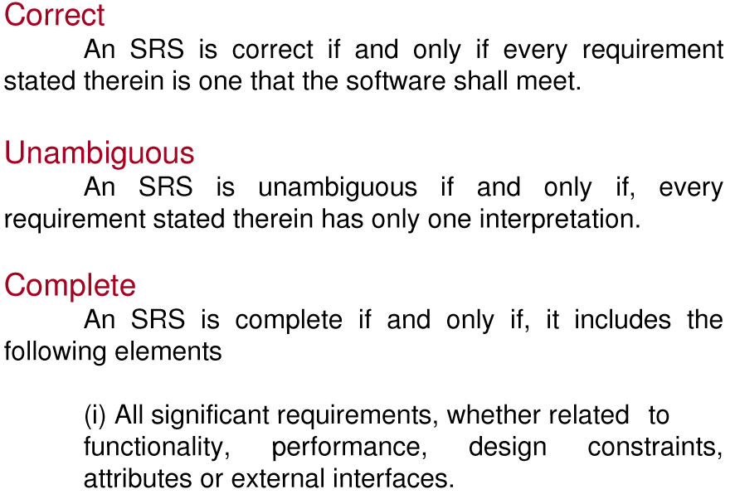
Software Documentation

Slide 6
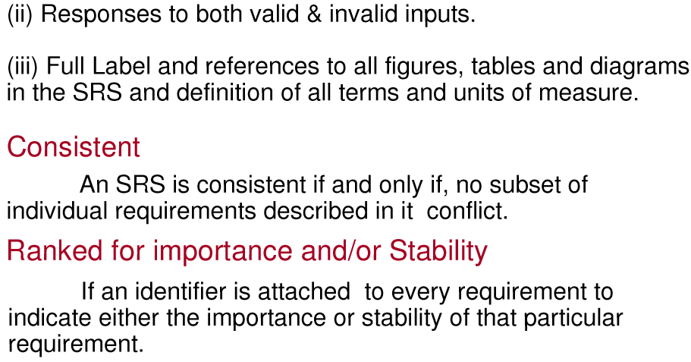
Software Documentation

Slide 7
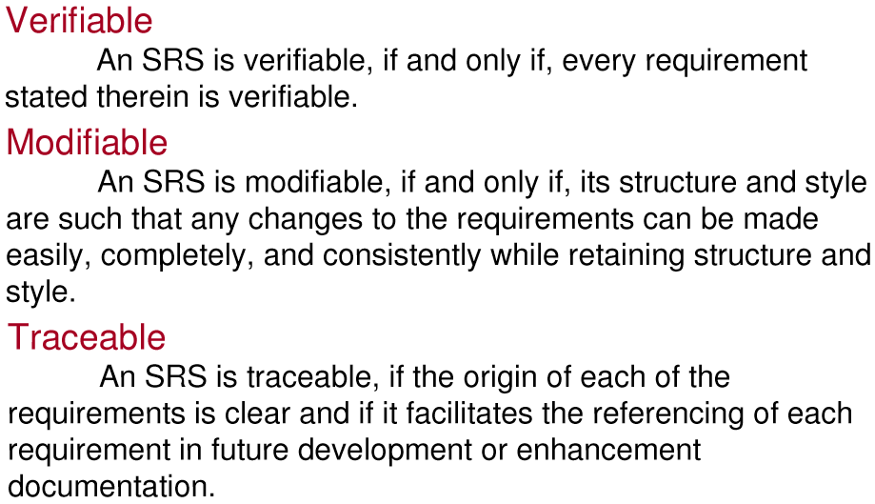
Software Documentation

Slide 8
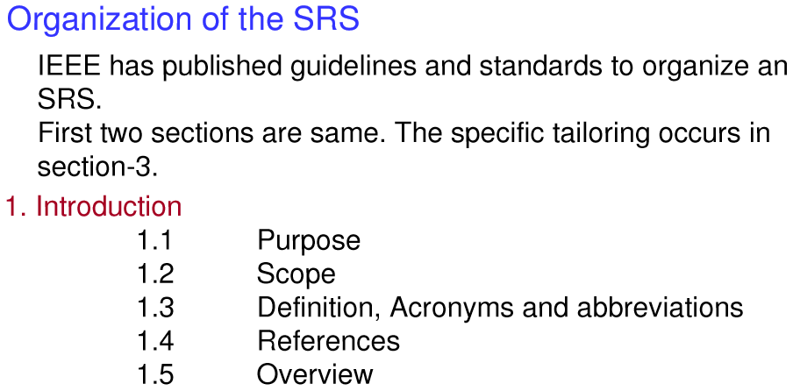
Software Documentation

Slide 9
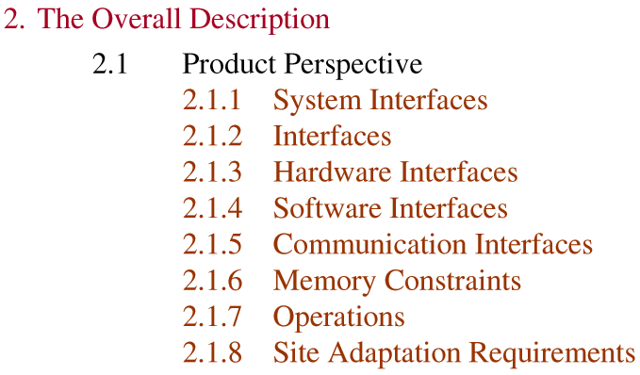
Software Documentation

Slide 10

Software Documentation

Slide 11
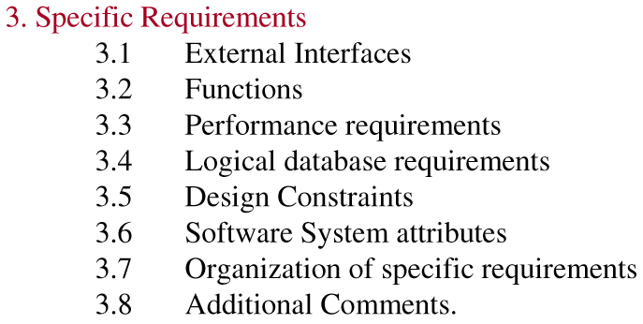
Software Documentation

Slide 12
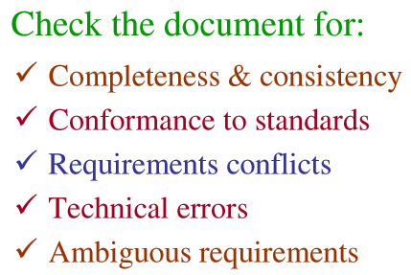
Software Validation

Slide 13
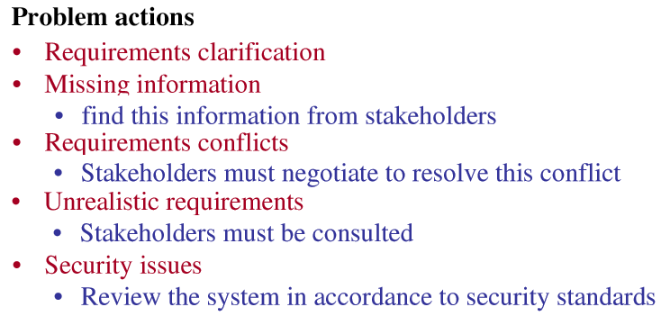
Software Validation

Slide 14
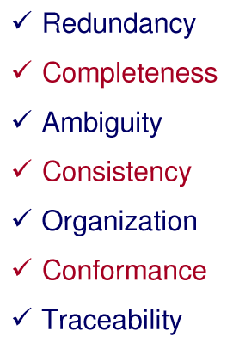
Review Checklist

Slide 15

Prototyping

Slide 16
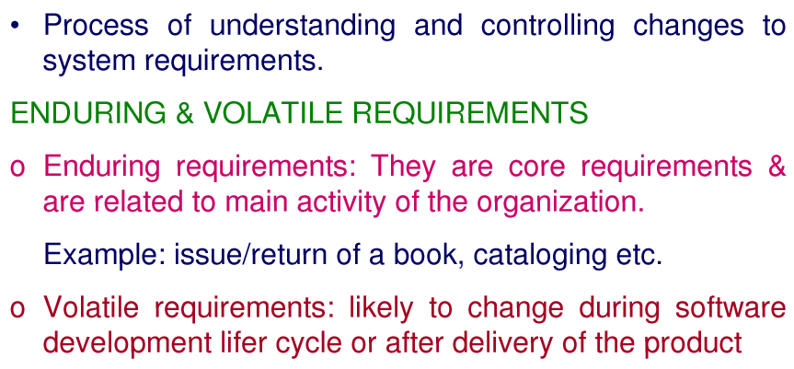

Requirements Management Planning

Slide 17
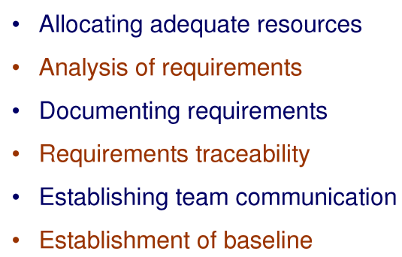
Requirements Change Management

Slide 18
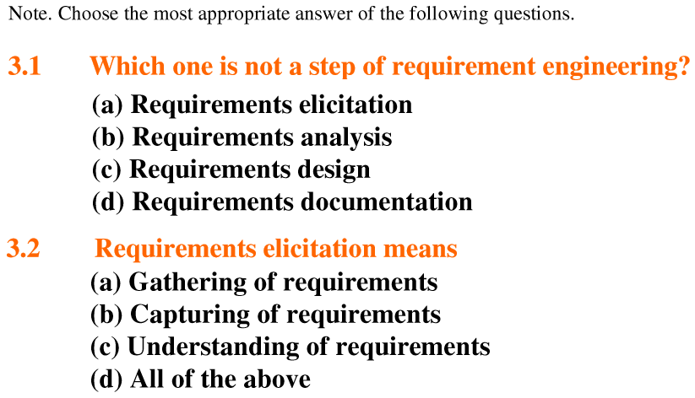
Multiple Choice Questions

Slide 19
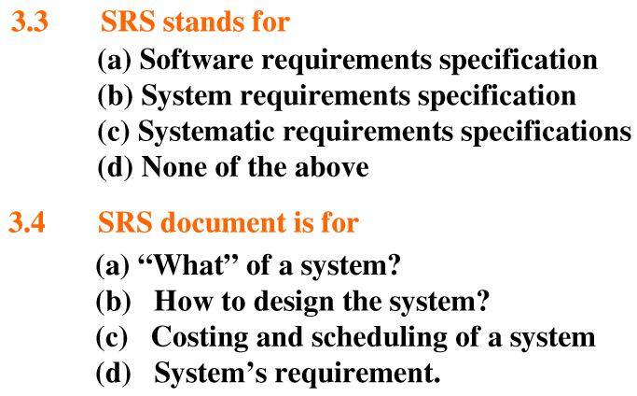
Multiple Choice Questions

Slide 20
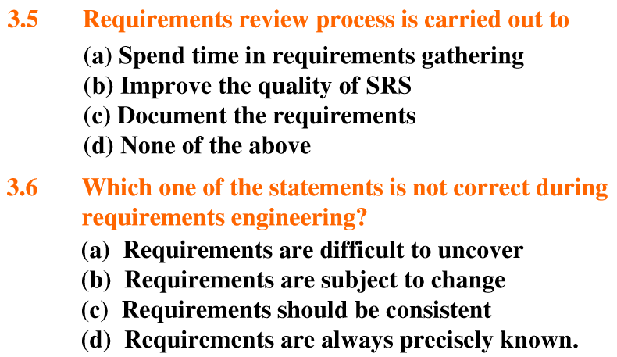
Multiple Choice Questions

Slide 21
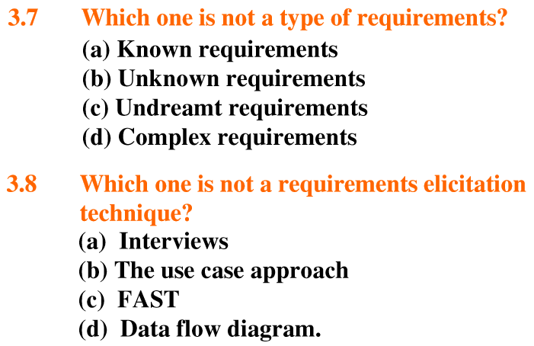
Multiple Choice Questions

Slide 22
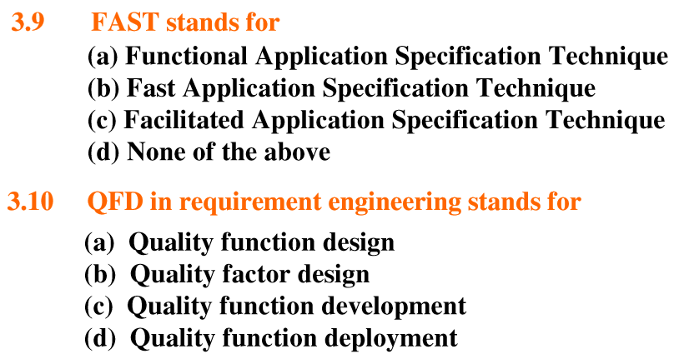
Multiple Choice Questions

Slide 23
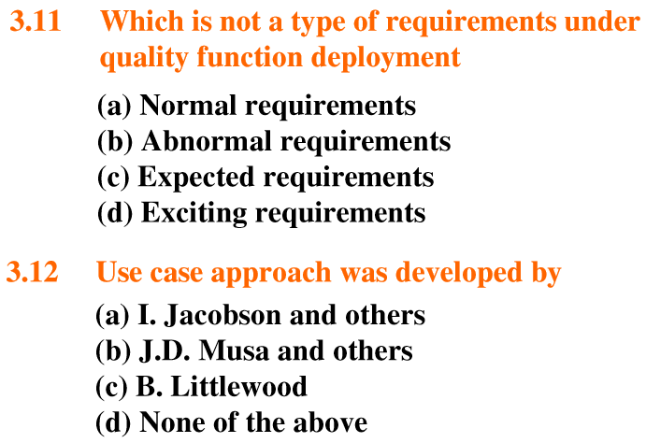
Multiple Choice Questions

Slide 24
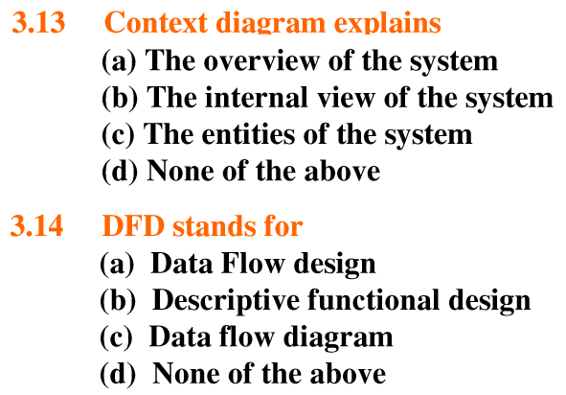
Multiple Choice Questions

Slide 25
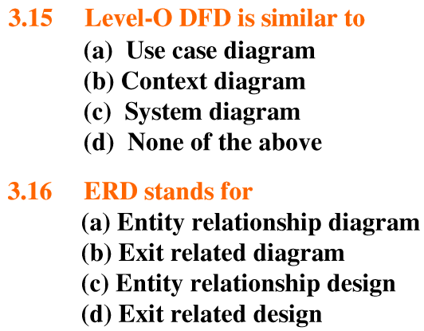
Multiple Choice Questions

Slide 26
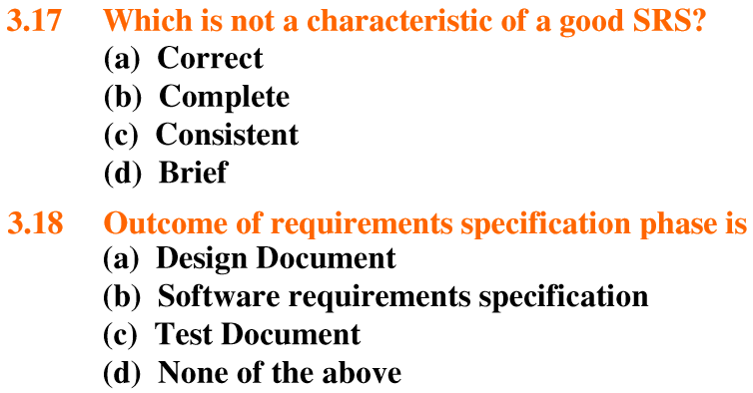
Multiple Choice Questions

Slide 27
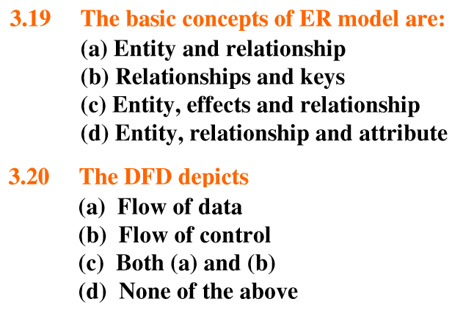
Multiple Choice Questions

Slide 28
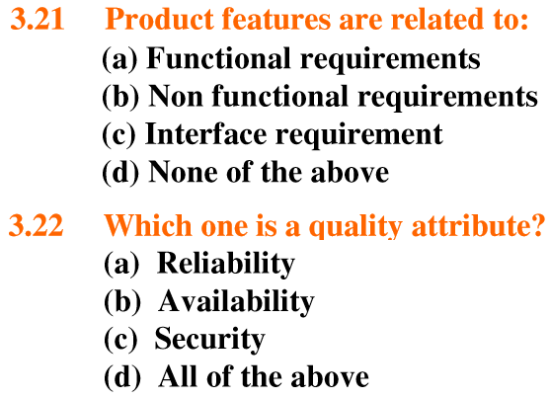
Multiple Choice Questions

Slide 29
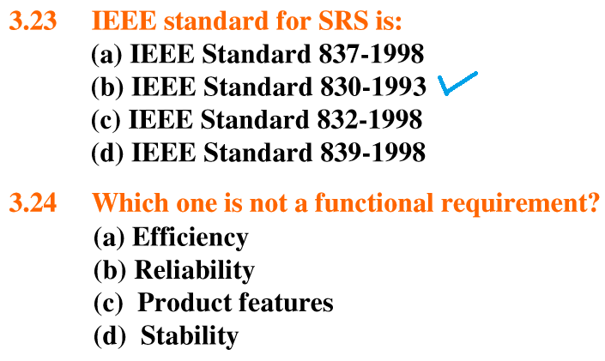
Multiple Choice Questions

Slide 30

Multiple Choice Questions

Slide 31

Assignment

