Slide 1
Quality Function Deployment

Slide 2
‘Quality Function Deployment’ means The responsibilities for producing a quality item must be assigned to all parts of a corporation.
Quality | Meeting Customer Requirements Function | What Must Be Done - Focusing the attention Deployment | Who Will Do It, When

Slide 3
Introduction
A QFD is used to capture the voice of the customer and translate it into technical information that an organization can use in order to create or improve a product.
Developed in Japan in the 1970s
Dr. Akao

Slide 4
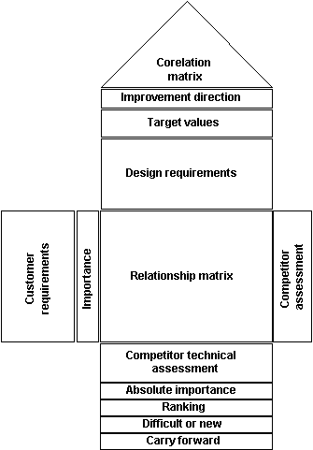
QFD
It is often called a House of Quality because:
Customer information is shown horizontally
Technical information is shown vertically
Customer Information
Technical Information

Slide 5
QFD
QFD’s are planning and communication tools:
Used for new product development
Used to conform to customer demands
Used any time you have customers and you need to identify their expectations and turn that information into workable technical specifications.
Used to help set strategic targets
Used to help determine priority issues
Used for analysis
Used to estimate what the competition is doing
Used to integrate complex information

Slide 6
QFD
QFDs encourage:
Team building
Consensus
Creativity
Structure
Organization
Development of new ideas
Remove suggestiveness from the product development process

Slide 7
QFD
Determine the Voice of the Customer
Capture the Voice of the Customer
Organize the Voice of the Customer

Slide 8
QFD
Determine the Voice of the Customer: Four types of customers
Those customers we already have and can’t lose
Those customers we could lose easily
Those customers we could gain with minor product changes
Those customers we can’t get.

