Slide 1
Software
Maintenance

Slide 2
What is Software Maintenance?
Software Maintenance is a very broad activity that includes error corrections, enhancements of capabilities, deletion of obsolete capabilities, and optimization.

Slide 3
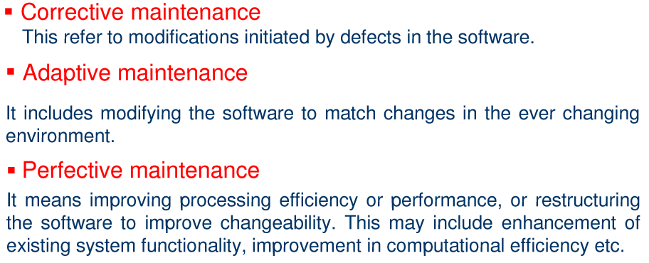
Categories of Maintenance?

Slide 4
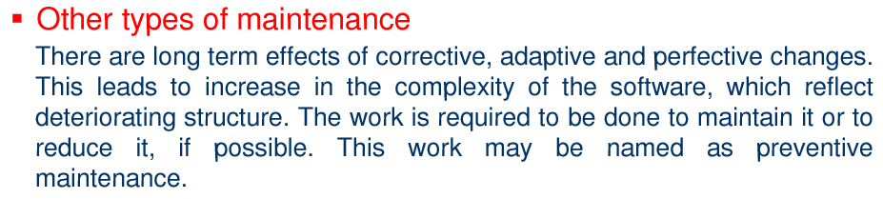
Categories of Maintenance?

Slide 5
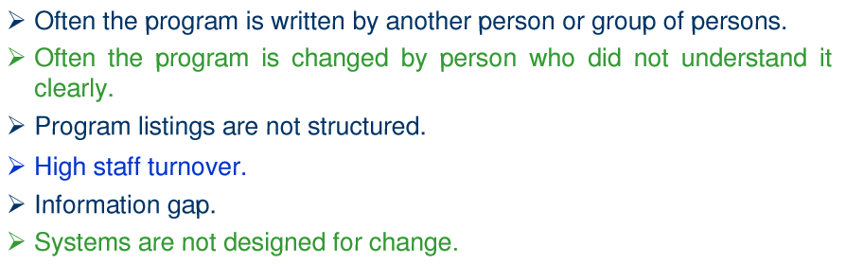
Problems during Maintenance

Slide 6
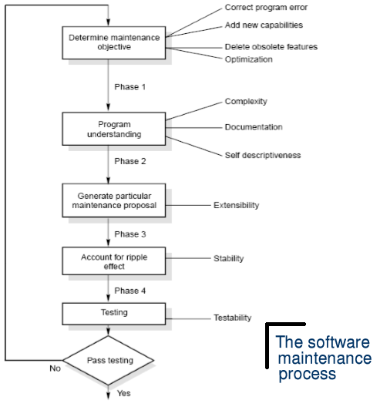
Maintenance Process

Slide 7
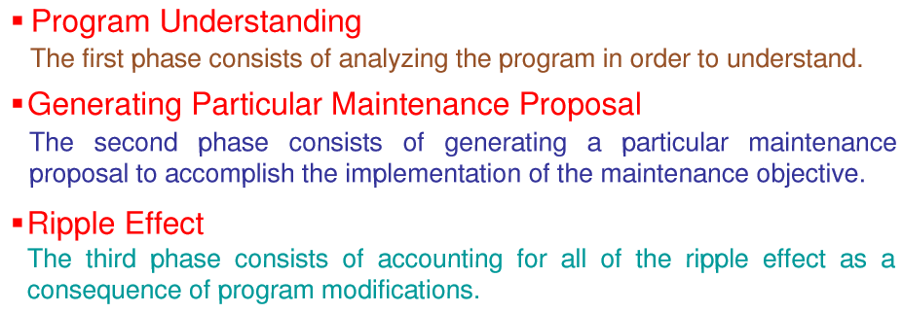
Maintain Process Elements

Slide 8
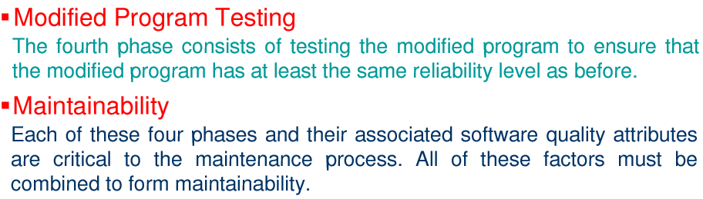
Maintain Process Elements

Slide 9
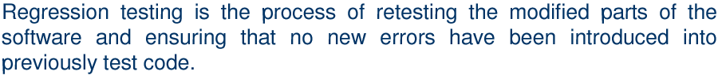
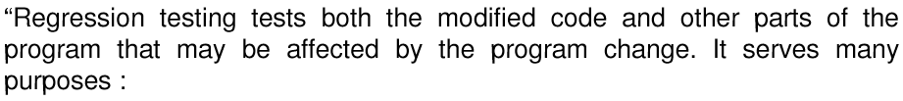
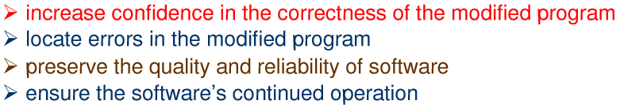
Software Maintenance
Regression Testing

Slide 10
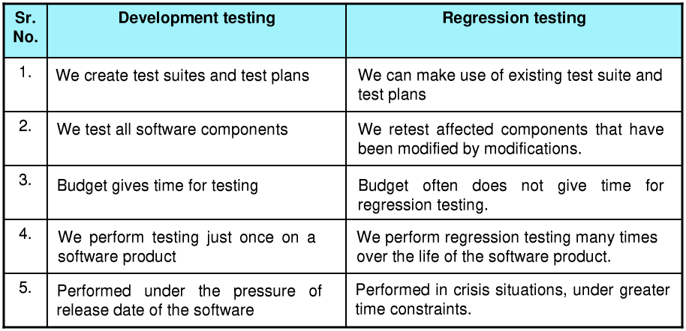
Software Maintenance

Slide 11



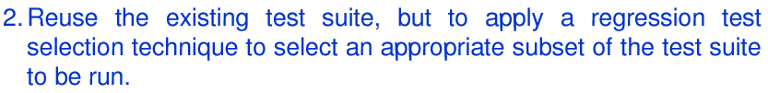
Software Maintenance

Slide 12

Software Maintenance

Slide 13
Software Maintenance

Slide 14
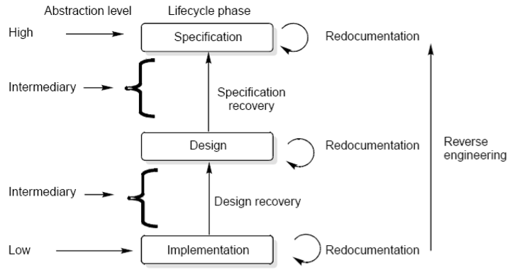
Software Maintenance
Levels
of abstraction

Slide 15
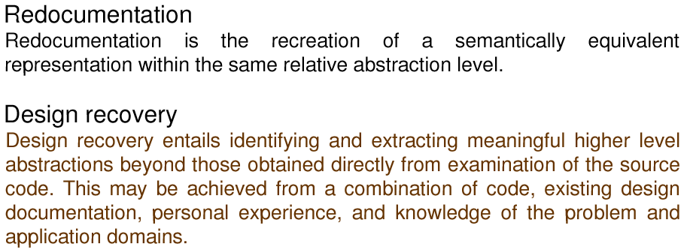
Software Maintenance

Slide 16

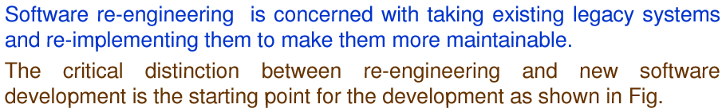
Software Maintenance

Slide 17
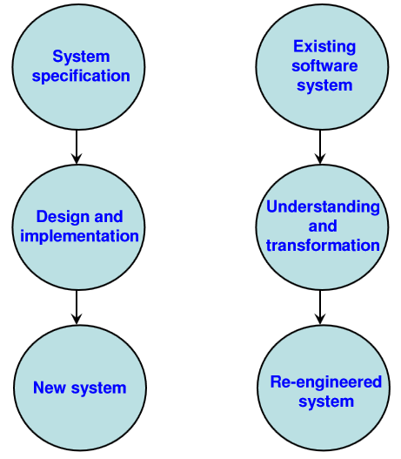
Software Maintenance

Slide 18
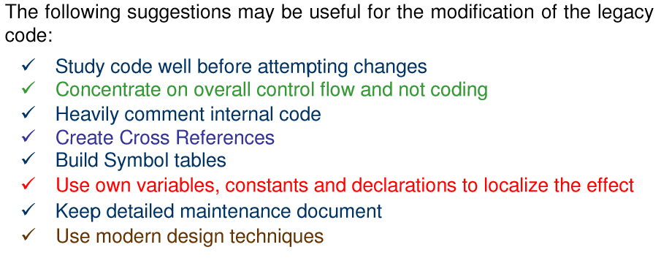
Software Maintenance

Slide 19
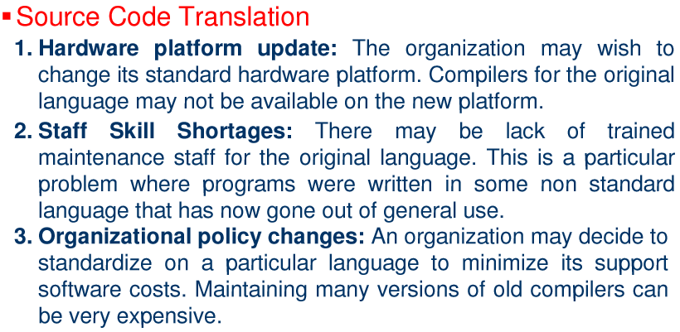
Software Maintenance

Slide 20
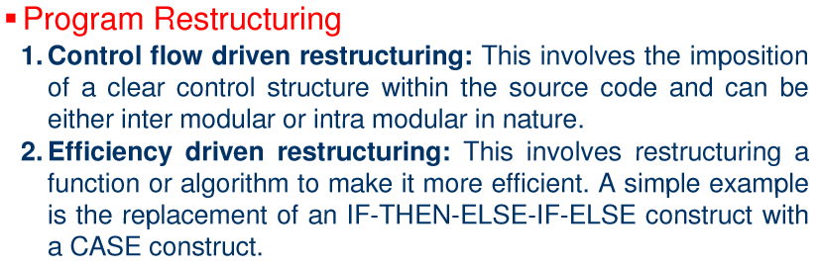
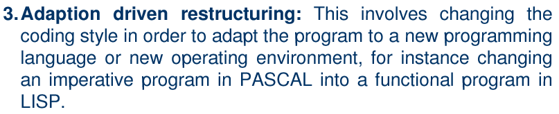
Software Maintenance

Slide 21

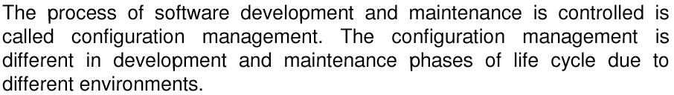
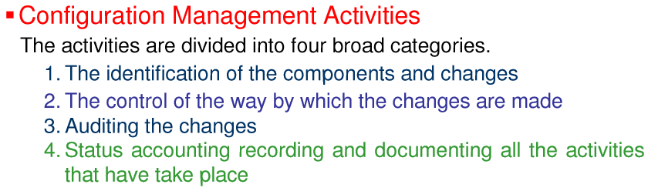
Software Maintenance

Slide 22
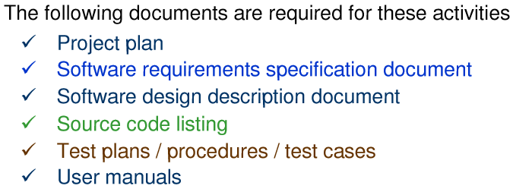
Software Maintenance

Slide 23
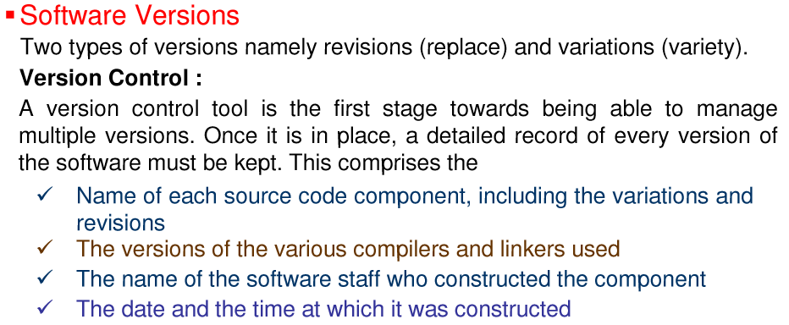
Software Maintenance

Slide 24
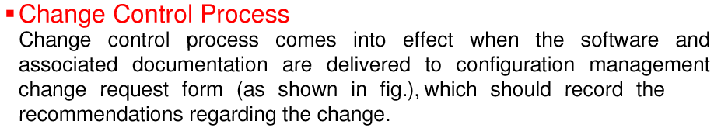
Software Maintenance

Slide 25
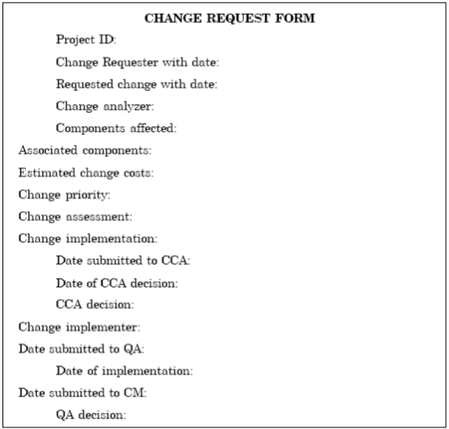
Software Maintenance

Slide 26
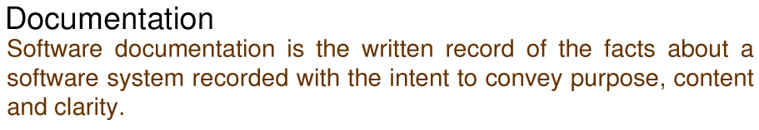
Software Maintenance

Slide 27
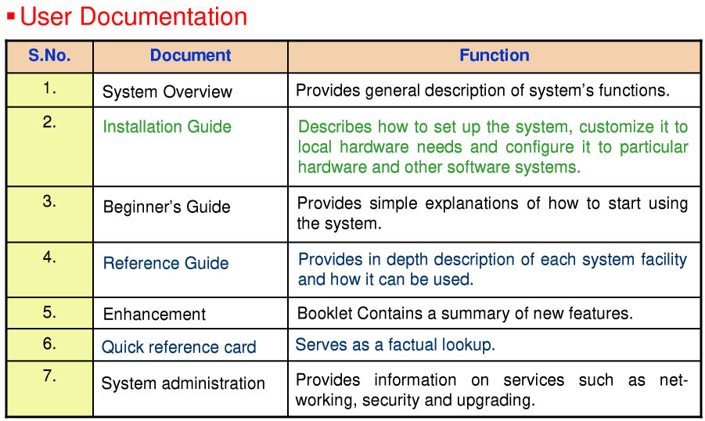
Software Maintenance

Slide 28
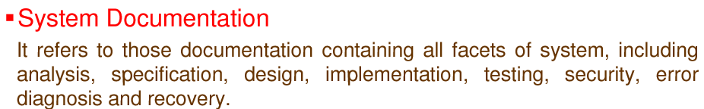
Software Maintenance

Slide 29
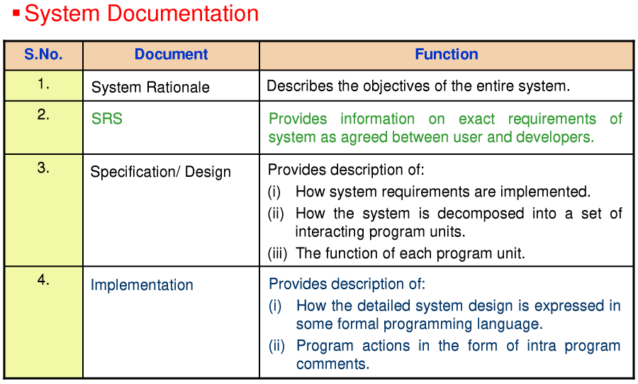
Software Maintenance

Slide 30
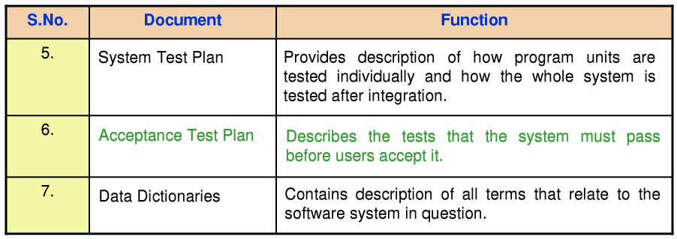
Software Maintenance

Slide 31
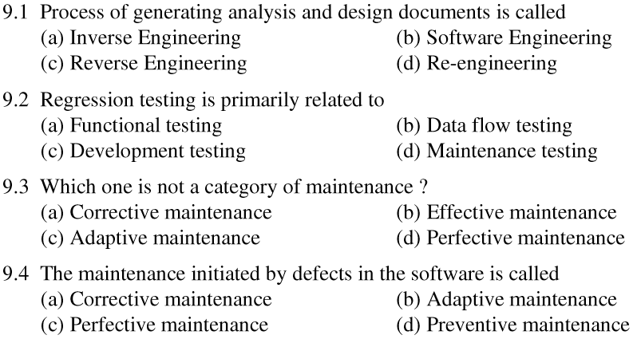
Software Maintenance

Slide 32
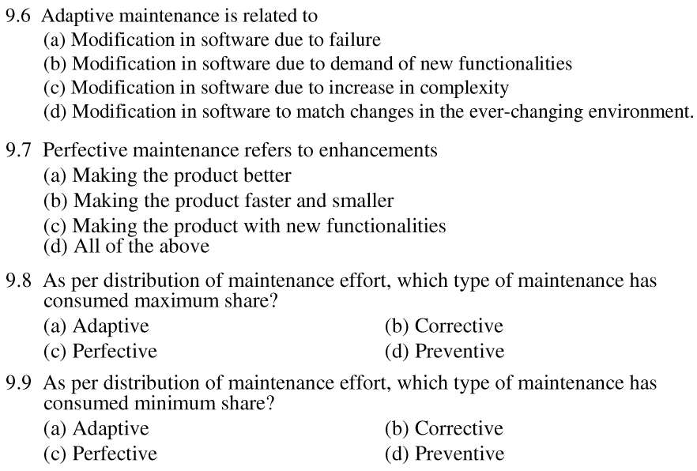
Software Maintenance

Slide 33
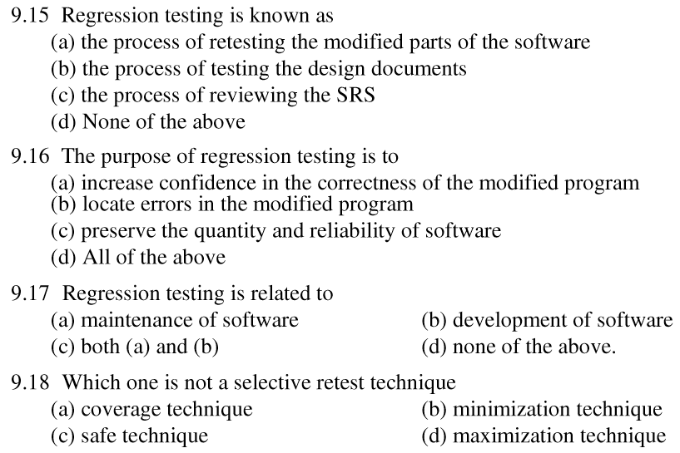
Software Maintenance

Slide 34
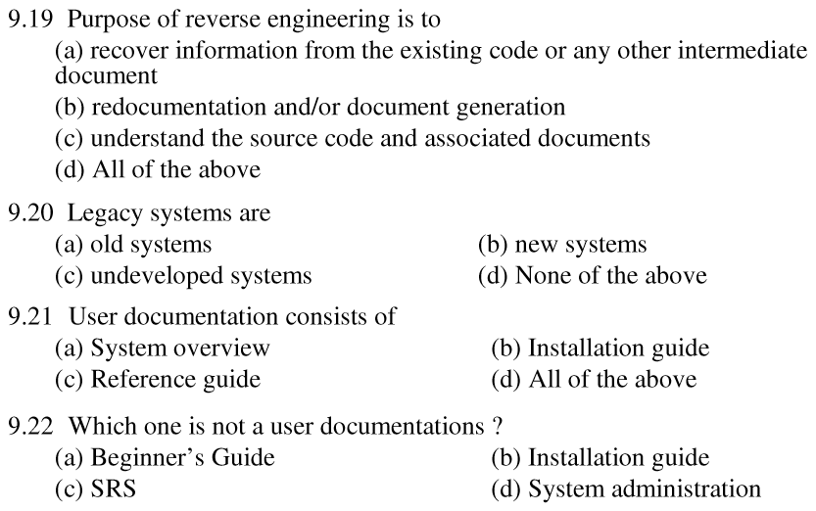
Software Maintenance

Slide 35
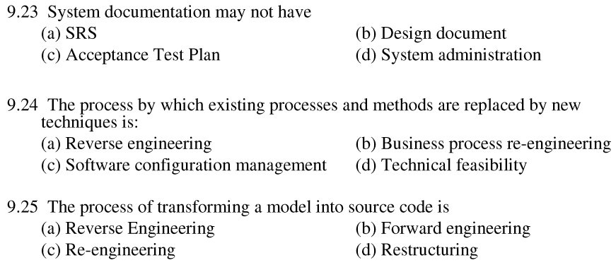
Software Maintenance

