Slide 1
Software
Testing

Slide 2
What is Software Testing?
Testing is the process of demonstrating that errors are not present.
The purpose of testing is to show that a program performs its intended functions correctly.
Testing is the process of establishing confidence that a program does what it is supposed to do.

Slide 3
What is Software Testing?
Testing is the process of demonstrating that errors are not present.
The purpose of testing is to show that a program performs its intended functions correctly.
Testing is the process of establishing confidence that a program does what it is supposed to do.
All Incorrect !!!

Slide 4
What is Software Testing?
Correct definition...
“Testing is the process of executing a program with the intent of finding errors”.

Slide 5
Why should we test?
In the software life cycle the earlier the errors are discovered and removed, the lower is the cost of their removal.

Slide 6
Who should do the testing?
Testing requires the developers to find errors from their software.
But, it is very difficult for software developer to point out errors from own creations.
Many organizations have made a distinction between Development and testing phase by making different people responsible for each phase.

Slide 7
What should we test?
We should test the program’s responses to every possible input. It means, we should test for all valid and invalid inputs. Suppose a program requires two 8 bit integers as inputs. Total possible combinations are 2⁸ x 2⁸. If only one second is required to execute one set of inputs, it may take 18 hours to test all combinations.
Practically, inputs are more than two and size is also more than 8 bits. We have also not considered invalid inputs where so many combinations are possible. Hence, complete testing is just not possible, although, we may wish to do so.

Slide 8
Some terminologies
Error, Mistake, Bug, Fault and Failure
People make errors. A good synonym is mistake. This may be a syntax error or misunderstanding of specifications. Sometimes, there are logical errors.
When developers make mistakes while coding, we call these mistakes “bugs”.
A fault is the representation of an error, where representation is the mode of expression, such as narrative text, data flow diagrams, ER diagrams, source code etc. Defect is a good synonym for fault.
A failure occurs when a fault executes. A particular fault may cause different failures, depending on how it has been exercised.

Slide 9
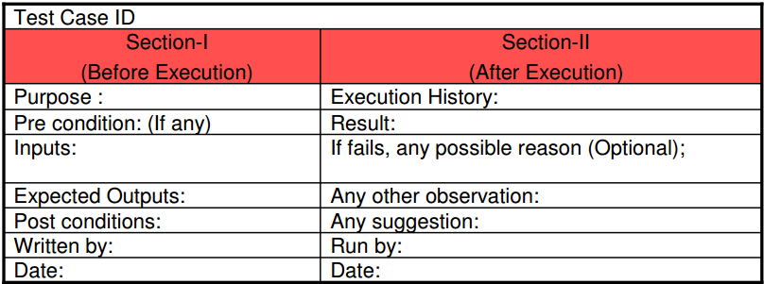
Test, Test Case & Test Suite
Test and Test case terms are used interchangeably. In practice, both are same and are treated as synonyms. Test case describes an input description and an expected output description.
The set of test cases is called a test suite. Hence any combination of test cases may generate a test suite.

Slide 10
Verification & Validation
Verification is the process of evaluating a system or component to determine whether the products of a given development phase satisfy the conditions imposed at the start of that phase.
Validation is the process of evaluating a system or component during or at the end of development process to determine whether it satisfies the specified requirements .
Testing = Verification + Validation

Slide 11
Testing Categories
The term Acceptance Testing is used when the software is developed for a specific customer.
A series of tests are conducted to enable the customer to validate all requirements.
These tests are conducted by the end user / customer and may range from adhoc tests to well planned systematic series of tests.

Slide 12
Testing Categories
The terms alpha and beta testing are used when the software is developed as a product for anonymous customers.
Alpha Tests are conducted at the developer’s site by some potential customers. These tests are conducted in a controlled environment. Alpha testing may be started when formal testing process is near completion.
Beta Tests are conducted by the customers / end users at their sites. Unlike alpha testing, developer is not present here. Beta testing is conducted in a real environment that cannot be controlled by the developer.

Slide 13
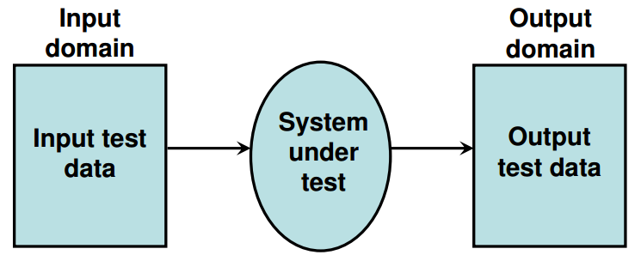
Functional Testing
Also called black box testing

Slide 14
Preparing Test data for black box testing

Slide 15

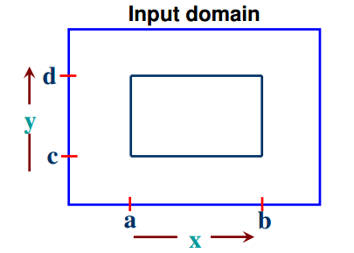
Boundary Value Analysis
Consider a program with two input variables x and y
These input variables have specified boundaries as:

Slide 16
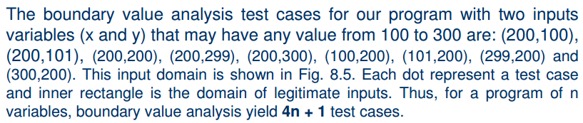
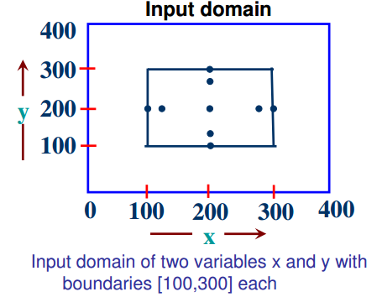
Boundary Value Analysis

Slide 17
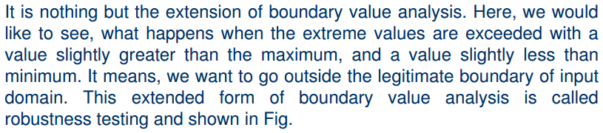

Robustness Testing

Slide 18
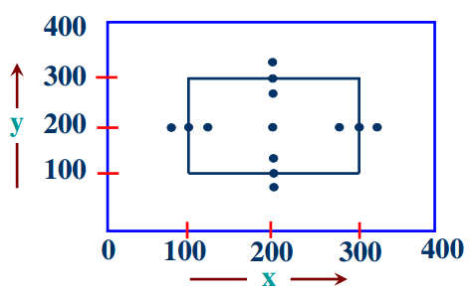

Robustness Testing

Slide 19
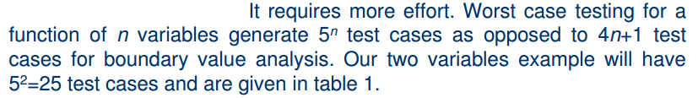
Worst case Testing

Slide 20
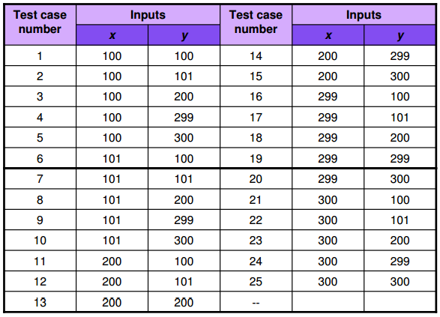
Worst case Testing

Slide 21
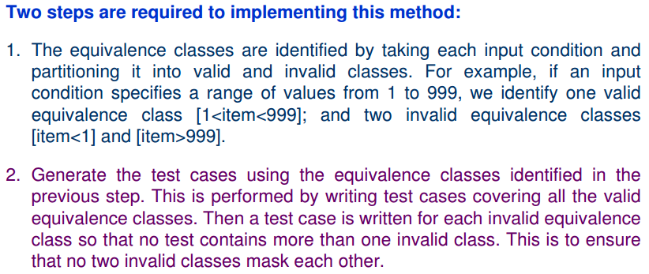
Equivalence Class Testing

Slide 22
Examples - Equivalence Class Testing
Example 1 Children under 2 ride the buss for free. Young people pay $10, Adults $15 and Senior Citizen pay $5. Classes: Price:0 -> Age:0-1 Price:10 -> Age:2-14 Price:15 -> Age:15-64 Price:5 -> Age:65-infinity
Example 2 (more than one parameter) Cellphones K80, J64 and J54 run Java 5. K90 and J99 run Java 6. But there are two possible browsers FireFox and Opera, J models run FF and K models run O. Classes: Browser:FF, Java:5 -> Phones:J64,J54 Browser:FF, Java:6 -> Phones:J99 Browser:O, Java:5 -> Phones:K80 Browser:O, Java:6 -> Phones:K90

Slide 23
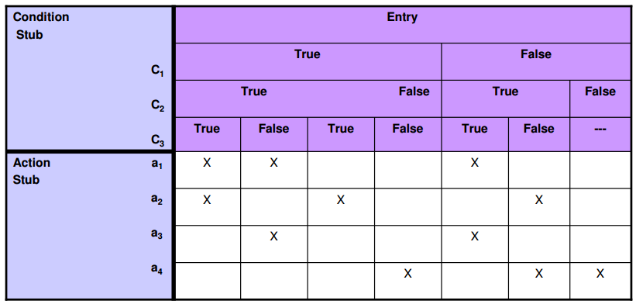
Decision Table based testing

Slide 24
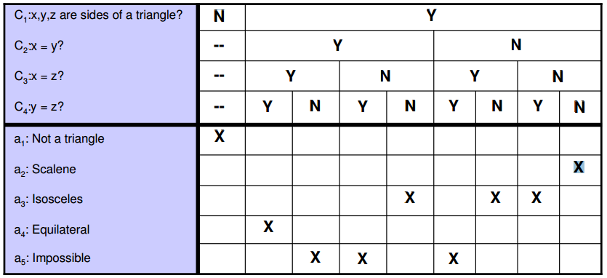
Test Case design

Slide 25

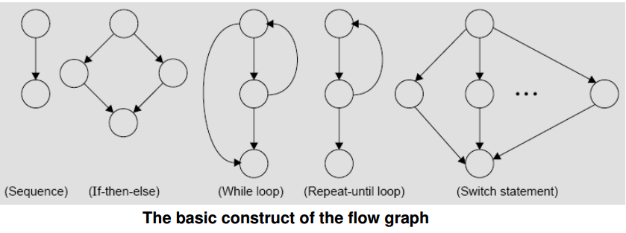
Flow Graph Testing

Slide 26
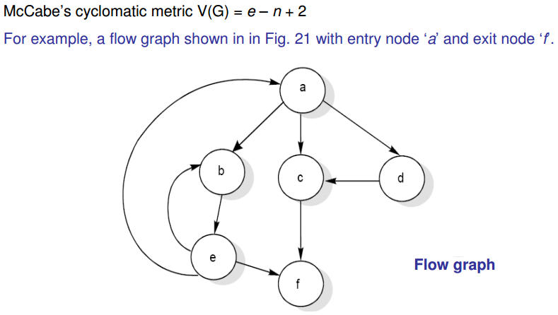
Cyclomatic Complexity

Slide 27
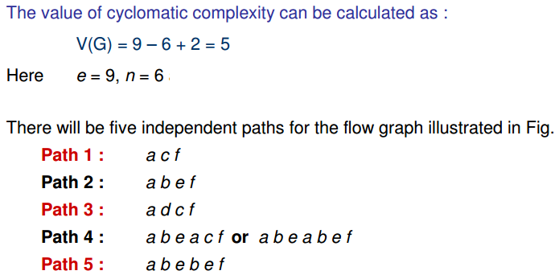
Cyclomatic Complexity

Slide 28
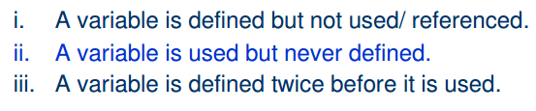
Data Flow Testing

Slide 29
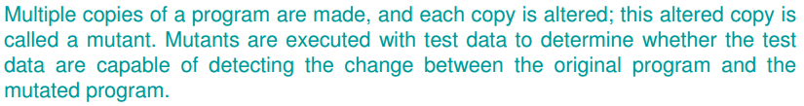
Mutation Testing

Slide 30
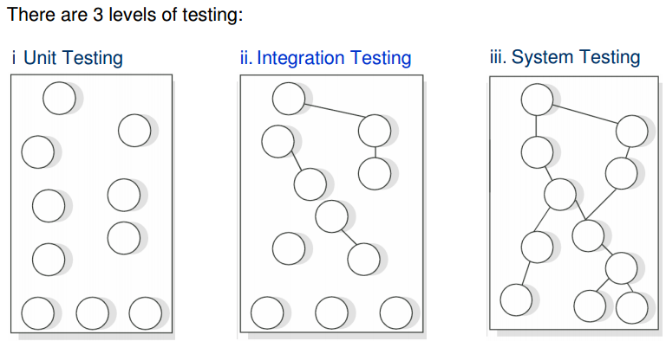
Levels of Testing

Slide 31
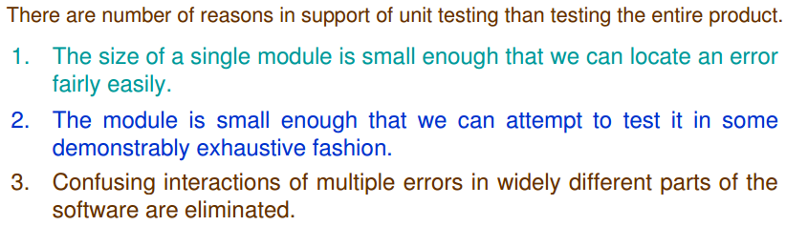
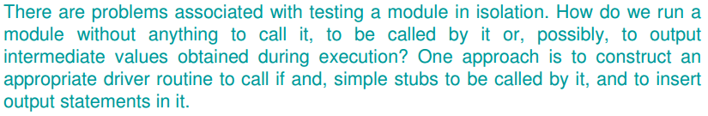
Unit Testing

Slide 32
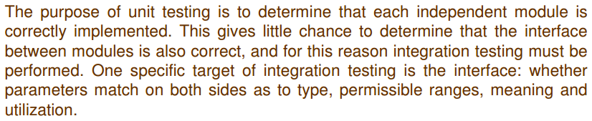
Integration Testing

Slide 33
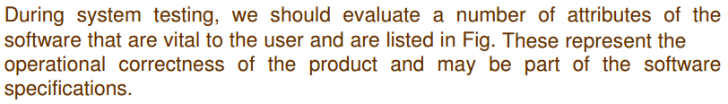
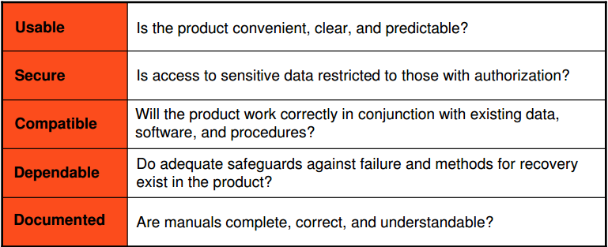
System Testing

Slide 34
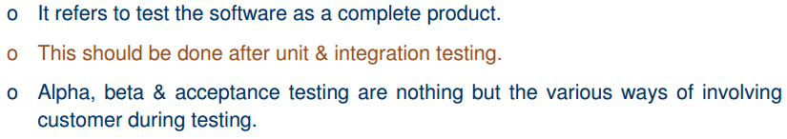
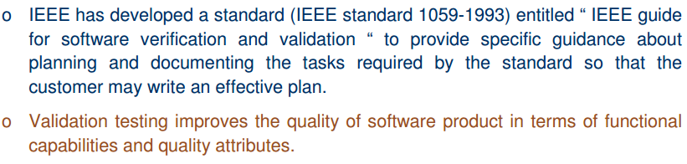
Validation Testing

Slide 35
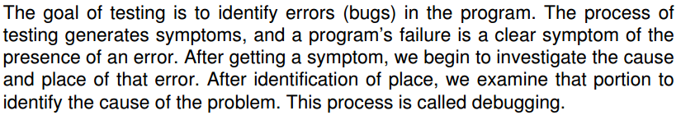
Debugging

