Slide 1
Software
PROCESS MODELS
OR
Software Life Cycle Models

Slide 2
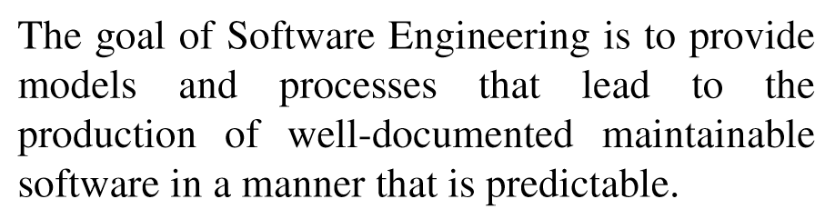
Software Life Cycle Models

Slide 3
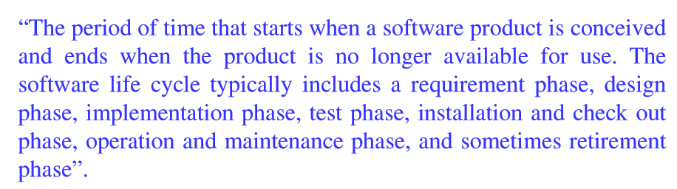
Software Life Cycle Models

Slide 4
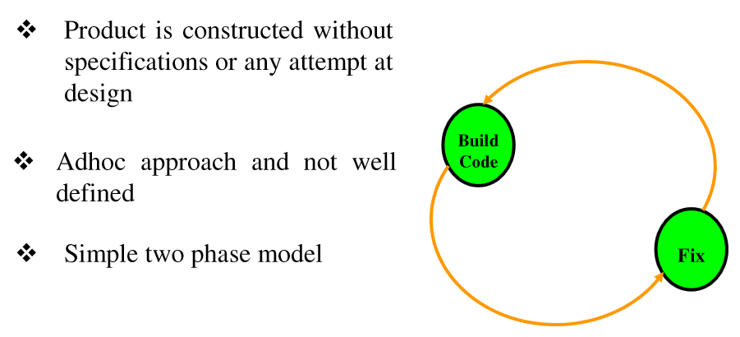
Build & Fix Model

Slide 5
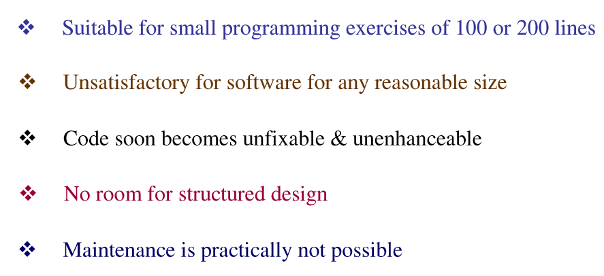
Build & Fix Model

Slide 6
Waterfall Model
Requirement Analysis & Specification
Design
Implementation & Coding
Testing
Deployment
Maintenance

Slide 7
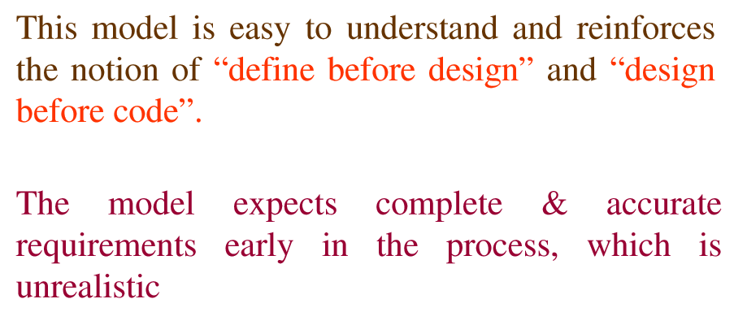
Waterfall Model

Slide 8
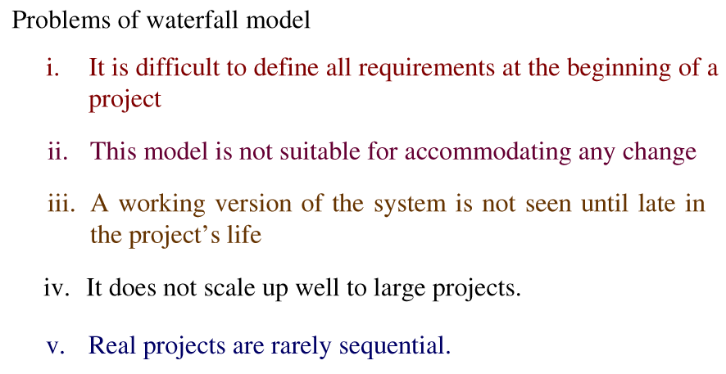
Waterfall Model

Slide 9
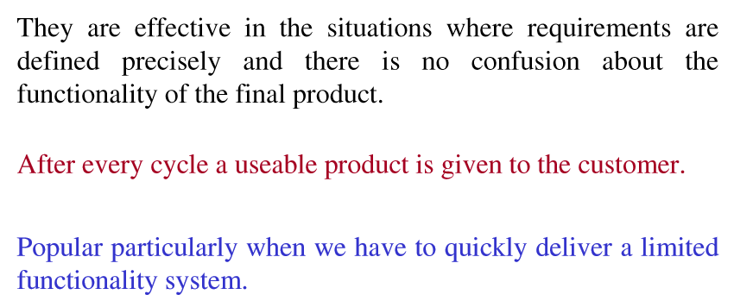
Incremental Process Model

Slide 10
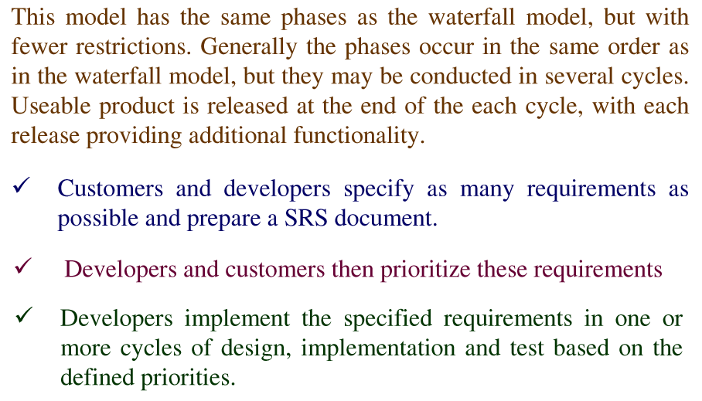
Iterative Enhancement Model

Slide 11
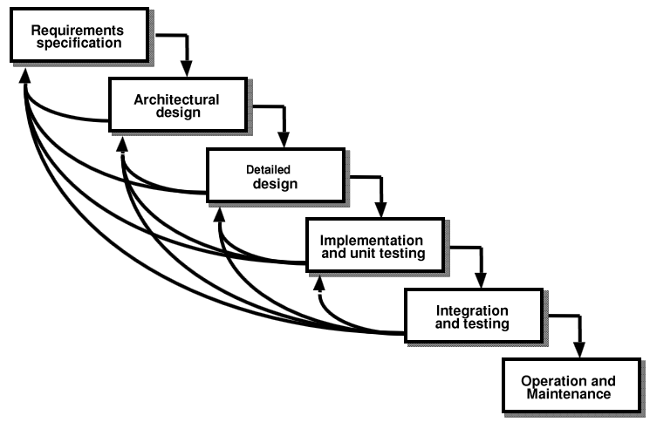
Iterative Enhancement Model

Slide 12
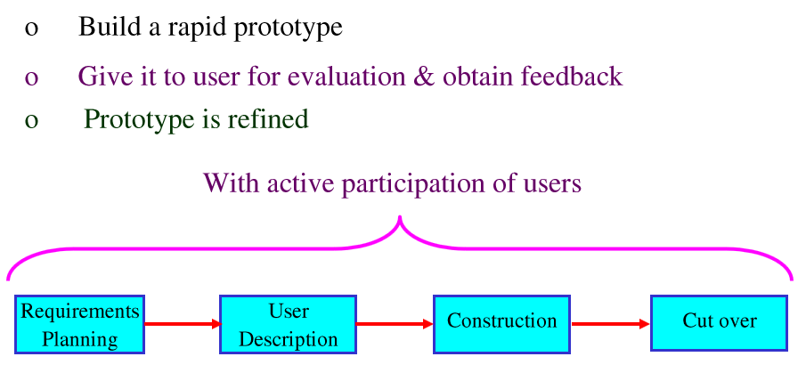
Rapid Application Model

Slide 13
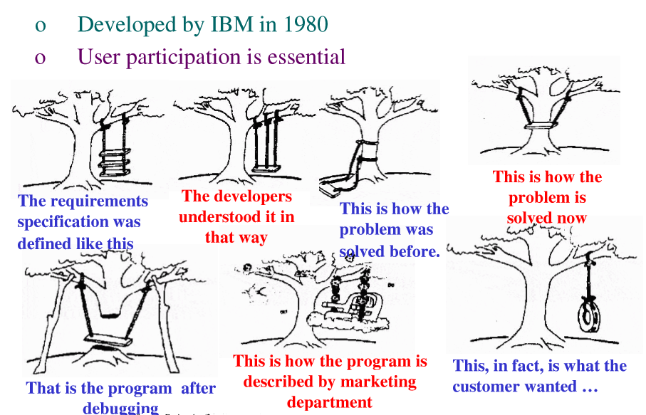
Iterative Enhancement Model

Slide 14
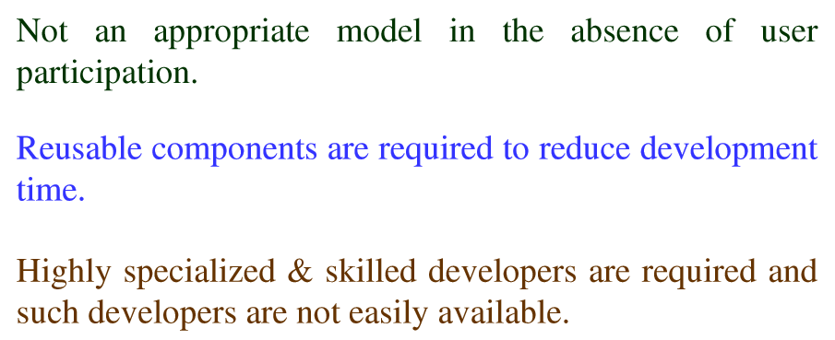
Rapid Application Development

Slide 15
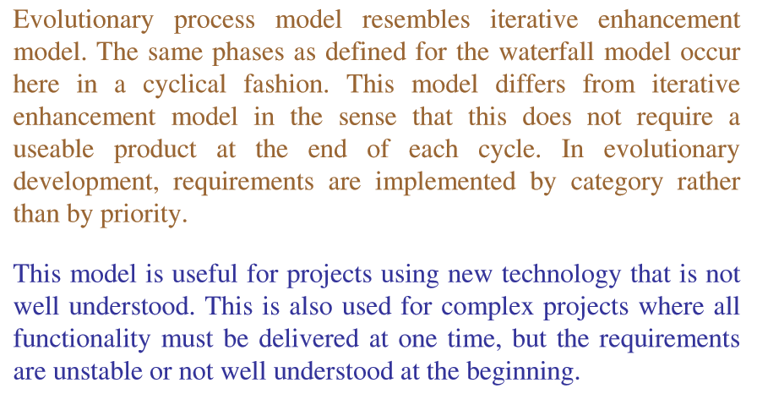
Evolutionary Process model

Slide 16
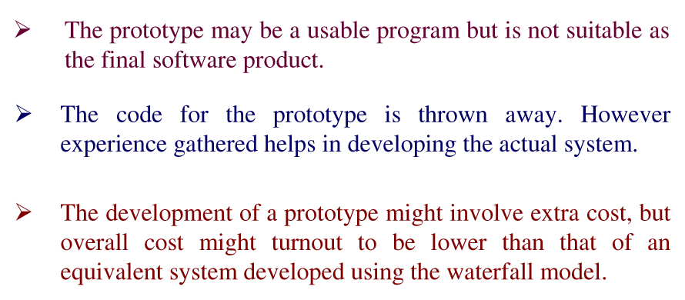
Prototyping Model

Slide 17
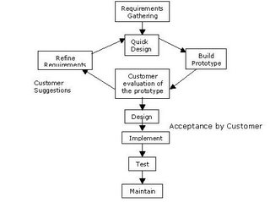
Prototyping Model

Slide 18
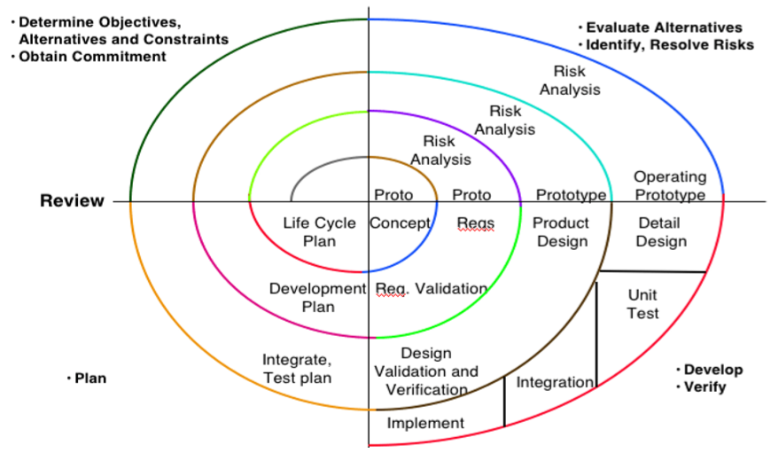
Spiral Model

Slide 19
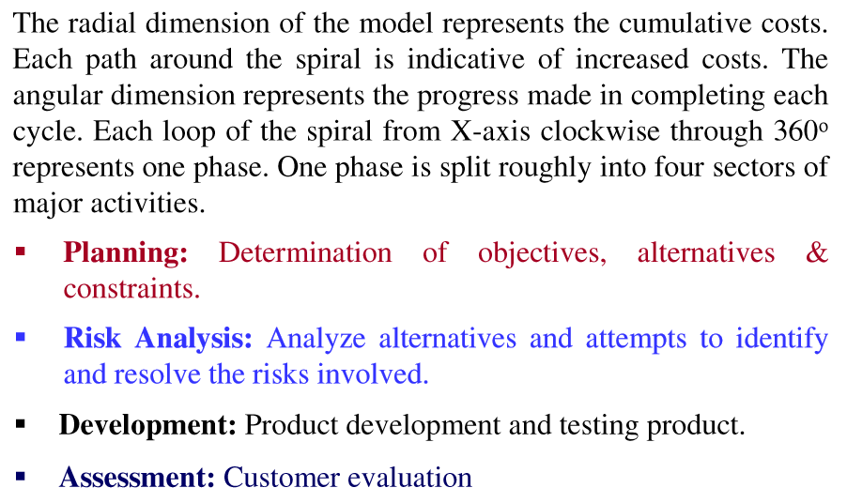
Spiral Model

