Slide 1
Cognitive e-commerce
Opportunities to leverage AI in online retail

Slide 2
Understanding AI?
What is AI
Simulation of human intelligence processes by computer systems including learning (the acquisition of information and rules for using the information), reasoning (using rules to reach approximate or definite conclusions) and self-correction.
Why a sudden explosion of AI
Exponential growth in of (BIG)data
Cheap computing power
Evolution and maturity in the field of Machine Learning and Deep learning.

Slide 3
AI opportunities in ecommerce
Cognitive Ecommerce
Personalization
Product Recommendation
Intelligent Search
Anomaly Detection
Customer Support
Inventory Management
Product Recommendation –based on customer behaviour, customer segmentation and profiling
Intelligent Search - move beyond simple text based search to image and voice based search based on natural language
Anomaly Detection – detect unusual buying pattern.
Customer Support – Digital Assistant, Chatbot
Inventory Management – Predict product demand, maximize probability of relevant items in stock, leaner inventory and faster fulfilment.
Personalization – Customization of shopping recommendation, m-commerce and e-commerce layout and promotions

Slide 4
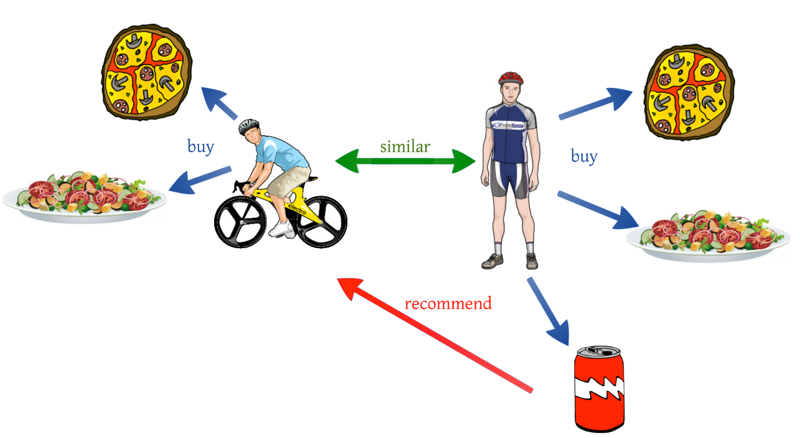
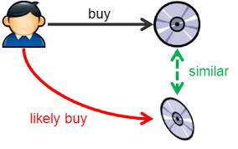
Product Recommendation
Collaborative Filtering
Past purchase pattern and activity
Identify customers with “similar interest/behaviour”
Recommend based on common interest.
Content Based Filtering
Build user profile
Identify associated/clustered set of products based on product interest/purchase and user profile.
Hybrid System
Combination of both the approaches
Image source: Medium

Slide 5
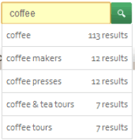


Intelligent Search
Text Based
Typeahead to complete query
Probable items based on sequence of characters
Image Based
Given images of items, recommend similar visually appealing images (based on texture, colour, shape etc).
Upload/key in image URL of image to search for relevant products matching the image.
Voice based
Given a voice input, reply with a list of relevant items
“what’s the best 43 inch SONY LED TV under $400
Spell Correction
Understand what user wants to type based on query formation.
Based on attributes/features of item(s) in the image
“Show me deal of the day”

Slide 6
Online Grocery Challenges (Need example of how ML can solve this and how it is different from is done now)
MarketPlace forecasting : To predict food/grocery demand supply, use predictive capabilities of AI in forecasting inventory needs
Pricing: Grocery is price sensitive, determining prices of products based on internal and external factors
Instead of rule-bases pricing and forecasting which is static , ML enables it dynamic, < need to showcase it>
- Automatically changes pricing depending on dynamic factors
- Stale inventory alert and price drop synchronization
- Connect to market feed and compare pricing and generate alerts
Scanning product images through HD camera (IOT) and report errors to admin in store (Fog Computing)
In-store specific promotion to regional promotion
Predicting surge in demand
Offline

Slide 7
<Add Deep Dive into one area, Dynamic pricing or Inventory Forecasting>
Use Rosemmon data from Kaggle to build model showcase actual vs ai driven forecasting

Slide 8
<Showcase solution Demo>
Showcase running model on notebook (Jupyter)

Slide 9
Idea on how AI projects are executed vs tradition projects ?

