Slide 1

Introduction to Machine Learning
Demystifying ML
Ramesh Natarajan
July 16, 2018

Slide 2
What we will cover
Artificial Intelligence (AI) vs Machine Learning (ML) vs Deep Learning (DL)
Machine Learning vs Traditional Programming
What’s Driving ML Explosion
ML Categorization
Classification vs Regression
Supervised vs Unsupervised
How do we implement Machine Learning
Practical Demonstration
Machine Learning Libraries and Frameworks
Recent Developments
Useful Resources
Questions?

Slide 3
AI vs ML vs DL
Artificial Intelligence
Machine Learning
Deep Learning
“Human intelligence exhibited by machine”
“Machine learns relationships in data—
when provided features—to make decisions”
“Machine learns features and relationships in data on its own to make decisions”

Slide 4
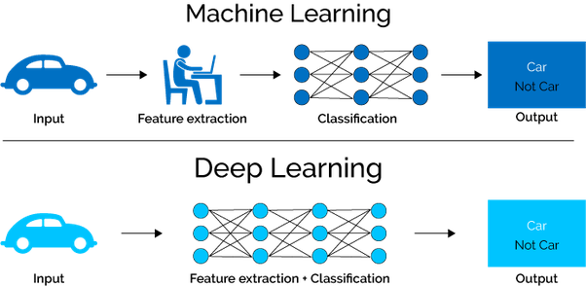
AI vs ML vs DL contd…
Source for Above Image: DL vs ML

Slide 5
Machine Learning vs Traditional Programming
Traditional Programming
Machine Learning
X (Input) | Rules | Y (Output)
77 | L O G I C | 25.0
99 |  | 37.2
1 |  | -17.2
21 |  | -6.1
91 |  | 32.8
44 |  | 6.7
62 |  | 16.7
41 |  | 5.0
48 |  | 8.9
5 |  | -15.0
62 |  | 16.7
3 |  | -16.1
66 |  | 18.9
46 |  | 7.8
85 |  | 29.4
X (Input) | Model | Y (Output)
77 | R E L A T I O N | 25.0
99 |  | 37.2
1 |  | -17.2
21 |  | -6.1
91 |  | 32.8
44 |  | 6.7
62 |  | 16.7
41 |  | 5.0
48 |  | 8.9
5 |  | -15.0
62 |  | 16.7
3 |  | -16.1
66 |  | 18.9
46 |  | 7.8
85 |  | 29.4
Fahrenheit to Celsius
(X°F - 32) x .5556 = Y°C

Slide 6
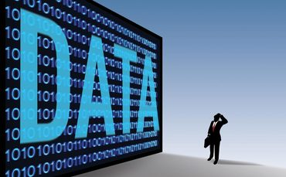
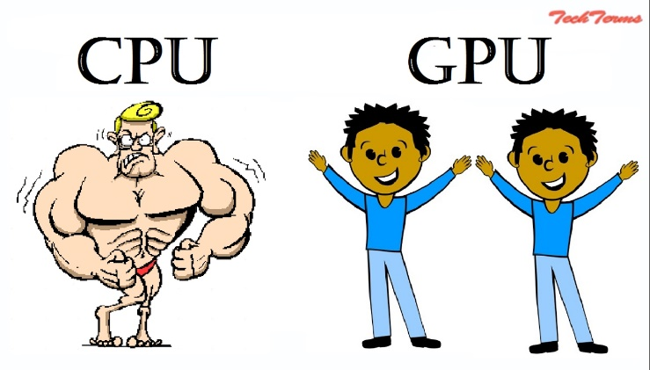
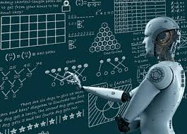
What’s Driving ML Explosion?
Big Data
Social/Business Interactions & Feeds
ERP/CRM
GPS & Sensor data
Video/Audio/Images
…
Computing Power
Graphics Processing Unit (GPU) - 1000s of “weak” cores capable of large scale parallel computing (NVIDIA, AMD…)
Matrix operation
Cloud computing services - AWS EC2, GCP
Algorithm Evolution
Optimization – Momentum, RMSProp, ADAM,
Activation functions such as RELU
Batch Normalization

Slide 7
ML Categorization – Classification vs Regression
Classification
Regression
Weather Data
Classifier
Chances of Rain tomorrow
High
Weather Data
Regressor
Tomorrow’s temperature
77°F
Classification:
Output Variable: Pre-defined output category (High|Medium|Low; Yes|No; A|B|C)
Example: Risk Management, Image recognition
Algorithms: Logistic Regression, Support Vector Machine (SVM), Neural Network, Decision Trees, kNN
Regression:
Output Variable: Continuous, can take any value
Example: Sales Forecast, Crop yield
Algorithms: Linear Regression, Polynomial Regression, Neural Network

Slide 8
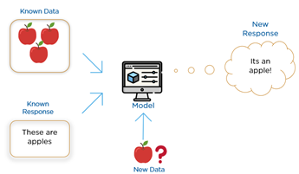
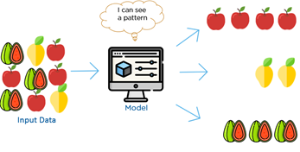
ML Categorization – Supervised vs Unsupervised
Supervised
Unsupervised
Supervised
Input: Labeled Data
Learning: Labeled output available to adjust the model and learn
Examples: Risk Assessment, Weather Prediction, Tumor categorization
Unsupervised:
Input: Unlabeled Data
Learning: Based on identifying relationship amongst input variables based on clustering (k-means) or association (PCA)
Example: Product Recommendation, Fraud Detection
Source for Above Images: Quora

Slide 9
ML Implementation – Data Preparation
Original Dataset
Training Set
Test Set
Option 1
Training Set
Validation Set
Test Set
Option 2
Train
Tune
Evaluate
Key Considerations:
Data Division
Training : Test | 70% : 30%;
Training : Validation : Test | 60% : 20% : 20%
Sampling Technique
Simple Random
Stratified

Slide 10
ML Implementation – Model Selection & Training
X (Input) | Model | Y (Output)
77 | R E L A T I O N | 25.0
99 |  | 37.2
1 |  | -17.2
21 |  | -6.1
91 |  | 32.8
44 |  | 6.7
62 |  | 16.7
41 |  | 5.0
48 |  | 8.9
5 |  | -15.0
62 |  | 16.7
3 |  | -16.1
66 |  | 18.9
46 |  | 7.8
85 |  | 29.4
Steps:
Feature Engineering
Choose ML Algorithm
Define Cost Function
ŷ = W*X + b
Weights Initialization
Training
Cost Optimization
Learning Weights
Epoch – One Pass over training set

Slide 11
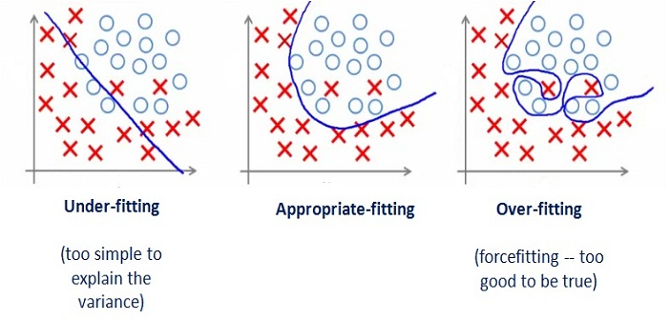
ML Implementation – Model Tuning & Evaluation
Tuning
Bias (Underfitting)
Choice of Model
Feature Engineering
Training Set Diversity
Variance (Overfitting)
More Data
Cross-validation
Early-stopping
Regularization
Classifier | Precision | Recall | F1 Score (HM) | Running Time (ms)
A | 95% | 90% | 92.4% | 90
B | 98% | 85% | 91.0% | 80
C | 97% | 96% | 96.5% | 1500
Evaluation
Model Accuracy (F1 Score)
Satisficing metric (e.g, 100 ms)

Slide 12




Machine Learning Libraries and Frameworks
Framework/Library | Description
 | Web-based, interactive computing notebook environment that enables editing and running human-readable docs supporting python coding while describing the data analysis.
 | Open source machine learning library for Python developed by Facebook's artificial-intelligence research group.
 | Open-source software library used for machine learning developed by Google.
 | Open source neural network library written in Python. It is capable of running on top of TensorFlow, Microsoft Cognitive Toolkit or Theano.

Slide 13
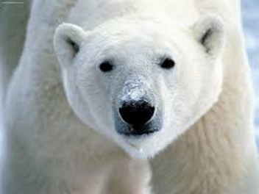
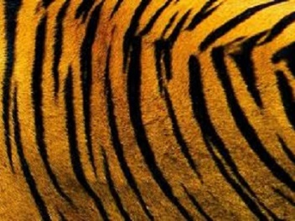

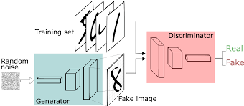
Recent Developments
Neural Style Transfer
+
=
Generative Adversarial Network (GAN)
Deep Reinforcement Learning
AutoML

Slide 14


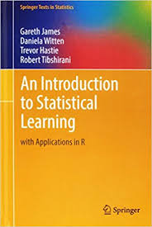


Useful Resources

Slide 15

Questions?

Slide 16
Appendix
ML Demo in Excel

