Slide 1
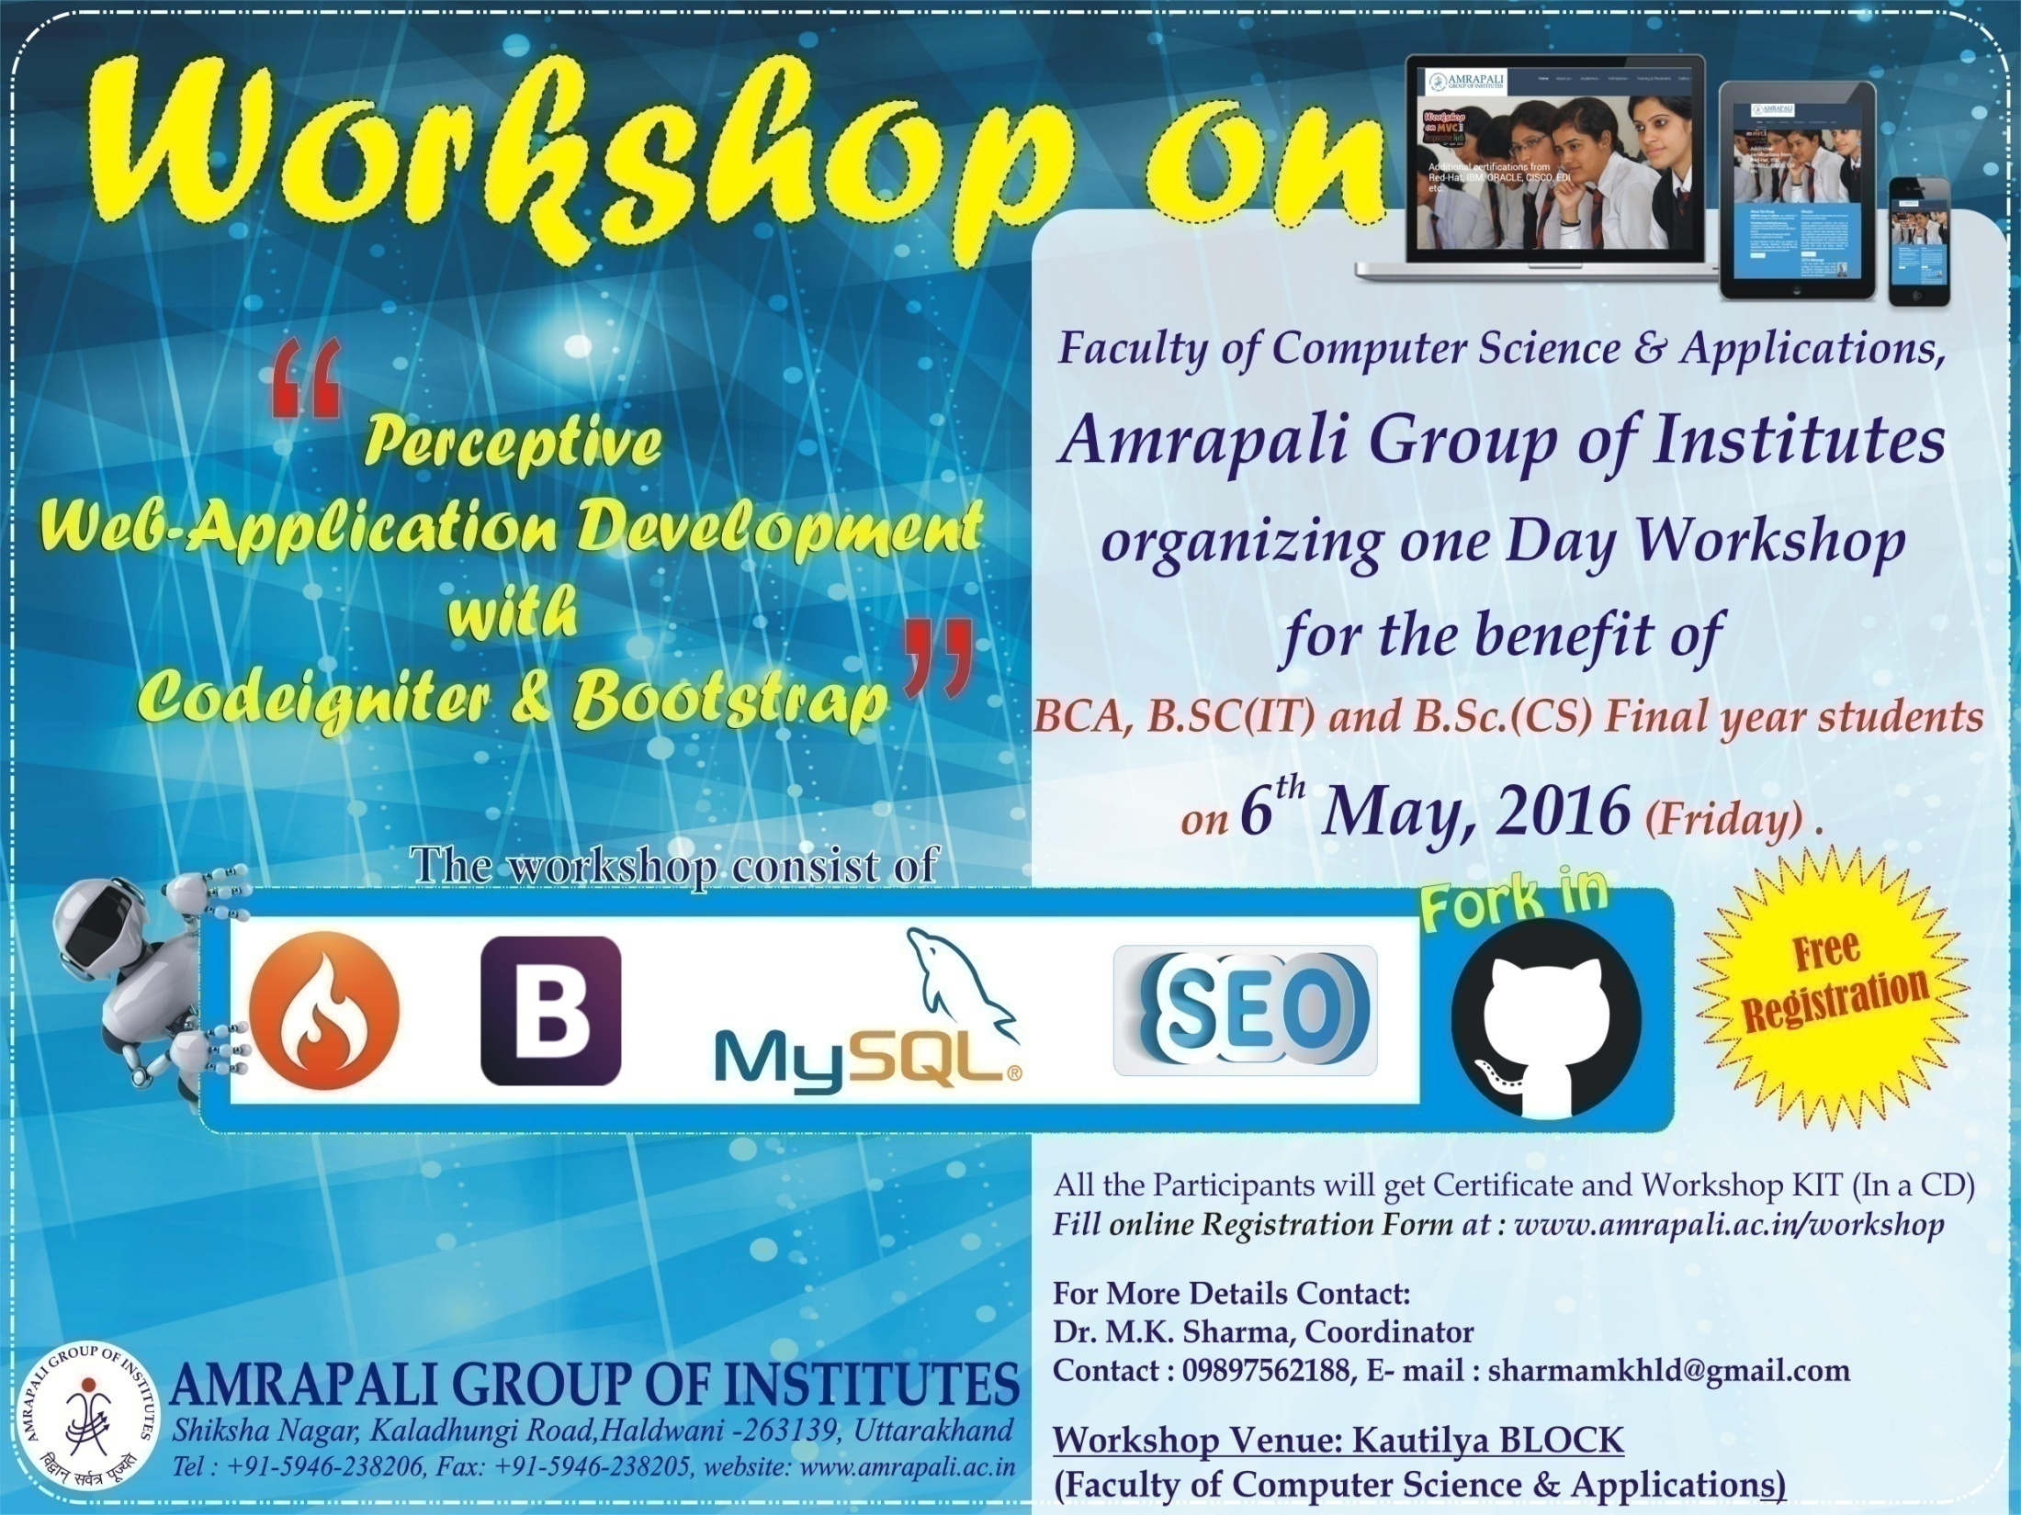

Slide 2
We feel proud to
Welcome
All The Dignitaries Guest participants and Faculty members
In Fourth Technical workshop
on
"Perceptive Web-Application development with Codeigniter & Bootstrap"
for final year students of BCA, B.Sc. (IT) , B.Sc.(CS)

Slide 3
This workshop will help the students to learn and practice
Bootstrap, Codeigniter
with
SEO & GitHub
for Code Sharing and Distributed Version Control System

Slide 4
Participating Teams
Trithakanr Mahaveer University, Moradabad
Jamun Prasad memorial College of Management & Technology, Bareilly
Apex College of Engineering, Rudrapur
Graphic Era Hill University, Bhimtal
Dev Sanskriti University, Haridwar
Sri Guru Ram Rai Institute of Technology, Dehradun
Soorajmal College of Engineering and Technology, Kiccha
Drona college of Management & Technology, Rudrapur
SRI RAM college of management & Technology, Kashipur
Pal College of Management & Technology, Haldwani
Jai Arihant College of Management & Technology, Haldwani
SSJ Campus, Almora
Vivekanand College of Management & Technology, Haldwani
D. S. B Campus, Nainital
Institute of management & Technology , Kashipur

Slide 5


Slide 6
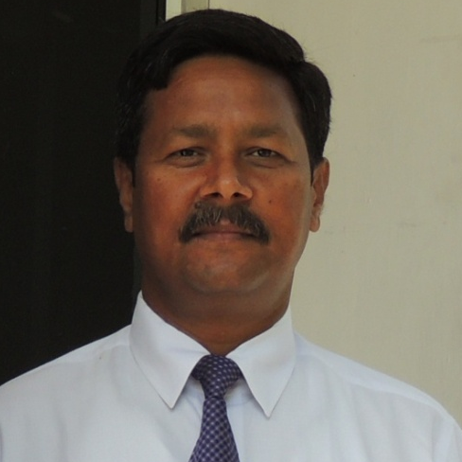
Prof (Dr.) M. K. Pandey
Director
Faculty of Computer Science & Applications
Amrapali Group of Institutes
Haldwani (Uttarakhand)
We feel proud to
Welcome
All The Dignitaries Guest participants and Faculty members

Slide 7
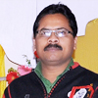
Dr. M. K. Sharma
Associate Professor
M.Tech, Ph.D(Computer Science) Amrapali Group of Institutes
Haldwani (Uttarakhand)
Dr. M.K. Sharma has 15 years experience of academics and industry. He is co-author of 10 Books and published various international and national research papers. He is study material writer for distance learning program of Chaudhary Devi Lal University, Sirsa, MCSE University Rajsthan, and Uttarakhand Open University Uttarakhand. He is coordinator of CSI student branch and active member of Computer Society of India and Special Interest Group for E-Governance. He is campus coordinator for IBM, Oracle and Sun Microsystems programs.

Slide 8
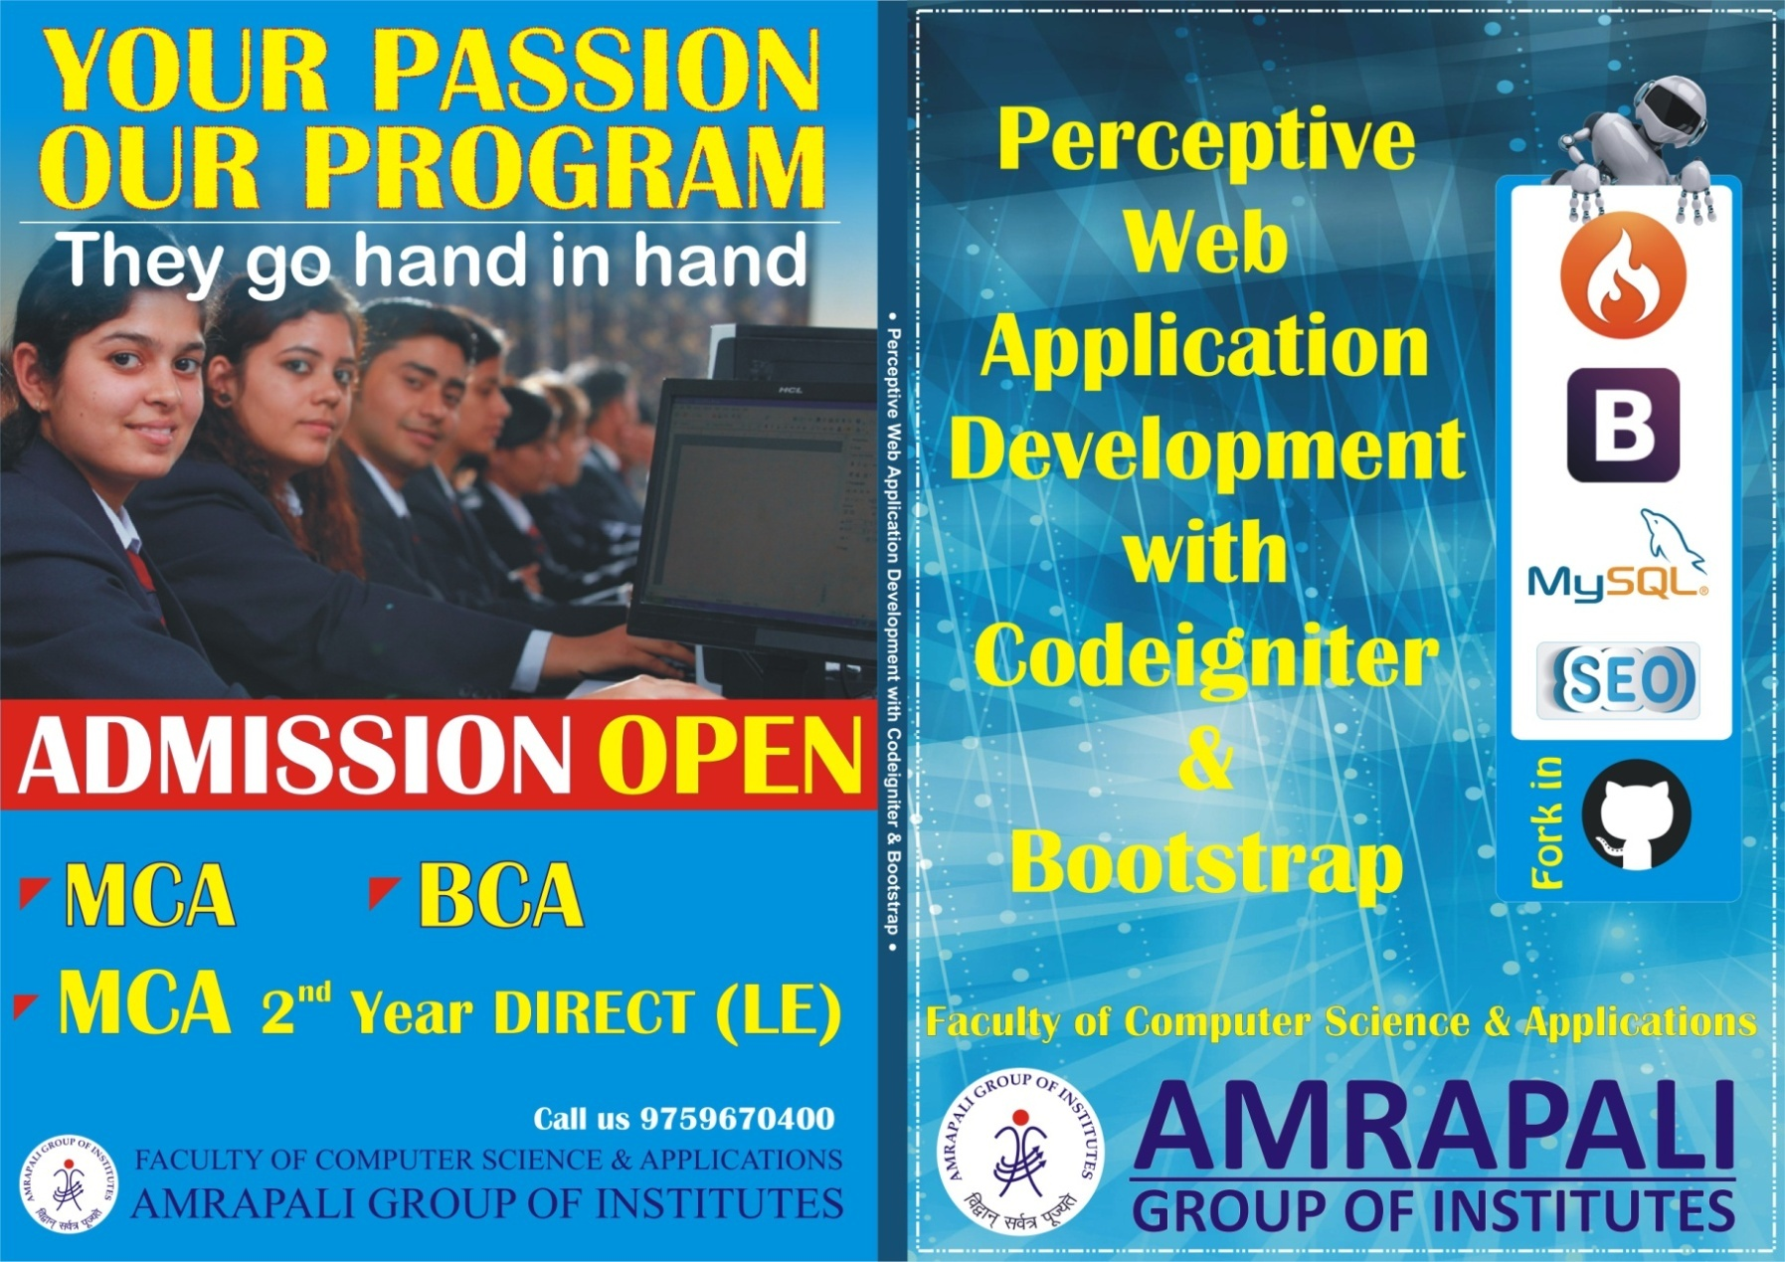
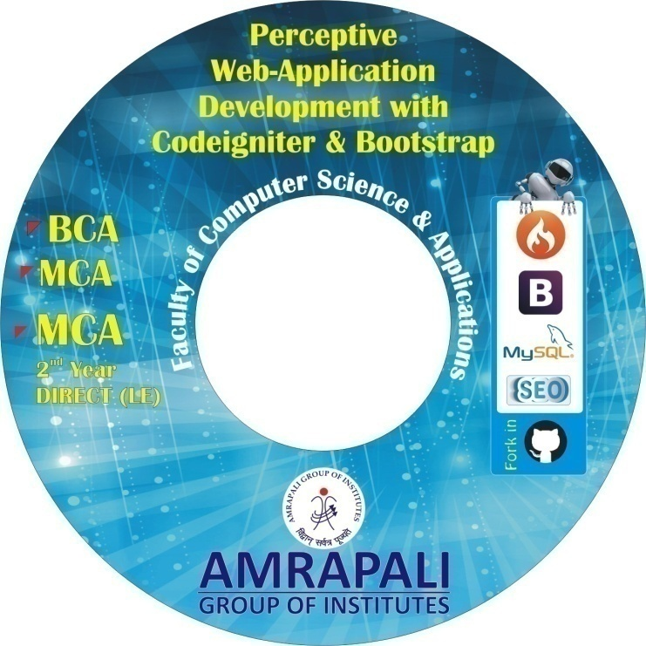
RELEASE OF WORKSHOP BOOK & DVD

Slide 9
SESSION - SCHEDULE
10:30 -11:30 Distribution of Workshop Kits to Participant
Session One
By: Mr. Nitin Deepak and Dr. Naveen Tewari
11:30 Refreshment (participants and Core Committee member)
11:50-12.30 Session Two By: Mr. Mukesh Joshi
12:30-2:00 Session Three
By: Mr. Nitin Deepak and Dr. Naveen Tewari
2:00 Lunch Break (outside Participants/Faculty Members )
2:45 Session Four
Hands on session in Central Lab
4:00 Valedictory Certificate Distribution

Slide 10
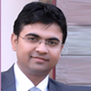
Prof. Nitin Deepak
Assistant Professor,
Ph.D.(submitted), M.Phil., MCA, P.C.W.E., Amrapali Group of Institutes
Haldwani (Uttarakhand)
Specialization - Algorithms, Web-technology, Software Engineering,
11 years of experience in Academics and Software Development.
Various publications in National & International Journals,
Member, Adivisory Board Arena Animation, Haldwani,
Expert, M/s Uttarakhand Online Retail & Consulting Enterprizes-(Pantnagar) & Relitservices-(Delhi) and Webgeomatrics-(Gurgaon)

Slide 11
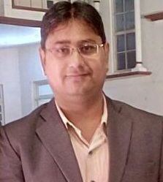
Dr. Naveen Tewari
Assistant Professor,
Ph.D.(Computer Science), MCA, DIM Amrapali Group of Institutes
Haldwani (Uttarakhand)
Specialization - Multimedia, Web-technology, Programming Concepts.
8 years of experience in Academics and Software Development.
Various publications in National & International Journals,
Expert, M/s Uttarakhand Online Retail & Consulting Enterprizes-(Pantnagar) & Relitservices-(Delhi) and Webgeomatrics-(Gurgaon)

Slide 12
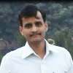
Prof. Mukesh Joshi
Assistant Professor,
Ph.D.(submitted), M.Phil., MCA,
Amrapali Group of Institutes
Haldwani (Uttarakhand)
Specializaion – Databases, Micro-Processor
11 years of experience in Academics and Software Development.
Various publications in National & International Journals,
Expert, M/s Uttarakhand Online Retail & Consulting Enterprizes-(Pantnagar) & Relitservices-(Delhi) and Webgeomatrics-(Gurgaon)

