Slide 1
Welcome to the Session II

Slide 2
Lets Answer some questions ???
Need Faster Development ??
Need language or platform itself to do some common jobs ??
Need independence in a team ??
Need to perform same category of task to individual in a team for 100% performance ??
Need Secure Development ??
Need least maintenance effort ??

Slide 3
MVC
A Software Design Pattern

Slide 4
Introduction to MVC
MVC as it is popularly called, is a software design pattern for developing web applications.
This pattern is made up of the following three parts:
Model - The lowest level of the pattern which is responsible for maintaining data.
View - This is responsible for displaying all or a portion of the data to the user.
Controller - Software Code that controls the interactions between the Model and View.

Slide 5
M
C
V
MODEL
VIEW
CONTROLLER
Database related, not necessary database. Data can be XML or Text Files.
Your website Design/ HTML files. No Images, CSS, etc. here. Only HTML Layout
Application Logic, Process the user request and get appropriate data, then output a design from view.

Slide 6
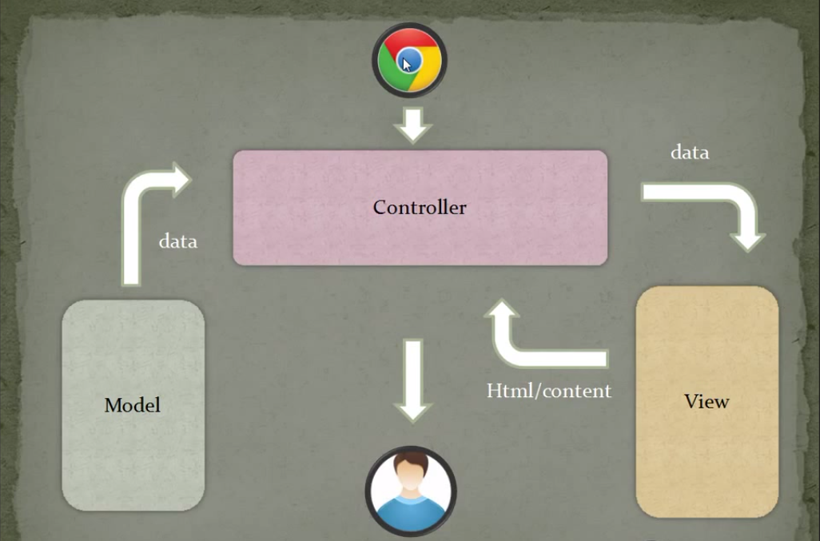
Working of MVC
User or
Viewer

Slide 7

CodeIgniter
A framework using MVC Design Pattern
- Version 2.2.0 -

Slide 8
Introduction
CodeIgniter is a toolkit for people who build web applications using PHP.
Its goal is to enable you:
To develop projects much faster than you could if you were writing code from scratch, by providing a rich set of libraries for commonly needed tasks, as well as a simple interface and logical structure to access these libraries
Creatively focus on your project by minimizing the amount of code needed for a given task.

Slide 9
CodeIgniter uses MVC
CodeIgniter uses the Model-View-Controller approach, which allows great separation between logic and presentation.
This is particularly good for projects in which designers are working with your template files, as the code these file contain will be minimized.

Slide 10
CodeIgniter Generates Clean URLs
CodeIgniter uses a segment-based approach:
http://www.example.com/index.php/news/article/345

Slide 11
CodeIgniter Generates Clean URLs
CodeIgniter uses a segment-based approach:
http://www.example.com/index.php/news/article/345
In which:
news – class
article – method
345 – parameter (can any no. of parameters)

Slide 12


CodeIgniter Architecture
CodeIgniter
Application
Controller
Model
View
System
User-guide
index.php

Slide 13
Steps for using CodeIgniter
Configure index.php
Configure config/config.php
Configure config/routes.php
Configure config/database.php (if needed)
Configure config/autoload.php
Steps for Executing a web page
Create Controller Class extending CI_Controller
Create Method in Controller Class to call web page needed.
Create Web page in View/pageName.php

Slide 14
What is Controller?
A Controller is simply a class file that is named in a way that can be associated with a URI.

Slide 15
How to Create Controller
Create file ‘myController.php’ in Controller folder
<?php
class MyController extends CI_Controller {
public function index()
{
$this->load->view(‘main');
}
public function diff_page()
{
$this->load->view(‘page2');
}
}
?>

Slide 16
What is Model?
Before proceeding Lets have some database in-between
Models are PHP classes that are designed to work with information in your database.
For example, let's say you use CodeIgniter to manage a blog. You might have a model class that contains functions to insert, update, and retrieve your blog data.

Slide 17
How to Create Model
Create file ‘myModel.php’ on Model folder
<?php if ( ! defined('BASEPATH')) exit('No direct script access allowed');
class MyModel extends CI_Model{
function insert_entry() { $this->title = $_POST['title']; $this->content = $_POST['content']; $this->date = time(); $this->db->insert('entries', $this); }
}
?>

Slide 18
Loading a Model
<?php
$this->load->model('Model_name');
$this->Model_name->function();
?>
Example:
<?php
$this->load->model(' MyModel ');
$this-> MyModel -> insert_entry();
?>

Slide 19
Loading a Library
<?php
$this->load->library(‘Library_Name');
?>
OR:
Configure config/autoload.php
If you need to use the library for database, session
$autoload['libraries'] = array('session', 'database');

Slide 20
Loading a Helper
<?php
$this->load->helper(‘Helper_Name');
?>
OR:
Configure config/autoload.php
If you need to use the helper for url, html form
$autoload[‘helper'] = array(‘url', ‘form');

Slide 21
Associative Array
Associative arrays are arrays that use named keys that you assign to them.
There are two ways to create an associative array:
$age = array(
"Peter"=> "35",
"Ben“ => "37",
"Joe“ => "43“
);
$age['Peter'] = "35"; $age['Ben'] = "37"; $age['Joe'] = "43";

Slide 22
PHP
PHP file should have extension “.php”. This language’s syntax are same as C and C++.
Use $ for every variable.
For example - $val = 12;
If, for or while control structures is used here is just like we use in C.
For Printing use “echo”. For example – echo “Hello World”;
Below is the example of foreach looping structure:
foreach($row as $item){
echo $item->name;
}

Slide 23
Some Queries in Modeling
Selecting Data
$this->db->get();
$query = $this->db->get('mytable'); // Produces:
//SELECT * FROM mytable

Slide 24
Queries in Modeling
Inserting Data
$this->db->insert();
$data = array( 'title' => 'My title' , 'name' => 'My Name' , 'date' => 'My date' );
$query = $this->db->insert('mytable‘, $data);
// Produces:
INSERT INTO mytable (title, name, date) VALUES ('My title', 'My name', 'My date')

Slide 25
Queries in Modeling
Updating Data
$this->db->update();
$data = array( ‘ID' => $id , 'name' => $name , 'date' => $date );
$this->db->where(‘ID‘, $id);
$this->db->update('mytable‘, $data);
// Produces:
// UPDATE mytable // SET title = '{$title}', name = '{$name}', date = '{$date}' // WHERE id = $id

Slide 26
Queries in Modeling
Deleting Data
$this->db->delete();
$this->db->where('id', $id); $this->db->delete('mytable');
// Produces: DELETE FROM mytable WHERE id = $id

Slide 27
Lets have a look…

Slide 28
Thanks

