Slide 1



Resolving Inventory Strain and Profitability Gaps in Gift Retail
Final Submission - BDM Capstone Project
Presented by: Nitin Gupta (22f3000272)

Slide 2

Background of the Business
Gupta Gift Shop, established in 2015, is a retail store located in Model Town Road, Himachal Pradesh. The shop specializes in selling a wide range of gift items. Despite steady sales volumes, the shop faced declining profitability due to inefficient inventory management and lack of strategic pricing.

Slide 3

Problems faced by owner
Limited financial awareness of the proprietor regarding key
business metrics, such as monthly turnover.
Difficulty in accurately determining and maintaining
appropriate profit margins.

Slide 4

Data Collection & Cleaning
Collected daily sales, cost, revenue, and profit data from April to November 2024.
Removed duplicate records, handled missing values, corrected data types.
Outliers treated to ensure accurate analysis.
Dataset provided a comprehensive 8-month view of business performance.

Slide 5
Analysis Methods
Top-selling product & category analysis.
Revenue-based ABC classification.
Quantity-based ABC classification.
Monthly sales trend analysis.
Profit simulations for revised margin policy.

Slide 6
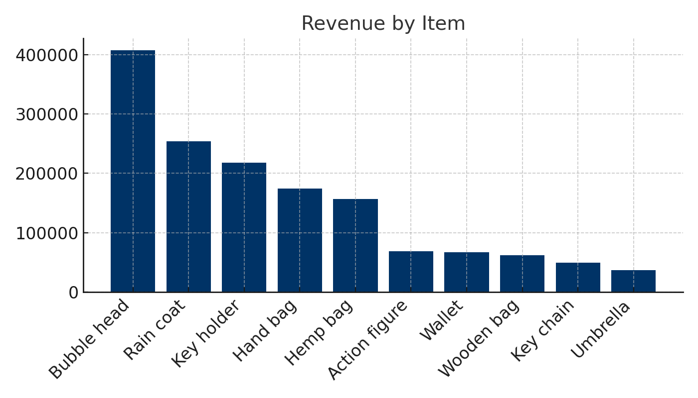
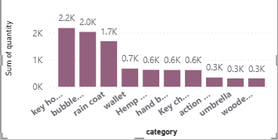
analysis
Quantity Based Analysis
Revenue based analysis

Slide 7
Key Findings - ABC Analysis
Category A (High Revenue): Bubble heads, Raincoats, Key holders.
Category B (Moderate Revenue): Handbags, Hemp bags, Action figures.
Category C (Low Revenue): Wallets, Wooden bags, Umbrellas, Key chains.
Revenue concentrated in a few items; low-margin items reduce profitability.

Slide 8
Insights from Visualizations
Key holders & Bubble heads contributed ~45% of total units sold.
Hemp bags & Wooden bags showed high profit contribution.
Umbrellas were least profitable.
Revenue fluctuated significantly, with peaks on weekends.

Slide 9
New Margin Policy
Bubble heads: Increase margin from 21% to ~35-40%.
Action figures: Slight price increase (~60% margin).
Hemp bags & Wallets: Increase margins to 75-80%.
Key chains: Keep constant margin (~167%), use for bundling.
Projected profit increase: ₹78,131.60 (+16.78%).

Slide 10
Recommendations
Adjust selling prices based on demand & profitability.
Focus inventory on high-margin & high-volume products.
Implement mid-week promotions to counter sales dips.
Launch premium variants of key chains & wallets.
Conduct quarterly margin reviews & automate ABC inventory control.

Slide 11
Implementation Impact Summary
Projected profit improvement: ~17%.
Better capital allocation & improved inventory turnover.
Evidence-based recommendations ensure sustainable profitability.
Foundation for long-term, data-driven business growth.

Slide 12
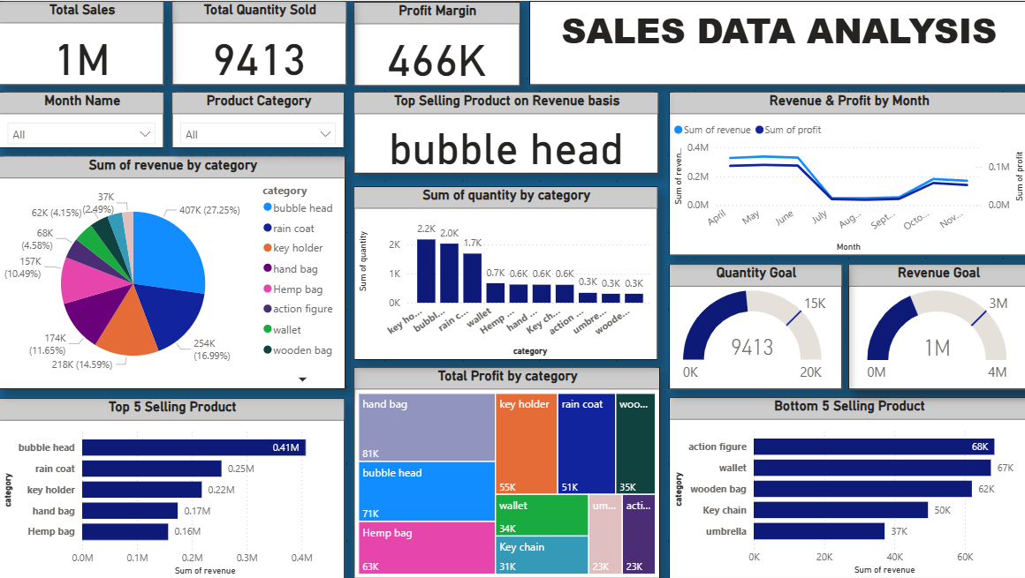
POWER BI Dashboard for Sales Data

Slide 13
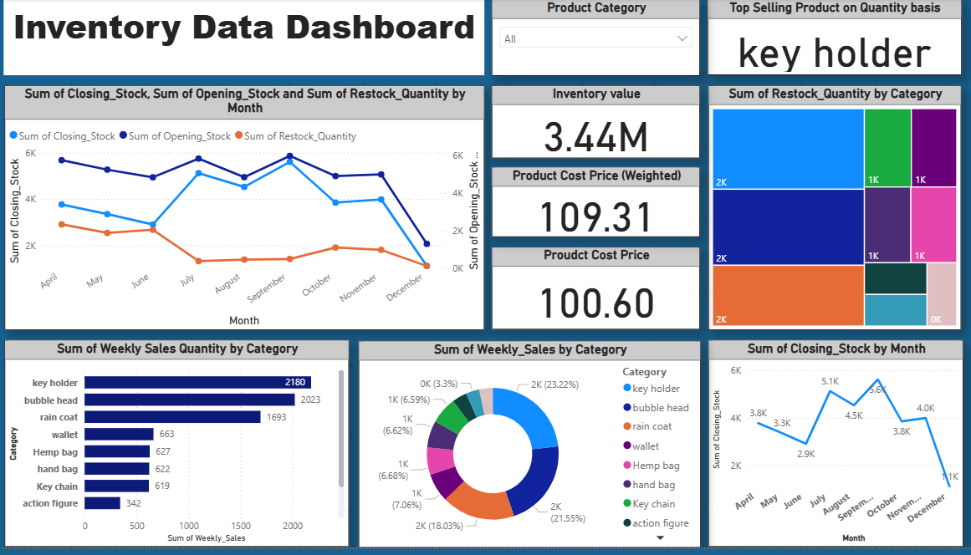
POWER BI DASHBOARD FOR INVENTORY DATA

Slide 14
I hope you enjoyed this presentation
You will get all the documents related to project in this link : Documents

