Slide 1

Geldium: Enhanced Delinquency Prediction Report
Storytelling with Business Insights & Visuals

Slide 2
1. Business Objective
How can Geldium predict and reduce delinquency risk through data-driven models?

Slide 3
2. Data Overview
891 records: Age, Income, Credit Score, Debt to Income Ratio, Loan Balance, Payment History.
Focus Features: Income, Credit Score, DTI, Loan Balance, Delinquent Accounts

Slide 4
3. EDA Summary
Top Correlated Features:
• Income (0.045)
• Credit Score (0.035)
• DTI (0.034)
No significant outliers or duplicates. Missing data treated via imputation.

Slide 5

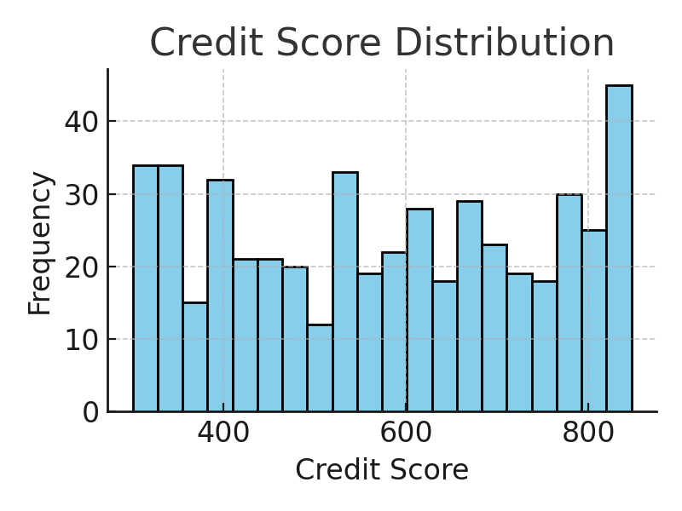
4. Credit Score Distribution

Slide 6
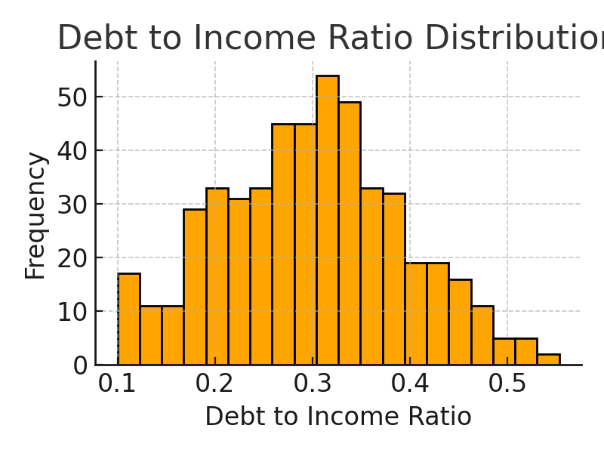
5. Debt-to-Income Ratio Distribution

Slide 7
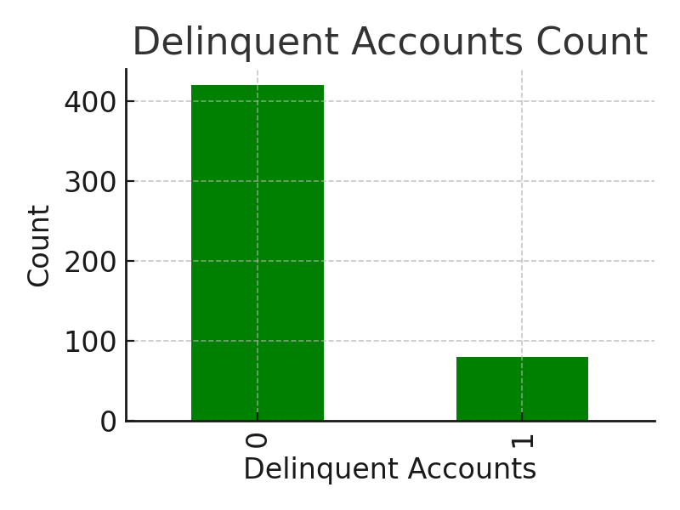
6. Delinquent Accounts Count

Slide 8
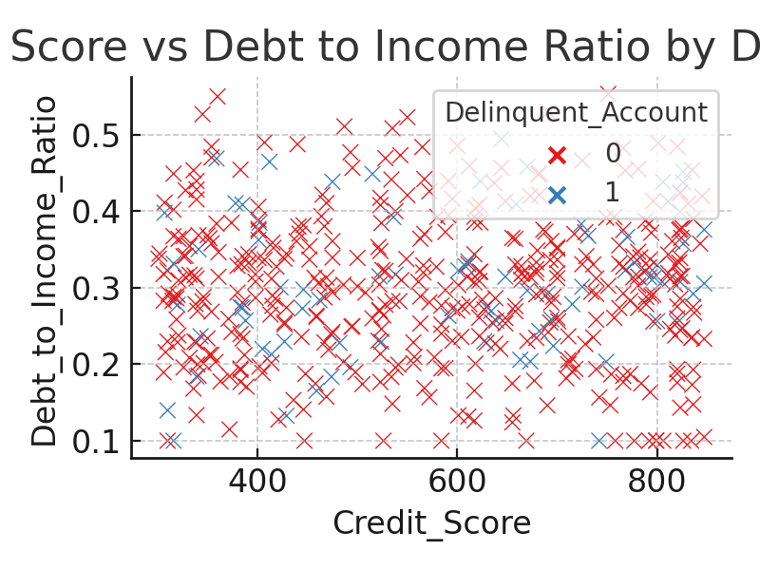
7. Scatter: Credit Score vs DTI

Slide 9
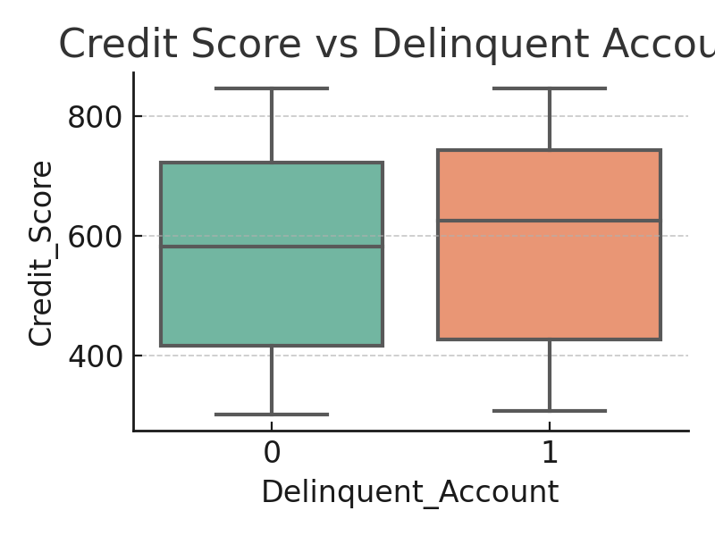
8. Boxplot: Credit Score by Delinquency

Slide 10
9. Predictive Model Strategy
Model: Logistic Regression
Benchmark: Random Forest, XGBoost
Metrics: Accuracy, Precision, Recall, AUC-ROC
Validation: k-fold Cross-Validation

Slide 11
10. Business Recommendations
1. Targeted Outreach
2. Customized Payment Plans
3. Early Risk Monitoring
Expected 15% Delinquency Reduction

Slide 12
11. Ethical AI Assurance
• No sensitive data used.
• Fairness verified on categorical variables.
• Transparent and Explainable Models.

Slide 13
12. Conclusion & Next Actions
• Model Deployment
• Pilot Intervention
• Performance Monitoring
Outcome: Risk Reduction & Customer Retention

