Slide 1
Identity and Access Management (IAM)
Overview, Key Components, Benefits, and Joiners Process Flow

Slide 2
Agenda
Overview of IAM
JML
Birth right access provisioning
RBAC (Role based access control)
Tools and Technologies
Key Components of IAM

Slide 3
Overview of IAM
Identity and Access Management (IAM) is a framework of policies and technologies.
The right individuals have access
To the right resources
At the right times
For the right reasons.
IAM systems are used to manage digital identities and control access to resources within an organization.

Slide 4
Key Components of IAM
1. Identity Management: Processes and technologies for managing digital identities.
2. Authentication: Verifying the identity of users.
3. Authorization: Granting access to resources based on user roles and permissions.
4. User Provisioning: Creating, updating, and deleting user accounts.
5. Single Sign-On (SSO): Allowing users to access multiple applications with one set of credentials.
6. Multi-Factor Authentication (MFA): Adding an extra layer of security by requiring multiple forms of verification.
7. Access Governance: Monitoring and auditing access to resources.

Slide 5
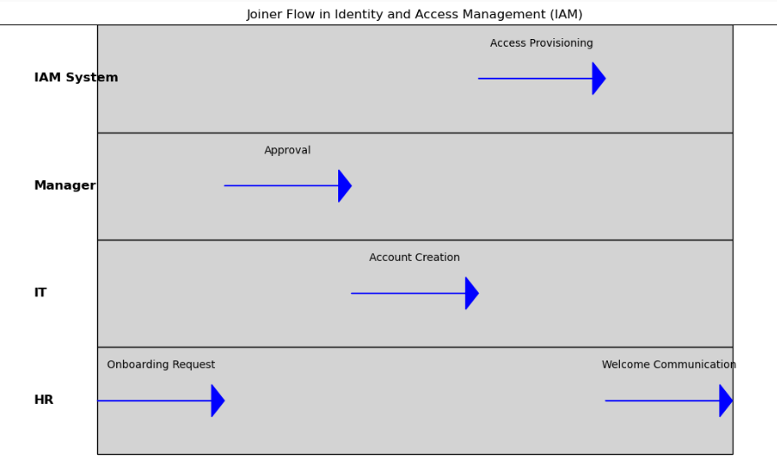
JML (Joiner Mover Leaver)

Slide 6
Birth right access provisioning
Birthright access refers to the default set of permissions and resources automatically granted to a user when they join an organization, based on their identity attributes such as role, department, or location.
This ensures that every new employee has the essential tools and access they need from day one—without manual intervention
Role/Department | Birthright Access Provisioned
All Employees | Email account, intranet access, HR portal, corporate calendar
HR Department | HRIS system, employee records database
Finance Team | Financial systems (e.g., SAP), budget reports
IT Support | Ticketing system, admin tools, remote access tools
Sales Team | CRM system (e.g., Salesforce), sales dashboards

Slide 7
RBAC (Role based access control)
🌟 What is Role-Based Access Control (RBAC)?
RBAC is a way to manage who can access what in a system based on their job role.
Instead of giving permissions to each person one by one, you:
Create roles (like HR, Manager, IT Support)
Assign permissions to those roles
Then assign people to the roles
🧠 Simple Example:
If Bob changes jobs and becomes a Manager, you just change his role — and his access updates automatically!
Person | Role | Access Granted
Alice | HR | HR system, employee records
Bob | IT | Admin tools, ticketing system
Charlie | Manager | Team reports, approval systems

Slide 8
Tools and Technologies
🔐 Top IAM Tools in 2025
Rank | IAM Tool | Market Share (2025)
1 | Microsoft Entra ID | 24.11%
2 | Google Cloud Identity | 10%
3 | Okta | 8%
4 | Saviynt
5 | Others

Slide 9
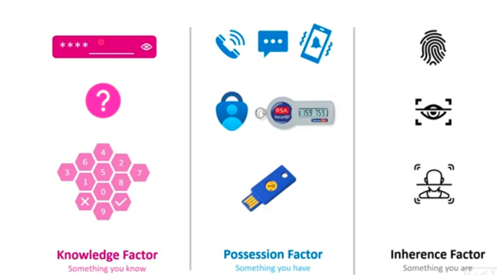
Multi Factor Authentication

Slide 10
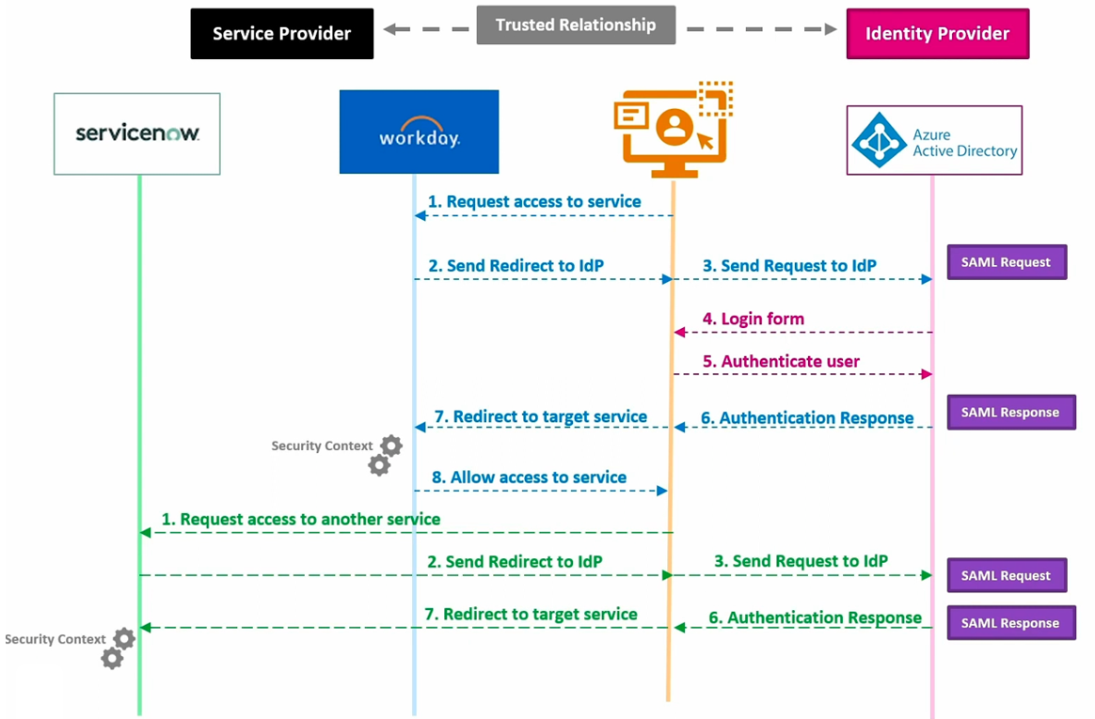
SSO (SAML) Traffic flow - Example

Slide 11
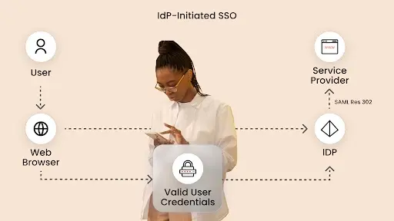
IDP initiated SSO

Slide 12
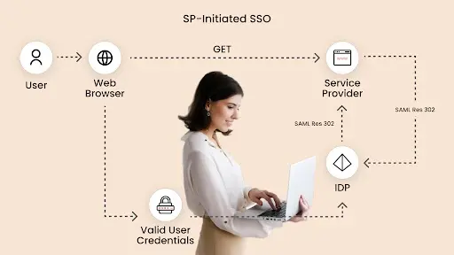
SP initiated SSO

Slide 13

Thank You!

