Slide 1
Introduction to LDAP
Lightweight Directory Access Protocol

Slide 2
Difference between LDAP and Active Directory (AD)
1. LDAP is a protocol, while AD is a directory service.
2. LDAP can be used to authenticate users across different systems, while AD is used for managing Windows domain networks.
3. AD uses LDAP as its primary protocol for directory services.
4. LDAP is more flexible and can be used with various directory services, while AD is specific to Windows environments.

Slide 3
A directory service is a specialized software system that stores, organizes, and provides access to information in a directory. Think of it like a digital phone book, but much more powerful and flexible.
Key Features of a Directory Service:
Hierarchical Structure: Information is stored in a tree-like structure, making it easy to navigate and manage.
Centralized Resource Management: It provides a central location to manage users, computers, printers, and other resources.
Authentication and Authorization: It helps verify user identities and control access to resources.
Standard Protocols: Most directory services use standard protocols like LDAP (Lightweight Directory Access Protocol) to communicate.
Common Examples:
LDAP – A protocol used by many directory services.
Microsoft Active Directory (AD) – A directory service for Windows domain networks.
OpenLDAP – An open-source implementation of LDAP.
Apache Directory – A Java-based directory service.
Use Cases:
Logging into a computer or application
Accessing email or shared files
Managing user roles and permissions in an organization

Slide 4
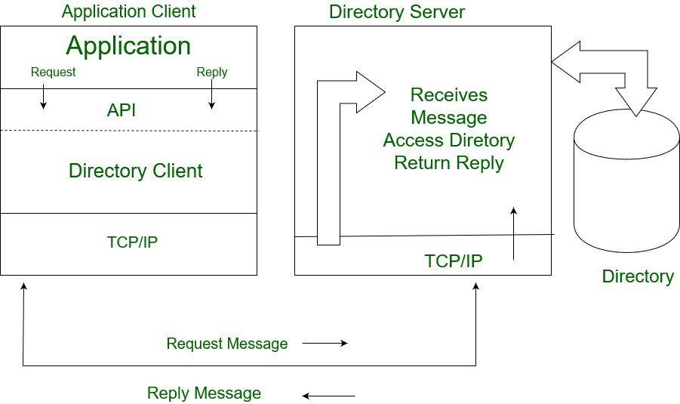
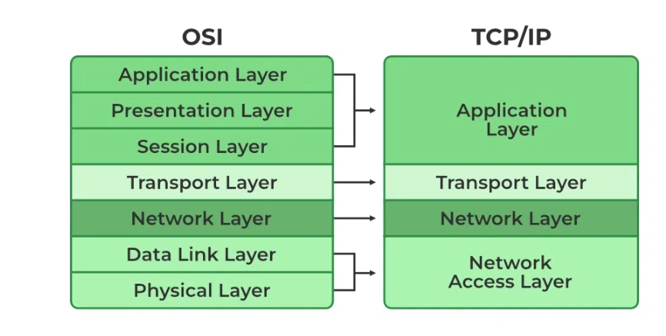
LDAP
Lightweight Directory Access Protocol (LDAP) is an internet protocol works on TCP/IP, used to access information from directories. LDAP protocol is basically used to access an active directory.

Slide 5
TCP / IP Protocol
A protocol is a set of rules that govern how data is transmitted and received between devices, especially in a network

Slide 6
DIT (Directory Information Tree)
LDAP organizes information in a hierarchical structure called the DIT, similar to a tree with branches and leaves.
This structure allows for efficient searching and retrieval of information.
Entries in the DIT represent objects like users, groups, computers, or printers.
Each entry in the DIT has a unique identifier called a distinguished name (DN).
The DN provides a way to locate and refer to a specific entry within the directory.
It is composed of a series of relative distinguished names (RDNs) leading up to the root of the DIT.

Slide 7
Advantages and Disadvantages of LDAP
Advantages:
1. Lightweight and efficient.
2. Platform-independent.
3. Supports a wide range of applications and services.
4. Provides centralized authentication and authorization.
Disadvantages:
1. Can be complex to configure and manage.
2. Limited support for advanced security features.
3. May require additional tools for integration with other systems.

Slide 8
Technical Architectural Diagrams of LDAP and AD
1. LDAP Architecture:
- Client-Server model.
- Directory Information Tree (DIT).
- Schema for defining directory objects.
2. Active Directory Architecture:
- Multi-master replication.
- Domain controllers.
- Global Catalog.
- Organizational Units (OUs).

Slide 9
LDAP defines a set of operations for interacting with the directory
Binding: Authenticating to the directory server (e.g., providing a username and password).
Searching: Retrieving information based on specific criteria.
Adding: Creating new entries in the directory.
Modifying: Updating existing entries.
Deleting: Removing entries.

Slide 10
Use Cases of LDAP Protocol
Centralized User Management: Storing and managing user accounts, passwords, and other user-related information.
Authentication: Verifying user credentials for accessing applications and services.
Resource Discovery: Finding network resources like printers, servers, or file shares.
Single Sign-On (SSO): Enabling users to access multiple applications with a single login.

Slide 11
How to configure LDAP
1. Install LDAP server software (e.g., OpenLDAP).
2. Configure the LDAP server by editing the configuration files.
3. Define the directory structure and add entries to the directory.
4. Set up access control and security settings.
5. Test the LDAP server to ensure it is working correctly.

Slide 12
Steps to configure LDAP
Go to the application where LDAP is required to be configured.
Look for sections related to authentication, user management, or security settings. The exact location will vary by application.
Examples:
N-able N-central: Go to Administration > User Management > SSO Providers and select Add > Microsoft Active Directory.

Slide 13
You'll likely need to configure:
LDAP Server: The IP address or FQDN (Fully Qualified Domain Name) of your Active Directory domain controller.
Port: Usually 389 for unencrypted LDAP (LDAP) or 636 for encrypted LDAP (LDAPS).
Base DN: The distinguished name of the organizational unit (OU) or container where your users are located.
Search Filter: A filter to locate users in Active Directory (e.g., sAMAccountName={0} or userPrincipalName={0}).
Authentication: Whether to use anonymous bind or a specific user account for searching the directory.
User DN and Password: If not using anonymous bind, you'll need a user account with read access to Active Directory.

