Slide 1

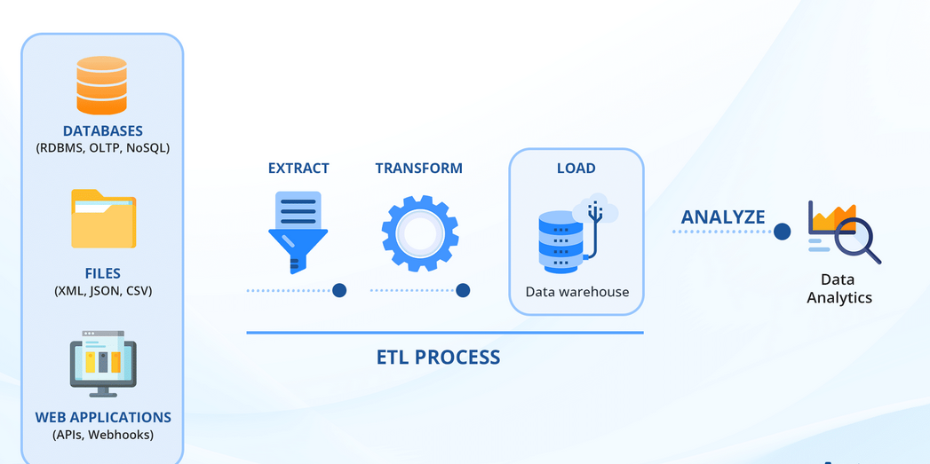

Welfare Schemes Management
Data Modeling and Transformation
I

Slide 2

INTRODUCTION
  This project focuses on leveraging advanced data modeling techniques to enhance the management, analysis, and reporting of relevant data.
  The primary objective of this project is to design a robust data infrastructure that supports the efficient handling and analysis of large data sets related to social benefit programs.
  Aim to improve decision-making processes, enhance operational efficiency, and ensure better outcomes for citizens through effective data management and analytics.
.

Slide 3
SCOPE
This project includes data modeling activities across various stages, including data ingestion, storage, processing, analysis, and visualization. We will explore how each component contributes to achieving the project objectives and improving the overall management of welfare programs.
Expected Outcome:
  Enhanced data accuracy, integrity, and security.
  Streamlined processes and operations, leading to better service delivery and citizen satisfaction.

Slide 4
Process Flow
Users: Department, Applicant, Admin, Bank.
Citizens Unique Data Authority. UIDAI.
Data Import via API Sharing
WEB PORTAL
Social Security Schemes
Dashboard- Scheme Matrix
Scheme Allocation Details
Daily Status Report
Data Transformation as per Govt rules.
Data Processing as per business rules.
Forwarded to Departments
Forwarded to Bank

Slide 5
Data Pipeline
Data Sources
Hadoop Cluster
Data Ingestion
CI/CD
Structured
RDBMS
ERP
Batch/ Scheduled
Processing
RAW Data Store
Transform
Power BI
Transformation
Batch Processing
Real Time
Processing
Reporting
Transform
Semi-Structured
JSON
XML
CSV
Real Time
Processing
Curated Data
Query Analysis
01
03
04
06
Exploratory Analysis
Predictive Modeling
Data Security, Governance and Monitoring

Slide 6
Use Cases
  Importing and Cleaning Data:
  Import data from various sources and clean it to standardize formats and resolve inconsistencies.
  Full and Incremental Load:
  Full Load complete datasets initially and periodically ingest new or updated data for ongoing updates.
  Data Transformation:
  Data transformation using Apache Spark to efficiently process, manipulate, and analyze large-scale datasets.
  Generate daily status reports and interactive dashboards to monitor schemes allocations with respective zones using power BI.

Slide 7
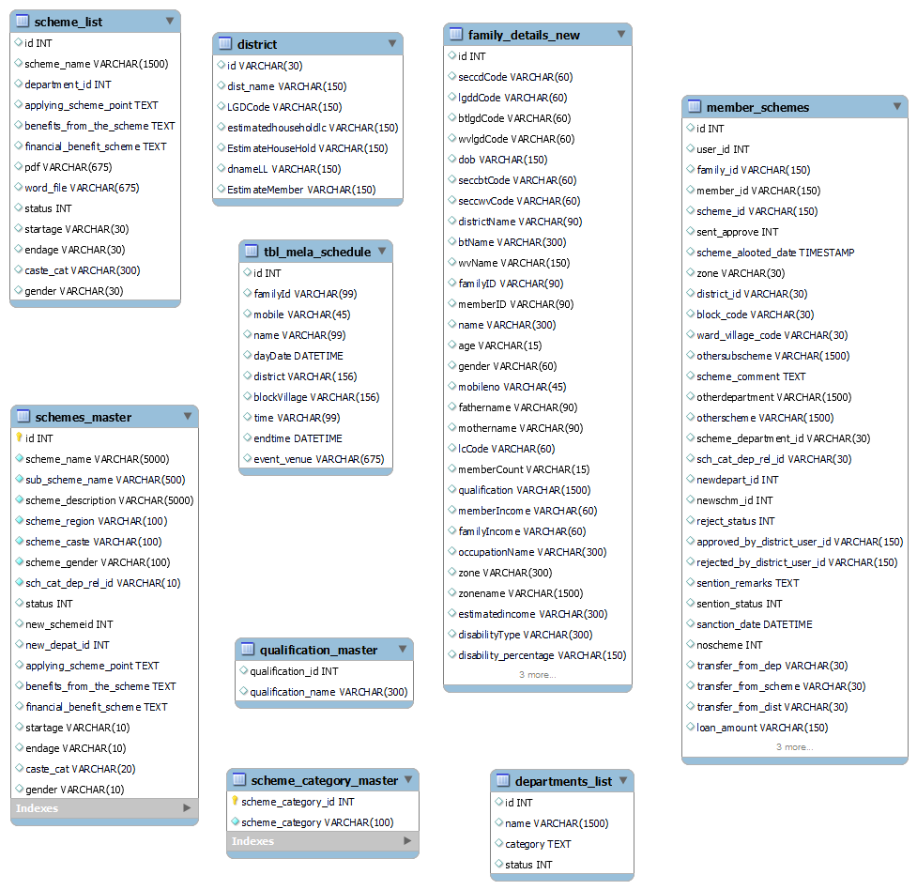
ER Diagram: Star Schema

Slide 8
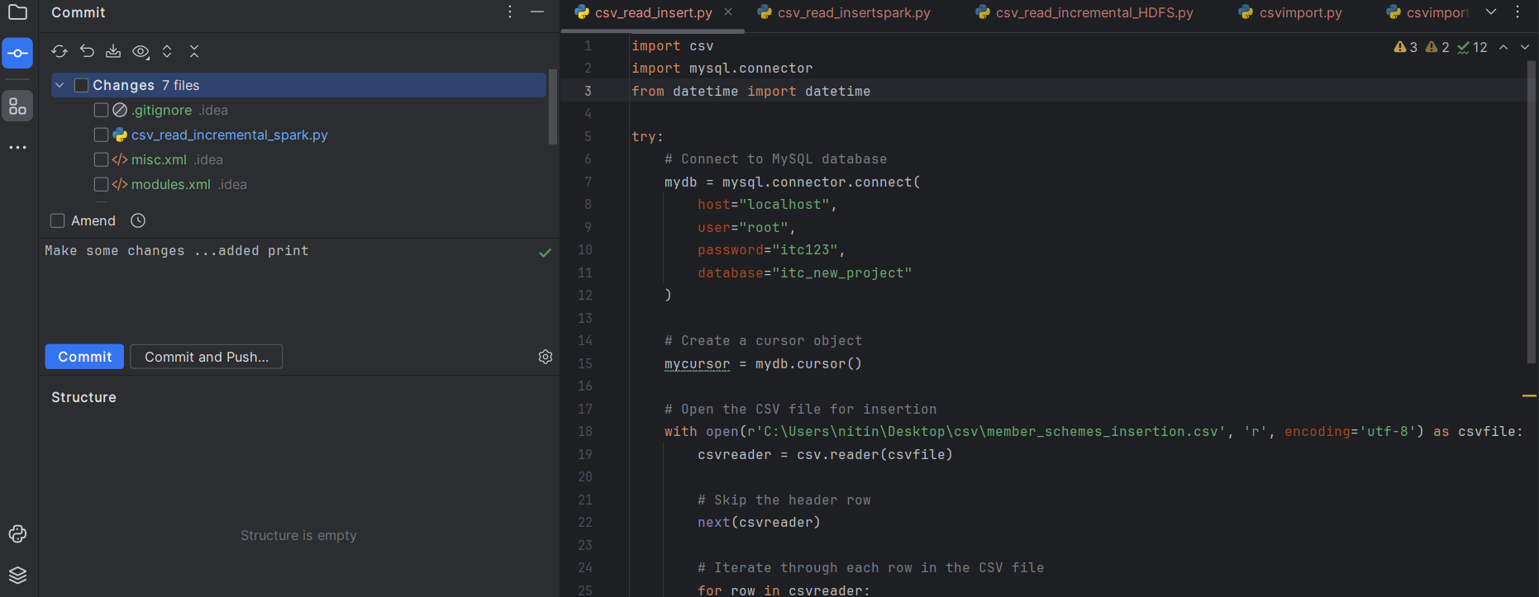
Git-Integration

Slide 9
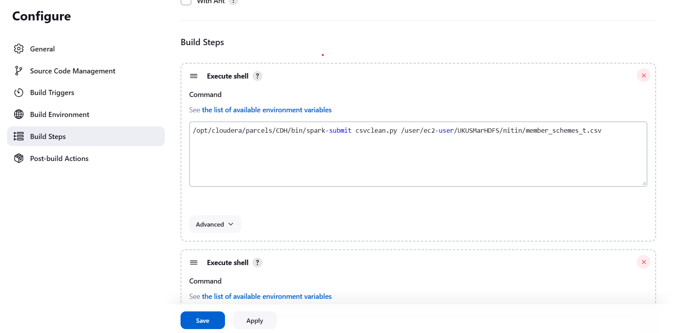
Jenkin-Job Submission

Slide 10
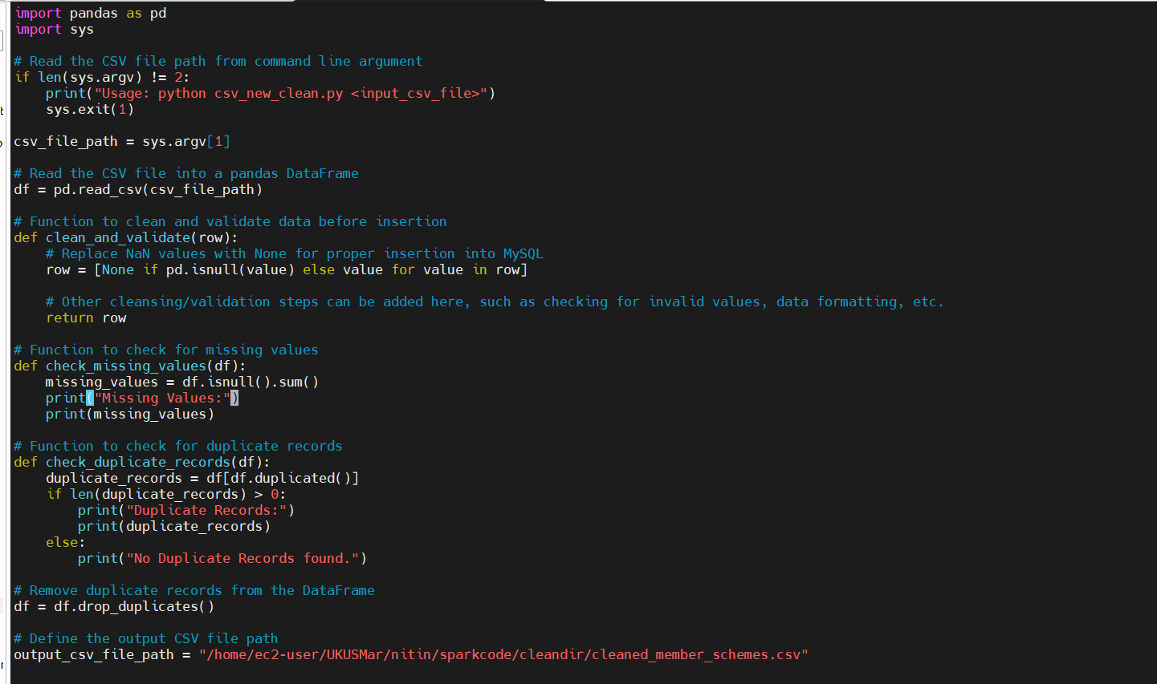
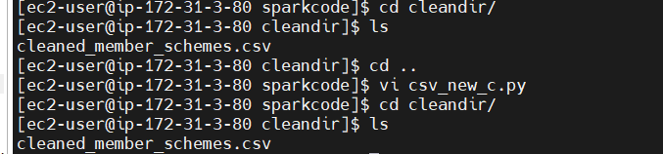
CSV:Cleaning

Slide 11
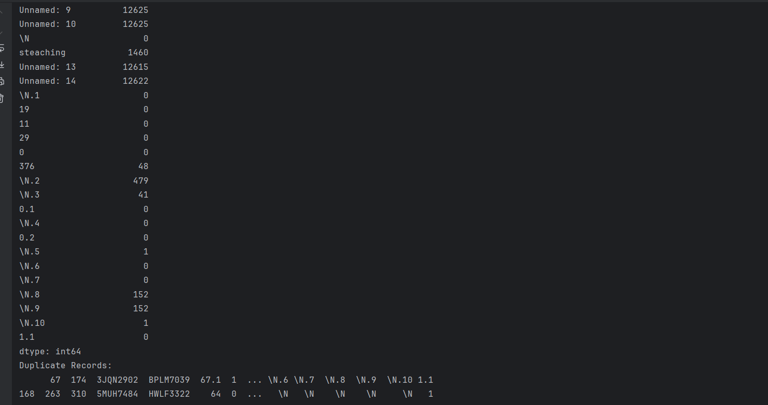
CSV-Import Full-Incremental

Slide 12
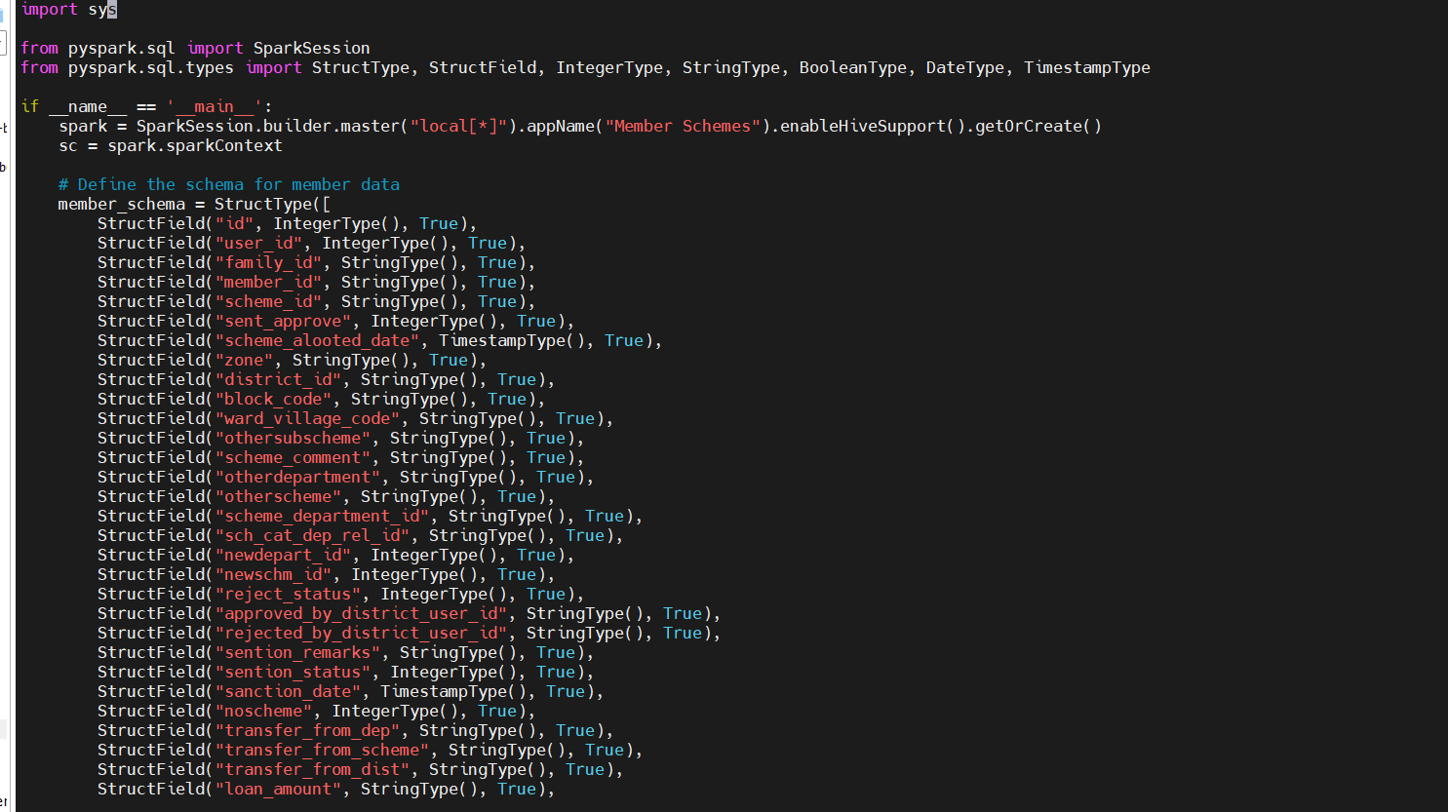
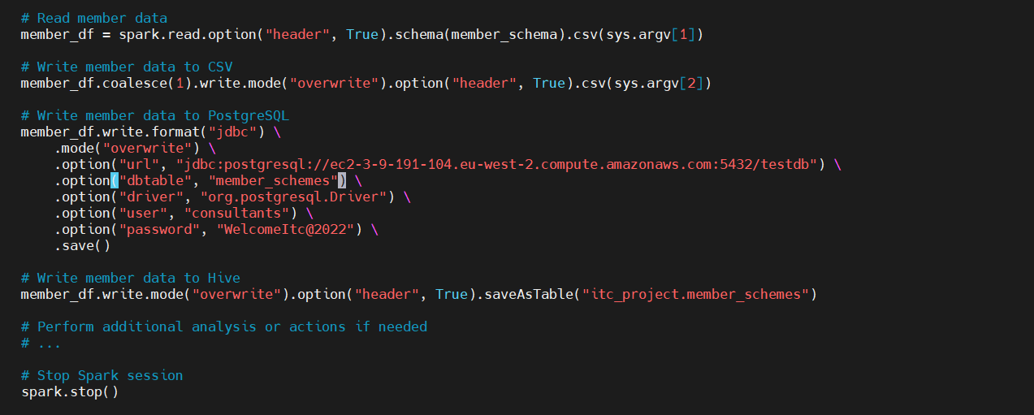
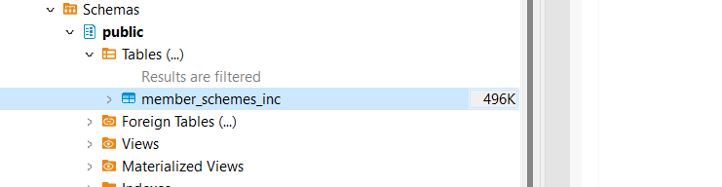
CSV-Import Full-Incremental

Slide 13
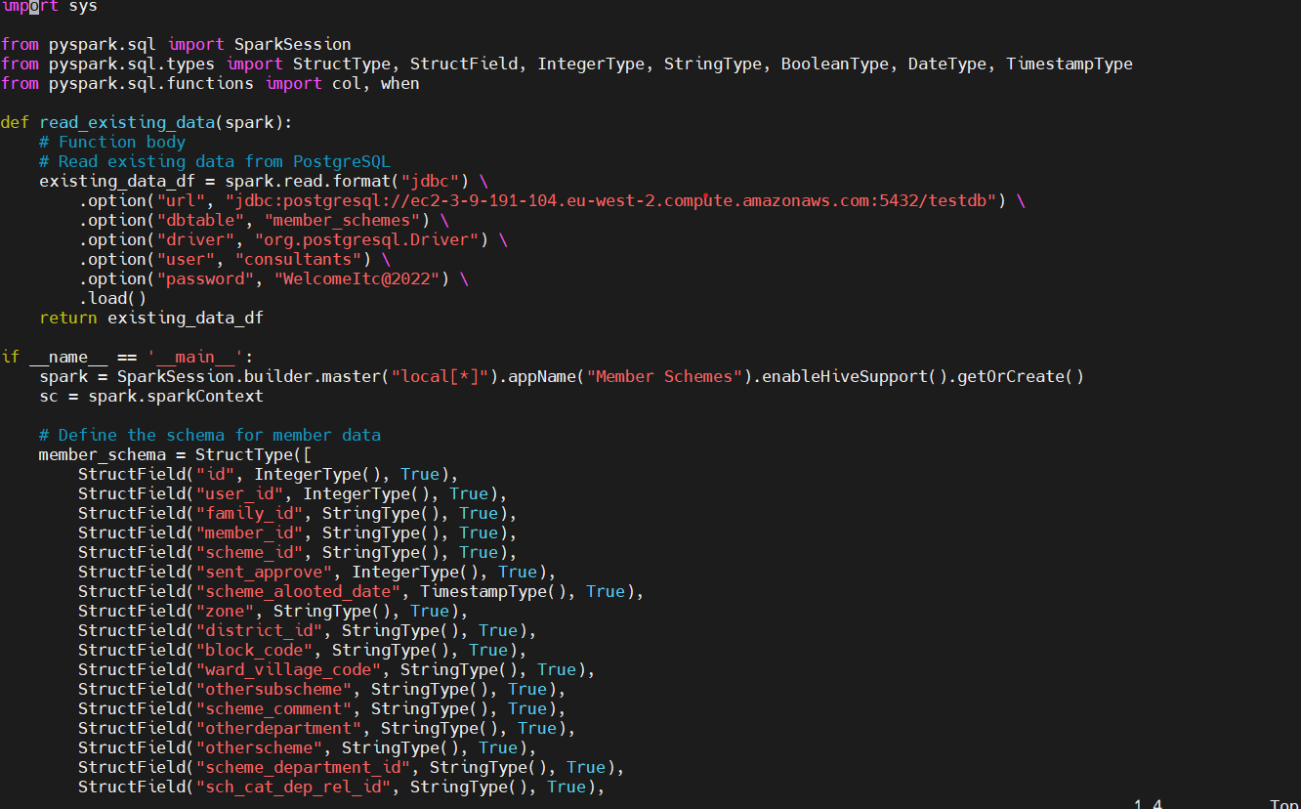
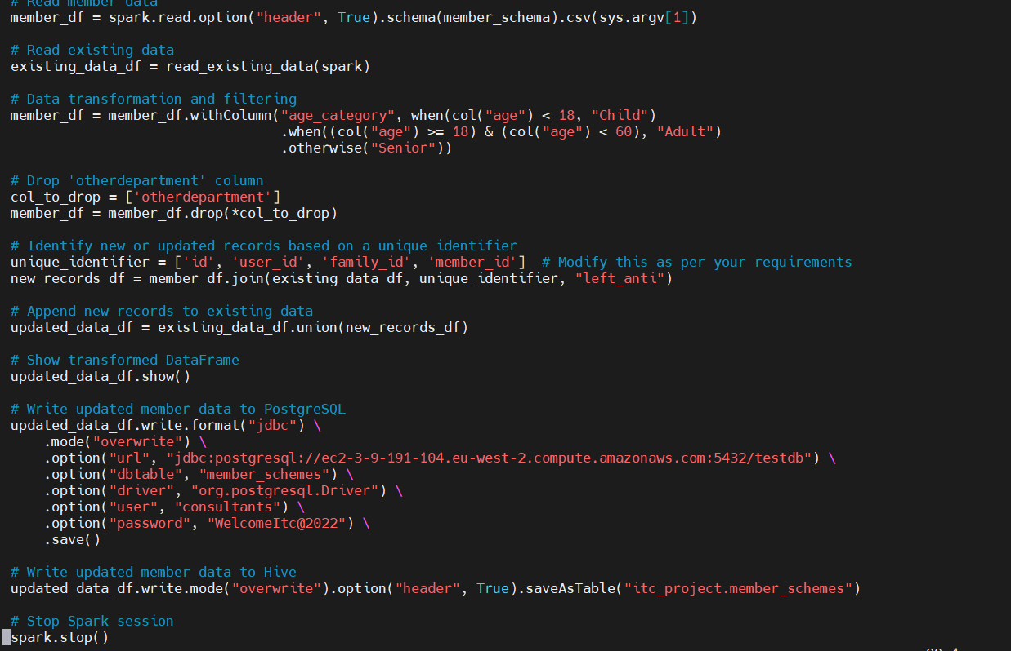
CSV-Import Full-Incremental

Slide 14
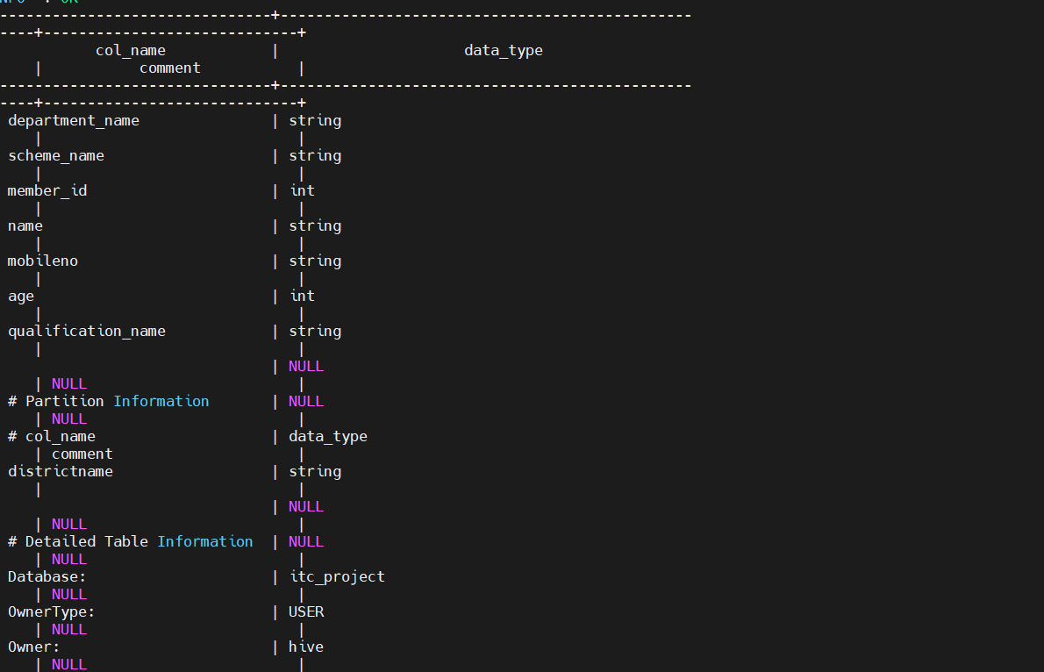
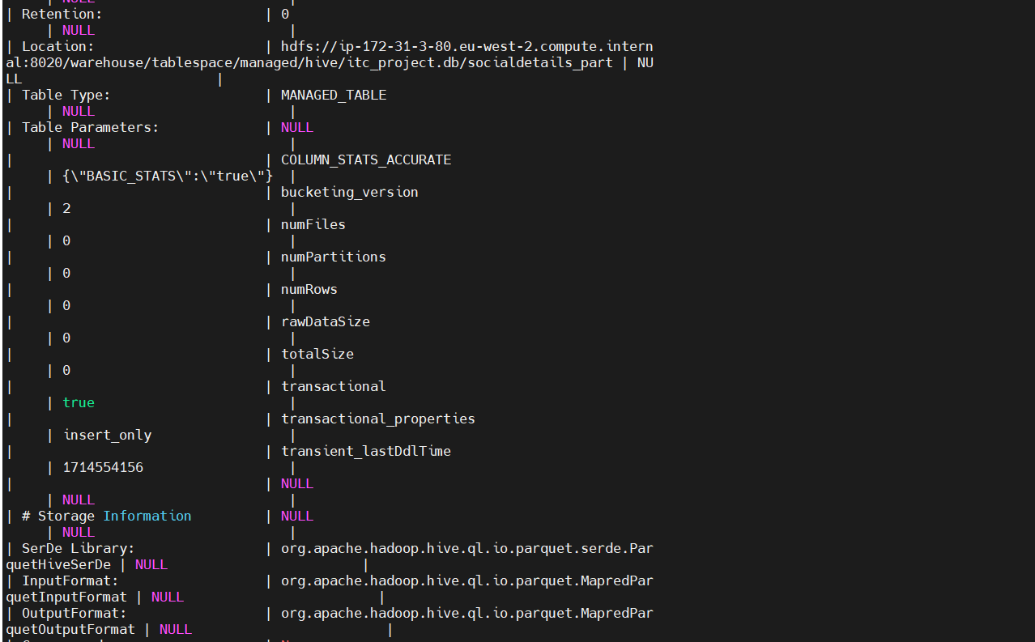
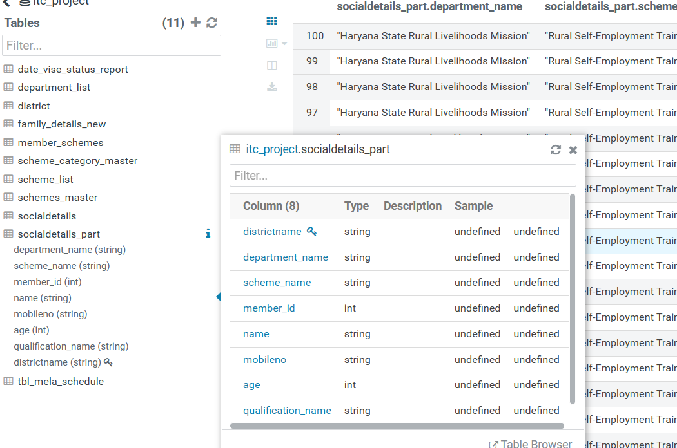
Hive Optimisation: Partition

Slide 15
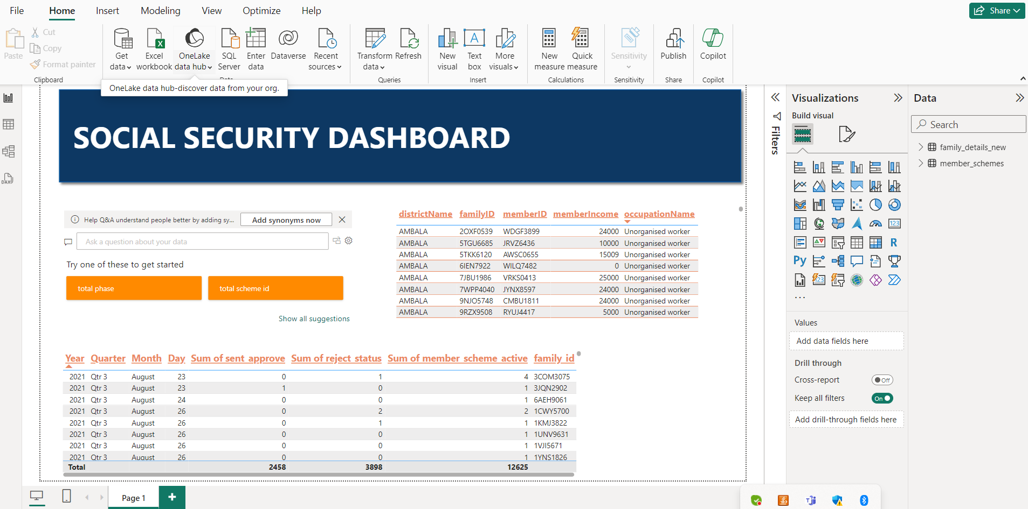
Data Visualisation

Slide 16
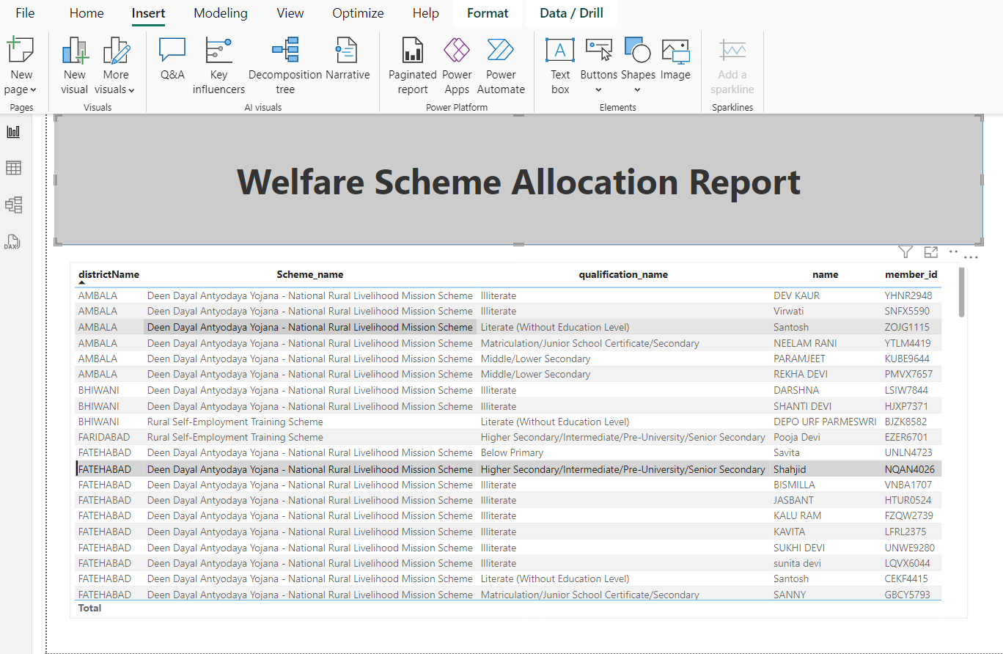
Data Visualisation

Slide 17
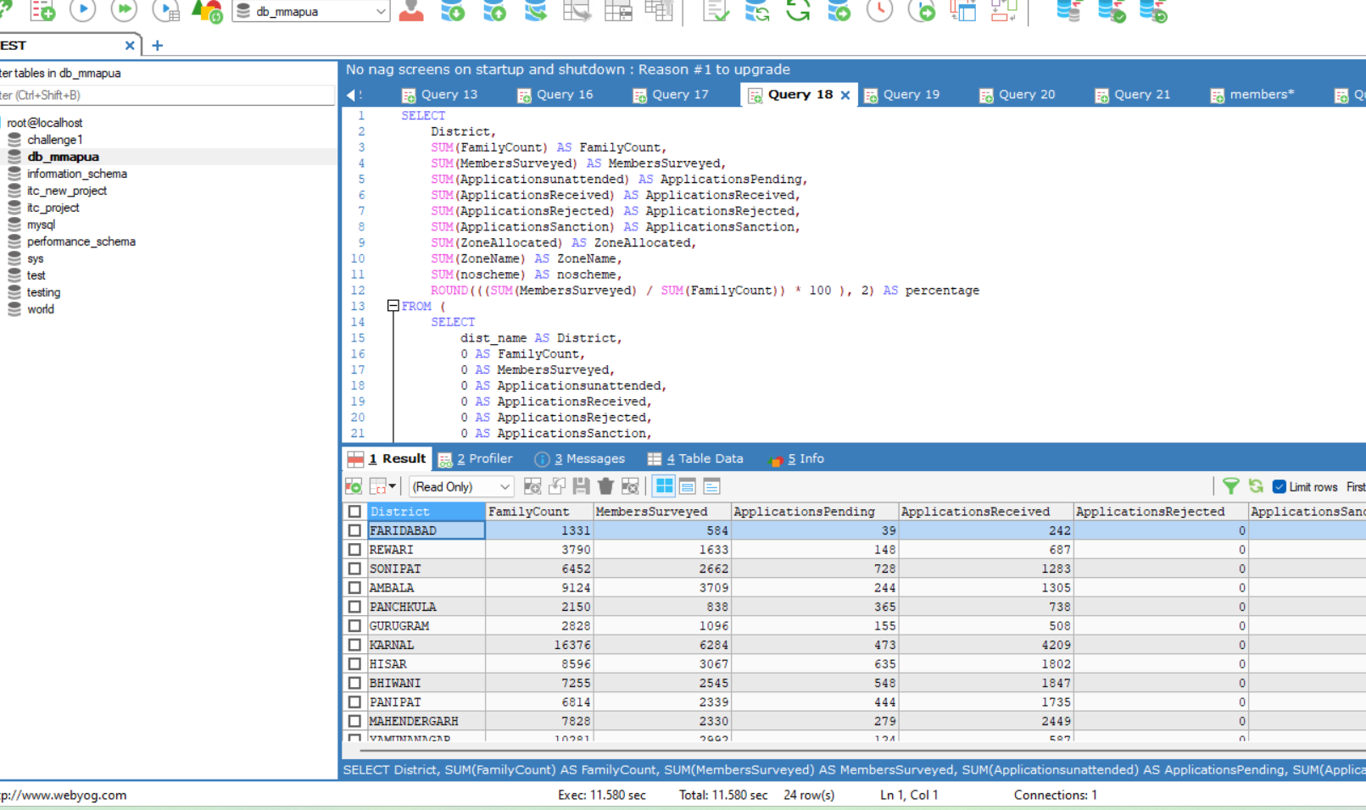
Comparative Analysis Query

Slide 18
Future Enhancements:
  Cloud Migration : Migrating this project to cloud-based infrastructure to take advantage of scalability and elasticity.
  Designing Denormalized Structures: This involves combining related tables into a single table or duplicating certain data to eliminate the need for joins.
  Data Quality Monitoring: Implement automated checks and validation routines to identify anomalies, errors, or inconsistencies in your data, and set up alerts to notify stakeholders when issues arise.
  Real-time Data Processing: Integrate real-time data processing capabilities in the project to handle streaming data sources..

Slide 19
Thank You...

Slide 20
CSV:Cleaning

Slide 21







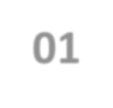
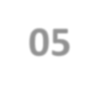
Process
Data Source: CSV/Json
Git/Jenkins Integeration
Power BI
Data Modelling
Applying Optimization Techniques.
Filtration of Datasets and applying Visulations rules.
01
02
04
05
06
07
03
Data Cleansing
Using Pyspark on Hadoop Cluster
Data Export
Data Export of Reports in CSV/Xls.
Power: BI Report Publishing
Data Import
Data Import in Hive and RDBS Full/Incremental

