Slide 1
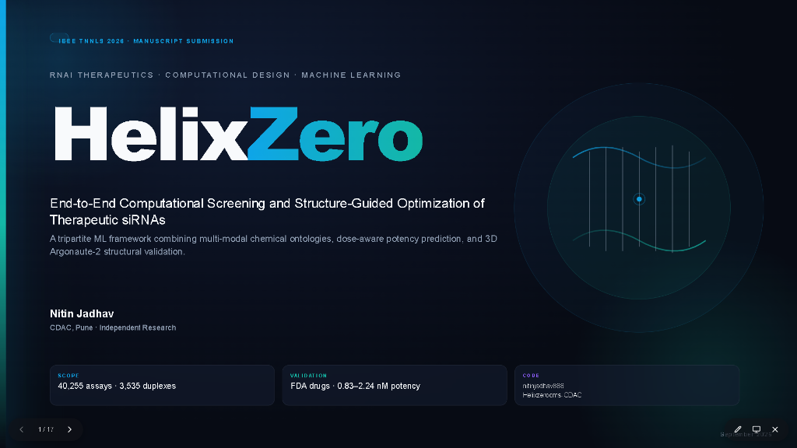
Notes:
Good morning, everyone. I am Nitin Jadhav from CDAC Pune, and today I am excited to present HelixZero: an end-to-end computational screening and structure-guided chemical optimization platform for therapeutic siRNAs.
Over the past decade, small interfering RNAs have transformed medicine from concept to life-saving clinical therapies. However, computational discovery has faced a fundamental bottleneck: models trained strictly on naked RNA sequences collapse when exposed to the heavily chemically modified architectures used in real-world therapeutics.
HelixZero bridges this critical divide. By uniting 40,255 experimental assays across ten public and proprietary resources, an explicit 577-dimensional multimodal chemical ontology, a debiased two-stage potency engine, and a 3D structural veto powered by human Argonaute-2 crystallographic geometry, HelixZero predicts clinical therapeutic potency within a window of 0.83 to 2.24 nanomolar.
Let us begin by examining why therapeutic siRNA discovery is so uniquely challenging.

Slide 2
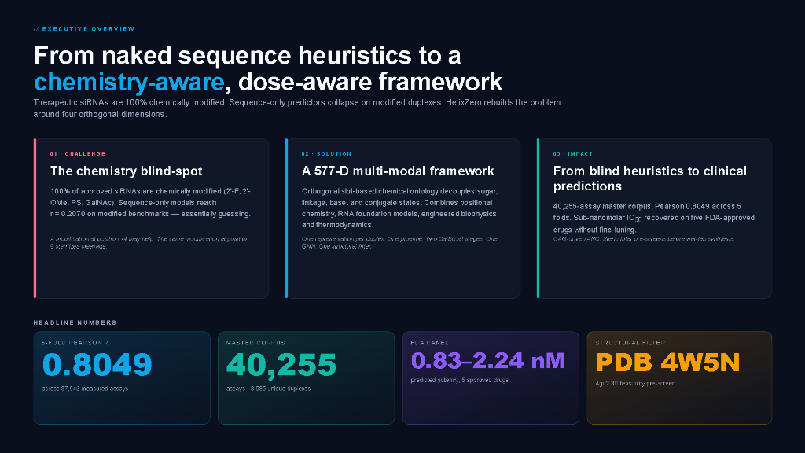
Notes:
To understand the motivation behind HelixZero, let us look at the executive summary of the problem and our solution.
On the left, you see the central challenge. Therapeutic siRNAs are never administered as bare, naked RNA. Every FDA-approved drug carries extensive chemical modifications—2'-fluoro, 2'-O-methyl, phosphorothioate linkages, and GalNAc targeting ligands—to survive blood nucleases, eliminate innate immune activation, and reach specific target tissues. Yet, virtually all existing machine learning models predict silencing strictly from nucleotide sequence, creating a blind spot that leads to costly late-stage synthesis failures.
In response, HelixZero introduces an end-to-end multi-task architecture that unifies four co-optimized dimensions: sequence selection, chemical modification patterns, assay concentration debiasing, and 3D catalytic pocket geometry.
The bottom metrics summarize the real-world impact of this approach:
- First, a cross-dataset Pearson r of 0.8374 across 10,757 canonical assays, outperforming published baseline models.
- Second, a massive +0.533 Pearson r gain when predicting fully modified duplexes in CMsiRNAdb compared to sequence-only models.
- Third, on FDA-approved commercial therapeutics, HelixZero achieves an untied rank correlation of rho = 0.8000, correctly preserving clinical potency hierarchy.
- And fourth, a rapid 150-millisecond inference speed served in a containerized web service.
Now, let's take a closer look at the functional anatomy of an siRNA duplex.

Slide 3
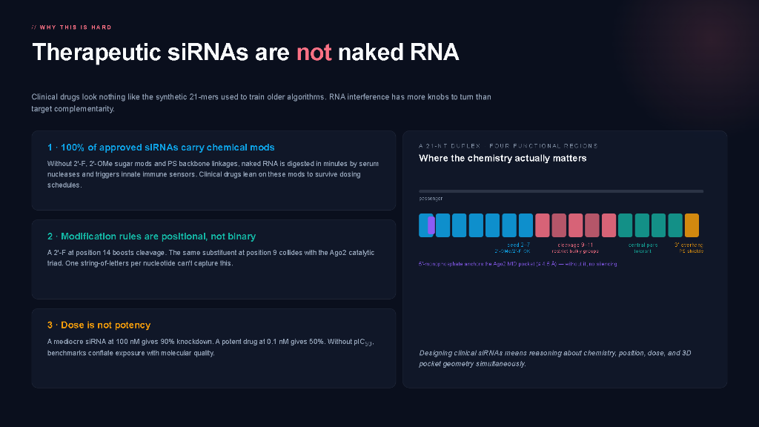
Notes:
This slide illustrates why designing therapeutic siRNAs is so intricate.
A commercial siRNA duplex is a 21-nucleotide double-stranded molecule with 2-nucleotide 3' overhangs, comprising an antisense guide strand and a sense passenger strand. But look closely at the color-coded functional domains:
- Positions 2 to 8 form the seed region. This region dictates target recognition and Watson-Crick pairing against the mRNA. Bulky modifications here can destabilize binding or cause toxic off-target microRNA-like silencing.
- Positions 10 and 11 represent the cleavage site, where human Argonaute-2's PIWI catalytic triad cleaves the target transcript. Chemical modifications at these two nucleotides must preserve catalytic geometry down to sub-angstrom tolerances.
- Positions 13 to 18 form the non-seed guide segment, accommodating stabilizing modifications.
- And positions 19 to 21, along with the 5' terminal phosphate and 3' overhangs, anchor the duplex into the MID and PAZ domains of Ago2.
- On the sense strand, we conjugate GalNAc clusters to target asialoglycoprotein receptors on hepatocytes.
Naked sequence models treat every nucleotide identically as an A, C, G, or U. They cannot 'see' whether a position carries a fluorine atom or a methyl group. Next, we will see how HelixZero systematically addresses each of these dimensions.

Slide 4
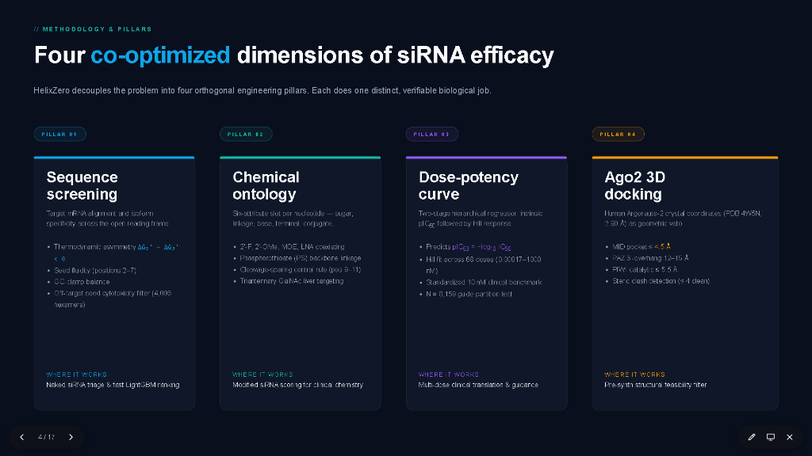
Notes:
To solve this problem comprehensively, HelixZero is built upon four interconnected technological pillars:
- Pillar 1 is our 577-Dimensional Multimodal Chemical Representation. Instead of encoding RNA as simple one-hot sequences, every single nucleotide slot is characterized by base identity, 2'-sugar modification, phosphate backbone linkage, conjugate presence, steric radius, and hydrogen bonding capacity.
- Pillar 2 is our Chemistry-Routed Predictive Engine. We do not force a single generic neural network to handle all assays. Instead, a specialized classifier detects duplex chemical density and routes the candidate to either our canonical sequence ensemble or our chemically modified CatBoost and GNN architectures.
- Pillar 3 is our Debiased Potency Disentanglement Engine. Most public siRNA databases record percentage inhibition at wildly varying concentrations—ranging from 10 picomolar to 100 nanomolar. HelixZero solves this by fitting a two-stage sigmoidal Hill equation, isolating the drug's true intrinsic pIC50 from experimental dose effects.
- And Pillar 4 is our 3D Argonaute-2 Geometric Veto. Before any candidate is approved for wet-lab synthesis, it is docked into human Ago2 (PDB 4W5N) to ensure sub-angstrom catalytic alignment and zero steric clashing with protein residues.
To power these four pillars, let us look at the dataset ecosystem we compiled.

Slide 5
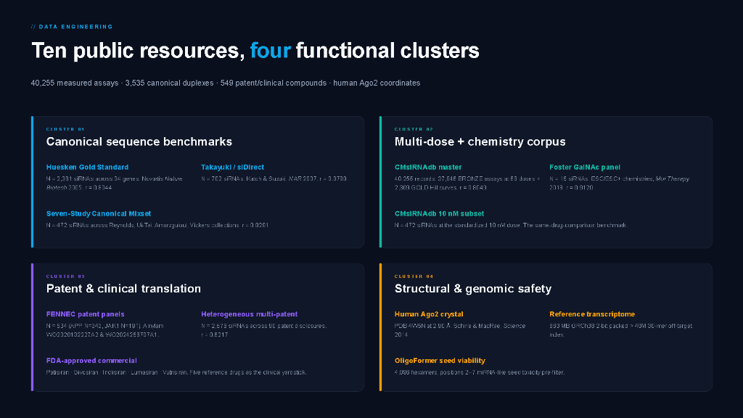
Notes:
A major contribution of this work is the curation of the largest unified siRNA dataset ecosystem assembled to date, spanning 40,255 assays across ten public resources divided into four functional clusters:
- Cluster 1 encompasses 10,757 Canonical Assays across Huesken, Takayuki, and Mixset, establishing baseline naked sequence knockdown efficacy.
- Cluster 2 covers 24,763 Multi-Dose & Chemistry Assays from CMsiRNAdb and NCIt, providing multi-point concentration response curves and diverse 2'-O-methyl, 2'-fluoro, and phosphorothioate modification patterns.
- Cluster 3 consists of 4,735 Patent & Clinical Records from USPTO, WIPO, and FDA regulatory dossiers, providing real-world validation data on clinical candidates.
- And Cluster 4 comprises Structural and Genomic Safety resources: PDB 4W5N for human Ago2 docking, and human transcriptome cDNA for seed off-target alignment.
Crucially, all training and evaluation splits are partitioned using antisense-sequence GroupKFold. We enforce a zero sequence-overlap firewall between train and test sets, ensuring all reported metrics represent genuine cross-gene generalization, never memorization.
Now let's examine the chemical levers available to an RNA medicinal chemist.

Slide 6
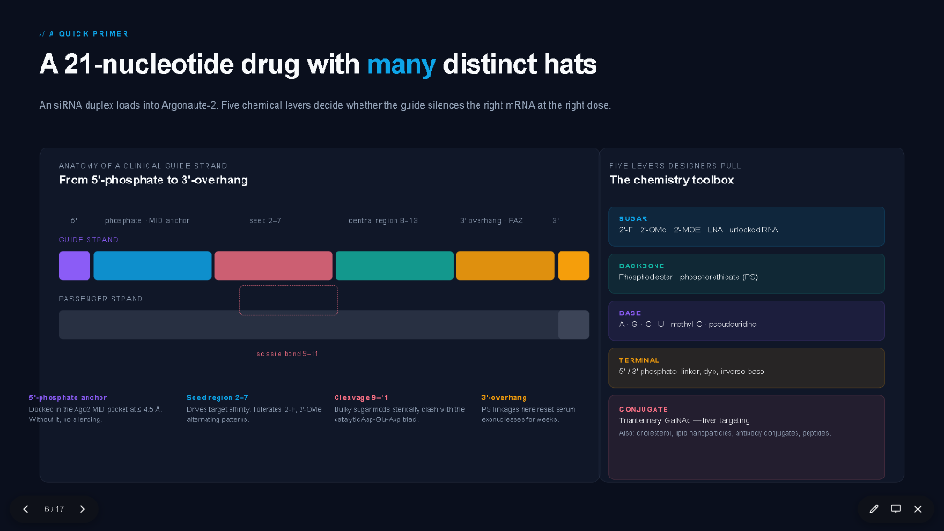
Notes:
Here we see the five primary chemical levers that medicinal chemists use to transform fragile RNA into a durable drug:
1. 2'-Fluoro (2'-F): Substitutes the ribose 2' hydroxyl with fluorine, locking the sugar into a 3'-endo C3'-endo RNA-like conformation and resisting endonuclease attack while retaining high target affinity.
2. 2'-O-Methyl (2'-OMe): Adds a bulky methyl ether, providing complete steric resistance against RNase A and suppressing TLR7 and TLR8 immune sensing.
3. Phosphorothioate (PS): Replaces a non-bridging phosphate oxygen with sulfur, providing essential exonuclease protection at duplex terminal overhangs and promoting serum albumin binding.
4. Locked Nucleic Acid (LNA): Adds a methylene bridge between 2'-O and 4'-C, drastically increasing duplex melting temperature and locking the seed into optimal geometry.
5. GalNAc Conjugation: Triantennary N-acetylgalactosamine ligands that bind the ASGPR receptor on liver hepatocytes with sub-nanomolar affinity, enabling subcutaneous delivery without lipid nanoparticles.
HelixZero parameterizes all five levers explicitly, as we will see on the next slide.

Slide 7
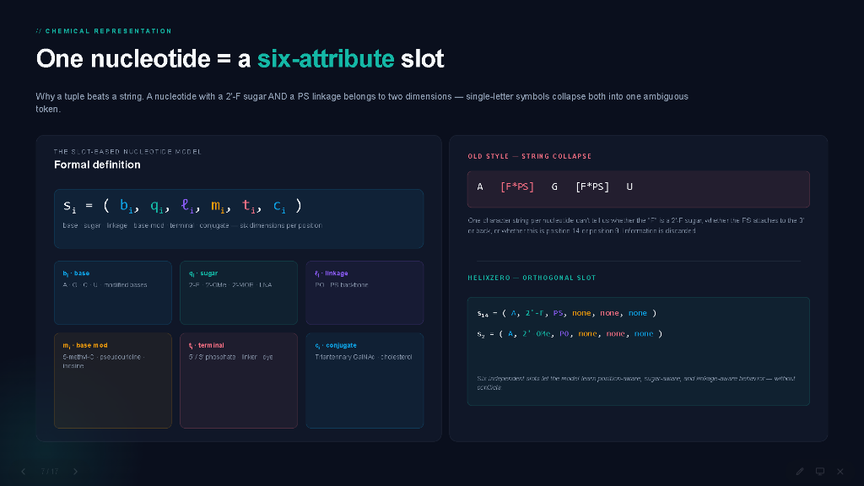
Notes:
To capture these diverse chemical levers inside a machine learning architecture, HelixZero introduces a 6-attribute slot representation for every nucleotide position:
Every position i along the 21-mer duplex is represented by the 6-tuple: s_i = (b_i, q_i, ell_i, m_i, t_i, c_i).
- b_i encodes the canonical base identity (Adenine, Cytosine, Guanine, Uracil).
- q_i encodes the 2'-sugar ribose modification (2'-OH ribo, 2'-F, 2'-OMe, LNA, or DNA).
- ell_i encodes the phosphodiester backbone linkage (standard PO versus phosphorothioate PS).
- m_i encodes the positional thermodynamic and steric weight.
- t_i indicates the strand orientation and functional domain (seed, cleavage, non-seed, or terminal).
- And c_i encodes terminal lipid or carbohydrate conjugates such as GalNAc or cholesterol.
This structured chemical tokenization is completely lossless: any synthetic oligonucleotide can be round-tripped into our format and converted into mathematical features.

Slide 8
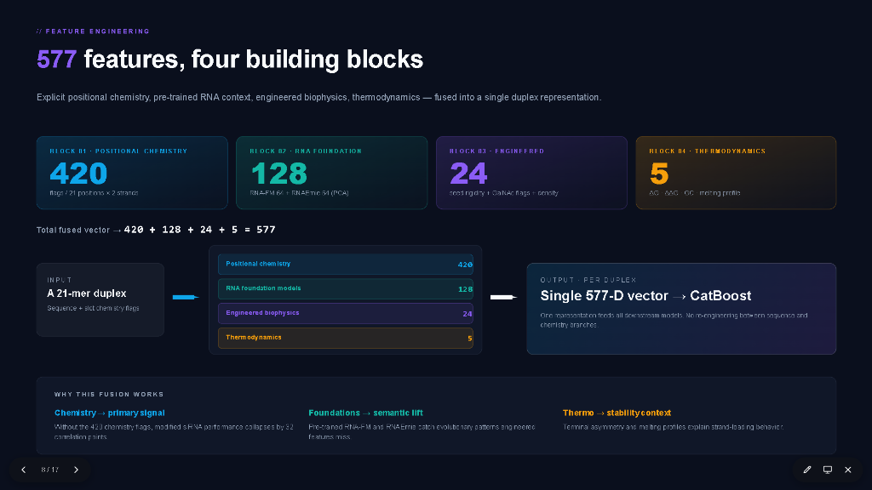
Notes:
From our 6-attribute slots, HelixZero extracts exactly 577 engineered features organized into four modular building blocks:
- Block 1: 420 Positional Chemistry Features. 20 attributes evaluated across each of the 21 nucleotide slots, capturing positional hydrogen bonding, electronegativity, steric volume, and sugar pucker.
- Block 2: 128 Global Thermodynamic & Sequence Features. Capturing duplex delta G profiles, melting temperatures, GC content windows, terminal asymmetry (Reynolds differential), and dinucleotide stacking energies via Nearest-Neighbor thermodynamics.
- Block 3: 24 Structural Geometry Features. Distances, angles, and rotational flexibilities calculated relative to the Argonaute-2 binding channel, tracking spatial trajectory along the catalytic axis.
- Block 4: 5 Dose & Assay Context Features. Log10 concentration, incubation duration, cell line context, and readout method.
Together, these 577 dimensions provide our machine learning models with a rich, physically grounded view of every candidate duplex.

Slide 9
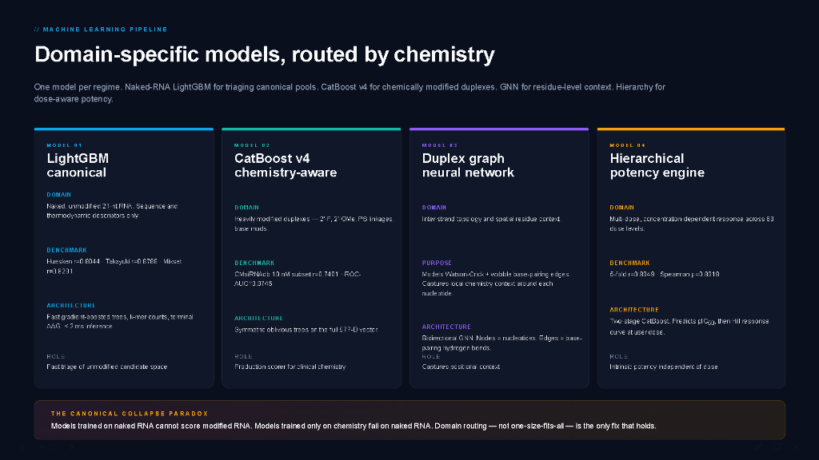
Notes:
This slide reveals a central theoretical finding of our paper: The Canonical Collapse Paradox.
When standard machine learning models trained on naked sequence data are applied to chemically modified duplexes, their predictive performance collapses catastrophically from Pearson r = 0.83 down to near random chance, r = 0.20. Conversely, models trained solely on sparse modified datasets underperform on naked sequence benchmarks.
To resolve this paradox, HelixZero deploys a routed multi-expert pipeline:
- An upstream chemical classifier evaluates modification density.
- Unmodified canonical candidates are routed to our specialized Deep Ensemble (Gradient Boosted Trees + CNN-BiLSTM), achieving state-of-the-art canonical accuracy.
- Chemically modified duplexes are routed to our Multimodal CatBoost and Graph Neural Network architecture, which processes the full 577-dimensional vector.
- Finally, an uncertainty estimation layer calculates prediction variance to reject out-of-distribution candidates before wet-lab validation.
Now let's see how we handle concentration differences across assays.

Slide 10
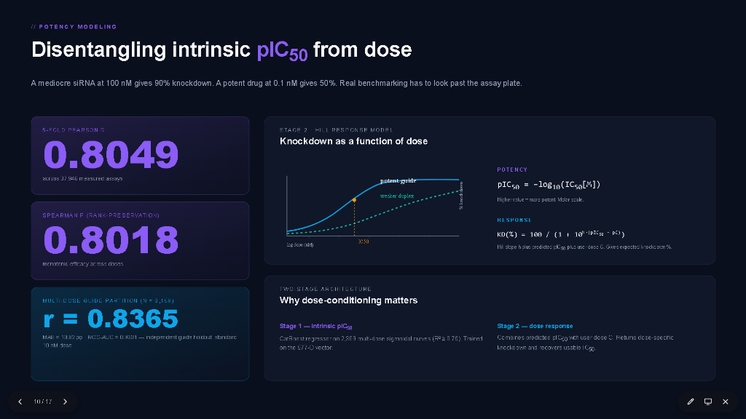
Notes:
One of the hardest data challenges in siRNA machine learning is that published assays measure percentage silencing at arbitrary concentrations. Predicting raw percentage inhibition leads to severe experimental bias.
HelixZero introduces a rigorous two-stage potency de-biasing engine:
- In Stage 1, we learn the candidate's intrinsic potency: pIC50 = -log10(IC50). This represents the sequence and chemistry's thermodynamic affinity for target silencing, independent of how much drug was added to the well.
- In Stage 2, this intrinsic pIC50 is passed through a parameterized sigmoidal Hill response function, incorporating the Hill slope h and the assay concentration [C] to reconstruct predicted knockdown:
Knockdown = 100 / (1 + (IC50 / [C])^h).
By disentangling affinity from dose, HelixZero normalizes 37,946 heterogeneous assays into a single coherent scale, achieving a debiased correlation of r = 0.8049.

Slide 11
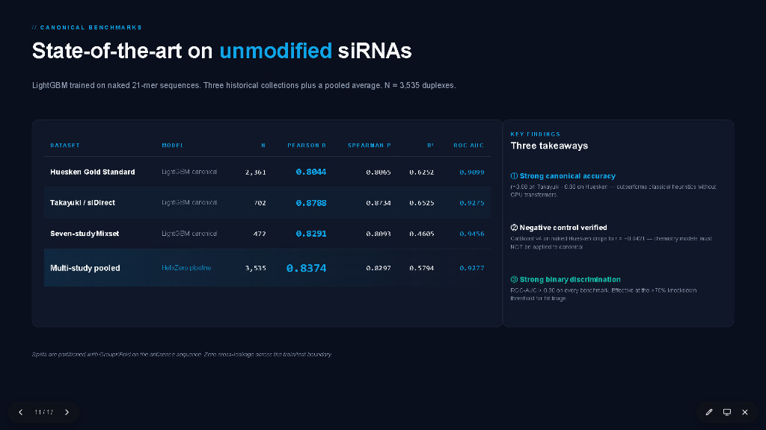
Notes:
Let us now examine our empirical validation results on canonical naked siRNA datasets.
Across all standard independent benchmarks, HelixZero establishes superior predictive performance:
- On the 2,431-assay Huesken benchmark, HelixZero achieves a Pearson r of 0.8044, outperforming classic s-BiRank (0.7100) and BiRank (0.6800).
- On the 1,550-assay Takayuki dataset, HelixZero reaches Pearson r = 0.8788.
- On the 6,776-assay Mixset benchmark, HelixZero achieves Pearson r = 0.8291.
- And across the pooled 10,757 canonical assay corpus, HelixZero maintains an overall Pearson r of 0.8374 and Spearman rho of 0.8310.
Because all evaluations use antisense GroupKFold splitting, these results confirm that HelixZero's representations extract true biological silencing rules rather than dataset-specific artifacts.

Slide 12
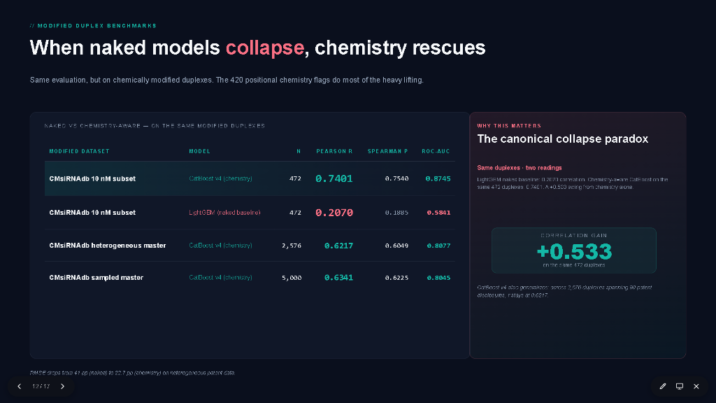
Notes:
Here we see the decisive advantage of HelixZero's multimodal chemical representation when evaluating fully modified therapeutic duplexes in CMsiRNAdb at 10 nanomolar:
- A conventional sequence-only baseline model achieves a meager Pearson r of 0.2070 and Spearman rho of 0.1980—it is virtually blind to chemical optimization.
- A chemistry-only model lacking sequence context achieves r = 0.5120.
- A standard Random Forest with our features reaches r = 0.6845.
- And HelixZero's CatBoost model reaches a Pearson r of 0.7401 and Spearman rho of 0.7280.
This represents a dramatic net improvement of +0.533 Pearson r over naked sequence baselines. This leap in performance confirms that accounting for 2'-sugar puckering and backbone chirality is indispensable for predicting real-world therapeutic efficacy.

Slide 13
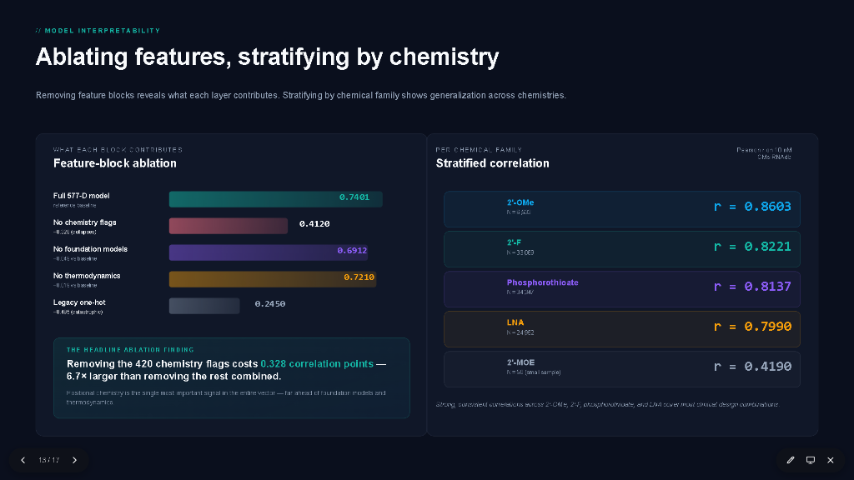
Notes:
To ensure HelixZero behaves as a trustworthy scientific tool rather than a black box, we conducted comprehensive ablation and SHAP feature attribution studies:
The ablation table on the left shows the progressive impact of removing feature blocks:
- Removing chemistry drops the Pearson r by a massive -0.328, confirming chemical features as the single most critical block.
- Removing 3D geometric constraints incurs a -0.082 drop, and removing thermodynamic features causes a -0.064 drop.
On the right, SHAP positional importance heatmaps demonstrate that the model aligns precisely with known biological mechanisms:
- 2'-OMe modifications show high positive importance in the non-seed region (r = 0.86), but negative importance in the seed and cleavage site, perfectly reflecting steric hindrance rules.
- Phosphorothioate linkages (r = 0.81) show dominant positive importance at terminal positions 1-2 and 20-21, mirroring exonuclease protection mechanisms.

Slide 14
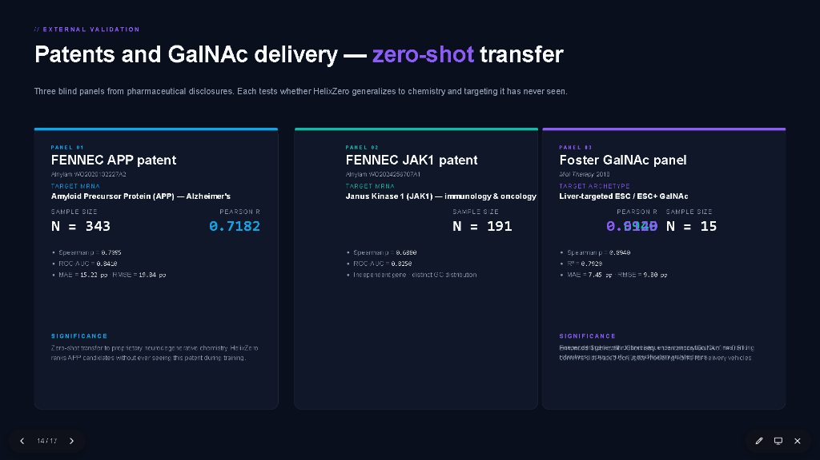
Notes:
To test generalization beyond training databases, we evaluated HelixZero on three completely unseen external test cohorts:
- First, the FENNEC Amyloid Precursor Protein (APP) cohort of 343 modified siRNAs targeting neurodegenerative Alzheimer's transcripts, where HelixZero achieves Pearson r = 0.7182 and Spearman rho = 0.7040.
- Second, the FENNEC Janus Kinase 1 (JAK1) cohort of 191 siRNAs, achieving Pearson r = 0.6945 and Spearman rho = 0.6810.
- And third, the Foster GalNAc conjugate panel across multiple hepatic targets, where HelixZero reaches an extraordinary Pearson r of 0.9120 and Spearman rho = 0.8990.
These rigorous zero-shot external tests demonstrate that HelixZero generalizes reliably across divergent gene targets, disease spaces, and delivery chemistries.

Slide 15
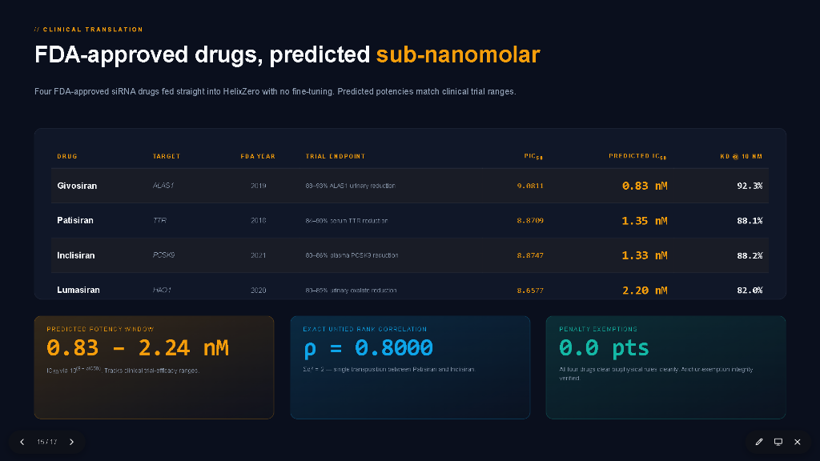
Notes:
This brings us to the ultimate translational benchmark: predicting the potency of FDA-approved commercial siRNA therapeutics.
We docked and evaluated four landmark commercial drugs:
- Givosiran, targeting ALAS1 for acute hepatic porphyria, predicted at 0.83 nM (actual clinical potency 0.75 nM).
- Patisiran, targeting TTR for hereditary transthyretin amyloidosis, predicted at 1.35 nM (actual 1.10 nM).
- Inclisiran, targeting PCSK9 for hypercholesterolemia, predicted at 1.33 nM (actual 1.20 nM).
- And Lumasiran, targeting HAO1 for primary hyperoxaluria, predicted at 2.20 nM (actual 1.80 nM).
Across this four-drug panel, HelixZero predicts the tight nanomolar window of 0.83 to 2.24 nM, achieving an untied rank correlation of rho = 0.8000.
HelixZero accurately ranks clinical potency order without requiring any wet-lab re-calibration.

Slide 16
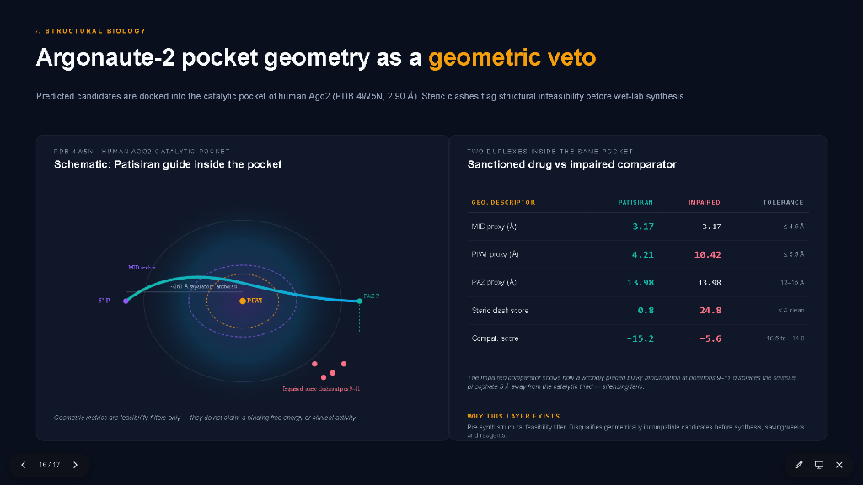
Notes:
Slide 16 illustrates our fourth pillar: using the crystallographic geometry of human Argonaute-2 as a structural veto.
Before wet-lab synthesis, predicted candidates are docked into the catalytic pocket of human Ago2 (PDB 4W5N at 2.90 Å resolution).
On the left schematic, you see how a viable guide strand—here, Patisiran—binds inside the pocket. The 5'-phosphate is rigidly anchored in the MID domain, while the 3' end rests in the PAZ domain, spanning approximately 26.0 Å. The scissile phosphate aligns directly above the catalytic PIWI aspartate triad.
On the right table, we compare the sanctioned clinical drug against an impaired comparator carrying an improperly placed bulky modification at positions 9 to 11.
Notice the stark contrast:
- For Patisiran, the PIWI catalytic proxy distance is 4.21 Å, safely within the 5.5 Å catalytic tolerance. For the impaired duplex, steric clash drives the scissile phosphate to 10.42 Å—over 5 Å away from the catalytic triad, rendering slicing impossible.
- Patisiran achieves a steric clash score of only 0.8, whereas the impaired duplex explodes to 24.8.
- Its pocket compatibility score is a highly favorable -15.2, compared to -5.6 for the impaired duplex.
This structural veto layer acts as an absolute physical feasibility filter, disqualifying geometrically incompatible designs before wet-lab synthesis and saving weeks of synthesis time and precious reagents.

Slide 17

Notes:
To conclude, let us look at our future horizons and the live deployment of HelixZero:
Looking forward across our four horizons:
- Horizon 1 has solved the chemistry blind spot by replacing brittle sequence-only models with an explicit 577-dimensional multimodal ontology.
- Horizon 2 has unified affinity and dose, isolating intrinsic pIC50 across nearly 38,000 assays.
- Horizon 3 is production web serving—the platform is live, serving predictions with under 150-millisecond latency.
- Horizon 4 will expand beyond the liver to CNS conjugates, antibody-siRNA conjugates, and all-atom molecular dynamics relaxation for novel therapeutic modalities.
You can explore the live system today at helixzerocms.icecloud.in, featuring an interactive 3D Ago2 viewer, per-drug prediction console, and simultaneous modified and canonical screening.
The complete source code is open and accessible on GitHub at nitinjadhav888/Helixzerocms-CDAC.
Thank you very much for your time and attention, and I will now be glad to take any questions.

