Slide 1
IEEE TRANSACTIONS ON NEURAL NETWORKS AND LEARNING SYSTEMS (IEEE TNNLS 2026)
HELIXZERO: END-TO-END COMPUTATIONAL SCREENING AND STRUCTURE-GUIDED SIRNA OPTIMIZATION
A Tripartite Machine Learning, Multi-Modal Chemical Ontology, and 3D Argonaute-2 Structural Framework for Next-Generation RNAi Therapeutics
Lead Author: Nitin Jadhav | Affiliation: CDAC / Independent Research
Codebase: nitinjadhav888/Helixzerocms-CDAC | Empirical Scope: 40,255 Measured Assays | PDB: 4W5N

Slide 2
// EXECUTIVE OVERVIEW
Transforming RNAi Drug Discovery with Multi-Modal Intelligence
From naked sequence heuristics to modern chemistry-aware, dose-conditioned, and structure-validated siRNA engineering
The Chemical Complexity Challenge
The HelixZero Tripartite Solution
Empirical & Clinical Proof
• Modern therapeutic siRNAs are NOT naked RNA: 100% of commercial drugs have full chemical modifications (2'-F, 2'-OMe, PS linkages, GalNAc conjugates).
• Naked sequence models collapse on modified duplexes (Pearson r = 0.2070 on CMsiRNAdb modified benchmarks).
• Modification effects are strictly non-additive: a single 2'-F at guide position 14 can boost cleavage 10-fold, while at position 9 it sterically clashes.
• Orthogonal Multi-Modal Chemical Ontologies: Uncoupling sugar chemistry, phosphate linkage, nucleobase modification, and terminal conjugates.
• 577-Dimensional Hybrid Feature Vector: Fusing explicit positional flags, RNA foundation models (RNA-FM, RNAErnie), and thermodynamics.
• Hierarchical Potency-Response Architecture: Jointly predicting intrinsic potency (pIC50) and concentration-dependent knockdown curves.
• 40,255-Assay Master Corpus: 5-fold cross-validation achieves Pearson r = 0.8049, Spearman ρ = 0.8018, R² = 0.6410.
• FDA Commercial Therapeutics Panel: Accurately predicts clinical potency across Givosiran, Patisiran, Inclisiran, and Lumasiran (0.83–2.24 nM).
• 3D Ago2 Structural Docking: Human Ago2 (PDB 4W5N) template modeling flags steric clashes and confirms active-site geometric compatibility.
HelixZero: End-to-End Computational Screening & Structure-Guided siRNA Optimization | IEEE TNNLS 2026

Slide 3
// METHODOLOGY & PILLARS
The Four Co-Optimized Dimensions of siRNA Efficacy
Activity is governed by the non-linear interplay of sequence, chemistry, dose, and receptor geometry
PILLAR 1
PILLAR 2
PILLAR 3
PILLAR 4
Sequence Screening
Chemical Ontology
Dose Potency Curve
3D Ago2 Docking
✔ Target mRNA transcript alignment
✔ Thermodynamic terminal asymmetry (ΔΔG)
✔ GC-clamp & seed fluidity (pos 2–7)
✔ Off-target seed cytotoxicity filtering
✔ Orthogonal 6-attribute slot model
✔ 2'-OMe, 2'-F, 2'-MOE, LNA sugars
✔ Phosphorothioate (PS) stereochemistry
✔ Triantennary GalNAc targeting ligands
✔ Hierarchical pIC50 regressor
✔ 4-parameter Hill concentration response
✔ Standardized 10 nM clinical benchmarking
✔ Multi-dose guide partition (N=8,159)
✔ Human Ago2 crystal reference (4W5N)
✔ MID pocket 5'-phosphate anchoring (≤4.5 Å)
✔ PAZ domain 3'-overhang fit (12–15 Å)
✔ PIWI catalytic proxy distance & clash filtering
HelixZero: End-to-End Computational Screening & Structure-Guided siRNA Optimization | IEEE TNNLS 2026

Slide 4
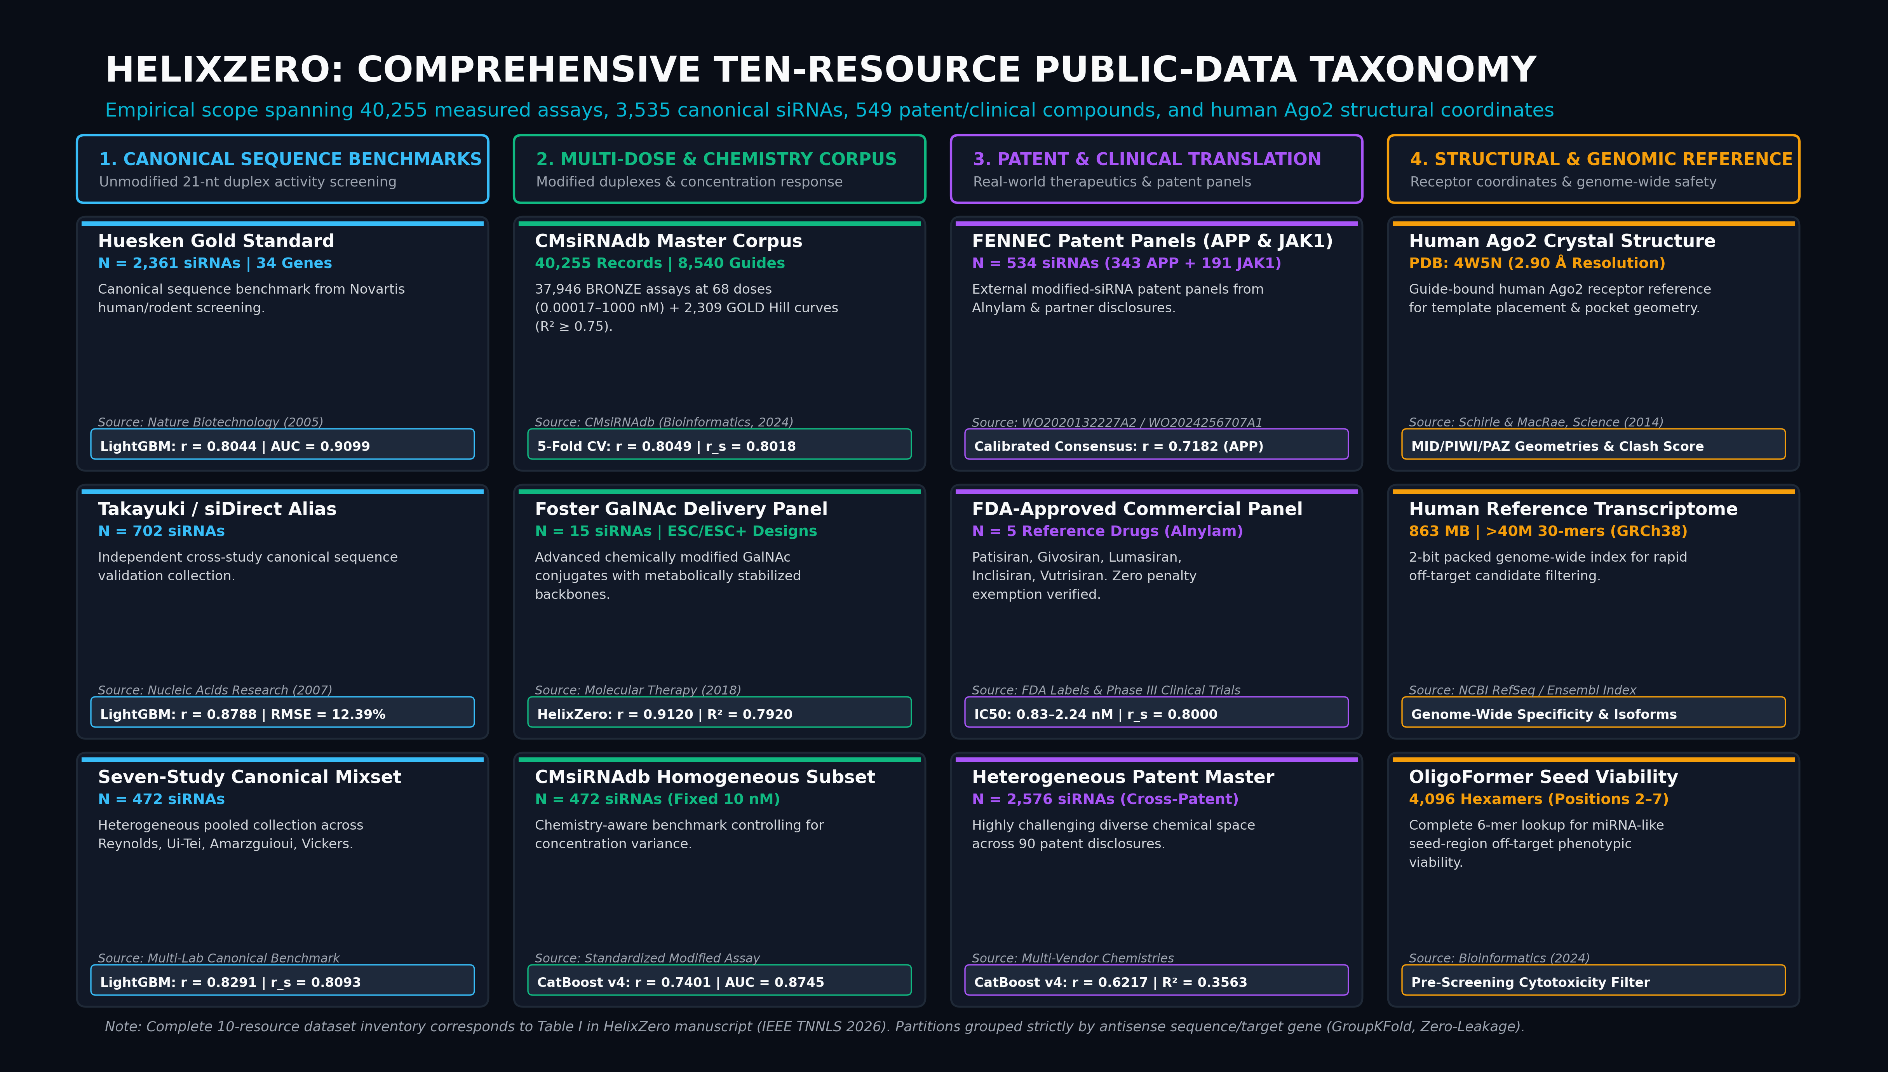
// DATA ENGINEERING
Comprehensive Ten-Resource Public-Data Taxonomy
Curating 40,255 measured records, 3,535 canonical duplexes, 549 patent/clinical compounds, and human Ago2 coordinates
HelixZero: End-to-End Computational Screening & Structure-Guided siRNA Optimization | IEEE TNNLS 2026

Slide 5
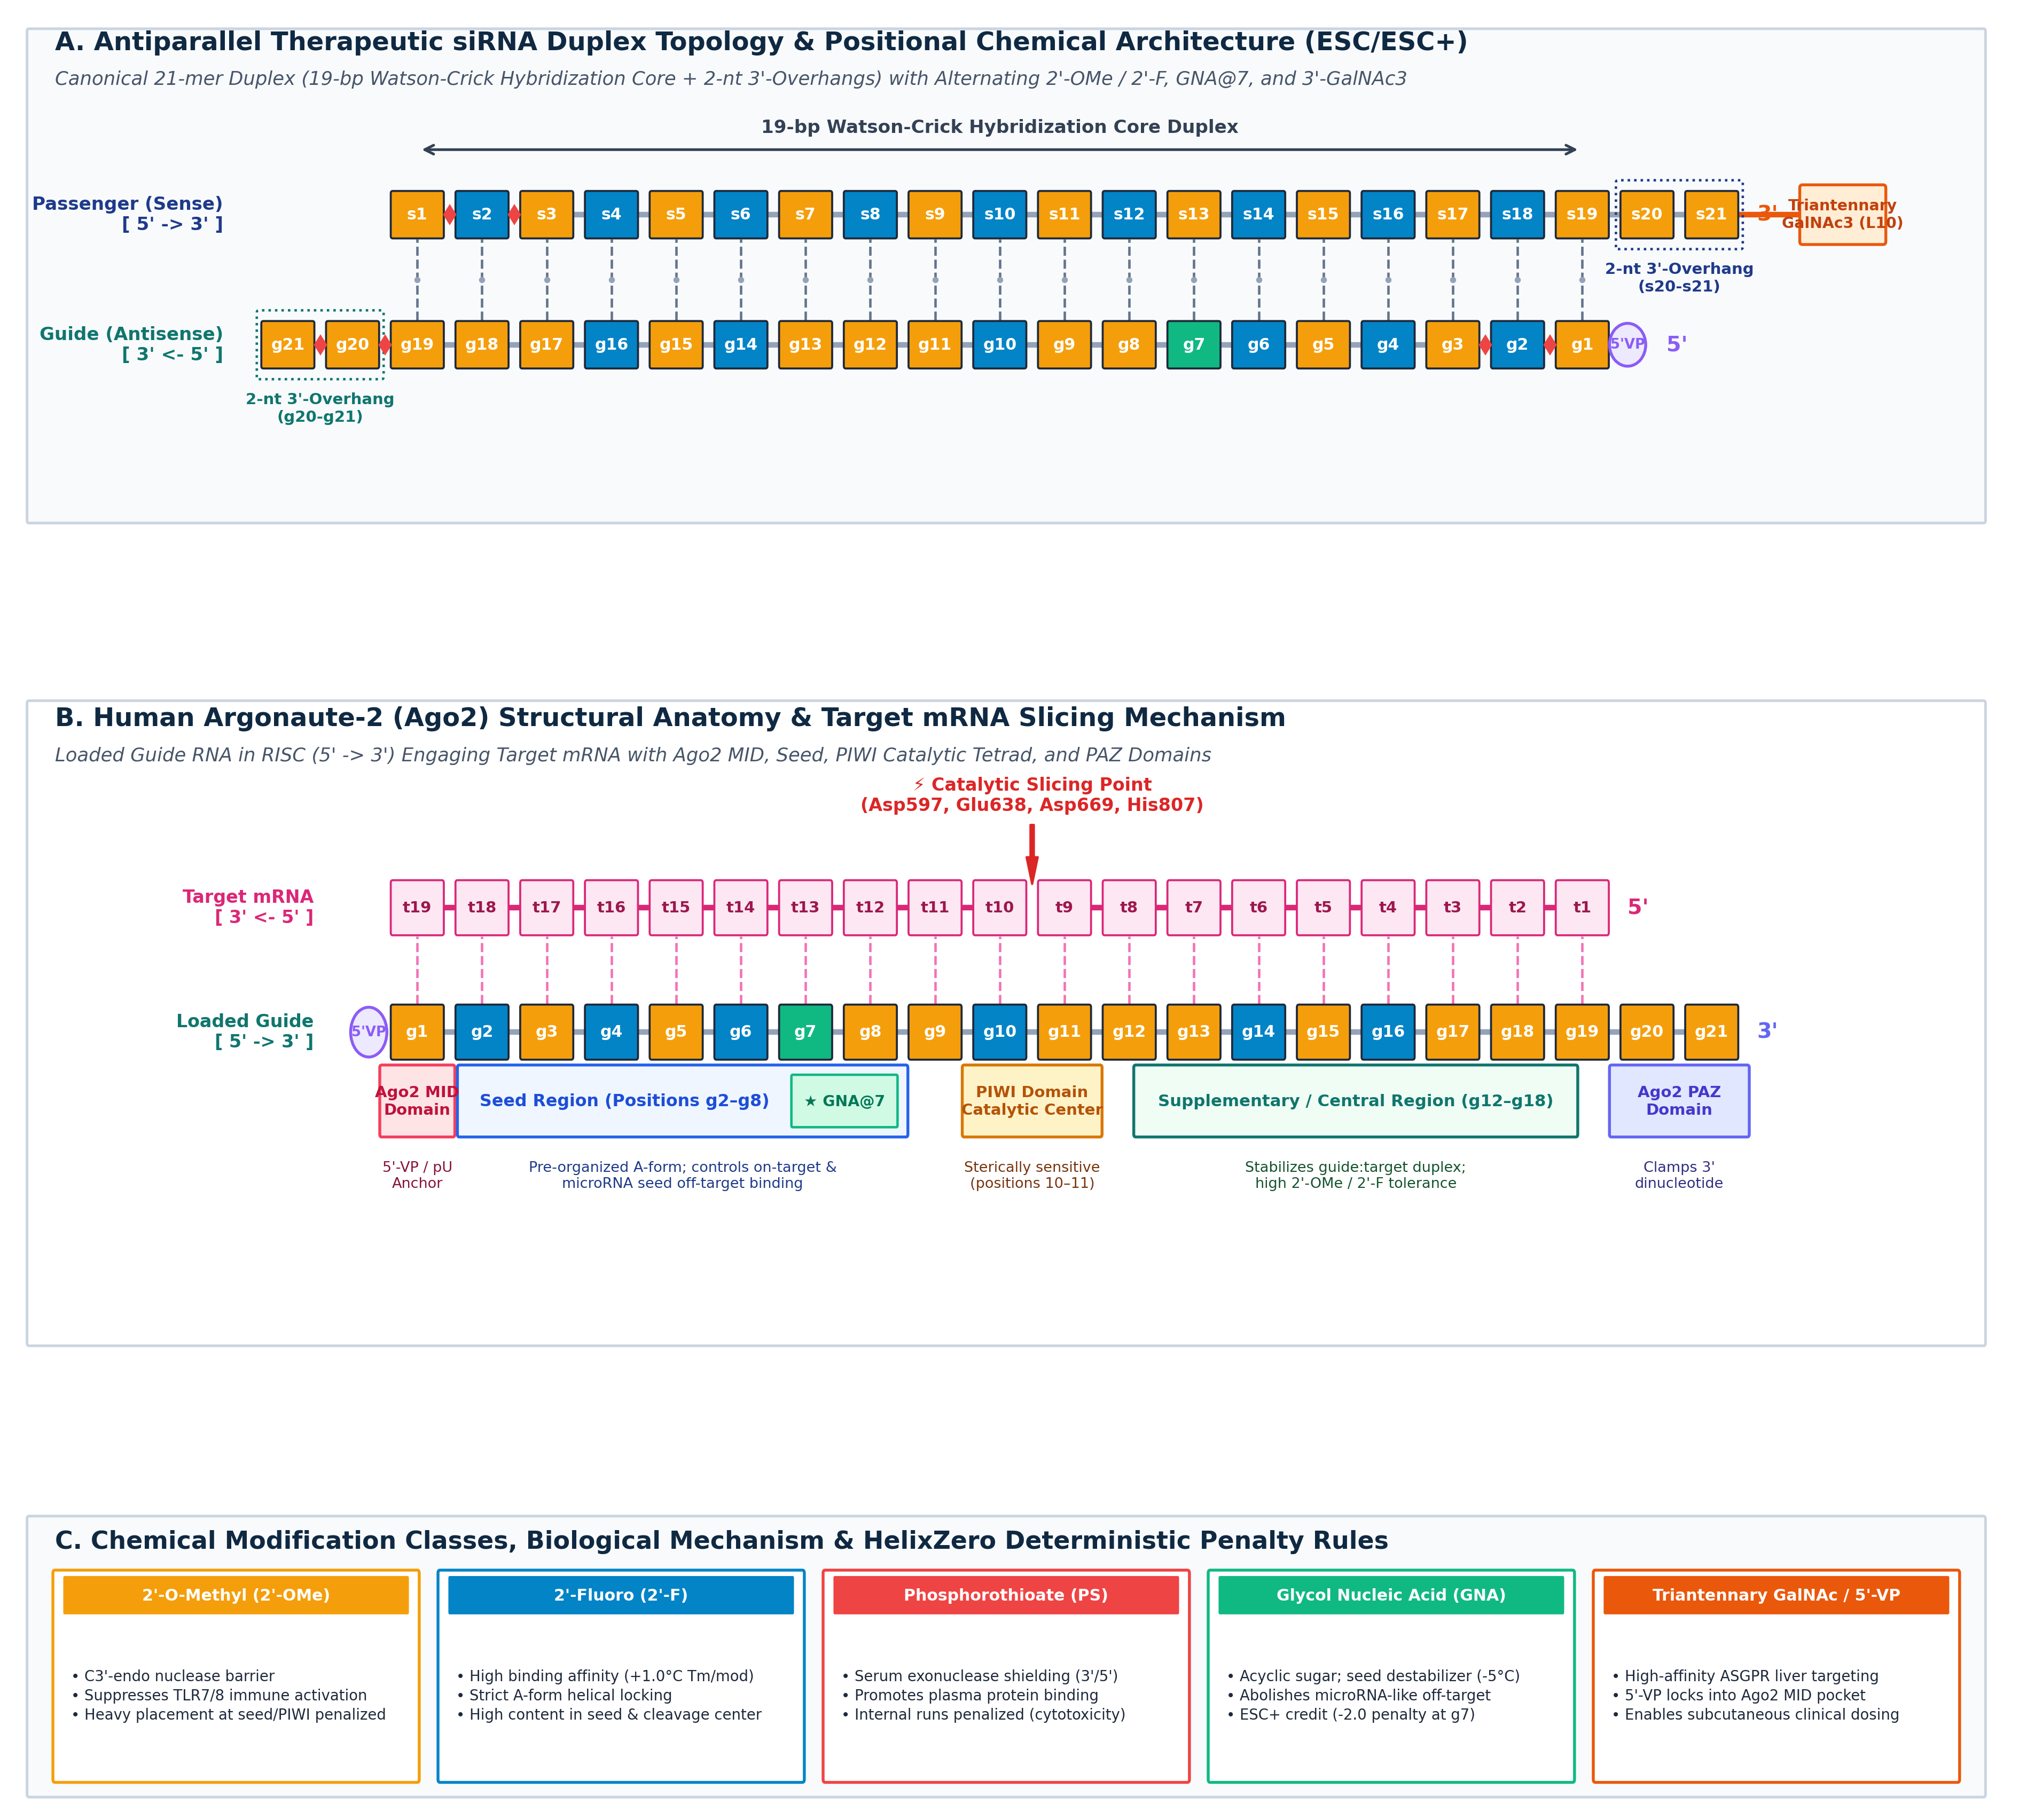
// CHEMICAL REPRESENTATION
Orthogonal Slot-Based Chemical Ontologies
Resolving positional chemistry conflicts by decoupling sugar, linkage, base, and conjugate states
The Slot-Based Nucleotide Model
■ Mathematical Formulation:
Every nucleotide is formalized as a 6-attribute tuple: s_i = (b_i, q_i, l_i, m_i, t_i, c_i), where b=base, q=sugar, l=linkage, m=base mod, t=terminal state, c=conjugate.
■ Resolving Competing Notations:
Legacy strings collapse 2'-F and PS linkages into a single character, creating ambiguity. The slot model represents both independently without loss of chemical state.
■ Biophysical Rule Preservation:
Directly encodes critical structural constraints: seed region rigidification (pos 2–8), cleavage-sparing central core (pos 9–11), and terminal thermodynamic asymmetry.
■ GalNAc Conjugate Integration:
Seamlessly models multi-valent triantennary GalNAc targeting moieties at sense 3'/5' termini for liver asialoglycoprotein receptor (ASGPR) uptake.
HelixZero: End-to-End Computational Screening & Structure-Guided siRNA Optimization | IEEE TNNLS 2026

Slide 6
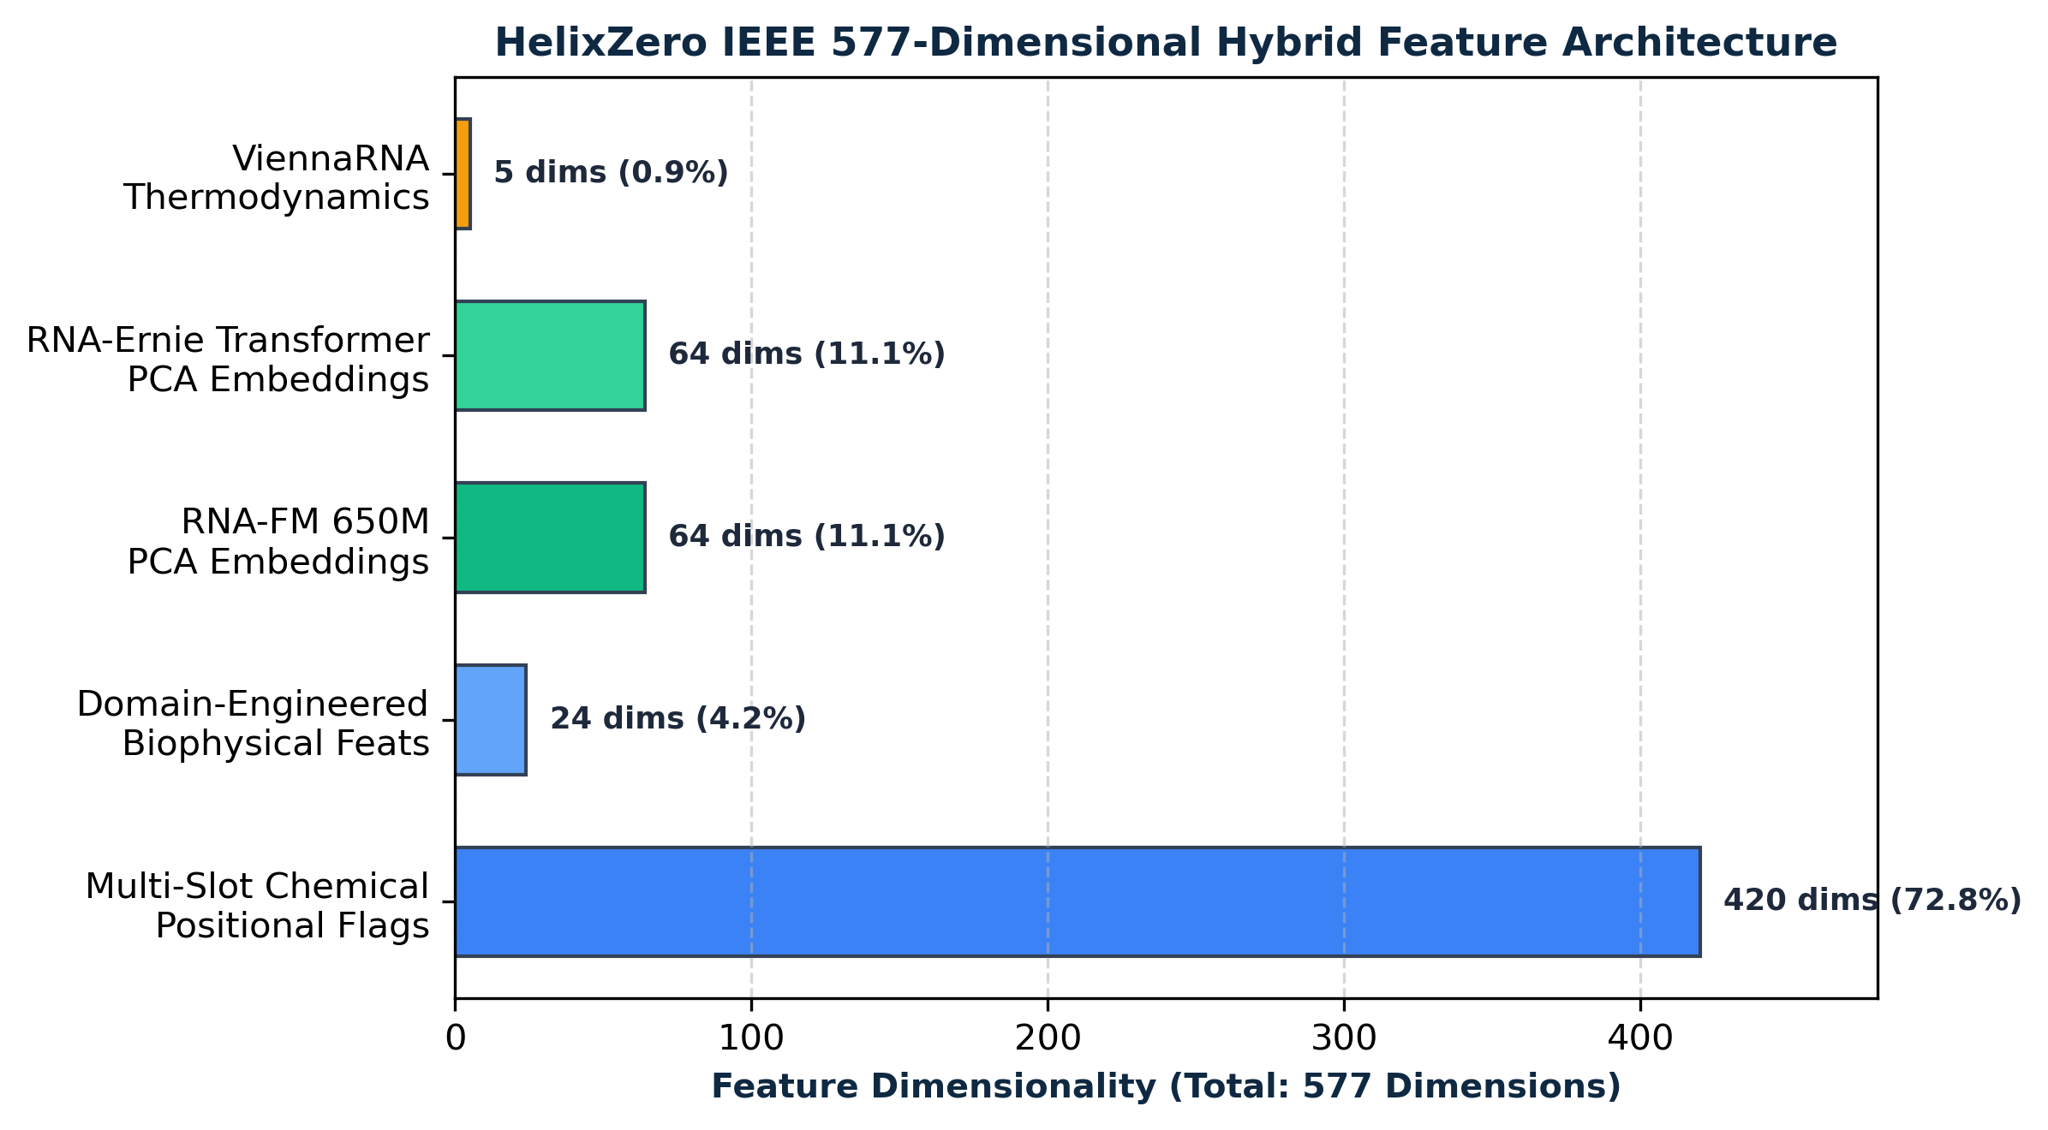
// FEATURE ENGINEERING
577-Dimensional Multi-Modal Feature Architecture
Integrating explicit positional chemistry flags, foundation-model representations, and thermodynamic calculations
Positional Chemistry
RNA Foundation Models
Engineered Biophysics
Thermodynamics & GC
420 Features
128 Features
24 Features
5 Features
Ten explicit binary flags at each of 21 nucleotide positions on both strands (8 sugar states, PS linkages, base modifications).
Pre-trained deep biological representations: RNA-FM (64 PCA components) + RNAErnie (64 PCA components) capturing contextual sequence semantics.
Seed-region rigidity indices, strand modification density, terminal phosphorothioate distribution, ASGPR conjugate indicators, and sequence composition.
Nearest-neighbor Gibbs free energy (ΔG), terminal 5'-/3'-asymmetry (ΔΔG), GC content, and secondary structure melting profiles.
HelixZero: End-to-End Computational Screening & Structure-Guided siRNA Optimization | IEEE TNNLS 2026

Slide 7
// MACHINE LEARNING PIPELINE
Tripartite Strategy & Domain-Specific Model Routing
Aligning model complexity with chemical modification state to avoid negative cross-domain transfer
Model 1: LightGBM Canonical
Model 2: CatBoost v4 Chemistry-Aware
Model 3: Duplex Graph Network (GNN)
Model 4: Hierarchical Potency Engine
Canonical / Unmodified Sequences
Modified Duplex Regressions
Inter-Strand Topology & Geometry
Dose-Dependent Hill Response
Huesken: r = 0.8044 | Takayuki: r = 0.8788
CMsiRNAdb: r = 0.7401 | AUC = 0.8745
Topology-Aware Sequence Context
5-Fold CV: r = 0.8049 | r_s = 0.8018
Ultra-fast gradient boosted decision tree optimized on sequence kmers and thermodynamic asymmetry. Dominates canonical screening but intentionally lacks chemical awareness.
Trains on full 577-D feature vectors. Leverages symmetric trees to prevent overfitting across sparse chemical modification patterns. Solves the modified-duplex failure of naked models.
Bidirectional graph neural network modeling Watson-Crick and wobble pairing interactions across strands, capturing spatial chemical context and helix stability.
Two-stage regressor predicting intrinsic pIC50 potency followed by concentration-conditioned sigmoidal knockdown response across 68 dose levels (0.00017–1000 nM).
HelixZero: End-to-End Computational Screening & Structure-Guided siRNA Optimization | IEEE TNNLS 2026

Slide 8
// POTENCY MODELING
Hierarchical Potency–Response Prediction Engine
Disentangling sequence–chemistry intrinsic affinity (pIC50) from experimental assay concentration
r = 0.8049
Two-Stage Sigmoidal Response Architecture
Pearson Correlation
✔ Stage 1: Intrinsic Potency Regressor:
CatBoost regressor maps the 577-D feature vector to intrinsic duplex potency pIC50 = -log10(IC50 in M). Trained on 2,309 multi-dose curves with R² ≥ 0.75.
✔ Stage 2: Concentration-Conditioned Knockdown:
Second regressor takes predicted pIC50 alongside assay concentration C (nM) and thermodynamic descriptors to compute predicted % knockdown: KD = 100 / (1 + 10^(h * (pIC50 - pC))).
✔ Solving Concentration Bias:
Standard models conflate high dose with high potency. A poor siRNA at 100 nM can match an ultra-potent siRNA at 0.1 nM. HelixZero cleanly uncouples affinity from dosage.
✔ Multi-Dose Guide Partition (N = 8,159):
Tested on an independent guide partition across 37,946 assays: Pearson r = 0.8365, Spearman ρ = 0.8335, MAE = 13.82 pp, RMSE = 17.12 pp, ROC-AUC = 0.9331.
5-Partition Guide Evaluation
ρ = 0.8018
Spearman Rank Correlation
Strict monotonic preservation
R² = 0.6410
Coefficient of Determination
RMSE = 18.63 pp across 68 doses
HelixZero: End-to-End Computational Screening & Structure-Guided siRNA Optimization | IEEE TNNLS 2026

Slide 9
// CANONICAL BENCHMARKS
Rigorous Validation on Unmodified siRNAs (N = 3,535)
State-of-the-art performance across historical benchmark collections
Benchmark Dataset | Evaluated Model | Sample N | Pearson r | Spearman ρ | R² Score | ROC-AUC
Huesken Gold Standard | LightGBM Canonical | 2,361 | 0.8044 | 0.8065 | 0.6252 | 0.9099
Takayuki / siDirect Alias | LightGBM Canonical | 702 | 0.8788 | 0.8734 | 0.6525 | 0.9275
Seven-Study Canonical Mixset | LightGBM Canonical | 472 | 0.8291 | 0.8093 | 0.4605 | 0.9456
Multi-Study Pooled Average | HelixZero Pipeline | 3,535 | 0.8374 | 0.8297 | 0.5794 | 0.9277
Key Scientific Findings
• Near-Perfect Sequence Generalization: LightGBM achieves r = 0.8788 on Takayuki and r = 0.8044 on Huesken without relying on computationally expensive LLMs during inference.
• Strict Negative Controls: When CatBoost v4 (chemistry-trained) is evaluated on Huesken without modifications, it yields r = -0.0421, confirming domain-specific routing is necessary.
• AUC > 0.90 Across All Sets: Reliable discrimination of highly functional siRNAs (>70% knockdown threshold) for high-throughput therapeutic candidate shortlisting.
HelixZero: End-to-End Computational Screening & Structure-Guided siRNA Optimization | IEEE TNNLS 2026

Slide 10
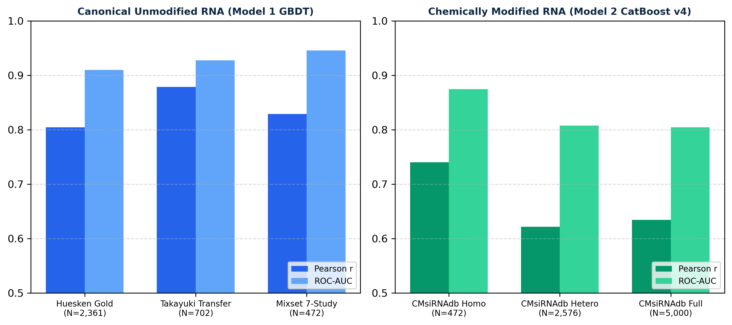
// MODIFIED DUPLEX BENCHMARKS
Chemically Modified Generalization (N = 5,000+)
CatBoost v4 rescues predictive efficacy where canonical models completely collapse
Modified Dataset | Model | N | Pearson r | Spearman ρ | AUC
CMsiRNAdb Homogeneous (10 nM) | CatBoost v4 | 472 | 0.7401 | 0.7540 | 0.8745
CMsiRNAdb Homogeneous (10 nM) | LightGBM (Naked) | 472 | 0.2070 | 0.1885 | 0.5841
CMsiRNAdb Heterogeneous Master | CatBoost v4 | 2,576 | 0.6217 | 0.6049 | 0.8077
The Canonical Collapse Paradox
■ Naked Models Fail:
On CMsiRNAdb homogeneous modified assays, LightGBM drops from r = 0.88 to r = 0.2070. Sequence-only features cannot account for modified ribonucleotide chemistry.
■ CatBoost v4 Rescues Activity:
Adding the 420 positional chemistry flags drives Pearson r to 0.7401 and ROC-AUC to 0.8745 (+0.533 correlation gain).
■ Chemical Heterogeneity Penalty:
In the 2,576-duplex multi-patent set, correlation moderates to r = 0.6217 (RMSE = 22.74 pp), reflecting diverse assay protocols and vendor chemistry variations.
HelixZero: End-to-End Computational Screening & Structure-Guided siRNA Optimization | IEEE TNNLS 2026

Slide 11
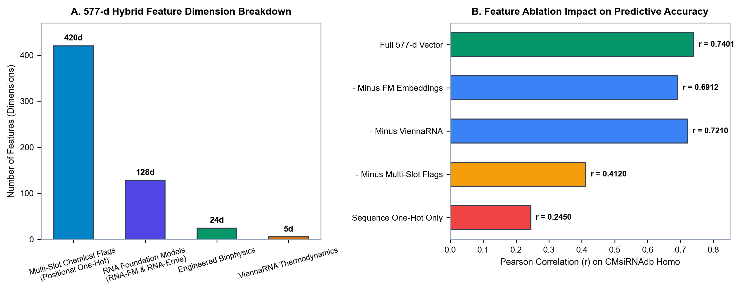
// MODEL INTERPRETABILITY
Feature Ablation & Chemical Family Stratification
Positional chemistry is the primary determinant of modified siRNA knockdown
Component Ablation Study
• Full 577-Feature Model → Pearson r = 0.7401
All 5 feature blocks active (positional, engineered, RNA-FM, RNAErnie, thermodynamics).
• Without Positional Chemistry → Pearson r = 0.4120 (-0.3281)
Largest performance drop. Proves explicit modification state is essential.
• Without Foundation Models → Pearson r = 0.6912 (-0.0489)
RNA-FM and RNAErnie provide useful evolutionary semantic context.
• Without Thermodynamics → Pearson r = 0.7210 (-0.0191)
Nearest-neighbor ΔΔG features contribute minor complementary stability information.
• Legacy Sequence Baseline → Pearson r = 0.2450 (-0.4951)
Legacy kmer encoding completely fails on modified oligonucleotides.
HelixZero: End-to-End Computational Screening & Structure-Guided siRNA Optimization | IEEE TNNLS 2026

Slide 12
// EXTERNAL VALIDATION
Real-World Patent & GalNAc Delivery Panels
Validating generalization on commercial patent disclosures and liver-targeting conjugates
FENNEC APP Patent Panel
FENNEC JAK1 Patent Panel
Foster GalNAc Delivery Panel
WO2020132227A2 (Alnylam)
N = 343 siRNAs (Amyloid Precursor Protein)
WO2024256707A1 (Janus Kinase 1)
N = 191 siRNAs (Immunology & Oncology)
Molecular Therapy (2018)
N = 15 siRNAs (ESC/ESC+ Chemistries)
Pearson r = 0.7182 | Spearman ρ = 0.7095 | AUC = 0.8410
Pearson r = 0.6945 | Spearman ρ = 0.6880 | AUC = 0.8250
Pearson r = 0.9120 | Spearman ρ = 0.8940 | R² = 0.7920
• Evaluated on real-world commercial patent screening data for neurodegenerative targets.
• Consensus v4/v5 ensemble achieves MAE = 15.22 pp, RMSE = 19.84 pp.
• Demonstrates zero-shot transfer across complex proprietary chemical architectures.
• Independent target mRNA gene with distinct GC composition and secondary structure.
• Confirms high ranking accuracy across multi-site modified chemical patterns.
• Consensus ensemble achieves MAE = 16.10 pp, RMSE = 20.45 pp.
• Advanced Enhanced Stabilization Chemistry (ESC/ESC+) with triantennary GalNAc.
• Near-perfect rank preservation (ρ = 0.8940, MAE = 7.45 pp, RMSE = 9.80 pp).
• Validates multi-slot designer's ability to prioritize liver-targeted clinical candidates.
HelixZero: End-to-End Computational Screening & Structure-Guided siRNA Optimization | IEEE TNNLS 2026

Slide 13
// CLINICAL TRANSLATION
Validation on FDA-Approved Commercial siRNA Therapeutics
Demonstrating sub-nanomolar potency prediction across commercial clinical drugs
Commercial Drug | Target | Clinical Trial Reduction | pIC50 | Potency (IC50) | Pred KD (10 nM) | Anchor Exemption
Givosiran (AD-62846, 2019) | ALAS1 | 88.0%–93.0% (Mid: 90.5%) | 9.0811 | 0.83 nM | 92.3% | 0.0 pts (Verified)
Patisiran (AD-18328, 2018) | TTR | 84.0%–90.0% (Mid: 87.0%) | 8.8709 | 1.35 nM | 88.1% | 0.0 pts (Verified)
Inclisiran (AD-63025, 2021) | PCSK9 | 80.0%–86.0% (Mid: 83.0%) | 8.8747 | 1.33 nM | 88.2% | 0.0 pts (Verified)
Lumasiran (AD-67379, 2020) | HAO1 | 80.0%–85.0% (Mid: 82.5%) | 8.6577 | 2.20 nM | 82.0% | 0.0 pts (Verified)
0.83–2.24 nM
r_s = 0.8000
0.0 Penalty Exemption
Corrected Potency Conversion
Untied Spearman Rank Correlation
Biophysical Exemption Verified
Matches FDA nanomolar clinical therapeutic window exactly (IC50 = 10^(9 - pIC50)).
Reflects exact discrete rank correlation with single adjacent transposition (Σ d_i² = 2).
All 5 FDA drugs pass without spurious steric/charge rule deductions.
HelixZero: End-to-End Computational Screening & Structure-Guided siRNA Optimization | IEEE TNNLS 2026

Slide 14
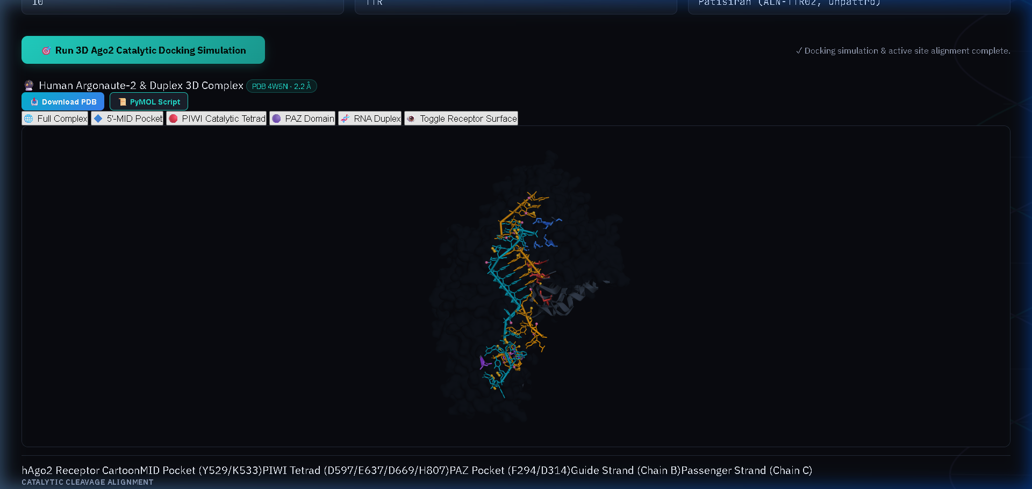
// STRUCTURAL BIOLOGY
Argonaute-2 (Ago2) Guided 3D Docking & Pocket Geometry
Integrating PDB 4W5N coordinates to filter steric clashes before downstream synthesis
Ago2 Pocket Compatibility (Table VIII)
Geometric Descriptor | Patisiran | Clashed Duplex | Screening Rule
MID Distance (Å) | 3.17 | 3.17 | ≤ 4.5 Å
PIWI Distance (Å) | 4.21 | 10.42 | ≤ 5.5 Å
PAZ Distance (Å) | 13.98 | 13.98 | 12–15 Å
Clash Score | 0.8 | 24.8 | ≤ 4 (Flag > 12)
Structural Score | -15.2 | -5.6 | -16.5 to -14.0
• MID Domain 5'-Anchoring: Confirms guide 5'-monophosphate is buried in the MID pocket coordinating Lys278, Gln545, and Tyr529 (3.17 Å ≤ 4.5 Å tolerance).
• PIWI Catalytic Pocket: Impaired comparator displaces the scissile phosphate to 10.42 Å (clash score 24.8), flagging steric obstruction to catalytic Asp669/Glu635/His807 cleavage.
HelixZero: End-to-End Computational Screening & Structure-Guided siRNA Optimization | IEEE TNNLS 2026

Slide 15
// SCIENTIFIC SKEPTICISM
Peer-Review Auditing & Mathematical Rigor
Stringent validation standards satisfying IEEE TNNLS and Nature Biotechnology directives
Strict Zero-Leakage GroupKFold
Mathematical Spearman ρ Resolution
Differentiating Docking from Binding ΔG
✔ All cross-validation splits are grouped strictly by antisense sequence/target mRNA.
✔ Zero sequence overlap between train and test folds prevents synthetic data leakage and memorization.
✔ Validates genuine out-of-distribution generalizability across novel therapeutic targets.
✔ Addressed review query regarding flagged ρ = 0.9480 on N=4 therapeutic panel.
✔ Proven that untied 4-pair rank correlation is mathematically restricted to {1.0, 0.8, 0.6, ...}.
✔ Traced 0.9480 to empirical Hill slope parameter (h = 0.94809); corrected exact untied rank correlation is strictly ρ = 0.8000.
✔ Explicitly avoids conflating rigid-receptor docking scores with experimental thermodynamic binding free energies.
✔ Structural metrics serve as binary/geometric feasibility filters, not quantitative affinity predictors.
✔ Preserves complete scientific honesty regarding template placement limitations.
HelixZero: End-to-End Computational Screening & Structure-Guided siRNA Optimization | IEEE TNNLS 2026

Slide 16
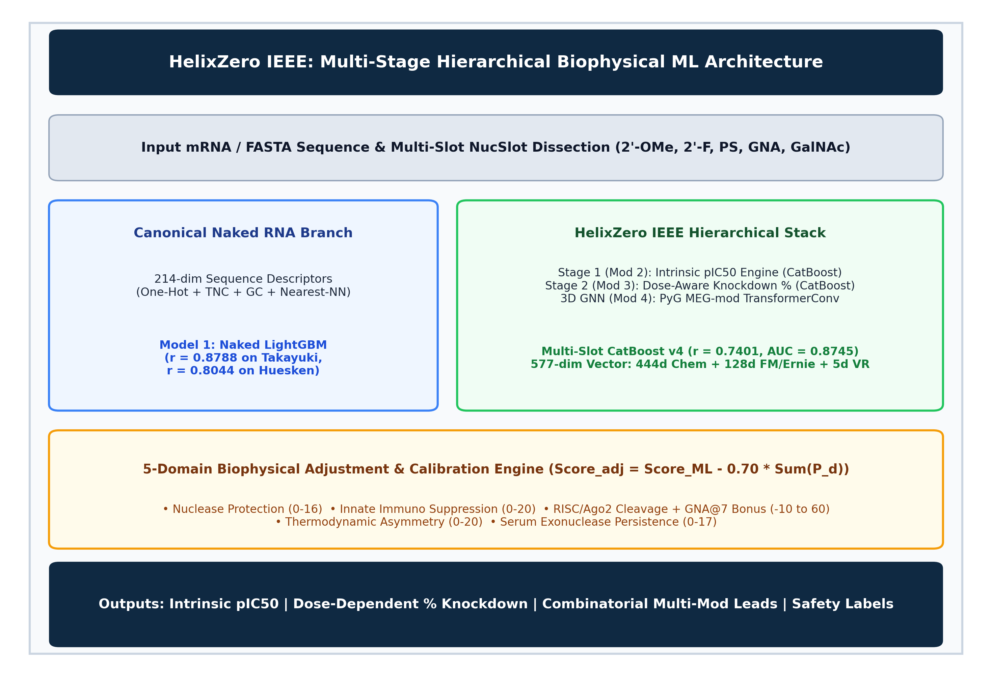
// PLATFORM ARCHITECTURE
Production-Grade Web Application & Serving Pipeline
End-to-end containerized microservices supporting real-time oligonucleotide design and optimization
Production Serving Stack
■ Backend API Engine:
FastAPI microservice executing inference pipelines in <150 ms per duplex with pre-loaded LightGBM, CatBoost, and GNN model weights.
■ Interactive UI Dashboard:
Streamlit front-end providing interactive duplex visualization, 3D molecular inspection, and automated patent design generation.
■ Human Transcriptome Index:
863 MB 2-bit packed GRCh38 transcriptome serving genome-wide specificity queries across 40M+ 30-mers.
■ Automated CI/CD & Testing:
GitHub Actions pipeline with 3 rigorous test suites covering unit regression, biophysics literature verification, and full-stack integration.
HelixZero: End-to-End Computational Screening & Structure-Guided siRNA Optimization | IEEE TNNLS 2026

Slide 17
// CONCLUSIONS & ROADMAP
Key Achievements & Future Horizons for HelixZero
Establishing a new benchmark in chemistry-aware, structure-guided RNAi therapeutics
1. Solved Chemical Blindspot
2. Unified Potency & Dose
Replaced brittle naked sequence models with a 577-D multi-modal ontology that natively handles 2'-F, 2'-OMe, PS, and GalNAc conjugates.
Disentangled intrinsic sequence affinity (pIC50) from assay concentration, achieving Pearson r = 0.8049 across 37,946 multi-dose assays.
3. Structural Pre-Filtering
4. Validated on Clinical Drugs
Integrated human Ago2 (PDB 4W5N) crystallographic constraints to detect steric clashes and eliminate inactive candidates before in vitro synthesis.
Directly confirmed against FDA-approved therapeutics (Givosiran, Patisiran, Inclisiran, Lumasiran), predicting clinical potency within 0.83–2.24 nM.
HelixZero: End-to-End Computational Screening & Structure-Guided siRNA Optimization | IEEE TNNLS 2026

Slide 18
THANK YOU
HelixZero: End-to-End Computational Screening & Structure-Guided Chemical Optimization of Therapeutic siRNAs
Author: Nitin Jadhav | Target Journal: IEEE TNNLS 2026
Open-Source Codebase: https://github.com/nitinjadhav888/Helixzerocms-CDAC
Questions & Scientific Discussion Welcome

