Slide 1
Clustering Assignment
By Nitin Jayan

Slide 2
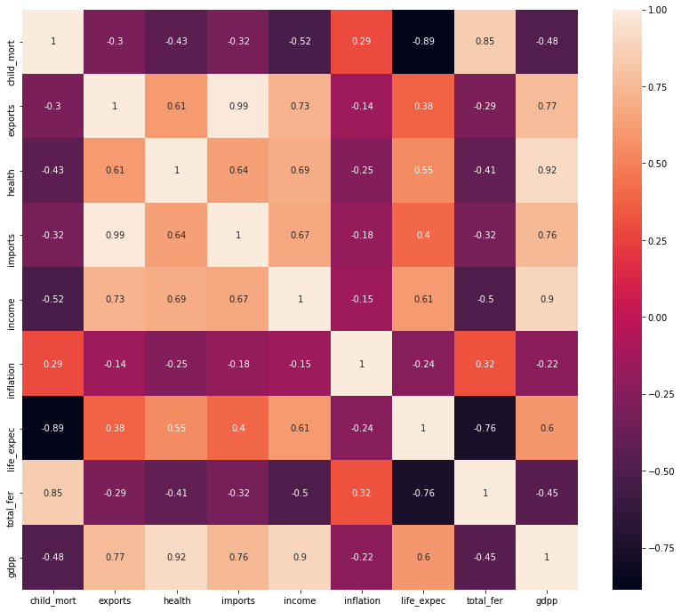
Correlation Heatmap
child_mort negatively correlated with gdpp, income, health, imports, exports and life_expec.
income shows strong positive correlation to gdpp, exports, imports and health.
Negative correlation between total_fer and life_expec.

Slide 3
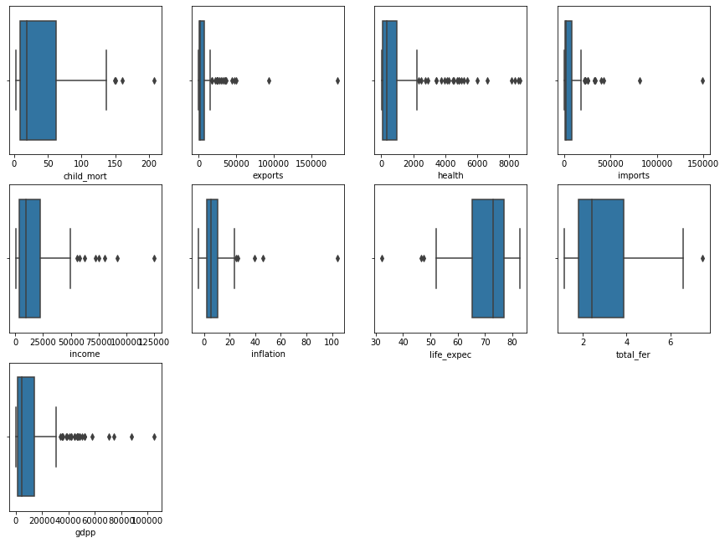
Outlier Visualization
For child_mort, total_fer and inflation, leaving the upper range outliers as is, since it could indicate stronger need for aid.
For other columns, leaving lower range outliers as is, but the upper range outliers need to be treated.

Slide 4
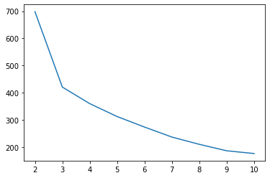
K_Means - Elbow Curve
We select the number of clusters as 3 according to the curve.
Also makes intuitive sense as one can categorize countries into underdeveloped, developing and developed nations.

Slide 5
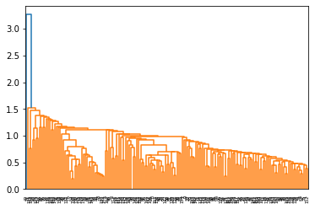
Hierarchical Clustering (Single Linkage)
It is evident from the single linkage dendrogram that this does not suit our needs.
We may use complete linkage dendrogram for the purposes of our data set.

Slide 6
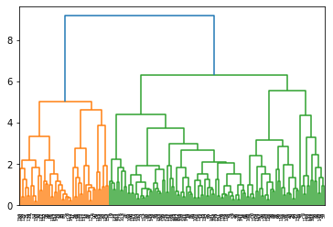
Hierarchical Clustering (Complete Linkage)
Appropriate for deciding on the number of cluster by cutting the dendrogram at threshold value.
Give us 3 clusters. cut at 3 branches which will give us 3 clusters

Slide 7
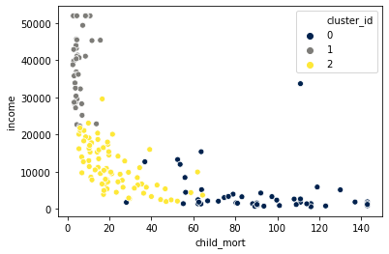
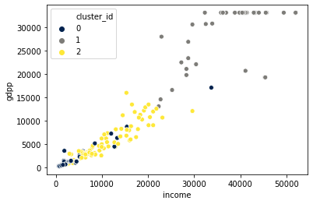
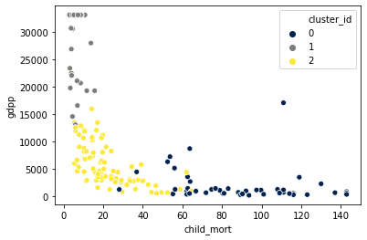
Scatter Plots

Slide 8
Scatter Plots - Inferences
cluster_id = 0 has a combination of low income and low gdpp.
cluster_id = 0 has high child mortality in combination with a low gdpp.
cluster_id = 0 has high child mortality in combination with a low income.

Slide 9
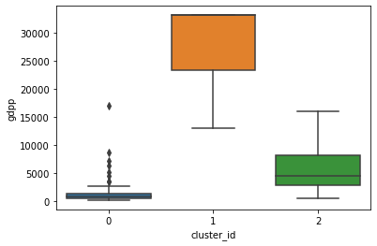
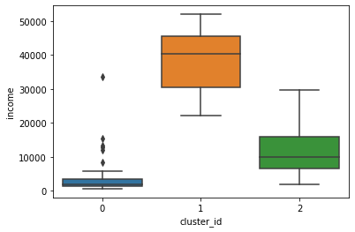
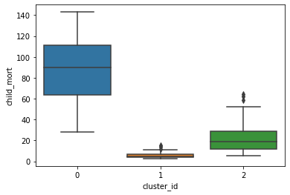
Box Plots ( K-Means Clustering)
Reinforcing our findings from the scatter plots, countries in cluster_id = 0 are most in need of aid.

Slide 10
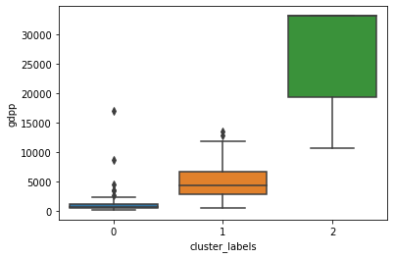
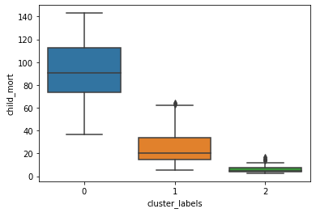
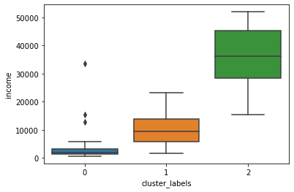
Box Plots (Hierarchical Clustering)
Countries in cluster_label = 0 has the most need for aid according to the box plots.

Slide 11
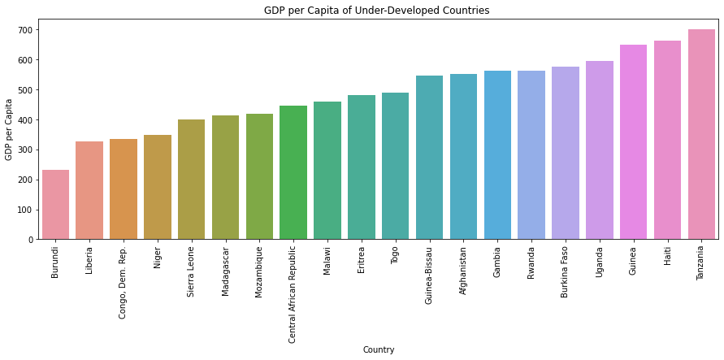
Bottom 20 - GDPP

Slide 12
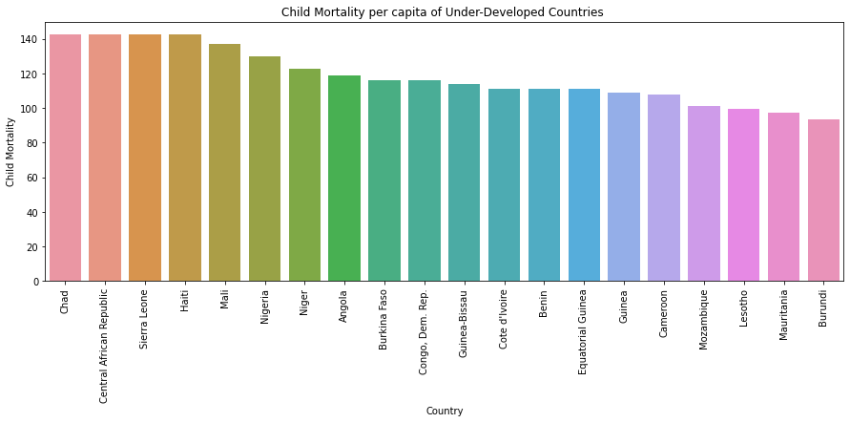
Top 20 – Child Mortality

Slide 13
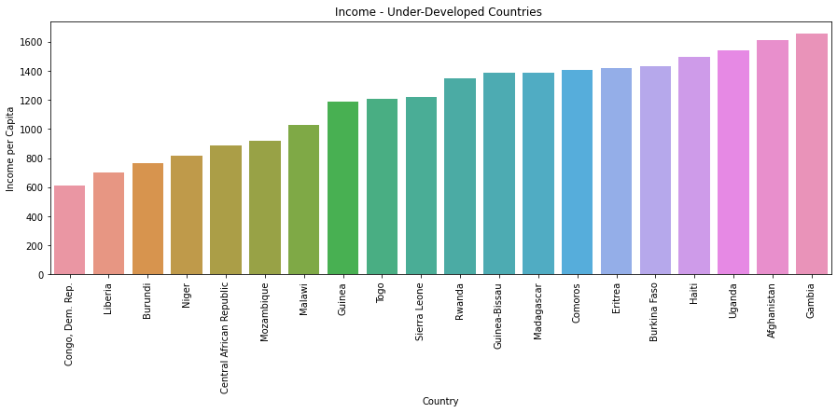
Bottom 20 - Income

Slide 14
Conclusions
K-Means and Hierarchical clustering gave roughly the same number of countries that need aid – 48 vs 43 respectively.
Based on multiple bad indicators, the countries that are most in need of aid are
Congo Dem. Rep
Central African Republic
Sierra Leone
Guinea – Bissau
Burkina Faso
Niger
Burundi
Mozambique
Haiti
Eritrea

Slide 15
Thank You

