Slide 1
Resilient Distributed Datasets ( RDDs )

Slide 2
Agenda
What is Resilient Distributed Datasets ( RDDs ).
What is Directed Acyclic Graph ( DAG ).
Types of Operations in RDDs.
What is Transformation Functions.
What is Action Functions.
Business Overview.
Apply Transformation and Action functions on RDDs.

Slide 3
Resilient Distributed Datasets
Resilient – Fault Tolerance and Recomputation.
Distributed – Data distribute on multiple nodes
Datasets – text file like csv, json, html etc.
In memory computation
Batch/offline data processing
10 TB data process in Hadoop take time 100 min
10 TB data process in spark in to RAM take time 1 min
10TB data process in spark on node take time 10 min

Slide 4
Distribution Of Data
Node
Data
10-TB
100 Mb/S
1000 Sec

Slide 5
Node-1
Data distributed in 2 TB
Node-2
Node-3
Data
10-TB
100 Mb/S
Node-4
Take 200 Sec
Each node
Node-5

Slide 6
Work flow of Spark
RDD
RDD
Spark Engine
Input Data
Output
RDD
RDD

Slide 7
Directed Acyclic Graph
DAG is a graph denoting the sequence of operations that are being performed on the target RDD.
DAG is set of vertices and edges.
Vertices represents RDDs
Edges represents operations which are apply on RDDs

Slide 8
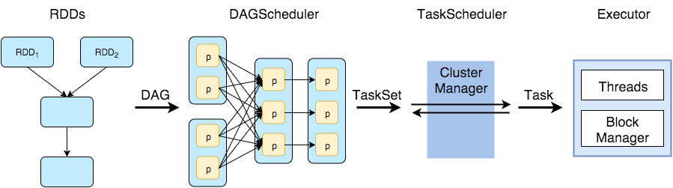
How DAG works
What is DAG Scheduler
What is Task Scheduler
Executor
Input Data
Stage-1
Stage-2
Stage-3
Platform to run Spark
Send Result to Driver

Slide 9
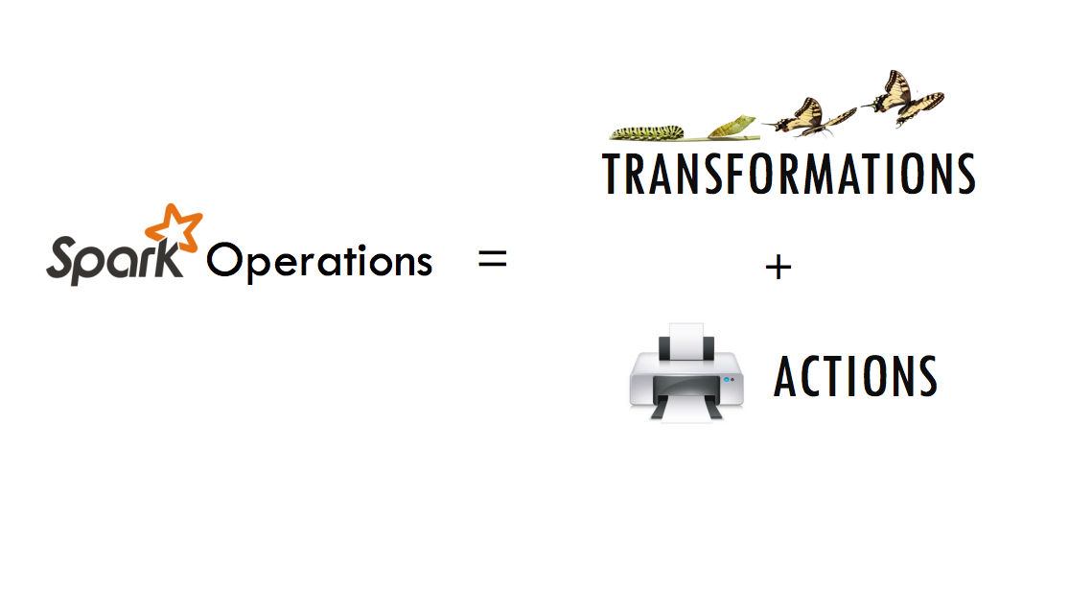
Types of Operations in RDDs.

Slide 10
What do you mean by Transformation
100000 => 10^5
300 sec => 300/60 = 5 min
Float 5.0 => int 5
STRING => string
X = [1,2,3,4,5]
X1 = [1,3,5]

Slide 11
Transformation Functions
Transformation is applied on existing RDD.
When you apply a transformation on RDD create a new RDD from the existing RDD.
Every time we are applying transformation then it will create a new RDD.
We use transformation to transform the data as per requirements.
Transformation applies on RDD as well as DataFrame both.
Transformation function like – map, filter, flat map etc.
Two types of the transformation function.
Wide Transformation. – Need shuffling data across node – groupby, join, etc.
Narrow Transformation. – No need of shuffling – map, flatmap , filter etc.

Slide 12
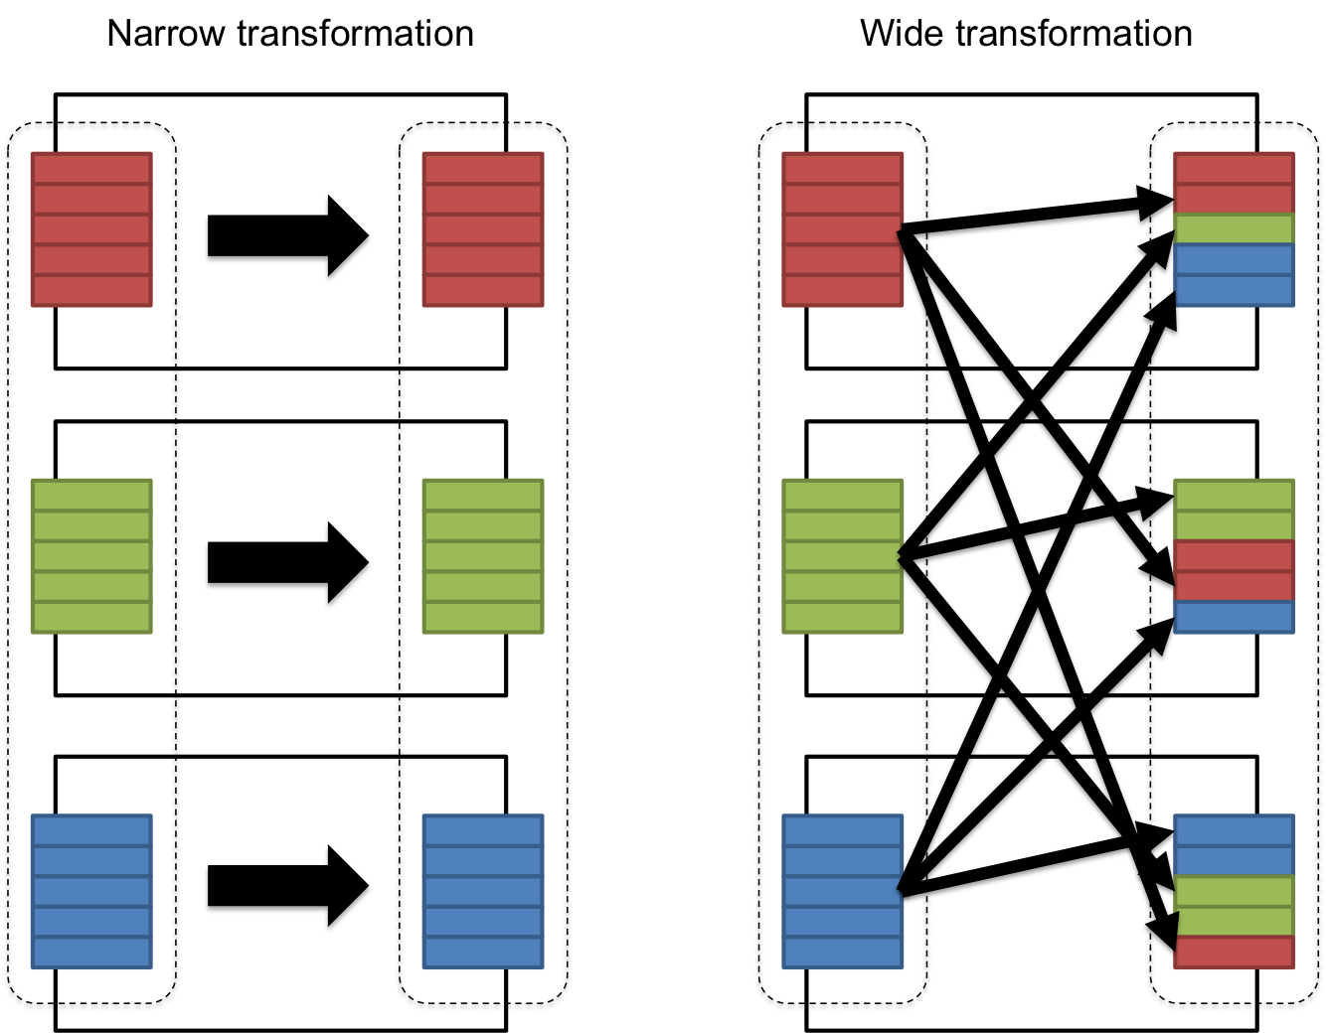

Slide 13
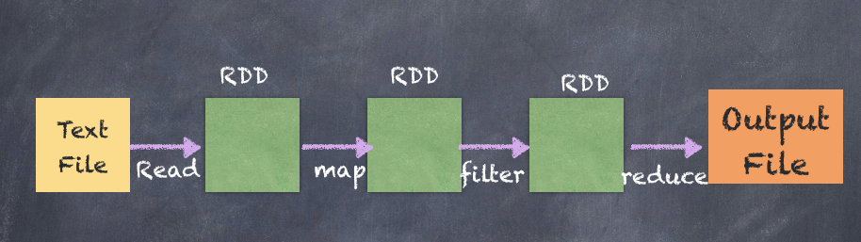
Transformation Work Flow

Slide 14
What do you mean by Action
Print
Result / Output
Y = [1,2,3,4]
Sum of Y is 10

Slide 15
Action Functions
Action will not create RDD like Transformation.
Action apply on transformed RDD.
Action return all entire RDD content.
Action function must be apply when you want to get result.
Action apply on RDD and DataFrame both.
Action function like – count , collect , sum , show etc

Slide 16
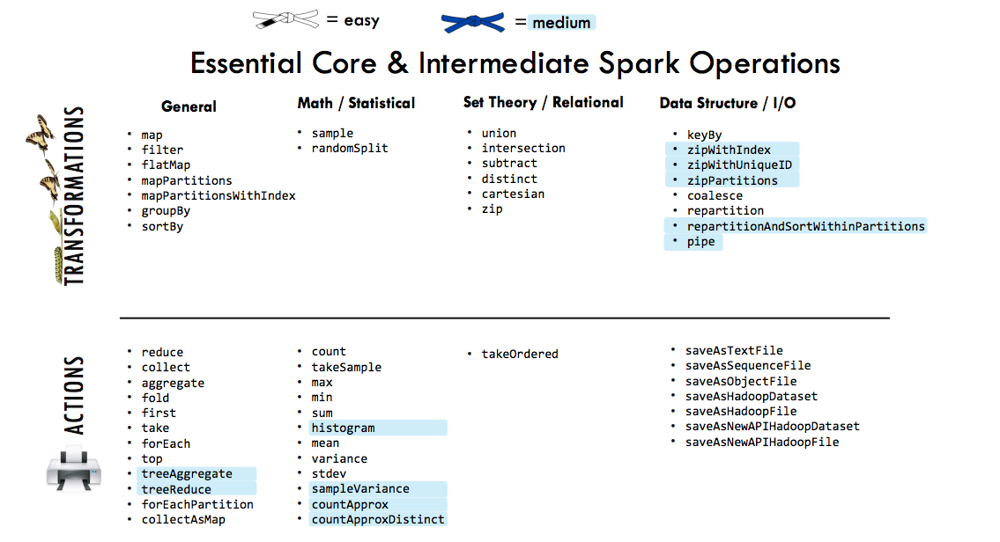

Slide 17
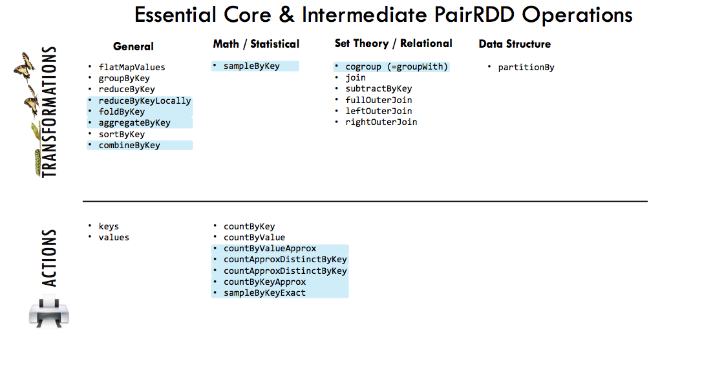

Slide 18

Business Overview

Slide 19

OVERVIEW OF AIRLINE

Slide 20
The airline industry encompasses a wide range of businesses, called airlines, which offer air transport services for paying customers or business partners.
The 3 different types of Airlines
Scheduled airline.
Charter airline.
Budget airline
Airlines are classified by their routes and by their schedules. The two major classifications are domestic airlines and international airlines. Domestic airlines provide services within a country. International airlines, on the other hand, operate both within a nation and between two or more nations.

Slide 21
ORIGIN AND DEST:
As its name suggests, Origin & Destination is the starting point (origin airport) and end point (destination airport) of a traveler's directional journey. For instance, the origin is LHR and the destination is LAX.
However, this doesn’t necessarily mean this is a non-stop flight. The passenger might have to change flights at JFK, for example, before getting to her/his destination of LAX.
LAX: Los Angeles International Airport
JFK: John F. Kennedy International Airport, More than 70 airlines operate out of JFK.
LHR: Heathrow International Airport (LHR) London.

Slide 22
CRS Departure Time And Departure Time:
A flight is counted as "on time" if it operated less than 15 minutes later the scheduled time shown in the carriers' Computerized Reservations Systems (CRS). And Departure performance is based on departure from the gate.
CRS Arrival Time And Arrival time:
A flight is counted as "on time" if it operated less than 15 minutes later the scheduled time shown in the carriers' Computerized Reservations Systems (CRS). And Arrival time is when the plane pulls up to the gate.

Slide 23
Arrival Delay:
A flight delay is when an airline flight takes off and/or lands later than its scheduled time. ... When a flight is delayed, the FAA (The Federal Aviation Administration) allocates slots for takeoffs and landings based on which flight is scheduled first.
Departure Delay:
A flight delay is when an airline flight takes off and/or lands later than its scheduled time. The Federal Aviation Administration (FAA) considers a flight to be delayed when it is 15 minutes later than its scheduled time.
Carrier Delay:
Air Carrier: The cause of the cancellation or delay was due to circumstances within the airline's control (e.g. maintenance or crew problems, aircraft cleaning, baggage loading, fueling, etc.). ... Late-arriving aircraft: A previous flight with same aircraft arrived late, causing the present flight to depart late.

Slide 24
Weather Delay:
Inclement weather, including thunderstorms, snowstorms, wind shear, icing and fog, creates potentially hazardous conditions in the nation's airspace system. These conditions are, by far, the largest cause of flight delays.
If passengers are unable to fly on time due to severe weather conditions, thick fog or an ash cloud, they are not entitled to compensation. This is because weather conditions are considered as an “extraordinary circumstance”.
NAS Delay:
Delays or cancellations coded "NAS" are the type of weather delays that could be reduced with corrective action by the airports or the Federal Aviation Administration.

Slide 25
Distance:
Route category lengths tend to define short-haul routes as being shorter than 600–800 nmi (1,100–1,500 km), long-haul as being longer than 2,200–2,600 nmi (4,100–4,800 km), and medium-haul as being in-between.
The term air mile, also known as a nautical mile, refers to the distance between two locations measured by traveling from one to the other over water or in the air.
Security Delay:
Security delay is caused by evacuation of a terminal or concourse, re-boarding of aircraft because of security breach, inoperative screening equipment and/or long lines in excess of 29 minutes at screening areas.

Slide 26
Apply Transformation and Action functions on RDDs.
How to create RDD
How to apply transformation function on RDD.
How to apply Action function on RDD

