Slide 1
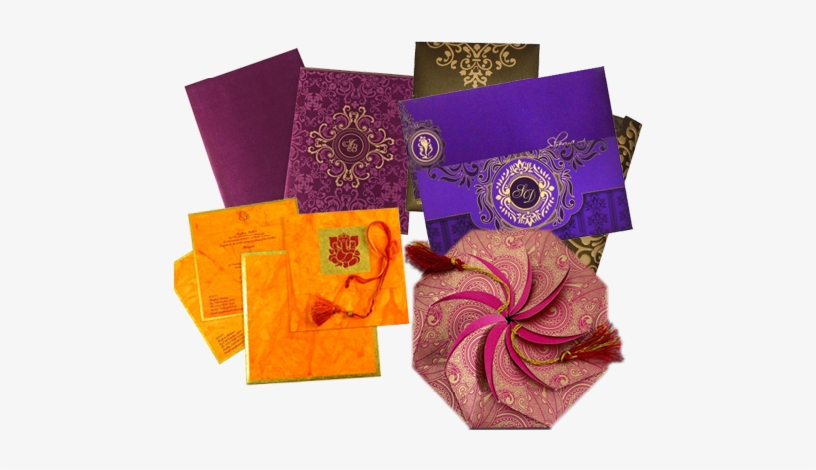
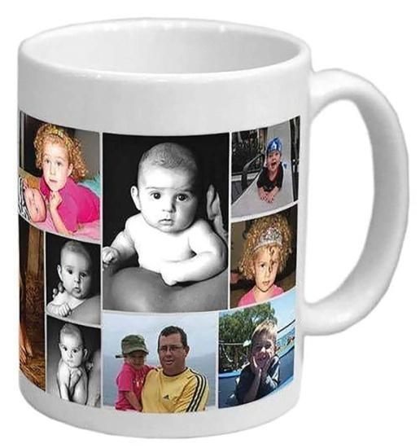
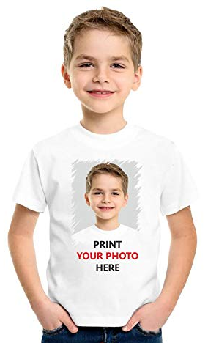
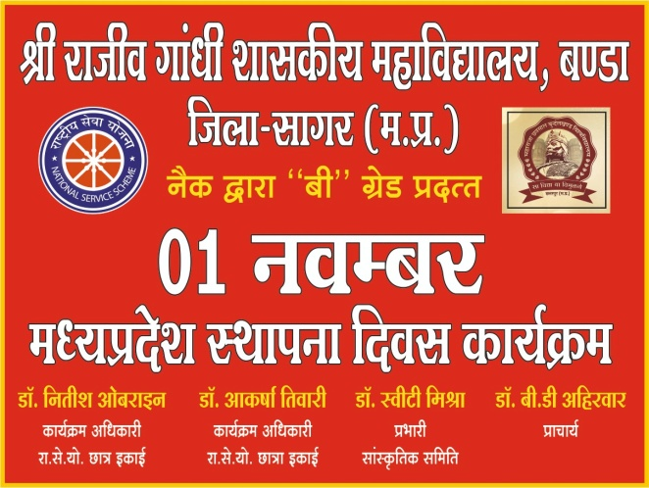
Project Report on
Online Printing Order

Slide 2
In offline mode
Designs limited
Printing Press Visiting Problem
Interested in online

Slide 3
Marriage Card Printing
Customer
Website
Details
Delivery

Slide 4

Online Printing Order
Search Here
Categories
Marriage Card
Visiting Card
Banner
T-Shirt Print
Mug Print
Key Ring
Frame Print
Cushion / Cap
Other

Slide 5





Online Printing Order
Search Here
Marriage Card
Hinduism
Christianism
Jainism
Muslism

Slide 6
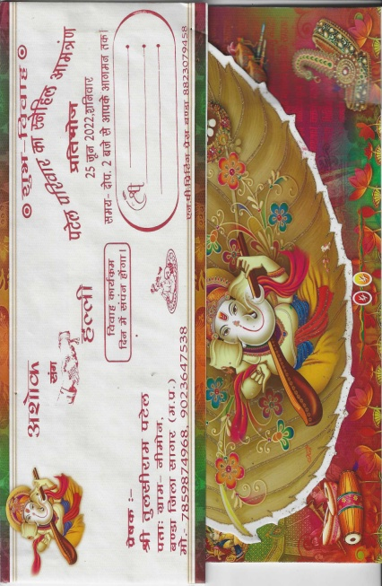
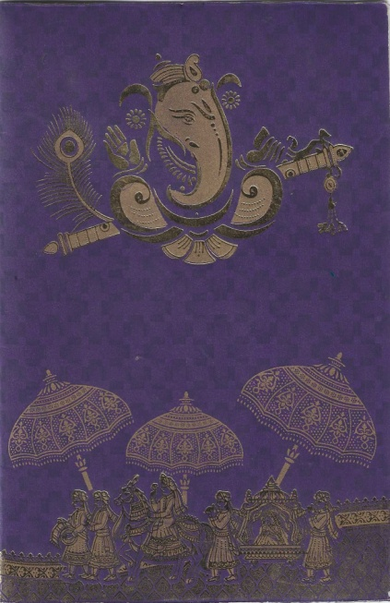
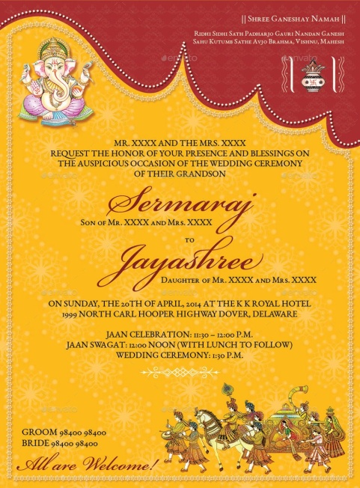
Online Printing Order
Search Here
Marriage Card
Hinduism
Select Language
Rs 15
Rs 10
Rs 25
Rs 30

Slide 7
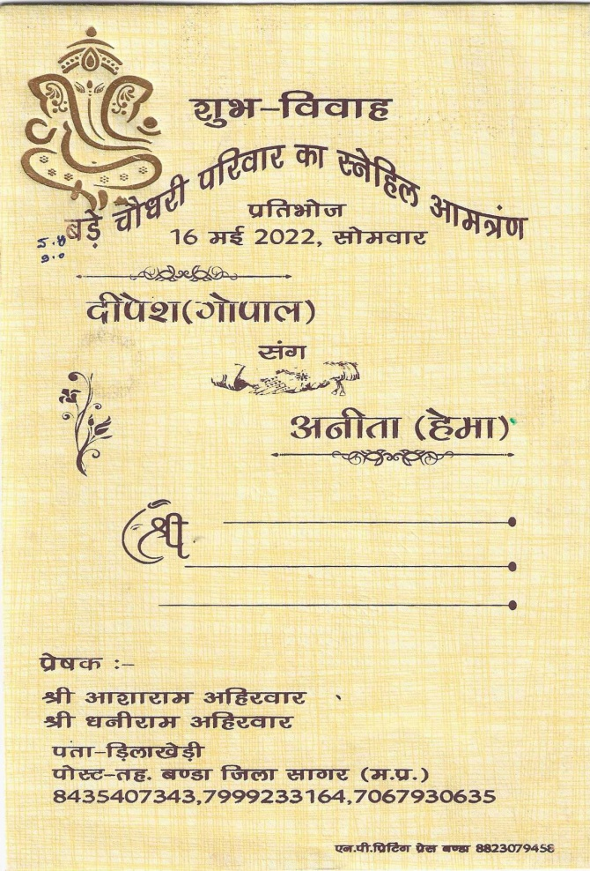

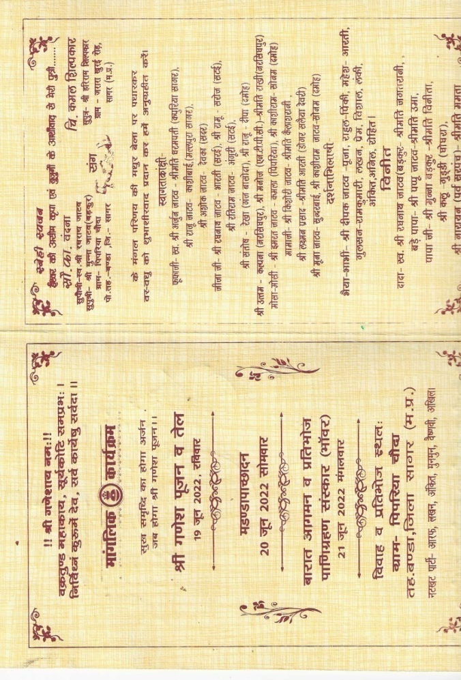
Online Printing Order
Search Here
Order Now

Slide 8
Online Printing Order
Search Here
LOGIN
New User
SIGN UP

Slide 9

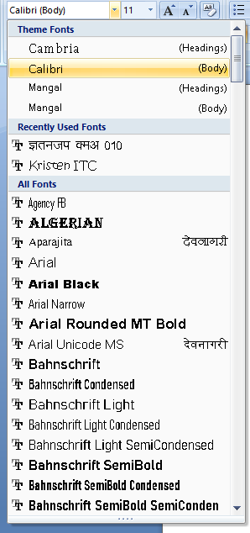
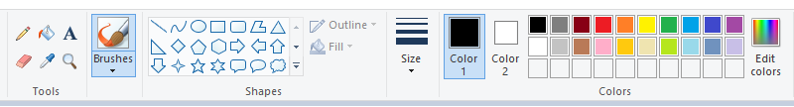
Online Printing Order
Search Here
Click
Edit
शुभ - विवाह

Slide 10
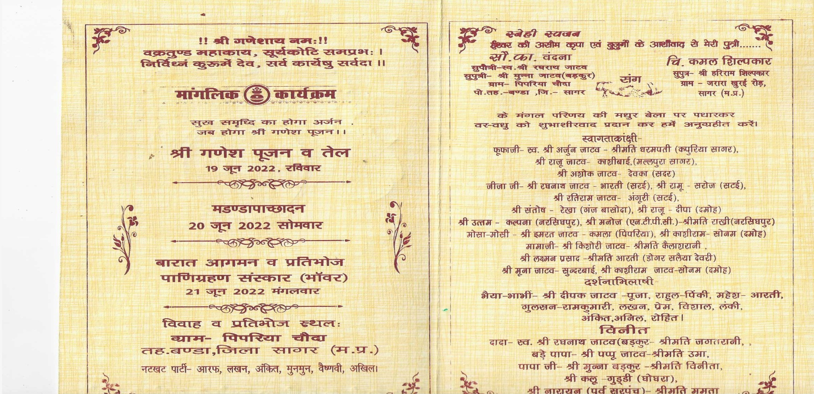
Online Printing Order
Search Here
Click
Edit
19 जून 2022
SAVE

Slide 11
Online Printing Order
Search Here
Order Details
CARD = 100
PRICE ( RS ) = 1500
CARD = 200
PRICE ( RS ) = 2500
Quantity

Slide 12
Online Printing Order
Delivery Details
Name
Father Name
City / Village
Full Address
State
District
Block
SAVE

Slide 13
We Will Work On
Marriage Card Printing
T-Shirts Printing
Mug Printing
Visiting Card Printing
Banner/Flex Printing
Key Ring Printing e.t.c.

Slide 14
Startup Process
Website Design
Offset Machine
Raw Material
Marketing

Slide 15
THANK YOU

