Slide 1



Slide 2
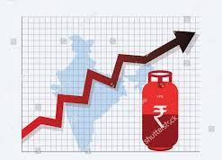
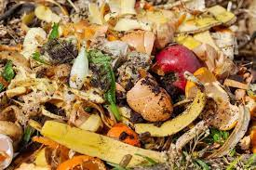
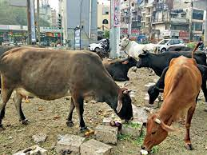
PROBLEM
To minimize the dependency on foreign countries for LPG Gas and reduce the use of LPG Gas.
LPG is limited in the environment to use.
LPG is harmful to the environment it is a type of pollutant gas.
LPG is heavy or dense gas.
LPG prize is fluctuate due to various factors. Such as global oil and gas market changes, Supply and demand dynamics, and geopolitical events.
As we all know the price of LPG Gas is so high. The dependency on foreign countries for LPG Gas. LPG is limited in the environment to use. LPG is harmful to the environment it is a type of pollutant gas.
LPG is a heavy or dense gas and dangerous gas. LPG price fluctuates due to various factors. Such as global oil and gas market changes, Supply and demand dynamics, and geopolitical events. There is less use of organic waste.
We see too many cows in cities they are roaming because the Goshala financial strength is weak.

Slide 3
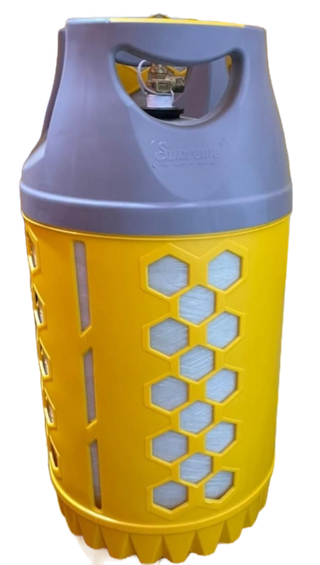
SOLUTION
CBG Gas for cooking purposes.
We are developing technology to store biogas in cooking gas cylinders for easy transportation and easy use in cooking in rural as well as urban areas.
It is affordable gas.
we help Goshalas through buy cow dung through this cows are roaming in cities. we will use organic waste.
Use of waste Vegetable from homes and Vegetable Market.

Slide 4
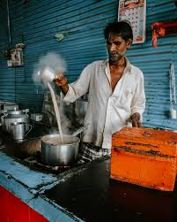
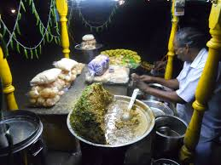

CUSTOMERS
Those who are cooking food such as Homes, Restaurants, Cafes, Dabas, Chat stalls, and many more.

Slide 5

CUSTOMERS ACCESS
Customers can access our Francies or Our Agencies.
To Access our product.
Our Distribution of cylinders is small as LPG Gas companies.

Slide 6









Competition in Market
Our competitors such as Think Gas, GAIL (India) Ltd, Gujarat State Petronet Ltd, Indraprastha Gas Ltd, Mahanagar Gas Ltd, and Adani Total Gas Ltd, These companies supply gas through the pipeline.
Indian Gas, HP Gas, Bharat Gas. These companies supply gas through cylinders.

Slide 7
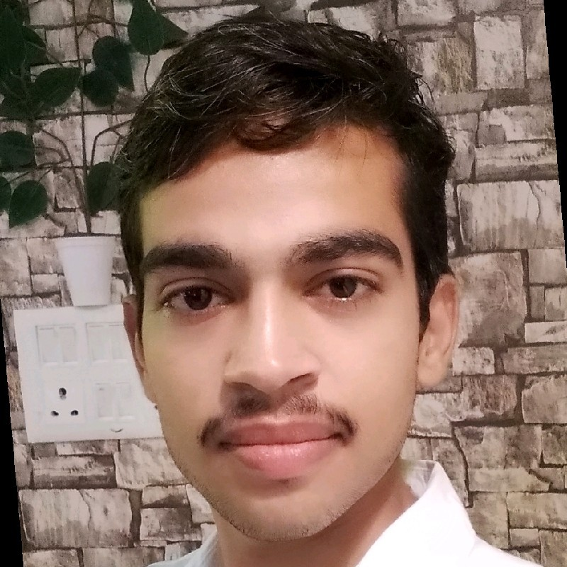
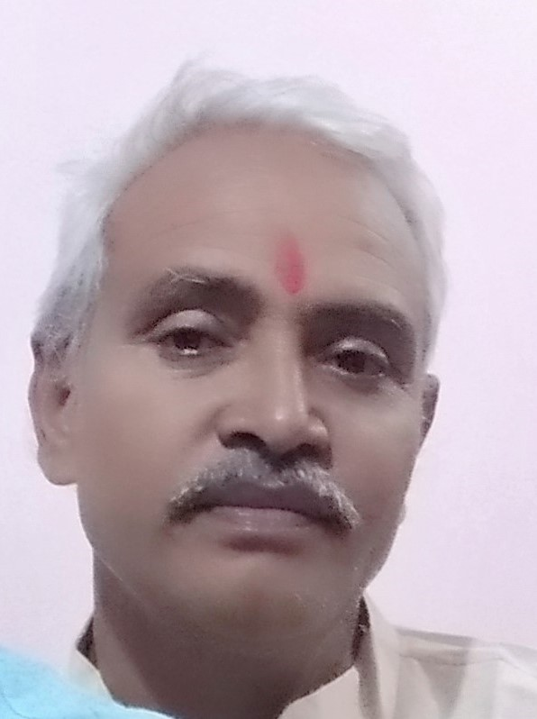
Core Team
ABHAY P S BUNDELA
(CEO)
BTECH(Electronic and Communication)
1 Year Experience in Business
SHIVPAL SINGH BUNDELA
(CFO)
Post Graduate (commerce)
15 Year Experience in Accounts

Slide 8

Immediate Help(FUNDING)
For setting up the plant.
For Machinery.
For Transportation of Raw Materials, Distribution of Products.
APPOX. 60 Lakh Rupees.

Slide 9
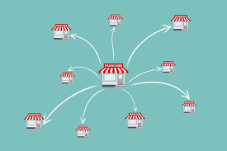
SALES & MARKETING
By providing franchises in every city.
Marketing through online and offline

Slide 10
MVP STAGE

Slide 11
Contact Details
ABHAY P S BUNDELA
(CEO)
Email. bungreenabhay@gmail.com
Mobile No. 9406601037

Slide 12
Thank you

