Slide 1

Pandit Bulao
Online Pandit Booking Platform For Your Puja’s

Slide 2
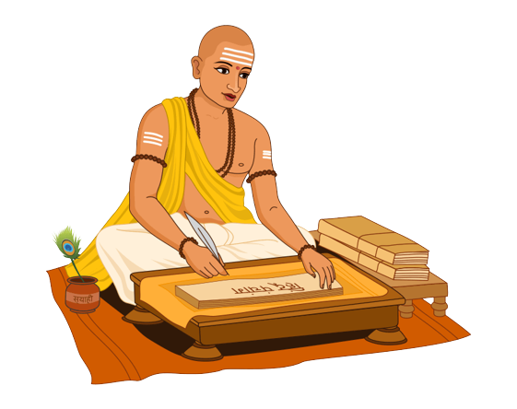
Who We Are ?
Online Pandit’s Booking Platform
Pandit Bulao is the online Puja’s / Pandit’s booking platform.
Pandit Bulao show the many puja’s with their descriptions, so people can check and book the online services.
Pandit Bulao is a platform where people can find the pandit according to Puja, Hawan, Katha, Bhajan, Jagran, and other religious work.
Pandit Bulao provides experience Pandit’s and also according to people budget.
Pandit Bulao also offer puja samagri and also provide knowledge about Puja’s and connect people with the God
Pandit Bulao also provide consultancy services regarding religious work from the pandit’s.
Pandit Bulao will also provides Astro services in future.

Slide 3

Problem
People are facing problem to find Pandit’s for their religious work.
People's are not aware with the Puja’s and about the process of the Puja.
People don’t able to find experience pandit’s .
There are some fake pandit’s also who have not any knowledge and they do puja’s

Slide 4
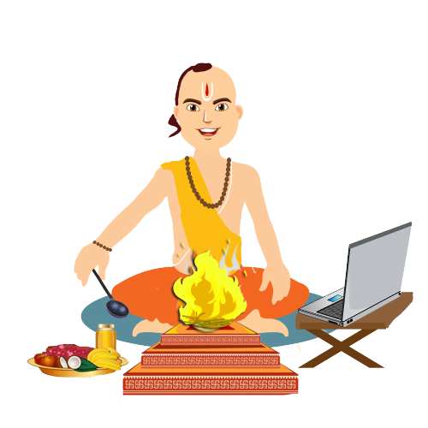
Solutions
Pandit Bulao is an online puja booking platform where you find the verified pandit’s .
People can book the Puja’s according to their need and according to the Pandit’s experience.
In this platform people can book the Pandit’s, book the Samagri of Puja, and also can book the consultancy from the Pandit.
We provide updated pandit’s, personal assistant for the both sides and also provide the 24*7 customer support.

Slide 5

Business Model
Pandit
Users
Register on Website
Search Pandit/ Puja and Book
Add Puja’s and
Services
Register on Website
Pandit Bulao
Make their
profile & get bookings
Contact & Fix Appointment
And Pay For Puja
Website Earn
Puja Percentage Fees
Additional Services
Advertisements

Slide 6


Roadmap Pandit Bulao
Our future plan for Pandit Bulao.
Pandit’s & Puja’s Booking
2
Will add Astrology
4
Will add dontation NGO
People can book Pandit’s and Puja’s .
People can consult with the astrologer
People can give the DAN to the pandits according to their wish
1
3
5
Will add Pujan Samgri
Will add online religious Books
People can book and order the puja samgri also
People can buy the books, Panchangs and other things.

Slide 7
Our Process is very easy
Search and Book
02
Search pandit & puja according to the need.
Check the experience and background
People can check the background of the Pandits.
01
03
Pay & Enjoy
People can pay and complete your puja.

Slide 8
Thank you!

