Slide 1


FBG
Innovation in BGs
Toys are children's words and play Is their language.
- Garry L. Landreth
(Author, Founder- Play Therapy)

Slide 2


Meet our team
Aditya Gupta
Faizaan Qureshi
JEC Jabalpur; Ui/Ux
IIT Bombay; Full Stack Developer

Slide 3
Table of contents
Problems
Our product
01
02
Competition
Innovation
03
04
Limited Choices, Lack Of Innovation, Market Gap
Toys, Board Games, Educational Toys, etc
Funskool, Mattle, Hasbro, etc.
AI, VR, AR, Designing and Branding

Slide 4
253,000,000
India has the largest adolescent population in the world, 253 million, and every fifth person is between 10 to 19 years.
Source: unicef.org

Slide 5
SWOT analysis
Strength
Weakness
Opportunity
Threat
S
W
Market Research, Innovation
Manufacturing and initial funding
O
T
Market Gap, Population and Need
Competitors like Funskool, Hasbro, Mattel, etc

Slide 6
Market size
Competitive Landscape:
Some of the leading key players in Indian toys industry are:
Funskool
Lego
Mattel
Hasbro
The Indian toys market reached a value of US$ 1.35 Billion in 2021. Looking forward, IMARC Group expects the market to reach US$ 2.73 Billion by 2027, exhibiting a CAGR of 12.6% during 2022-2027.
Source: www.imarcgroup.com

Slide 7
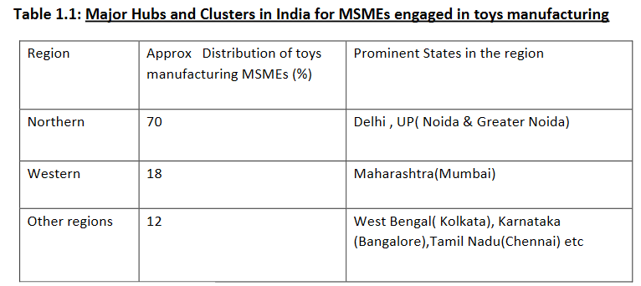
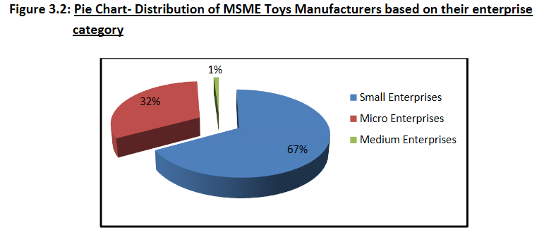
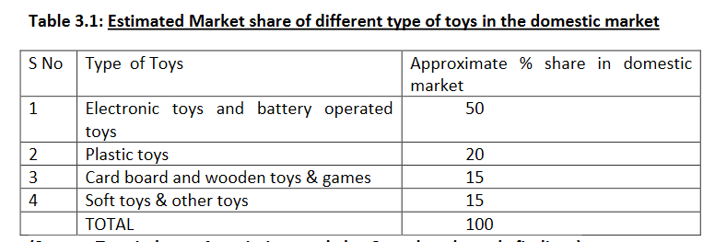
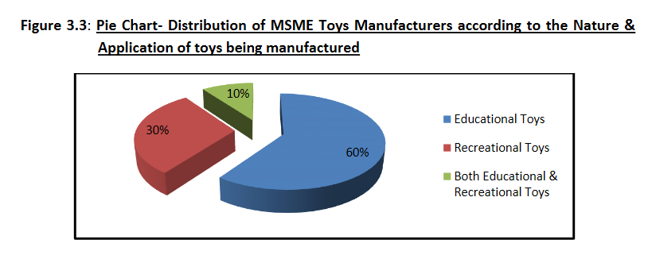
Market
Source: from Linkedin

Slide 8
Business model
Model 1
Model 2
Model 3
FlyOver Business Model
Brand value chain model
Franchise Model

Slide 9
Target market
Boys
60%
Toy Cars, Puzzle, Board Games, Strategic , etc.
Girls
75%
Soft toys, Teddy, Dolls, Kitchen, etc.

Slide 10
Features
Research
Target Marketing
Innovation
Futurstic & Tech.
Brand Value
Network Chain
Doing the Market Research and Analysing the Data
Exact Targeting of Consumers
Making the product more valuable, fun & interesting.
Use of technologies such as AI, VR, AR, etc.
Creating the Brand Value to work successfully in Flyover Business
Creating Social media, B2C, and B2B Chains to enhance production.

Slide 11



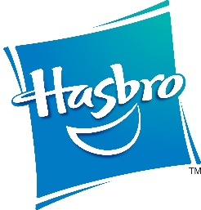
Competitors
Funskool
Mattel, Hasbro
Funskool (India) Ltd. is an Indian toy manufacturing company, founded in 1987 with headquarters in Chennai, Tamil Nadu.
Mattel, Inc. is an American multinational toy manufacturing and entertainment company founded in January 1945 and headquartered in El Segundo, California.

Slide 12
Thanks!
Temp. Mail: Maakadityagupta@outlook.com

