Slide 1
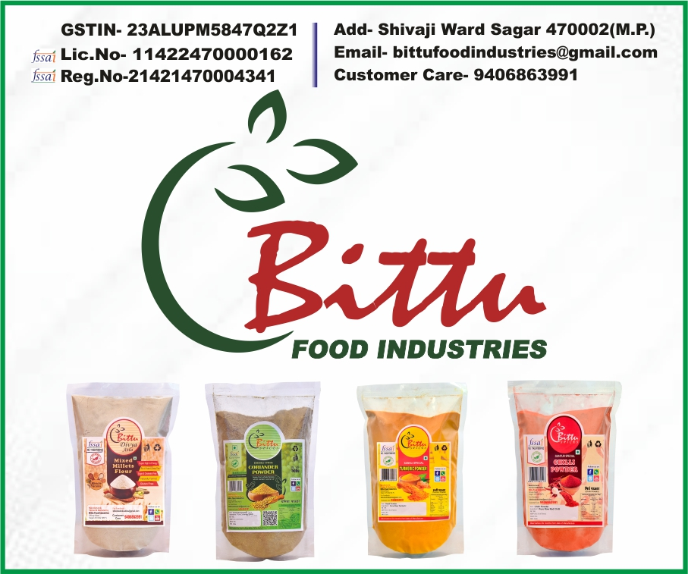

Slide 2

Where is a problem.
In the modern world due advancement of technology and Industrial development, peoples life style have changed.
People are now virtually more connected rather than truly.
People are now more adapted to eat recipes available on online platform rather than cooked personally at home.
Which is directly hampering their Health and Pocket. Which in turn destroying mental peace.

Slide 3
How are you solving that problem
At Bittu Food Industries we are trying to provide healthy, nutritious and pure food Items to common citizen at affordable price. For This we have Chosen Millets especially Shridhanya Millets.
Millets are SMART FOOD and they have a unique standing in the arena of super food, they are easy and friendly to cultivate and nearly organic and have good nutritional content.
Good for the consumer: they can help overcome some of the biggest nutritional and health problems (iron, zinc, folic acid, calcium, diabetes and more);
Good for the planet: they have a low water footprint, are able to survive in the hottest driest climates and will be important in coping with climate change, and more;
Good for the farmer: can increase yields up to 3 fold, have multiple uses (food, fodder, fuel), and are typically the last crop standing in times of drought being a good risk management strategy for farmers.

Slide 4
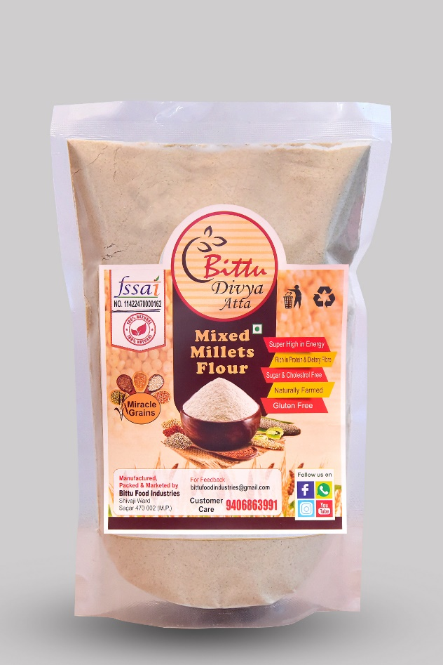
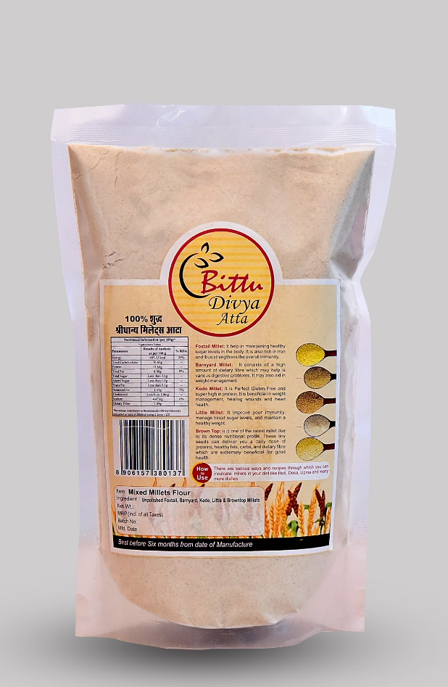
ShriDhanya Mixed Millets Flour

Slide 5




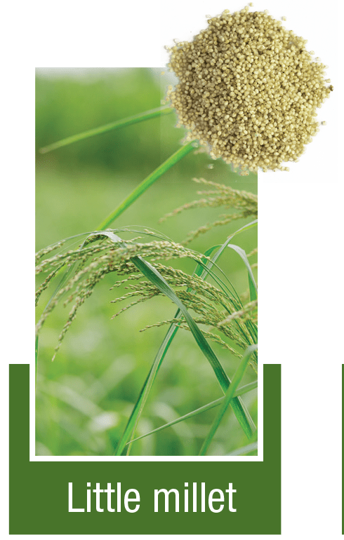
Shridhanya Millets Or Positive Millets

Slide 6
Millets are Powerhouses of Nutrition
Millets possess unique nutritional characteristics specifically have complex carbohydrates, rich in dietary fibre. Millets are natural source of iron, zinc, calcium and other nutrients that are essential for curbing the problem of malnutrition in India.
Small millets are more nutritious compared to fine cereals. They contain higher protein fat and fibre content. The dietary fibre, due to higher viscosity and water holding capacity, plays a key role in reduction of blood glucose level as well as insulin response. It also lowers the level of cholesterol and decreases the risk of bowel disorders. Dietary fibre components exert their beneficial effects mostly by way of their swelling properties, and by increasing transit time in the small intestine. Millets confer good health and protection against non-communicative diseases.
Reference: Story of Millets by KSDA & ICAR-IIMR-Hyderabad

Slide 7
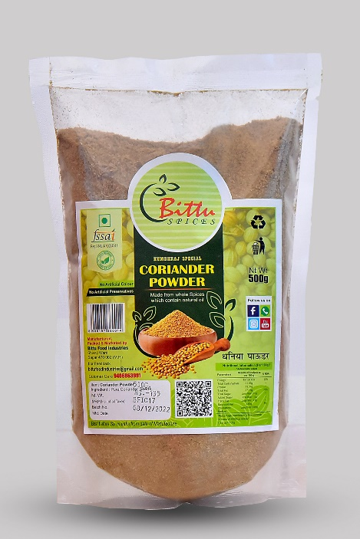
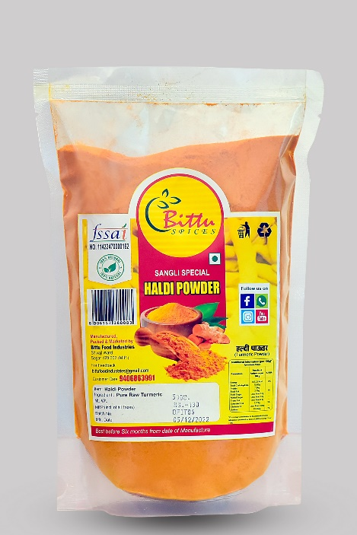
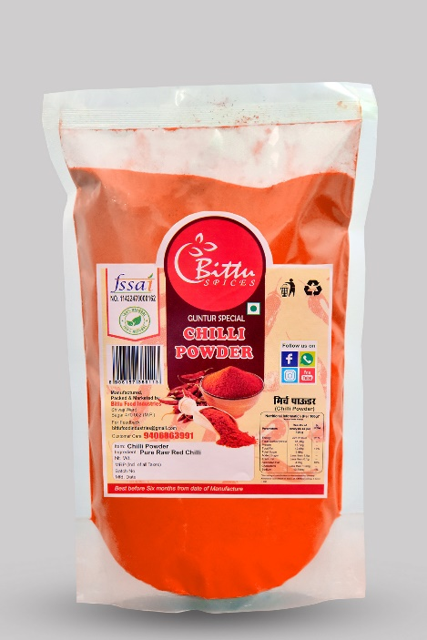
Our Other Range of Products

Slide 8
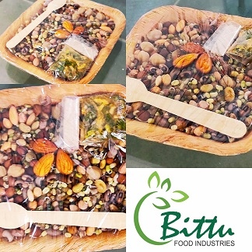
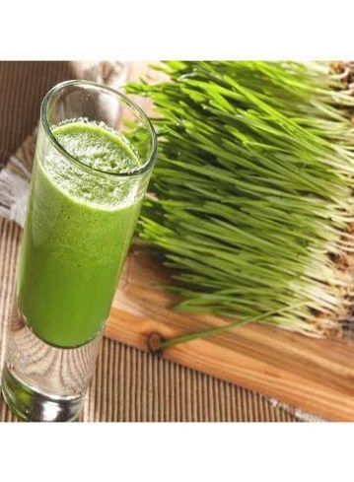
Our Proposed Products
Sprout Chat
Wheat Grass Juice

Slide 9
Who are our customers?
Dealers, Distributor & Retailers (B2B)
Directly to End-Users (Through Direct Sale through online platform)

Slide 10
Where One can Get the Products
They can approach near-by Retail Outlet.
They can buy through online platform like Amazon, FilpKart or WhatsApp.

Slide 11
Who are our Competitors/Rivals in the market?
As far as retails are concern there is almost monopoly in our product.
On Online platform some of the competing products are available but they are charging too high.

Slide 12
Our Core Team Members.
Our team consist of Volunteers, Workers and Owners.
Mr. Sanjeev Suhane – Having almost 15 years of experience in handling various projects through his NGO is a Chief- Mentor of Our Team.
Mr. Prateek Kumar – Marketing Manager.
Mr. Satish Kumar – Sales Incharge.
Mr. Prakash Rajput – Operation Head.
Mr. Anupam Raj Mishra Director/Owner. Having around 20 years of experience in Marketing. MBA Marketing (DAVV- Indore).

Slide 13
Our Immediate Requirements
We are in need of Online Platform , like Website and App to showcase our products.
We are in need of sufficient fund in order to scale – up our products.
We need technical expertise from food department to make our product more useful like organic certification etc. guidance.
Proper Space for Office and Marketing.

Slide 14
Activities to Market Our product?
We are planning to run advertise on social media.
We are running canopy Campaign as Brand Building activity.
We are Planning to Publish Posters to Highlights our Products and Company.
We are trying to build good distribution Network.
We are Conducting Marketing / Sales Visits Locally.

Slide 15
Current Status/Stage of your startup
We Have Registered Our Business in February 2022 as a Food Processing Unit and started Manufacturing in August 2022.
Revenue (Last Quarter)-1,35,708 INR (as per last GST filed.)
Number of unique customers- Approx 25

Slide 16
Contact Details
Founder’s Name: ANUPAM RAJ MISHRA
Email: anupamrajmishra@gmail.com
Mobile Number: 9425424888
Website, if available: not available.

Slide 17


