Slide 1
WOW
WHAT AN IDEA
BY
Jaya Rani
WELLNESS PRACTIONER
NATUROPATHY,ACCUPRESURE,YOGA
Notes:
Panchtatva Nature Cure

Slide 2
Problem Scenario
Covid Pandemic
Solution – A start up idea to combat Covid pandemic, generating employment and prospering happiness through Integrated Wellness Approach .
A combination of Traditional & Complimentary Medicines
and Conventional Medicine.
Start with “WOW” and gradually grow.
PANCHTATVA NATURE CURE
Notes:
Panchtatva Nature Cure

Slide 3
Indian Traditional Medicine
Ayurveda
Sidha
Unani
Yoga
Naturopathy
Homeopathy
PANCHTATVA NATURE CURE

Slide 4
Complimentary Medicines
Aroma Therapy
Music Therapy
Reflexology
Postural Drainage
Reiki
Meditation
Acupressure
Diet & Nutrition
PANCHTATVA NATURE CURE

Slide 5
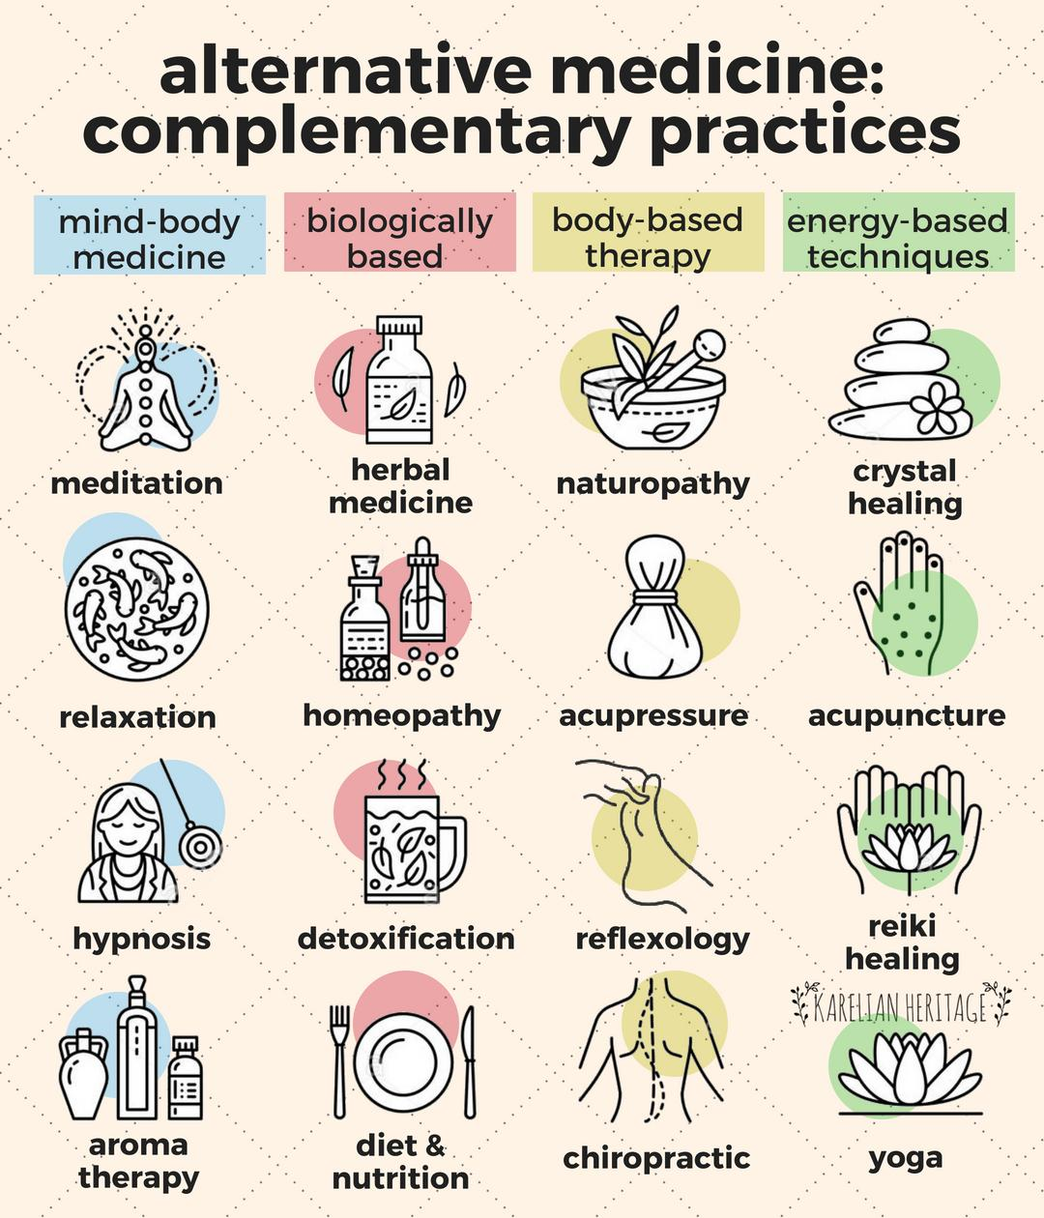
Mix bag of traditional and complementary medicine
PANCHTATVA NATURE CURE

Slide 6
Someone said,
  “Imagine a world - oriented toward healing rather than disease, where physicians believed in the natural healing capacity of human beings, and emphasized prevention above treatment.
  In such a world, doctors and patients would be partners working toward the same ends.”
PANCHTATVA NATURE CURE
Notes:
Panchtatva Nature Cure

Slide 7
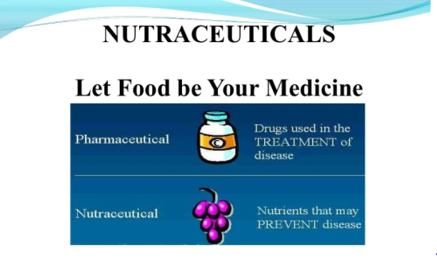
Herbalism as Neutraceuticals
PANCHTATVA NATURE CURE
Notes:
Panchtatva Nature Cure

Slide 8
What are neutraceuticals ?
Neutraceuticals are food or part of food that provides health benefits including the prevention and/or treatment of a disease.
Don’t have side effects
Part of natural diet suppliment.
PANCHTATVA NATURE CURE

Slide 9
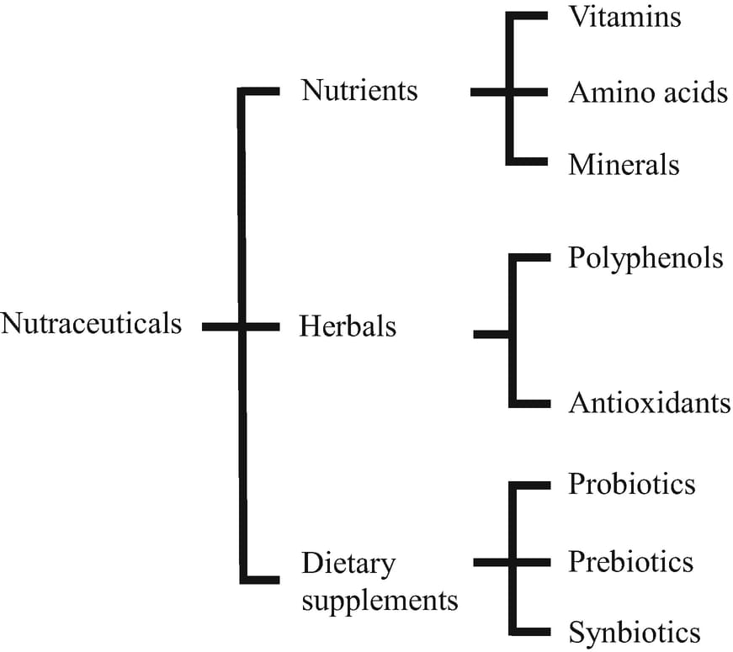
PANCHTATVA NATURE CURE
Notes:
Panchtatva Nature Cure

Slide 10
What I am doing ?
I am running a small holistic health and wellness clinic ‘Panchtatwa Nature Cure’ at my own house.
Equiped with Steam bath,spinal bath,hip bath,enema,mud therapy,shirodhara stand and pot,massage bed etc.
Giving consultation for ‘Diet and Nutrition’,Accupresure and meditation.
PANCHTATVA NATURE CURE

Slide 11
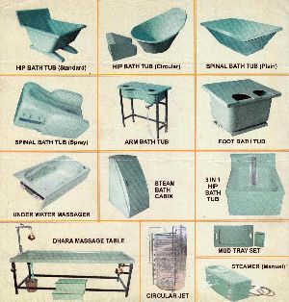
Glimpse of Naturopathy equipments
PANCHTATVA NATURE CURE

Slide 12
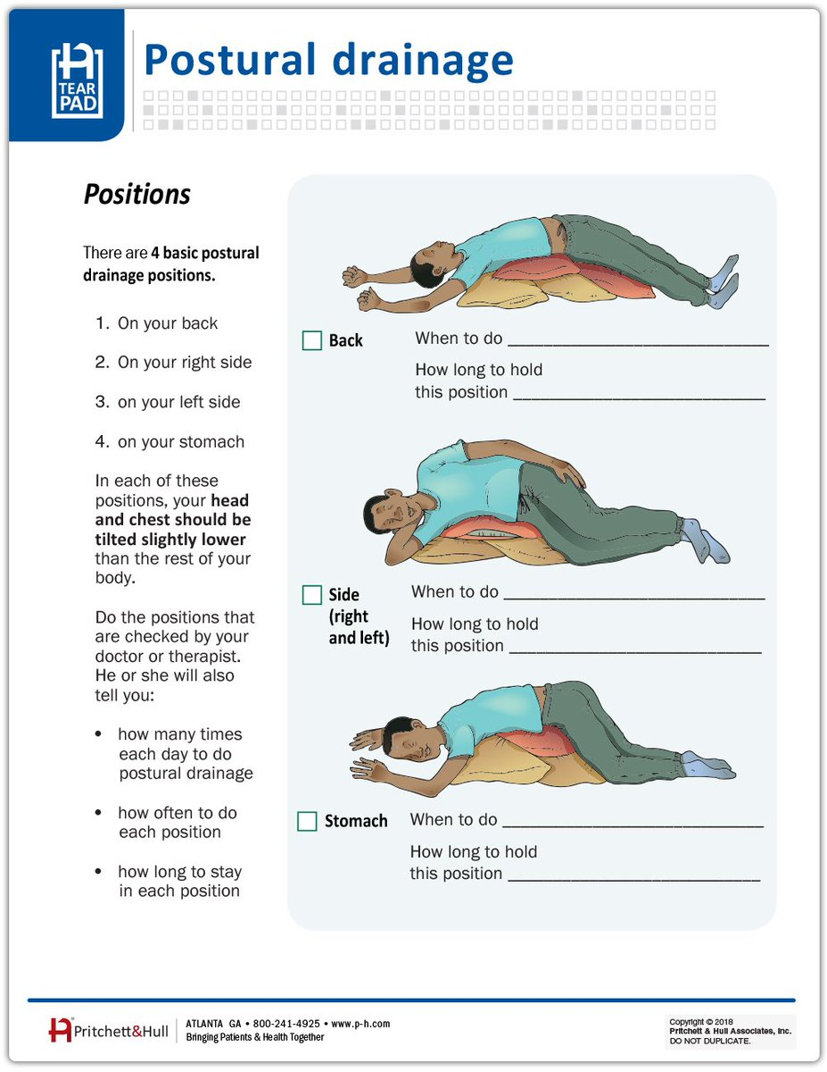
PANCHTATVA NATURE CURE
Notes:
Panchtatva Nature Cure

Slide 13
What am I talking about ?
Here , I am boosting a new concept of integrative or functional medicine.
This concept combines both the TRADITIONAL MEDICINE AND CONVENTIONAL MEDICINE.
PANCHTATVA NATURE CURE

Slide 14
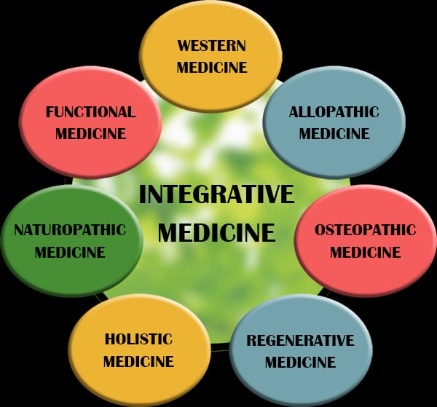
Definitions
PANCHTATVA NATURE CURE
Notes:
Panchtatva Nature Cure

Slide 15
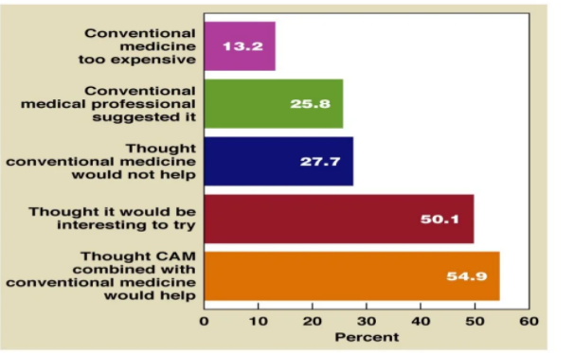
PANCHTATVA NATURE CURE
Notes:
Panchtatva Nature Cure

Slide 16
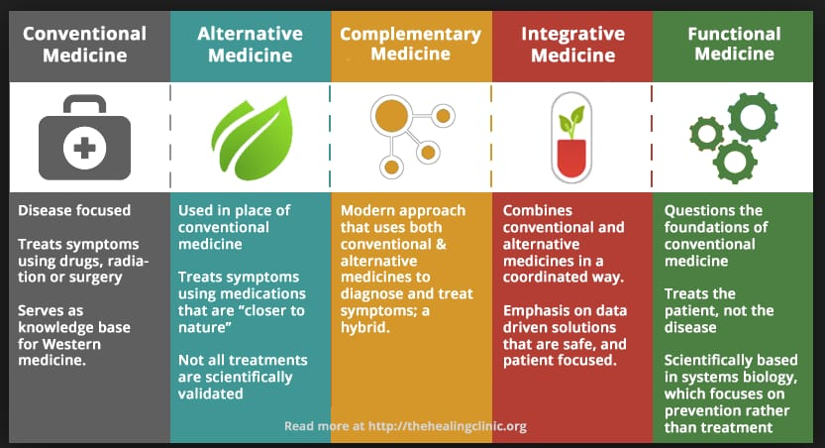
PANCHTATVA NATURE CURE
Notes:
Panchtatva Nature Cure

Slide 17
Areas to be Focused
Cost effectiveness
Approachable
Comfort level
Result oriented
Should work on follow ups.
Research oriented.
PANCHTATVA NATURE CURE

Slide 18
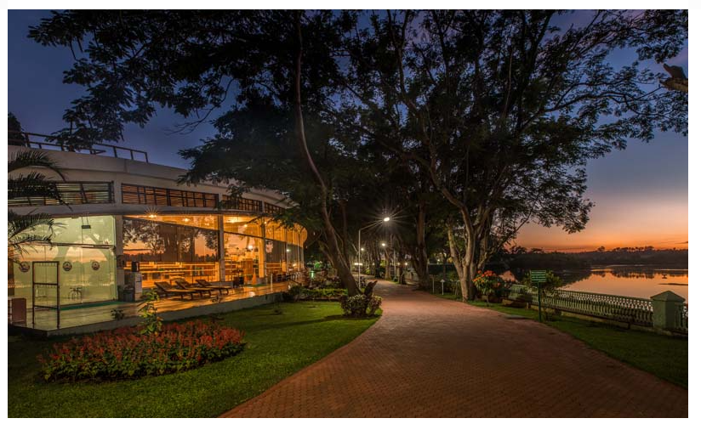
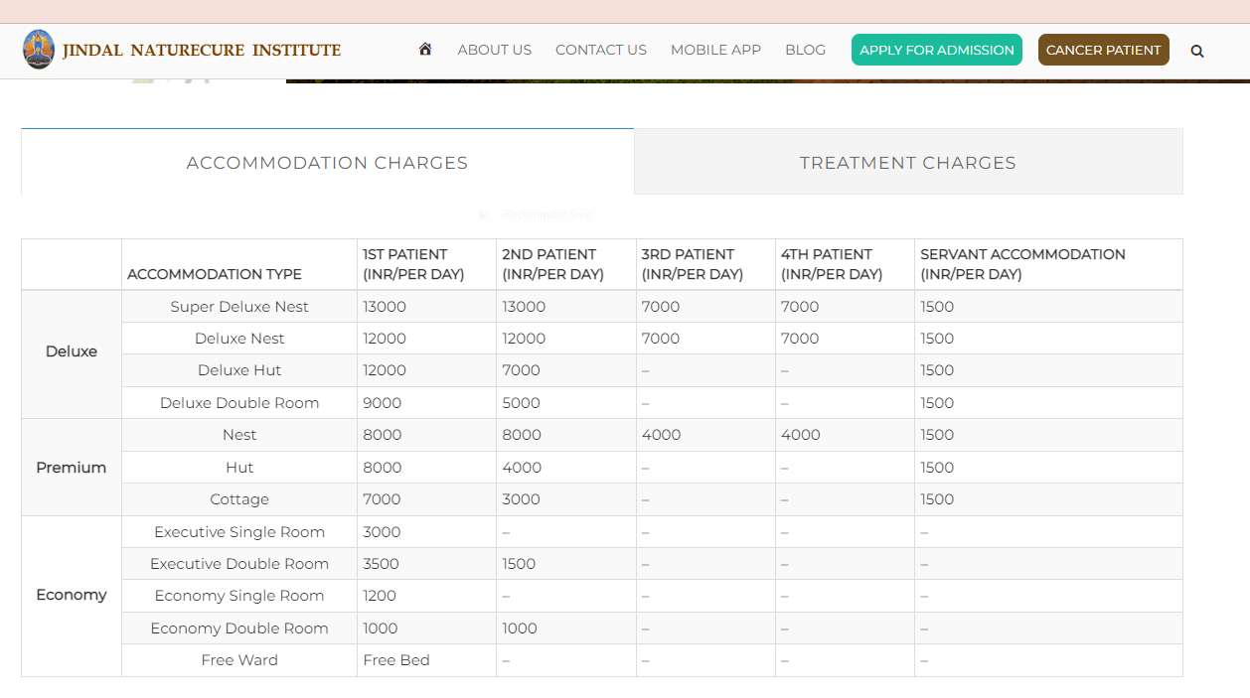
Jindal nature cure, Bangalore
PANCHTATVA NATURE CURE

Slide 19
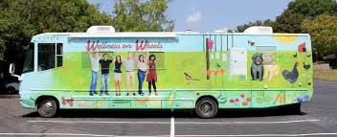
Remedial way
WOW
Wellness on wheels
PANCHTATVA NATURE CURE

Slide 20


Wow movement
Research and Training centre
WELLNESS POINT
WELLNESS POINT
WELLNESS POINT
WELLNESS POINT
WELLNESS POINT
WELLNESS POINT
WELLNESS POINT
WELLNESS POINT
WELLNESS POINT
WELLNESS POINT
WELLNESS POINT
WELLNESS POINT
PANCHTATVA NATURE CURE

Slide 21
What we will do through Wow’s?
Awareness and therapy workshops on wow.
Small diet corner.
Compact therapy corner.
Diagnosis corner.
Consultation canopy.
Selling window {Health kits}.
PANCHTATVA NATURE CURE

Slide 22
Now, the integration part comes.
Existing multispecialty hospitals.
Corporate offices.
Schools ,colleges and universities.
FOR WHAT ?
We need 1000 to 2000 sqft sharing space to run our wellness activities and two therapists from their existing staff. We will train the staff.
PANCHTATVA NATURE CURE

Slide 23
At Research and Training centre
This centre will work as a head quarter of all our wow’s and wellness points.
Customer support system and follow ups will be the backbone of this movement.
Virtual consultation and guidance to customer/patient.
Preparation of health kits.
Research work for different ailments.
Residential training for partners and their staff.
Residential workshops for preventive and curative purposes.
Reconnect sessions for every wellness point employees after a stipulated period.
PANCHTATVA NATURE CURE

Slide 24
Wellness on wheels (wow)
These buses will move around the cities(news) for different workshops and cater to customer/patient.
Equipped with necessary diagnosis tools and experts team.
Availabililty of the health kits and fresh raw diet foods according to the season.
PANCHTATVA NATURE CURE

Slide 25
Need of wellness points
These points cut the cost of establishing the self set ups at multiple places and their maintenance cost too. Can use existing set up and manpower with low maintenance cost.
Direct point of contact with customer or patient.
Regular preventive and curative care point.
Diet point for health lovers.
Recreational activities for the complete family.
Elder care point.
PANCHTATVA NATURE CURE

Slide 26
Requirements
Wow buses.
Research and training centre set up.
Half acre open land and 5000 sqft constructed building, in pollution free environment(Lease/ Rent out).
Infrastructure- Basic furniture,health equipments,IT equipments and team.
Same can be sourced from non-performing units.
PANCHTATVA NATURE CURE

Slide 27
One nation one health policy
Debasree Chaudhuri, Union Minister of State for Women and Child Development, said that healthcare has been a priority sector in India. With the pandemic situation and crisis and challenges of existing healthcare mechanisms, it is time to look forward in terms of how the healthcare needs of common citizens will be met.
An integrated health system called ‘One Nation, One Health System’ will be implemented by 2030 which would integrate modern and traditional systems of medicine like Allopathy, homoeopathy and Ayurveda in medical practice, education and research. She was speaking at the Inaugural Session of CII IWN Lifestyle & Wellness Summit.
Source : The New Indian Express Tuesday, February, 08, 2022
PANCHTATVA NATURE CURE
Notes:
Panchtatva Nature Cure

Slide 28
One nation one health policy
My preview
There is lot of opinion differences in implementing these policies on govt. level. Many corporates and big companies of conventional industry are not in favor of such strategies.
We as a citizen of India needs to support traditional medicine system by engaging private investors which will create a positive impact on releasing the govt pressure, imposed by conventional system bodies.
PANCHTATVA NATURE CURE

Slide 29
THANK YOU!
PANCHTATVA NATURE CURE
Notes:
Panchtatva Nature Cure

