Slide 1
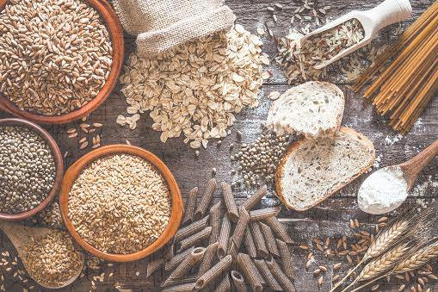
WELCOME TO
MANAV SEWA UTPAAD
PRO. :- RASHI RAJGOUND

Slide 2

About Our Brand :-
Manav Sewa Utpaad is wholesale & retailer supply wheat flour, gram flour, rice and different types of spices and cereals at suitable prices and less waiting time.

Slide 3
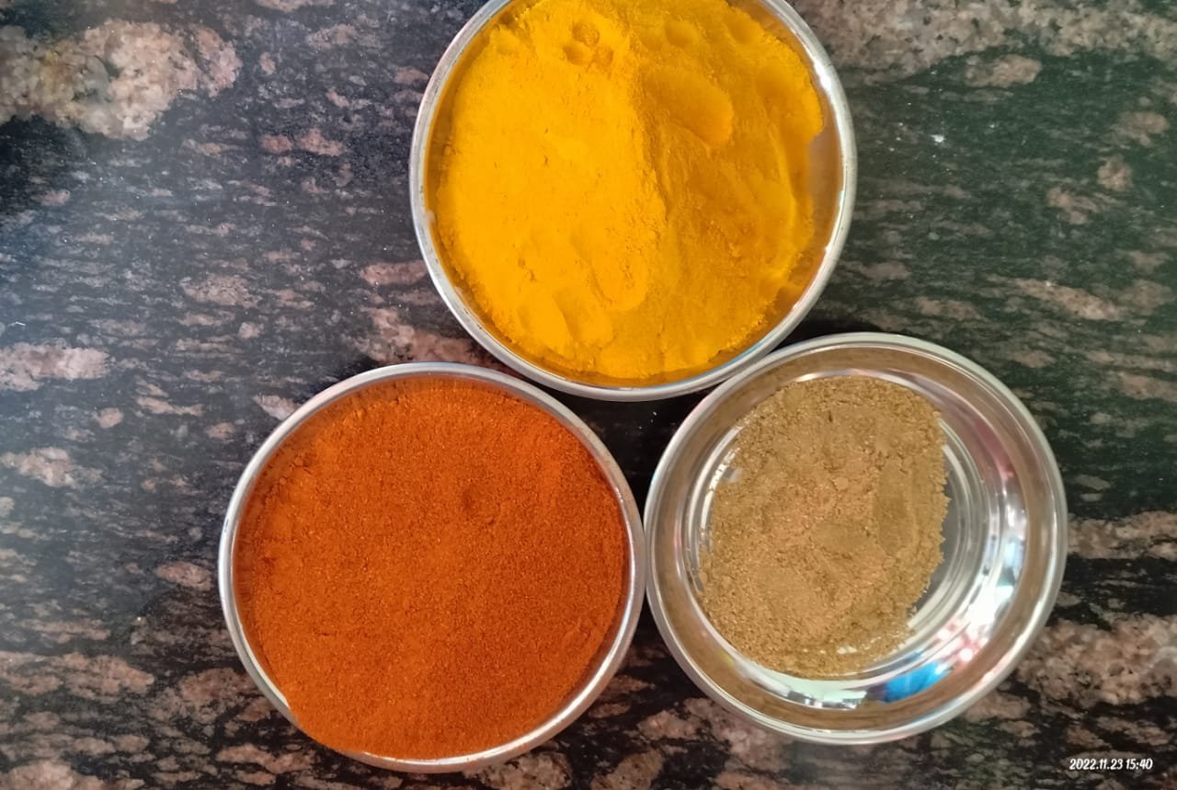

Slide 4
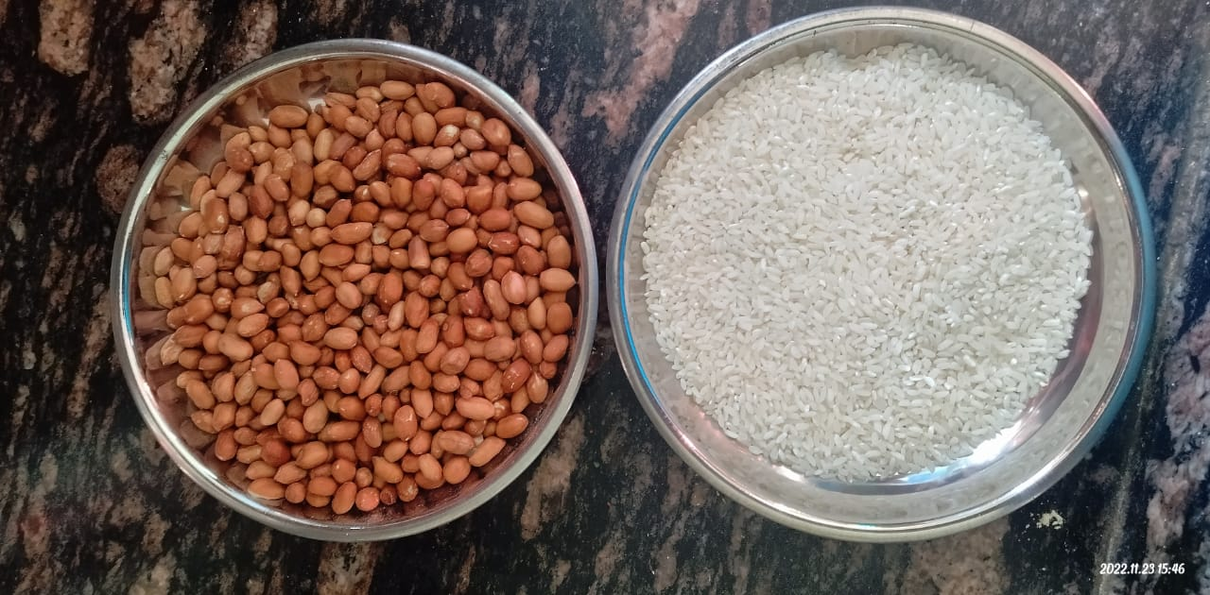

Slide 5
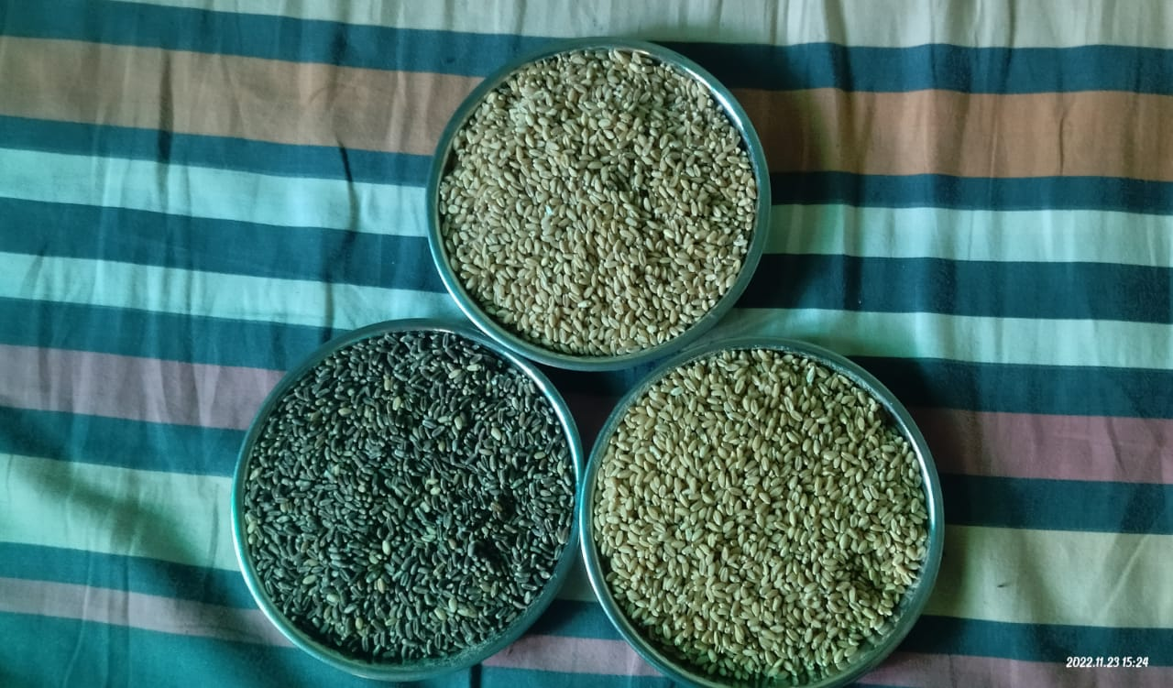

Slide 6
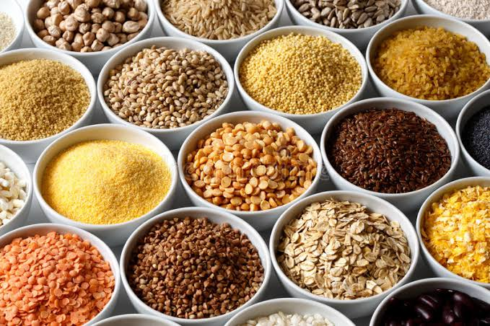

We provide good quality of food grains , spices deliver freshly prepared and suitable prices at less waiting period.

Slide 7
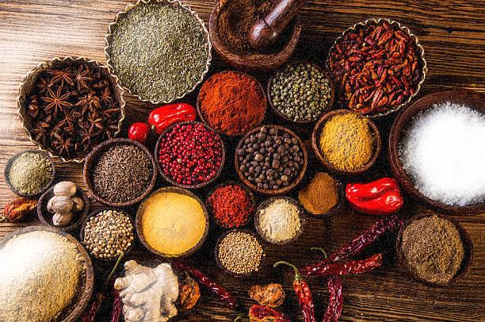
We provide different types of spices:-
Chilli
Coriander
Turmeric
Garam Masala
Cumin Seed
Mustard Seed
Fenugreek Seed
We also provide the Powder form of above products.

Slide 8
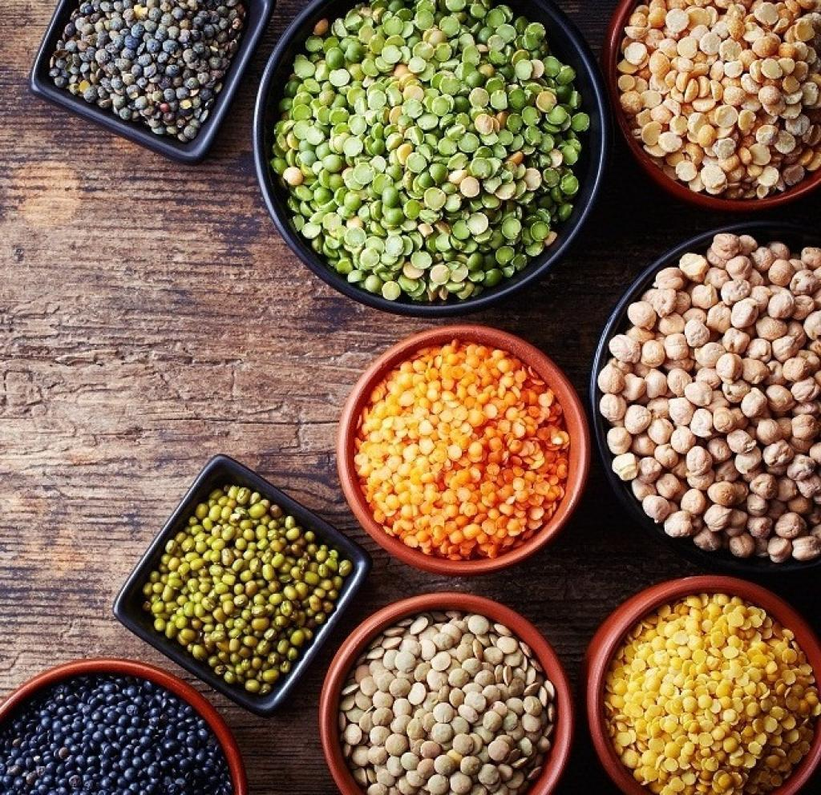
We also Provide different types of Pulses :-
Moong Dal
Chana Dal
Arhar/ Toor Dal
Udad Dal
Dried Peas
Masoor Daal

Slide 9

We provide various types of wheat :-
306
1544
Sharbati
Black wheat

Slide 10
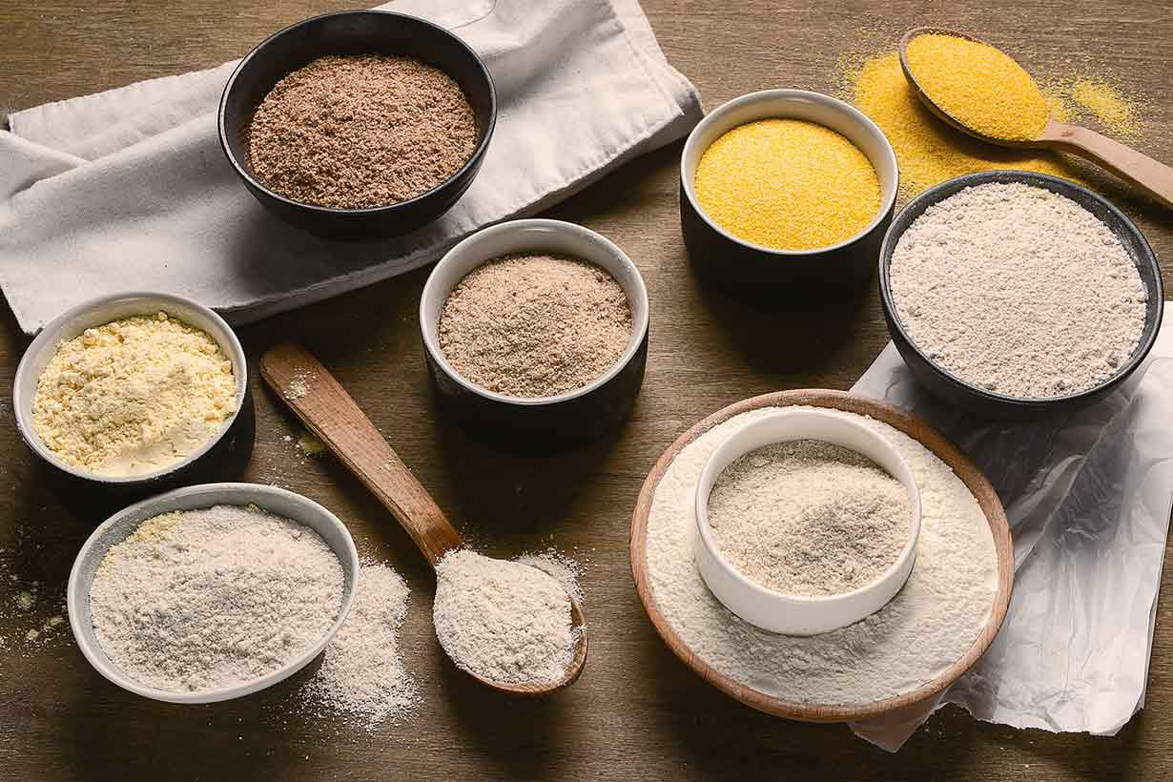
We Provide different types of Flours:-
Wheat flour
Gram Flour
Porridge
We also grind the all forms of Grains

Slide 11
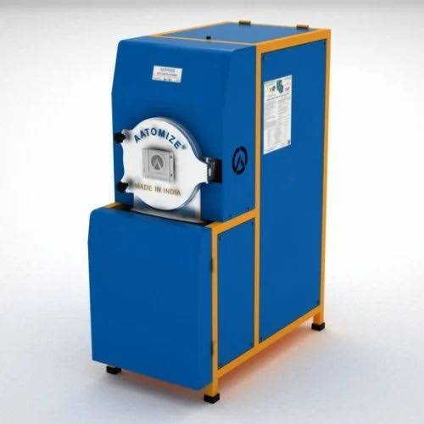
The Modern Age Grinding Machine.

Slide 12



Slide 13

India is No. 2 among countries with most deaths caused by poor food.

Slide 14
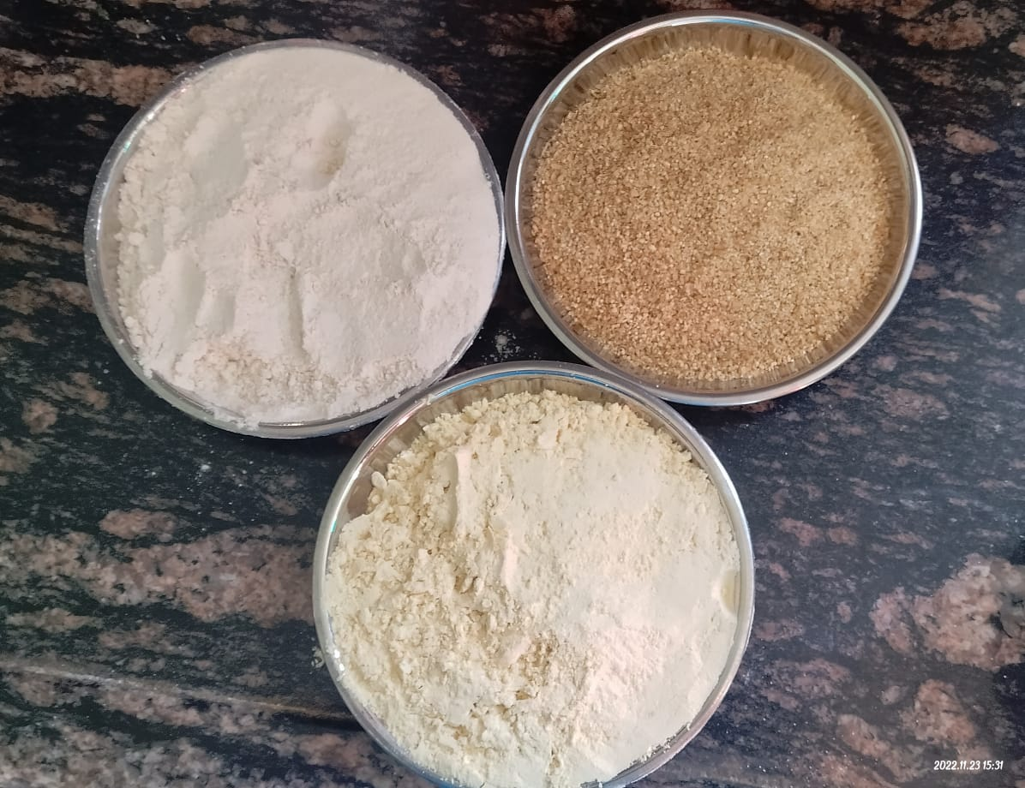

Slide 15
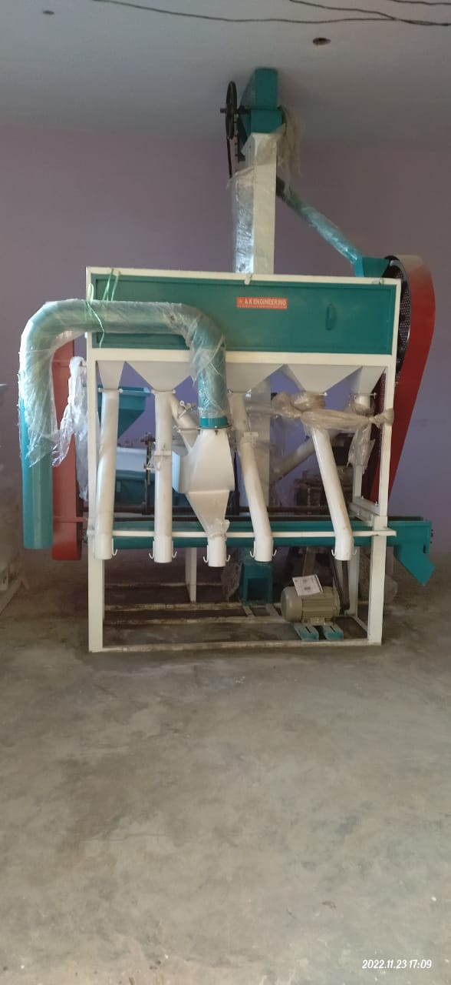

Slide 16
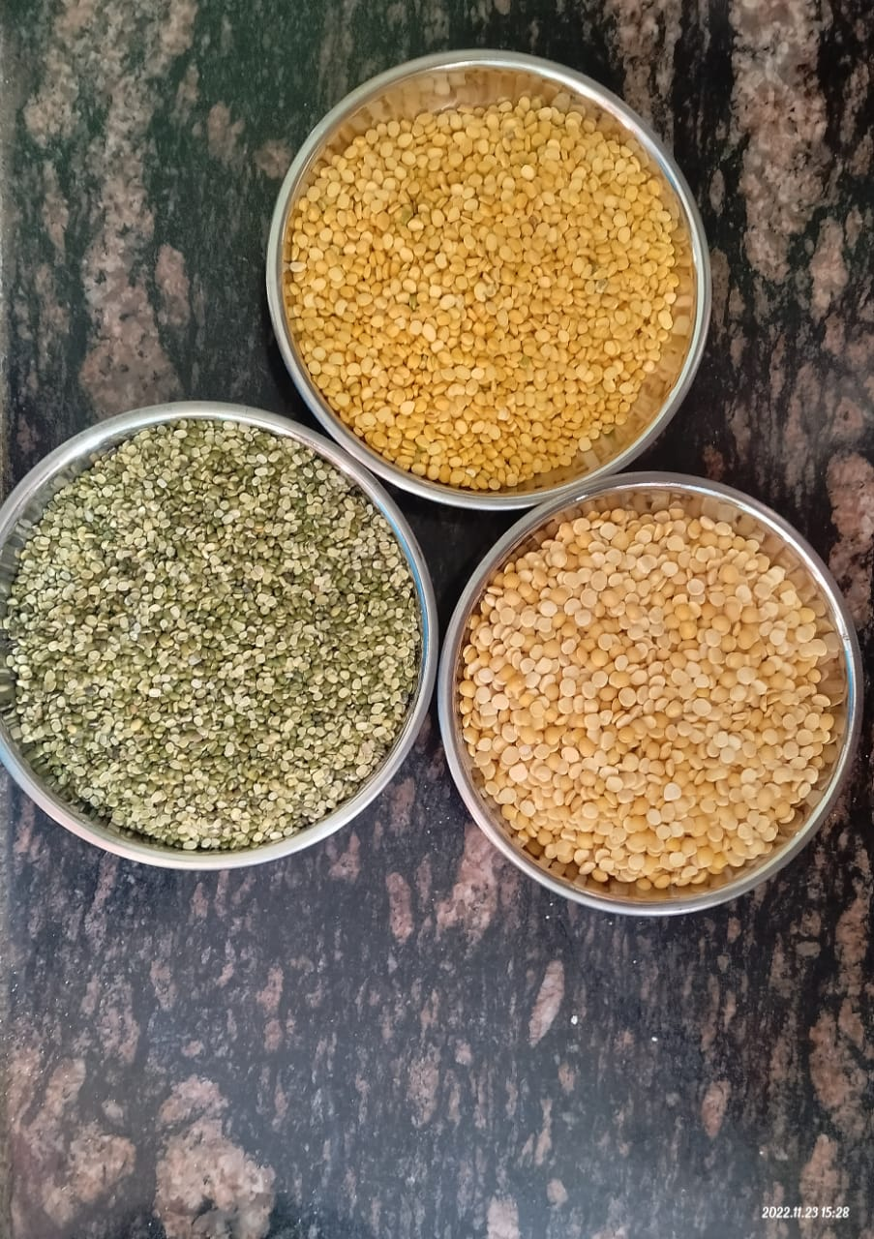

Slide 17

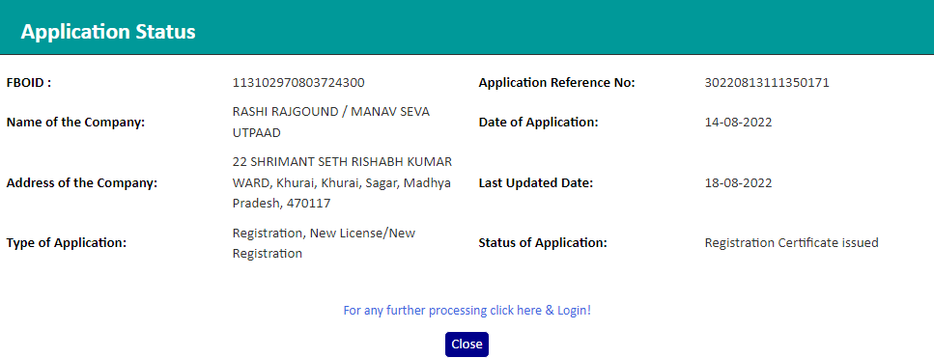

Slide 18
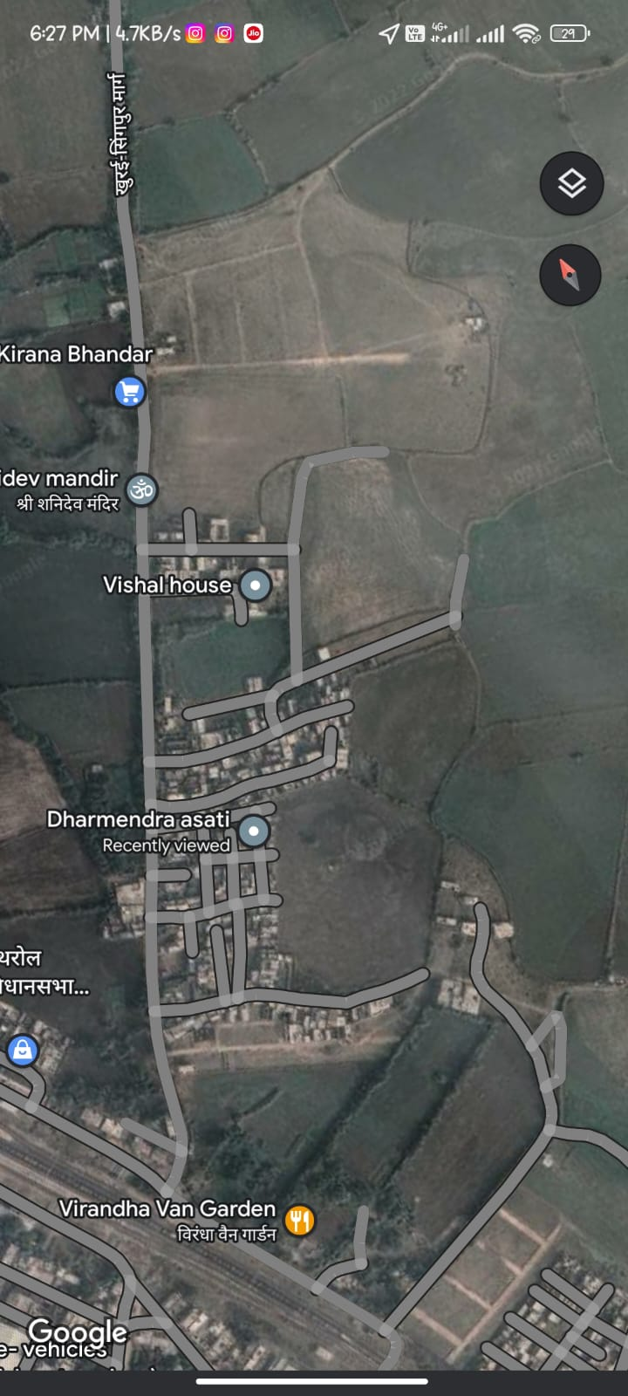

Location:- Rishabh Kumar Ward Khera Naka Khurai Distt.Sagar M.P

Slide 19
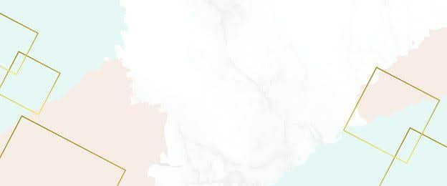
Find Us:-
Brand :- Manav Sewa Utpaad
Pro :- Rashi Rajgound
Contact no :- 9407526174
Email Id:- manavsewautpaad@gmail.com
Rishabh Kumar Ward Khera Naka
Khurai Distt. Sagar M.P
Opening Hours :- 9:00 AM to 6:00 PM
Holidays :- Tuesday

Slide 20

THANK YOU

