Slide 1


GIFTOMART.COM
To The World of
FREE GIFT ON EVERY PURCHASE
A Part of Adamstar India Private Limited

Slide 2
Project Outline
Introduction
Process of E-Commerce
Features
Using Language and Tools
Data Flow Diagram
Business Process and Model
Advantage of this Project
Future Plan

Slide 3
Introduction
What is E-Commerce
Commonly Known as Electronic Marketing.
The business of buying and Selling Products over the Internet.
It consist of buying and selling of goods and services over an electronic systems such as the internet and other computer network.

Slide 4
About Giftomart.com
Giftomart.com is an E-Commerce website where people can buy products online from PAN India.
We provide free gift on every purchase.
We deliver the product in gift wrap for everyone.
We monitor the activity of users and check every transactions.

Slide 5
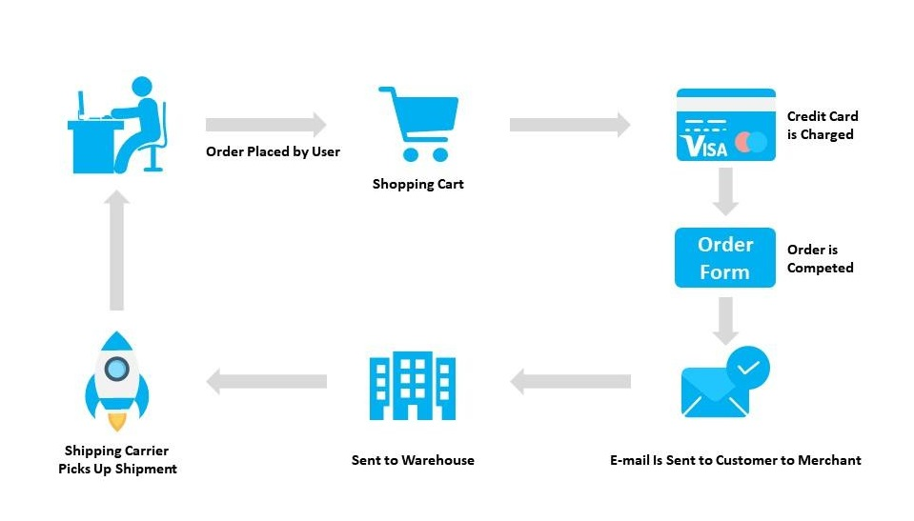
Process Of Giftomart.com

Slide 6
Features
Menu
Category
Category List
Product List
Product Browsing
Shopping Cart
Checkout
Auto Generate Bill/Invoice
Payment Gateway
Logistic
Service/Feedback

Slide 7
Tools:
Language:
Wordpress
HTML
CSS
Bootstrap
Woocommerce
Xampp
Plugins
Photoshop

Slide 8
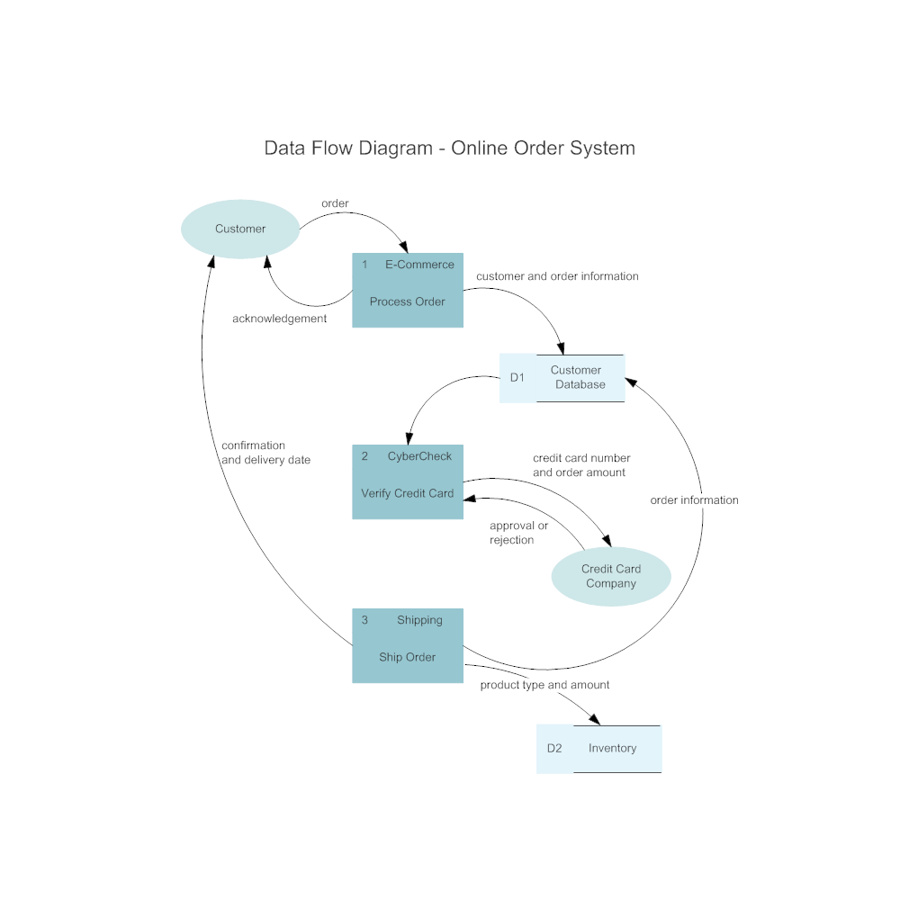
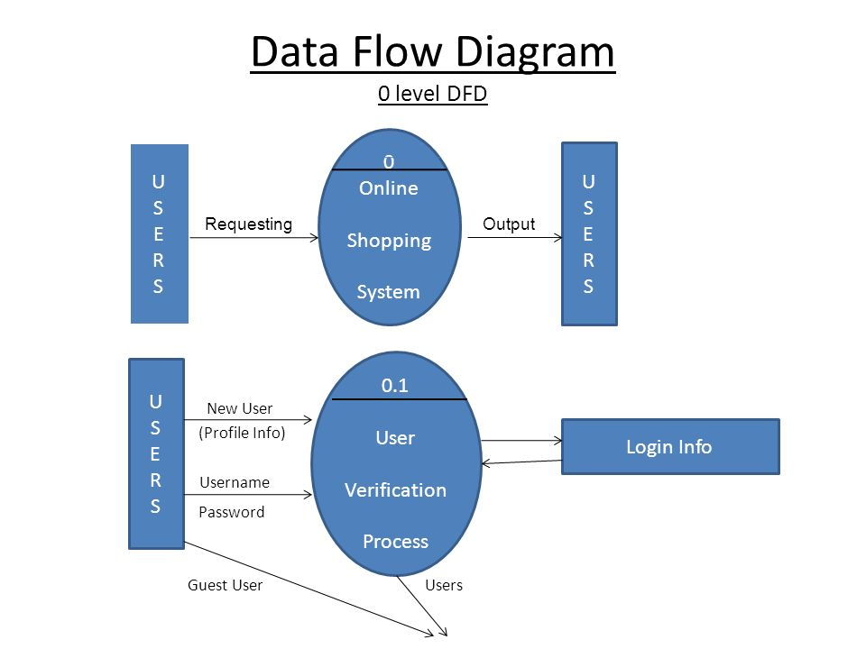
Data Flow Diagram

Slide 9
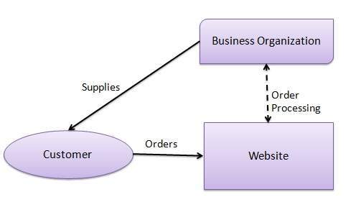
Business Process and Model

Slide 10
Advantage of E-Commerce:
Easy to find product with fast buying/ selling procedure 24/7.
More reach to customer without area limitations.
Low operational costs and better quality of service.
Easy to start and manage business.
Large scalability of customer.

Slide 11
Future Plan:
We are thinking of some modification and adding some advanced new features in our system.
GUI Modification (More User Friendly).
Users can sell their products in future.
Users can signup/login using their social media account such as Facebook, Twitter, Google etc.
Launching Offline Store at multiple location on Franchise Module.

