Slide 1


HOUSE SERVE- a smart home services
FOUNDER NAME -VIPENDRA SINGH SENGAR
houseserve.in@gmail.com
9981287987,9713287987
SAGAR M.P

Slide 2
About idea- Title
Smart home service will easily meet the needs of all the people in a very short time . Smart home services will easily meet the daily needs of the family in a smart way.
Details
Idea-Theme - Service Based Startup

Slide 3

Problems
People- Short service option
01. Lacks of Time.
02. short option.
03. Irregular Rate.
04.Low Quality.
05.Time Consuming service.
06.Non Trustable.
07/.Lacks of Family Members.

Slide 4
1/.Time saving 2/.Reliable. 3/.affordable. 4/.Budget friendly. 5/.Professional. 6/.Easy Reach. 7/.Trustable. 8/.Customer support.
Solution

Slide 5





Services-
1.Home Renovation services.
2/.Modular kitchen.
3/.POP work and False ceiling and Wall putty work ,and House painting.
4/.Wall wallpaper

Slide 6



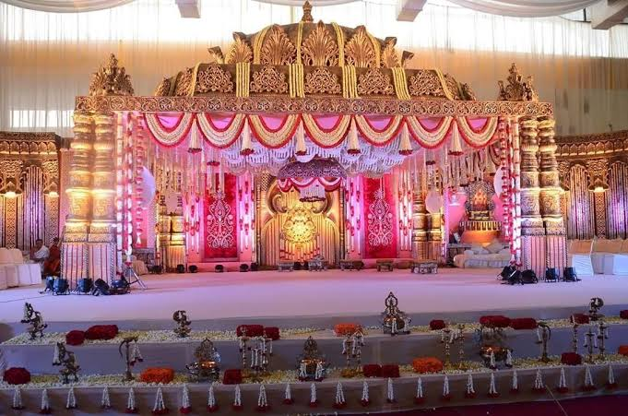
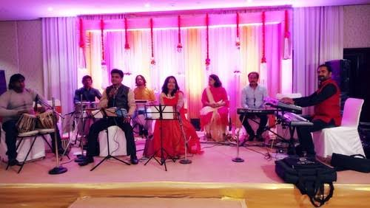
Saloon at Home-Bridal makeup
Services-Wedding Event Management.
2/.Flowers decoration.
3/.Music show.
4/.Bridal makeup and women's saloon
Flowers decoration
Music show

Slide 7




Services-
1.Electritian services.
2/.Plumber services.
3/.CCTV camera installation.
4/.Car Driver.

Slide 8
Business Model
Revenue Model
Customers service charge(Revenue )
Vendors charge(2nd phase)
Material sale
OUR LAST YEAR REVENUE -22 LAKH
NEXT 2 TO 3 YEAR REVENUE APPROXIMATELY 80 LAKH TO 1CRORE .

Slide 9

LAST YEAR JOURNEY

Slide 10
CUSTUMER EASILY ACESS OUR SERVICE.
1/WEB SITE.
2/SOCIAL MEDIA PLATEFORM.
WHAT’S UP.
FACEBOOK.
INSTAGRAM.
OFFLINE.

Slide 11
NEXT YEAR PLAN
EXPAND OUR BUISSNESS IN DISRICT LEVEL .
METRO CITY LIKE BHOPAL OR INDORE.

Slide 12

UPCOMING SERVICE
.CAR RENTAL SERVICE.

Slide 13
CONTACT DETAILS
1/FOUNDER NAME=VIPENDRA SINGH SENGAR
2/EMAIL=houseserve.in@gmail.com
3/MOBILE NUMBER=9981287987,9713287987
4/www.houseserve.in

Slide 14
Thank you
www.houseserve.in
Contact nu.-9981287987,9713287987
Gmail-houseserve.in@gmail.com

