Slide 1

ARTS AND COMMERCE COLLEGE
Project report on business plan
CUSTOMISED PRODUCTS
Prepared By:-
Garima Shrivastava M.Com 1st Year

Slide 2
What is a customised product..?
Product customization refers to enabling customers to personalize a product according to their needs and preferences. Add ons, exclusive functionalities, templates, and flexibility with product design all count as different forms of personalization
Customised products
Customization of products means a customer can select features like color, design, functionalities, add-on components or other options to make a more unique item rather than a mass produced one. For example, a shoe company can allow customers to design and order a one-of-a-kind sneakers through their online platform

Slide 3
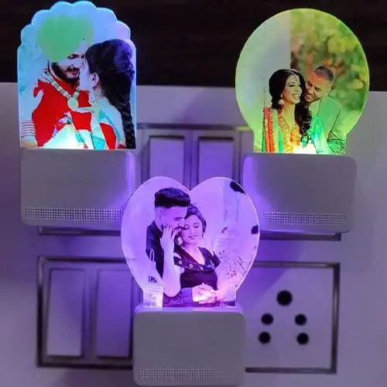
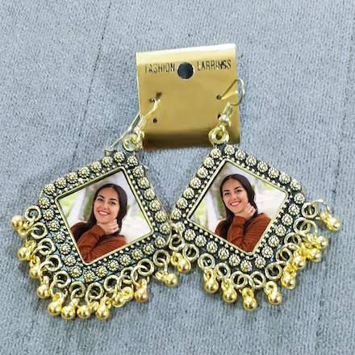
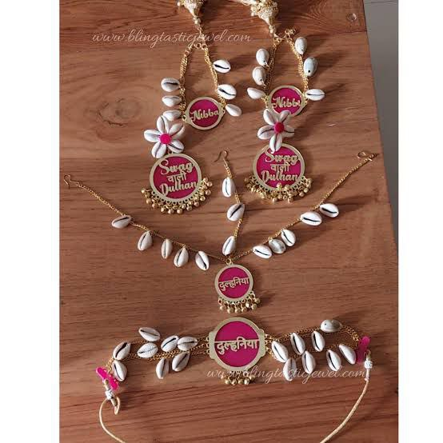
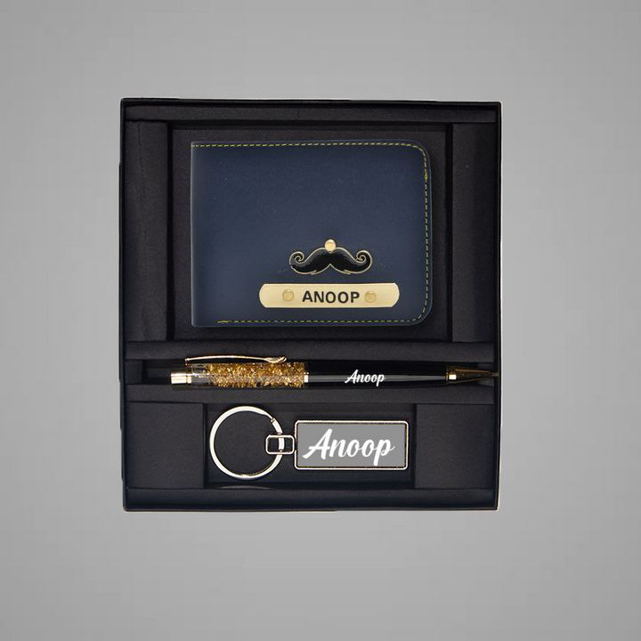
Some example of customized products

Slide 4
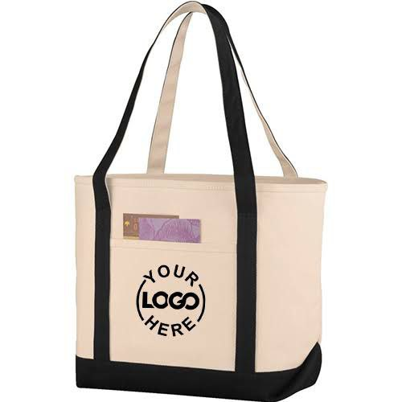
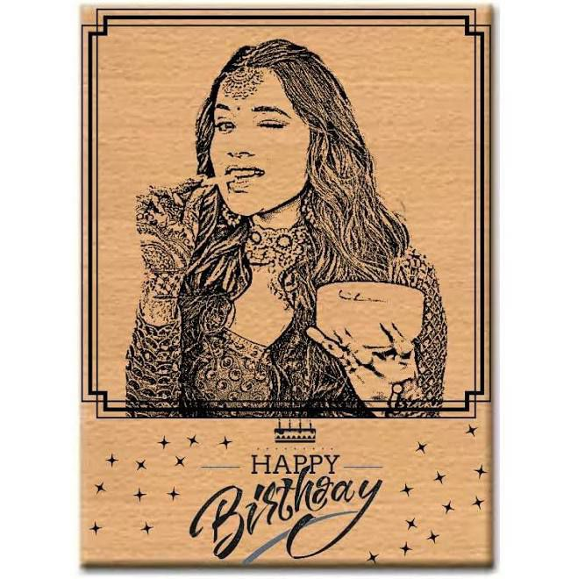
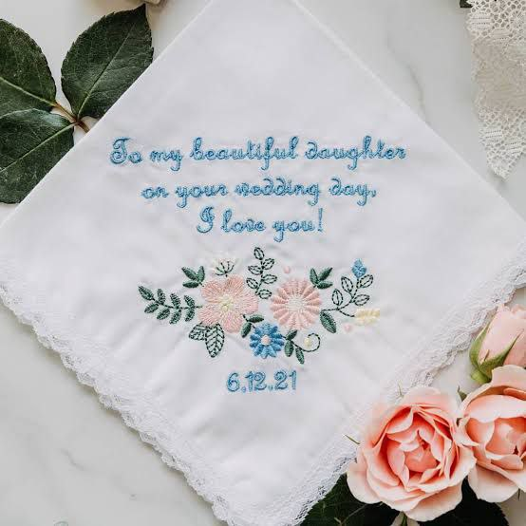
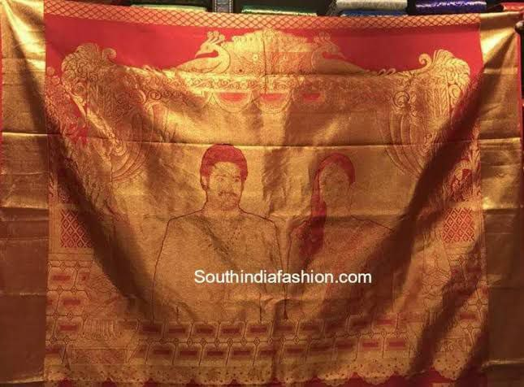
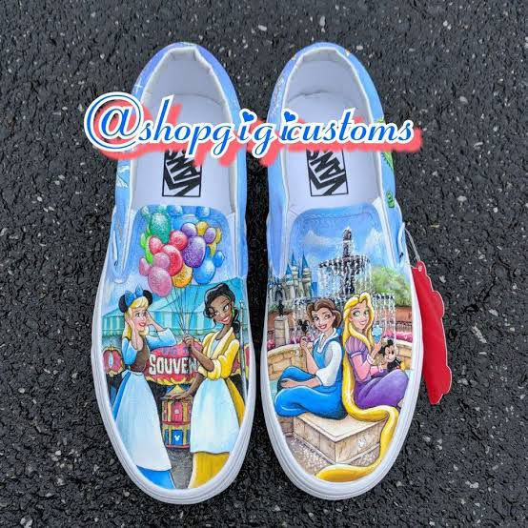
Some example of customized products

Slide 5
Project goal and scope
The online gifting industry is one of the contributors to growth of Indian e-commerce. It sets to take a larger pie in overall market in coming future.
Goals- our goal is to provide customised products at reasonable prices. As the demands of Customize products is rising day by day. We are going to provide all kind of products in customised form.
We will also provide a new clothing brand R&M in our products. We will do white labelling in clothing and provide them in reasonable rates.
We will mostly look up for the Charm pricing of goods and provide them at 99 ,149, 199..

Slide 6
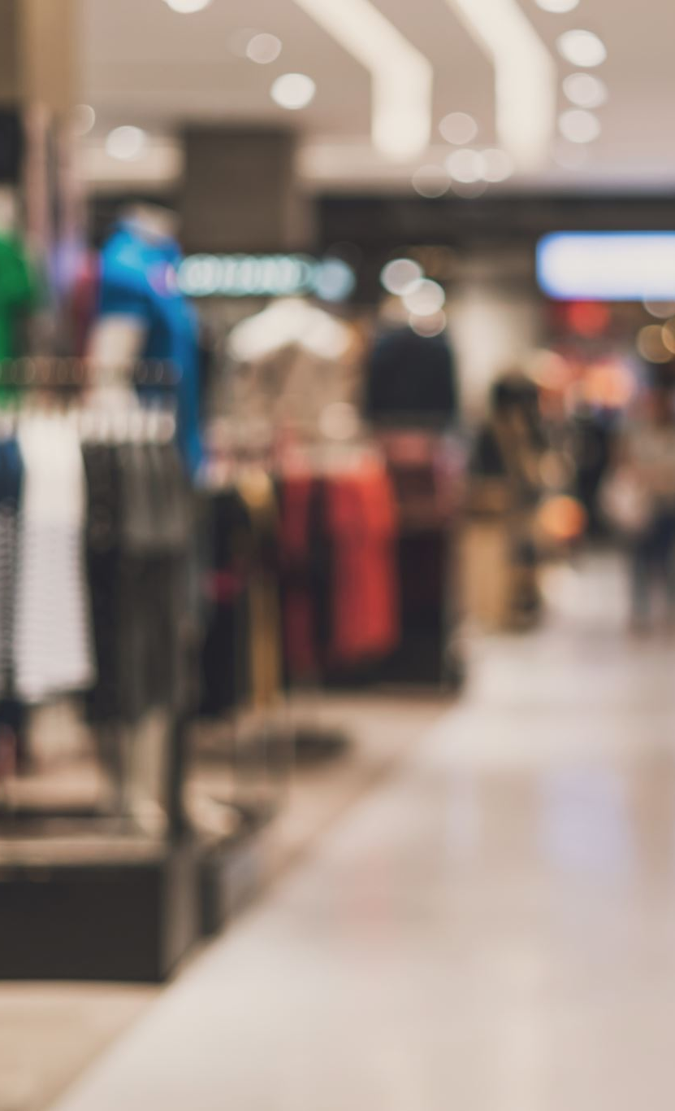
Mode of operations
I’ll go for the online mode to sale our products and also connect with the retailers regarding it.

Slide 7

Profita calculation
Product cost – 35-40 Rs
Printing -12-15 Rs Packing -3-4 Rs Electricity cost per product -4-5 Rs Overall cost = 60 -65₹ approx.
Expected sale through website plus other sources 500 product in a month it will be -500×99= 49500 And approx. 20%-25% margin on per product
so It profit estimation 10000-12500.

Slide 8
Project report at a glance
DETAILS OF UNIT
NAME AND ADDRESS OF A UNIT
R.M FASHION HUB ( REASONABLE MATERIAL FASHION HUB )
GOPAL GANJ SAGAR MP
EMAIL- GARIMA.SHRIVASTAVA02@GMAIL.COM
PHONE- 9644260275
CONSTITUTION – PVT LTD
TOTAL PROJECT COST- 300000/-
WORKING CAPITAL-
PROFITABLILITY- 20%

Slide 9
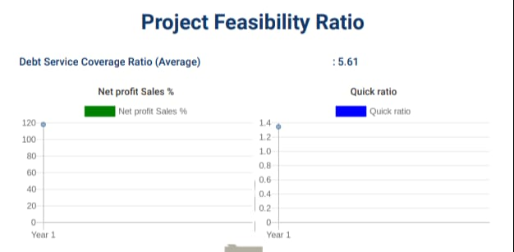
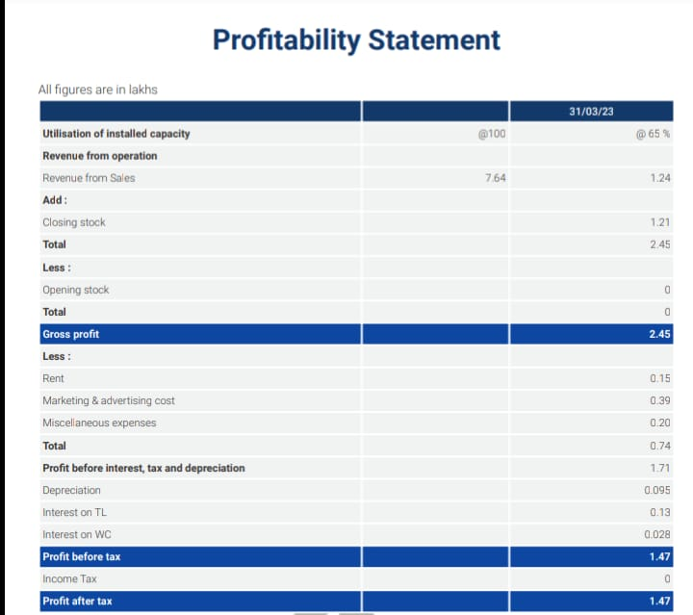
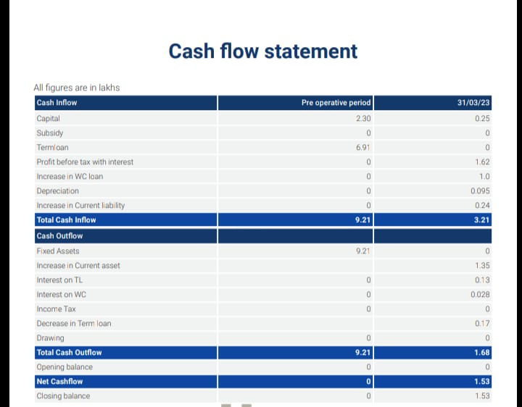
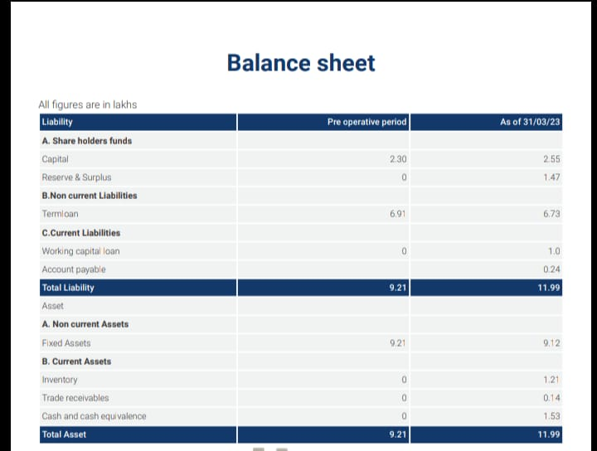
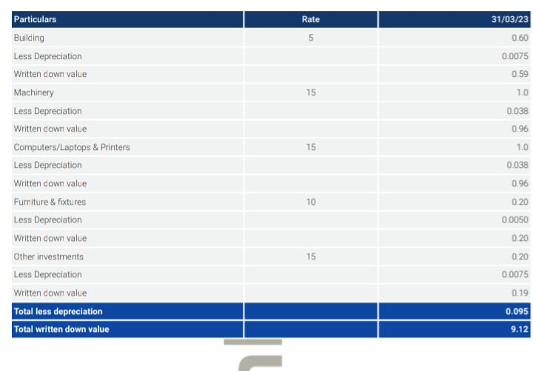
FIGURE AND FACTS

Slide 10
CONCLUSION
Customization is a great business strategy because it makes customers happier, and happy customers repeat customers.

Slide 11

Thank you

