Slide 1

Sanjeevni Ras
LIVE LIFE HEALTHY LIFE

Slide 2
PROBLEMS
TOO MUCH POLLUTION.
TOO MUCH EATING SNAKES.
GROUND WATER BECOMES TOXIC DUE TO THE DENSE POPULATION.
DRINKING RO WATER (THAT REMOVE MANY TYPE OF ESSENTIAL MINERAL THAT ARE IMPORTANT FOR OUR BODY)

Slide 3
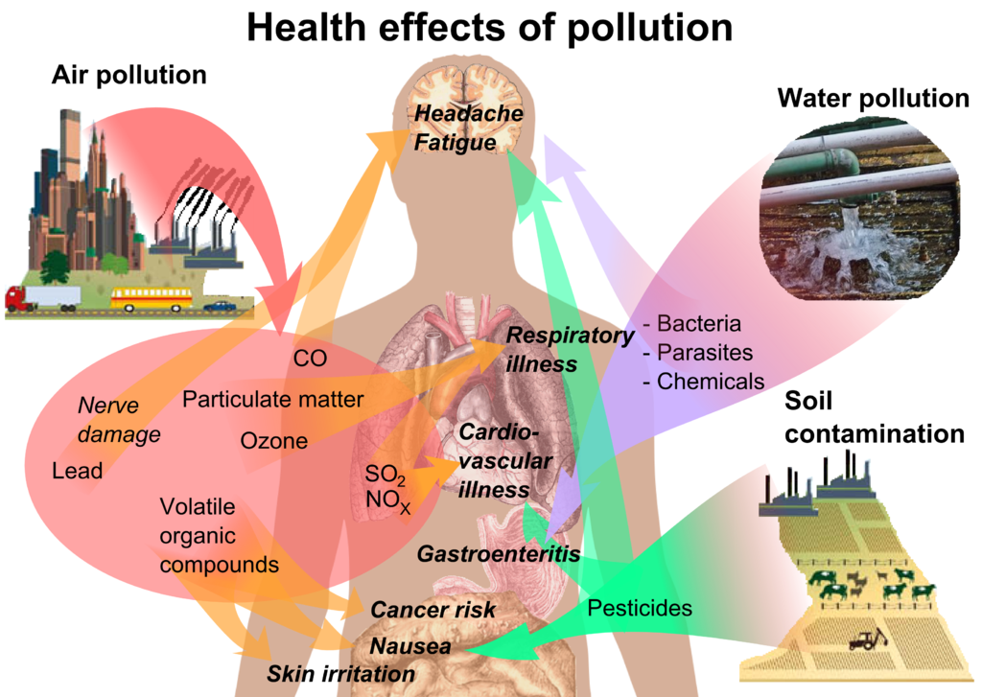

Slide 4
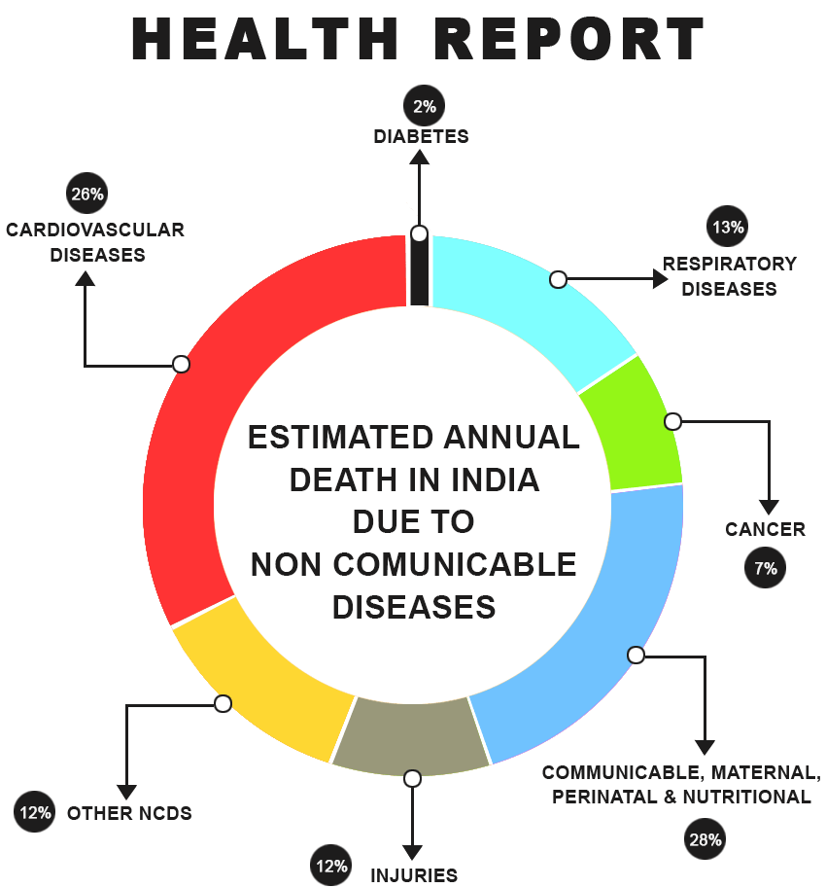

Slide 5
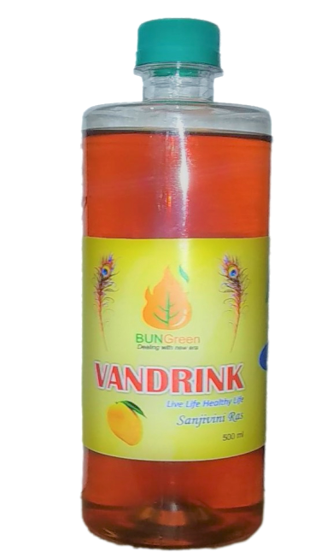
VAN DRINK
It is a solution whose name is Sanjivini Ras.
It has the following elements.
11 minerals.
8 Vitamins.
3 Enzymes.
2 Acids.
It is a type of immunity booster

Slide 6
Minerals
Vitamins
Vitamin B1
Vitamin B2
Vitamin B3
Vitamin B5
Vitamin B6
Vitamin B7
Vitamin B9
Vitamin B12
Sodium
Calcium
Iron
Zinc
Potassium
Magnesium
Chromium
Iodine
Copper
Selenium
Maganese
ENZYMES Acids
Protease
Lipase
Urokinase
Fulvic Acid
Humic Acid

Slide 7
BENEFITS
It helps to recover from debates, heart problems, stomach problems, and blood pressure. Within 4 -5 Months.
It helps in increasing platelets within 2 days it doubles the platelets counts.
It takes it regularly as a tonic to take multivitamins and several minerals that are required for the body to be healthy.
It has zero side effects.

Slide 8
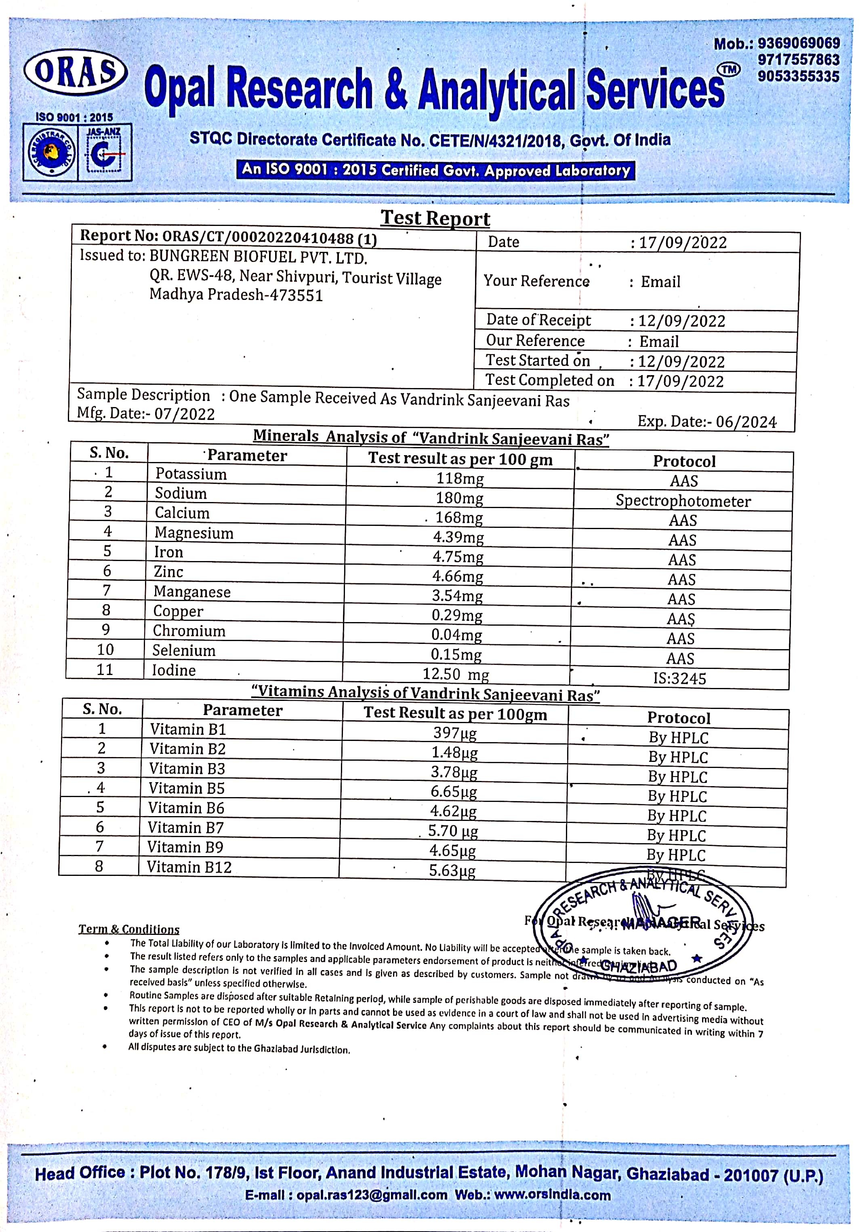
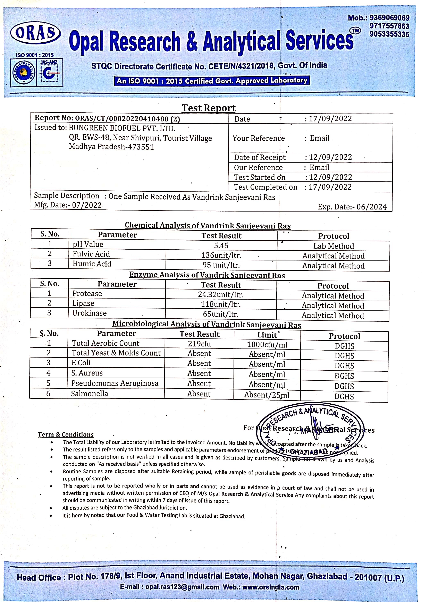

Slide 9
OUR CUSTOMER IN INDIA
Diabetes patients
Digestion problem
Brain problem
Heart problem
If these people take our drink as a regular tonic, then get multivitamins and several minerals to remain healthy. They will recover from these diseases early.
Healthy person can also take it as a regular tonic to get multivitamins, minerals, and other essential elements.
Health Conscious People.

Slide 10
Digestion problem
Our customer size in INDIA
Diabetes problem
Digestion problem is 50%(65 Crore) of the country’s population
TOTAL POPULATION 130 CRORE.
This data is from the 2019-2020 year.
Diabetes problem is 10%(13 Crore) of the country’s population.
TOTAL POPULATION 130 CRORE.
This data is from the 2019-2020 year.

Slide 11
Brain problem
Our customer size in INDIA
Heart problem
Heart problem is 1%(1.3 Crore) of the country’s population.
TOTAL POPULATION 130 CRORE.
This data is from the 2019-2020 year.
Brain problem is 4% (5.20 Crore)of the country’s population.
TOTAL POPULATION 130 CRORE.
This data is from the 2019-2020 year.

Slide 12
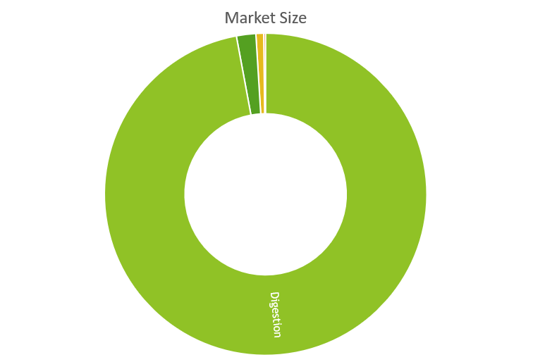
OUR MARKET SIZE IN INDIA
Digestion problem has a market size of 16250 crores.
Diabetes problem has a market size of 325 crores.
Brain problem has a market size of 130 crores.
Heart problem has a market size of 32 crores.
Total market size 16737 crore. In India (this data is from the 2019-2020 year)
INDIA, 84.5 crore parents will buy our service at Rs 6000 per year for one customer.
This translates into a market potential of Rs 5,07,000 crore per year.

Slide 13
BUSINESS MODEL of our bottle
We will generate revenue from our product VAN DRINK whose price is Rs 250 for a 500ml bottle.
In that we have 45 % expenses and 55% profit.

Slide 14

CUSTOMER ACCESS
They can access our service through the following ways.
1. WhatsApp.
2. website.
3. our morning stall.
WE ARE NOW ALSO AVAILABLE ON MESSHO.
We are in the progress of installing a healthy cafe.
We are in process of listing our product on Flipkart, amazon, and our site.

Slide 15
COMPITITION IN MARKET as surf in Bottle
ARG manufacturing companies such as IMC, an
Some sanjeevni solution manufacturers.
No awareness regarding VAN DRINK.
In case of CAFE model the competition is with Starbucks

Slide 16
SALES MARKETING
We are selling our drinks by putting stalls in Tir-1 Cities Parks.
By providing varieties of fruit flavors.
Through the online mode, placing our product on amazon, Flipkart, and our site.
We are going for a subscription model for diabetes, and cancer patients.
We market our customers through morning stall online marketing and offline market.
Holdings where the crowd is held
Morning stalls.

Slide 17
USP Unique Selling Proposition
Our production strategy.
Our Unique marketing strategy. By installing a stall in the morning for Sanjivini Ras awareness.
We are adopting stall model customers with easy service so they can directly access us.

Slide 18
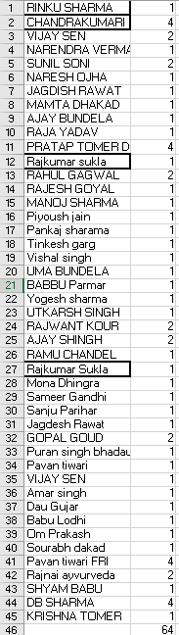
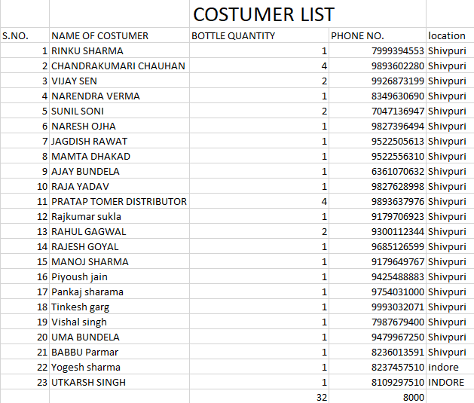
CURRENT STAGE
REVANUE STAGE
REVANUE – 15000 IN LAST MONTH.
TOTAL CUSTOMER 45 AS WE STARTED FROM 11 AUGUST. 2022

Slide 19
Problem we face and solution
Problem-1:- Customer conutinity.
Solution-1:- Stall Model in Tir-1 and Tir-2 cities.
Problem-2:- Production continuity.
Solution-2:- Manufacturing unit with gowsala.
Problem-3:- Funding issues.
Solution-3:- Need Funding up to 20 Lakh.

Slide 20
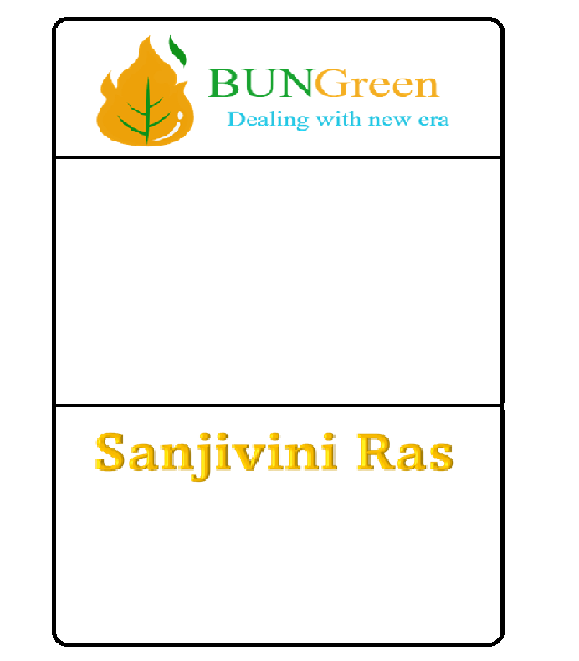
New Revenue Strategy
This is the morning stall – In this, we will provide the solution in a cup.
1 cup will have 20 ml of solution and 30-40 ml of water and the cost of the cup is 20 Rupees. This is for those above 18 years old.
For those below 18 years old cups will have 10 ml of solution and 20-30 ml of water and cost 10 Rupees.
If they take our monthly card then we will give them 50% off.

Slide 21
Let’s take we have 5-morning stalls.
1000 or more people are gone for every corner of the city.
We set up our stall in five corners of the city where on average 2000-3000 people come for a morning walk.
On average if each stall gets 300 customers for 5 stalls so the customer will be 1500 per day.
1500 customers and the cost of the cup is 20 Rupees.
Total revenue in a day is 30,000 Rupees and for a month 9,00,000 Rupees per month
For a year 1,08,00,000.
Expenses are about 55% and 45 % profit.

Slide 22
Investment for 7% of company
FUNDS REQUIRED IS Rs 20 lakh.
FUNDING purposes are as follows-
FOR OFFICE SPACE
FOR PRODUCTION UNIT
FOR MANPOWER HIRING
FOR RAW MATERIAL
FOR MARKETING
FOR MACHINERY

Slide 23
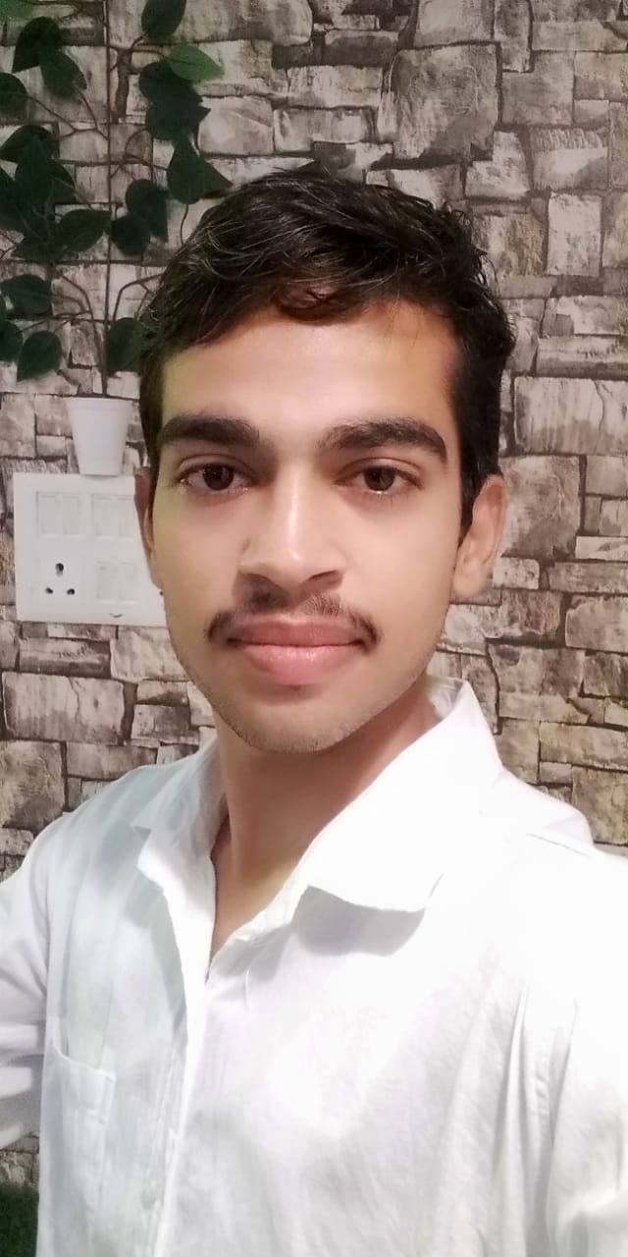
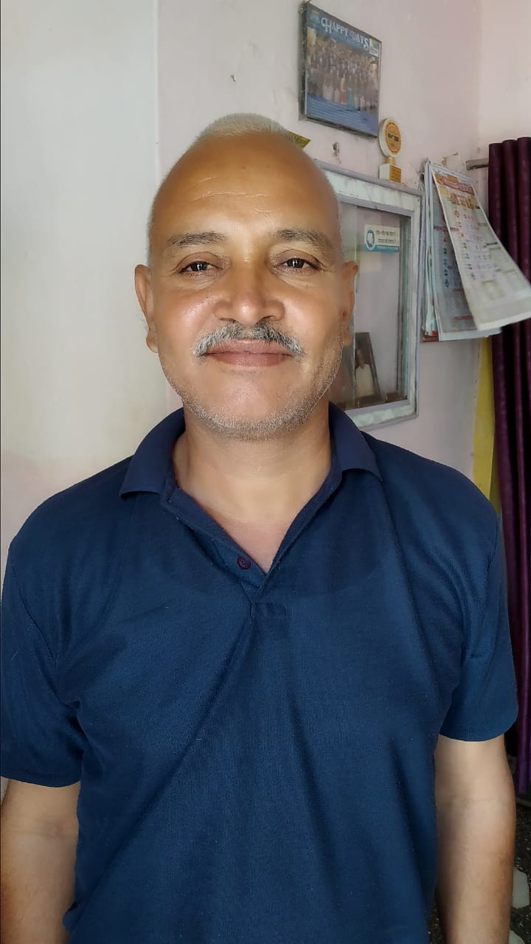
Core team
Shivpal Singh Bundela
DIRECTOR
(50% OF CAMPANY SHARE)
Postgraduate(M.COM)
Abhay P S Bundela
FOUNDER AND CEO
(50% OF THE COMPANY SHARE)
Graduation (Running THIRD YEAR)
B.Tech (Electronic and communication)

Slide 24
If you have doubt in our product.
Then try it.
https://www.meesho.com/van-drink/p/2u99je?_ms=1.2.

Slide 25
Parent company name- BUNGREEN BIOFUEL PRIVATE LIMITED.
COMPANY EMAIL ID – bungreenabhay@gmail.com
Company contact no.- 9406601037,7509781348

