Slide 1

Happiness Group
Live your life with Happiness

Slide 2
INTRODUCTION
Happiness Group is an order & delivery
Service, fulfilling all the consumer’s shopping needs
as per their demands.We provide grocery delivery, food delivery,
around the city. We are “Netflix for Shopping”.
Our mission:
help pepole to “Save Their Time” and order their essentials online and get them delivered at their doorstep.
To provide delivery services to the consumer with all safety measures.
Our promise:
We provide best quality products with return facility and get the delivery done within 30-40 minutes.

Slide 3
IDEA BEHIND HAPPINESS
The ideology behind the happiness group arrives from the problems faced in real life, for example-: sometimes the shop is too far from our reach and in order to get product/food, etc. from it when we are busy it becomes impossible inside a place like “jhabua” –where there are no delivery facilities already available.
So, seeking this opportunity and ideology we shaped our point of vision into a live business ecosystem henceforth emerging as a platform to solve delivery issues, that’s what “HAPPINESS INDIA” is.

Slide 4
What problem our startup is solving
“Complex conditions of lifestyle leads to
insufficient time to purchase household necessities.”
Complex Conditions
Busy work-schedules, friends & families, traffic jams
and etc.
Insufficient time
Not enough time to spare.
Household necessities
Things that really matter in life.

Slide 5
How are we solving this problem?
Help customers to get their products delivered quickly & inexpensively.
Help consumers to order their necessities' from their favorite shops.
Orders are picked up and delivered within 30- 40 minutes.
Easy order and tracking through our android app -:
“HAPPINESS INDIA”.

Slide 6
Challenges faced by us during the initial days-:
1.) Implementation Challenge
2.) Family And Peer Pressure
3.) Money Problems
4.) Time Management

Slide 7
RISK LEVEL
Input/Output Risk -: At the time of running our business, self-doubt was created inside our mind while hearing negative thoughts from nearby people like -: what if your business fails?
Input -: Input turn out to be a risk because we consumed a lot of time for our business as well as a lot of money was invested in this idea.
Output-: At the time of investment in our idea we were least bothered about the output but after seeing our hard work, time, and money at risk we became highly demotivated but never gave up.

Slide 8
What is the USP of your solution
Within 30 minutes delivery.
Same prices from shops.
Less delivery charges..
Widest range of coverage in shops
Attractive incentives(for delivery partners)

Slide 9
How much money you can arrange/have already arranged, to start your startup?
We have arranged seed-funding of 1 lakh rupees from RGPV University.
At the initial stages of our startup, we arranged 30 thousand to start our business.
Then, later on we used our revenues to grow our startup.

Slide 10
Who are/can be your customers?
Tier 2 and Tier 3 cities
Household wives
Old aged people
Immigrated students

Slide 11
How will your customer access your product/service – Web/App/Offline etc.?
We have our application-Happiness India on play store from where our customers can access our services.
Also we offer offline ordering to old-aged groups who can order using our customer support numbers.

Slide 12
VISION AND FUTURE WORK
Happiness India has a big vision and dream, we have also planned to open many outlets in Madhya Pradesh in the upcoming years. In Addition to this, we have future plans for scaling Happiness India to the entire country instead of just limiting it to a particular state.
Our main focus however would be on quality and not quantity. Trust is the key of our business.

Slide 13
Contact Details
Founder’s Name: Satyendra Rajak
Email: happinessgroup86@gmail.com
Mobile Number:9691214855

Slide 14
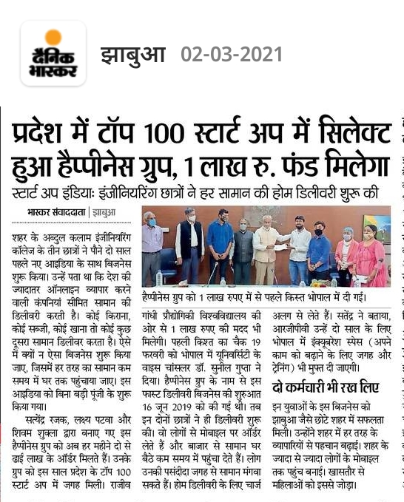
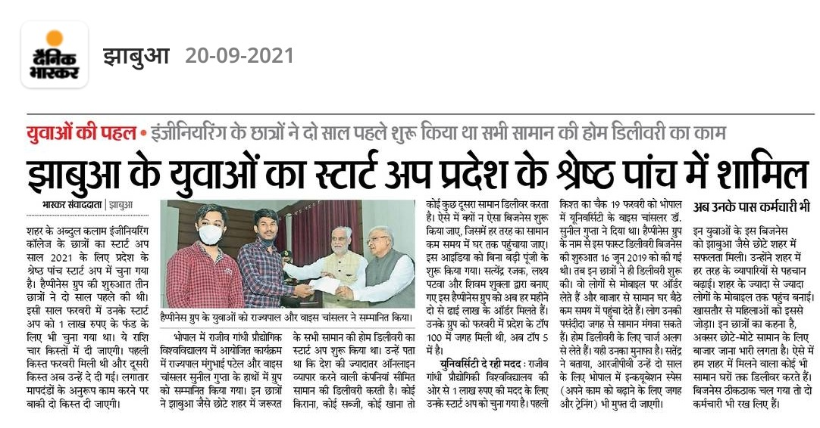
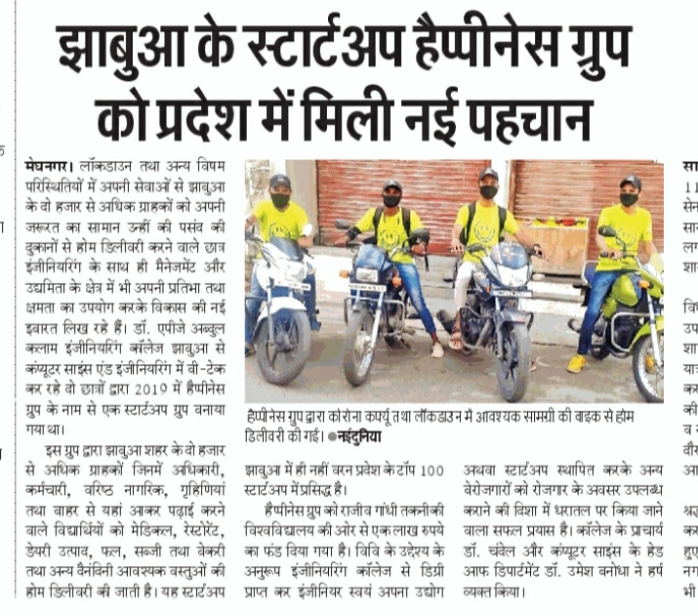
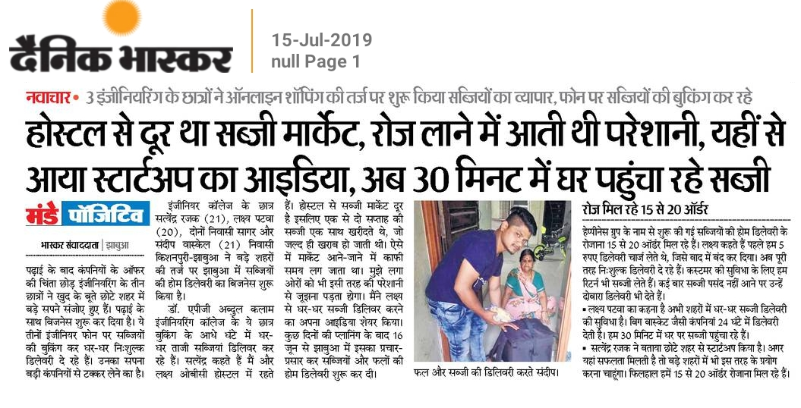
Our Achievements-:
We aim to achieve more heights like this…

Slide 15


