Slide 1
Clean Master Services
Housekeeping & Home Cleaning
BMC Road In front of Atal park behind Dr.N.S. Morya Hospital Sagar (M.P.) MOB-9109628777

Slide 2
About Us
We, Clean Master Service in Sagar District Madhya prdesh provide elite cleaning services to keep your Space sparkling and beautiful .
We are committed to provide professional cleaning services using advanced technology highly effective safe chemicals .
We offer highest cleaning quality standards through our dedicated staff .
We constantly seek to improve our Services by providing remarkable client support all.

Slide 3
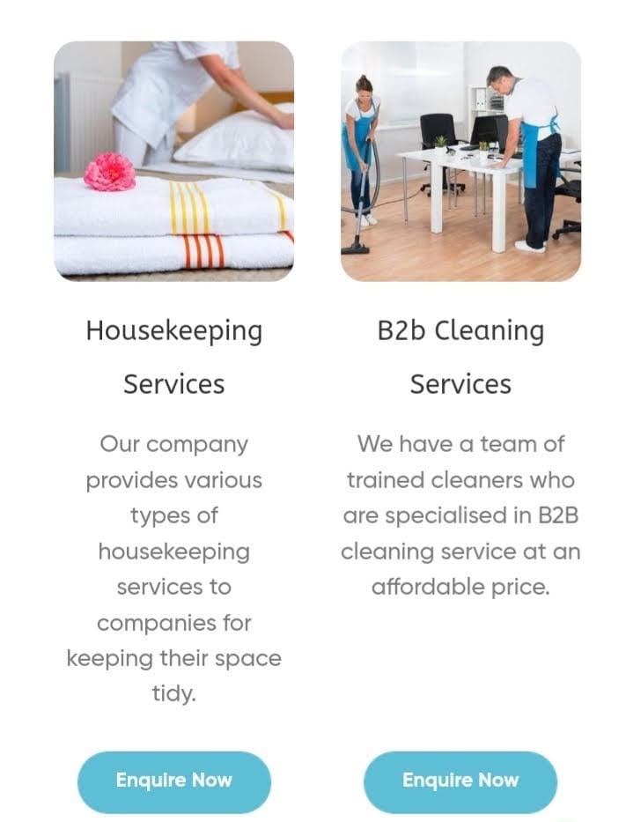
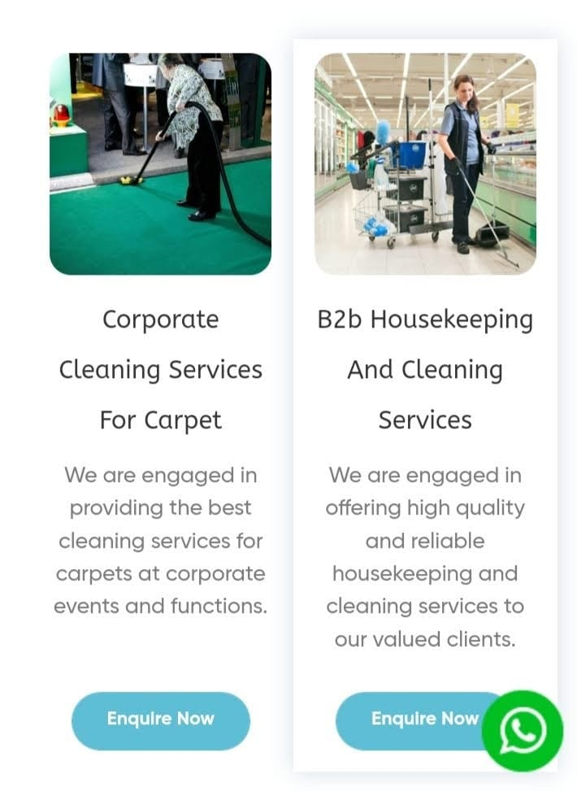
Services

Slide 4
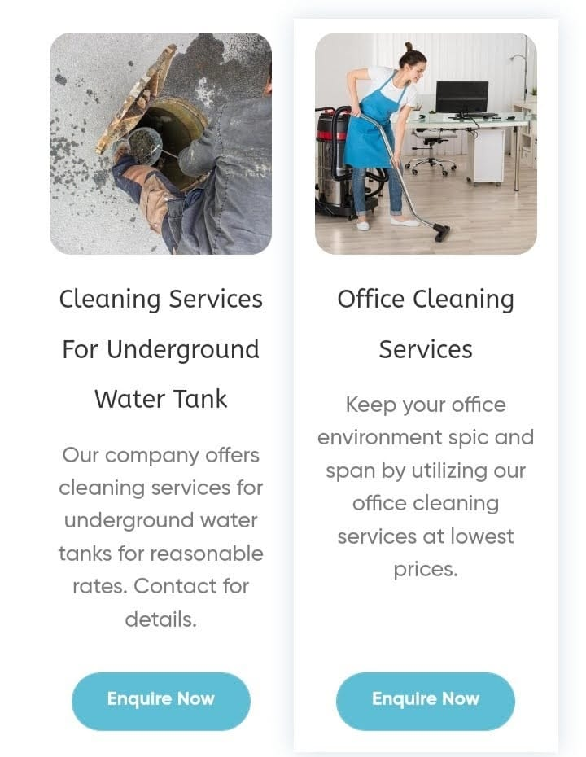
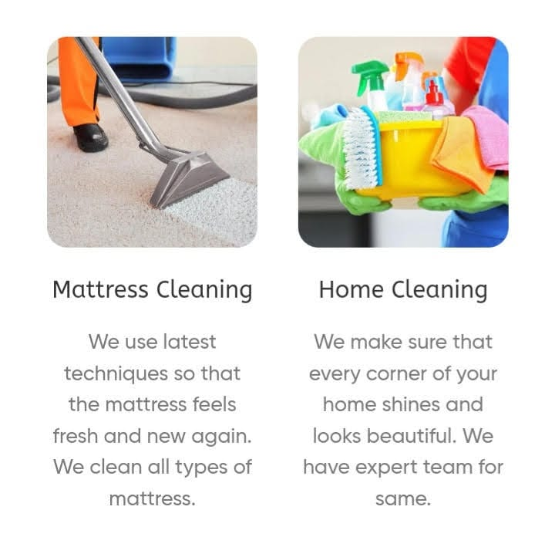

Slide 5
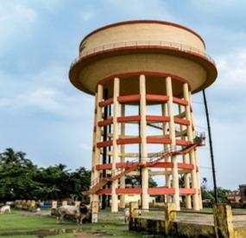
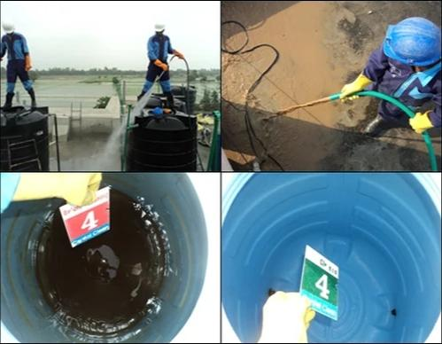
Home cleaning Services
Water tank Cleaning

Slide 6
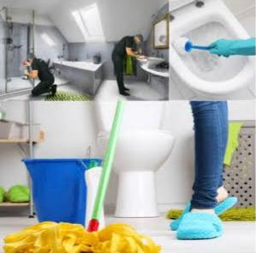

Toilet Cleaning

Slide 7
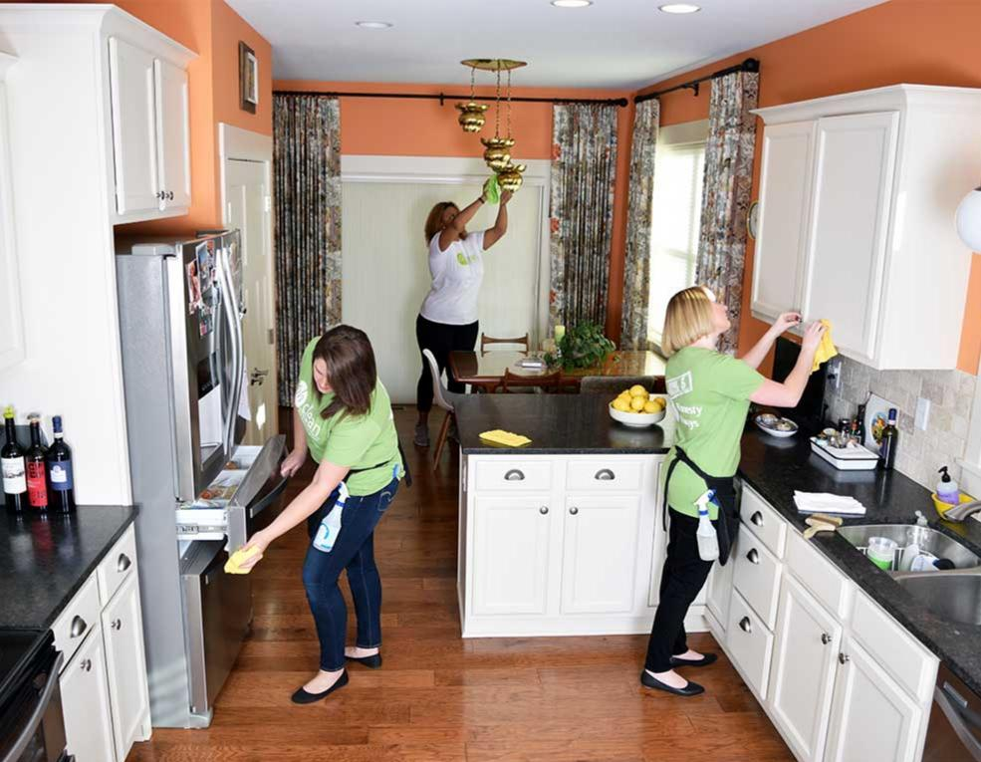
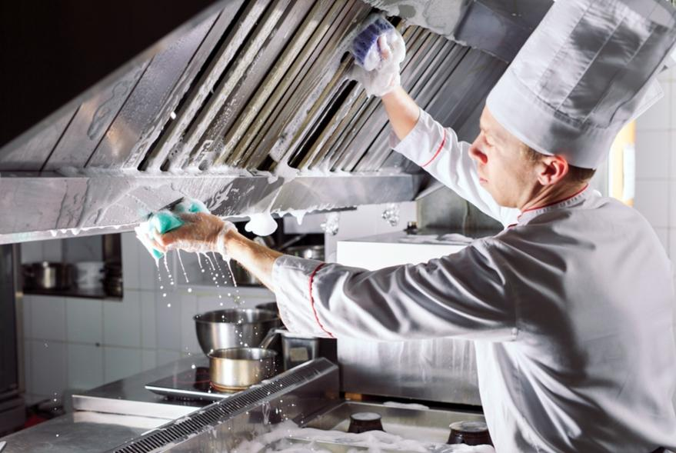
Kitchen cleaning

Slide 8
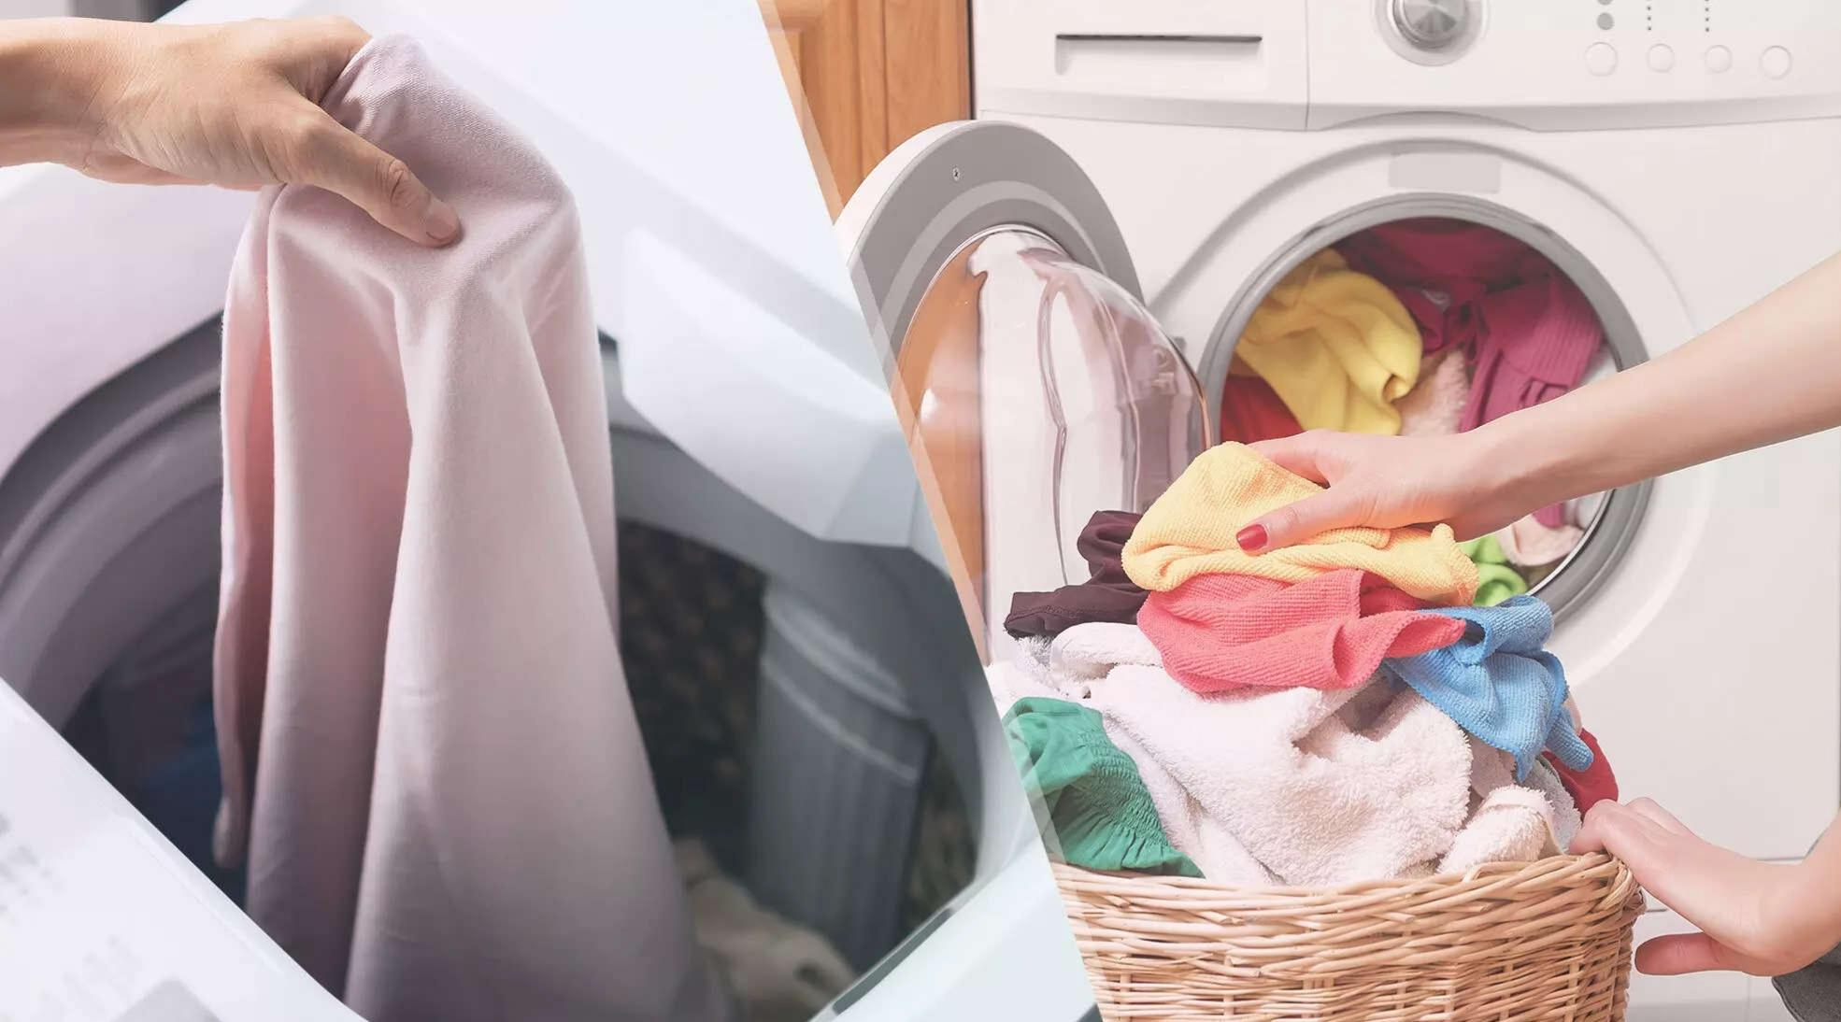
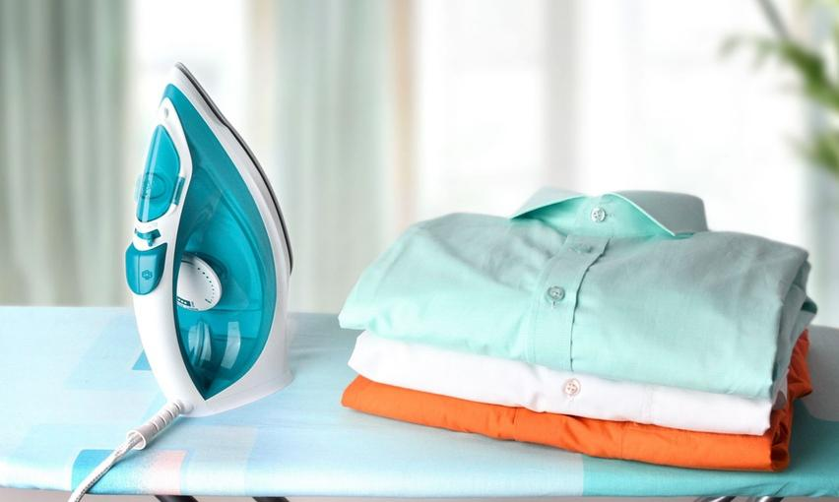
Laundry Services

Slide 9
Contact No-9109628777
Office add. - Clean Master Services
B.M.C. Road Sagar (m.p.)

Slide 10

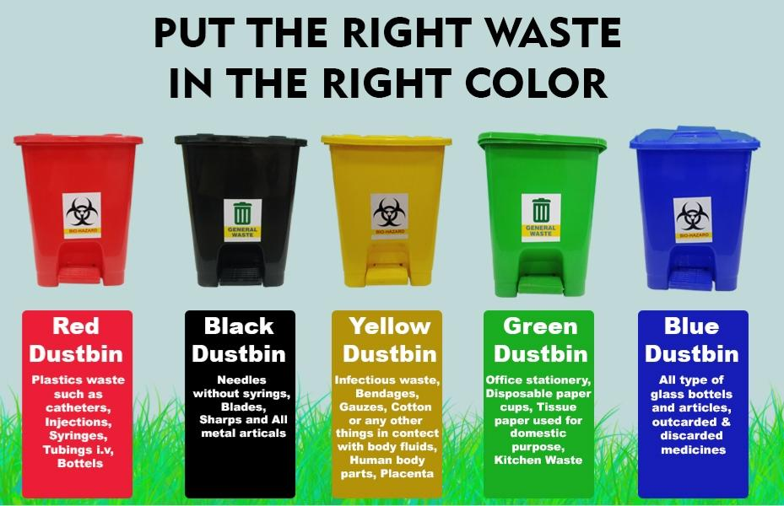

Thanks for watching
CLEAN SAGAR & CLEAN SOCIETY

