Slide 1
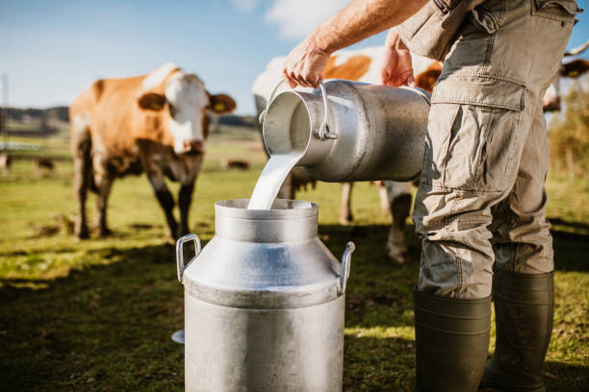
Dairy Farming

Slide 2
What is Dairy Farming?
Dairy farming is a type of Agri-business involved in the production of milk from Domestic Animal. The plant which processes milk and produces milk product are called dairy plant or dairy. Animals which are used for milk production in India cows, She-buffaloes and female goats are generally used for milk production on a dairy farm.

Slide 3
Variants of animal milk
Milk is a good source of protein
The two major proteins in milk are casein and whey.
Casein accounts for about 80 % of the protein in milk. There are also different types of casein, one of which is called Beta-casein.
Beta-casein makes up about 30 % of the protein in cow’s milk. A1 and A2 are two variants of beta-casein.
Today, most of the milk available from the local grocery store contains mostly A1 protein.
The structure of A2 protein is more comparable to human breast milk, as well as milk from goats, sheep, and buffalo.

Slide 4
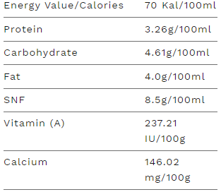
A2 BENEFITS
A2 milk from the indigenous (Desi) Indian cow which is easily digestible. Structure of the A2 cow's milk is similar to human milk.
NUTRITION FACTS benefits
EASILY DIGESTIBLE
diabetes friendly
boosts immunity in infants and adults
reduce risk of cancer
helps to build strong bones
increase brain development
nourish skin & hair
enhance fertility in women
rich in omega 3
high in antioxidant
vitamin a, b2, b3

Slide 5
What problem my startup is solving ?

Slide 6
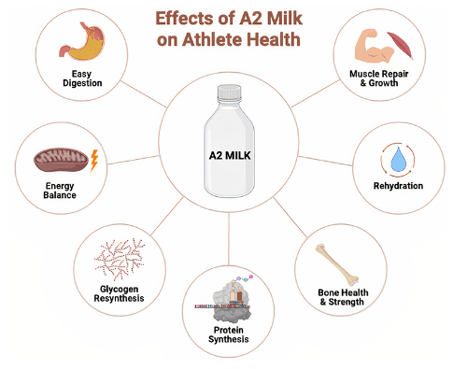
1.Quality
we provide A2 type quality milk, which causes considerably fewer gastrointestinal symptoms and pain. The study is resulted by that the group which consumes A2 milk presents fewer intolerance symptoms.

Slide 7
2.Ensuring sustainability
The word “sustainability” is similar to “healthy”
Environmental sustainability
Green House Gasses
Animal welfare & health
Water quality & quantity:- The first sustainable objective is to minimize the water required per liter of milk production. Minimizing or eliminating the impacts from the application of fertilizer, manure, biocides, and other types of water contamination that may impact water bodies and aquafers.
The first sustainable objective is to minimize the water required per liter of milk production. Minimizing or eliminating the impacts from the application of fertilizer, manure, biocides, and other types of water contamination that may impact water bodies and aquafers.
Circular production systems:- The challenge for the dairy sector is to reconsider the position of the dairy cow in a circular food system. Future feed rations should focus more on residuals from plant products and byproducts from the food industry.
Farm inheritance:- Farm inheritance is a big challenge for dairy farmers, specifically for household and family farms. High opportunity costs and better career opportunities may hinder farm inheritance by the next generation.

Slide 8
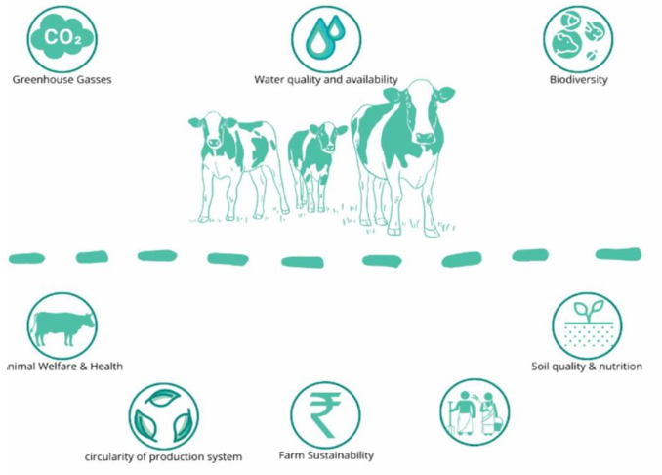

Slide 9
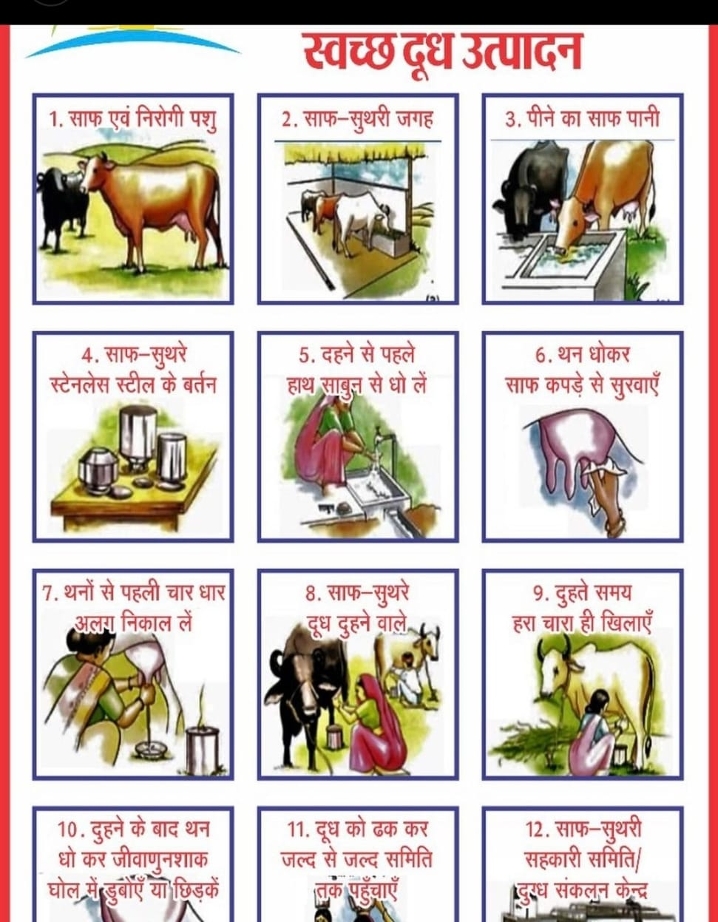

Slide 10
Different types of animal milk
Cow’s Milk:
There are two different types of cow’s milk — A1 and A2.
Research shows that some people have a hard time digesting milks
made with A1 casein, but not those with A2.
So, if you want to drink cow’s milk and your stomach is a little on the
sensitive side (but you’re not lactose intolerant) probably best to go for
the less inflammatory A2 varieties.
2. Buffalo’s Milk:
Buffalo milk has a higher fat, protein, lactose, vitamin, and mineral content than cow's milk. It's also whiter and has a thicker consistency, which makes it perfect for the production of fat-based dairy products.

Slide 11
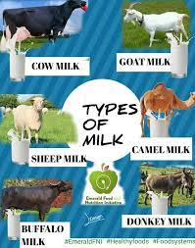

Slide 12
Continuous…….
3. Goat’s Milk:
Goat milk is an excellent source of protein, calcium, potassium, phosphorous, magnesium and vitamin A. When you look at the nutritional qualities of goat milk, it is higher in fat and calories when compared to cow milk, and it also contains more protein, vitamins and minerals.
4. Sheep’s Milk:
Sheep milk contains about one-third more energy than cow or goat milk. It has double the protein and much more of the right kinds of fats, vitamins and minerals, particularly calcium, iron, magnesium, phosphorus, and zinc while being lower in sodium.
5. Camel’s Milk:
Camel milk is the closest to a human mother's milk. Camel milk is different from other milks, however, having low sugar and cholesterol, high minerals (sodium, potassium, iron, copper, zinc and magnesium, and vitamin C). The milk is considered have medicinal characteristics as well. It contains A2 caseins.

Slide 13
What is Milk Adulteration?
Unlike contamination, this is deliberate. Often performed to intentionally degrade the quality (and increase the quantity) of milk to make profit illegally.
Milk adulteration poses serious health hazards. Common milk adulteration techniques include adding water, detergent, etc. to the milk.
example of adulteration
Example of adulteration, Water is the most common adulterant. Milk is generally diluted with water to increase the volume. It reduces the nutritional value. It also include cane sugar, starch, sulfate salts, urea and common salts are added to increase solid-not-fat (SNF).

Slide 14
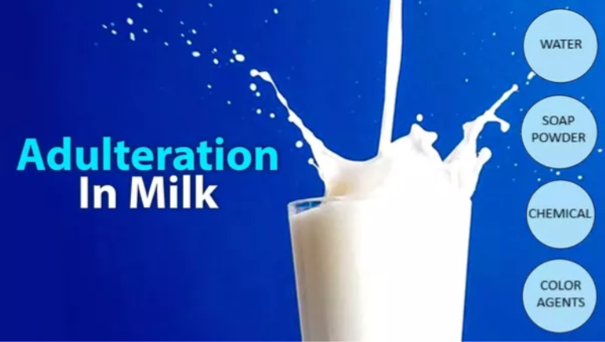

Slide 15
How will customer access my product/service??

Slide 16
1. APP

Slide 17
2. OFFLINE

Slide 18
Sales & Marketing Straggles
Globalization:- It is one of the greatest strategic challenges for all Industries as well as dairy Industry. Globalization has increased significantly over the last decade, and despite financial crises and recession in many parts of the world globalization will likely continue — albeit with less force than before. Globalization is far from a unique concept. Globalization can also have multiple dimensions and applications. In this context, globalization is defined as follows:
Globalization is the continuing development of a firm’s international involvement concerning geographical markets, products, management, resources (labour, raw materials etc.) for the purpose of optimization of the international market opportunities and threats. Globalization is not just about selling to foreign customers. It is also about recognizing the international competition and to adjust production, resources, investment and organization to these challenges.

Slide 19
Continuous…..
Dairy marketing:- These include promotion of nutritional value, appeal to the organic market, and use of social media networks and development of new dairy products. According to American Marketing Association marketing as “the process of planning and executing the conception, pricing, promotion, and distribution of ideas, goods, and services to create exchanges that satisfy individual and organizational objectives.”
marketers must know what information will convince consumers to buy their product, and whom consumers perceive as a credible source of information. Some marketing strategies use fictional characters, celebrities, or experts (such as doctors) to sell products, while other strategies use specific statements or “health claims” that state the benefits of using a particular product or eating a particular food.

Slide 20
Contact Details :-
Founder’s Name: DEEPAK MISHRA
Email: deepakmishra30032003@gmail.com
Mobile Number: 7489504863

Slide 21
THANK YOU

