Slide 1

Rooms Near You

Slide 2
Who We Are ?
RoomsNearYou is the online rooms, apartments, flats, etc. rental aggregation website for peoples in need of independent and comfortable living spaces in our city Sagar.
By the partnering with property owners and landlords we provide the verified listing to everyone.
We’re here for anyone, regardless of age or professional status.
We show you real photos and high-quality videos of the property and neighborhood.
We play a important role between local landlords and tenants by offering excellent customer support in several languages on both sides.

Slide 3

Problem
Tenants face lots of difficulties in searching rooms in other city.
Broker take advantages from both sides and demands some percentage from their rents.
There are many house owners, who are not honest when rent their property.
Landlord also search for verified tenants and some of the tenants who fulfill there criteria like, gate close at 8pm, pure veg, only girls/ boys/family.
There are many other issues like, budget, location, false promise, rent, etc.

Slide 4

Solution
RoomsNearYou rental platform lets you find verified tenants without any broker acting as a middleman.
We make sure that each room is verified and directly from owner.
We directly connect Tenants to verified Landlords to save brokerage.
We provide real and updated photographs of rooms, flats ,etc.
We can provide personal assistant to the tenants.
Tenants can search and book rooms from anywhere as per their convenience.
We provide 24*7 customer support to users.

Slide 5


Business Model
Landlord
Tenant
Register on Website
Search & Choose Room
Add Room Details
Register on Website
List Your Room
Contact & Fix Appointment
Website Earn
Subscription Fees
Additional Services
Advertisements

Slide 6
Business Model Canvas
Key Partners
Property Owners
Technology Partners
Property Consultant/ Experts
Legal Partner
Key Activities
Manage Property Listings
Payment Management
User Management
Advertisement Management
Assistance to customers
Market Activities
Value Propositions
Connect landlords to tenants
Provide verified tenants
Provide verified properties
Convenient way to find property
Customer Relationships
Easy way to list property
Easy way to rent property
Social Media
24/7 customer support
Customer Segments
Landlords
Tenants
Advertisement Clients
Channels
Website
Mobile Application
Online & Offline Advertisement
Key Resources
Online portal to manage property listing.
Marketing & sales team
Cost Structure
Technology Cost
Cost of human resources
Advertisement cost
Cost of operation
Revenue Streams
Subscription Plan for landlord
Featured listing
On page advertisment

Slide 7

Revenue Model
Free Pack | Standard Pack | Premium Pack
Validity: 30 Days | Validity: 90 Days | Validity: 90 Days
ID Verified Tenants | ID Verified Tenants | ID Verified Tenants
Unlimited Bookings | Unlimited Bookings | Unlimited Bookings
Customer Support | Customer Support | Customer Support
 | Expert Photoshoot | Expert Photoshoot
 | Verified Property Tag | Verified Property Tag
 | Digitally Promoted | Digitally Promoted
 |  | Expert Video Shoot
 |  | Featured Listing
 |  | Trusted Landlord Tag

Slide 8

400+
56k+
87k+
Website Traffic
Website Views
Social Media Reach

Slide 9
Our process is easy
Book Property
Fill the form and send us a booking request. Our multilingual team will contact you shortly to confirm the availability of the property.
02
Search Rooms / Property
Use our search engine with all criteria (area, duration of your stay…) fill and select one or more rooms you are interested in!.
01
03
Enjoy Your Stay
Once your request is accepted, you can confirm it by paying some fee. You will receive an email / sms to prepare your arrival and start your new adventure!

Slide 10






Competitor Matrix
HIGH VALUE 2
OLX
30 properties
Homeonline
50 properties
99acres
20 properties
LOW VALUE 1
HIGH VALUE 1
Housing
19 properties
Magicbricks
10 properties
Justdial
1 properties
LOW VALUE 2

Slide 11
Roadmap
Sagar all rent properties
on RoomsNearYou
Adding small businesses like tiffin centers, groceries, etc..
Adding features to
find roommates.
1
3
5
2
4
6
We will add furniture on rent feature in roomsnearyou and try to cover tier 1,2,3 cities
Include local services
like plumber, electricians, etc.
Adding buying properties like Home, flats, plot, lands , etc.

Slide 12
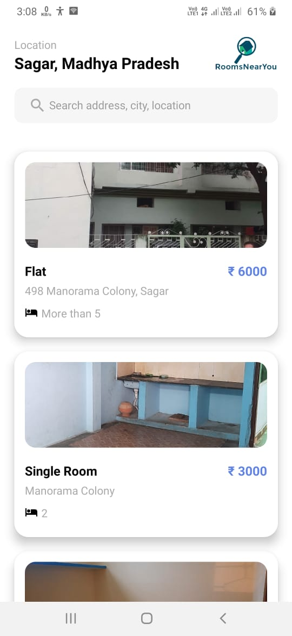
Mobile Application
Mobile application view of RoomsNearYou.

Slide 13
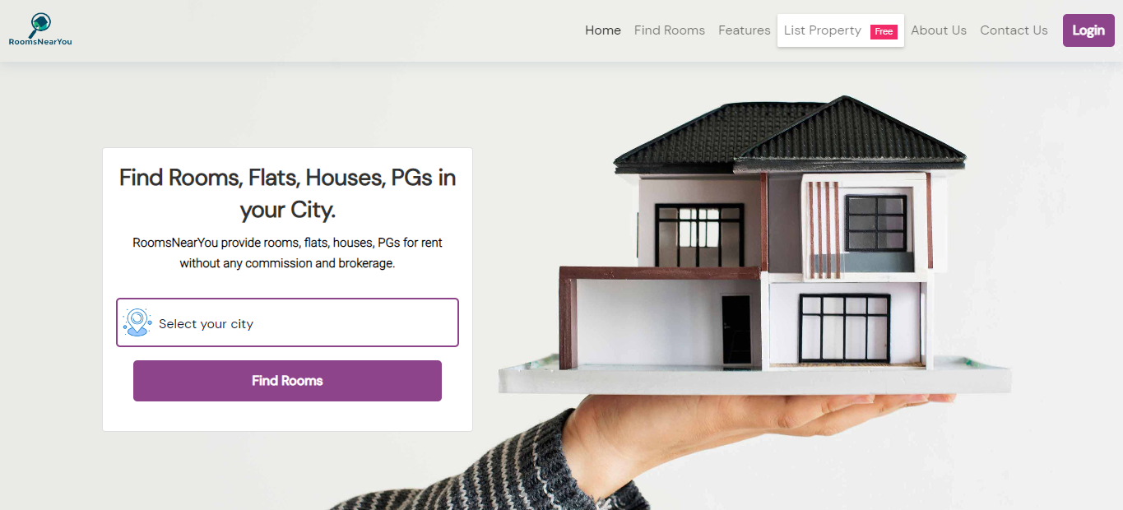
Desktop project
Desktop view of RoomsNearYou website, full-responsive in all devices.

Slide 14
We Are Seeking For
We want mentorship for how to market and grow our startup.
We are looking for funding / Grant from which we can use that fund for marketing,
tech and other necessary things for our startup
3. We are looking for some staff ( Marketing & sales, tech, and other)

Slide 15
Marketing Straggles
We are mostly focused on digital social media marketing
We are also working in the field of offline marketing
We are trying to market our business through verbal and referral marketing
We are planning to host / sponsor events and parties.
We are providing T-shirt, Mug and other gadgets.

Slide 16
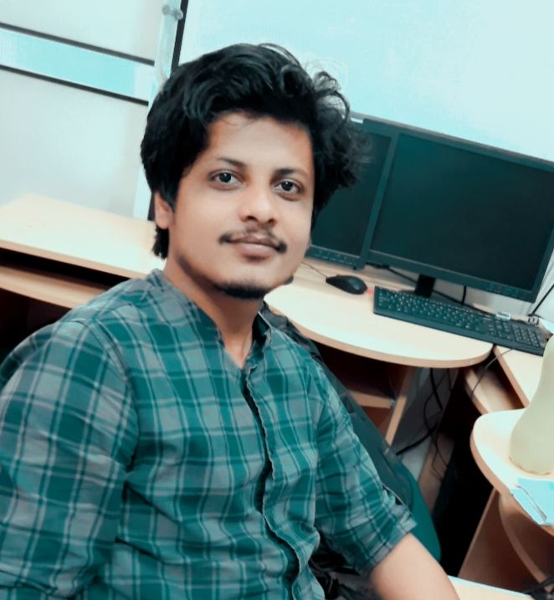

Our Team
Arvind Vishwakarma Backend Developer / Mobile Application Developer
Shrikant Dwivedi Frontend Developer / UI Desiginer

Slide 17







Thanks!
Any questions? You can find us at:
roomsnearyou.in
roomsnearyou@gmail.com
@roomsnearyou
@roomsnearyou
@roomsnearyou
@roomsnearyou

