Slide 1




Registered under: MSME UDYAM-MP39D0016680
Register under NGO: J-28781
Registered Under NITI Ayog NGO Darpan: UP/20220323524
ISDM Registration No.: ISDM/MAD/2021/184
INNOVATIVE
Academic Director
SONIK NAMDEO
MCA, M.Ed.
Life Care of Youth : Industrial Training, a step towards
the Smart City…

Slide 2
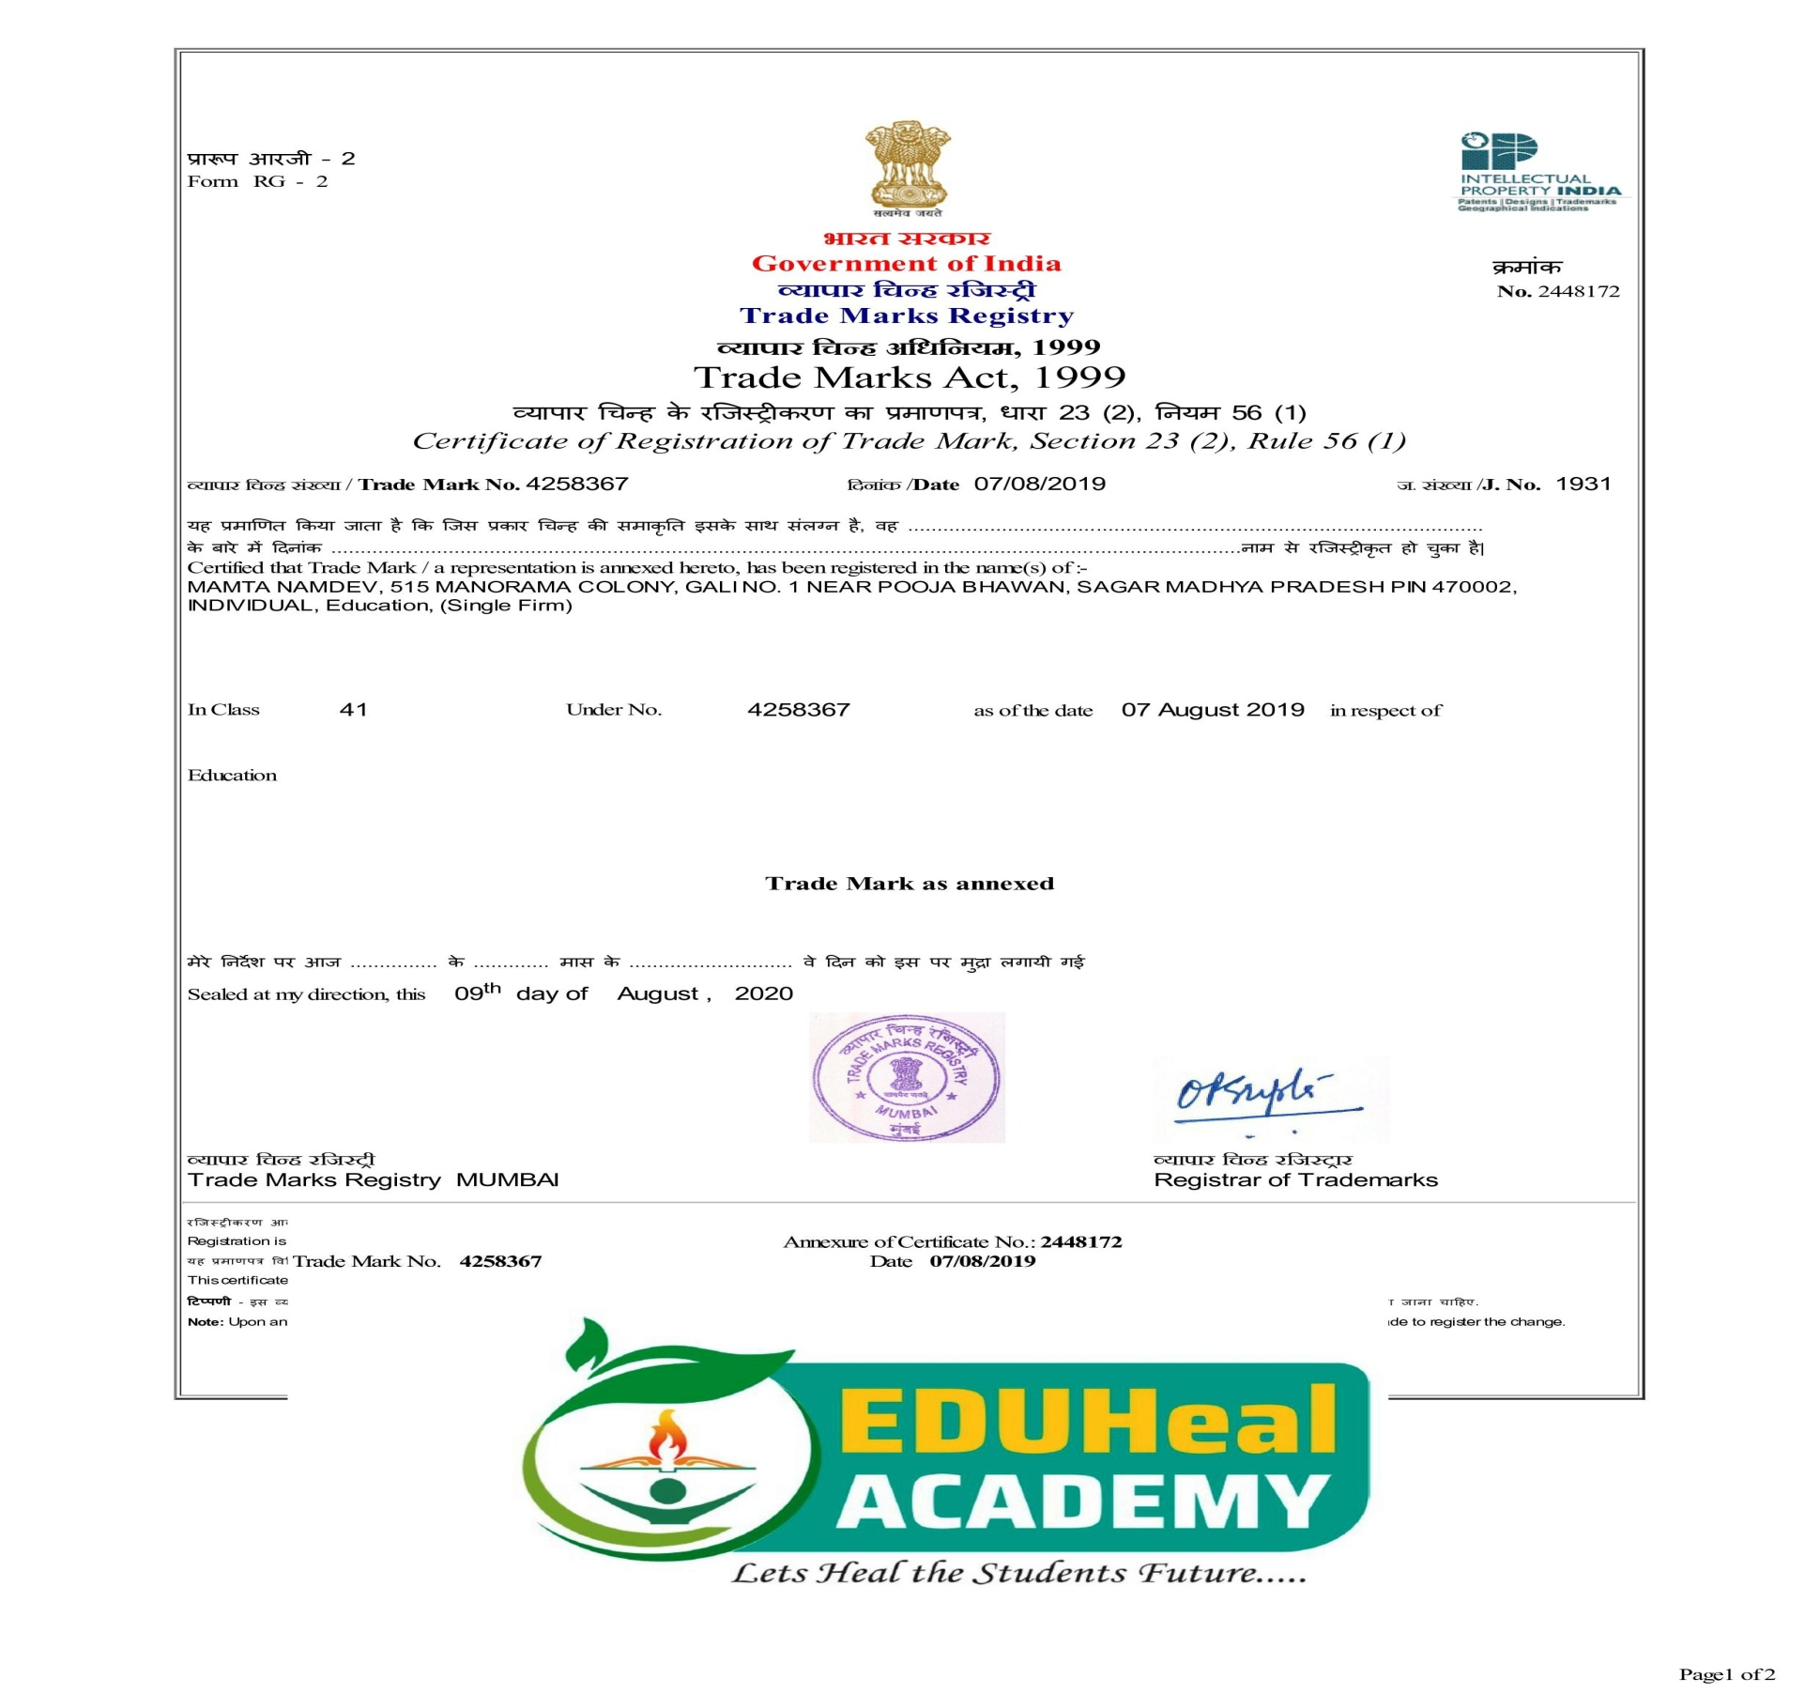
Affiliation and Registered Under

Slide 3
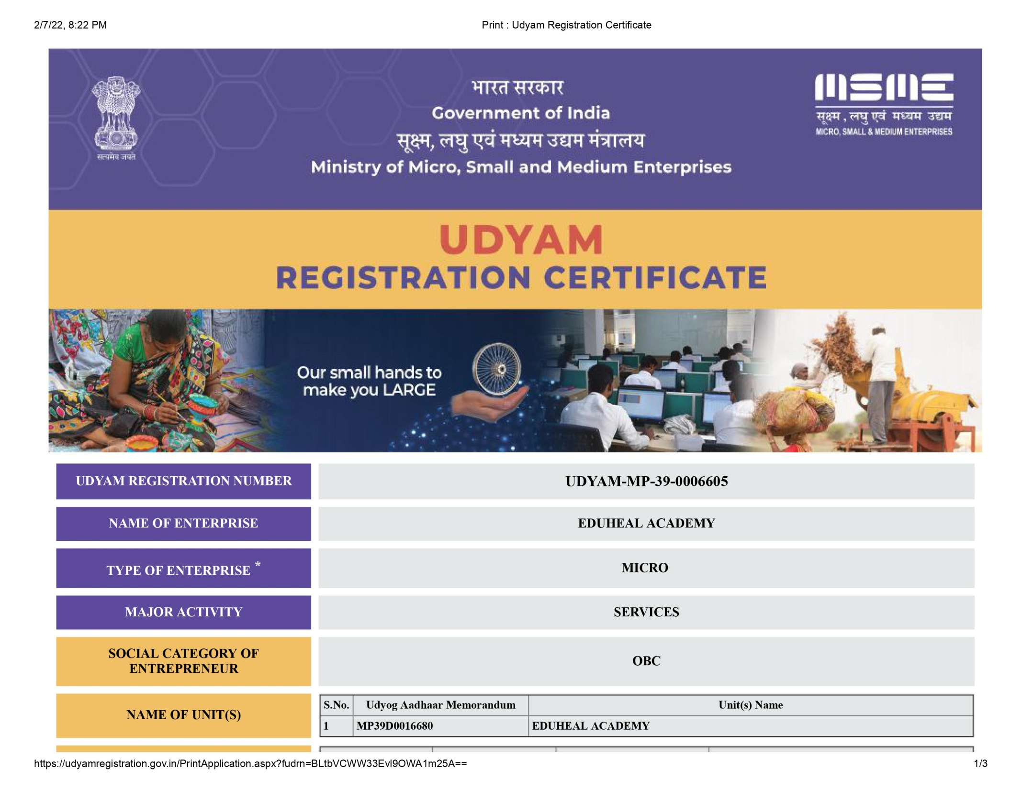

Slide 4
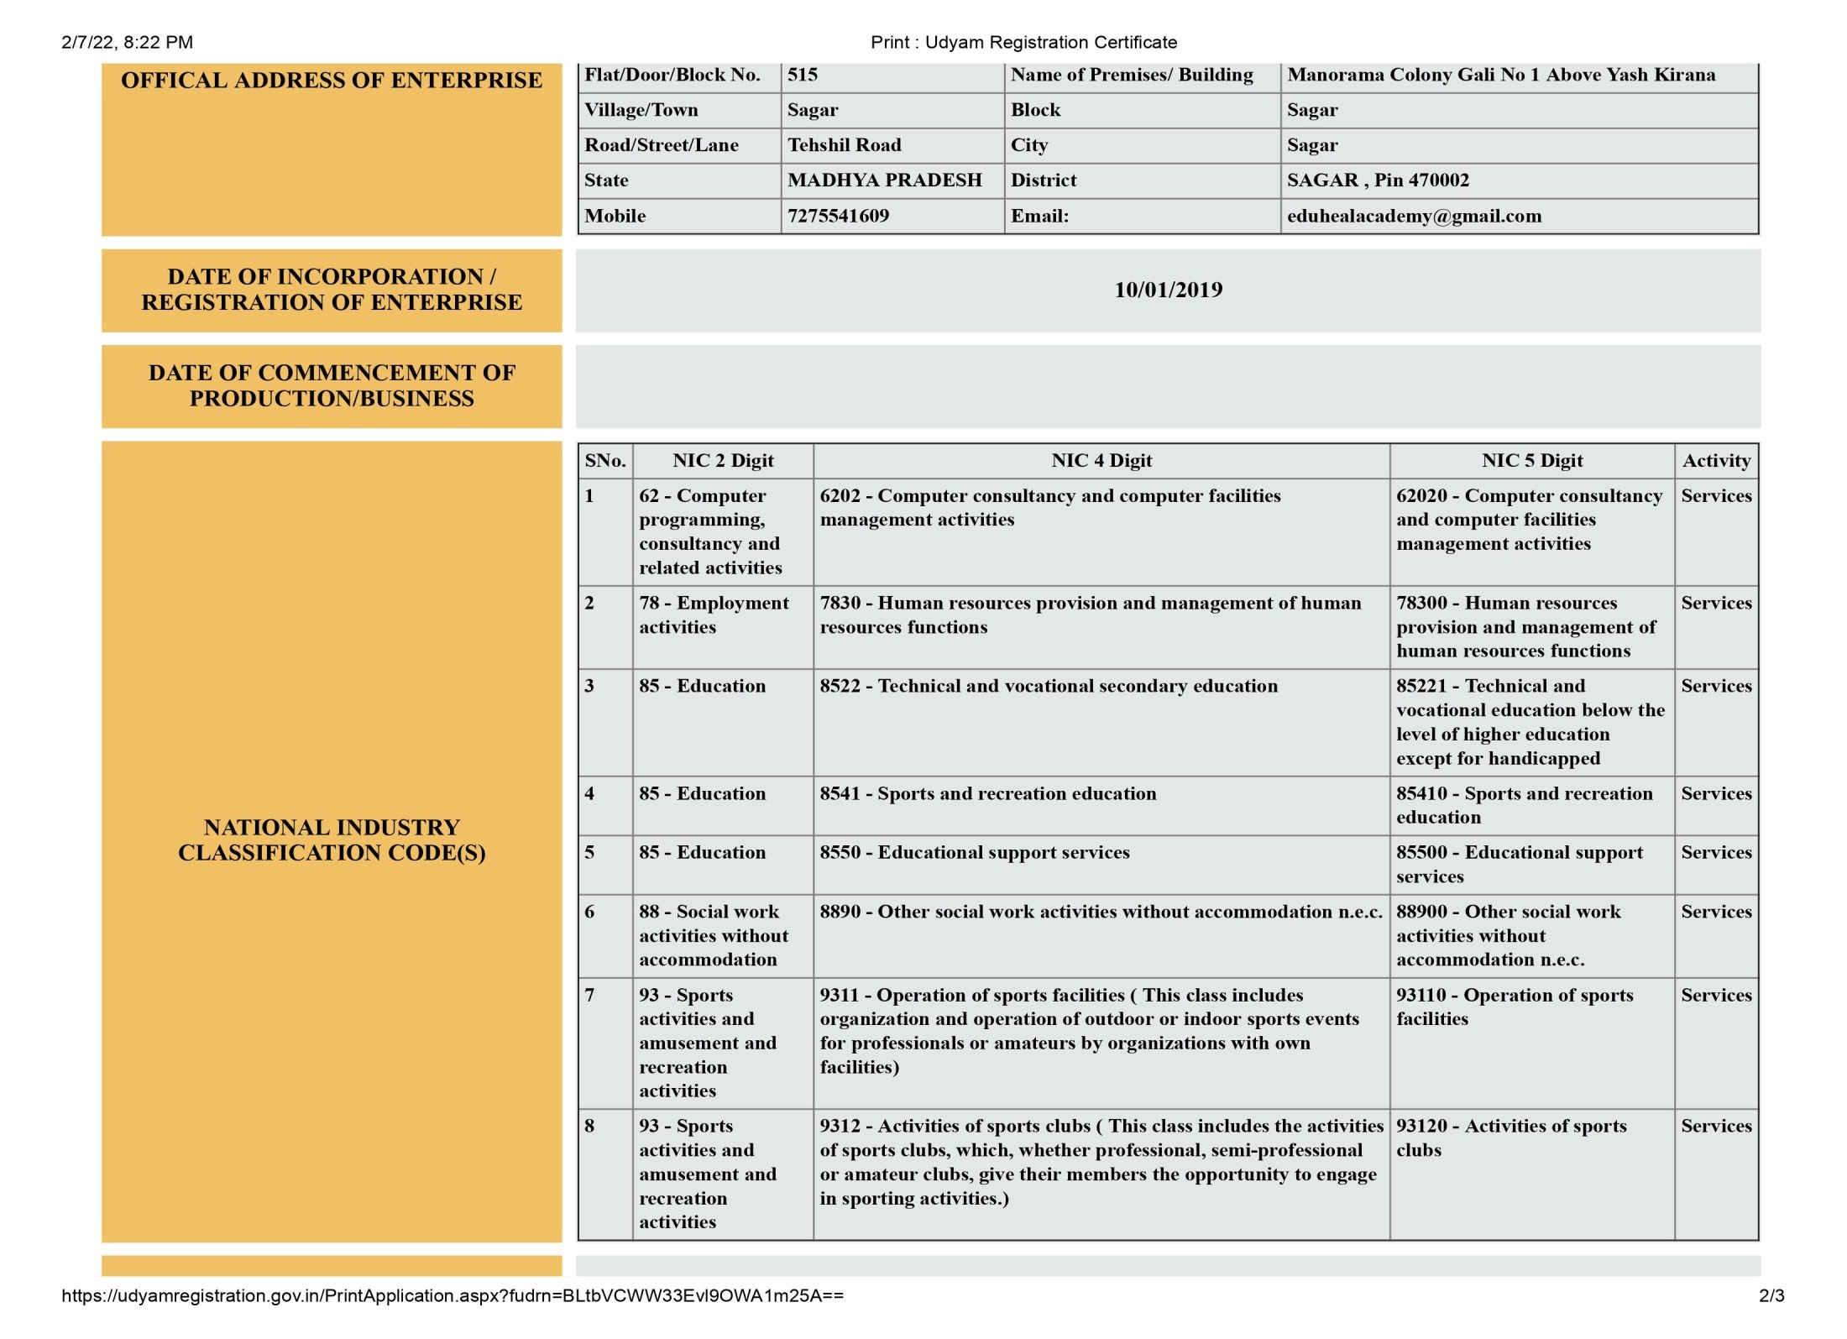

Slide 5


Skill Development & Industrial Training
AIMS ..
“1. To create the Industrial hub in the Sagar district and provide Industrial Training for the basic need of all aspirants i.e., JOB/CAREER.
2. To develop the model town/village and future students.
3. To achieve the satisfaction level of parents & society”

Slide 6
Mission
Career Oriented Course..@Sagar (Rural & Urban)
Job seeker…Mind Wash for career only
Entrepreneurship Development…stand on its own
Employment Development in any field ..
Empowerment for Girls weaker section..
Skill Development for the Youths….
Generating the innovative idea….

Slide 7
Objectives
To create the new horizons for the students and to build the Expectations for the smart and standard life.
To create the new entrepreneur and make students to stand on their own in this 21st century.
To mold the students futures in the era of 21st century and design their future DREAM of earning.
TO provide the practical knowledge, this can empower their future dreams.
To make them self dependent and hardworking with faith in them “YES I CAN DO”
To nurture the upcoming futures of Sagar this can bring the Sagar in the maps of development.
To develop the model village and cities for the high tech education.
To generate the JOB SKILL AND CAREER SKILLS among the guardians and make them feel happy.

Slide 8
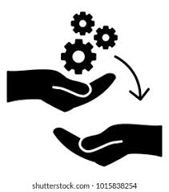
WHY? Skill Development……IT Academy
Each Students is wrap with problems of Knowledge….
Education is given like a half cup of milk…incomplete nutrients..
We as leading institutes teaches the students about individual inner space…
We try to fill the gaps………
We trained like what the market needs..
We are the upcoming futures of Students..
We provide industrial training and Jobs….
We are the trusted brand and ready to create ENTREPRENUERE….

Slide 9
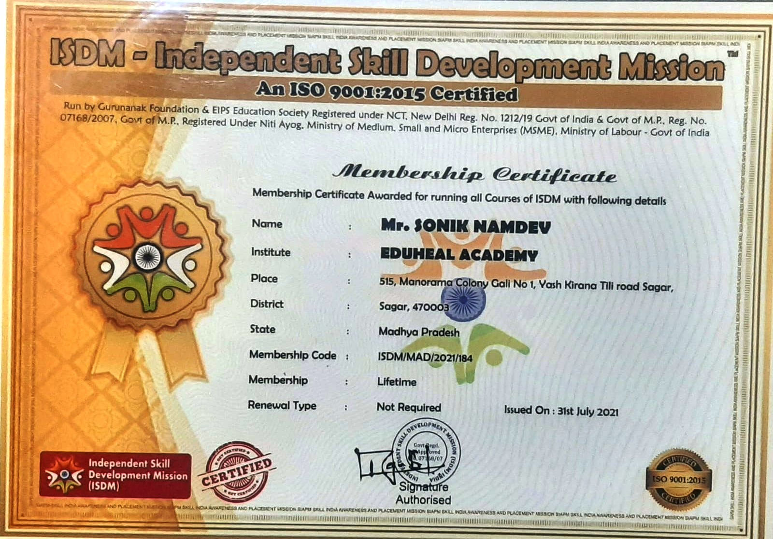

Slide 10
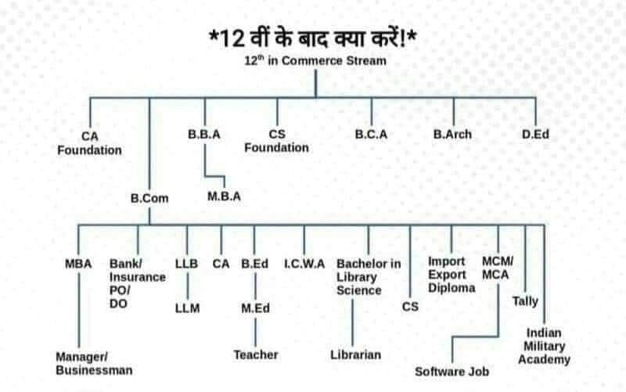
Career Courses….after 12th

Slide 11
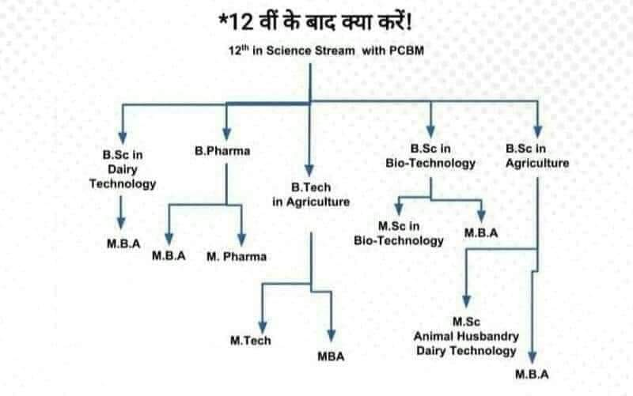
Career Courses….after 12th

Slide 12
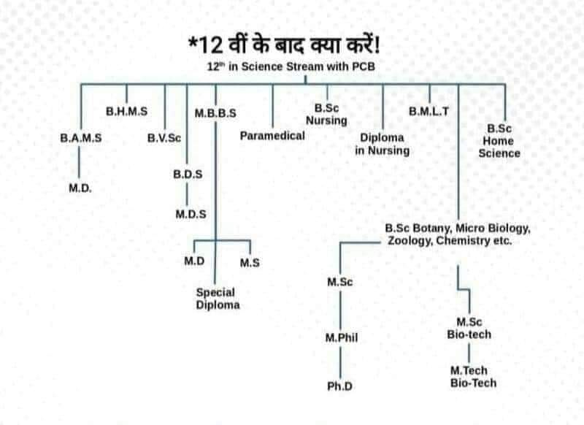
Career Courses….after 12th

Slide 13
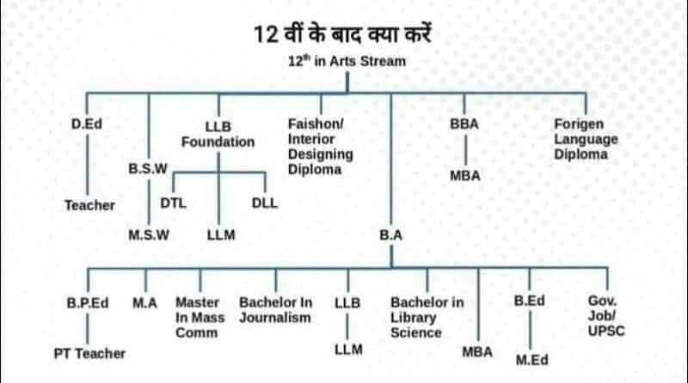
Career Courses….after 12th

Slide 14
Academy Courses…
Industrial Training for class 12th pass out(ADIT)
Industrial Training for UG/PG pass out (PGDIT)
Advance office Management Course (3 month)
Globalization and Industrialization Course (one Year Diploma)
Advance Communication English Training (Spoken English )
Six month Advance Course in Social Media and online
Advance Diploma In Industrial Training (1Year)
Advance e- accountant (6 Month)
Advance application Course in I.T g for UG pass out (PGDIT)

Slide 15
Competition Courses..
UPSC
Civil Services
CDS
CPF
IES
NDA
CLAT
Sainik School
Navodhya School
Many Others

Slide 16

EDUHeal Academy - 2019
Our aim is to provide the world class education to each students with basic speak and write knowledge so that s/he may stand any part of this world.
World is moving with speed of Bullet and we like to make the same to our new generations is our mission.
To inculcate the habits of learning we came with CONCEPT of VERBAL English and COMMUNICATION English and NEP say about the three language system….
We our with the Trade Mark of Healing the Education and our tag line is “Let’s Heal The Student Future..”
We like to associate with the governments schemes for the nation development by adopting the Villages and Cities and like to create a Change and Chain of SUCCESS….

Slide 17

Smart City…Smart Students
Smart City will be care by Smart Students…with Smart Education..
Smartness doesn't need support…only Knowledge and direction…
Dream to become is like a Day dream…because of English..
Fear and Hesitation is the plant growing in the students mind and heart…
We will be removing all these Mountains….

Slide 18
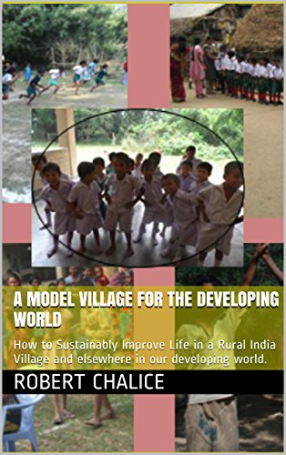
Model Village and Smart City..
As per the PM of India, “ We have to adopt 5 Villages for development”, Padega Bharth Bade Ga Bharth.
Like to work on this model at Sagar district with Latest Education and Technology.
NEP-2020 is declared the vocational education and skill education to be the part of curriculum and I like to take this opportunity to impart this in every government schools and colleges…
I take myself with the government machinery and act as a Communication cum Spoken English Instruction and provide training to school teachers and students.

Slide 19

St. Namdev Ji Skisha Sanstha (NGO)
We as a group which includes the Administration and Educational Partners like to work for such development with an AIM of Development of our nation.
We registered NGO – 2016 can work in all over India with basic objectives of careers at rural level and urban level with joining hands with Administration.
Our aim is not to earn the money, but to earn the best wishes from students and parents and to get the satisfaction in our self that YES we are the part of SMART INDIA PROJECT

Slide 20

Financial/Capital Help/Administration Support
We look forward to our Kind and Favorite M.P/MLA/Administration for his kind approval for the Smart Kids for this Smart City….
Ministry of Social Justice and Empowerment, Ministry of Skill Development and NSDC is providing such grants….
We are looking for government aided projects for the Welfare of Students future……

Slide 21

Thank you for listening….

