Slide 1




How Agritech startups transforming farm sectors ?

Slide 2




What is a Go-to-Market Strategy?
How do you deliver the value?
How do you create value?
How do you capture the value?

Slide 3

What Should I Include in a Go-To-Market Strategy?
Interviewed potential customers
Validated business
Feedback from Customers
Mapped price strategy
Customer persona
Detailed information on who your competitors are
A positive strategy

Slide 4
GTM Strategy Helps You Succeed
Clearly communicate strategy and focuses efforts & investments
Guides all other PM2 strategies & decisions
Reduces risks of failure and brand damage
Establishes path for growth
Improves time-to-market
Enhances customer experience
Increase your chances of market success

Slide 5
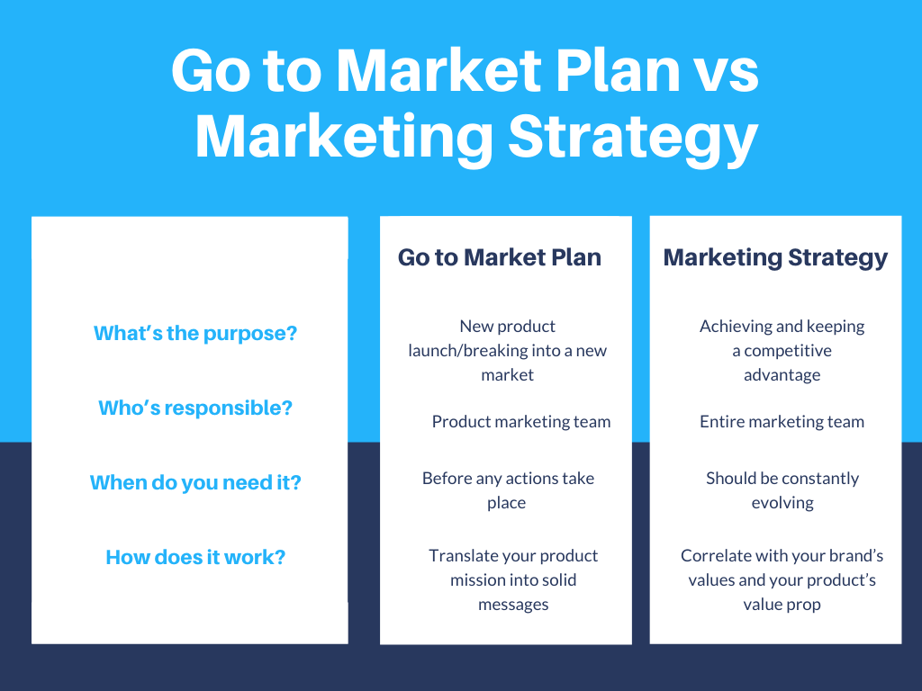

Slide 6



When to start the go to marketing
While planning the product.
DURING PRODUCT DEVELOPMENT
Once the product is ready to launch

Slide 7

Key Strategy Decisions
Positioning –designing the company’s offer so that it occupies a distinct and valued place in the target customer’s minds.
Competitive Advantage - developing a combination of attributes that allows a company to distinguish itself and outperform its competitors.

Slide 8

Key GTM Strategic Objectives
Create awareness, get first customers
Where are you getting customers?
Maximize market share
Attack competitors
New markets/users
Increase usage
Defend market share
Against competitors
Defend a position
Harvest product for maximum profitability

Slide 9
Understanding of Target Markets
Who they are
Personas
Why they buy
Problems they want to solve
How they buy
What is their buying process
Where do they look

Slide 10

Competitive analysis
Top 3 to 5 competitors.
Strategy
Product
Financials
Evaluate
Strength & Weakness

Slide 11

Market Ecosystem Dynamics
Macro Forces
Industry Forces
Customers
Company
Competitors
Suppliers
Partners
Create Understanding:
Opportunities & Threats
Strengths & Weaknesses

Slide 12
Thank you
Questions?

