Slide 1
FOODGOD FARMER PRODUCER COMPANY LIMITED – fposagar.com
PRECISION AGRICULTURE
A Recognized Startup – DIPP105083
Watch Our Drone Journey

Slide 2
What problem your startup is solving
Following problems during manual pesticide spraying using pump.
No uniformed spraying
Crop damage during manual spray
More Pesticide consumption
More water consumption
Time consuming
Hazard issues
Unavailability of labor
No spray solution for crop like Sugar Cane, Paddy, Corn, rahar

Slide 3
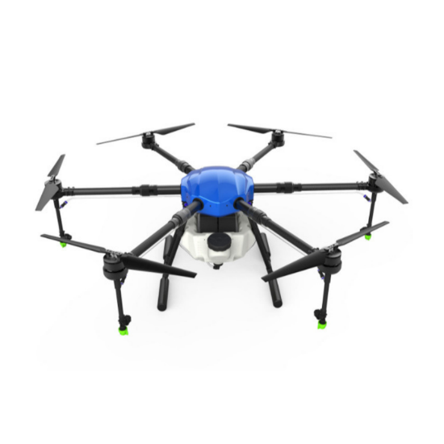
How are you solving that problem
Spraying Drone - Uniformed spraying
No crop damage during spray
Less Pesticide consumption
Less water consumption
5-6 acres in just one hour - Time saving
No hazard issues
Auto pilot mode with land mapping
Only solution for crop like Sugar Cane, Paddy, Corn and rahar
Watch Our Drone Journey
Precision Agriculture - Our Complete Solutions

Slide 4
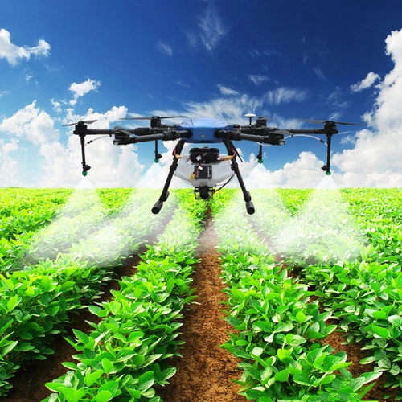
Who are/can be your customers?
Small, medium and large size farmers

Slide 5
How will your customer access your product/service – Web and Offline?
Fposagar.com

Slide 6
Any Competition/Rivals in the market?
No local competitor yet
iotech – agroboat in this small size (25KG) category

Slide 7
Who all are there in your Core Team?
Manish Patel / Director : Retd. General Manger, DGCA Certified Pilot, MCA, BCA, CDAC, PMP, IELTS,
Arvind Chaturvedi / Director : A teacher
Rihanna Khatoon / Director : Farmer
Trilok / Director : Farmer
Deepak / Director : Farmer

Slide 8
What is the immediate help you need?
Seed Funding and Startup India loan to get the type certified and start the operations.

Slide 9
Sales & Marketing Straggles – How are you planning to market your product?
Online Marketing SEO Google Marketing
Social Media Marketing Facebook and Twitter
Franchise Model
Sales and Marketing Team

Slide 10
Current Status/Stage of your startup
We have the working product and we are looking for funding to expend.
Detailed Project Report

Slide 11
Contact Details
Founder’s Name: Manish Patel
Email: RMANISH2000@YAHOO.CO.IN
Mobile Number: 9850820909
Website, if available: fposagar.com
Click to see the entire Drone Building Journey
https://photos.app.goo.gl/T31c79gQtMxAU1pd9

Slide 12


