Slide 1
Sagar Smart City Transport
Mr.Brijesh Vishwakarma
brijeshvishwakarma10@gmail.com
7805001768
Sagar M.P.

Slide 2
Idea- Smart Public Transport
Details –To Provide a Low fare,Safe,Smart transport .
Them – Online & Smart Public transport service provide.
Its provide a Cheep & Smart public Transport service for all.

Slide 3
Problem
Costly & Non equal Fare
Old & Uncomfortable Taxi.
Overloading
Untrained taxi driver.
Air Pollution & Noise Pollution.
No any monitoring of Crime.

Slide 4
Solution
All Transport are connect together ( Trams, City Bus,Taxi,Auto)
Equal Fare for all.
No Over loading.
Fare payment by Asses card,QRcode,Through App.
New EV auto and Taxi replace from old Taxi
Closely Monitor every passenger and Taxi driver.
Alarm Install for any emergency.

Slide 5
Equipment Install In Vehicle
Access Card .
QR Code Scanner.
Thumb or Palm Reader .
GPS.
Emergency Alarm.
CCTV Camera.
FM Radio for Entertainment.

Slide 6
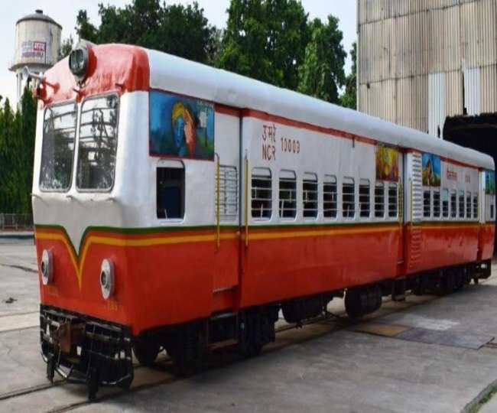
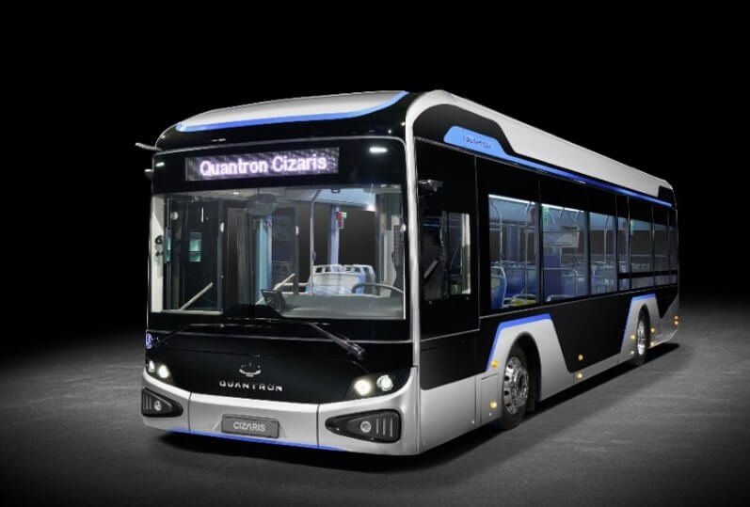
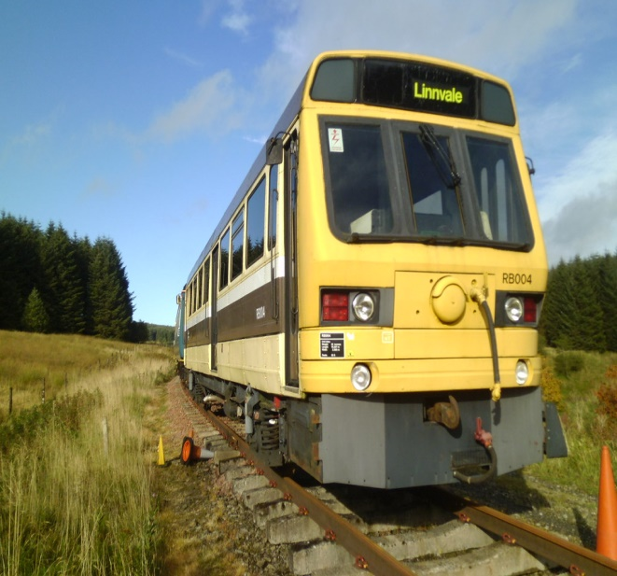
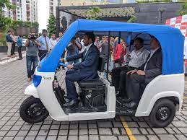
Rail Bus , City Bus Taxi, Auto
Connect With Software, GPS

Slide 7
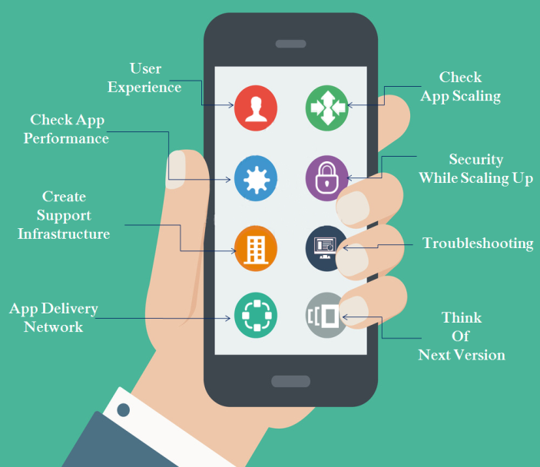
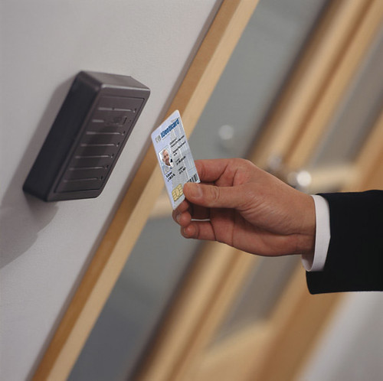
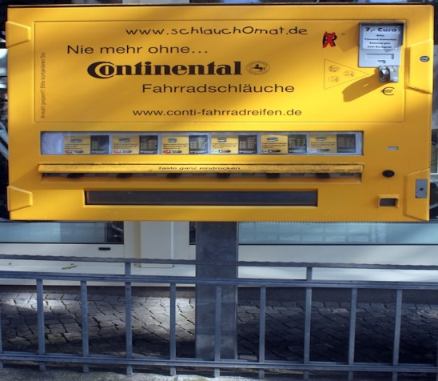
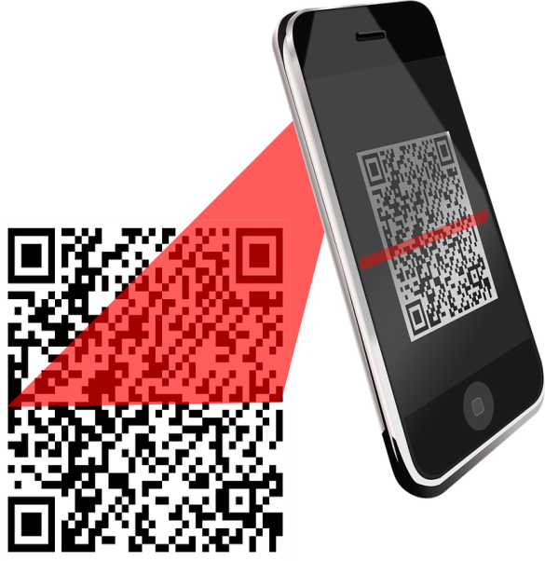
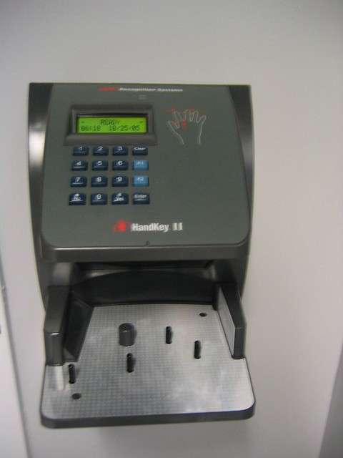
Fare paid by Assess card,QRcode,Through App, Thumb & Palm Impression , vending Machine For QR Card

Slide 8
Aim/Vision/Goal
Problem Solving of City Transport.
Provide comfortable cheep & safe transport.
Motivate for Use public transport .
All service are provide at one Place.
Pollution (Noise & Air) free Environment Provide.
Centralized all Service.
New Employment Generation.

Slide 9
Services
EV Based City Bus, Trams ,Taxi, Auto.
Access card and QR code Card for all type of fare payment.
Training for taxi driver.
Reduce Pollution.
New Employment Generate .

Slide 10
Competitor or Target Group
To whom competitor or group of people you will target to execute your idea
Local Transporter
Old taxi Service provider
Government Body.

Slide 11
Revenue or Profitability
5 Rs. Fixed charges then 1Rs/Km.
For Example In Auto 6 Passenger carry So fixed charges is 30 Rs. And auto run only 5 Km. so earning 30 Rs and 5 km EV Cost is 70 paisa /KM so 0.70x5=3.50 rs Maintenance 0.50x5=2.50Rs.Taxes 1x5=5 Total Expenses 11, So 30-11=19 Saving. Driver Salary is 30percent of Profit 5.70
Earning 30Rs –Expenses16.70 Rs. =13.30 Profit
13.30 /5= 2.66 /Km approx.

Slide 12
Other Important Remark
This is implement by Government,Smart city or Private Company.
Overall India
Best Service for Costumer, Monitoring of every Passenger and Driver.
Employment generate for Driver Access card seller.
Problem Solving:-

Slide 13
Thank you

